Slide 1
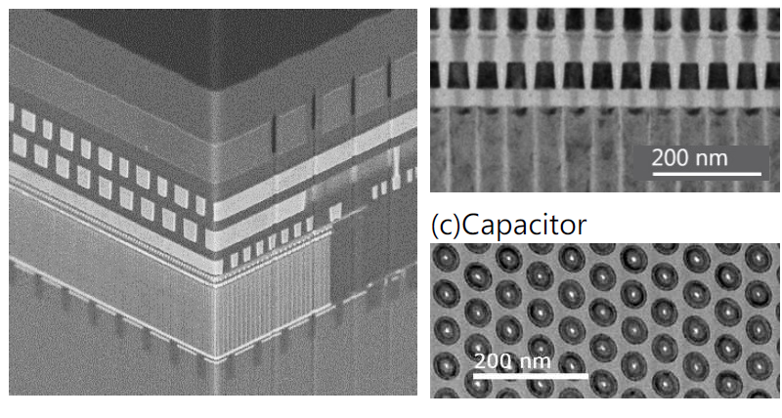
Highlight Paper (MT)
4F2 OCT DRAM with Reversed Stack
Paper #139, Oxide-semiconductor Channel Transistor DRAM(OCTRAM) with 4F² Architecture,
Shosuke Fujii^{1*}, ¹Kioxia Corporation, Japan. ²Nanya Technology Corporation, Taiwan
.
A new type of 4F2 DRAM with gate-all-around InGaZnO vertical channel transistors and new integration scheme with transistor on the top the high aspect ration capacitor.
The InGaZnO VCT achieved over 15µA/cell ON current, 1aA/cell OFF current, and stability against BEOL processing.
A 275Mbit OCTRAM array was successfully fabricated, demonstrating the potential for future high-density, low-power DRAM technologies.

