Slide 1
Accelerating Innovation for Product & Foundry Leadership – System Design Studio
TSLRP 2023
TSLRP leads: Vivek Rajan, Tanay Karnik
TSLRP Fellow Sponsor: Eric Fetzer, Atul Kwatra
TSLRP VP Sponsor: Vinoo Srinivasan, Bob Brennan
TSLRP PM: Sophie Lennon
Core Team: Bala I., Surhud K., Slade M., Rob M., Ravi M., Ram V., Lalitha S., Satish S., Chris R.,…

Slide 2
Executive Summary
Context
Inflection Points & Threats
Proposed Solution
Co-develop a design studio to accelerate system prototyping and deliver proven STCO solutions
Risks of falling behind in our IDM 2.0 targets
IDM 2.0 requires open platforms & interoperable solutions
Lack of integrated solutions for system-level PPAC analysis
Competition has a head start but we can embrace & extend
3X ↓ in Concept to Engineering Commit time + effort
STCO: system technology co-optimization
PPAC: performance, power, area & cost

Slide 3
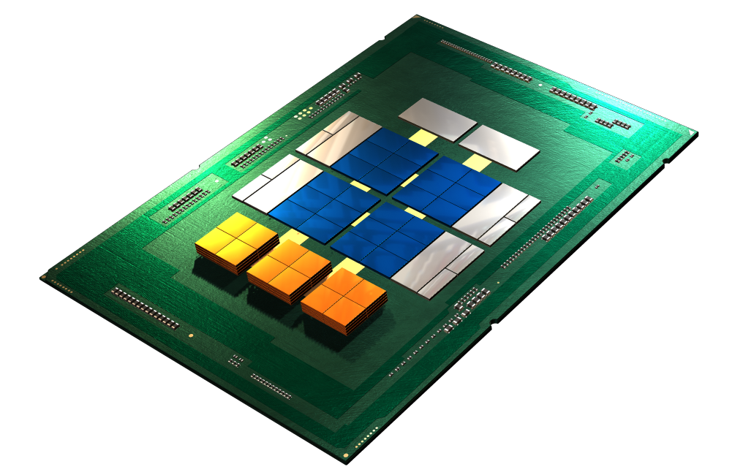
Focus of This TSLRP
Application & Workloads
Goals of STCO program are
Translate system needs and bottlenecks into technology requirements
Explore the possibility to enable new architectures leveraging unique software and technology co-design
A Full System
System Software
Software
System Architecture
Advanced Packaging
Packaging
Chiplets
Cores & Accelerator IP
IPs + Chiplets
How to enable Intel and our foundry customers to develop optimal systems is this TSLRP focus
Foundational IP
Transistors & Interconnect
Silicon Stack
Process Technology
STCO: system technology co-optimization

Slide 4
A Unique Phase for Intel
Present
Past
1970s
Future
2030s
Success built on
proprietary hardware
proprietary solutions
open software
Intel in a saddle period
Future success requires
open platforms
interoperable solutions
unlock partnerships
Q: How do we enable open platforms and unlock partnerships?
Hint: Let us learn from Microsoft’s turnaround strategy…

Slide 5




Microsoft’s Turnaround Strategy
2014
Past
Future
Success built on
proprietary OS
proprietary software
proprietary applications
Satya Nadella appointed as CEO
Turnaround enabled by
open platforms
open solutions
partner-first mindset
Visual Studio: a powerful developer tool that enables you to complete the entire development cycle in one place.
GITHUB: The complete developer platform to build, scale, and deliver secure software.
Microsoft cloud: access, management, & development of applications & services via globally-distributed data centers
… this required cultural transformation as well

Slide 6
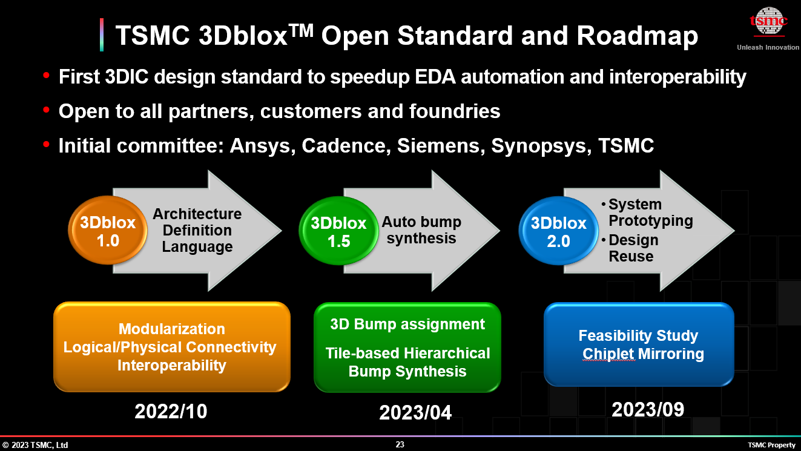

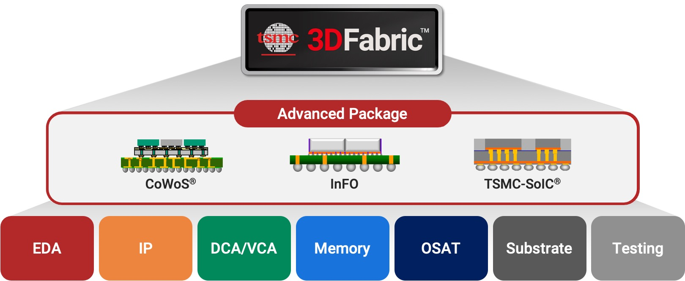

Competitive Landscape
….
3Dblox is a language to model key physical stacking and the logical connectivity information in 3DIC designs in a single format
Example: 3DBlox co-developed with AMD; currently being standardized with EDA
A Bottom-up & Hardware Centric Approach: Language, Automation, Co-Design

Slide 7



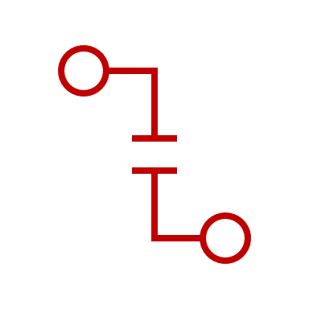

Intel has Better Opportunity with Our Assets, But …
Library + IPs
Full Stack
High Fidelity Solvers
Simulations
Applications
Interconnect
Boards
Cost
e.g, Simics
Task Level
Partitioning
FDIO, HDIO, …
Components
Packages
Thermal
Functional
Co-Simulation
HW/SW Partitioning
EMiB, Foveros,
IPs
(with PnP models)
Chiplets
Power Delivery
Electrical
Silo
Static Perf/Watt
Disjointed solvers
Unique Solvers for early Tech analysis
ARM, RISCV, ...
Signal Integrity
Summary of challenges
Proprietary solutions and interfaces
Fragmented solutions
Interoperability issues
Embrace
Lack of
Standards
Interoperable
Issues
Novel idea
Unique Differentiation
… detailed case-study in slides ahead

Slide 8
To Win, We Must …
ACT
DELIVER
REALIZE
Pervasive benefits to internal products and foundry customers
Embrace industry solutions
An Integrated studio for top-down and end2end system solutions
Extend with Intel differentiation

Slide 9
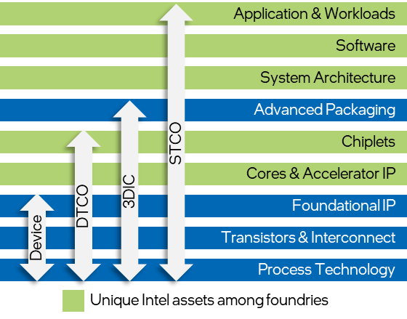






Upside of an Integrated Studio
Super-powers
Ubiquitous Compute
Cloud to Edge Infrastructure
Pervasive Connectivity
Sensing
Artificial Intelligence
New advanced node customers
Public-private partnership
Chiplet platform: enable startups & academics to rapidly innovate and drastically reduce costs
CSP
Auto OEM & Tiers
MAG
1
Full-stack optimization of systems
2
3
Bolster IFS business
Govt. benefits from the same
CSP: Cloud Service Provider
MAG: Military, Aerospace, Government

Slide 10




We Propose … System Design Studio
Partitioning
Co-Simulation
research
Customer
Secure repository
Task Level
Functional
Electrical
Collateral
Libraries
tools
Cost
Thermal
Power Delivery
Signal Integrity
System Design Studio
Applications
System Design Studio
Reference Designs
Reference Methodologies
HW / SW Systems
reference
Constraints
Chiplets
Packages
Boards
Foundry Customers
stack
Tools
Solvers
Interconnect
IPs
(with PnP models)
Components
Secure Repositories
1
Studio for Foundry Customers
2
3X↓ in Concept to Engineering Commit time + effort
infrastructure
Cloud
Common representation
EDA Solutions
Embrace
Unique differentiation
Embrace + extend
Research
… quantification of 3X benefits in slides ahead

Slide 11


Top-Down System Design Studio Workflow
Applications
Workloads
Profiling
Embrace
Standard
Compliance
Interoperable
System
Design
Studio
SW / HW Partitioning
Novel idea
Unique Existing Differentiation
SW Libraries
SW Spec
HW Spec
Design Libraries
SW Modules
IPs/Chiplets/Models
Analysis Engines
Feedback

Slide 12
System Design Studio Workflow #1
Applications
Workloads
Profiling
Embrace
Standard
Compliance
Interoperable
System
Design
Studio
SW / HW Partitioning
Novel idea
Unique Existing Differentiation
SW Libraries
SW Spec
HW Spec
Design Libraries
SW Modules
IPs/Chiplets/Models
Analysis Engines
Feedback

Slide 13
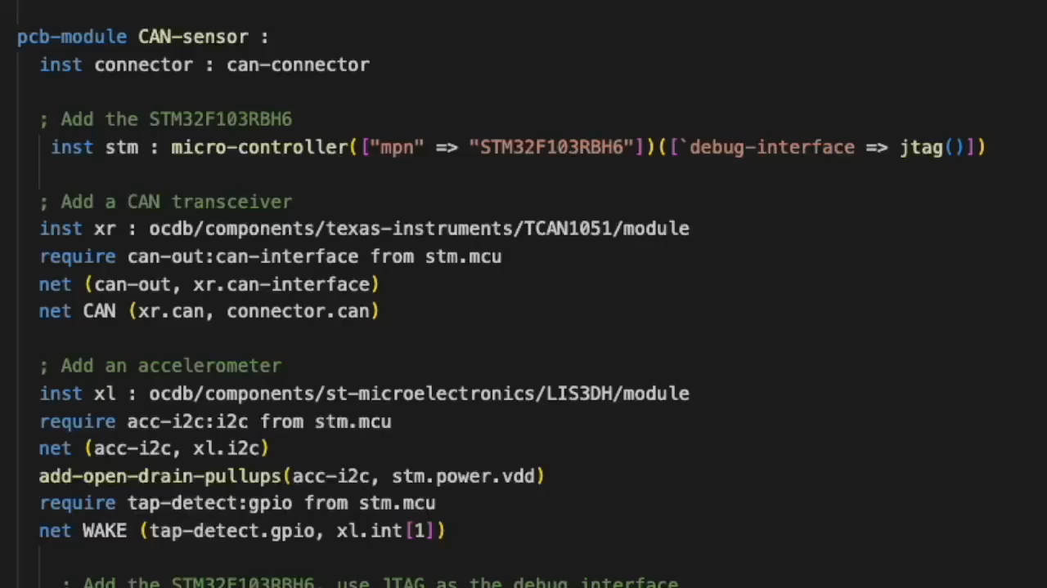
1a. Common Representation of Hardware
HW Representation
Board
Package
Chiplets
Components
IPs
(Specs + FW)
Parametrized and reuse-friendly library
Full-stack HW representation
Software Defined Hardware

Slide 14
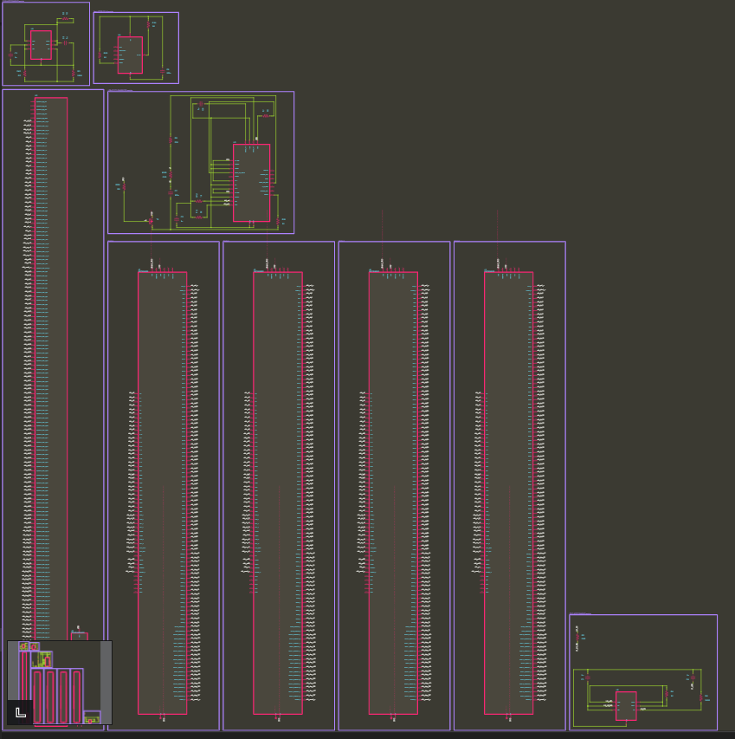
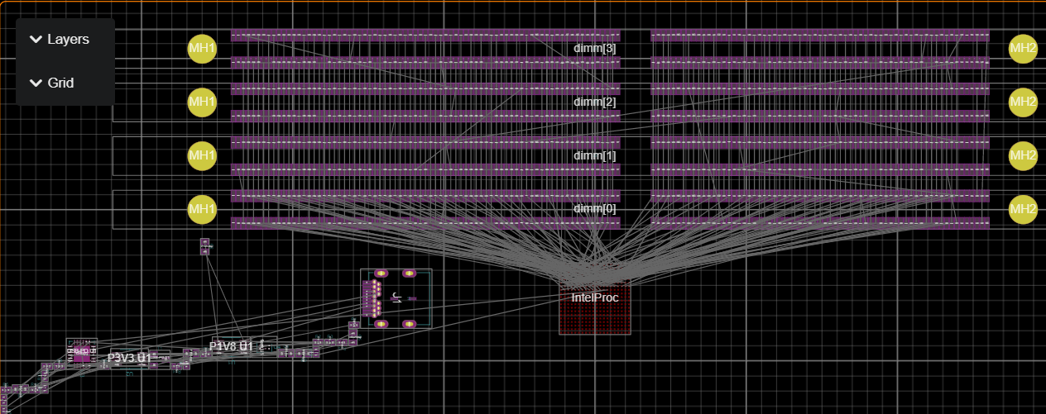
1b. System Prototype
Optimized Schematic
; ================================
; Compute Chiplet
; ================================
module compute-chiplet :
port system-io : system-io
port ucie : UCIe-interface(UCIe-Advanced)
inst uclane : ucie-module(UCIe-Advanced, 22.0e-3)
net (uclane.ucie ucie)
inst hublane : ucie-module(UCIe-Advanced, 22.0e-3)
net (hublane.ucie ucie)
inst jtag-interface : io-block(jtag(), 55.0e-3)
net (jtag-interface.io system-io.jtag)
place(uclane) at loc(1.0, 0.0) on Top
place(hublane) at loc(-0.75, 0.0) on Top
place(jtag-interface) at loc(-0.0, 0.0) on Top
property(self.shape) = Rectangle(2.0, 2.0)
property(self.thickness) = 0.5
property(self.PDK) = "Intel-18A"
property(self.RTL) = "compute.vl" ; some model - composed of smaller models
layer(Courtyard(Top)) = property(self.shape)
schematic-group(uclane) = compute-1
schematic-group(hublane) = compute-2
; ================================
; Board (full system)
; ================================
module board :
port system-io : system-io
inst IntelProc : package-board-interface(0.6, Top)
net (system-io IntelProc.system-io)
net GND ()
inst dimm : DDR4-dimm/component[4]
for i in 0 to 4 do:
place(dimm[i]) at loc(0.0, to-double(i) * 9.0) on Top
require ddr : DDR4-interface from dimm[i]
net (system-io.ddr4 ddr)
net (dimm[0].VDD dimm[i].VDD)
net (dimm[0].VPP dimm[i].VPP)
net (GND dimm[i].VSS)
schematic-group(dimm[i]) = (Ref(to-string("DIMM-%_" % [i])))
inst P1V8 : components/ADP3336ARMZ/module(1.8)
inst P3V3 : components/ADP3336ARMZ/module(3.3)
inst J1 : ocdb/components/belfuse/SS-52400-003/component
inst USB-PD : components/STUSB4500QTR/module ; USB-C PD device
net (J1.vbus USB-PD.Vbus)
net (J1.CC1 USB-PD.CC1)
net (J1.CC2 USB-PD.CC2)
require ctrl:i2c from USB-PD.U1
net (system-io.sys-i2c ctrl)
inst flash : components/AT25SL321-U/module
place(IntelProc) at loc(0.0, -15.0) on Top
property(self.shape) = RoundedRectangle(200.0, 70.0, 1.0)
Characterized and parametrized system
Characterized and parametrized component
Optimized (layout) Design

Slide 15
1c. New Intermediate Representation for Design Exploration
Data-sheets
Std. Interfaces, components, …
Placement
Library
Thermals
Supply chain data
Routing
Signal Integrity
Power Delivery
Design requirements & goals in code
ESIR
Design #1
ESIR
Design #2
ESIR
Design #3
ESIR
Solvers
Design validation
ESIR
Export CAD files
…
Optimization goals
Design space exploration
System SW, Firmware configuration
Test Plan
ESIR: Electronic Systems Intermediate Representation
ESIR is an open standard: https://github.com/JITx-Inc/open-components-database/blob/main/README.md

Slide 16
System Design Studio Workflow #2
Applications
Workloads
Profiling
Embrace
Standard
Compliance
Interoperable
System
Design
Studio
SW / HW Partitioning
Novel idea
Unique Existing Differentiation
SW Libraries
SW Spec
HW Spec
Design Libraries
SW Modules
IPs/Chiplets/Models
Analysis Engines
Feedback

Slide 17
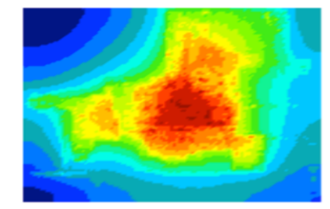
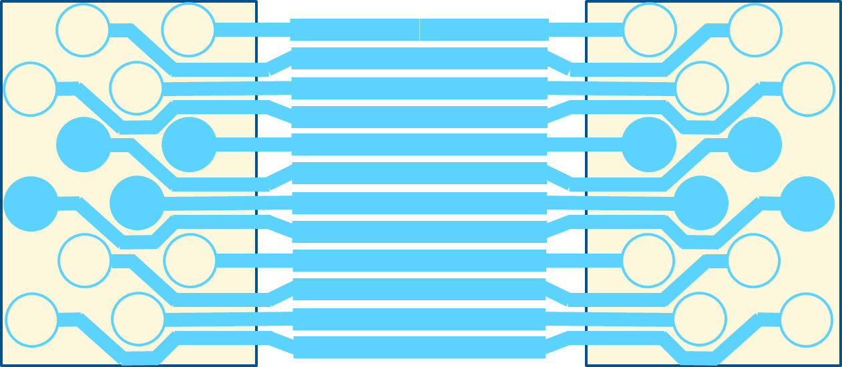
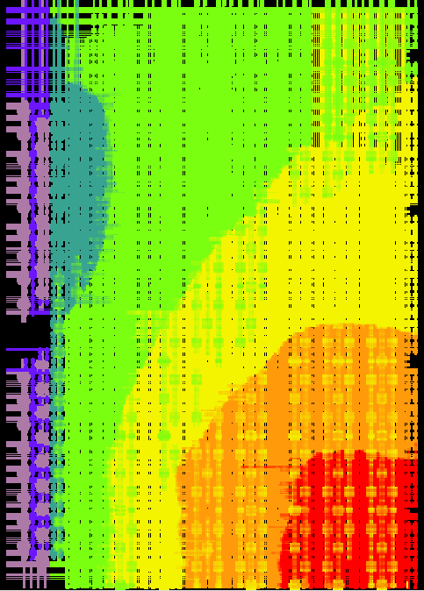
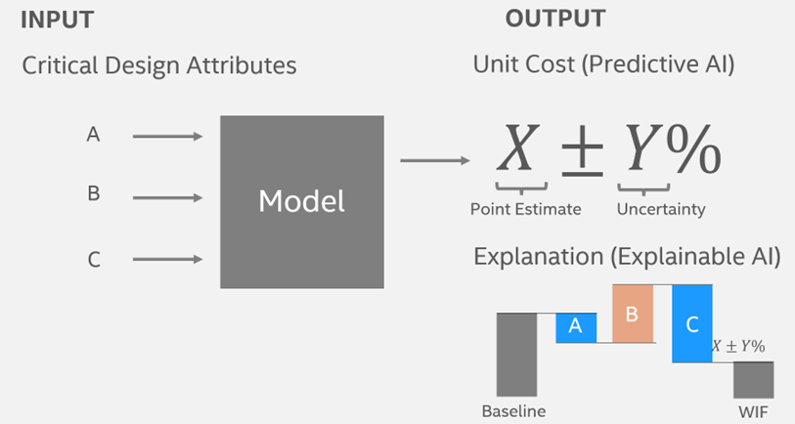
2a. Solvers for Design Space Exploration
Mechanical
Electrical
Thermal
Thermal / temperature characteristics and constraints
Bump and wire sizes
Bonding footprint
xyz constraints
Cost Modeling
Power delivery
Noise margin
Capacitance
Predict PCOS
Democratize real-time cost prediction
https://unitcost.intel.com/
Integrated Solvers for System Prototyping and Cost Analysis
One Design Representation → Multiple Solvers

Slide 18
2b. Integrated Simulators for Modeling and Co-design
Simics HW/SW Co-design and validation
Micro arch simulators: Microarchitectural tuning
Emulation, FPGA, RTL hybrids : Silicon Readiness to SW
CoFluent Architecture exploration
Docea
Power, performance and thermal tuning
Workloads (SW function)
Validated SW & architecture
Cross-domain PnPnT Modeling & Dynamic Simulation
Leverage and unify a set of existing models/simulators
Used from architecture pathfinding to SW validation
Support Continuous integration and deployment (CI/CD)

Slide 19
Research Directions for System Design Studio
Applications
Workloads
Profiling
Embrace
Standard
Compliance
Interoperable
System
Design
Studio
SW / HW Partitioning
Novel idea
Unique Existing Differentiation
SW Libraries
SW Spec
HW Spec
Design Libraries
SW Modules
IPs/Chiplets/Models
Analysis Engines
Feedback

Slide 20
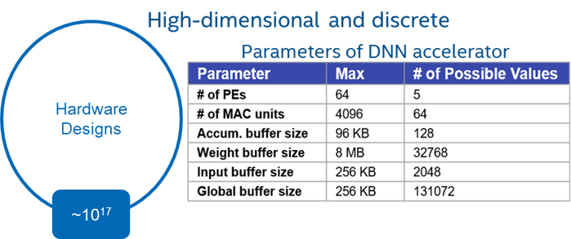
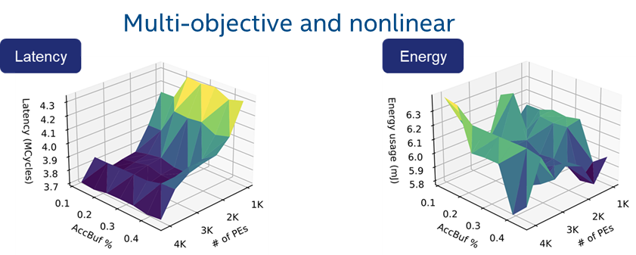

Explore HW Bindings for AI/ML Algorithms
AI / ML Dataset
System Design Studio
design space exploration
large design space ~ 10¹⁷
optimized network
System = Chiplets + Software
….
SW
Achieves 5% more efficient system design
https://people.eecs.berkeley.edu/~ysshao/assets/papers/vaesa-ispass2022.pdf

Slide 21
With AI & LLM Every Studio User Can be a Power User
Faster iterations
Example: Generate new design ideas and explore different configuration options
Reduce errors
Example: Flag potential issues with specification in system context
↑ Optimization space
Example: Suggest system improvements and help make tradeoffs

Slide 22
Use Cases
Use Cases
1. TTM acceleration for Internal products
2. Bolster IFS business
3. Platform enablement for government programs

Slide 23
Case Study #1: Product STCO Analysis
The challenge: developing systems requires evaluating many options
High-expertise within and cross domains
Does not scale
Breaks down for IFS customers
To address: need methodology with following pillars
Common (plug-able) model
Studio - easy to use, extensible
Built on industry standards
Action: System Design Studio
Develop or embrace common model
Co-develop the Studio
Leverage existing Industry solutions
M11
M12
M13
M14
Cost
Model
1
RAYS
hours
ROT
mins
PCOS
days
ChSolver
hours
M21
M22
M23
M24
KPI
Model 2
Simics
mins
Docea
hours
Martini
hours
Marlin
hours
M31
M32
M33
M34
M35
PnP
Model 3
System
Concept
Perf
mins
Keiko
days
Avalanche
weeks
IDPA
weeks
TCO
hours
M41
M42
M43
M44
M45
Electrical
Model 4
Scalars
days
SimTools
weeks
RedHawk
weeks
Clocking
weeks
SITools
weeks
M51
M52
Physical
Model 5
Floorplan
months
Thermals
weeks
EDA
Intel
STCO: system technology co-optimization
For detail map and description of see here
Notes:
The challenge: developing systems requires evaluating many options
Problems (within & cross-domains) built on high-expertise
Does not scale to large # of options or evaluating new opportunities
Breaks down for IFS customers
To address: need methodology with following pillars
Common (shareable) model of different views (plug-able by others)
A studio, can be used by anyone (easy to use / debug; extensible)
Built on open / industry standards
Action: System Design Studio
Develop or embrace common model
Co-develop the Studio
Leverage existing Industry solutions

Slide 24

System Design Studio Benefits
M1
Current System Design | With System Design Studio
Cost
Unified Cost Analysis
Model Creation | Days | Minutes
Analysis | Minutes | Minutes
M2
System
Concept
KPI
Integrated Architecture Exploration
Model Creation | Hours | Hours
Analysis | Hours | Hours
Common
Model
M3
PnP
Integrated Microarchitecture Exploration
TCO
Model Creation | Weeks | Days
Analysis | Days | Minutes
M4
Electrical
Multi-Physics Early-Analysis Engine (SI, PI, Reliability)
Model Creation | Weeks | Days
Analysis | Days | Hours
M5
Physical
Software Defined Generators
Model Creation | Month | Days
Analysis | Days | Hours
EDA
Intel
Embrace Industry Solution & Extend
A studio: easy-to-use, resource optimized
Notes:
Reduced resource requirement

Slide 25
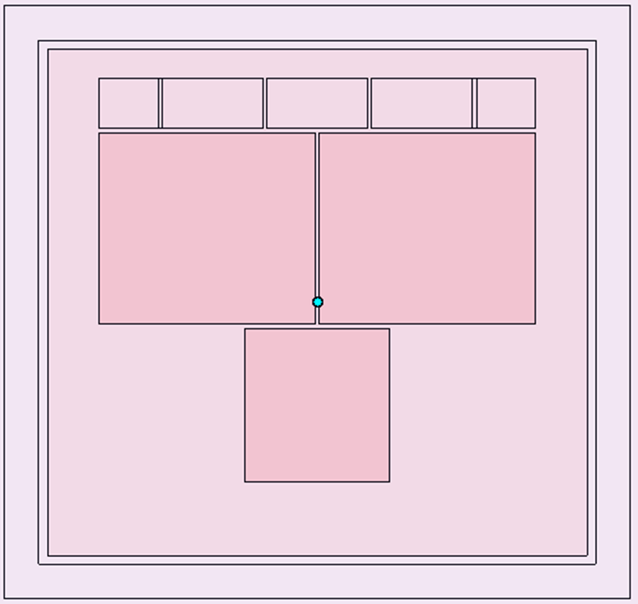
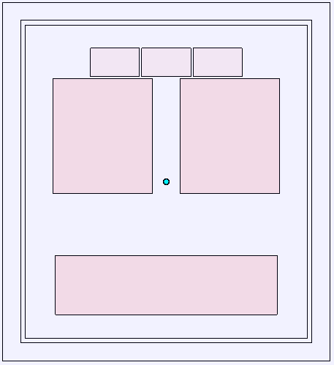
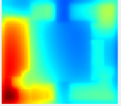
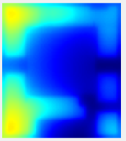
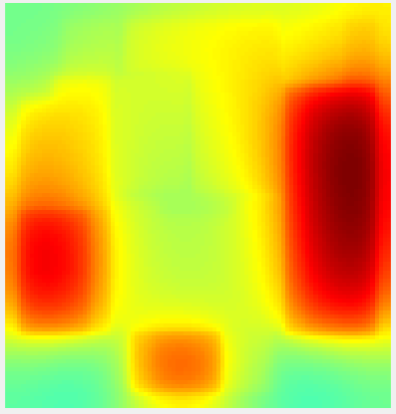

Case Study #2: Thermal Challenge
Original proposal to customer
Thermal/architecture co-designed solution
T_{j,max,die1} = 130 ºC
T_{j,max,die2} = 125 ºC
TDP = 81.4 W
T_{amb} = 88.5 ºC
T_{j,max,die1} = 120.5 ºC
T_{j,max,die2} = 120.7 ºC
TDP = 80.7 W
T_{amb} = 88.5 ºC
Focused
2-week redesign
effort with Si Experts
Results from 2-weeks of Thermal/Silicon co-optimization: “un-selectable” → “winning the race on thermal”
Current Methods built for relatively slow optimization times!
Target by end of 2023, optimization can be done in ~2 days
System Design Studio Target: by end of 2024, optimization can be done in ~2 hours
Notes:
Refloorplan and some IPs redesigned

Slide 26
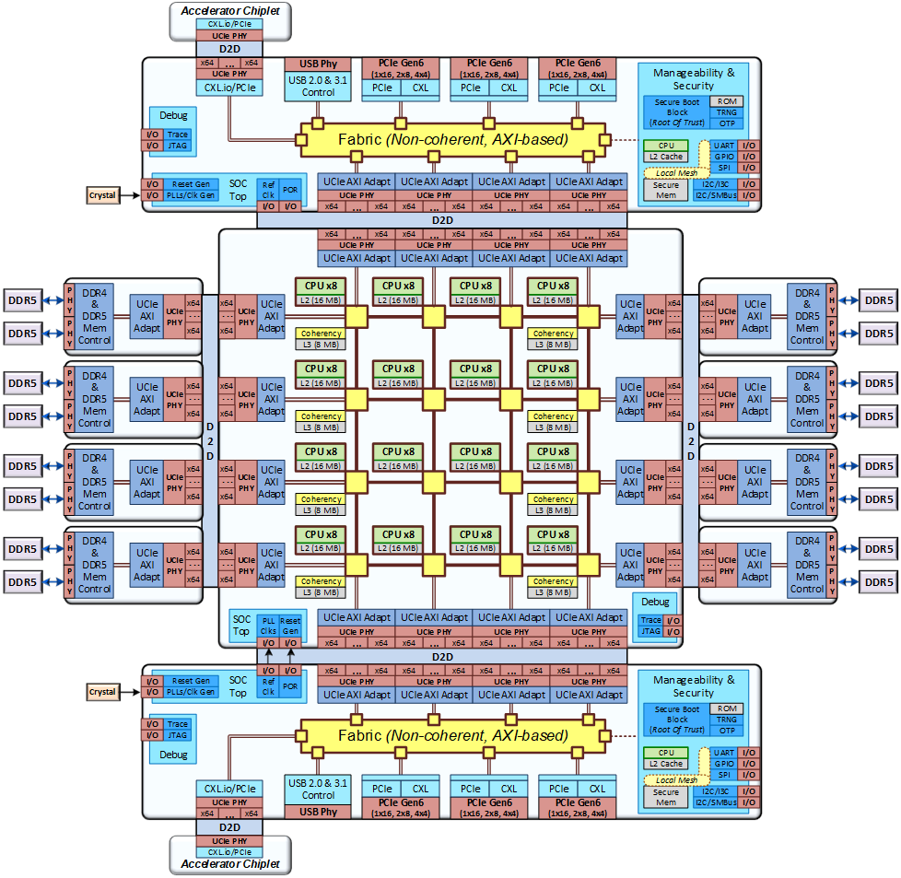
Case Study #3: Optimal Silicon Partitioning for Foundry Customer
Cost Contributions | Monolithic (Intel18A) | Compute (Intel18A) + DDR/IO (Intel3) | All Chiplets (Intel18A)
PCOS ($/u) ± 1σ @ISO 685 | High | Low-1 | Low-2
Silicon Cost Contribution | High % | Medium % | Medium %
Packaging And Test (PAT) Cost Contribution | Low % | Medium % | Medium %
Advance Packaging Cost Contribution | N/A | < 10% | < 10%
Scrap Cost Contribution | < 5% | < 10% | < 10%
IO Chiplet
DDR Chiplet
Compute Chiplet
DDR Chiplet
IO Chiplet
Comparative / pairwise analysis for any homogeneous or heterogeneous implementations

Slide 27


Case Study #4: Platform Enablement for Government Programs
Secure repositories and studio for semiconductor solutions
Upcoming USG Program | Description
NAPMP | Advanced packaging manufacturing
CHIPS | Chips for America
3D-PRODIGY | 3DIC-Physical design, validation, architecture
System Design Studio
repositories
secure access
with proven solutions
government
programs
Proven components, Chiplets, and IPs to jump start grand challenges

Slide 28
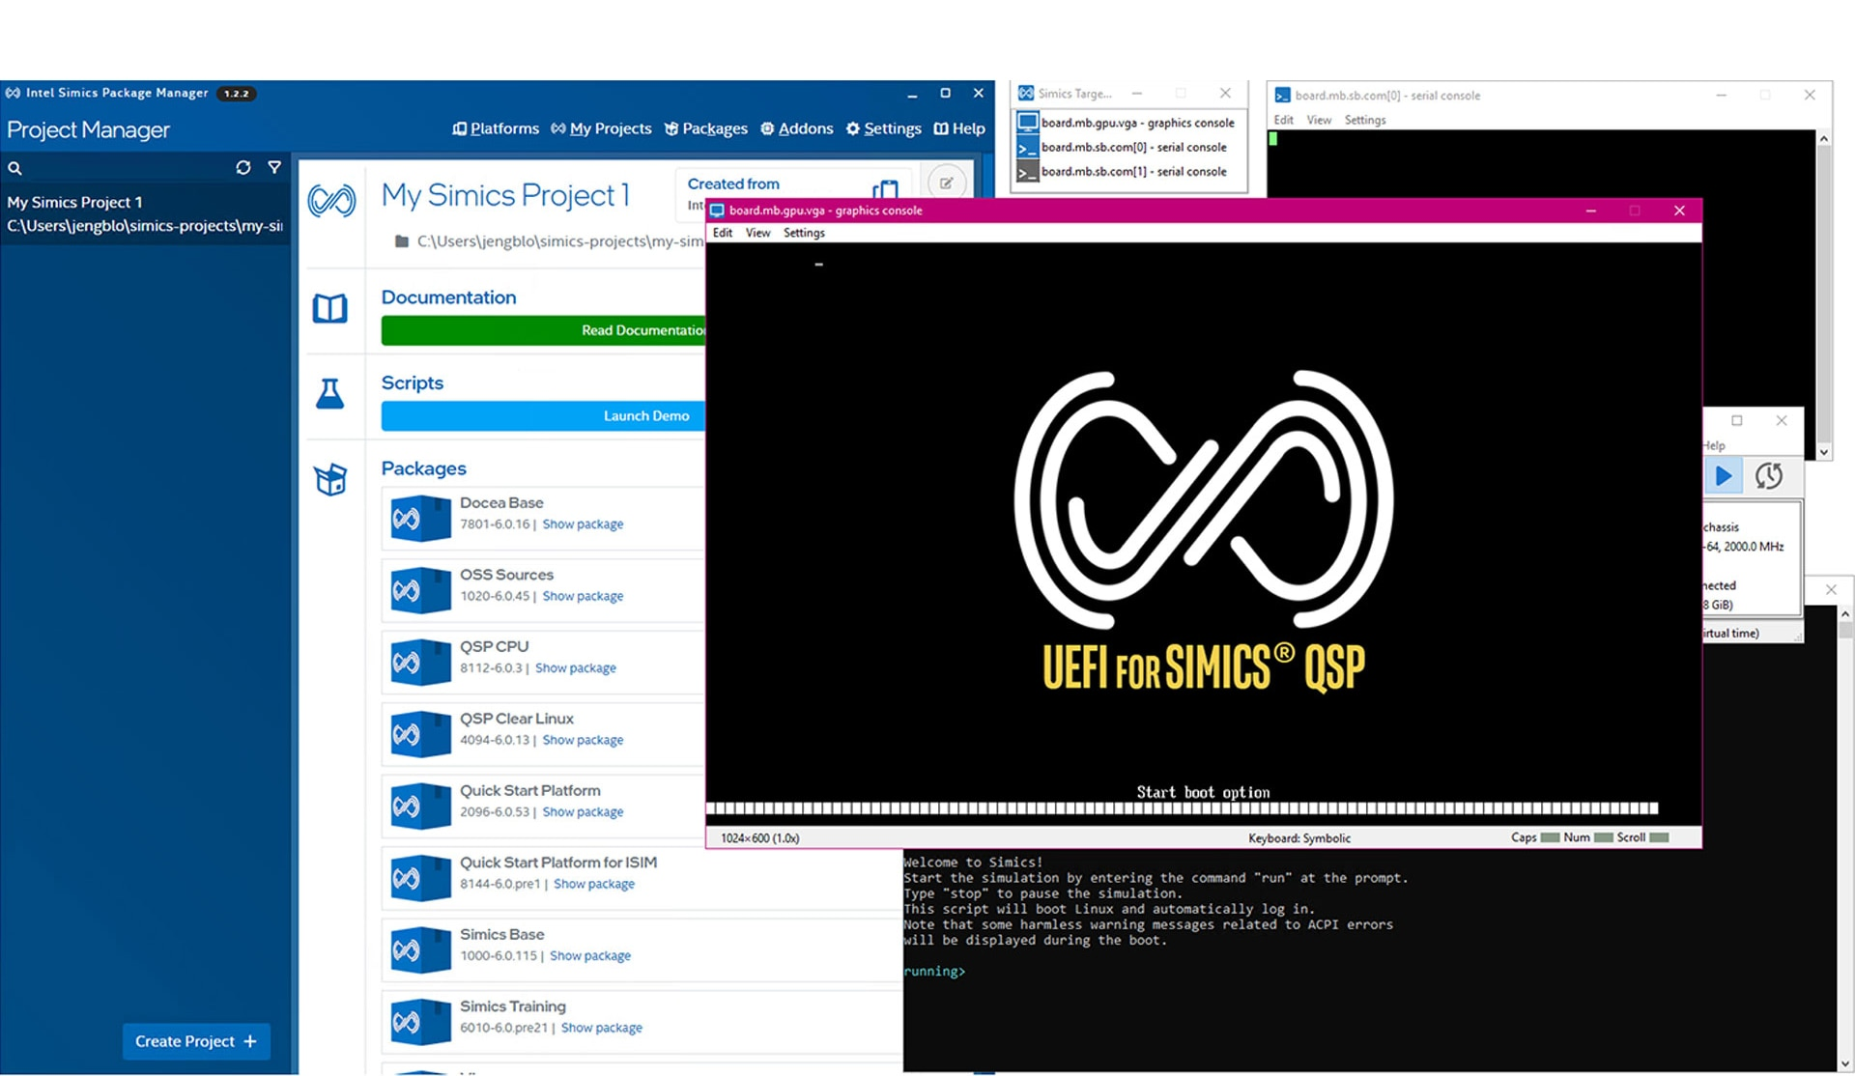

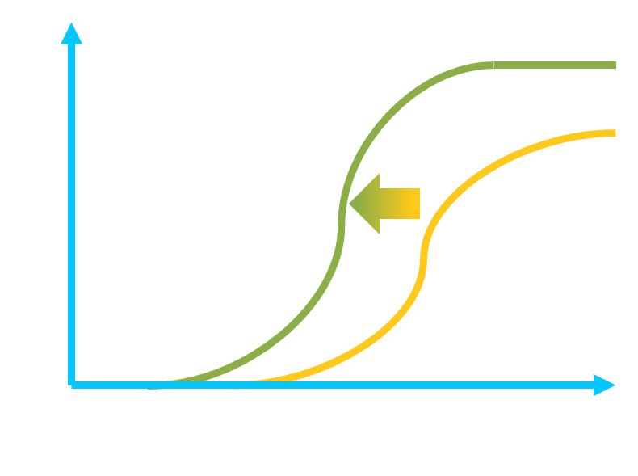

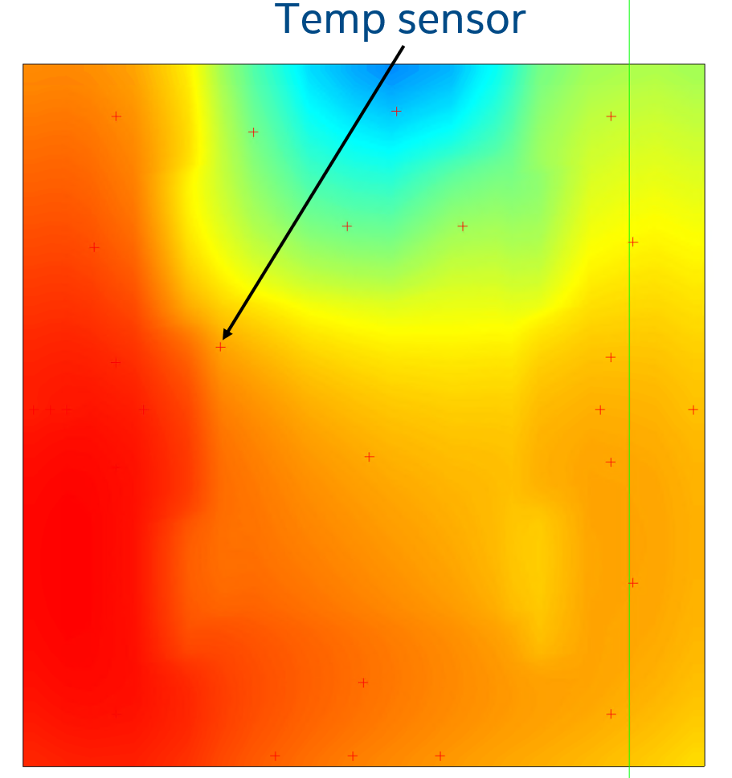
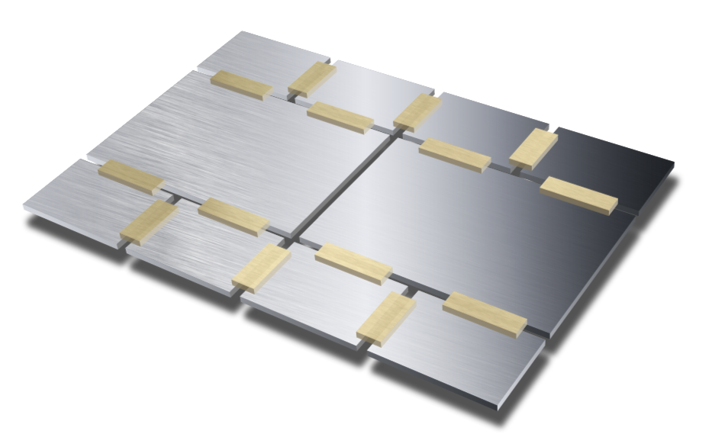


Overall System Design Studio Value Thesis
Bring heterogeneous parts to market, faster, with better PPA & yield
Accelerate Time to Leadership
Development Accelerated
Proven STCO Solutions
Robust Products
Architecture
STCO Optimization
Mechanical
Intel ® Simics®
Thermal
Intel® Docea™
Firmware Accelerated
Cost
Performance
Intel® CoFluent™
Validation Accelerated
STCO: system technology co-optimization

Slide 29




System Design Studio Development Plans
EDA Collaboration
Example: https://www.cadence.com
Looking for strategic partnership [pending discussion]
Niche start-ups with significant potential
Example: https://www.jitx.com
System Design Studio
University collaboration
Focus: research directions
Example: https://stanford.edu [App Store]
Lead driver of co-development: https://intel.com
Intel’s role: drive strategic alliance and use-cases for IDM 2.0

Slide 30
Our Approach will Drive Increasing Value
Continue Status Quo
Partner w/ Govt
All-In
Participation
Partnering
Leading
Heterogenous Systems will organically grow
Incubate & accelerate grand challenges
Prioritize holistic studio for systems
Approach
Participate in the ecosystem
Intel assets are key for system challenges
Massive benefits, leapfrog competition
Assumptions
Our competitors (TSMC, AMD, …) leapfrog us
Competition acts faster seeing ↑ benefits
Culture & externalization challenges
Risks

Slide 31
Call To Action
Near Term: 1 year
Medium Term: 1 – 2 years
Long-Term: 4+ years
Develop Studio Tech
Acceleration
Strategic Innovation
TD
Enable APIs for Systems Solvers
Offer proven recipes for co-design
Develop generators for predictive process kits
SATG
Unify a set of existing models/simulators
Release an always-alive architecture models
Automate SW-HW Partitioning
DEG
Embrace 3DBlox
Adopt common-model (ESIR)
Intercept pathfinding of 2026 products
Introduce AI + LLM for System exploration
IFS
Certify reference designs & methods
Pilot use cases with IFS customers
Link: Natural Language Guided Si Product Development
Partnership
Confirm strategic EDA partner
Develop Studio monetization streams
Establish an App store for Systems
“Going forward, the focus is going to be on the methods and tools that help enable STCO.” – Ann Kelleher, EVP, Intel Corporation
Notes:
Who will lead and thy have to work together
COE formation

Slide 32
Acknowledgements & Sub-Teams
Relation to past TSLRPs
[2021] Silicon at the Speed of Software – SiFive presentation
[2021] Compiler Inspired HW Design
[2022] Open-Source Silicon Stack
Current 2023 TSLRP
Natural Language Guided Product Development: Advance Intel AI-ification by assessing future potential of LLMs + Intel data to streamline E2E development
Team | Leads, Partners
Core Team | Vivek Rajan, Tanay Karnik, Bala Iyer Eric Fetzer, Atul Kwatra, Vinoo Srinivasan, Bob Brennan, Mark Doran Ravi Mahajan, Satish Surana, Lalitha Immaneni Rob Munoz, Shubha Bommalingaiahnapallya Surhud Khare, Slade Morgan Ram Viswanath, Chris Rothstein
Studio Sub Team | Rajiv Mongia Mark Doran Nanda Kuruganti Jin Yang
Product Fit Sub Team | Slade Morgan, Surhud Khare Takuya Abe
Business / Market / Ecosystem Sub Team | Rob Munoz Bob Brennan Ram Viswanath, Al Fazio Global Supply Chain Team
Long Range Sub Team | Mahesh Subedar, Desmond Kirkpatrick, Fadi Aboud

Slide 33
BACKUP

Slide 34
STCO Tools Details
Cost Analysis
PnP Analysis
Electrical Analysis
Physical Analysis
LTD RAYS (PF Si Cost)
Hours
Standalone system
Excel + JMP
ATTD RoT (PF PAT Cost)
Mins
Standalone system
Web UI
LTD + MPE + Finance (PK-PRQ PCOS)
Days
Standalone system
Excel based
Chop Solver (SKU stack)
Hours
Standalone system; ongoing integration w/ RAYS
Software Optimizer
Analytical Perf Model for broad workloads (PF)
Mins
Integrated with Avalanche for power-constrained perf (V/F)
Excel
Keiko/Coho/IWPS
Days
1C/cycle accurate/full-system simulators
Software models
Avalanche (Bin-Split/PnP)
Weeks
Integrated with analytical model for perf CPI inputs
Software automation
IDPA (Power)
Weeks
Integrated with Avalanche
Software automation
TCO Model
Mins to hours
Standalone system
Various versions from excel to python-based tool
Process scalars
Days
Standalone system
PDK→ block scaling
APR analysis by PESG TFM
3DIC integration models
Weeks
D2D IO/TSV/IP Scaling
Circuit simulations tools
Power Delivery (platform/PKG/3DIC)
Weeks
Standalone system
Bedspring (PF)
Red Hawk
Clocking
Weeks
Standalone system
Circuit simulations tools
Signal Integrity
Reliability
Floor-planning
IPs
Die
3DIC
Package
Weeks-Months
Standalone systems
Thermal

