Slide 1
The Gen AI Opportunity
Pradeep Dubey Intel Senior Fellow and Director, Parallel Computing Lab
April 2024

Slide 2
AI Problem Statement & the GenAI Opportunity
AI Update:
Trained on text, image, code or protein … data, AI can now learn a model that generates a novel text, image, code or protein … that is indistinguishable, yet original compared to the training data
→ AI’s Dream Moment: claiming to do human minds do every night while dreaming
We can avoid training-from-scratch for various use cases, and instead cheaply (in cost terms) fine-tune or augment a large model down to a smaller-and-better model for a specific context.
AI Opportunity:
Above two have significantly sped up the permeation of AI into various content creation and decision-making workflows, which were reluctant in adopting AI so far, simply because of economies-of-scale associated with more machine-and-less-human-cycles in the workflow.

Slide 3
Intel Opportunity in the Generative AI Era Is this another iPhone moment for Intel?
Compute flops-bandwidth requirements have gone up 100-1000x or more at the high end (pre-training) and 10-100x for the volume server and client as well.
Easier to meet compute flops needs than feed needs
Highest-level manifestation of limitations that could end-it-all:
Energy cost of sustaining AI compute needs: primarily rooted in cost of data movement
Developer disconnect: Growing gap of ninja-performance vs. data-scientists
System Asks:
Compute
North-South: Feed the compute
East-West: Scaling up/out
Packaging it all

Slide 4
Technologies for AI-27
Workstream
Baseline
Disruptive ‘27
Disruptive,
Tech readiness at risk for ‘27
High Memory
Bandwidth
(Rajat A)
ADM Gen3
Memory Cube
HBM4
LPDDR Extreme Channel count
Networking Protocols
(Brad B)
Optical Interfaces
(Matt A)
Ethernet
UXI + PCIe Switches
OEM fabrics
Standards-based scale-up interface
Industry Protocols: UEC/Falcon-Lite/CXL
Optical Interface (GilaBend+, Mystery Bay) (Platform and Silicon Integration ready)
Packaging
(Pooya T)
Super reticle expansion
Wafer over Wafer Bonding
High ball-count package
Organic: 2.5, 3D
Glass substrate (Laurentide)
Process
(Eric F)
Low Power Perf. optimization (1280)
VccMin reduction
Power Via++, Power Delivery
Power Delivery (Rich) &
Cooling: (Tejas S)
1.8KW Single Phase and Pumped Two-phase cooling
PVR, IVR
Top side power delivery
Series power
48V into Module, VR Chiplet
Immersion cooling
(PoC with Omniva, DoE)
AI System (Saurabh)
&
Compute (Max)
Compute: 4b Datatype
Compute: Next-Gen X86 Core
Compute: Next-Gen Xe4 IP
Integrated System Solutions
(Optimized Xeon + Xe GPU in a scalable Box with NW, Mem, Storage with AI Infra and enterprise platform )
Software
(AlexH)
Library based Compiler
Compiled OOB AI performance
AI generated performant code
AI27 Core Team: Brad Burres, Mathew Adiletta, Nevine Nassif, Pradeep Dubey, Sailesh Kottapalli, Sundar Balasubramaniam

Slide 5
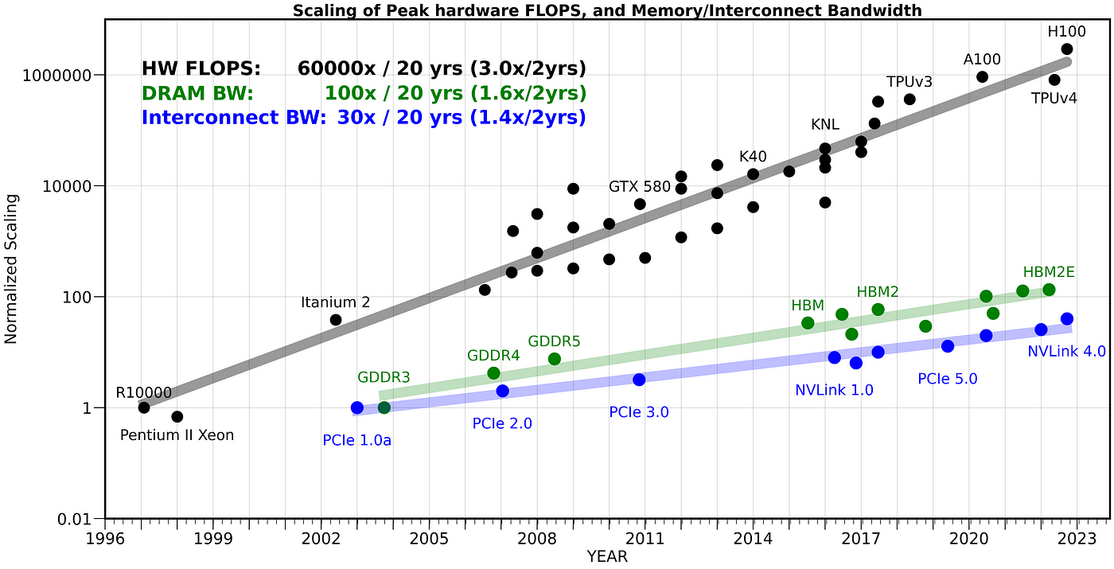
Credit: Amir Gholami: https://medium.com/riselab/ai-and-memory-wall-2cb4265cb0b8

Slide 6
AI Today | Dominated by Nvidia
Nvidia DGX H100
Component | AI Server
CPU | $ 5,200
8 GPU (incl. HBM) | $ 128,000
Networking (8 NICs, 4 NVSwitches) | $ 77,908
Memory | $ 7,860
Storage | $ 3,456
chassis, MB, Cooling, PS | $ 2,586
Assembly & Test | $ 1,485
Markup | $ 42,000
Total | $ 268,495
Infiniband Switch
...
Infiniband Switch
Infiniband Switch
...
Infiniband Switch
CPU
UXI
CPU
Bluefield
IPU/DPU
Bluefield
CX8 NIC
Bluefield
CX8 NIC
Bluefield
CX8 NIC
Bluefield
CX8 NIC
Bluefield
ICX8 NIC
Bluefield
ICX8 NIC
...
PCIe/CXL
H100
GPU
H100
GPU
H100
GPU
H100
GPU
H100
GPU
H100
GPU
DGX H100
DGX H100
Each H100 is expected to sell for ~$16k
Each NVSwitch is ~$15k
Each Infiniband Switch is ~30k
NVLink
NVSwitch
NVSWitch
NWSwitch
NVSwitch
DGX H100
Standard Ethernet Datacenter Network (Storage, Tenant VMs, etc)
Networking makes up > 1/3 of the total DGX cost
Credit: https://www.semianalysis.com/p/ai-server-cost-analysis-memory-is

Slide 7
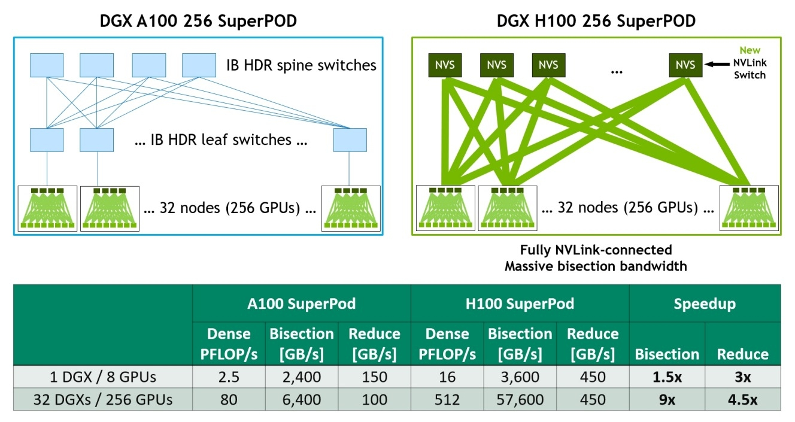
Credit: https://www.exxactcorp.com/blog/HPC/NVIDIA-H100

Slide 8
Photonics Based Disruptive AI Networking
Proof of Concept (POC):
32 Nodes, 256 Falcon Shore 1 (FS1) GPUs
SLEEK (Electronic IC, Intel designed/architected): TapeOut Q3’24
Engineering Validation and Testing Q1-Q2’25
Product
30K+ Falcon Shore 1 GPUs per systems
2H’26
Collaboration
Photonics Startup – SoW in place
CSP Partner – SoW is WIP
Objective By 2026, in collaboration with a definitional CSP partner and a photonics technology provider, deliver a photonics-based networking solution for AI that achieves: a) >3x bisection bandwidth and >2x network power saving under iso-network-capex cost, with respect to contemporary Ethernet; and b) achieves an AI datacenter deployment at a scale of >100K Falcon Shores.

