Slide 1
Parallel Processing Environments
Two categories of parallel processing environments
  Symmetric-Multi-Processing (SMP): resources shared among processors. a single operating system.
  Shared-Nothing-Design: each processor has exclusive access to hardware resources with dedicated operating system, and communicated via a high-speed network
    Hardware executing modern workloads is significantly different from SMP
    Massively Parallel Processing(MPP): Physically housed in the same box
    Cluster Processing: physically dispersed.
SMP systems performance scaling can be limited by CPU, Memory and/or Storage A
  CPU-limited jobs: more cores using adv. logic technology can speed up overall performance
  Memory-limited jobs: memory performance (latency, bandwidth and capacity) can be improved such as cachelet (cache capacity gap), HBM (main memory bandwidth gap) and TC-DRAM (memory subsystem hierarchy gap)
  Storage I/O limited jobs: Scalability of storage throughput by transfer rate and number of channel
Share-Nothing-design performance is managed by resources provisioning per workloads (anticipated)
  Core Counts Grow, Clock Speeds Stay Constant: scalable fabric with modular resources (memory/storage/IO and protocol) are in high demand
  I/O continues to Increase in Speed: Protocol, bandwidth per channel and number of channel

Slide 2
Modularity as the framework for Compute Platform Scalability
These flowing examples illustrate scalable electronic hardware systems across different computing environments.
AWS IoT Greengrass: a platform that extends cloud capabilities to edge devices.
Azure IoT Edge: It enables containerized modules to edge devices for proximity processing.
Raspberry Pi and Arduino Ecosystems: These single-board computers can be used in various client, edge, and cloud applications.
NVIDIA DGX Platform: designed for AI accelerators; a scalable hardware framework deployed in client, edge and cloud computers.
The white paper is to augment the pathfinding direction for external manufacturing technology based on the business landing of Intel products.
POD is a scalable solutions for Client Compute to Datacenter, covering classic workload to ML/inferencing. We will first seek to understand the technology context of a modern POD architecture; then strategize a System-Technology aligned roadmap to bridge the gap with external supply chain technology portfolios.

Slide 3
Roadmap based Technology-System Co-Pathfinding
DerChang Kau, Jan/2/2024
POD as the targeted Landing – a modular platform from Client to Edge to Cloud
Enabling technologies for advanced computing system &
Challenges and opportunities to external technology pathfinding
  ALT for high bandwidth, energy efficient Processor Subsystem
  MT for latency-throughput-capacity-cost balanced Memory Subsystem
  HSIO to build Hierarchical Compute Topology enabling protocol continuum
  Power/Thermal to manage power delivery and dissipation

Slide 4
POD – Performance Optimized Datacenter
Intel vs. Nvidia vs. Amd
Technology Content:
  Compute Infrastructure
  Memory and Storage Solutions
  Networking
  Power and Thermal management
Notes:
Key Attributes are Scalability, Modularity, Efficiency, Sustainability, Density, Performance, Manageability, Automation and Security.
Technology Content include:
Compute Infrastructure: including high-performance processors and memory configurations to explore hardware accelerators, GPUs, and TPUs for specialized workloads.
Memory and Storage Solutions: Scalable solutions, such as DRAM, SSDs and NVMe for data-intensive applications as well as software-defined memory and storage such as CXL for dynamic provisioning.
Networking: Implement high-speed, low-latency networking solutions to facilitate seamless communication between components.
Power and Thermal management: Optimize PDN and cooling for energy efficiency.

Slide 5

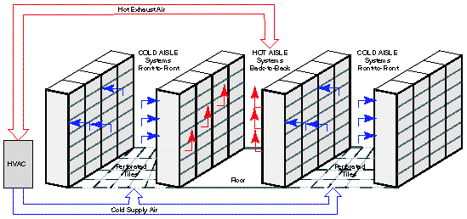
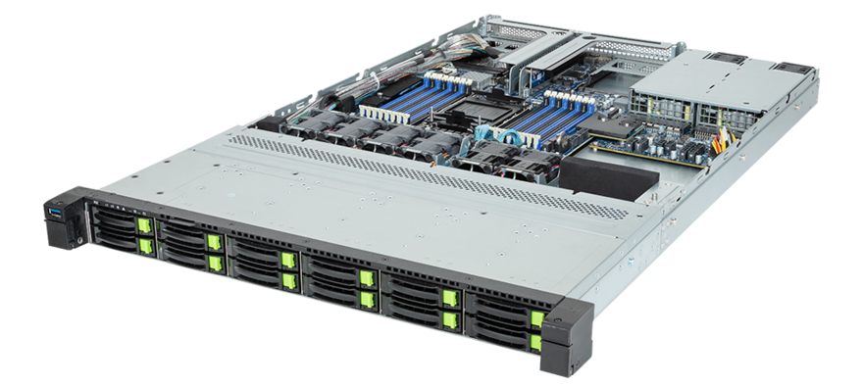
Modular, Scalable Datacenter –
Performance Optimized Datacenter (POD)
What is a Data Center?
  To store, process, and distribute data and applications.
  Components include computing, storage, and network.
POD is evolving fast
  AI – Workload optimized data analytics and ML/Inferencing
  Colocation – security and cost advantage
  PUE – Cooling efficiency
  Modularity – Agility in customization and Time to deployment
  Modular – Scale up enablement from Client to Edge to Cloud
Let’s design a high tier data center @ 1GW capacity (1 nuclear reactor)
  One 7’6”-rack@25KW can house 50 500W-1U blades (or servers in this exercise)
  1GW power capacity can support 40K racks ➔ 2M servers per DC
  50U-rack footprint: 8’X2’ ➔ 40K racks take up ~640K ft², 11 football fields
Trivia –
  A typical large pressurized water reactor has a capacity 1~1.6 gigawatts at full load
  Google’s Pryor Creek datacenter at Mayes County, Oklahoma ~1M ft² (17 football fields)
  4 of DGX H100 (8U/20KW) fit in a 50U-rack (64% vertical occupancy)
  32 GPU/rack * 40K racks in 1M ft² (64% floorspace utilization), 3.2GW for 1.28M GPUs
  2 nuclear reactors needed for Pryor Creek-like datacenter

Slide 6
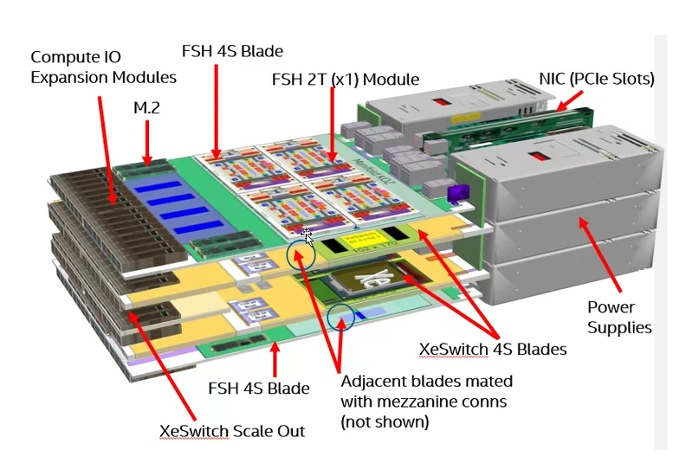
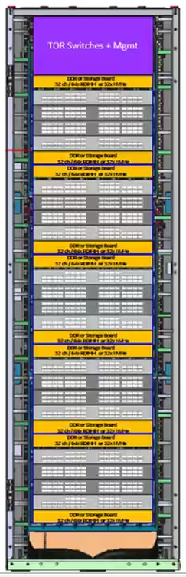
FalconShore POD Mockup
POD: Performance Optimized Datacenter
Modular datacenter solutions
A single-aisle, multi-rack enclosure
Built-in hot- or cold-aisle containment
Collection of tightly coupled nodes
Node: A self-contained computing chassis
housing xPU, memory, storage and switches
1 to several sockets in a blade
1 to several blade in a chassis
May run one or more OS instances
Courtesy of “Unified scaling fabric” by Nayan Suthar, Brijesh Tripathi of AXG

Slide 7
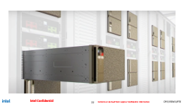
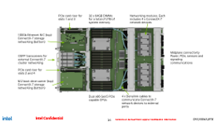
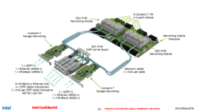

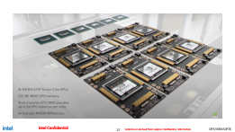
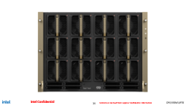
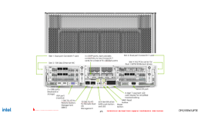
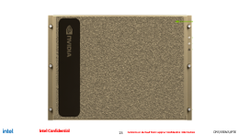
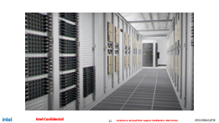
Nvidia DGX POD
Servers or workstations specialize in using general-purpose GPU to accelerate deep learning
Based upon a rackmount chassis with motherboard that carries high performance x86 server CPUs
Plus a set of (4 to 16) GPU modules on an independent system board
Large heatsinks and powerful fans to cool KWs power consumption
Provisioning multiple network switches for low latency high bandwidth data comm channels
https://docs.nvidia.com/dgx/dgxh100-user-guide/index.html#
https://youtu.be/vY61ExKhnfA

Slide 8
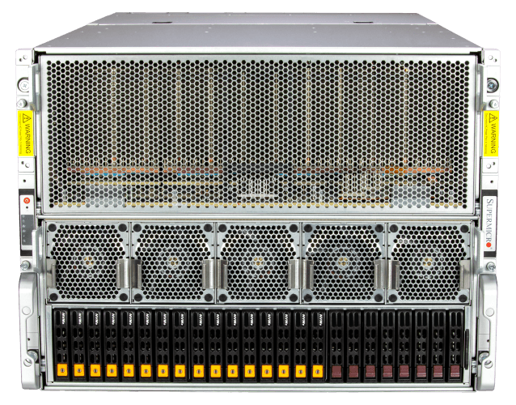
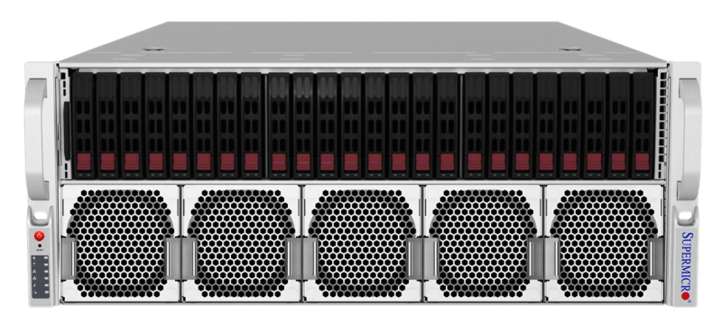
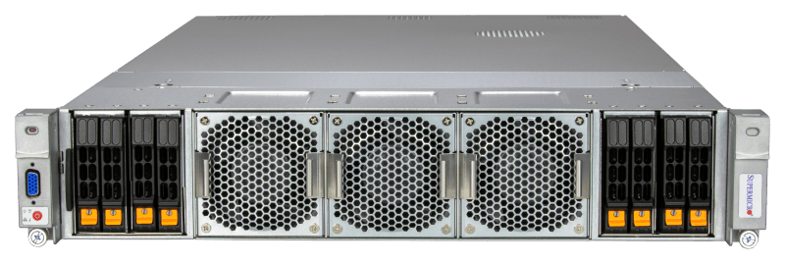
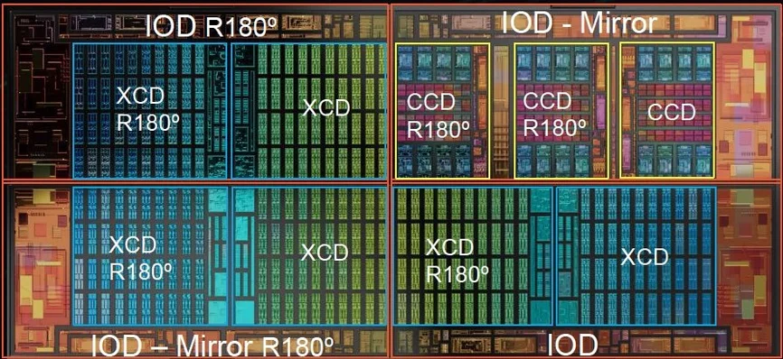
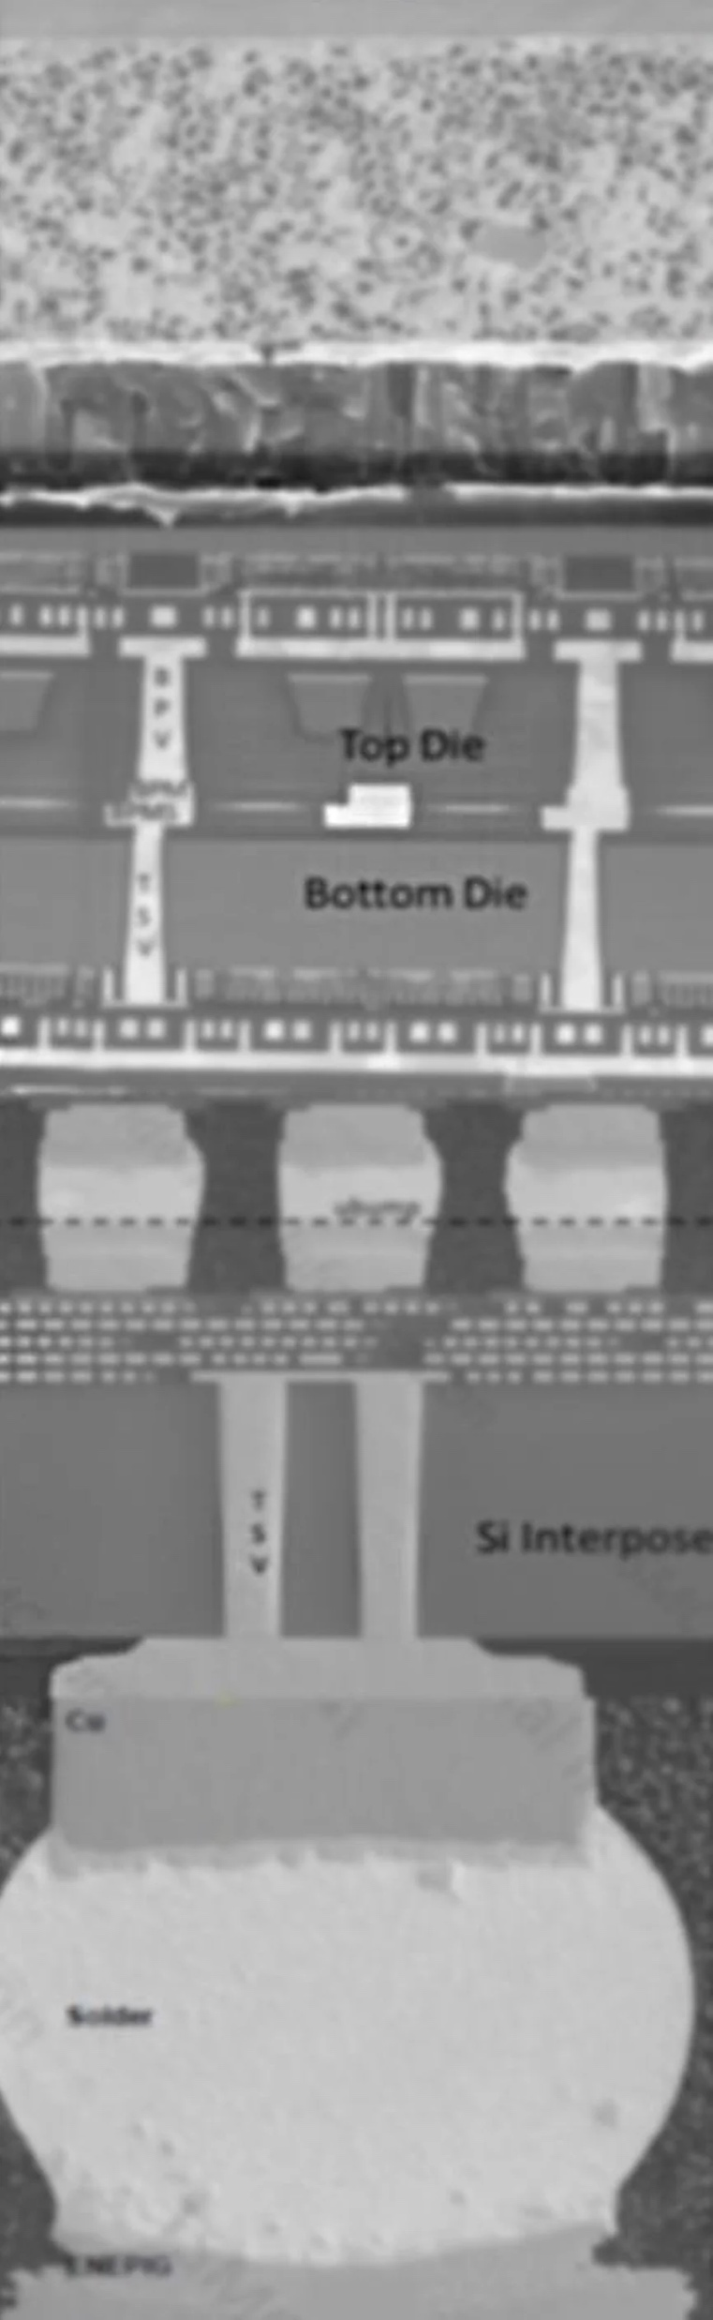
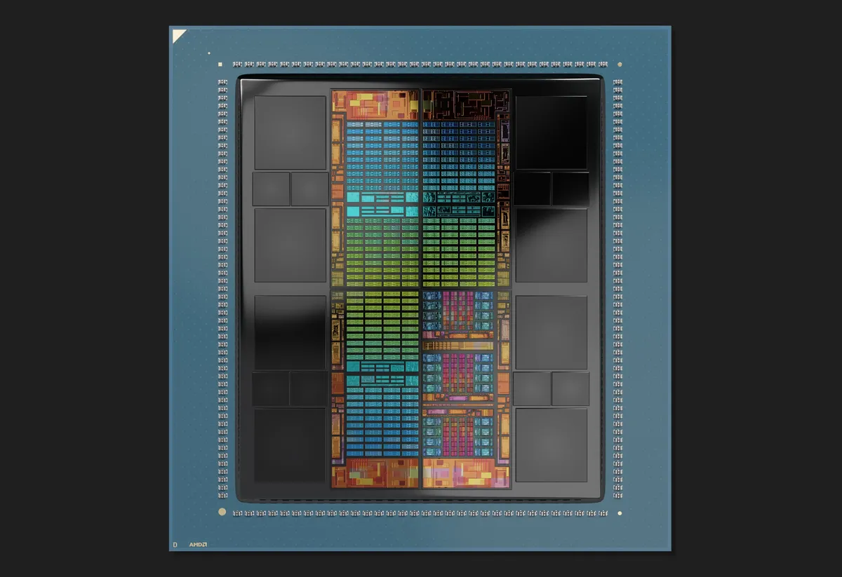
SuperMicro-AMD MI300
https://spectrum.ieee.org/amd-mi300
Form Factor | 8U Air-cooled | 4U Air-cooled | 2U Liquid-cooled
CPU | 2x EPYC9004, 128 cores/socket | 4x MI300A, 24 cores/chiplet
GPU | 8x MI300X, 304 CDNA 3 GPU/MI300X 8x 2GBx12 HBM3 stack, 5.3TB/s per MI300X | 4x MI300A, 228 CDNA 3 GPU/MI300A 8x 2GBx8 HBM3 stack, 5.3TB/s per MI300X
Memory | 24x 256GB 4.8GT/s DDR5 RDIMM/LRDIMM | N/A (unified HBM3 memory)
SSD | 16x hot-swap PCIe 5.0 U.2 NVMe, 1x onboard M.2 NVMe | 8x hot-swap 2.5" U.2 NVMe 2x onboard 2280 or 22110 M.2 NVMe
HDD | 2x 2.5" SATA | NA | 2x 2.5" SAS/SATA
Switches | 8x PCIe 5.0 400G Ethernet or InfiniBand | 4x PCIe 5.0 + 2x AIOM (OCP 3.0) with up to 400G
Topology | AMD Infinity Fabric™ Links, 896GB/s p2p inter-GPU connectivity | AMD Infinity Fabric™ Links, 384GB/s p2p inter-GPU connectivity
Power | 8x 3KW | 4x 1.6KW | 4x 1600W redundant Titanium Level power supplies

Slide 9
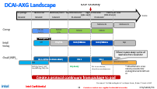
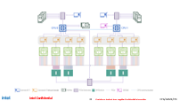
Takeaway of Advanced Computing System (ACS)
Processor: high performance x86 server CPUs + GP-GPU to accelerate deep learning and low latency inferencing
Memory: High Bandwidth IPM, multi-channel low cost JEDEC DRAM, and capacious NVM using SSD and HDD
Fabric: High thruput network switches with connectivity continuum from packages to PODs
Power and Thermal: The power grid deliver hundreds of amperes of current to the chips on the top of stack attached to large heatsinks using powerful fans with or without proximity heat exchanger or direct liquid cooling to cool KWs power consumption

Slide 10
Opportunities and Direction for
External Technology Pathfinding
Four Subsystems in ACS
  Processor Subsystem
  Memory Subsystem
  High Thruput Network
  Power and Thermal management
  And overall supply chain integration

Slide 11
Enabling Technologies for Advanced Computing System
Processor subsystem
  Computing IP disaggregation, folding
  ALT choices for computing cores, SoCs and active fabric
  Cache memory disaggregation
  Tightly Coupled DRAM such as XBM and VHM™ to bridge gaps between SRAM and JEDEC DRAM
  Connectivity topology (technology): shoreline (2.xD) vs. vertical (3D)
Memory Subsystem
  Memory Cubing for capacity and BW
  JEDEC memory augmentation
  CXL memory
  Low pJ/b persistent memory
High Speed Data Path and Switching
  HSIO technology and circuit: SiPho, SerDes
  Variability reduction/compensation
  Displacement energy scaling
Power and Thermal
  SiC/GaN for high efficiency power conversion
  High density low loss decap for PI/SI
  Junction cooling – Passive (Packaging) and Active (eg. MEMS, TEC)
  Ambient cooling – Mass and Flow management
  Chassis cooling – Air vs. Emersion
Supplier Enablement and Enabling Technology PoC
  SF4, SF5
  SF2 and SF1.4
  3DIC

Slide 12
Advanced Logic Technology Pathfinding: L0 to SiP Mockup for Optionality
ALT Mockup as manifest in
  Process Flow and costing
  L0 (compact model, design rules) and primitive collateral
  L1 and basic standard cell and PDK based PPA assessment
  L2 and (limited) cell library and block level PPA assessment
System Level assessment
  Heterogenous FE-3D for Computing Core: IP folding with technologies and corresponding bonding option.
  Cache Memory subsystems
  TC-DRAM (XBM, VHM, LLW, LLC and etc)
  HBMx/Saint-D
  Disaggregation Optionality: Technology hybridization and Packaging option
Internal BU BTR (semiannual): First Product-Technology Alignment planed in Q2/2024
Q1: Demonstrate capabilities on system model, trade-off, modularity assessment and optionality beyond Razor Lake
(with MN1.4, using 3D-Blox vs. system design studio)
Q2: BU alignment on success criteria and product prototype for supplier’s technology exploration for 2028 productization
Q4: Product Mockup PPC scorecard using the tool (need to consider DCAI product)
External SiFO ATR (annual): To be planned, targeting Q3/2024 with TSMC and Best OSAT candidate
Team Leader: Andy Wei (also Logic lead)
Content expertise leadership: Mike Goldsmith (Platform), Chung-Ching Peng (Integration), Ping-Chen Liu (Memory subsystem), Klaus Goebel (Packaging)

Slide 13
Memory Technology Exploration
SRAM chiplet
  2.3/3D µB module PoC using MDC stack and develop optimized Cachelet module
  2027 product intercept for Client Compute
  Leader: Dany Ly-Gagnon
TC-DRAM
  Initial VHM™ engagement with AP Memory
  Supply chain management for FE-3D/HBI integration (DRAM, SiFO, OSAT and EDA)
  Leader: Klaus Goebel
Terraced Memory Cubing
  Lead collaboration candidate: ASE
  JEDEC memory module and package candidates for PoP, IPM and CAMMx intercept
  Leader: CC Kuo
JEDEC Memory Augmentation
  Saint-D with Samsung
  Aligning with System Arch & Tech, Establishing QTM with Samsung Memory/Foundry, also include LLW, LLC and PIM
  Leader: Dany Ly-Gagnon
CXL Persistent Memory Exploration
  Optane™ continuation with System Arch Engineering
  Low voltage low Latency 1T1OTS > 35MB/mm² by 2026 (on par or better than 1z DRAM)
  Aligning with System Arch & Tech, Initiate Macronix engagement (+ top tier memory suppliers for 2nd sourcing)
  Leader: DerChang Kau

Slide 14
High Speed IO
Study Plan include
  Electrical IO technology roadmap
  Optical IO technology roadmap
  Electrical-to-Optical & Optical-to-Electrical transition
Formfactor / Hierarchy
  Formfactor: Module, Package, Board/Chassis, Rack
  Hierarchy: IP, Host-Acc, node, pod

Slide 15
Power and Thermal Management System
Package Level PDN integration
  Scalable High density decap for PI/SI heterogenous 2.x/3D integration
  (technology selection and Supplier engagement)
  Voltage Regulation and efficient Power delivery
  (SiC/GaN for high efficiency power conversion and Supplier’s engagement)
Active junction Cooling
  TEC and bonding
Ambient cooling – Mass and Flow management
  MEMS for high-speed thermal mass displacement
Chassis cooling – Air vs. Immersion

Slide 16
Supplier Enablement and Enabling Technology PoC
Building Porting Methodology
  Advanced Logic Technology Mapping Matrix (TSMC vs. Samsung vs. Intel)
  Content: Core, UnCore, Custom IP
Roadmap based porting strategy established
  Ex. SF2 for NVL graphics tile- DTCO with a specific product
  Enable HIPs
  Enabling assembly combinations
Establish test chip roadmap
  HIPs need silicon data prior to A0

Slide 17
Product Integration
Transition from Pathfinding to Development

Slide 18
Holistic Semiconductor Engineering for Processor Subsystem
Product Design: typically involves a collaborative efforts
  integrating IPs cross various design expertise in software and hardware design teams.
Collaboration cross domain expertise for NPI:
  Intel BU BKM – Work with DEG/GEMS for chip design and package for product integration.
  Apple, Qualcomm and Nvidia, with internal design execution, work with SiFO or OSAT directly
  Google and Meta leverage the expertise of semiconductor designers globally, by collaborating with Broadcom for example, to implement the custom or semicustom xPU architecture.
  This collaboration may involve exchanging ideas, refining the design, and ensuring that the final product meets system performance and efficiency goals.
Manufacturing Partnerships:
  At system integration stage, technology choices are brainstormed among key collaborators.
  Disaggregation strategy, including 3D vs. 2.xD IC scheme, require strong product architecture understanding and SiFO/OSAT knowledge to comprehend capability, availability and roadmap.
  Ultimately, NRE and cost of HVM will drive the decision. A roadmap-based co-development is a vital component for successful productization.

Slide 19
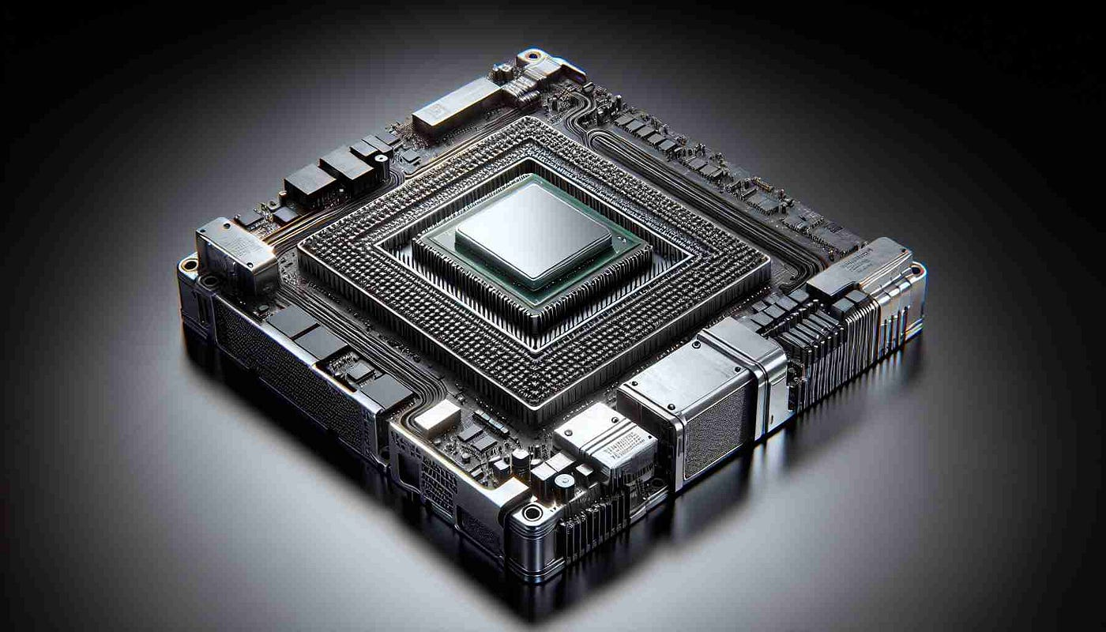
Google’s TPU v5p
https://www.theregister.com/2023/09/22/google_broadcom_tpus/
Google Gemini architecture team work with design and technology companies for TPU implementation.
Broadcom made those chips a reality for Google, by providing key design, including
  Synthesize Core Logic: turn Google engineers' TPU specifications and blueprints @ TSMC
  IP Design: Providing essential building blocks, such as SerDes IP for high-speed IO
  Integration Expertise: integrating multiple chiplets into a single package
  AVGO ramped N5 TPU5 starting Q3’24; 2024 YoY CoWoS capacity will upside around 90%
"We are productively engaged with Broadcom and multiple other suppliers for the long term.”
Can “GEMS to BUs” be “Broadcom to Google”

Slide 20
Supporting Materials

Slide 21
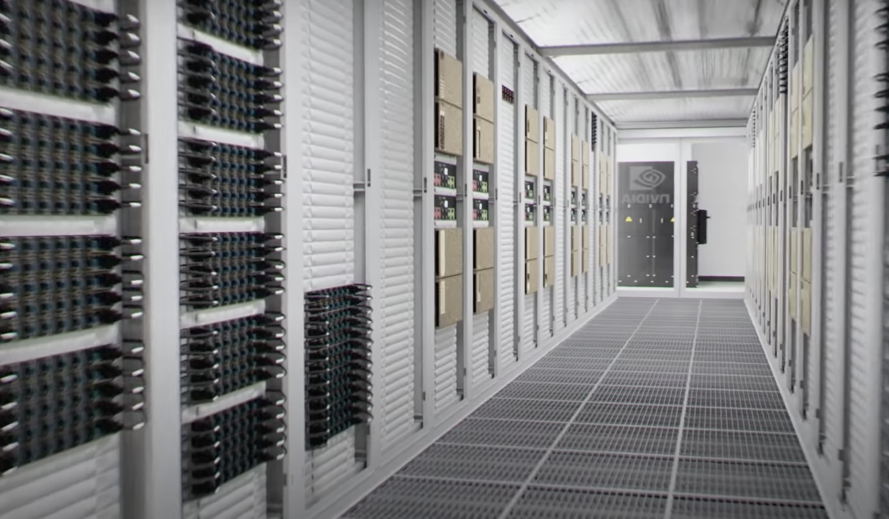

Slide 22
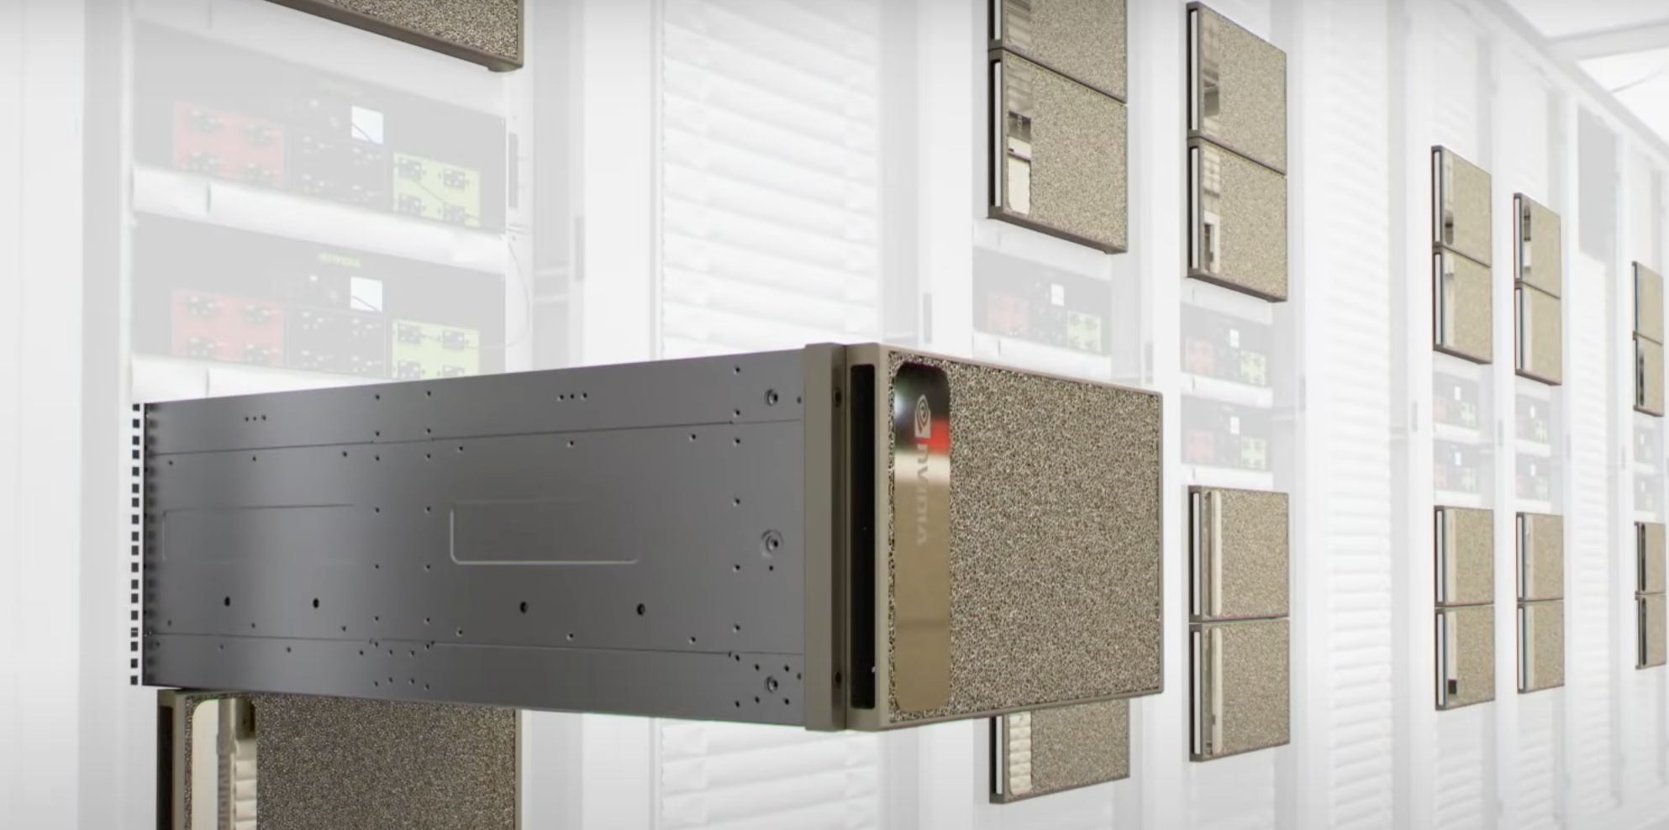

Slide 23
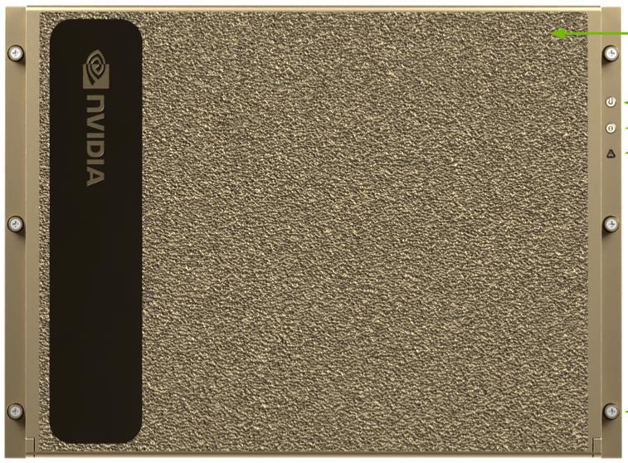

Slide 24
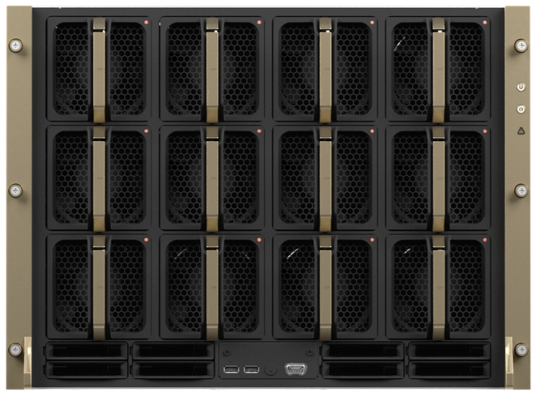

Slide 25
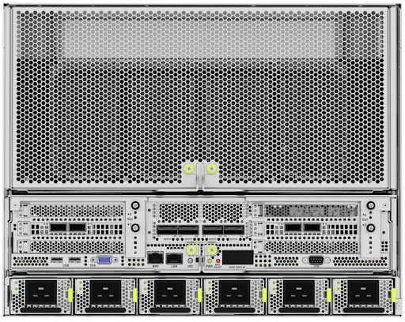
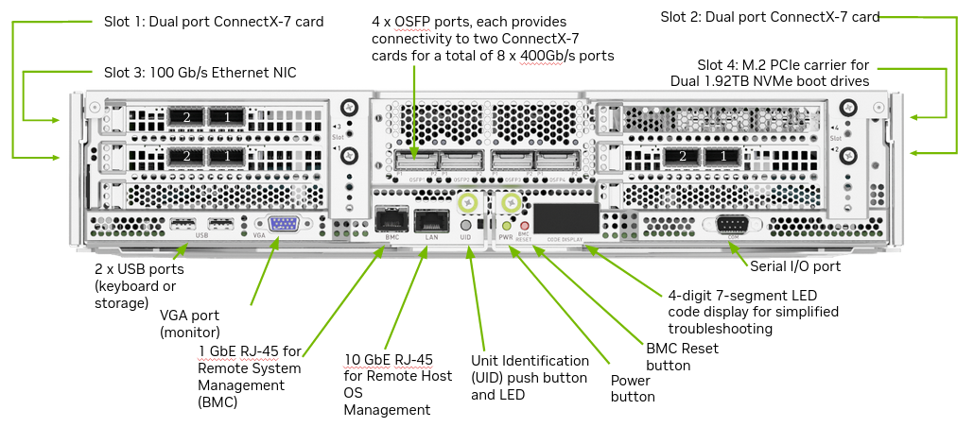

Slide 26
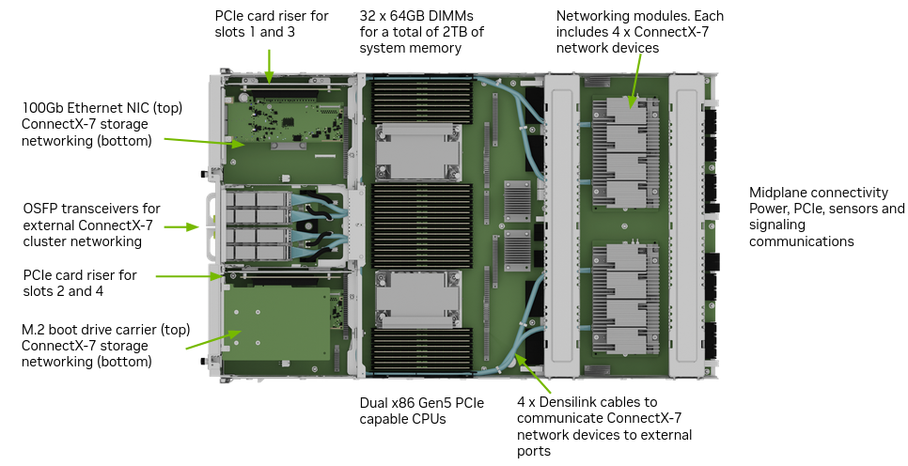

Slide 27
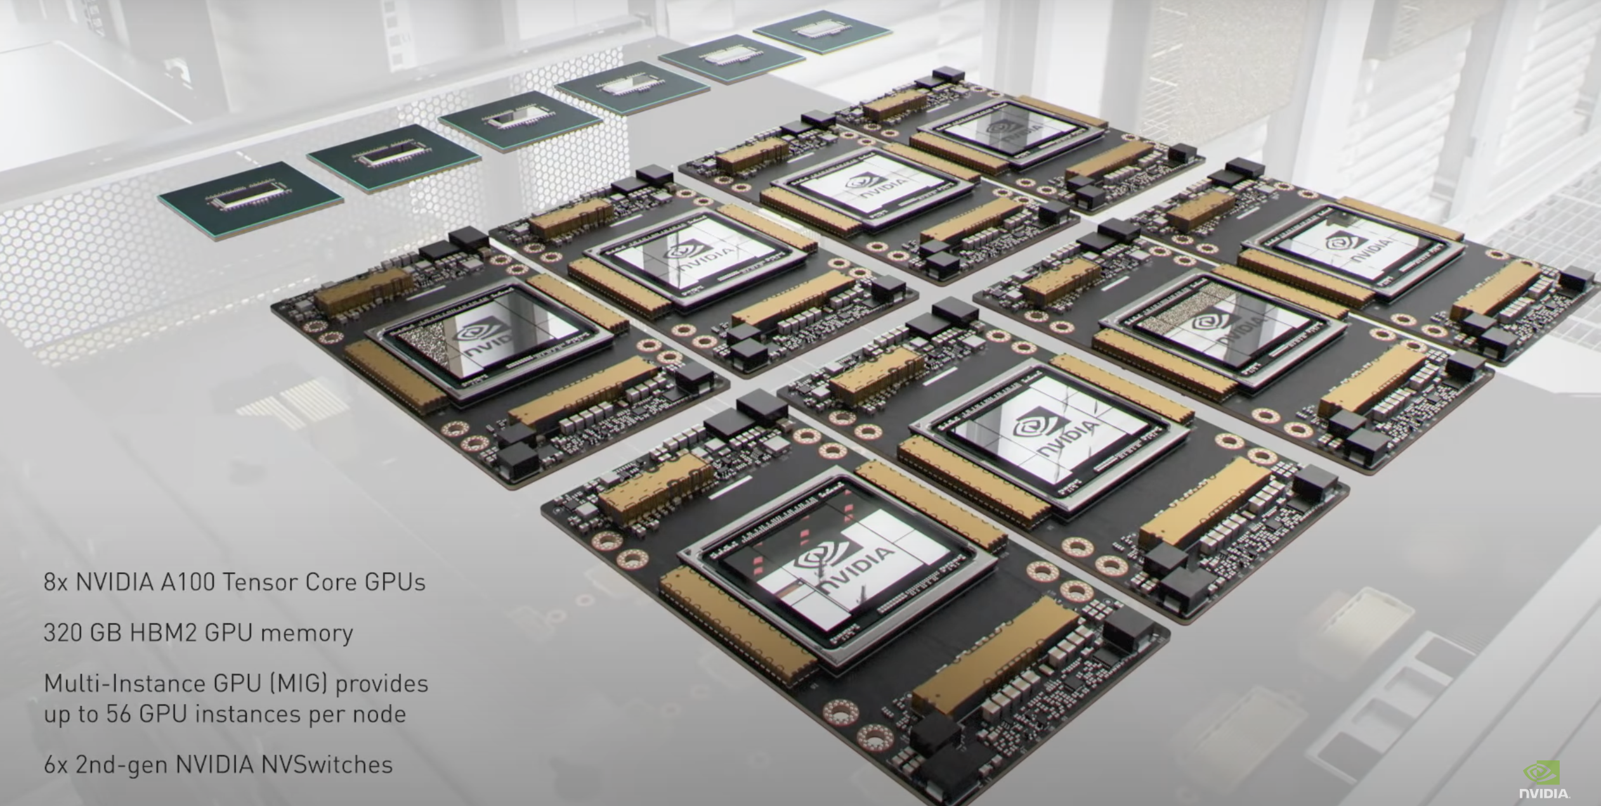
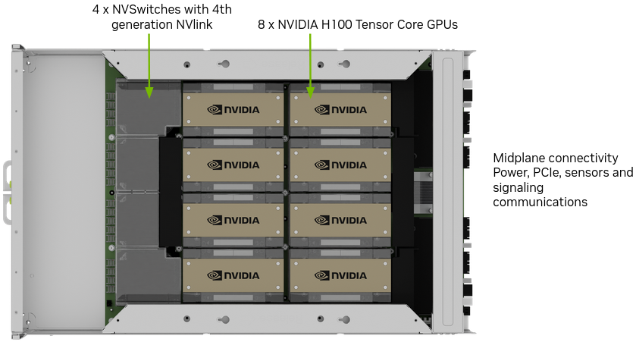

Slide 28
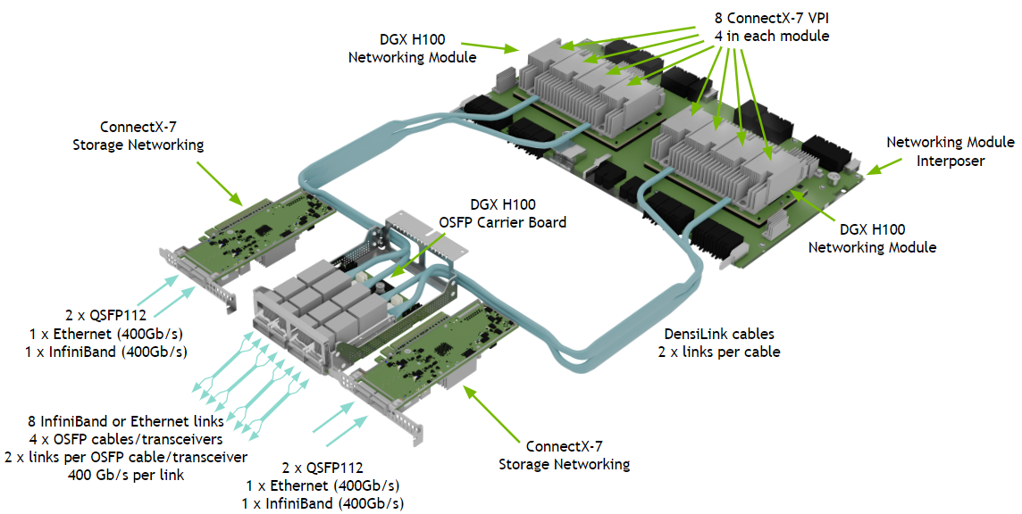

Slide 29
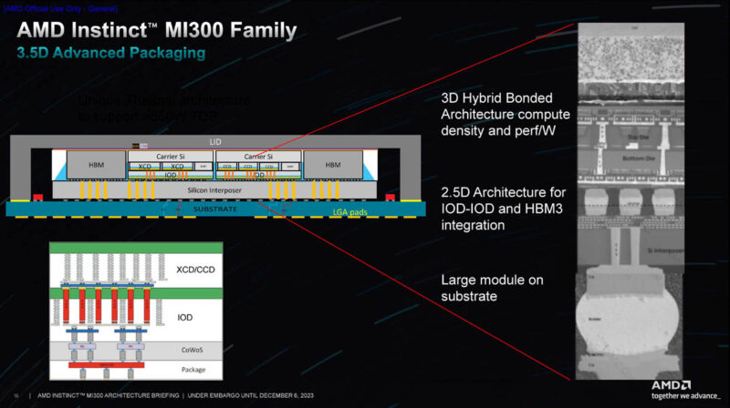

Slide 30
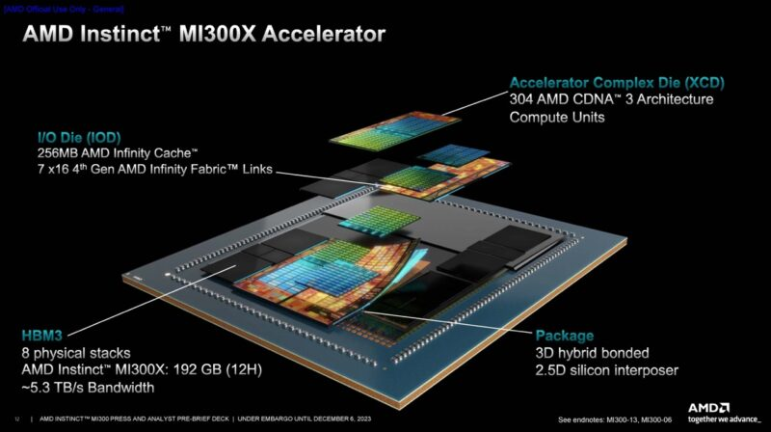
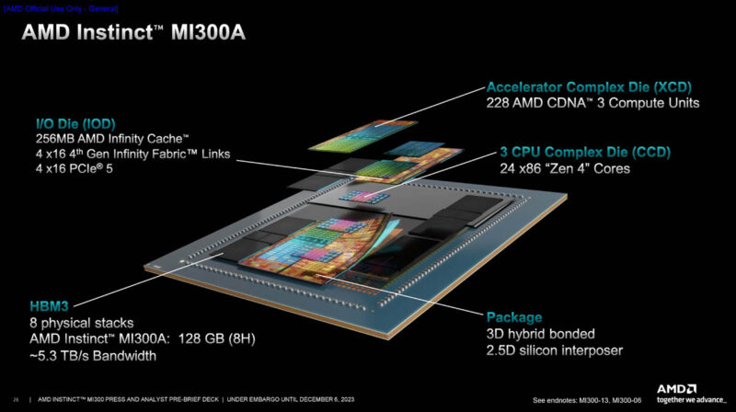
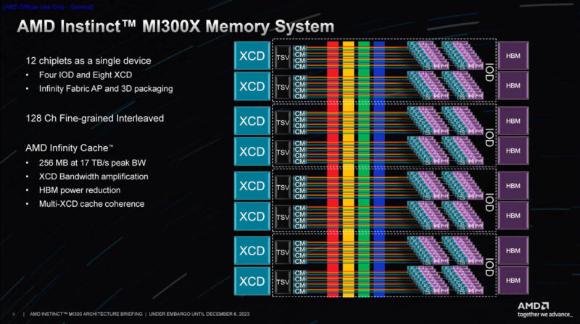
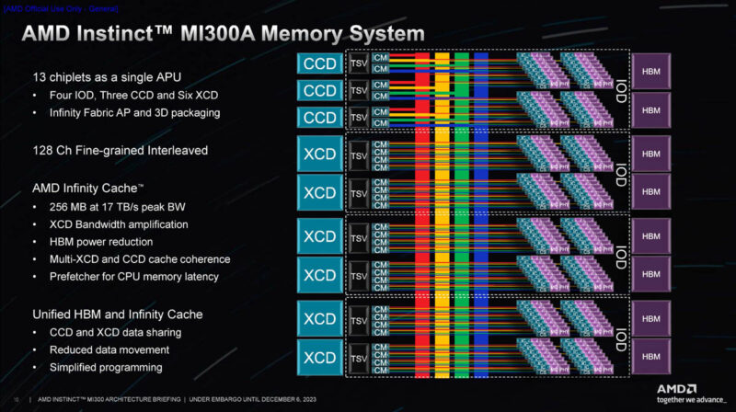

Slide 31
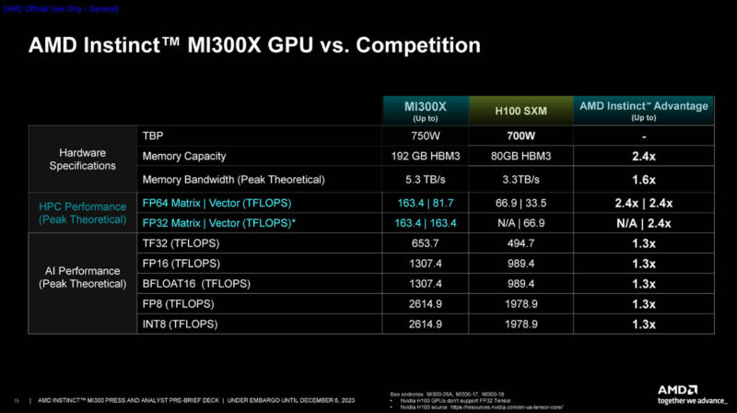
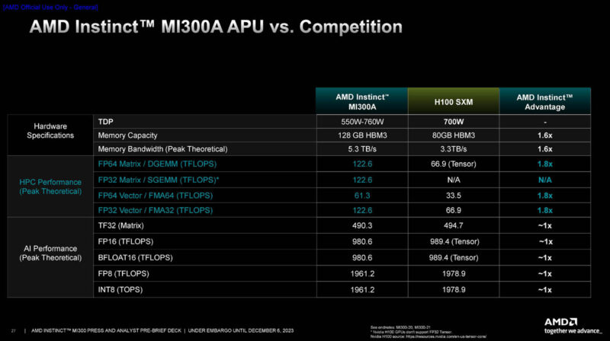
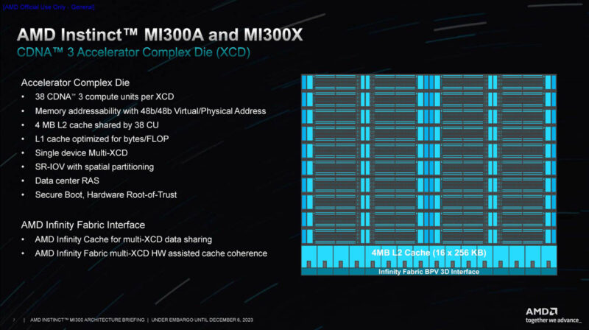
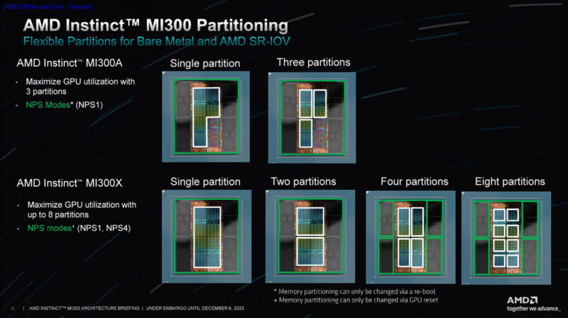

Slide 32
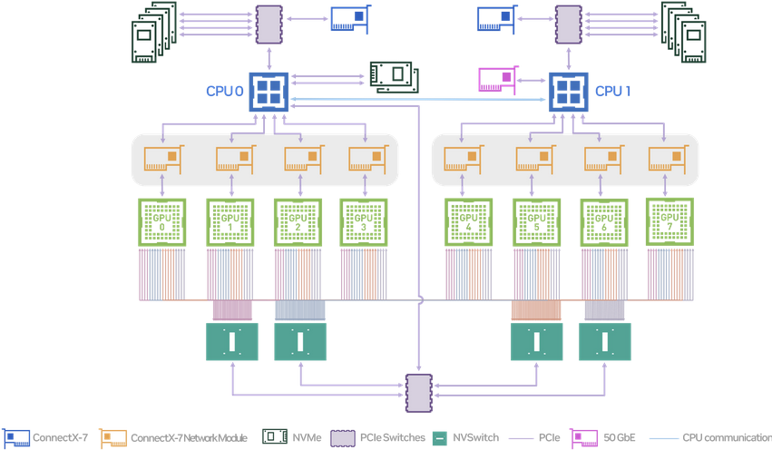

Slide 33
DCAI-AXG Landscape
Node boundary
On-package Host-to-host Host-to-acc/mem High BW Acc-to-Acc High BW Pod-scale Data Center scale
(upto say 8) (100s of accel)
Coherent Coherent Coherent IO-coherent IO coherent
Scale
Mellanox IB
Mellanox IB
Comp
NVLink
.SMP(?)
NVLink
/PCIe
NVLink
NVLink
Heterogenous
Intel
today
UPI
PCIe/CXL
XeLink/Habana
XeLink/Habana
Gap
Different system design points will need more than one solution
Goal (WIP)_
CXL 1-3 (PCIe for device attach)
CXL 3
CXL 3
UXI
Ultra Ethernet 0.0
SMP (e.g. Xeon) – UXI
Non-SMP (e.g. FSX) - CXL
Any-to-any
CXL for appliances;
Ultra-Ethernet elsewhere
* Ultra-Ethernet is a new industry consortium for evolving Ethernet for HPC and AI
Create a protocol continuum from package to pod
Courtesy of “Unified scaling fabric” by Nayan Suthar, Brijesh Tripathi of AXG
Notes:
Commentary:
This slide depicts the current protocol landscape and its desired evolution at different scales.
The industry is fragmented in the way accelerators are networked within the node and outside.
Nvidia and AMD have NVLink and Infinity fabric. These are used for CPU-CPU, CPU-GPU and GPU-GPU connectivity. They likely are a combination of few different protocols. Nvidia has multiple fabric options for pod-scale. They have announced high radix NVSwitches and they have the IB solutions that scale from pod to exa-scale. Many AI startups are creating their own purpose-built fabrics.
Today we at Intel have a heterogenous mix of protocols and interfaces within the node, and upcoming pod scale. And we have a gap in the exa-scale fabric space.
The goal is to continue evolving CXL as a standard for a unified scaling fabric to cover the in-node and pod-scale fabric. UXI that is a combination of UPI and CXL will address the multi-processor SMP space. So effectively CXL will span from within package to pod-scale. Intel is participating in the Ultra-Ethernet consortium to evolve Ethernet to address the large scale HPC-AI requirements.
Note that in the pod-scale network there are multiple design points and more than one solution will exist. More details in a subsequent slide.
In the next few slides we will cover the motivation and approach being taken to achieve this goal.

Slide 34
Scratchpad

Slide 35
Pillars of Modern POD Architecture:
  Scalability, Modularity, Efficiency, Sustainability, Density, Performance, Manageability, Automation and Security:
Technology Content:
  Compute Infrastructure: including high-performance processors and memory configurations to explore hardware accelerators, GPUs, and TPUs for specialized workloads.
  Memory and Storage Solutions: Scalable solutions, such as DRAM, SSDs and NVMe for data-intensive applications as well as software-defined memory and storage such as CXL for dynamic provisioning.
  Networking: Implement high-speed, low-latency networking solutions to facilitate seamless communication between components.
  Power and Thermal management: Optimize PDN and cooling for energy efficiency.
Roadmap for System-Technology Co-Development:
  Research and Assessment: thorough assessment of current technologies, market trends, and business requirements to identify potential areas for improvement and innovation.
  Technology Selection: Choose technologies that align with the scalability, efficiency, and security requirements of a modern POD architecture. Partnerships or collaborations with technology vendors for specialized components.
  Prototyping and Testing: Use test vehicle for prototyping of modular units and conduct rigorous testing for performance, scalability, and reliability.
  Integration and compatibility ensuring seamless integration between different modules and compatibility with existing datacenter infrastructure.

Slide 36
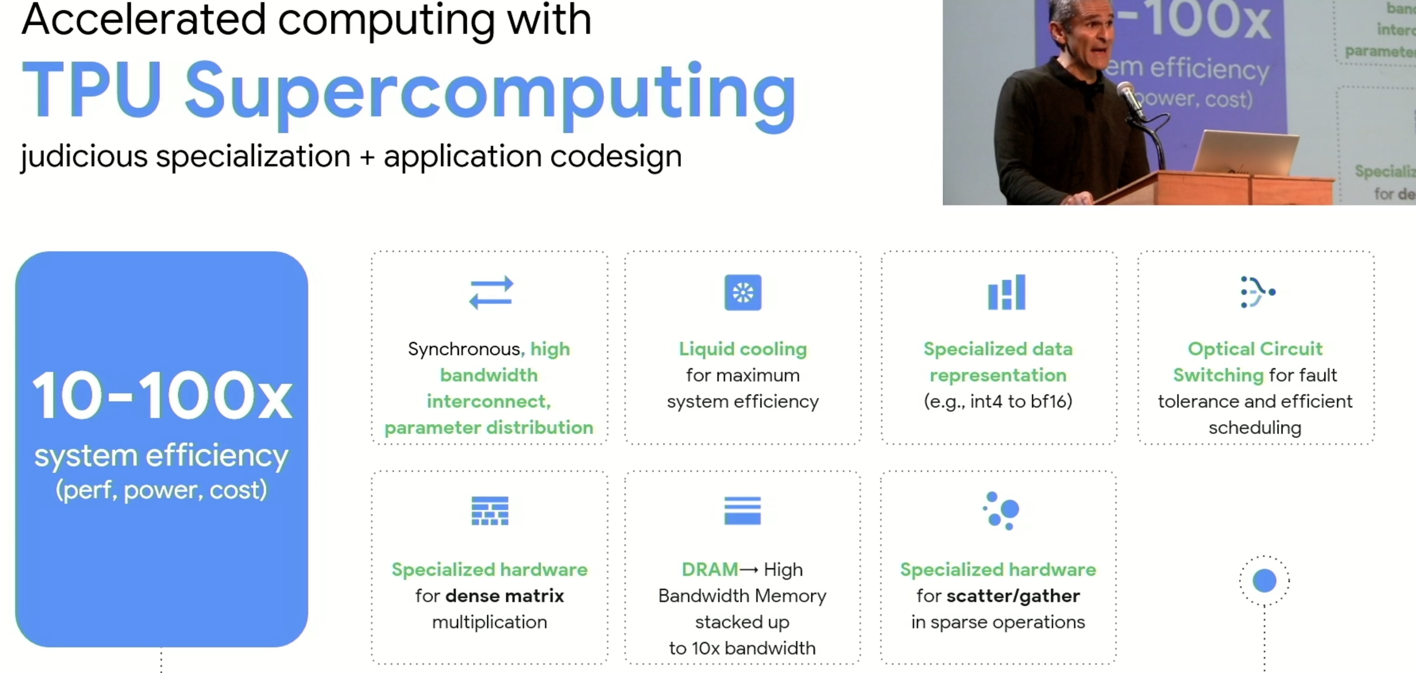
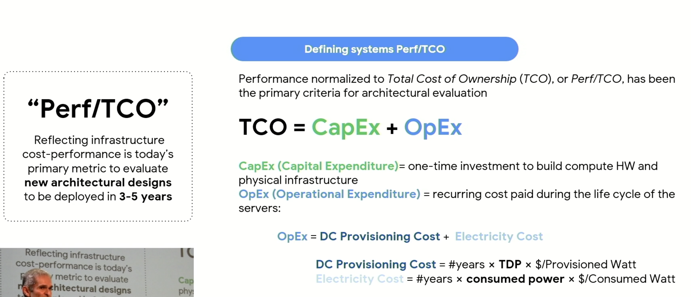
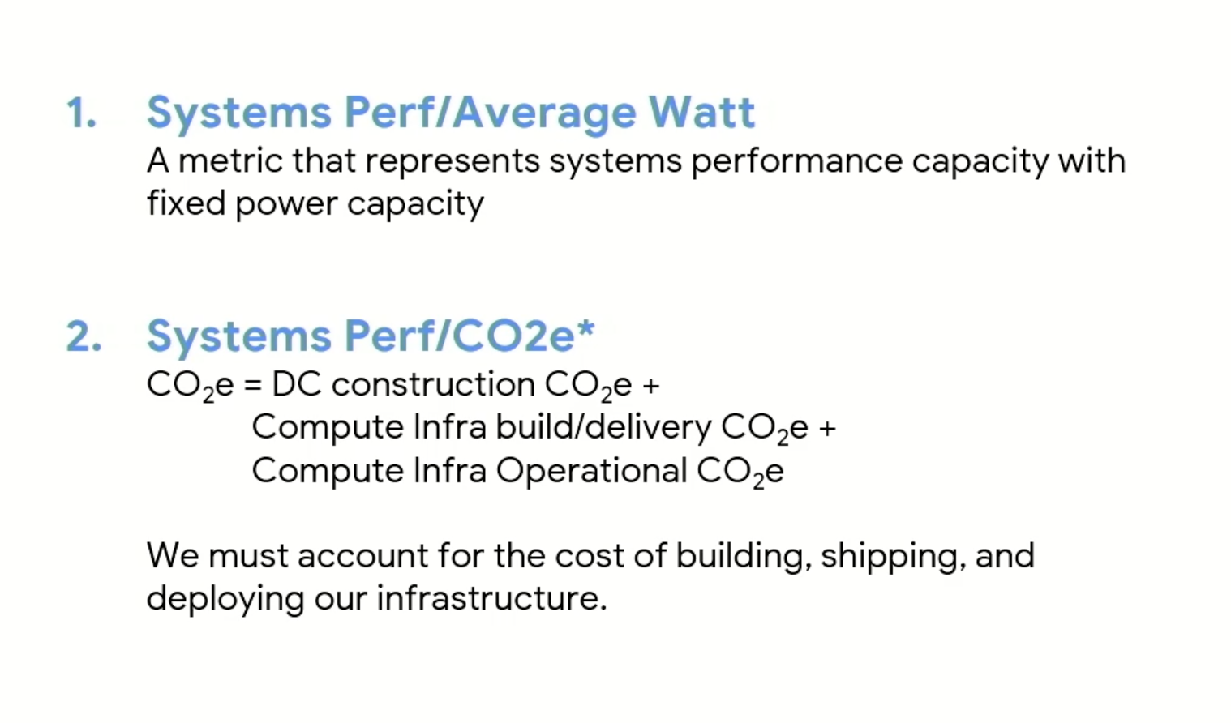
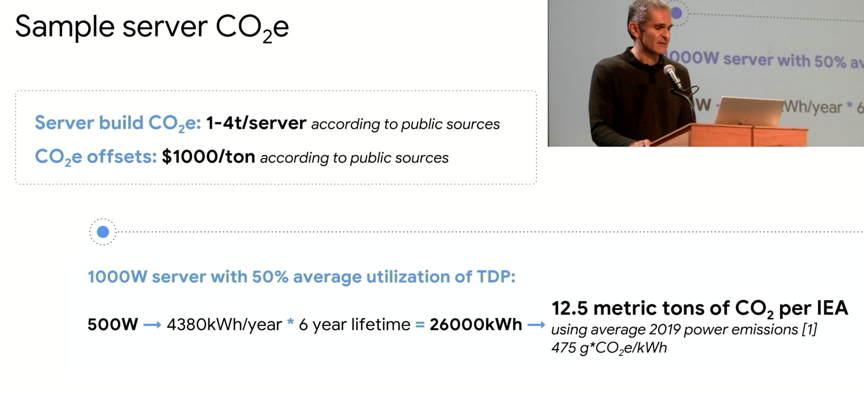
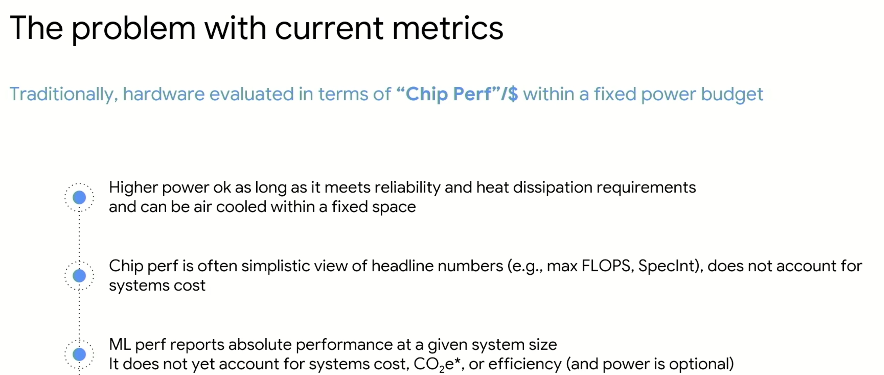

Slide 37
Summarize the pre-work key message(s)
Traditionally IO BW scaling has lagged Compute performance scaling.
Industry has addressed this problem by innovating around PCIe with custom links such as NVLink and Intel’s upcoming Xelink (Exponential Link as part of Pointe Vecchio - PVC GPU)
Silicon Photonics offers significant promise due to increased IO BW thru multidimensional scaling beyond traditional Electrical cadence.
Light Express is a combination of Technologies
  Light Bender, Memory Bender, Compute Express Link, Chiplet Express Interconnect - being defined with definitional customer
Photonics with Standardized Protocol enables leadership for Intel

Slide 38
Proposed Extensions
1) Currently CXL.UIO (Unordered IO) type is under consideration as part of CXL 3.0 specification. UIO can meet the requirements of ‘B’ (scale-up) in Figure 2 in terms of peer-to-peer access of HDM (Host managed Device Memory).
2) Allow device specific opcode extensions (potentially through TLP – Transaction Layer Prefix)
3) For source ordered, IO-coherent transactions only:
a. provide a configuration mechanism to create non-tree topologies.
b. allow any shared memory location to be accessible over multiple ports
4) For transactions that go across address domains (‘C’ or scale-out in Figure 2) allow ID based routing. A given path in the network may carry a mix of address-routed (scale-up) and/or ID-routed (scale-out) transactions. Allowing mix will help devices to use scale-up network paths to tunnel scale-out traffic. This flexibility of ID-based routing is also required for initiators to accomplish dynamic or adaptive routing.

Slide 39
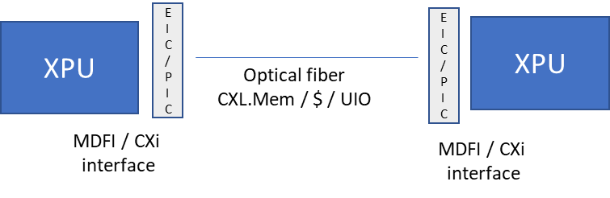
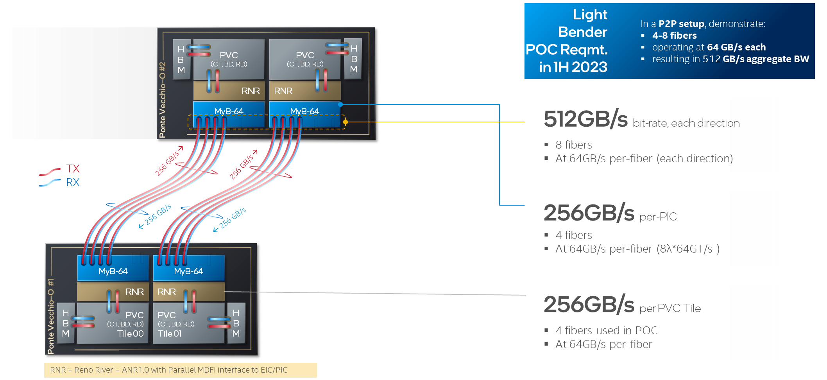
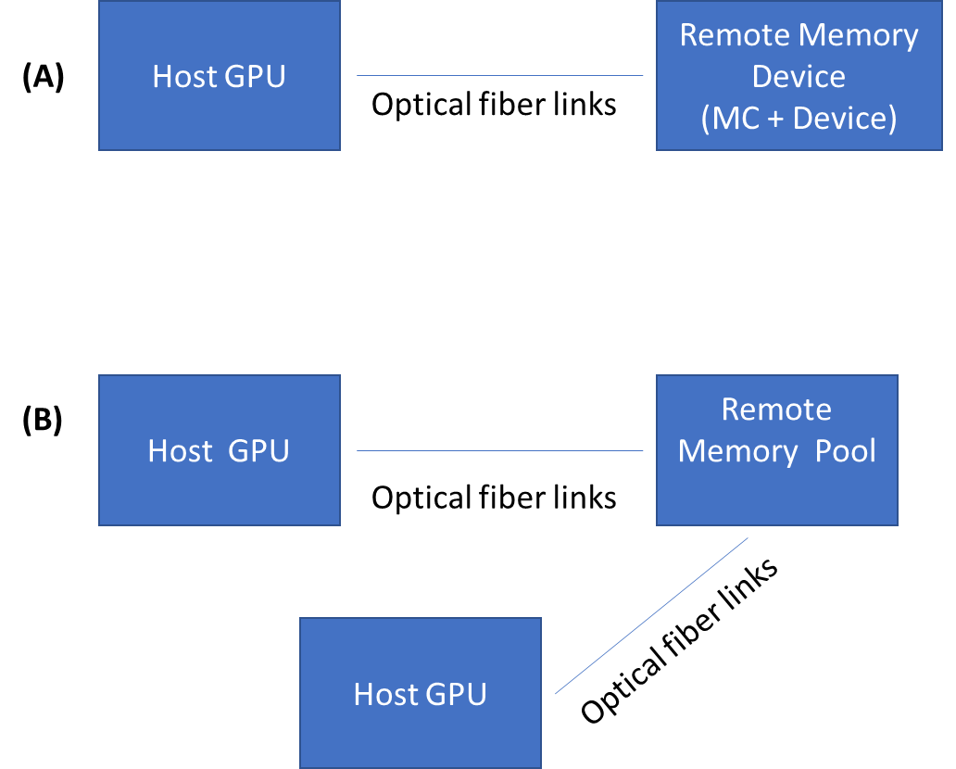
Optical Link Long Term Vision
Next Intercept
Host-Host/Host-Acc/Acc-Acc Host/Acc-Mem/Storage

Slide 40
Package Ingredients for High-Speed SerDes
Low loss package routing
  Low loss dielectric material and metal roughness
  Skip-layer design
Transition to board through PTH/BGA/Socket
  PTH-BGA
Transition from silicon backend/bump
  TSV-PSB
Transition on top side through connector/optical
  Optical integration
Die
Die
Die/Conn
3
4
1
2
Package substrate
Board
224G SerDes requires significant interconnect improvements
ATTD pushing on all aspects of the next gen SerDes package

Slide 41
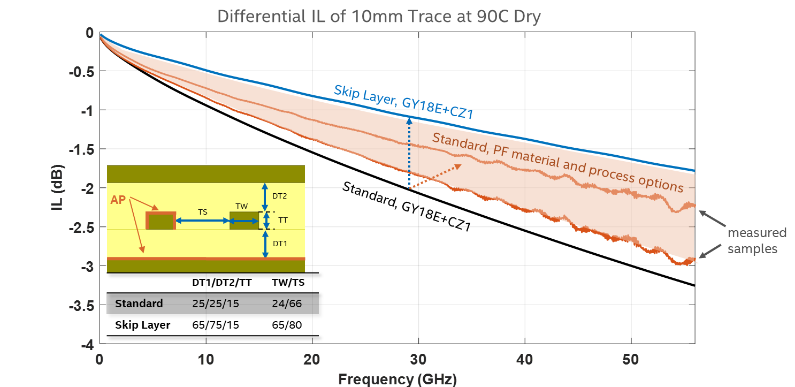


Package Routing Improvements
4-lane package
512-lane package
small portion
New design architectures equally important as new material and processes
Yet utilization of these architectures have many design dependencies

Slide 42

Example Product Package Routing Loss Capability
2021
2024
2026PF
2024
2026PF
28 GHz
56 GHz
30mm routing loss at 56 GHz is trending to ~6 dB in 2024 and ~4 dB in 2026

Slide 43




Package-PCB/Silicon Interface Improvements
Signal Solder Joint Width Measurement
IL Delta at 56 GHz
Foveros TSV-PSB
Insertion Loss (dB)
Measurement
Package-PCB Interface
Package-Silicon Interface
Targeting:
              Reduced solder volume & controlling joint shape variation for package-PCB interface
              Significant TSV-PSB performance improvements for package-silicon interface

Slide 44
Call to Action
224G high-speed SerDes applications require significant performance improvements in all channel interconnects including the package
ATTD driving technology improvements for all package ingredients
  We need very strong collaboration between IP, technology, and design teams for silicon/package/board to strategically co-develop most cost/performance optimal 224G SerDes products and technologies for Intel

Slide 45
Next-Gen Die-to-Die I/O KPI targets
Column1 | Lowest Cost (Organic) D2D I/O | Best KPIs (Advanced Packaging) D2D I/O
Bump Pitch | 100um to 130um | 25um to 55um
Data Rate (Gbps) | 4/8/12/16/24/32 | 4/8/12/16/24/32
BW/shoreline TX + RX (GB/s/mm) | 28-224 | 165-1317
BW bump are TX + RX (GB/s/mm^2)* | 22-125 | 188-940
Energy Efficiency (pJ/b) * | 0.5 (4 GT/s, short reach) 1.0 (≤ 16 GT/s, long reach) 1.25 (32 GT/s, long reach) | 0.5 (≤ 12 GT/s) 0.6 (≥ 16 GT/s)
Raw BER | 1e-27 (≤ 8 GT/s) 1e-15 (> 12 GT/s) | 1e-27 (≤ 12 GT/s) 1e-15 (≥ 16 GT/s)
Latency end-to-end TX + RX + adapter * | <2ns
Idle entry/exit latency* | <1ns
Channel reach | 10mm (short reach) 25mm (long reach) | 2mm
* Representative parameters based on “good” implementation and not specification

Slide 46

3D Hybrid Bonding Channel
Hybrid bonding pad <10fF @ 9µm pitch
Enable “Zero” ESD
2 TB/s/mm² are feasible
Channel energy consumption <1 fJ/b @ 0.6V
Further scaling could be limited by circuit at 6µm pitch and below
bump limited scaling
circuit limited scaling

Slide 47
Summary
Tremendous bandwidth density scaling of all three categories of D2D channels
  2.5D EMIB channel is feasible to support 650 GB/s/mm
  2D standard channel is feasible to support 220 GB/s/mm with 4 routing layers
  3D hybrid bonding channel is feasible to support 2 TB/s/mm²
Call to action: Deep collaboration between product architecture, IP and packaging teams to optimize the D2D solution for maximum performance/$

Slide 48

Outlook for PCIe 7 and UPI beyond 64Gb/s, Backwards Compatibility
Intel Interconnect & Connectivity Summit – Prework Recap
Zuoguo (Joe) Wu, Sr Principal Engineer
Mohiuddin Mazumder, Sr Principal Engineer
I/O Technologies and Standards, DCAI

Slide 49
Key Metrics for PCIe 7.0: Requirements
Metrics | Expectations
Data Rate | 128 GT/s, PAM4 (double the bandwidth per pin every generation)
Latency | < 1ns adder for Transmitter + Receiver over 64 GT/s
Bandwidth Inefficiency | < 1% adder over 64 GT/s
Reliability | 0 < FIT << 1 for a x16 (FIT – Failure in Time, number of failures in 10⁹ hours) Almost identical to 64 GT/s
Channel Reach | Similar to PCIe 6.0 under similar set up for Retimer(s) (maximum 2)
Power Efficiency | Better than PCIe 6.0
Low Power | Similar entry/ exit latency for L1 and L0p low-power states
Plug and Play | Fully backwards compatible with PCIe 1.x through PCIe 6.0
Others | HVM-ready, cost-effective, scalable to hundreds of Lanes in a platform – electrical cable and optical cable friendly
Need to make the right trade-offs to meet each of these metrics!

Slide 50

PCIe 7 PHY Outlook
128 GT/s is within the capability of advanced SerDes
PAM4 signaling is optimal for backwards compatibility
ADC based I/O scales well with data rate and process technology
Must target BER < 1E-6 to enable light-weight FEC and low latency
Influence the industry standard to align with PHY architecture
ADC based I/O
128 GT/s PAM4 PHY is feasible to meet PCIe 7.0 requirements

Slide 51



PCIe Channels: Backwards Compatibility Challenge
Desired Trend
Card Electro-Mechanical (CEM) Connector
SFF-TA-1002 (Gen-Z) connector
SFF-TA-1016 (MCIO) connector + cable
Nyquist frequency for 128 GT/s PAM4 = 32 GHz
Mitigating resonances between 30 to 50 GHz is key to backwards compatibility

Slide 52


Optical I/O
Optical I/O enables longer reach and higher density with wavelength as a new dimension
Optical and electrical I/O will co-exist for right usages
Both parallel and serial E/O interface should be considered
Make PCIe 7.0 ready for optical transition

Slide 53
Key Trends in High-speed Ethernet, OIF and Consortia, and Their Wide-spread Impacts to Intel and the Interconnect Industry
Intel Interconnect & Connectivity Summit (IICS) – Pre-work Recap
Kent Lusted, NCNG Ethernet PHY Standards Advisor

Slide 54



Ethernet PHY/Media Key Trends – 1 of 3
Trend | Impact | Actions Needed
The Shift from Passive to Active Copper Cables | Technical & Economic Feasibility: Need new, low-cost media for server/IPU/xPU connections | Cultivate healthy IEEE/OIF/industry specs and ecosystem for ACCs/AECs Develop and influence cabled host architectures for server implementations
New Cable Types
Passive reach is down
New System Architectures

Slide 55

Ethernet PHY/Media Key Trends – 2 of 3
Trend | Impact | Actions Needed
The Growth of New Optical Form Factors | Compatibility & Economic Feasibility: New system architectures and SERDES/media requirements | Define lower-lane count CPO/NPO form factor spec that align to compute needs Build specific SERDES for new use case to meet area/power targets
Only High-lane Count Connectors Exist
New Optical Form Factors

Slide 56

Ethernet PHY/Media Key Trends – 3 of 3
Trend | Impact | Actions Needed
The Rise of Multifaceted Pluggable Media | Compatibility: No longer PnP, device/vendor-specific functions. Link training on interfaces. | Drive divergent module config/init/monitor approaches into a single, scalable solution Expand interoperability with media vendors for “PnP” experience
Increasing Module Complexity

Slide 57




Chiplet Architecture
Prior split-and-stitch like SPR
Trending towards hierarchical architecture
  Deeper disaggregation inside the chiplet tiles
  Organic package integration of tiles for optimal bandwidth-cost trade-off
  Better for core count scaling, chiplet reuse, and flexibility of integration and SKU creation
Demanding significant I/O bandwidth with organic substrate
  Creating competitive UCIe-S
Core1
Core2
IO1
IO2
Core3
Core4

Slide 58

UCIe-S w/ Organic Substrate
UCIe-S spec defines a path for bandwidth scaling with organic substrate
1st wave targets 16 Gb/s with four routing layers
2nd wave at 24-32 Gb/s supports the architecture evolvement
UCIe-A with 45 µm bump pitch
UCIe-S with 110 µm bump pitch and four routing layers

Slide 59






16 Gb/s UCIe-S Channel Development
Spec Reference | Product Design Stretch | Motivation
Monolithic die | Stacked-die with TSV | Enable 3D chiplet tiles
Stripline | Dual stripline or microstrip only for very short reach | Reduce one ground layer
49 $\text{μ}$m pitch | 40 $\text{μ}$m pitch | Save under-die routing real estate for power delivery
25 mm max reach | 35-40 mm max reach | Increase design flexibility to support more SKUs
50 $Ω$ Rx termination | Adjustable Rx termination | Reduce I/O power
Ground referencing | Dual referencing (tbd) | Reduce total layers for power&ground
vss
signal
vss
signal
vss

Slide 60






UCIe-S Channel Scaling
Data rate (24, 32, ...) for BW/mm
  Improved-shielding bump map
  Circuit enabler (EQ, on-die coils, etc.)
Potential bump pitch shrinking for BW/mm²
  From 110 to 100, 90, and so on
Package layer count control
  Stack-up and design rules
  Dual referencing
Bump Map Comparison
Areal Bandwidth Density (GB/s/mm²)
Bubble size: data rate
Shoreline Bandwidth Density (GB/s/mm)

Slide 61

I/O for 3D Integration
Pitch scaling with hybrid bonding
  Bonding channel parasitics <30m$Ω$/5fF
  Channel power consumption <1 fJ/b
Path for >10 TB/s/mm² at clock freq
  Enable “deep” disaggregation
  Require “Zero” ESD and TSV scaling
  Require array-based redundancy
Standardization with UCIe-3D

Slide 62
Summary
To meet the hierarchical architecture trends of server/workstation products
  Significant UCIe-S channel development to enable 1st wave 16 Gb/s solutions
  Future bandwidth scaling path identified for the architecture continuation
  Meanwhile, 3D advanced packaging required for "deep" disaggregation
Call to action: Co-optimize between product architecture, IP and packaging solutions to maximize performance/$

