Slide 1
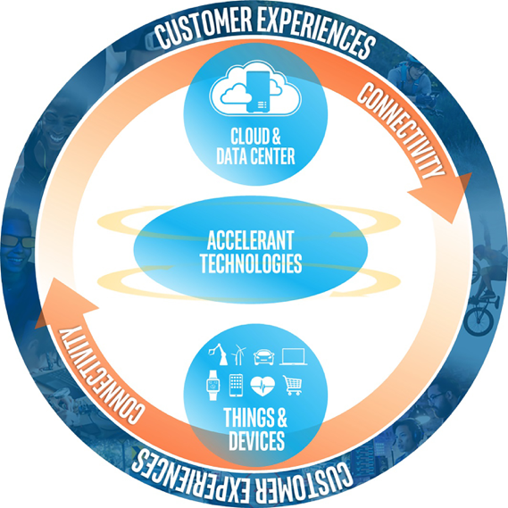
ISAS 2021 Passdown Summary
ISAS Event Dates: Feb 8-10, 2021
Notes:
ISAS is one of the Fellows Technology Summits (FTS), a series of up to five, invitation-only events, produced annually for PE-Sr Fellows from across the company. FTS provide a platform for tech domain experts to collaborate, learn & innovate game-changing ideas that enhance Intel business results.
All Fellows Technology Summits are sponsored by an Intel Fellow, or group of Fellows. The sponsoring Fellows for each summit form the Fellows Technology Summit Advisory Board. This advisory board provides the annual recommendation as to which events to offer, and that recommendation is then approved by our ELT sponsor, Raja Koduri.
While we have a basic strategy of which events are held annually, as well as the total number of events delivered, that strategy is modified every year based on Intel’s current biz needs, and those of the technical community.

Slide 2
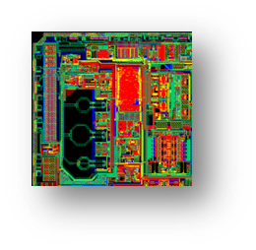
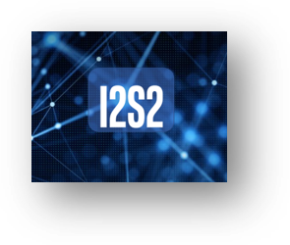

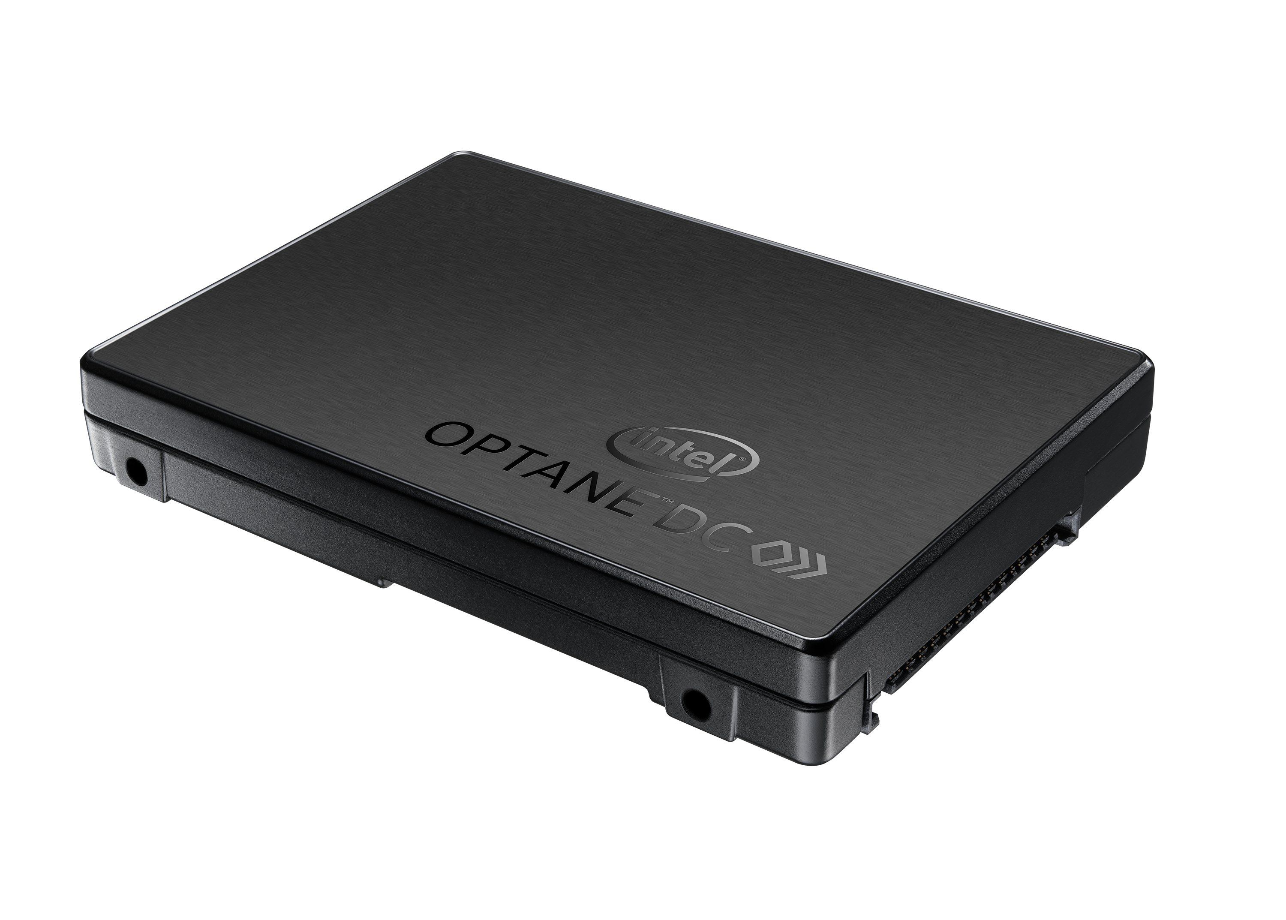
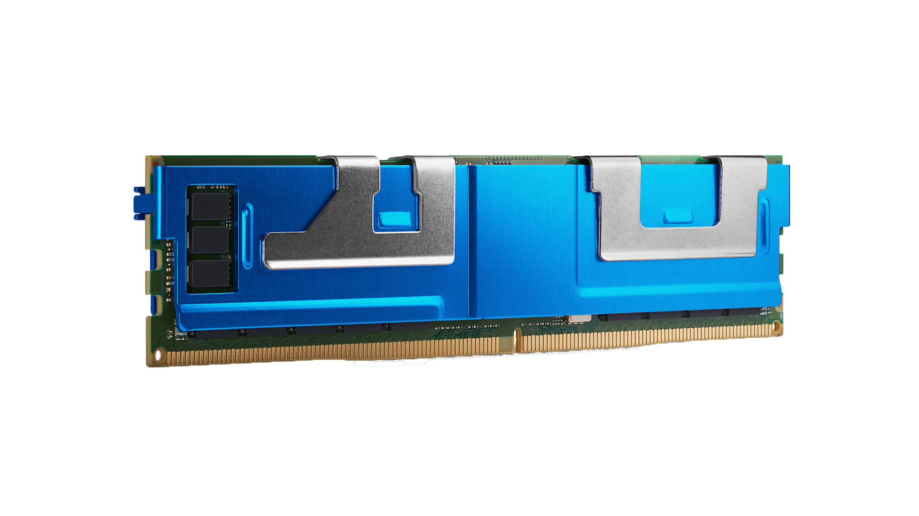
2020 Fellows Technology Summits
ICTS
Intel Circuits Technology Summit
Rescoped – accelerators and memory/storage topics move to IMSCS
Fellow Co-sponsors:
Vivek De & Ian Young
Aug 31-Sept 2
IMSCS
Intel Memory, Storage, &
Compute Summit
Multi-Track event for
Memory, storage, compute
uarch, and accelerator
communities
Fellow Co-Sponsors:
Frank Hady & Knut Grimsrud
IMSCS: Sep 21, 23, 25
Accelerators: Nov 2 & 4
IMAS: Nov 9 & 11
ISAS
Intel Systems
Architecture Summit
Rescoped to include
distributed systems
topics
Fellow Co-sponsors:
Geoff Lowney
Reset for Feb 8-10, 2021
I2S2
Intel Intelligent
Systems Summit
Fellow Sponsor: Ravi Iyer
Reset for April 5-7, 2021
Notes:
ISAS was approved as part of the 2020 event roadmap, but for a variety of reasons, we delayed delivery from Q4 of 2020 into Q1 of 2021.
The 2021 event roadmap is not yet finalized, but as soon as it is, the Fellows Office will notify the global PE-Sr Fellow community.

Slide 3
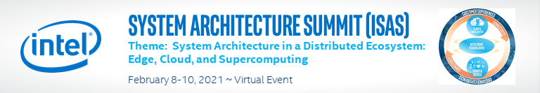
Consisted of Pre-work Technical Papers, Presentation Recaps and Q&A Panels
Keynotes on:
  DPG Technical Vision – Next Gen Hyperscale Architecture/DCoF - Matt Adiletta, Intel Sr Fellow, DCG
  Emerging AI Applications: Going Beyond ResNet50 on ImageNet – Amir Gholami, Research Scientist, ICSI and Berkeley AI Research (BAIR)
Sessions on:
      Future Hetero AI
      Systems Technology Visual Computing and Big Data
      Enabling Accelerators in the Cloud Tools
      Security Storage
Notes:
ISAS Content Consisted of:
Pre-work technical papers & Q&A Panels. As this was a virtual event, and virtual events are much shorter than FTF, the main content was distributed prior to ISAS in the form of technical papers for participants to read before attending.
Live sessions were scheduled over 3 days and included a 10-minute recap by each presenter of the key messages from their technical paper to refresh participant memories, followed by a Q&A Panel for participants to ask their questions about the content.
There were up to 208 attendees, PE+, spanning all major BUs.

Slide 4
Topic Recaps

Slide 5
Future Hetero

Slide 6
Tightly-Coupled Heterogeneous Systems
Presenter: Samantika Sury, Principal Investigator and Pathfinding Lead for HPC Silicon and Memory Architectures is a Principal Engineer in DPG/CESG/ASE
Key Points:
Today’s CPUs and GPUs are “loosely-coupled” discrete computing elements
Data Migration and Offload costs prevent Fine-Grained Acceleration
Elimination of acceleration overheads through can improve performance by more than 50%
Call to Action: Build Tightly-Coupled Heterogeneous XPUs
    Leverage Chiplet based Disaggregated Architectures
    Provide Uniform and Unified Memory for all Computing Elements

Slide 7
Optimizing OS and ISV SW for Hybrid
Presenters: Mike Chynoweth, Russ Fenger, Rajshree Chabukswar
Key Points:
Client Hybrid roadmap extends to next 3+ generations, provides us way to be competitive
Significant work and collaboration with OSVs and tools/libraries to enable for Hybrid
Enable our own SW stacks and external key ISVs to work well on Hybrid architecture
Call to Action:
Find proactive Hybrid showcase opportunities with your SW stack/ISVs
Create long term differentiation with key SW stack for long term Hybrid strategy to win against competition
Focus on long term HW/architecture differentiation

Slide 8
Systems Technology

Slide 9
Hardware-Accelerated Distributed Runtime
Presenter: James Tsai is a Research Scientist in Intel Labs
Key Points:
Distributed cloud applications are the new norm
Distributed Runtime is the brain of the distributed system
Loosely-coupled software solution will not scale up to meet 400/800Gbps demand
Call to action: Acceleration of Distributed Runtime with tightly coupling of IPU and CPU has potential of disruption

Slide 10
AI module for hot/cold page classification in a memory pooling context
Presenter: Lidia Warnes DPG Platform Architect
Co-authors: Durgesh Srivastava, Sujoy Sen, Rasika Subramanian, Neha Pathapati, Francois Dugast
Key Points:
Increased CSP interest in memory pooling with the emergence of new technologies and use cases
Proposed AI module improves memory pool performance by up to 5% by dynamically moving cold pages into the pool
Proposed AI module enables workload classification for the creating of CSP pricing tiers.
Call to action:
  Investigate acceleration opportunities
  Workload classification hints for different CSP pricing tiers
  AI cold page module use with other devices connected to the memory pool as peers.

Slide 11
oneAPI Level Zero
Presenter: Ben Ashbaugh is a Principal Engineer and GPU Compute Software Architect in GSE and is a Level Zero architect.
Key Points:
Intel needs consistent interfaces to accelerator hardware to transition from a CPU company to an XPU company.
Level Zero is a low-level interface for oneAPI accelerator hardware.
Level Zero is shipping and used today for Intel GPU products.
Call to action: Level Zero is the path forward! Optimize and expand support for Level Zero in oneAPI runtimes and libraries. Adopt Level Zero for Intel accelerator hardware.

Slide 12
Enabling Accelerators in the Cloud

Slide 13
XPU over Fabric
Presenter: Sujoy Sen. Sr PE in DPG, leading pathfinding work on Heterogenous Systems @Scale in DPG
Key Points:
Data Center Infrastructure requires flexibility to meet emerging AI/HPC workloads
Accelerators (XPU) Pooling and Disaggregation over fabric can meet that need
Intel developed XPU-over-Fabric technology to deliver a solution to this problem
Call to action:
  Deliver support for XPU-oF across all Intel’s ingredients and XPU portfolio. Specifically, SW (One API…), IPU (Mt Morgan...), XPUs (PVC, Habana…) and Xeon

Slide 14
Inter-Kernel Links (IKL): Direct Inter-FPGA communication Framework
Presenter: Susanne M. Balle. Senior PE, Software Architect leading pathfinding in distributed FPGA frameworks, Accelerator peer-to-peer communication, and µservices acceleration in FPGAs, etc. in DPEA/SIL.
Key Points:
FPGAs are used to accelerate datacenter workloads as well as for infrastructure acceleration. The use of multiple FPGAs, speedup computation and distribute the data set when it exceeds a single FPGA’s memory.
Direct inter-FPGA communication is a critical component in today’s accelerated datacenter.
With IKL, developers write kernels communicating across networked FPGAs from high-level languages and VHDL/Verilog using their familiar tooling.
Call to Action: Integrate IKL into OneAPI via straight-forward interfaces. Need customer use cases on µservices and accelerator offload in FPGAs and other XPUs especially around accelerator chaining.

Slide 15
Native Scale-out Architecture for Intel XPUs
Presenter: Narayan Ranganathan, Principal Engineer in Intel Labs leading DSA architecture and software enabling.
Key Points:
Datacenter applications require distributed system infrastructure supporting high network loads with low bounded tail latency (@microsecond-scale)
Systems use RDMA today to achieve lower latency with one-sided remote memory access, but RDMA has several scaling challenges; de-coupled evolution of XPUs and NIC/IPUs also makes optimization harder
Native Scale-out (NSO) is an architecture that enables higher scalability of XPUs with predictable tail performance by combining platform data movement abstractions and optimizations with remote memory primitives and flexible congestion control over the network
Call to action: Join a collaborative effort to tackle various architecture, design, prototyping, modeling and software development issues and translate the NSO architecture into a realizable implementation for Xeon and XPU platforms.

Slide 16
Reliable Transport and Fabric Protocol Engine
Presenter: Mark Debbage, Sr PE
Innovate to leap-frog ahead of NVIDIA/Mellanox
SPARTAN reliability layer for best effort networks
  100-1000x better tolerance to drops compared to RoCEv2
  Product intercept is Ponte Vecchio 2 I/O Bridge
Fabric Protocol Engine to provide key HPN offloads
  Product intercept is the Mount Eden SmartNIC
  Existing SmartNIC infrastructure dramatically reduces the HW investment
  Retain existing RDMA protocol engine for storage and legacy
New libfabrics provider to enable rich HPN SW ecosystem

Slide 17
AI

Slide 18
Scaling Beyond Node
System Architecture for Next Generation AI
Presenter: Ajaya Durg, Sr PE, GTCHE/IAGS, Server dGPU SOC Arch/Connectivity
Key Points:
Deep Learning Models are growing rapidly beyond multiple XPUs
Current hierarchy of communication is not sustainable; Adding intermediate hierarchy (pod/supernode) can provide significant perf gains (10%-2x)
Further exploration areas: Compute in Connectivity, In Network Compute, Co-packaged Optics (SiPh)
Call to action:
Collaborate on converged Sale-out for XPUs (joint work with Xeon Scale-out)
Collaborate on research/POC SOC/Platform with SiPh for GPUs
Collaborate on In Network Compute/Parameter Server

Slide 19
Leveraging x86 for Scale-Out Deep Learning Training
Presenter: Alexander Heinecke, PE, Intel Labs
Key Points:
Everything starts with Software and Services and not Hardware in 2021, with a virtual Tensor ISA we can start today and prepare for new CPU ISAs ahead
CPUs are well suited for DL, it’s all about memory movement but not compute IP. CPUs are normally killed by the balancing act with SpecINT performance.
Xeon & AMX with HBM and scale-out: This can be the BlueGene of AI, while reusing as much IP as possible and building on the x86 ecosystem!
Call to action:
  Investigate Feasibility of Xeon AI SKU to mirror Google and NVIDIA efforts in scaling the “crown-jewels” from Edge to Datacenter for AI

Slide 20
1000X AI System
Presenter: Dipankar Das, Research Scientist in Parallel Computing Lab working on AI software, systems, and hardware.
Key Points:
Memory subsystem is at once in a generation overhaul stage as key enabling technologies (ADM cube, hybrid bonding, in-package optics) are knocking on the door.
Propose a 2LM for AI and Data Parallel systems with near memory at 16-32TB/s or more bandwidth to 32-64GB capacity. Far memory is shared disaggregated memory with 4TB/s per socket at bandwidth-capacity ratio of 1.
Combined with sparsity and suitable middleware, this system can deliver upto 1000X over state-of-the-art.
Call to action: Build and prove out key technologies. Put them together in a system implementing the proposed 2LM

Slide 21
Novel Simulation Infrastructure for Next Generation Discrete GPUs
Presenter: Sudarshan Srinivasan, Research Scientist, Intel Labs
Key Points:
1. Large design space to explore the HW/SW for rapidly exploding AI models
2. Need Performance tools at different levels of abstraction to study AI models system
behavior
3. Analytical/Detailed /Transaction fabric model developed for dGPU exploration and provide
quick feedback to Design/Software team
Call to action: Extend support to Xeon+dGPU upcoming integrated design and other XPU

Slide 22
Visual Computing and Big Data

Slide 23
System Engineering Best Practices for Designing, Developing & Producing Volumetric Video in the Cloud
Presenter: Guy Almog, Senior System Architect, Intel Sport. I’m architecting our next generation systems. My focus is E2E view of the system, making sure all our subsystems are couples into a single system and meets products requirements
Key Points:
Our 1st generation volumetric video was an “on premise” system with limited functionalities
Our 2nd generation volumetric video is designed to run on the cloud, as it requires ~x900 more processing & data management. It can be considered as a “Big Data” system, which need to process lots of frames/sec in real time
Moving such a complex system & workloads to the cloud is not easy, redesign and a new architecture was needed. Various system engineering methods were used, lessons learned during the journey
Call to action: if your BU has plans to move major workloads or systems to the cloud, I advise you to learn our use case, you’ll benefit a lot from it

Slide 24
Intelligent Collaboration (IC)
Enhancing the Communication and Collaboration Experience
Presenter: Mike Rosenzweig, Chief Technologist for CCG AI Architecture in CCG/CPSA
Key Points:
IC is a fusion of Imaging, Media, AVS, Graphics, Connectivity and AI, with real-time, low latency, and low-power constraints with aggressive demands on individual IPs to yield KEIs for new “intelligent” features.
System architecture enhancement and E2E flows – Optimizations to reduce residencies for compute, b/w for memory, and software changes for better energy efficiency across IPs. Few examples - Efficient IP interconnects, minimize memory accesses, maximize package idle time, improve IP synchronization, and better CPU, GPU, Memory orchestration.
Software Enhancements with partners – OSVs and ISVs to fully leverage end user benefit.
Call to Action: IC will require orchestration of best in class building blocks through HW/SE codesign of numerous subsystems with E2E workloads, to realize competitive features and KEIs.

Slide 25
Tools

Slide 26
Intel Workload Performance Simulator (IWPS)
Presenter: Wim Heirman, Technical Lead for the IWPS performance simulator in DPG
Key Points:
Trading of some (~10%) accuracy for significant (1000x) speedup allow for much more relevant performance simulation
IWPS models full-chip Intel Xeon processors and many more architectures, can run real workloads for billions of instructions
IWPS is used by several Intel groups and customers for architecture design, pre-silicon software optimization, performance projection for RFP responses, …
Call to action: check out the simulator at http://goto/iwps and use it for your own architecture exploration / software analysis / hardware-software co-design project

Slide 27
Full-application, Full-system Performance Analysis and Prediction: an end-to-end framework for large-scale heterogeneous system co-design
Presenter: Philippe Thierry. Principal Engineer in DPG running hardware/software codesign projects with HPC customers, including performance prediction.
Key Points:
New complex node designs do not account for real HPC/AI application behaviors
It is impossible to perform scale-up and scale-out accurate modeling
Application communications, compute, and power can drive more optimized designs
Call to action: Invest in large scale realistic simulation of HPC and AI applications to bridge the gap with architecture teams designing complex and heterogeneous topologies

Slide 28
Advancement of Platform Debug and
Providing Debug as a Service
Presenter: Enrico Carrieri, Principal Engineer in DEG/iVE as a Debug Architect and Strategist.
Key Points:
There is a paradigm shift from today’s component-centric debugging to system-centric debugging using standards and a developed industry ecosystem.
Securing debug will enable the extension of debug into FPGAs, GPGPUs, AI and other XPU accelerators, and push debug beyond the lab environment into the field.
The “necessary evil” of debug can be monetized by providing debug as a service to our customers and their customers (i.e., the end user).
Call to action:
Understand and support debug beyond the CPU to incorporate the full system.
Support standardization and development of a debug ecosystem.
Partner with us to identify opportunities where debug as a service can be a differentiator that adds value to your customer.
Notes:
Key points:
There is a fundamental shift from how we are doing things today to a more cohesive, system-centric solution to debug. Systems use both Intel and non-Intel components and standards where a common ecosystem is necessary to be successful. We need to go beyond debugging just the CPU or a single component and realize that many issues are between components and develop an effective way to debug these issues.
Security must be addressed as the debugging moves from in the labs to the field on production systems.
The “necessary evil” of needing to debug must evolve where debug can provide monetary value as a feature. We can develop debug as a service and provide a better debug experience to our customers and their customers. Intel has the hardware and software capabilities to enable debug as a service in a multi-tenant server environment and provide industry-leading capabilities such as self-diagnosis and self-healing.
Call to action/help needed:
Need everyone’s support in making this paradigm shift to a system-centric debugging solution. Need to acknowledge and take action to change how we do our debug of components beyond the CPU, such as accelerators.
Need support for the use of industry standards to drive cohesion across the industry and to include all the components of a system. We need standardized interface technologies and protocols as well as secure methods and communication between components. We need to drive and pressure vendors to supply the ecosystem needed to enable this vision.
Want more input from others to supply more ideas and use cases where debug as a service can be used. We provided some example usages but assume that there are more. Need feedback on where else this concept can provide value and a competitive edge.

Slide 29
Security

Slide 30
Cloud Security: big deal or not?
Presenter: Ron Perez, Fellow in DPG responsible for Security Architecture and Pathfinding (not “chief” of anything)
Key Points:
Security as Assurance vs. Enabler: must have/table stakes vs. enabler of cloud growth (the bar is higher for past winners, and those who want to win now will do more)
Confidential Computing: the most important [security-related] opportunity for enabling cloud growth (security continues to be a top concern for cloud customers/users)
Industry trends = security challenges and opportunities (4D):
Diverse (OK, heterogeneous), Disaggregated, Decentralized, and Distributed
Call to action: engage your customers on their security challenges, engage the Intel security community, answer the question for yourself (big deal or not?)

Slide 31
Storage

Slide 32
Storage Acceleration on Xe with oneAPI and DAOS
Presenter: Johann Lombardi, Lead architect of a nextgen storage stack called DAOS built from the ground up for Optane technology in DPG/CESG
Co-presenter: Mohamad Chaarawi, senior DAOS architect in DPG/CESG
Key Points:
AI is voracious data consumer and optimized data path required to keep GPGPU busy
NVIDIA GPUDirect Storage gaining momentum and demonstrated 80GB/s per node
oneAPI lacks behind and should adopt built-in storage framework integrated with DAOS
Call to action: create cross-organizational working group to define, implement and benchmark a oneAPI storage acceleration library with DAOS/NVMe/S3 backend connectors.

Slide 33
Scale-out Storage Architecture for Next Gen
SmartNICs/IPUs
Presenters: Jose Niell is a PE and silicon architect in DPEA Systems Innovation Lab. Yadong Li is a PE and leads software architecture in CG Ethernet Products Group
Key Points:
SmartNICs/IPUs are a new class of XPUs focused on data center Infrastructure Processing
On the first generation, Mt Evans, scale-out storage offloads have been co-architected with a Tier1 CSP to deliver industry leading capabilities for IaaS and bare-metal hosting. Industry standard NVMe over Fabrics can be supported with software on SmartNIC cores.
The second generation, Mt Morgan, we propose to incorporate new scale-out storage acceleration features and also support full HW offload of NVMe over fabrics with RDMA.
Call to action: Call on the Intel community to develop a scale-out storage solution co-optimized with SPDK, open-source stacks, and Intel SmartNICs/IPUs. Scale-out and distributed storage is a fundamental technology in modern cloud data centers.

Slide 34
Disrupting Legacy Storage Software for Data Acceleration
Presenters: Allison Goodman is a Sr. PE and Optane Solutions Architect in IOG/DPG focused on finding customer memory and storage bottleneck that can be addressed with Optane persistent media or Optane SSDs. Kapil Karkra is a PE who leads storage software architecture and pathfinding Optane solutions in IOG/DPG.
Key Points:
Introduction of new faster storage, Optane P5800X SSD, is revealing software data paths that are grounded long history of storage and not built for optimizing NVMe storage performance
Storage path has functions that are good candidates for offloaded HW acceleration. These are showing big latency reduction, but still not enough reduction to start taking advantage of the Optane SSD latencies
Re-architected and re-written storage software does have the ability to build native NVMe performance paths and take advantage of faster storage
Optane SSD application for taking advantage of low latencies likely requires a combination of disruption through both HW acceleration and new storage software coming from disruptive new usage models such as AI, disaggregated storage, etc
Call to action: Seeking partners to collaborate on HW accelerated storage offload and storage software stack re-designs to take advantage of Optane SSD low read/write latencies, especially under high write pressure.

Slide 35
ISAS Materials
Want more detail? Check out Technical Papers and Session video recordings at:
https://intel.sharepoint.com/sites/ISAS2
Notes:
Technical papers and video recordings of the live sessions are posted on sharepoint. As slides are a recap of the technical paper, and recorded in the session recording, slides are not posted.
Site access is currently limited to event participants, BUT, PE+ (as defined by job code) can request access to the site.
Technologists not in the PE job code should contact the presenter directly for a copy of their technical paper.

