Slide 1
PVC HBM Errors and ECC
Zion Kwok (MIO)
July 10, 2024
Intel Confidential

Slide 2
Outline
DRAM overview
HBM fault patterns and ECC
HBM Column Soft Errors
HBM Row Soft Errors

Slide 3
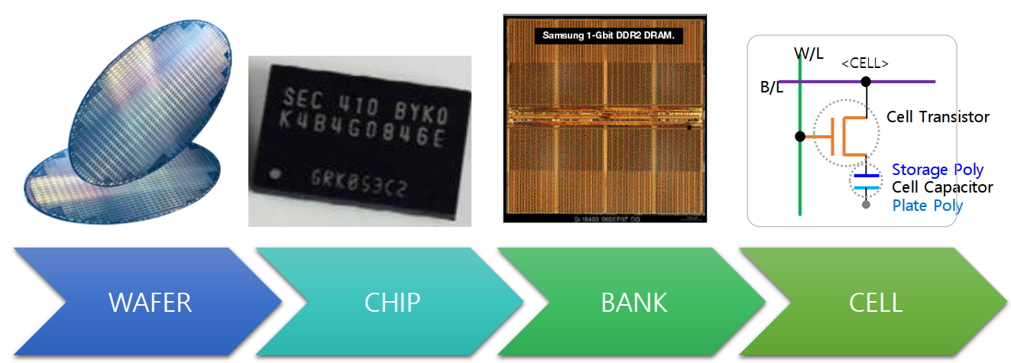
DRAM components
Bitline
Wordline
From Samsung: Graphic explanation Bank,Block,Row,Column for Intel_230913.pdf

Slide 4
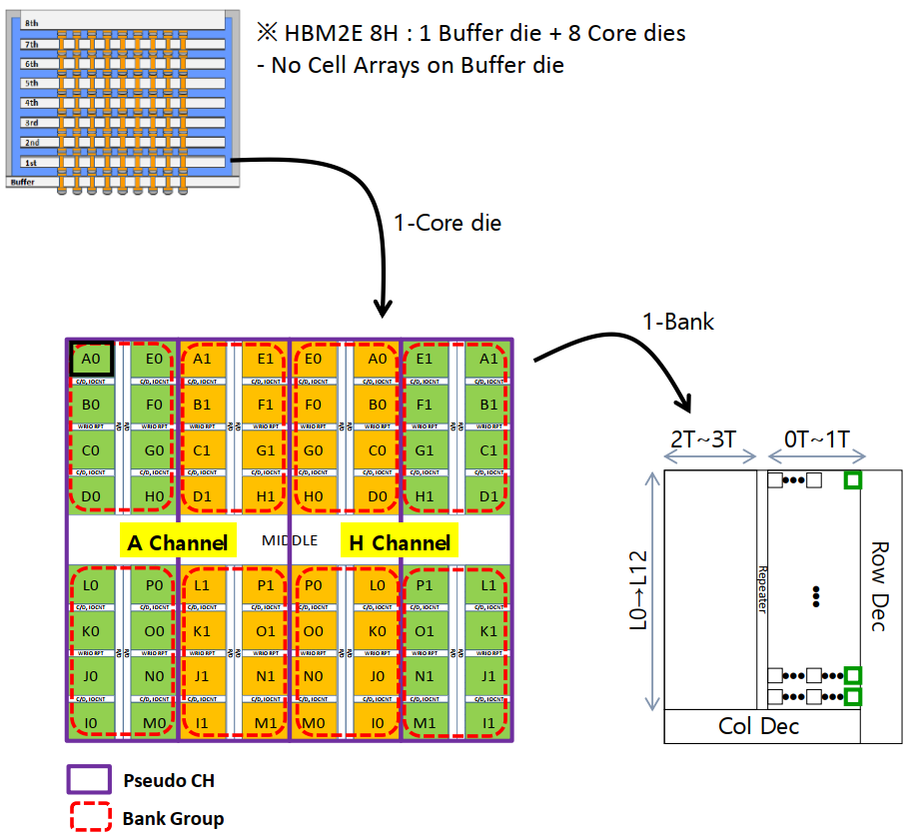
Inside a DRAM chip
There may be multiple dies in a DRAM package
DRAM dies have peripheral logic for I/O channels, mode registers, etc
DRAM dies have a dense array of cells, each with one transistor and one capacitor that stores charge
The array is divided into bank groups
Bank groups have multiple banks
Banks have row and column address decoders
From Samsung: Graphic explanation Bank,Block,Row,Column for Intel_230913.pdf

Slide 5
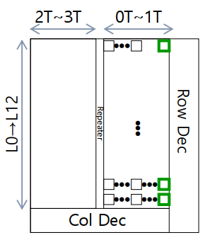
Inside a bank
No money in this bank
Green squares are cell array blocks
Cell array blocks may also be called memory array tiles (MAT)
A row of MATs may be called a subarray
In this example there are 13 subarrays (L0→L12)
Each MAT may have ~1000 rows and ~1000 columns
For each row activate, one row is activated on all MATs in a subarray (row of MATs)
During a read or write, one row may be activated per bank
Refresh may choose to activate more rows per bank
Column address chooses some bits from each MAT
From Samsung: Graphic explanation Bank,Block,Row,Column for Intel_230913.pdf

Slide 6
Cell Array Blocks / Memory Array Tiles (MATs)
Sense amplifiers are between rows
Sense amplifiers store the “page” or “row buffer”
Sense amplifiers may or may not be shared between MATs above and below
Left and right MATs share subwordline drivers
Row address decoder → one main wordline → multiple subwordline drivers → multiple subwordline arms → cell transistors turned on
Cell capacitors charge/discharge bitline → sense amplifiers detect and maintain logic level
The column address will select e.g. 8 bits from each MAT when reading or writing
MAT
Subwordline arms
Subwordline driver
Page / Row Buffer
Bitline
Cell
Column Address
Sense amplifier
Read/Write
8 bits

Slide 7
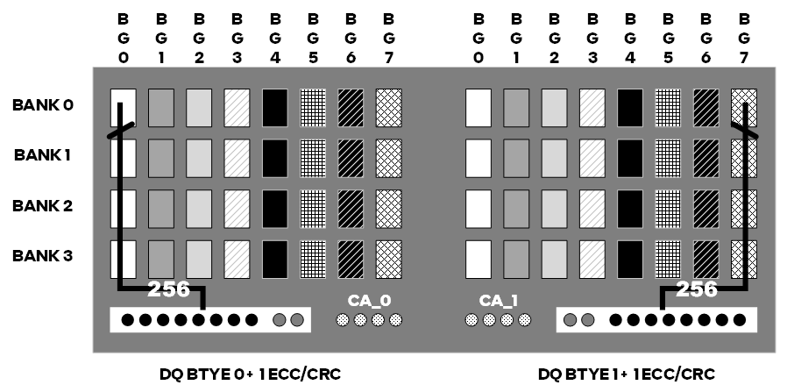
Putting it all together
During a row activate, the row address is transferred: CA pins → bank group → bank → row decoder → one wordline → multiple subwordlines
Subwordlines asserted → cell transistors turn on → cell capacitors charge/discharge bit lines → sense amplifiers detect and maintain logic levels
Column address: CA pins → bank Group → bank → column decoder → column select lines
Column selects subset of sense amplifiers
During a write, data → DQ pins → bank group → bank → selected sense amplifiers → bitlines → cell transistors → cell capacitors
During a read, data from selected sense amplifiers → out of bank → out of bank group → prefetch buffer → DQ pins
Prefetch buffer
From Intel - Samsung[External] Updated DDR6 Die Architecture Rev2.pptx

Slide 8
What are some common fault patterns?
Single bit errors
Could be caused by a cell capacitor that leaks charge too quickly
Sometimes two neighbouring cells have a small short circuit that affects both DRAM cells
Could be related to channel I/O signal integrity as well
Column faults
Could be caused by a short circuit or open circuit in the bitline, or just higher resistance
Could be caused by a defect in the sense amplifier transistors
Affects multiple row addresses
Column select line (CSL) faults can affect multiple columns
Row faults
Subwordline driver or subwordline arms may have a defect
Multiple row faults
MAT faults
Some other faults could affect a number of cells within a cell array block / MAT

Slide 9
How do fault patterns relate to ECC codes?
Single bit errors are the most common, and projected to increase significantly in future DRAM generations
DDR5 DRAM components have on-die ECC, which is single-error correction (SEC), which can correct most single bit errors
Row faults are now responsible for a larger percentage of DDR5 DRAM errors
Pareto of faults varies for each memory supplier, for each process generation, and for each product
Row and column faults map to DQ and burst patterns: want to group these bits into ECC symbols
Samsung’s HBM2E also has on-die ECC
Single error correction double error detection (SECDED)
Stronger than DDR5’s on-die ECC

Slide 10
Pontevecchio (PVC) HBM

Slide 11
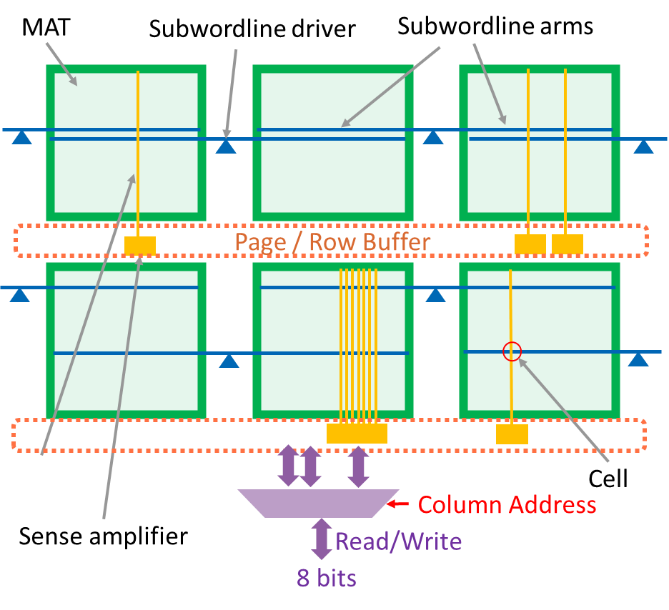
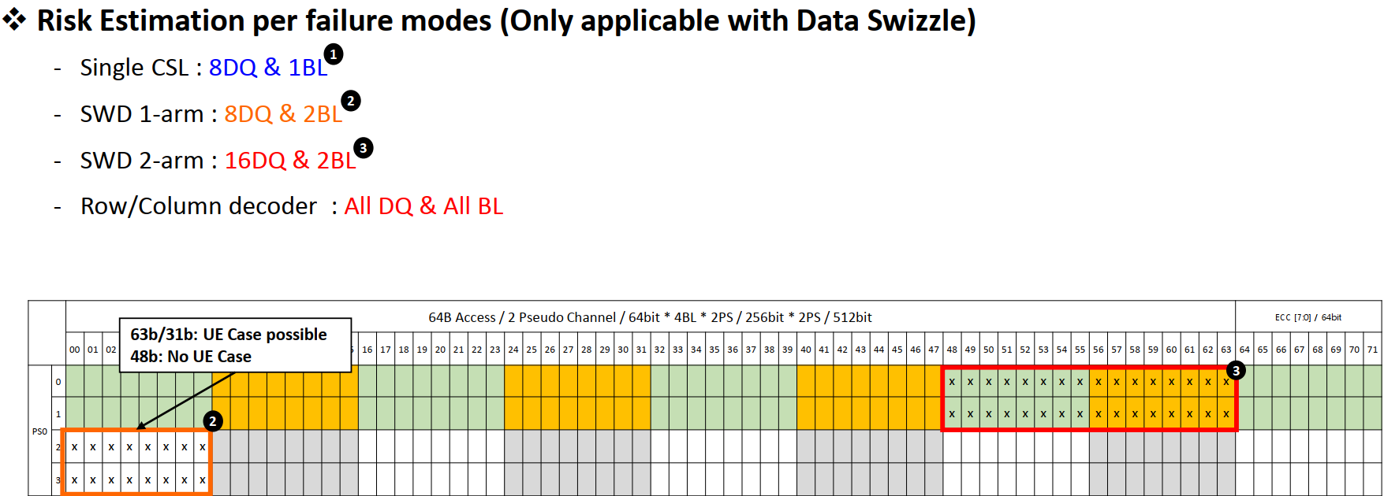

Mapping of fault patterns to Samsung’s HBM2E
PVC system ECC can correct one 8DQ x 2burst region
72 DQ lanes
From Samsung: Samsung Response - Intel RAS Review(SPR vs.PVC)_230326.pdf

Slide 12
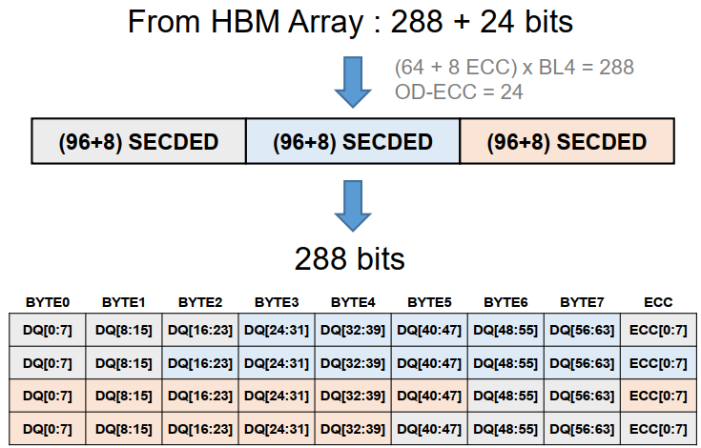
Samsung’s HBM2E On-die ECC
“When a CSL error occurs, and even it is miscorrected, it happens within same CSL, it doesn’t go beyond CSL.”
From Samsung: 2019040_Samsung_Flashbolt_ODECC.pdf
From Samsung: Samsung Review about Aurora System_240704.pdf

Slide 13
On-die ECC H matrix
A possible reconstruction of the H matrix:
1 CSL
If there are 2-bit errors, P7 = 0 and P6:P0 != 0000000 → OD-ECC UE
If there is a column select line (CSL) fault that affects a group of 8 bits
If 1 bit error, then SECDED will correct that bit → OD-ECC CE
If 2, 4, 6, or 8 bit errors, then SECDED will detect P7 = 0 and P6:P0 != 0000000 → OD-ECC UE
If 3, 5, or 7 bit errors: P7 = 1 and P6:P3 will match the value for the group of 8 bits → miscorrect within same 8 bits
If the CSL fault affects OD-ECC parity bits
If 1 bit error, then SECDED will correct that bit → OD-ECC CE
If 2, 4, 6, or 8 bit errors, then SECDED will detect P7 = 0 and P6:P0 != 0000000 → OD-ECC UE
If 3, 5, or 7 bit errors: P7 = 1 and P6:P3 can be anything → OD-ECC UE or miscorrect 1 bit with many possible locations

Slide 14
On-die ECC H matrix
A possible reconstruction of the H matrix:
1 CSL
1 SWL
If there is a subwordline (SWL) fault that affects a group of 16 bits
If 1 bit error, then SECDED will correct that bit → OD-ECC CE
If 2, 4, 6, 8, 10, 12, 14, or 16 bit errors, then SECDED will detect P7 = 0 and P6:P0 != 0000000 → OD-ECC UE
If 3, 5, 7, 9, 11, 13, or 15 bit errors, then P7 = 1 and P6:P3 will match the value of one of the two groups of 8 bits → miscorrect within same 16 bits
If there is a subwordline (SWL) fault that affects the OD-ECC parity only
If 1 bit error, then SECDED will correct that bit → OD-ECC CE
If 2, 4, 6, 8, 10, 12, 14, 16 bit errors, then SECDED will detect P7 = 0 and P6:P0 != 0000000 → OD-ECC UE
If 3, 5, or 7 bit errors: P7 = 1 and P6:P3 can be anything → OD-ECC UE or miscorrect 1 bit with many possible locations

Slide 15
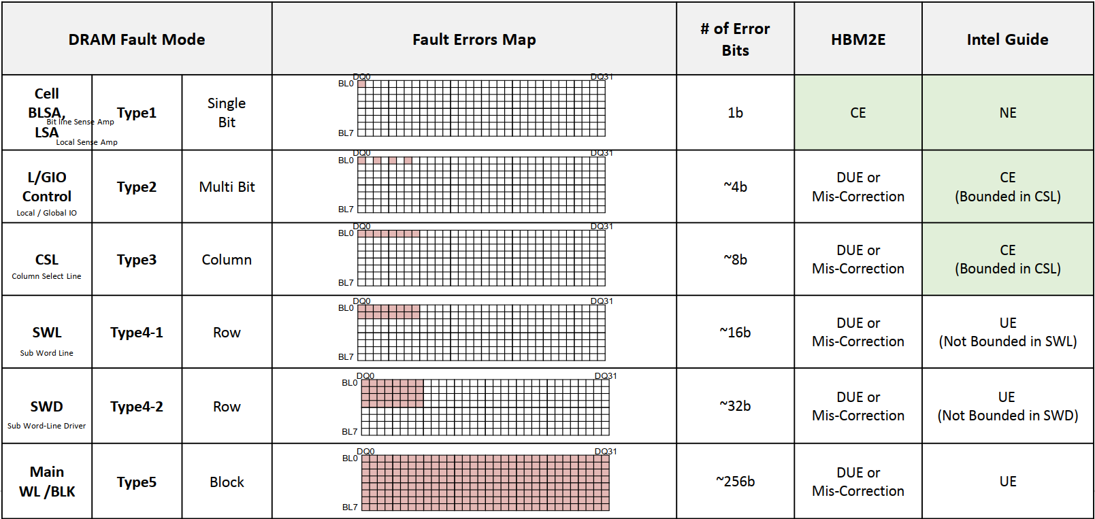
Combination of OD-ECC and System ECC
From Samsung: Samsung Review about Aurora System_240711.pdf
* Note that Fault Errors Map corresponds to HBM3, not HBM2E, but other columns are correct.
Our possible reconstruction of H matrix was bounded in SWL

Slide 16
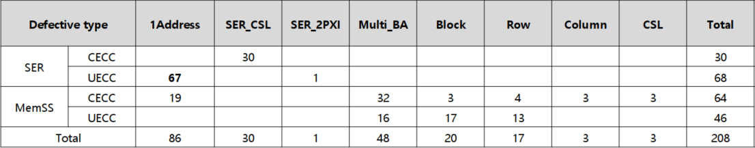
Failure Summary
These failures exclude early life failures
Collected from 510,000 HBM devices on the Aurora supercomputer over ~3 months
DPM can be calculated as # failures x 8, but the # failures is strongly correlated to utilization, so some fine tuning is needed
Soft errors contribute a significant portion of failure events (more details in later slides)
The cause of the uncorrectable errors that happen only once is not clear
From Samsung: Samsung Review about Aurora System_240711.pdf

Slide 17
Recent learnings from PVC HBM debug
Row and column repair enable latches are most vulnerable to soft error events
This results in correctable or uncorrectable errors that can only be fixed by resetting the DRAM
Row repair soft errors may look like a die failure case during ECC decoding
Row repair soft errors can result in reading the wrong address, which will may silent data corruption (SDC) if the ECC codeword is on only one die (e.g. LPDDR, HBM)
Server CPUs have scrambling based on the address, which should detect most cases
Vulnerable if scrambling is turned off or if the scrambling is based on column addresses only
When errors are reported from multiple banks, it may be the result of a DQ channel signal integrity issue, and not a soft error

Slide 18
Column Repair Soft Errors

Slide 19
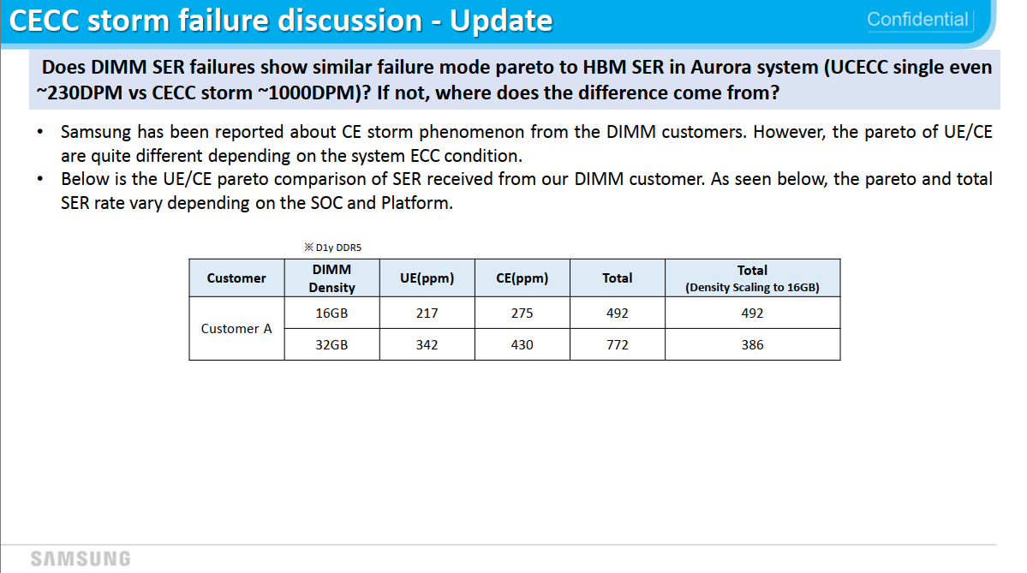
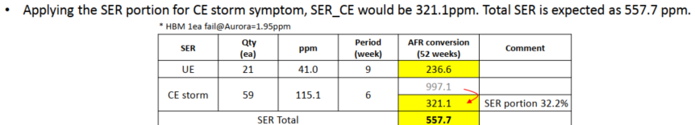
From Samsung: The Mechanism of SER CE storm_240502

Slide 20
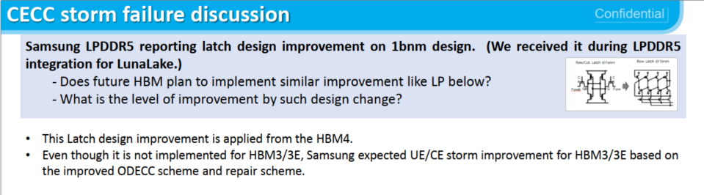
From Samsung: The Mechanism of SER CE storm_240425

Slide 21
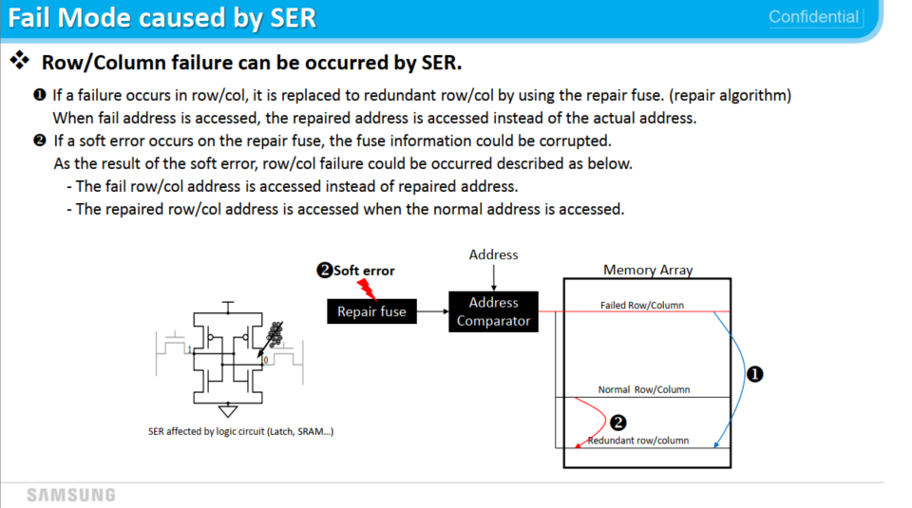
From Samsung: The Mechanism of SER CE storm_240418

Slide 22
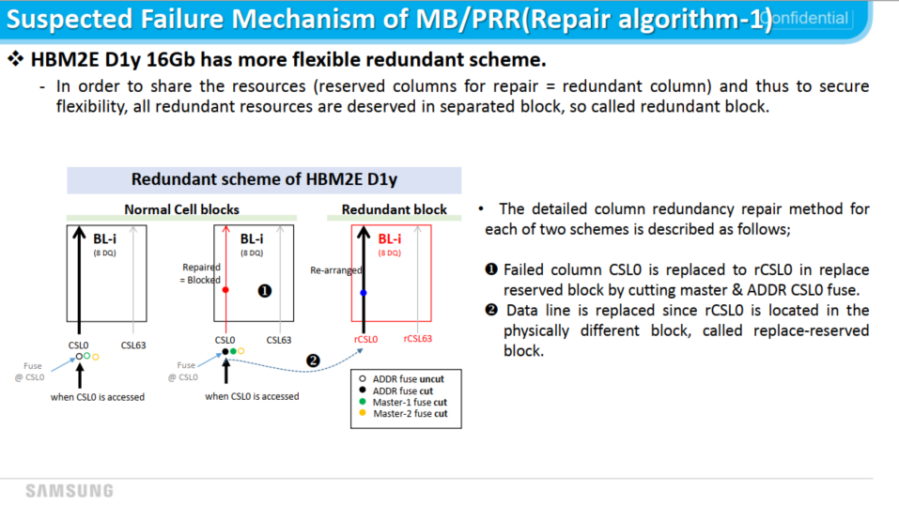
From Samsung: The Mechanism of SER CE storm_240418

Slide 23
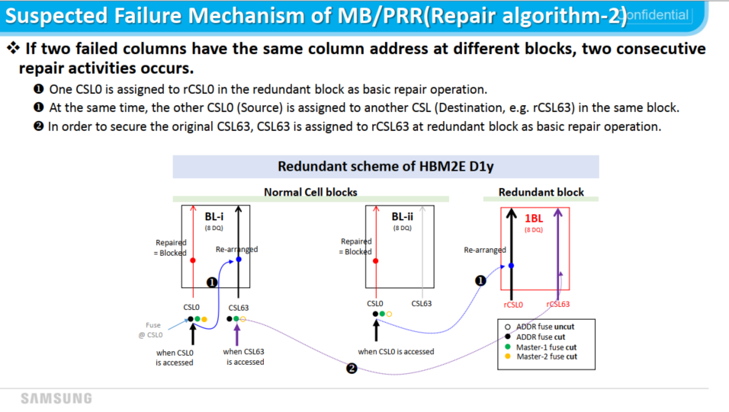
From Samsung: The Mechanism of SER CE storm_240418

Slide 24
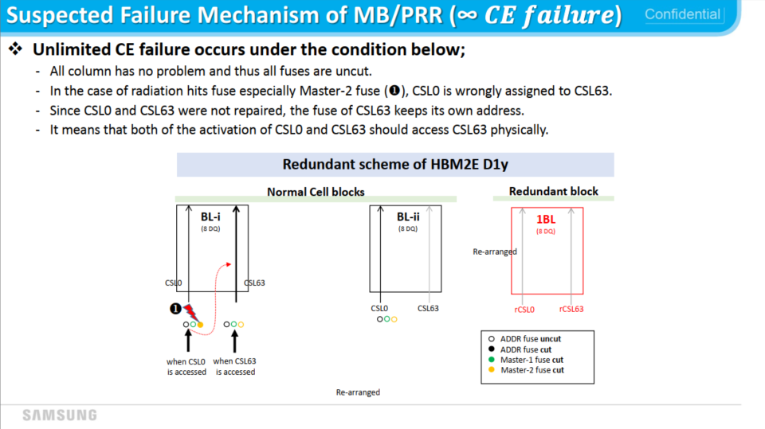
From Samsung: The Mechanism of SER CE storm_240418

Slide 25
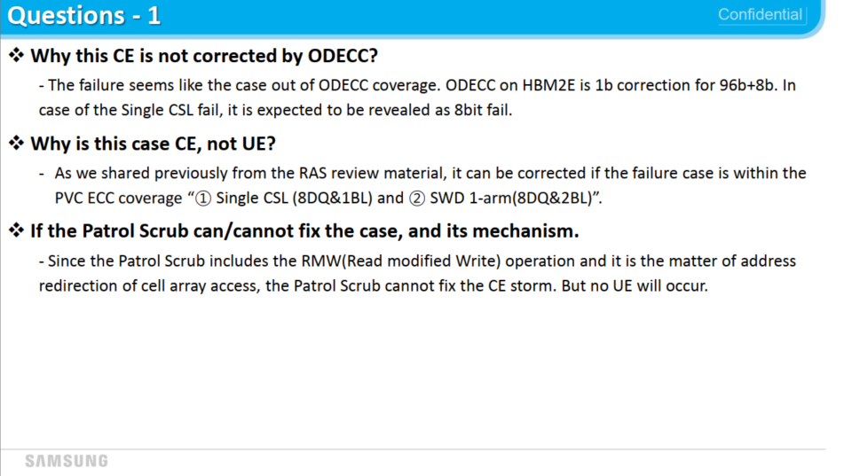
From Samsung: The Mechanism of SER CE storm_240418

Slide 26
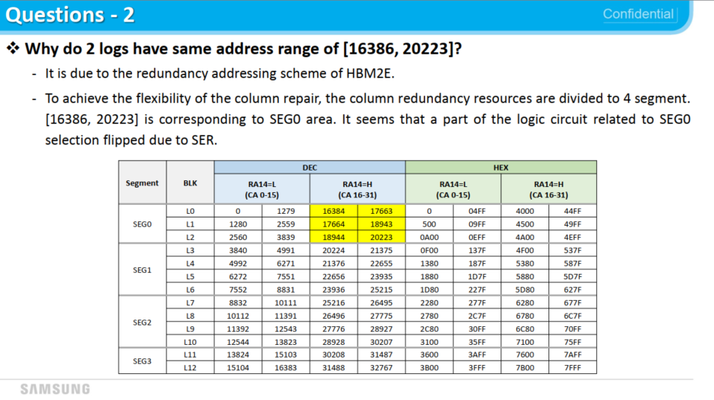
From Samsung: The Mechanism of SER CE storm_240418

Slide 27
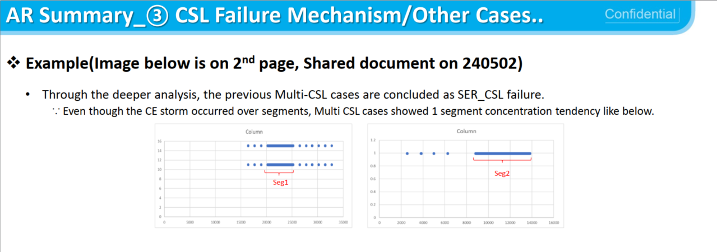
From Samsung: Samsung Review about the SDC Possibility_240613

Slide 28
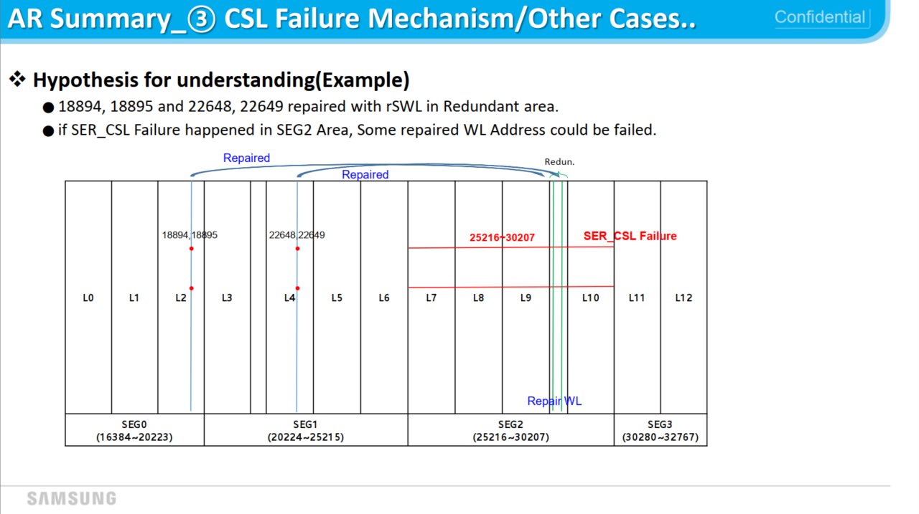
From Samsung: Samsung Review about the SDC Possibility_240613

Slide 29
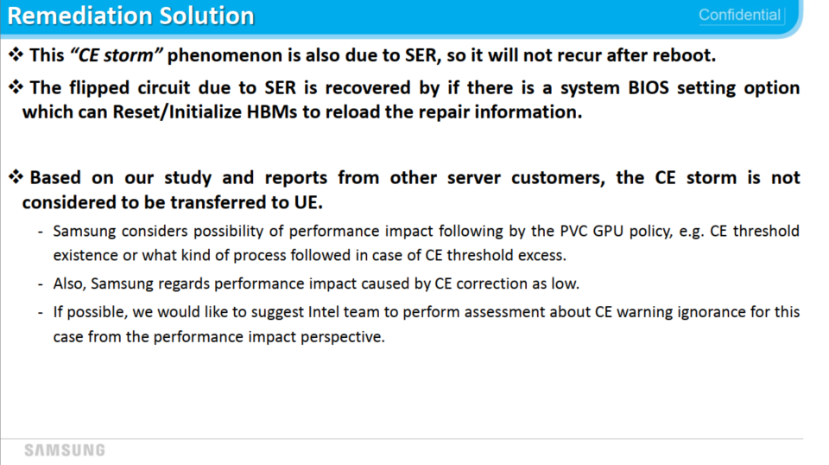
From Samsung: The Mechanism of SER CE storm_240418

Slide 30
Row Repair Soft Errors

Slide 31
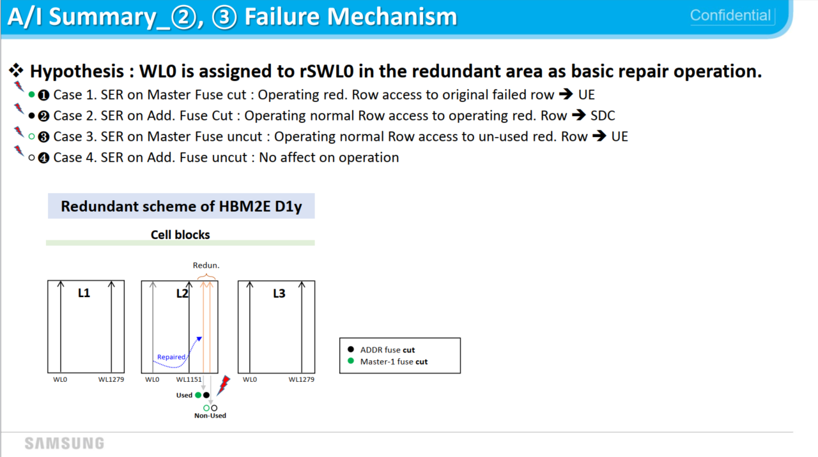
 | Master fuse not cut (repair originally disabled) | Master fuse cut (repair originally enabled)
SER on master fuse | Case 3 | Case 1
SER on one of 14 address fuses | Case 4 | Case 2
From Samsung: Samsung Review about the SDC Possibility_240523

Slide 32
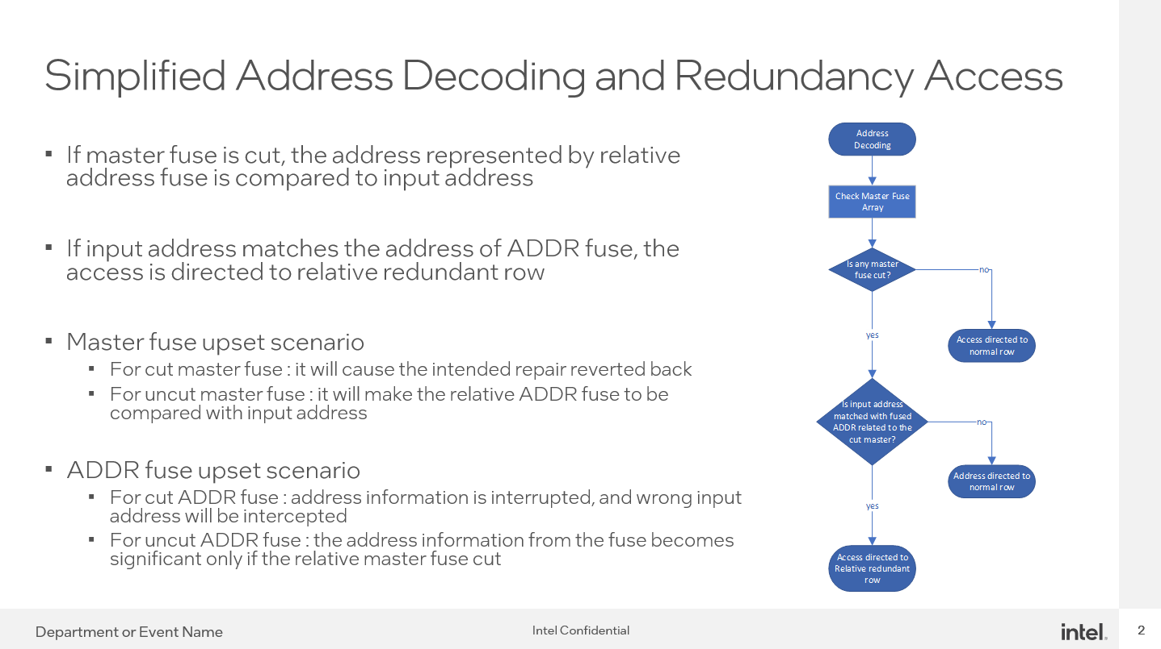
From WH Song’s Samsung Redundancy Scheme and Failure Model.pptx

Slide 33
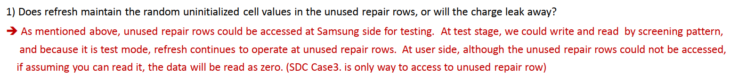
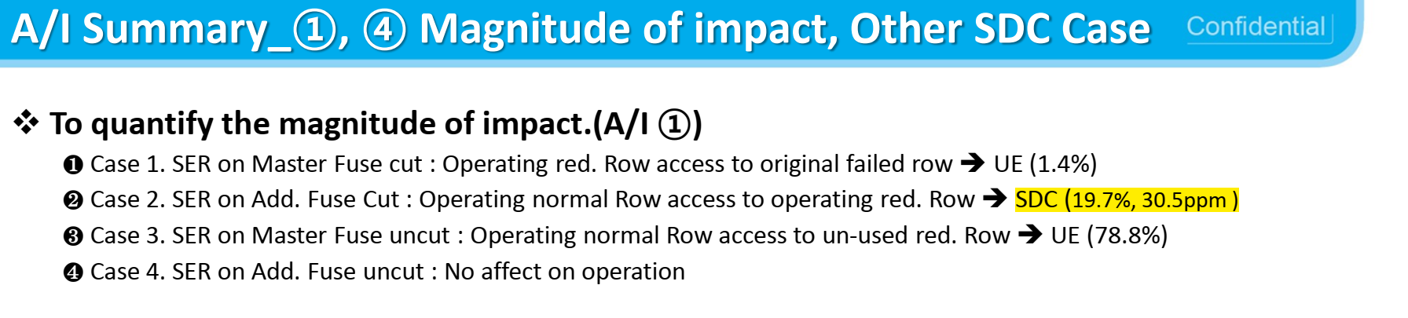
Row Repair SER will cause SDC
From Samsung Review about SDC Possibility_240621.pdf
- All zero data is a correctable codeword for PVC, because scrambling is disabled!
- Memory controller will not detect an error → Silent Data Corruption (SDC)
SDC
SDC
From Samsung Review about SDC Possibility_240523.pdf

