Slide 1
DMR-XP Memory Controller RAS Features
Feature Name: DMR-XP Memory Controller RAS Features
Feature HSD # https://hsdes.intel.com/appstore/article/#/14022145091
Presenter(s) Hsing-Min Chen

Slide 2
Topic | DMR-XP Memory Controller RAS Features
Link to HSD feature | https://hsdes.intel.com/appstore/article/#/14022145091
Link to HAS 0.2 | https://docs.intel.com/documents/arch_datacenter/DMR/DMR-AI/RAS/DMR-AI_RAS_HAS.html
WG Reviews | Mem Arch WG, DMR-XP RAS WG
Presenter | Hsing-Min Chen Collaboration with Intel Lab: Wei Wu
Scribe | John Holm
Required Attendees/Stakeholders | Rajat Agarwal Philip Hillier Hussein Alameer Sreenivas Mandava Jing Ling Wei Wu
Notes:
Give e.g. for UFI.

Slide 3
Plan for DMR-XP Memory Controller RAS Features
Feature Request Part 1 - Today | Feature Request Part 2 - WIP
Two Memory ECC schemes Low-cost mode vs. RAS mode Error coverage Comparison with DMR-AP Poison/TEE (detail pattern TBD) | Error Logging/Error Signaling MCA and platform domain Patrol/Demand Scrub PFD Memory sparing feature Detailed Poison/TEE patterns Error injection

Slide 4
Feature Overview – Part 1
Feature Description
Developing two ECC schemes for low-cost mode (high bandwidth mode) and RAS (lockstep) mode in DMR-XP with LPDDR5
Feature Motivation
Provide the required error coverage capability for LPDDR5 memory systems in DMR-XP
Feature Summary
Two ECC schemes are designed based on currently known vendors’ failure pareto
Low-cost mode ECC; RAS (lockstep) mode ECC
Coverage table for transient and permanent faults
All ECC bits are reserved for ECC usage; poison/TEE supported without repurposing any ECC bits
Support error containment (poison) by using poison pattern in these two modes
Support trusted execution environment (TEE) indication by using TEE pattern in these two modes
Notes:
Give e.g. for UFI.

Slide 5
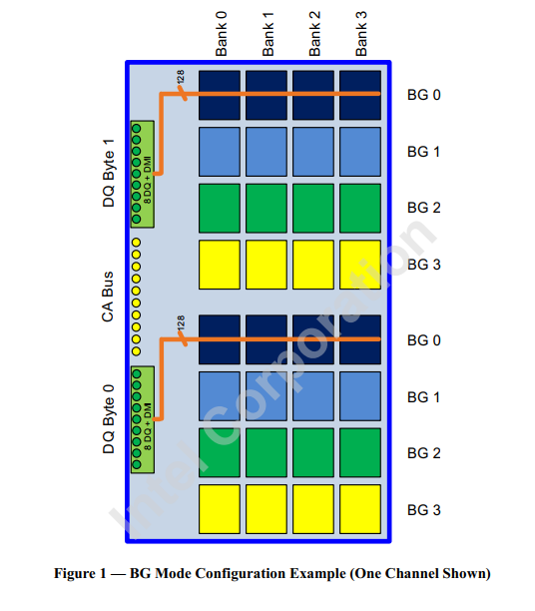
Background: DDR5 vs. LPDDR5 Layout
DDR5 10x4 DIMM
DDR5 10x4 example
A single cacheline is read from one sub-channel.
x4 IO, 512b data + 128b ECC (Each device provides 64b)
A failed device corrupts up to 64b, can be 100% corrected by 128b ECC (1 failed device vs. 2 ECC device ratio)
LPDDR5
A single cacheline is read from the same device/bank
Example: x16 IO, BL 32 reads 512b
Internal-ECC bits routed through DMI pins. DRAM internal ECC gen/check is disabled.
512b data + 32b ECC
A failed device corrupts up to 512b
Single Data Device Correction (SDDC)
SDDC is the expectation for datacenter memory error coverage
Sub-Channel 0
Sub-Channel 1
D8
D6
D4
D2
D0
D8
D6
D4
D2
D0
D9
D7
D5
D3
D1
D9
D7
D5
D3
D1
LPDDR5 device, figure is from JEDEC spec

Slide 6
Modes of Operation in DMR-XP
ECC Device
LP5 Die
LP5 Die
Die
LPDDR5 device, figure is from JEDEC spec
x16
x8
x40
1. Low-cost Mode | 2. RAS (Lockstep) mode
x16 with BL32 | x8 with BL16 5 devices in lockstep
Only access to 1 LPDDR5 device per sub-channel | 1 extra ECC device per 4 data devices
Single cacheline is read from the same device | Single cacheline + additional ECC are read from 5 devices
32b inline ECC read through DMI | 40b inline ECC read through DMI

Slide 7
LPDDR5-ECC-MC Microarchitecture
RAS Mode
Low-cost mode
MC
X8 Device
Sub-Ch0
MC
X8 Device
lockstep
ECC
Device
Sub-Ch0
X8 Device
ECC
X8 Device
Sub-Ch1
ECC
Device
Sub-Ch1
X8 Device
Device
ECC
Sub-Ch2
X8 Device
Sub-Ch2
ECC
X8 Device
Device
Sub-Ch3
X8 Device
ECC
X8 Device
Sub-Ch3
X8 Device

Slide 8
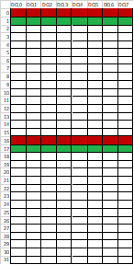
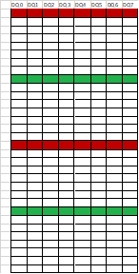
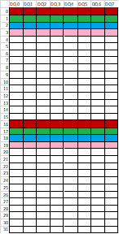
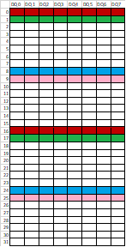
LPDDR5 Failure Patterns
This slide is provided by Wei Wu
(Data is Vendor Confidential)
DDR5 has DQ oriented errors vs. LPDDR5 has burst oriented errors
1 Failure Symbol = 8 bits = 1 burst
1 burst
2 burst
4 burst
4 burst
8 burst
8 burst
 | 1 symbol | 2 symbols | 4 symbols (A) | 4 symbols (B) | 8 symbols (A) | 8 symbols (B) | Full symbols
Micron | CSL | SWL ARM | SWL DRV |  |  |  | MWL
Samsung | CSL |  |  | SWL ARM |  | SWL DRV | MWL
Hynix |  |  | SWL ARM |  | SWL DRV |  | MWL

Slide 9
DMR-XP ECC Summary
1.
512b
32b
Lockstep 5 devices
2.
128b
8b
128b
8b
128b
8b
128b
8b
128b
8b
Mode | Data vs. ECC bits configuration | Max failed bits per device | Key ECC Coverage | PFD | Poison/TEE
1. Low-cost mode | 512 data + 32b ECC[1] all from the same LPDDR5 Device | 512b | 100% CE for Random 1b/2b, 2 bursts [3] | Enhance detection for 4 burst/8 burst/full device error [3] | Support poison/TEE by XORing defined patterns in ECC
2. RAS mode | Lockstep 5 devices, each device provides 128b + 8b ECC[2]. 4 data devices + 1 ECC device makes overall 512b data + 168b ECC | 128b | 100% CE for Random 1b/2b/3b, 4 bursts, 0 SDC for single device failure [3] | 100% CE for single permanent fault device [3] | Support poison/TEE by XORing defined patterns in ECC
[1] assume turning off on-die ECC and receive 32b from DMI pin from 1 device [2] assume turning off on-die ECC and receive 8b per device from DMI pin [3] Error coverage details in ECC coverage slide
CE: correctable error; DUE: detectable but uncorrectable error; SDC: silent data corruption

Slide 10
Error Coverage Details
Src: Hsing-min & Wei
Error Pattern\ECC Scheme | Low-cost mode |  | RAS mode
#ECC bits | 32b ECC per cacheline ECC symbol 8b |  | Same 32b ECC as high BW ECC with 136b parity
1b | 100% CE |  | 100% CE
2b | 100% CE |  | 100% CE
1 burst - 8b | 100% CE |  | 100% CE
2 bursts - 16b | 100% CE |  | 100% CE
4 bursts (A) – 32b | Non-Permanent 0 % CE 99.915% DUE 0.085% SDC (8.5E-4) | Permanent[1] 100% DUE | 100% CE
4 bursts (B) – 32b |  |  | 100% CE
8 bursts (A) – 64b |  | Permanent[1] 99.999999977% DUE 0.000000023% SDC (2.3E-10) | Non-Permanent 99.999999977% CE 0.000000023% DUE (2.3E-10) 0% SDC | Permanent[2] 100% CE
8 bursts (B) – 64b
Full Device / All bursts
Note | Doesn’t provide full device level correction |  | Provide full device level correction and 0 SDC
[1] If PFD is enabled in high bandwidth mode, error coverage is enhanced for 4 burst/8 burst and full device error
[2] If PFD is enabled in lockstep mode, error coverage is enhanced for 8 burst and full device error
[3] All schemes are designed without providing additional metadata bits, … add here

Slide 11
Error Coverage Comparison
Src: Hsing-min & Wei
Error Pattern Per Device | 1b | 2b | Column | Row /Bank /Full device | Note
Mode of operation
Low-cost mode | 100% CE | 100% CE | 100% CE | <= 16b block: 100% CE > 16b block: 0 % CE, 0.085% SDC | Single/double bit and some sub device protection
SPR-HBM | 100% CE | 5.4% CE, 0% SDC | 100% CE | <=32b block: 99.9985% CE, 0% SDC >32b block : 0% CE, 0.03% SDC | Single bit and some sub device protection
RAS mode | 100% CE | 100% CE | 100% CE | Persistent faults: 100% CE Transient faults : 99.9999999% CE, 0% SDC | Full device protection
DDR5 10x4 | 100% CE | 100% CE | 100% CE | Persistent faults: 100% CE Transient faults : 99.999999999999991% CE, 0 SDC | Full device protection
DDR5 5x8 | 100% CE | 49.6% CE, 0% SDC | 100% CE | 0% CE, 0.00000000000000021% SDC | Single bit and some sub device protection

Slide 12
Poison/TEE Pattern Support in DMR-XP
The same methodology (read/write flow) for poison/TEE implementation in legacy (GNR/DMR), the only difference is XOR pattern size (128b in DDR5 10x4/5x8 vs. 32b in LPDDR5)
No other metadata are repurposed for ECC
Flow is identical to DMR-AP, exact patterns will be provided in 0p5
See backup slides for DMR poison/TEE flow
DMR MC IP HAS poison flow
DMR MC IP HAS TEE flow

Slide 13
Power/Power Management Impact
Power Architecture Contact: Nilanjan Palit
If any of the following questions are answered in the affirmative, please fill out the detailed impact table provided in backup and schedule a review at PAF prior to SAF review.
# | Change / Impact Item | Y/N
1 | Does the feature have a significant impact (> 50 mW) on infrastructure power (Vinf, sideband fabrics, x4clk, x8clk, etc.)? | N
2 | Does the feature have any implications on idle power or power at low BW? | N
3 | Does the feature require the addition, removal or does it create a new dependence between any clock or voltage domains? E.g., if a uclk FUB is moved from Vcfc to Vcfn/VFixDig then this answer is yes. | N
4 | Does the feature require a new / different voltage level (FIVR or MBVR or Power Gate) or a new / different clock freq. compared to current PoR for its functionality? | N
5 | Does the feature change any frequency or voltage domains from static to dynamic or vice-versa? | N
6 | Does the feature require PM (e.g., GV, link training, link states, etc.) to meet its PnP or functional goals? | N
7 | Does the feature eliminate the ability to exercise PM control over some domain? | N
8 | Does the feature add / increase the potential for di/dt for any domain? | N
9 | Does the feature add / remove a new clkreq, Q-ch/Qactive, P-ch./Pstate, or PkgC6 wake event? | N
10 | Does the feature add / remove functionality to an early boot domain (prior to cores exiting reset)? | N
11 | Does the feature require changes to telemetry for low power modes or BW / latency requirements? | N
Notes:
Give e.g. for UFI.

Slide 14
Security Impact
No impact
Notes:
Give e.g. for UFI.

Slide 15
Validation Impact
All ECC correction and detection will be implemented within memory controller, only impact MC IP.
Two ECC algorithms will also be formally verified by formal verification group.
This ECC feature doesn’t interact with complex legacy flow such as reset/BIOS/Power management
Notes:
Give e.g. for UFI.

Slide 16
Components Affected
Class | Component | Description of Impact
IPs | Memory controller | New ECC logic to perform error correction and detection and poison/TEE indication.
FW | BIOS | BIOS needs to configure which ECC schemes to be used in two modes

Slide 17
Summary
Today’s coverage – Part 1
Two ECC schemes: Low-cost vs. RAS mode
Error coverage and comparison to Xeon products
Poison/TEE support via patterns
Part 2 will cover:
Error Logging/Error Signaling
MCA and platform domain
All supported ECC modes
Flat2LM
Patrol/Demand Scrub
PFD
Memory sparing feature
Detailed Poison/TEE patterns
Error injection

Slide 18
BACKUP (Any supporting data that might be needed to support the presentation, and any content that might be helpful to someone reviewing the strawman material after the fact.)

Slide 19
LP5 Device Construction
Native Mode
Byte Mode
A device can be configured in multiple ways
Data width can be x16 or x8
Burst length can be BL32 or BL16
Byte mode gives 2x the capacity
LP5 Die
LP5 Die
x16
x8
x8
x16
Data Width | x16 | x8 | x16 | x8
Burst length | 32 | 16 | 16 | 32
Bits per access | 512 bits | 128 bits | 256 bits | 256 bits
Power Efficiency | Best | Worst due to 2x capacity and low BW efficiency | In-between (low BW efficiency but 1x capacity) | Lower than x16/BL32 due to 2x capacity
BW Efficiency | Best | Worst due to BL16 | Worst due to BL16 | Same as x16/BL32
RAS | Worst. Will be same as x8/BL16 with 256B access | Best for 64B accesses | Same as x8 BL16 with 128B access, else lower | Same as x8/BL16 with 128B access, else lower

Slide 20
High Bandwidth Mode – Detection/Correction Flow
Requested line A and A is read from the same LPDDR5 device
512b
32b
Single cacheline 512b and 32b ECC will be provided by DMI
32b ECC performs 1b/2b/1 burst/2 burst correction and some level of detection
Cacheline and 32b ECC
Y
If syndrome matches 1b/2b/1 burst/2 burst error symptom, perform correction
Declare DUE for the other cases
Error detected by 32b ECC
N
No Error

Slide 21
High RAS (Lockstep) Mode – Detection/Correction Flow
Requested line A and A is split into 4 different devices A0, A1, A2, A3 (128b each)
AP is additional ECC
A0
A1
A2
A3
Lockstep
128b
8b
128b
8b
128b
8b
128b
8b
128b
8b
Access will be similar to DDR5 5x8
Cacheline A will be accessed from 4 devices (in lockstep), and ECC (32b tier1 + Parity 128b+8b) performs detection/correction based on all lockstep data
32b tier1 ECC performs detection only, use all tier-1 ECC bits and Parity to determine final CE or DUE (no SDC for single device error)
Request line B, will be read from 4 devices and 1 parity device
Y
If tier-1 and parity identified failed device => single device CE
Declare DUE for the other cases
Error detected by tier-1s or Parity
N
No Error

Slide 22
DMR 10x4/5x8 Full SDDC – Poison Pattern Mask
10x4/5x8-128b
Each ECC unit: 256b data + 64b ECC
2 ECC units for a single cache line
ECC Structure
Poison pattern (mask): all zero data + non-zero ECC pattern
Need two units both hit SDC then it is an SDC.
Write flow (single ECC unit):
Poison pattern Mask – 10x4/5x8-128b
FFFF_FFFF
FFFF_FFFF
0000_..._0000
0000_..._0000
FFFF_FFFF
FFFF_FFFF
0000_..._0000
0000_..._0000
Poison pattern Mask – 10x4/5x8-128b
256b data
256b data
64b ECC
256b data
ECC^MASK
DRAM
XOR 64b Poison Pattern Mask

Slide 23
DMR 10x4/5x8 Full SDDC – TD Pattern Mask
10x4/5x8-128b
Each ECC unit: 256b data + 64b ECC
2 ECC units for a single cache line
ECC Structure
TD pattern (mask): all zero data + non-zero ECC pattern
Need two units both hit SDC then it is an SDC.
TD pattern Mask
AAAA_AAAA
AAAA_AAAA
0000_..._0000
0000_..._0000
AAAA_AAAA
AAAA_AAAA
0000_..._0000
0000_..._0000
TD pattern Mask

Slide 24
