Slide 1
System/Technology Co-design Methodology for Energy-efficient Multi-tier 3D IC DNN Accelerators
September 15 , 2022
Presenter: Srivatsa RS
Gauthaman M, Dileep Kurian, Adel A Elsherbini, Tanay Karnik (Manager)
Heterogeneous Platforms Lab (HPL)

Slide 2







Today`s presentation
Re-architecting ML accelerator for higher throughput per mm²
Architectural simulations using ScaleSim/STONNE for motivation
Modified DELPHI (SPH`s ICE) architecture simulator to study the benefits of re-architecting DELPHI
3D Accelerators
Architecture and design space exploration
Exploration of benefits of hybrid bond interconnects (HBI) for 3D accelerator

Slide 3
Overview
Current ML accelerator trends
Re-architecting ML accelerator
2D accelerator case study
3D ML accelerator architecture and design space exploration
Future work

Slide 4
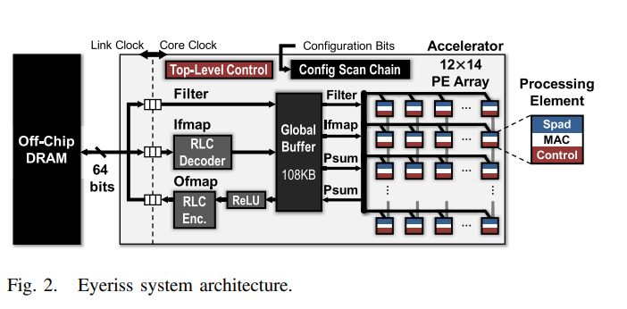


How does DRAM BW affect the throughput?
Eyeriss – A fixed interconnect
accelerator

Slide 5
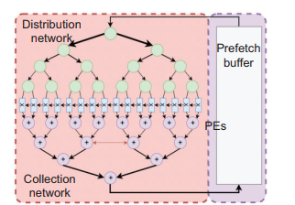
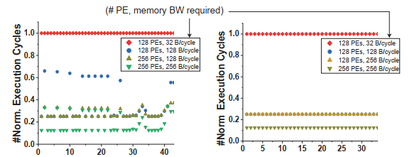





Memory BW vs Throughput Analysis
MAERI – a flexible
interconnect architecture
#Convolution layer in SSDMobileNetv1 (left) and ResNet34 (right)
Effect of SRAM BW on execution time

Slide 6
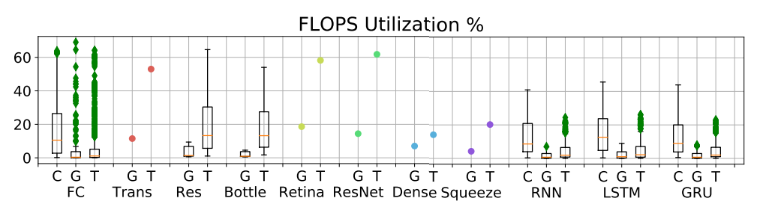








Case study: Commercial 2D Inference Engines
G-GPU
T-TPU
TPU v3: 64k MAC units
Offers ~100TOPS theoretical throughput
Practical PE utilization on ResNet50 ~30%
SPH: 48k MAC units
Offers ~48-92 TOPS theoretical throughput
~48% PE utilization on ResNet50

Slide 7
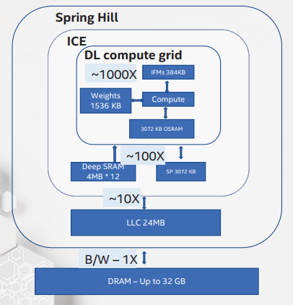
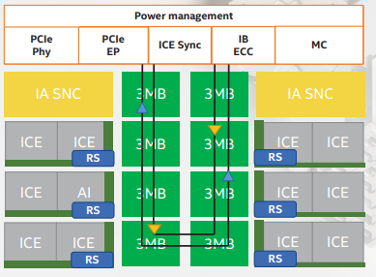
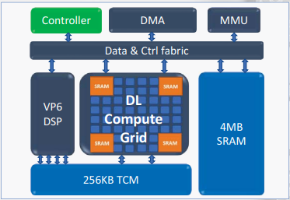















Case study: SpringHill (SPH) high level architecture
4K MAC units per compute grid (DELPHI/ICE)
Each ICE unit has a 4MB DeepSRAM
A 3MB LLC is shared by two ICE units
https://en.wikichip.org/wiki/intel/microarchitectures/spring_hill
https://ieeexplore.ieee.org/stamp/stamp.jsp?tp=&arnumber=8875671
Notes:
ØPerforma as a post processing step.
Ø Flow
ØWhile computing L1 fetch L2 data also.
ØAfter the compute while streaming out L1 data DELPHI can perform element wise addition.
ØReLU befor eand after element wise addition
Ø
ØThroughput 64 elements per cycle.
Ø
ØOverhead : Fetch of L2 data from memory.
ØIf the layer is input BW limited – Delay in compute

Slide 8
















Case study: DELPHI (ICE within SpringHill)
AXI/CVE interface
Broadcast across tiles, 32KB
Load unit
Store unit
ISRAM
Write
Ctrl
ISRAM
ISRAM
Buffer
………
ISRAM
Buffer
MEM
BSRAM Write
Ctrl
IP Registers
Tile-31
IP Registers
IP Registers
BRAM
Buffer 0
GEMM Ctrl
BRAM
Buffer 0
Tile-0
GEMM Ctrl
GEMM Ctrl
BSRAM
Buffer 0
DELPHI
CNN Ctrl
PE-0
PE-1
PE-N
CNN Ctrl
8 MACs
PE-0
PE-1
PE-7
DNN/FC Ctrl
PE-0
PE-1
PE-15
OSRAM
Buffer
OSRAM
Buffer
OSRAM
Buffer
Nonlinear Ctrl
OSRAM
Read/Write
Ctrl
OSRAM
Buffer
OSRAM
Buffer
OSRAM
Buffer
OSRAM
Buffer
OSRAM
Buffer
…………
OSRAM
Buffer
1.Unique per tile per PE
2.Holds output data
3. 8KB per tile (total 256KB)
1.Broadcast across PEs
2.CNN-Kernels, 4 KB per tile (total 128 KB)
Notes:
Ø Flow
ØWhile computing L1 fetch L2 data also.
ØAfter the compute while streaming out L1 data DELPHI can perform element wise addition.
ØReLU befor eand after element wise addition
Ø
ØThroughput 64 elements per cycle.
Ø
ØOverhead : Fetch of L2 data from memory.
ØIf the layer is input BW limited – Delay in compute

Slide 9

Case study: DELPHI (JBL Version)
AXI/CVE interface
Broadcast across tiles, 32KB
Load unit
Store unit
ISRAM
Write
Ctrl
ISRAM
ISRAM
Buffer
………
ISRAM
Buffer
SMEM
(16 MB)
AXI
(512b)
BSRAM Write
Ctrl
IP Registers
Tile-31
IP Registers
IP Registers
BRAM
Buffer 0
GEMM Ctrl
BRAM
Buffer 0
Tile-0
GEMM Ctrl
GEMM Ctrl
BSRAM
Buffer 0
DELPHI
CNN Ctrl
PE-0
PE-1
PE-N
CNN Ctrl
8 MACs
PE-0
PE-1
PE-7
DNN/FC Ctrl
PE-0
PE-1
PE-15
OSRAM
Buffer
OSRAM
Buffer
OSRAM
Buffer
Nonlinear Ctrl
OSRAM
Read/Write
Ctrl
OSRAM
Buffer
OSRAM
Buffer
OSRAM
Buffer
OSRAM
Buffer
OSRAM
Buffer
…………
OSRAM
Buffer
1.Unique per tile per PE
2.Holds output data
3. 8KB per tile (total 256KB)
1.Broadcast across PEs
2.CNN-Kernels, 4 KB per tile (total 128KB)
Notes:
Ø Flow
ØWhile computing L1 fetch L2 data also.
ØAfter the compute while streaming out L1 data DELPHI can perform element wise addition.
ØReLU befor eand after element wise addition
Ø
ØThroughput 64 elements per cycle.
Ø
ØOverhead : Fetch of L2 data from memory.
ØIf the layer is input BW limited – Delay in compute

Slide 10
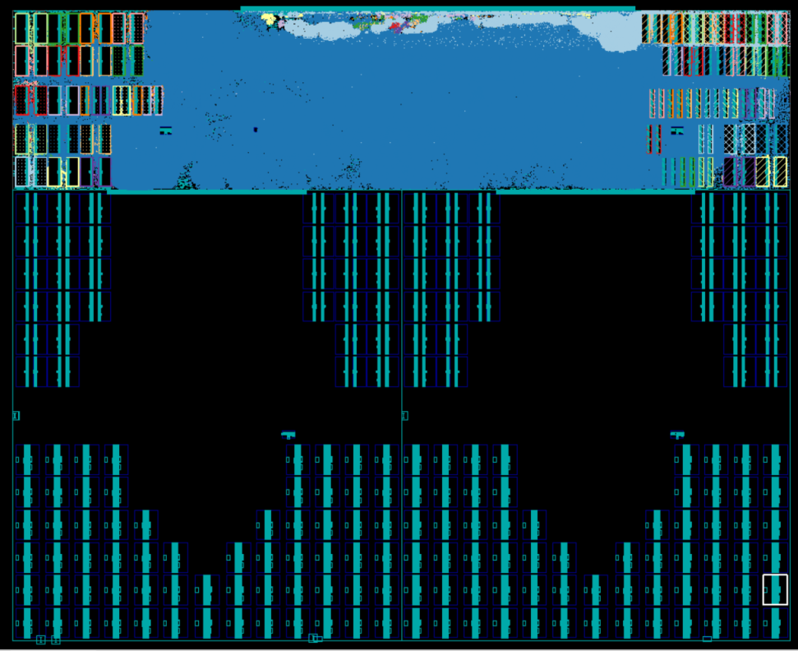
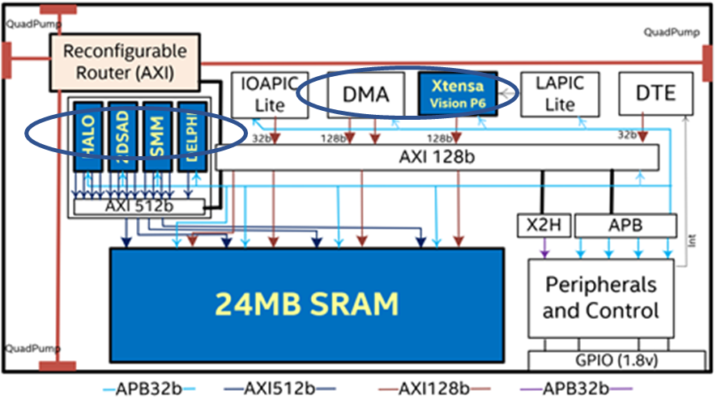


Why tiling isn’t a great solution?
1.35 mm
ISRAM:
40 RF instances
Area: 260um x320um
control logic
BSRAM: 32KB
BSRAM: 32KB
BSRAM: 32KB
BSRAM: 32KB
2048 MACs
16 PEs
16 Tiles
2048 MACs
16 PEs
16 Tiles
1.11 mm
4mm
16 MB
OSRAM: 64KB
OSRAM: 64KB
OSRAM: 64KB
OSRAM: 64KB
4mm

Slide 11
Scaling trends in DELPHI
Simulations performed with modified tightly coupled memory (ISRAM, BSRAM, OSRAM) bandwidth
Notes:
Assuming we have enough routing resources

Slide 12
Scaling trends in DELPHI
Saturates after 40% improvement

Slide 13
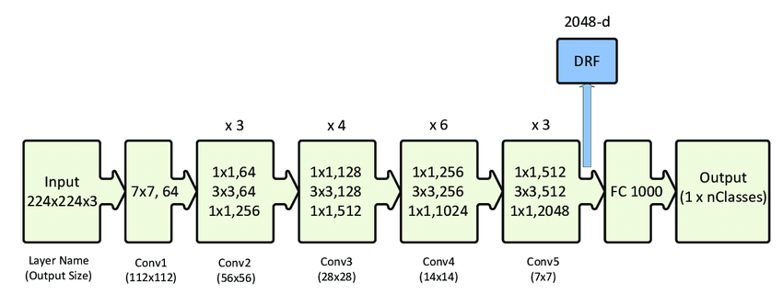
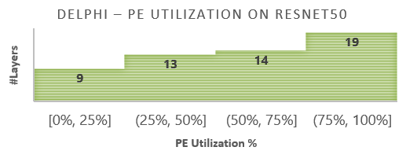
Scaling 2D DELPHI and Mapping ResNet50
Tiles | 64
#MACs | 8K
Design Frequency | 500 MHz
Average PE utilization | 48%
Theoretical throughput | 8 TOPS
Effective throughput | 3.93 TOPS
Throughput per area | 1.75 TOPS/mm²
ResNet50 Model
Notes:
BW limited due to routing resources

Slide 14
Avoiding Deep SRAM/SMEM
Read to PEs
Output FIFO
ISRAM Buffer
OSRAM Buffer
Write From PEs
Read to Adder and quantizer
Adder + quant
Write From DRAM
Write to DRAM

Slide 15
Memory/Near-memory accumulator Architecture
From PEs
From NMAQ
16 x 32b
Output FIFO
Controller EN
32
ISRAM Buffer
32-bit adder
32-bit adder
32-bit adder
1
2
16
8 KB
8 KB
16 x 32b
To NMAQ
32-bit Quant.
32 –bit Quant.
Quant.
9-bit Quant.
9-bit Quant.
9-bit Quant.
2:1
8 x 9b
To I/P NW Config.
16 x 9b
Write 512b to OFIFO
Write 512b to OFIFO
Write 512b to OFIFO
Write 512b to OFIFO
Write 512b to OFIFO
From PE
adder/quant
Read 512b from OFIFO
Read 512b from OFIFO
Read 512b from OFIFO
Read 512b from OFIFO
Write 144b to ISRAM every #IFMs cycle
Write 144b to ISRAM every #IFMs cycle
Write to ISRAM

Slide 16
Tightly coupled PEs and Memories
PE with 8 MAC units
ISRAM 1
(16 KB)
x3
ISRAM 2
(16 KB)
x3
ISRAM 3
(16 KB)
x3
ISRAM 4
(16 KB)
x3
A 64 PE tile design
Divided into 4 groups (4 sets of PEs and ISRAM)
OFIFO of depth 2 – to enable store and accumulate
ISRAM – 64 KB to store outputs from a single PE block
Additional 128 KB required to store outputs from different tiles – to enable next layer computation.
144b
72b
72b
72b
72b
144b
144b
72b
72b
72b
72b
144b
PE1-17
PE1-18
PE1-49
PE1-50
Inputs from other PE blocks
PE1-1
PE1-2
PE1-33
PE1-34
144b
PE1-15
PE1-16
PE1-31
PE1
32
PE1-47
PE1-48
PE1-63
PE1-64
144b
512b
512b
512b
512b
OFIFO 1
(128 B)
OFIFO 2
(128 B)
OFIFO 3
(128 B)
OFIFO 4
(128 B)
144b
512b
512b
512b
512b
144b
NMAQ 1
NMAQ 2
NMAQ 3
NMAQ 4
144b
144b
144b
144b
To ISRAM 1-1
To ISRAM 2-1
To ISRAM 3-1
To ISRAM 4-1

Slide 17
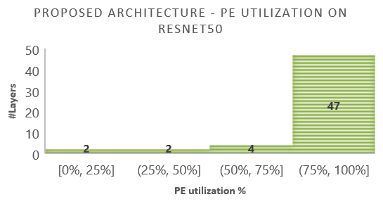
Benefits of Re-architecting
Near memory adder and quantizer
Feature Maps
3 MB
x64
Weights
1.25 MB
PE1
PE2
PE3
PE16
PE1
PE2
PE3
PE16
PE1
PE2
PE3
PE16
PE1
PE2
PE3
PE16
Tiles | 64
#MACs | 8K
Design Frequency | 500 MHz
Average PE utilization | 89%
Theoretical throughput | 8 TOPS
Effective throughput | 7.29 TOPS
Throughput per area | 3.24 TOPS/mm²

Slide 18
3D accelerator architecture exploration
OFIFO | Read to (stride 1) | Stride 2 | To DRAM (stride2 – stride 1)
OFIFO 1 | ISRAM 1, 15, 16 | ISRAM 1, 8, 9, 16 | 8, 9
OFIFO 2 | ISRAM 1, 2, 16 | ISRAM 1, 9 | 9
OFIFO 3 | ISRAM 1, 2, 3 | ISRAM 1, 2, 9, 10 | 9, 10
OFIFO 4 | ISRAM 2, 3, 4 | ISRAM 2, 10 | 10
OFIFO 5 | ISRAM 3, 4, 5 | ISRAM 2, 3, 10, 11 | 2,10, 11
OFIFO 6 | ISRAM 4, 5, 6 | ISRAM 3, 11 | 3, 11
OFIFO 7 | ISRAM 5, 6, 7 | ISRAM 3, 4, 11, 12 | 3, 4, 11, 12
OFIFO 8 | ISRAM 6, 7, 8 | ISRAM 4, 12 | 4, 12
OFIFO 9 | ISRAM 7, 8, 9 | ISRAM 4, 5, 12, 13 | 4, 5, 12, 13
OFIFO 10 | ISRAM 8, 9, 10 | ISRAM 5, 13 | 5, 13
OFIFO 11 | ISRAM 9, 10, 11 | ISRAM 5, 6, 13, 14 | 5, 6 , 13, 14
OFIFO 12 | ISRAM 10, 11, 12 | ISRAM 6, 14 | 6, 14
OFIFO 13 | ISRAM 11, 12, 13 | ISRAM 6, 7, 14, 15 | 6, 7, 14, 15
OFIFO 14 | ISRAM 12, 13, 14 | ISRAM 7, 15 | 7, 15
OFIFO 15 | ISRAM 13, 14, 15 | ISRAM 7, 8, 15, 16 | 7, 8, 16
OFIFO 16 | ISRAM 14, 15, 16 | ISRAM 8, 16 | 8
8K MAC 3D accelerator architecture
Compute tier
PE - 8
PE - 7
PE - 9
PE - 10
Controller
PE - 5
PE - 6
PE - 12
PE - 11
IP NW Config
PE - 13
PE - 14
PE - 4
PE - 3
PE - 15
Weight SRAM
PE - 16
PE - 1
PE - 2
Input SRAM
Weight SRAM
ISRAM
OFIFO
Memory tier
Near-memory accumulator
& Quantizer (NMAQ)
Output FIFO
Hybrid bonds
Only 4 layers in ResNet50 have a stride of 2

Slide 19
Area and 3D connection analysis based on 7nm technology – Per Single PE block
ISRAMs within a PE block
Metrics (per bank) | Values
Bits | 72
Words | 912
Size | 8.015 KB
Unit Memory Area | 4589 um²
Total memories required | 12x2banks
Total Area for 24 banks | 0.11 mm²
Path | #3D Connections per PE group
ISRAM to PE | 72x12 = 864
PE to OSRAM | 32x64 = 2048
Total | 2912
Silicon Area | 112,500 um²
Hybrid bond pitch 9 um | 99x12 = 1,188
Hybrid bond pitch 5 um | 179x24 = 4,296
crossbar
PE - 4
PE - 3
PE - 1
PE - 2
Power/GND connection NOT included
Hybrid logic+memory integration technology required

Slide 20
Memory on Logic Integration
Path | #3D Connections per PE group
ISRAM to PE | 72x12 = 864
PE to OSRAM | 32x64 = 2048
OSRAM to NMAQ | 32x64 = 2048
NMAQ to ISRAM | 9x64 = 576
Total | 5,536
Silicon Area | 112,500 um²
Hybrid bond pitch 9 um | 99x12 = 1,188
Hybrid bond pitch 5 um | 179x24 = 4,296
Hybrid bond pitch 2 um | 449x61 = 27,389
Hybrid bond pitch 1 um | 899x124 = 111,476
crossbar
PE - 4
PE - 3
PE - 1
PE - 2
NMAQ moved to bottom tier

Slide 21
Learnings from the architectural exploration
3D architecture can offer 85% practical throughput improvement (based on ResNet50)
INT8: >50k connections between PEs and memories
Such heavy 3D connections are impossible to achieve using micro-bumps
Higher computation precision and higher compute logic requires more and more 3D interconnects to achieve maximum PE utilization
Finer 3D hybrid-bond pitches are required for better accelerator hardware scaling
Further scaling can be enabled through chipletization

Slide 22
Summary
Design | 2D DELPHI | Proposed 3D Architecture | ∆%
Tiles | 64 | 64
#MACs | 8K | 8K
Design Frequency | 500 MHz | 500 MHz
Average PE utilization | 48% | 89% | 41%
Theoretical throughput | 8 TOPS | 8 TOPS
Effective throughput | 3.93 TOPS | 7.29 TOPS | 85.4%
Throughput per area | 1.75 TOPS/mm² | 3.24 TOPS/mm² | 85.4%

Slide 23
Thanks for listening!

