Slide 1
Unified scaling fabric – CXL based
Nayan Suthar, Brijesh Tripathi - AXG
Debendra Das Sharma, Robert Blankenship, Sridhar Muthrasanallur – DCAI-MIO
Acknowledgements:
Uri Elzur, - AXG
Sudarshan Srinivasan - IL
Notes:
Scaling strategy large scale systems.

Slide 2
Executive Summary
Review of approaches for scaling in Data Center
Evolution of CXL as a scaling fabric beyond a node
On-package fabric and CXL
Convergence opportunities for scaling
Partnerships and ecosystem development with CXL as a scaling fabric

Slide 3
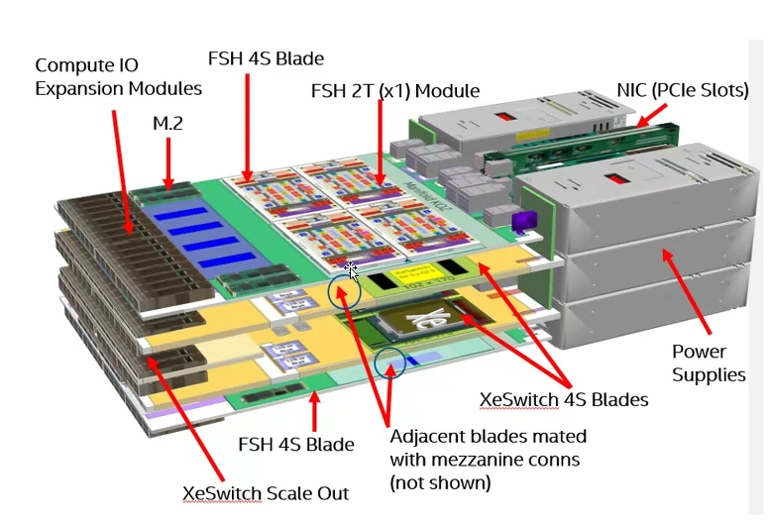
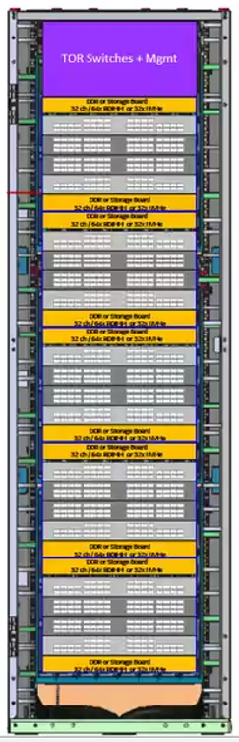

Definition
Node:
A self-contained server chassis. Typically has 4 to 8 sockets (CPUs/GPUs/XPUs), storage, mem, etc.
May run one or more OS instances
Pod:
Collection of tightly coupled nodes (10s to 100s XPUs) with typically an order of magnitude higher bandwidth than exa-scale
Data center scale.

Slide 4
Landscape
Node boundary
On-package Host-to-host Host-to-acc/mem High BW Acc-to-Acc High BW Pod-scale Data Center scale
(upto say 8) (100s of accel)
Coherent Coherent Coherent IO-coherent IO coherent
Scale
Mellanox IB
Mellanox IB
Comp
NVLink
.SMP(?)
NVLink
/PCIe
NVLink
NVLink
Heterogenous
Intel
today
UPI
PCIe/CXL
XeLink/Habana
XeLink/Habana
Gap
Different system design points will need more than one solution
Goal
Focus for this meeting - Unified Scaling Fabric
CXL 1-3 (PCIe for device attach)
CXL 3
CXL 3
UXI
Ultra Ethernet 0.0
SMP (e.g. Xeon) – UXI
Non-SMP (e.g. FSX) - CXL
Any-to-any
CXL for appliances;
Ultra-Ethernet elsewhere
* Ultra-Ethernet is a new industry consortium for evolving Ethernet for HPC and AI
Create a protocol continuum from package to pod
Notes:
Commentary:
This slide depicts the current protocol landscape and its desired evolution at different scales.
The industry is fragmented in the way accelerators are networked within the node and outside.
Nvidia and AMD have NVLink and Infinity fabric. These are used for CPU-CPU, CPU-GPU and GPU-GPU connectivity. They likely are a combination of few different protocols. Nvidia has multiple fabric options for pod-scale. They have announced high radix NVSwitches and they have the IB solutions that scale from pod to exa-scale. Many AI startups are creating their own purpose-built fabrics.
Today we at Intel have a heterogenous mix of protocols and interfaces within the node, and upcoming pod scale. And we have a gap in the exa-scale fabric space.
The goal is to continue evolving CXL as a standard for a unified scaling fabric to cover the in-node and pod-scale fabric. UXI that is a combination of UPI and CXL will address the multi-processor SMP space. So effectively CXL will span from within package to pod-scale. Intel is participating in the Ultra-Ethernet consortium to evolve Ethernet to address the large scale HPC-AI requirements.
Note that in the pod-scale network there are multiple design points and more than one solution will exist. More details in a subsequent slide.
In the next few slides we will cover the motivation and approach being taken to achieve this goal.

Slide 5
UXI and CXL Cache/Memory Architecture
UXI
CXL.Cache
Proprietary
CXL.Mem
(Home Agent, Caching hierarchy, etc)
L1 Req
L2 Req
L3 Req
CXL.Mem/
UXI.Mem
L1 Snp
L2 Snp
L3 BISnp
UXI.Coh
L2 WB
L3 RwD
L1 RSP
L2 Rsp
L3 NDR /DRS
/BI-RSP
CXL.Cache
(CXL View of Coherency/ Memory across all architectures)
UXI works seamlessly with CXL and PCIe, as envisioned with CXL from the beginning
Notes:
UXI enables “Type-2” Accelerator devices that offload global coherence managed for CXL.mem to the host home agent. This was originally required for memory centric arch but could be usable with standard Xeon topologies as well.
CXL is the best answer for devices that want long term compatibility and broad eco-system adoption.
Each layer in a cache hierarchy adds an additional layer of tracking which adds to latency/ storage cost, but enables better scaling and abstracts upper layer for simpler re-use.

Slide 6
Unified scaling fabric
. . .
. . .
. . .
. . .
. . .
. . .
Latency sensitive entities may use direct connect
Today
Goal
Many protocols leads to Execution complexity.
Uniform interfaces and protocols for all data movement. Ease of execution, leverage IP eco-system, single in-node switch type.
Unified network. Dynamic bandwidth sharing for any-to-any. Improved utilization (critical for emerging apps). e.g. potentially 50% higher scale-up BW in one of the configs.
Dedicated interfaces lead to under-utilization and bottlenecks.
e.g. host interface maybe idle during scale-up.
(The package/silicon is shoreline limited to meet increasing memory and comms bandwidths needs of emerging apps.)
Based on CXL 3.0 with incremental changes.
CXL 3.1 (WIP) already comprehends several changes needed.
Efficient for both cacheline access and bulk.
Call to Action - Drive eco-system to innovate cables, connectors, optics, fabric mgmt. Lead/Partner industry in switch development, photonics evolution.

Slide 7
Flexibility for multiple platform design points
Uniform protocol from on-SoC to pod-scale
Preferred for tightly coupled appliances
Some customer or OEM assembled pods may prefer Ultra Ethernet for large scale-out solutions
Allow flexible protocol bridging and tunnelling for allowing multiple platform design points
Call to Action
Invest early in integrated UE NICs, in-node switches
Lead industry in photonics evolution
Notes:
Commentary:
As mentioned before there will be multiple design points in the pod scale deployment.
For tightly couple appliances (e.g. AI training appliances), CXL will be preferred as it provides a continuum for efficient fine-grained transactions.
For larger scale-pods or loosely coupled pods assembled by some OEMs or customers, they may prefer one network over the other due to rack level considerations.
It’s important to retain flexibility to serve different deployments. e.g. ability to tunnel CXL unordered traffic over Ultra-Ethernet, or tunneling ultra-Ethernet traffic over CXL.

Slide 9
Backup

Slide 10


CXL™ 1.0/CXL 1.1 Usage Models
Type 1 Device
Caching Devices/Accelerators
Type 2 Device
Accelerators with Memory
Type 3 Device
Memory Buffers
Usages:
  PGAS NIC
  NIC atomics
Protocols:
  CXL.io
  CXL.cache
Usages:
  GPU
  FPGA
  Dense
  Computation
Protocols:
  CXL.io
  CXL.cache
  CXL.memory
Usages:
  Memory BW expansion
  Memory capacity expansion
  2LM
Protocols:
  CXL.io
  CXL.mem
Accelerator
NIC
Accelerator
Memory
Buffer
Cache
Cache
Memory
Memory
Memory
CXL Link
CXL Link
CXL Link
DDR
DDR
DDR
CPU
CPU
CPU

Slide 11

CXL™ 2.0: Resource Pooling at Rack Level, Persistent Memory Support and Enhanced Security
Resource pooling/disaggregation
  Managed hot-plug flows to move resources
  Type-1/Type-2 device assigned to one host
  Type-3 device (memory) pooling at rack level
  Direct load-store, low-latency access – similar to memory attached in a neighboring CPU socket
  (vs. RDMA over network)
Persistence flows for persistent memory
Fabric Manager/API for managing resources
Security: authentication, encryption
Beyond node to rack-level connectivity!
Enterprise Server
DDR
CPU
PCIe 5.0/CXL
Enterprise Server
DDR
CPU
DDR (Mem)
CXL
Switch
PCIe 5.0/CXL
Enterprise Server
Enterprise Server
DDR
CPU
Pooled
Memory
DDR (Mem)
PCIe 5.0/CXL
Enterprise Server
Disaggregated system with CXL optimizes resource utilization delivering lower TCO and power efficiency

Slide 12
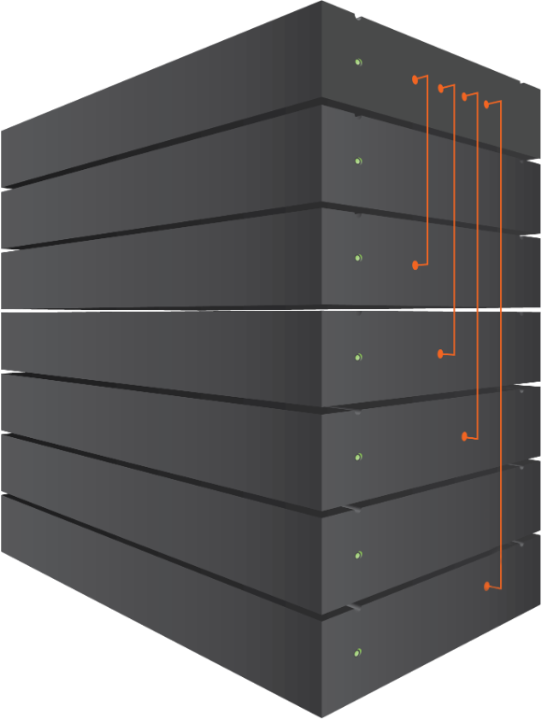

CXL™ 3.0 Enhancements
Bandwidth doubling with 64 GT/s at 0-latency add
Protocol enhancements with direct peer-to-peer to HDM memory
Composable systems with spine/leaf architecture at rack/pod
Spine
CXL 3.0 Fabric Architecture
Interconnected spine
switch system
Leaf switch NIC enclosure
Leaf switch CPU enclosure
Leaf switch accelerator enclosure
Leaf switch memory enclosure
CXL Switch
CXL Switch
CXL Switch
Spine Switches
Fabric Manager
Leaf Switches
Leaf
CXL Switch
CXL Switch
CXL Switch
Accelerator
Memory
CPUs
…
CPUs
Memory
GFAM
Memory
NIC
…
NIC
End Devices
Example Traffic Flow

Slide 13
UXI and CXL Cache/Memory Architecture
UXI is the “Bare Metal” protocol we use inside our CPUs
  Tuned for total scale: # of caches, Cache size, Memory bandwidth, latency.
  Limited compatibility
  Incorporates CXL.mem (Formally defined bridging, Routing and Link Layer).
CXL adds coherence to devices.
  Simple coherence model hides host complexity from devices
  Enables Flexible/Large memory expansion
  Extends PCIe device model for Fabric level Load/Store (IO coherent)
  Backward compatibility REQUIRED
Notes:
UXI enables “Type-2” Accelerator devices that offload global coherence managed for CXL.mem to the host home agent. This was originally required for memory centric arch but could be usable with standard Xeon topologies as well.
CXL is the best answer for devices that want long term compatibility and broad eco-system adoption.
Each layer in a cache hierarchy adds an additional layer of tracking which adds to latency/ storage cost, but enables better scaling and abstracts upper layer for simpler re-use.

Slide 14
Flexibility for multiple platform design points
Some customer or OEM assembled pods may prefer Ultra Ethernet for large scale-out solutions
Critical to have flexible protocol bridging and tunnelling in both CXL and Ultra-Ethernet for allowing multiple platform design points
Call to Action
Invest early in integrated UE NICs, in-node switches
Lead industry in photonics evolution

Slide 15
Fabric requirements
and CXL advances
Requirement | CXL feature - timeframe
Extend beyond single coherency domain | CXL Fabric – CXL3.0 Global attached discrete memory (GAM) access – CXL 3.0 Global host/device Integrated memory (GIM) access – CXL 3.1 (proposed)
Efficient unordered accesses. Flexible topologies for unordered, IO-coherent traffic | Unordered IO – CXL3.0 Any-to-any, flexible topologies – CXL 3.1 (proposed)
Extensibility: Tunnel other protocols (e.g. RDMA) Device specific operations (e.g. in-network-compute) | Initiator assigned routing ID, device specific TLP headers on UIO – CXL 3.1 (proposed)
Extensibility: Vendor defined atomics | Vendor defined atomics - CXL3.1 (proposed)
Scaling CXL beyond the node into the pod needs analysis of scaling issues (beyond protocol – software, multi-pathing, congestion management, etc.) and eco-system enablement for cables/connectors/etc.

Slide 16
Emerging Applications
HPC and AI are merging.
AI is driving memory and bandwidth requirements.
HPC is where programming models may evolve. (Tight CPU-GPU coupling, PGAS, …)
Observations
Models are growing at a dramatic pace. HBM capacity is not enough. High bandwidth (>>100GB/s) DRR is becoming essential ¹.
Peaks of memory access, scale-up and scale-out usually do not overlap.
Dedicated interfaces for memory, scale-up, scale-out, host connectivity no longer tenable due to perimeter limits.
Proposal
Use uniform interfaces and semantics for all types of data movement, and allow dynamic use of available perimeter
High bandwidth accesses need not be encumbered by coherency or ordering
Communication bandwidth requirements continue to grow. Ultra high (>> 100 GB/s per GPU) communication bandwidth is now required at pod-scale (100s of GPUs) ².
Provision unordered IO-coherent bandwidth over large scale
Different system design points (cost/perf tradeoffs) lead to contradicting memory and communication requirements for even the same application ³.
Key Takeaway
Bandwidth requirements are growing – memory, scale-up and scale-out
Different applications, design points and different phases of app have different distribution
Perimeter not enough for dedicated interfaces
1 - GPT3-175B Prompt, DLRM27TB, GNN-626M show benefits with > 250 GB/s mem bandwidth. DLRM on small machines may require TB capacity.
2 – GPT3-175B NLP pre-training benefits from upto 400GB/s scale-out bandwidth per GPU
3 – On smaller systems memory bandwidth is the bottleneck, on larger systems communication becomes the bottleneck for GPT3 and DLRM
(Chat-GPT uses GPT3)

Slide 17
Variety of node configurations are emerging
Key Takeaway
Fast evolving domain and algorithms, multiple node design points will exist
Flexibility in bandwidth allocations, topologies and protocol extensions is critical
Collect – collectives acceleration
Opt – Optimizer. Data type conversion
These are AI centric compute operations.

Slide 18
Protocol bridging
Though CXL would be our protocol of choice for appliances, some customers may choose Ultra-Ethernet to build their own pods.
Native CXL UIO transactions can be tunneled over Ultra-Ethernet as data grams
Ultra-Ethernet flows can be tunneled over CXL.
CXL3.1 has features (proposed) like vendor defined TLP prefix on UIO and source routing to enable such tunneling.
Flexibility for different platform configurations
* Ultra-Ethernet is a new industry consortium for evolving Ethernet for HPC and AI

