Slide 1

The Vmin Right Hand Turn
TSLRP 2023
Co-Leads:
Dave Bradley & Alexandra Kern
Sr PEs – DEG, XEG Data Center Technology
Fellow/Business Sponsors:
Eric Fetzer – DEG Technology Alignment Fellow
Ryan Tabrah - DCAI, GM of E-Core Products
Team: Latha Rao (PM), Davianne Duarte , Surhud Khare , Ram Krishnamurthy, Julien Sebot, Tiff Shih, Sukru Yemenicioglu
Notes:
TRANSITION WORDS
Slide Transition: Our main argument/problem statement…
Motivational Story
Earlier this year, Alex and I were running early performance simulations for Rogue River Forest, evaluating different technology options with a relatively crude early performance calculator.
We found some anomalies that suggested certain SKUs were Vmin limited even when running Integer dominated code.
Since then, the models have improved, and the Rogue river Forrest situation has improved.
However, the experience was impactful enough to make us realize that the floor was near, and so the experience inspired us to bring this TSLRP topic this year
Transition: Our main problem statement can be boiled down to 4 main points

Slide 2




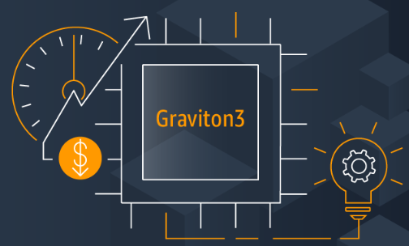


Next “right-hand turn” imminent for perf/W
Data Center Goals: 1.3x/18mo
Perf/W and perf/TCO drive data center
Voltage scaling has fueled Perf/W scaling
We are approaching a Vmin Wall
Our competition is responding
TCO = Total Cost of Ownership
Notes:
TRANSITION WORDS
1. First, …
2. Second, …
3. Third, …
4. And 4th,…
SLIDE CHANGE: Finally, 5th, or “the good news”
Our main problem statement can be boiled down to 5 main points
First, Data center revenue is driven by delivering best-in-class Perf/W and Perf/TCO
Second, about half of our perf/W gains per generation come from the process, and half comes from our ability to scale voltage down to make power room to augment our core count
Third, we are approaching a CMOS voltage floor that will stymie this strategy
Fourth, many of our competitors are in a better position to compete in this perf/watt space at Vmin, especially in segments where customers care less about single-threaded performance minimums.
Finally, through a behavioral right-hand turn in multiple areas we as an IDM control, we can turn our projected weakness into a strength – re-establishing leadership in throughput computing for the next decade, and for the next 25 minutes we will outline our vision of how to do that.

Slide 3
Next “right-hand turn” imminent for perf/W
Data Center Goals: 1.3x/18mo
Intel as an IDM is uniquely positioned to LEAD – with a cultural/behavioral “right-hand turn” to prioritize perf/W
Notes:
SLIDE CHANGE: Let’s talk about what is changing
Through a behavioral right-hand turn in multiple areas we as an IDM control, we can turn our projected weakness into a strength – re-establishing leadership in throughput computing for the next decade, and for the next 25 minutes we will outline our vision of how to do that.

Slide 4

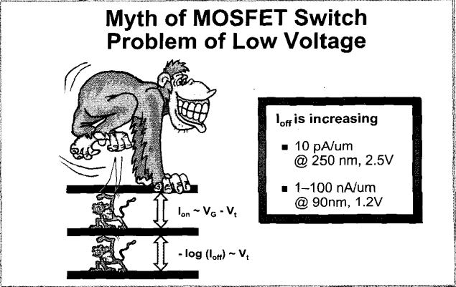

The Vmin floor isn’t new, our proximity to it is
Dennis Buss (VP Texas Instruments)
“When MOSFET Switches Become MOSFET Dimmers”
ISSCC 2002
>20 years away
“No big deal”
<7 years away
“Need a plan NOW”
Notes:
TRANSITION WORDS:
1. A presentation by “Dennis Buss” titled “When MOSFET Switches become MOSFET Dimmers”
2. If this problem has been around for over 20 years, what has changed?
SLIDE CHANGE: We need a plan
Lets dig in a bit to that Vmin floor
Attended first ISSCC in 2002, and one thing I remember from that conference was a special topic delivered by Dennis Buss from Texas Instruments titled "When MOSFET Switches Become MOSFET Dimmers"
In that talk, Dennis presented the graphic shown on the left
Depicting a donkey-kong like gorrilla trying to compress voltage, but that voltage was held up by two "difficult to compress" forces
Looking back, Dennis was about 98% right in his observations. So if this problem has known for 20 years, what has changed.
Well, simply put, whats changing is how close we are to hitting it. 20 years ago, we were much more focused on aggressively pursuing Dennard scaling and reaping the exponential rewards of Moore's law. Now we are much closer to hitting the floor, and we need a plan.
Transition:

Slide 5
What is Vmin?
Technology Node Sense
Product Sense
Minimum voltage required to keep fundamental circuits robust
with good yield.
Minimum productizable voltage for my specific product.
Asymptotic Product Sense
For data center applications
Tester Vmin @ 100C ≈ 400-450mV*
*Vmin here is quoted at 100C. Does not include additional system-level voltage guardbanding. Temperature compensation automatically increases the voltage for lower temperatures
Notes:
TRANSITION WORDS:
1. If you ask a technologist from TD…
2. If you ask a product guy…
3. For this presentation
SLIDE CHANGE: Consequences of hitting Vmin

Slide 6

What comprises Vmin?
System Vmin
CPU Voltage
Guardband
BIGGER**
Tester Vmin
Overdrive
Controls Frequency
SMALLER
Threshold Voltage Variation
BIGGER*
Threshold Voltage (Vt)
Controls Leakage @100C
BIGGER
* Ignoring one-time competitive “fix” vs. TSMC in 1276/1278
** Steeper F vs. V at low V has historically caused guardband increases
Notes:
TRANSITION WORDS:
1. Starting at the bottom…
2. Next, we have voltage variation..
3. Next, we have overdrive…
4. Finally, we add…
5. Now, as we scale into subsequent technology nodes
SLIDE CHANGE: Lets look at the consequences of hitting Vmin

Slide 7

Consequences At Vmin
BASELINE + 2YR
Common Core
1.15x Perf/W
VMIN FLOOR
BASELINE
1.36x Perf/W
Per-Thread
Performance
ThroughputPerformance
1.15x Perf/W
1.27x Perf/W
Vmin floor cuts our Perf/W gains in half…
… and puts significant pressure on common core strategy.
Notes:
TRANSITION WORDS:
1. Losing horizontal scaling cuts our Perf/W gains in half, but there is a greater consequence
SLIDE CHANGE: After I introduce you…

Slide 8
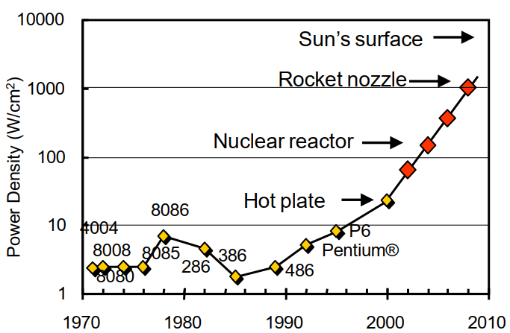
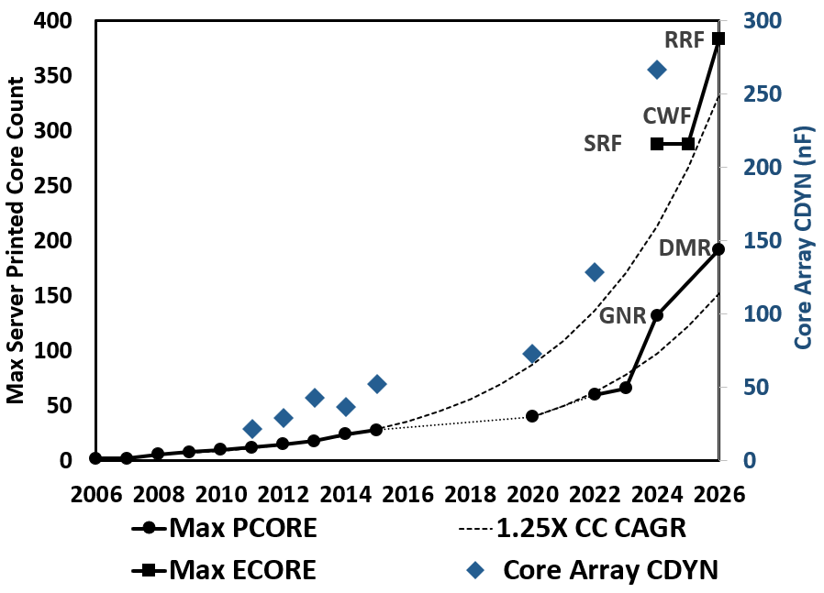
Our post-RHT strategy breaks at Vmin floor
SPR→GNR:
2X CDYN
HSX→SPR:
3X CDYN
SIR VCC: 1V→0.67V
Gelsinger, 2001
The “Right-Hand Turn” recognized a limit to frequency and power-density scaling…
…and launched new strategy for core count, IPC, & voltage scaling Intel has followed for 2 decades.
This formula breaks at the Vmin floor – a new approach is needed!
Notes:
This matters to Intel for three key reasons.
[CLICK]
First, our post-RHT strategy breaks at the Vmin floor.
Two decades ago, Pat led Intel on the first “Right Hand Turn”.
Recognizing a limit to frequency and power-density scaling, this “Right-Hand Turn” launched a new core count scaling strategy.
[CLICK]
Since then, data center has followed this new formula to deliver perf/W:
Increasing core count and instructions per cycle (or IPC) a rate exceeding process CDYN scaling
Reducing voltage to achieve perf/W targets.
Between HSW and SPR we increased the total CDYN of the core array by 3X and reduced voltage from 1V to 0.67V
This trend continued with another 2X increase in CDYN from SPR to GNR.
[CLICK]
This formula will break when we hit the VMIN floor, and we lose a critical tool for delivering perf/W scaling.

Slide 9
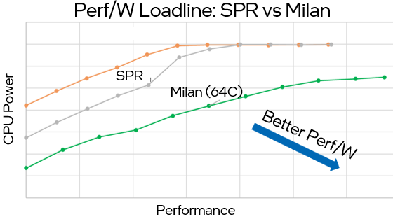
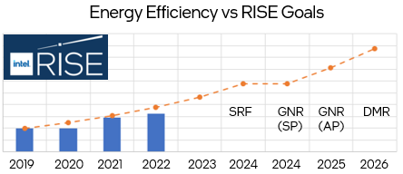
Power efficiency is the new performance
“Global datacenter power is capped, and capacity is constrained. SPR power will cause Azure to have less cores/rack; increase TCO$/year; at high risk that SPR volumes will be significantly cut”
- Microsoft
Intel corporate RISE goals require 10X power efficiency improvement by 2030
==
1.3-1.4X perf/W/generation from 2019
Power efficiency critical for customer TCO (Intel MSS)…
…and Intel’s sustainability goals
Notes:
Second, it matters because power efficiency is critical for Intel’s future success.
Customers are increasingly escalating when Intel’s perf/W lags competition.
In the example at left, where the graph shows Milan matching SPR performance at much lower power, Microsoft highlighted lower cores/rack and higher TCO versus AMD as a factor putting their purchase of SPR at risk.
And in addition to the business imperative to lead on perf/W, our corporate RISE goals require us to achieve 10X energy efficiency improvement by 2030.

Slide 10
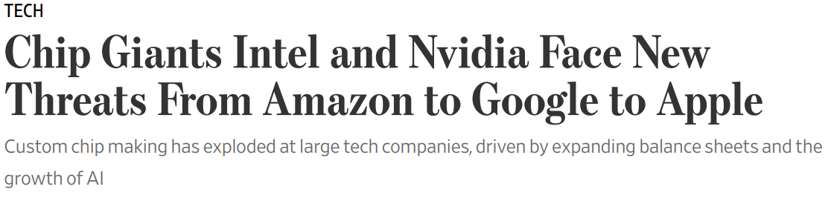
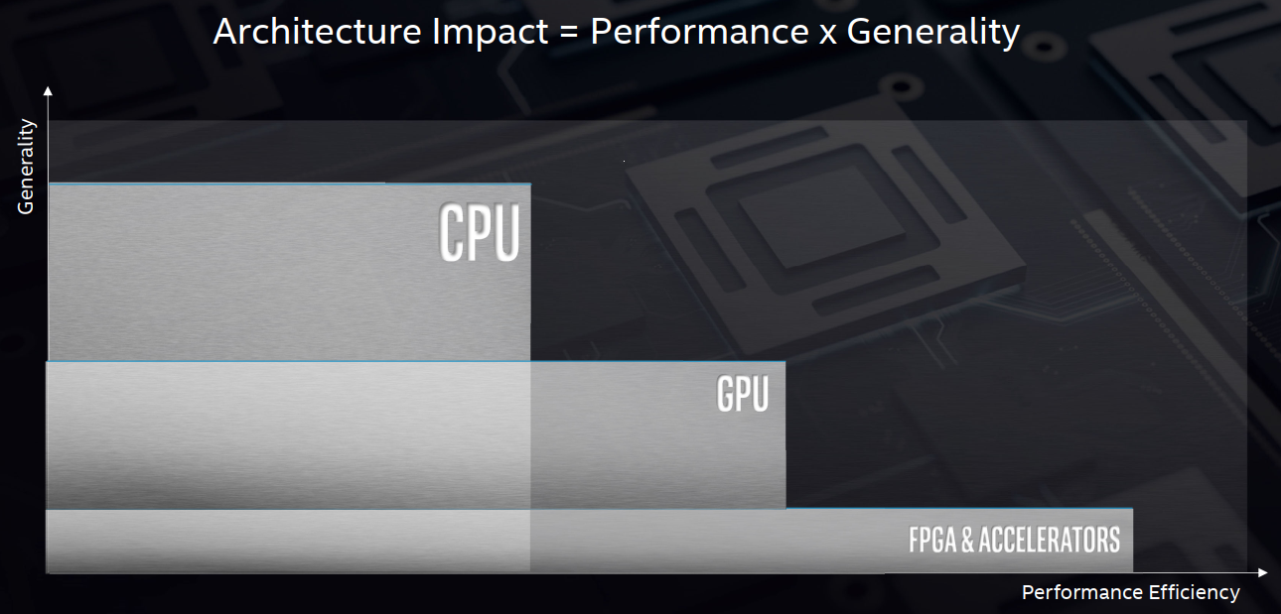
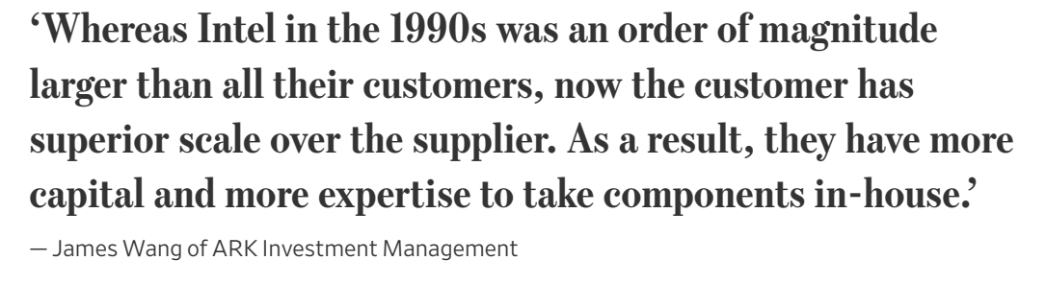
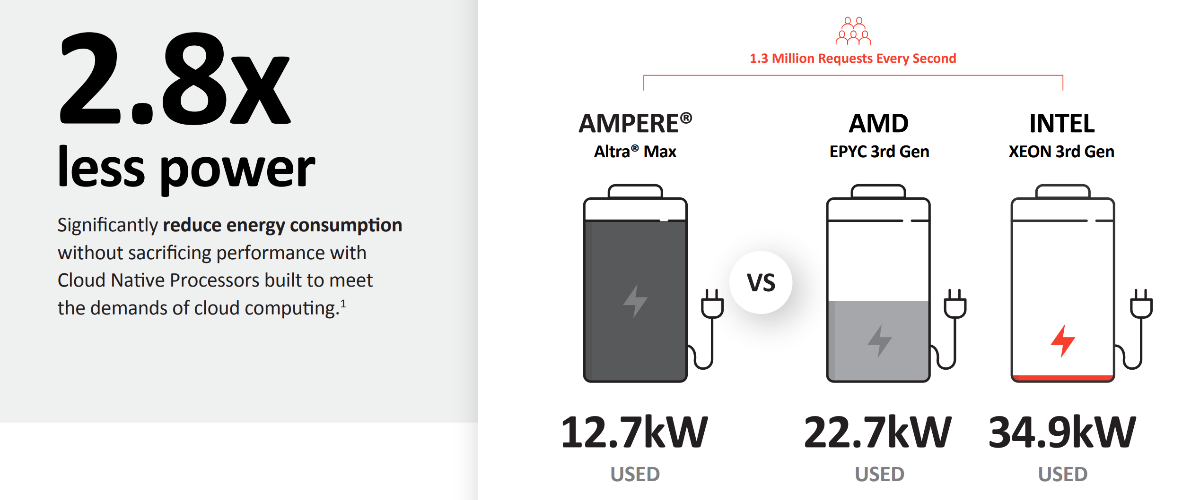

One size fits all (n)one:
Si leadership + one-size-fits-all CPU: No longer enough to win
Specialization = efficient performance¹
Customers/competition specializing²
Specialization could be architecture (illustrated) or other vectors including physical design and process.
¹ Source: Raja Koduri, Intel Architecture Day 2020; 2. Source: Wall Street Journal, December 2020 & Ampere
Notes:
Third and finally, it matters because competition to deliver power efficiency is intense.
Si leadership plus a “one-size-fits all” CPU is no longer enough to win.
When specialization – either in architecture or in physical design or process - provides a path to more power efficient performance -
one-size-fits-all becomes one-size-fits none.
Our competition is acting:
Hyper scalars are investing in proprietary custom Si design for their data centers.
Competition is differentiating for power efficiency and aggressively marketing their power efficiency advantages over Intel.
To highlight just one example, Ampere AltraMax claims 2.8x power-efficiency benefit versus 3rd Gen Xeon.
So – to summarize – it matters because:
We’re losing a key tool to continue scaling perf/W..
…at a time when power efficiency is critical…
..and competition to deliver it is fierce.

Slide 11
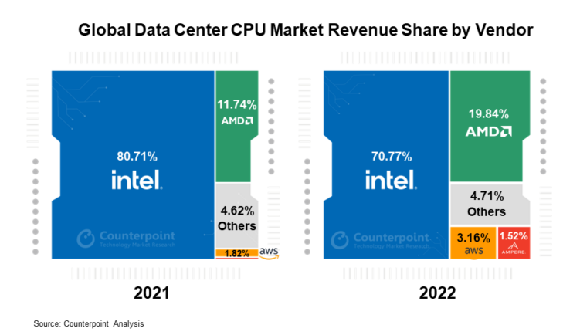
E-Core Must Differentiate on Perf/W
E-Core is Intel’s perf/W answer to ARM threat
To win in data center, need E-Core optimized without constraint for perf/W at low-voltage
DCAI “bets” to deliver perf/W leadership
  Embrace P-Core/E-Core differentiation
  ISA convergence is not free - consider limiting convergence or investing to “right size”
AMD/ARM growth tied to superior perf/W & density
(*10% MSS in 2025; up to 50% in 2030)
Notes:
We’ve already taken a critical first step - with the introduction of the Forest line of E-Core based server products.
E-core is our perf/W answer to the ARM threat.
But our ARM competition continues to optimize for perf/W and thread density.
AMD/ARM growth in recent years (and in future projections) is tied to their leadership on these metrics.
To win in data center, we need an E-Core optimized without constraint for perf/W and thread density near VMIN.
This means fully embracing P-Core/E-Core differentiation, optimizing E-Core for perf/W and density and serving our perf/C focused customers with P-Core.
We must also be mindful that ISA convergence is not free; it comes with CDYN taxes that can make us less competitive on perf/W for general purpose compute.
We need to make a considered and conscious “bet” on what perf/W cost customers will be willing to pay for the flexibility offered by ISA convergence between PCORE and ECORE.
We can consider limiting convergence or investing in uArch strategies to “right size” implementation.

Slide 12
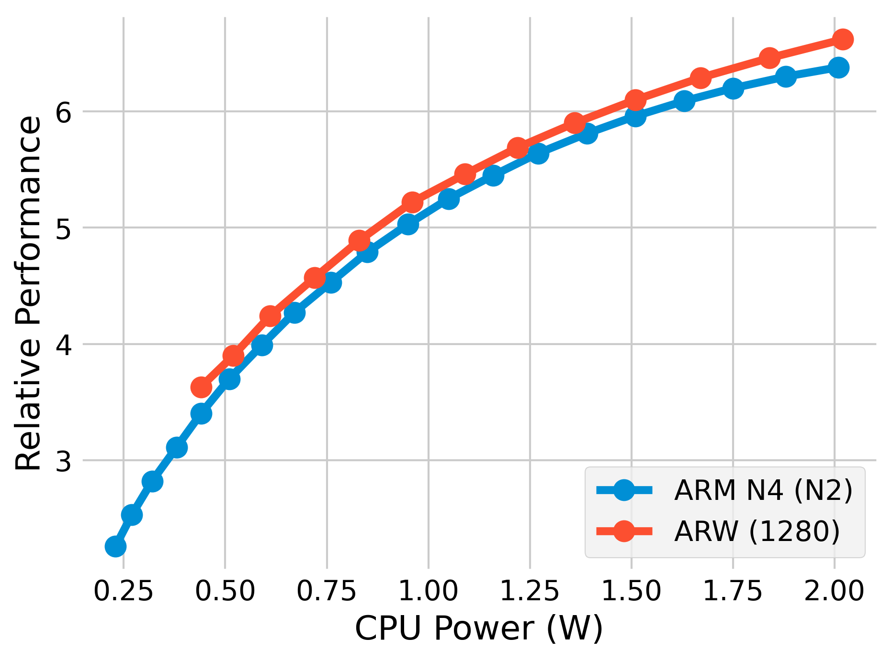
2027 E-Core competitive…with exposure
ARW & ARM N4 competitive
between 0.5-2W/core
525mV
ARW near Vmin <0.5W
N4 scale-out advantage
N4 further from Vmin
600mV
Source: CPU IP Model_WW12’23 – Native Process Vccgate PnP – Aurora Universal View: 30 Compute Behaviors (3627 workloads) N4 = ARM Neoverse 4 N-Series, ARW=Artic Wolf E-Core
Notes:
This slide shows core performance versus power for:
Intel’s 2027 E-core (Artic Wolf on 1280)
versus our ARM competition (Neoverse 4 N-Series on N2).
ARW is competitive with N4 on perf/W between 0.5 a Watt and 2 Watts per core.
But ARW bottoms-out just below 0.5W/core at 525mV and N4 scales down to quarter watt/core at 0.6V, achieving lower power/core at higher voltage.
This means N-Series will be able to scale-out to higher core count at a given socket power without hitting the VMIN floor.
The Rogue River Forest 384C/350W TCO SKU is already operating near the bottom of the ARW range at <0.5W per core. E-core inability to scale down per-core power is a competitive exposure for thread density and TCO sensitive applications, especially if ARM N-Series and E-core continue to diverge in future generations.

Slide 13

Quantify opportunities for perf/W at Vmin
Recognizing our strategic intent to deliver leadership products that enable the most energy-efficient data centers in the world…
…we have selected three opportunities to differentiate data center for perf/W…
..and quantified their timelines and potential contribution to continued perf/W scaling beyond the impending Vmin floor.
Image: Clearwater Forest EC
Notes:
Now that we’ve reviewed what’s changing and why it matters, let’s talk about the solutions proposed in this TSLRP.
If we recognize our strategic intent to deliver leadership products enabling the world’s most efficient data centers
we must act to define a path to continued perf/W scaling beyond the impending VMIN floor.
We have selected three opportunities for differentiating the data center core for perf/W at low-voltage.
And we have quantified the timeline and scale of their contributions to extending perf/W scaling.
<<Transition to Dave here>>

Slide 14
Three Pillars of Perf/W Differentiation near Vmin
(in CMOS era)
Low-V Optimized
Process
Capacitance Optimized
E-Core Hardening
Microarchitectural
Perf/W Focus
NOT mutually exclusive; phased in over time…
Beyond CMOS: Disruptive enabler for higher Perf/Watt (i.e. SEEDC)
(Outside scope of this TSLRP)
SEEDC = Super Energy-Efficient Devices and Circuits (2021 TSD )
Notes:
TRANSITION WORDS:
First pillar is process differentiation
These three pillars are not mutually exclusive
Beyond CMOS…
NEXT SLIDE: Lets look at each of these three pillars in a bit more detail
To tackle the performance challenge at Vmin, we’ve identified 3 distinct actionable pillars which can extend our perf/W scaling near Vmin
The first pillar is process differentiation. By sacrificing high-end voltage, we can create a process variant that better optimizes transistor performance at low volage.
Next is physical differentiation. By targeting a low-voltage optimized physical hardening of RTL, we can get improved perf/W over our current one-size-fits-all approach.
The third pillar focuses on microarchitectural work. By adding Vmin focused and power efficiency focused features to the design, we can further extend our perf/W scaling.
These three pillars are not mutually exclusive – instead we expect that these can be phased in over time to extend our scaling.
However, there will come a point where these three pillars run out of gas, and when that happens we need a disruptive change.
Beyond CMOS devices have the promise to break-through our CMOS Vmin problems with promises of productizible devices running near 200mV supply voltage without the leakage problems of current CMOS. These are outside the scope of this TSLRP effort, but they do form an important bookend for the TSLRP work.
Now lets look at each of these three pillars in a bit more detail

Slide 15
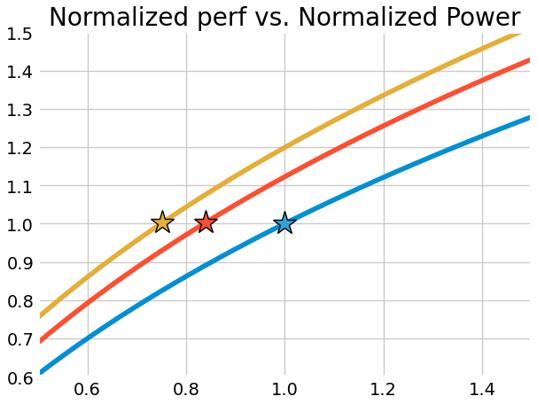
Low Voltage Optimized Process
MAIN IDEA
  Low-voltage specific transistor tuning
BENEFIT
  About ½ process node benefit at low voltage
MAIN CHALLENGES
  Lower Voltage Ceiling
  Reduced high voltage performance
Node N+1, , LV Optimized Process
Thinner Gate Oxides
DIBL Optimization
Node N+1, Traditional
Performance
Node N
550mV
1.19x Perf/W (528mV)
1.33x Perf/W (522mV)
Power
NEXT STEPS
  Disaggregation strategy for enablement
  Product-level post-silicon experiments on 1276.
Analog
High Perf/Thread Products
DIBL = Drain Induced Barrier Lowering
Traditional Assumptions: 1.11x Iso-Voltage Freq every 18mo. 0.91x Cdyn every 18 months. 0.90x Iso-Voltage Leakage Power every 18 months
LV Process Assumptions: 1.15x Iso-Voltage Freq every 18mo. 0.88x Cdyn every 18 months. 0.70x Iso-Voltage Leakage Power every 18 months
Notes:
TRANSITION WORDS:
The benefit
However, this isn’t “for free”/MAIN CHALLENGES
We still need to invest
NEXT SLIDE: Now lets look at the capacitance optimized e-core

Slide 16
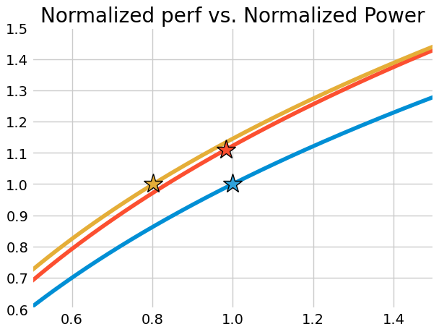
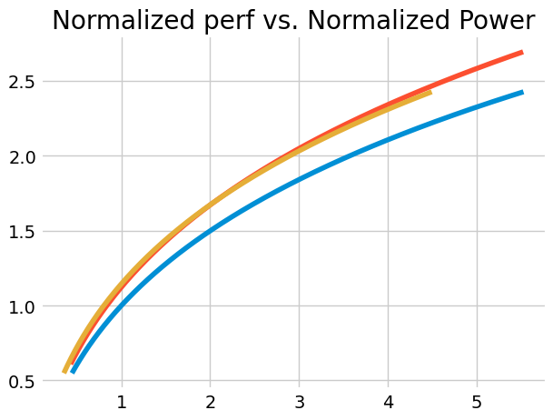
Capacitance Optimized E-core
MAIN IDEA
  Retarget construction tools for alternate optimization
  Use smaller height standard cell library
BENEFIT
  Great Perf/W without scaling voltage!!
  (Vmin immune)
CHALLENGES
  Different physical hardening (resources)
  High-voltage performance
Reduced Iso-Voltage Frequency Target
Aggressive Capacitance Reduction Target
Node N+1, Cap Optimized
Node N+1, Traditional
Node N
550mV
550mV
Performance
528mV
550mV
PERF CEILING
Power
Traditional Assumptions: 1.11x Iso-Voltage Freq every 18mo. 0.91x Cdyn every 18 months. 0.90x Iso-Voltage Leakage Power every 18 months
Cap-Optimized Assumptions: 1.00x Iso-Voltage Freq every 18mo. 0.82x Cdyn every 18 months. 0.75x Iso-Voltage Leakage Power every 18 months
Notes:
TRANSITION WORDS:
By using the smaller standard cell ht library, we’re able to produce
But again, this isn’t for free/CHALLENGES
NEXT SLIDE: Finally lets look at some microarchitectural improvement

Slide 17

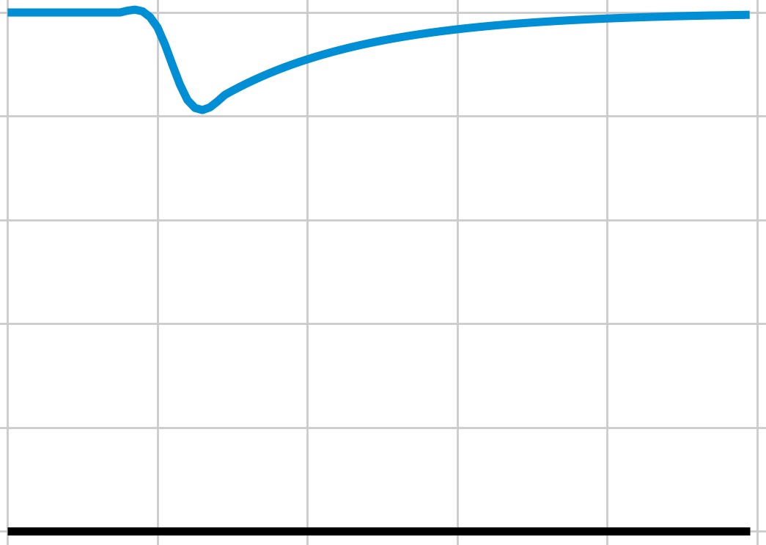

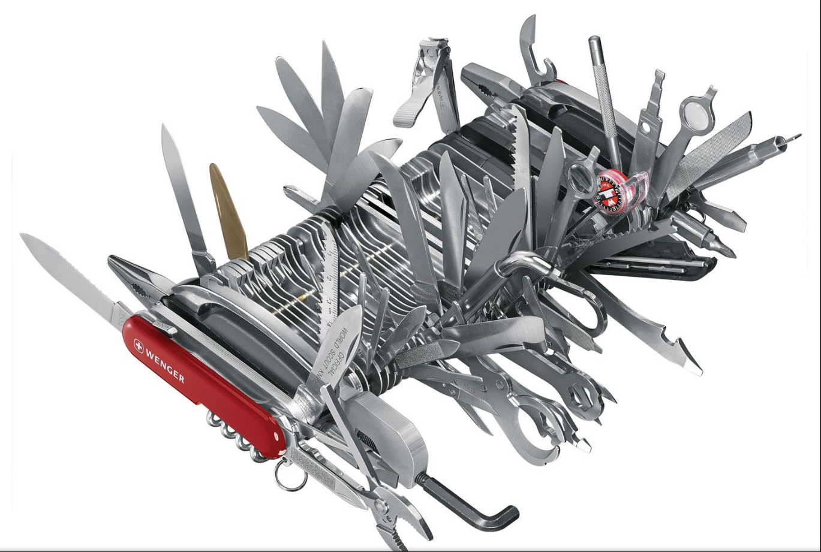





Microarchitectural Improvements
Synergistic
Move Higher Vmin Circuits
Better Clock Gating
Reduce Transient Power-Supply Droop Impacts
Aging Monitors
…
enable
Low-Voltage Specific
Removing/Disaggregating Register Files
“Measured” IPC Growth
“Right-Sized” Accelerators vs. ISA Bloat
vs.
E-Core
IPC = Instructions Per Cycle
Notes:
TRANSITION WORDS:
First we have a set of synergistic microarchitectural features
Low-voltage specific
NEXT SLIDE: With some combination of these three pillars of differentiation, we believe we can stave off the worst of the upcoming Vmin floor

Slide 18
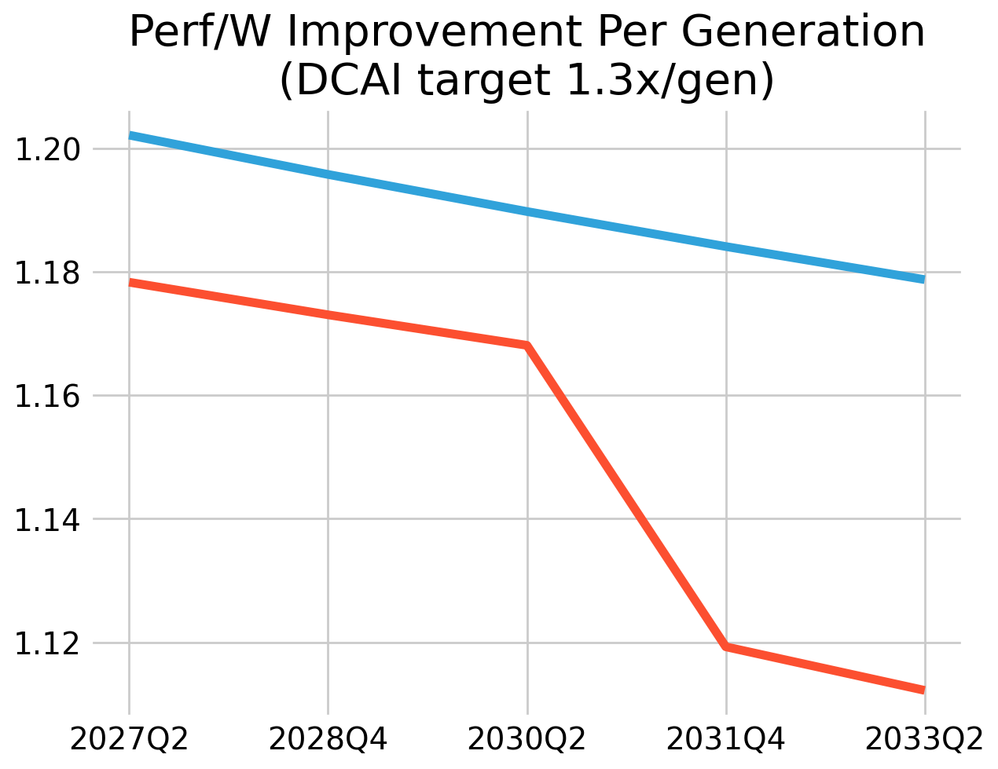
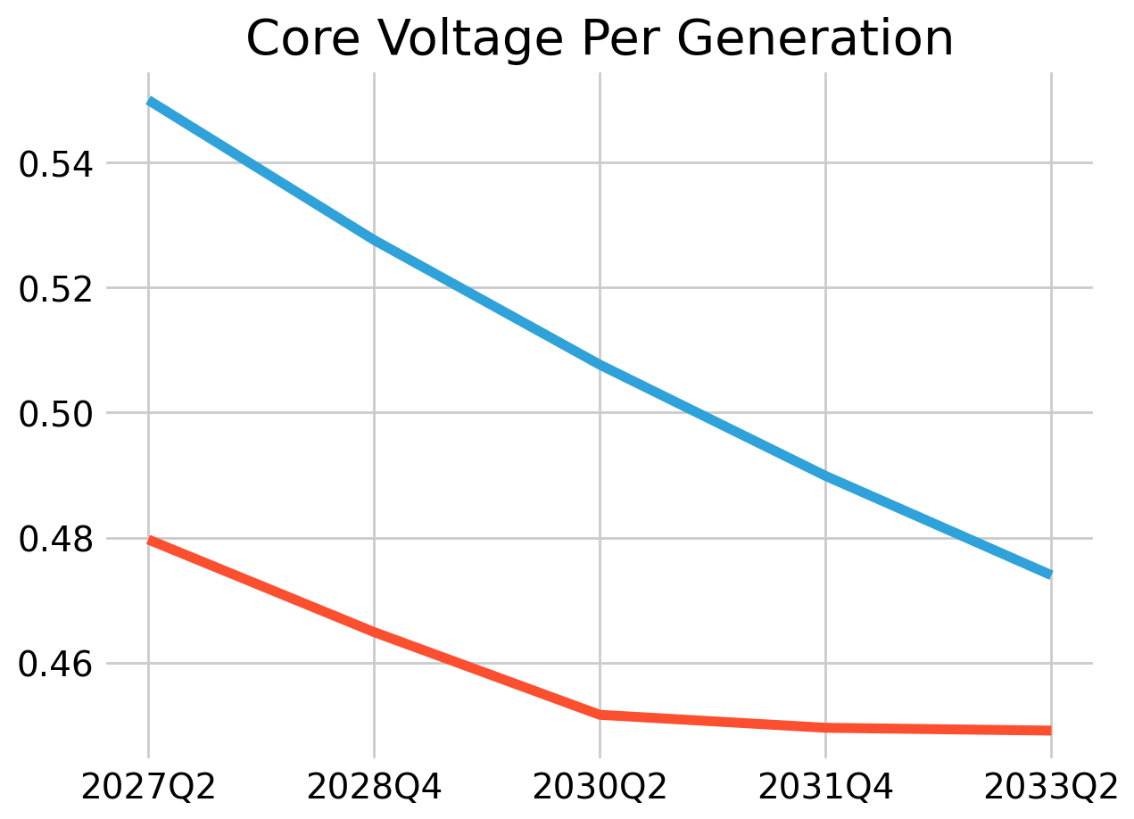
Current “Do Nothing” Scenario Bleak
LIGHTER WORKLOAD
HEAVIER WORKLOAD
LIGHTER WORKLOAD
HEAVIER WORKLOAD
MODELED VMIN FLOOR
Fine Print Assumptions: 1.11x Iso-Voltage Freq every 18mo. 0.91x Cdyn every 18 months. 0.90x Iso-Voltage Leakage Power every 18 months. Lighter/Heavier workloads are 1x/2x SpecInt Avg. Cdyn
Notes:
Now that Dave has explained the process, physical hardening, and architectural opportunities to optimize E-core for perf/W at low-V, I’ll show how they can extend our ability to deliver generational perf/W in the data center.
Our projections – illustrated in these charts – show a bleak future if we choose not to act.
The left chart shows generational perf/W scaling – starting with RRF - for a core with 1X gen to gen performance. The right chart shows the associated core voltage.
You can also interpret the perf/W scaling as the amount of course count scaling we can fit in the same power budget.
We are already challenged to meet our generational perf/W scaling target for Rogue River Forest and heavier workloads are already near the VMIN floor.
If we do nothing, these heavier workloads will reach the VMIN floor within 2 more generations.
Furthermore, given the steeper slope of the VF curve near VMIN and the requirement not to invert per core performance, the “do-nothing” approach will be increasingly challenged on generational perf/W until finally hitting VMIN.

Slide 19
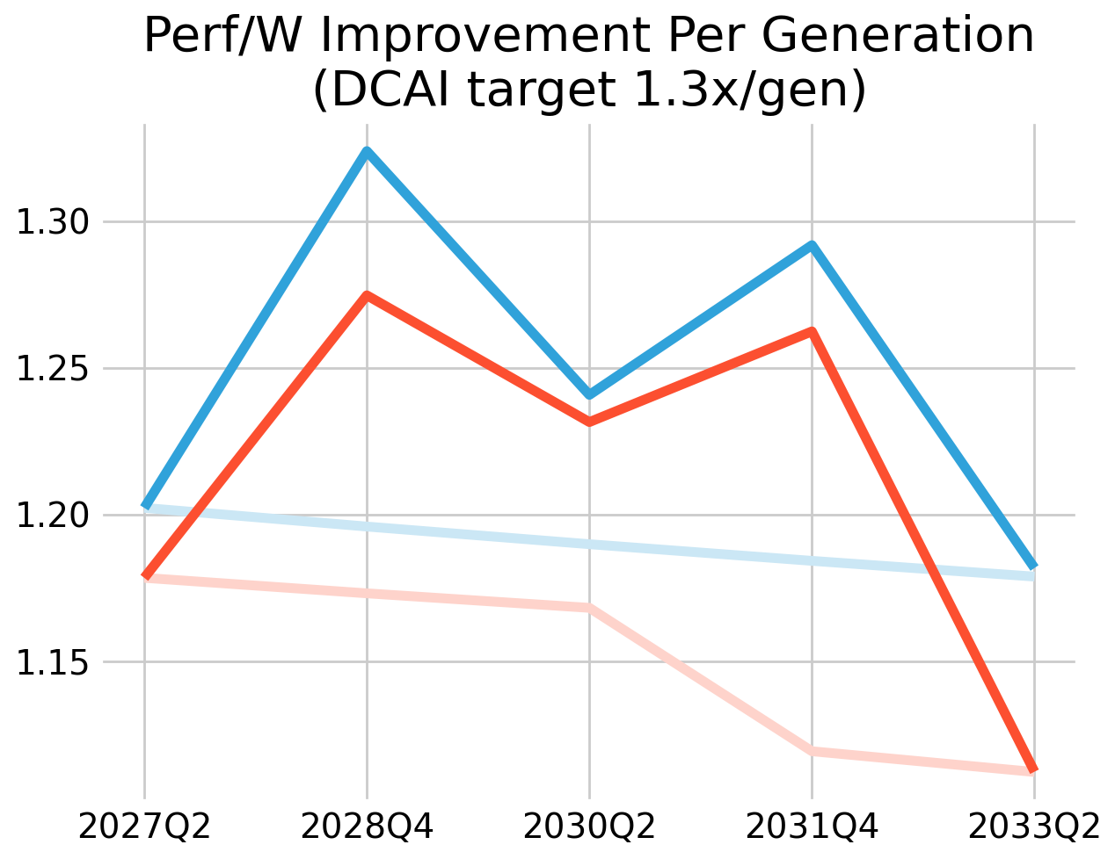
Actioned Scenario is Much Improved
PERF/W TARGET
Low-V Process
Q4’28:
Capacitance-Optimized E-core
Q2’30:
Synergistic uArch Investment
Q4’31:
LIGHTER /HEAVIER WORKLOAD
MODELED VMIN FLOOR
Fine Print Assumptions: 1.11x Iso-Voltage Freq every 18mo. 0.91x Cdyn every 18 months. 0.90x Iso-Voltage Leakage Power every 18 months. Lighter/Heavier workloads are 1x/2x SpecInt Avg. Cdyn
IMPROVEMENT ASSUMPTIONS: LV Process: +4% Freq, -3% Cap, -20% Leakage. Cap-Optimized E-core: -10% Freq, -8% Cap, -25% Leakage. Synergistic uArch Investment: -10mV droop/GB, -10% Cdyn
Notes:
Fortunately, investing in a capacitance-optimized E-Core with low-V process and synergistic uArch features in the three generations after RRF dramatically improves the picture.
With these investments, we believe we can achieve 1.25-1.3X perf/W scaling in each of those three generations while delaying the VMIN floor to ~2033.

Slide 20
TSLRP Goal: Perf/W roadmap to 2035
If we “do nothing” we will hit the voltage floor by ~2030
Voltage
1
Embrace P-Core/E-Core differentiation
2
Optimized E-Core can delay voltage floor until ~2033
3
Beyond CMOS commercially viable in ~2033
4
Demand
2
Beyond CMOS
4
Useable
Vmin
Q2’24
SRF
Q4’25
CWF
Q2’27
RRF
Q4’28
Q2’30
1
Q4’31
Q2’33
3
Q4’34
Current
Low-V Process
Cap-Optimized Hardening
uArch Investment
Notes:
Putting this all together, we can show how these differentiations enable a viable perf/W roadmap to 2035.
[1]
As we showed in the last section, if we do nothing, we expect to deliver generational perf/W below our business targets until we hit the VMIN floor within two generation of RRF.
[2]
To improve this picture, we must embrace Pcore/Ecore differentiation and shift perf/Core customers to PCORE, allowing E-core to differentiate without constraint for perf/W at lowV.
[3]
We must then invest in optimizing a version of E-core for perf/W through low-V process, capacitance optimized hardening design, and synergistic uArch.
By phasing in these three perf/W optimizations in the generations after RRF, we can meet our generational perf/W targets and delay hitting the voltage floor until ~2033.
[4]
By 2033, Beyond CMOS solutions could be commercially viable, IF we invest in time.

Slide 21
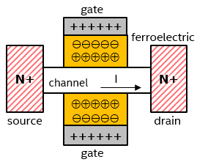
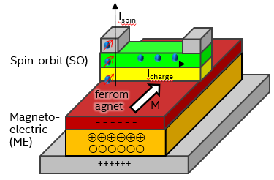


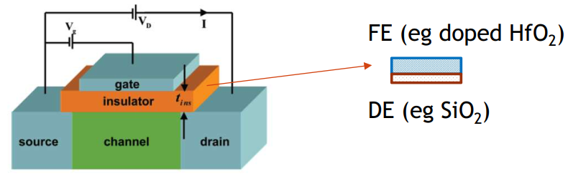
Global Compute Power: Challenge=Opportunity
1E+22
Beyond CMOS Devices
Global energy production
1E+20
CMOS, Energy limited scenario
SEEDC: still trending Energy limited but with Higher Performance
Compute Energy in J/year
Current trend,
CMOS device scaling
Ferroelectric FET
200mV
Spintronic (MESO)
100mV
1E+18
1E+16
2010
2020
2030
2040
2050
Negative Capacitance FET
Source: SRC Decadal plan for semiconductors, 2020
CMOS E-Core differentiation IS NOT a substitute for “Beyond CMOS”
  We need the order of magnitude perf/W improvement “Beyond CMOS” can deliver
“Beyond CMOS” IS NOT a substitute for CMOS E-Core differentiation
  There will be a time gap to cover…no matter how fast we move on “Beyond CMOS”
Source1: “Beyond CMOS: Super Energy-Efficient Devices and Circuits (2021 TSD )” Source2: “CMOS Device Technology For the Next Decade”, 2021 VSLI Technology Symposium
Notes:
The graph at left shows that if our industry fails to deliver perf/W scaling to match the pace of compute demand increase, the percent of global energy spent on computing will rise until it becomes limited by market dynamics.
Julien Sebot will update on the status of the 2021 Beyond CMOS TSD in the next presentation, but “in a nutshell” these devices provide non-linear improvements in perf/W at voltages well below the current CMOS VMIN floor.
The investments proposed in this TSRLP are complementary – not mutually exclusive – with Beyond CMOS.

Slide 22
How will Intel lead on perf/W?
Do Nothing
Buy (More) Time
Lead the next
perf/W inflection
Market won’t support (or reward) perf/core tradeoffs required to optimize for perf/W
Market will reward perf/W differentiated CMOS ECORE;
“Wait and see” approach on Beyond CMOS
Intel sees strategic opportunity to lead power efficiency breakthrough w/Beyond CMOS
Beliefs
Low-V Process
Capacitance-optimized E-Core
Synergistic Perf/W
uArch Work
Approach
Continue reusing traditionally-optimized common core in server
Low-V Specific uArch Work
Accelerated Beyond CMOS
(Including Rearchitecture Work)
Beyond CMOS
(Including Rearchitecture Work)
Intel loses to ARM-based solutions on perf/W
Fail to meet RISE goals
Compete in CMOS core, but TSMC and design competitors lead transition to Beyond CMOS
Big bet on new technology.
Risks
Notes:
How will our beliefs influence our approach?
If we believe that the market won’t support the perf/core trade-offs required to optimize for perf/W we can choose to continue re-using the client-optimized E-Core in server products. Given the criticality of perf/W for data center scale-out, we believe this approach risks losing market to ARM-based solutions and failing to meet our RISE power efficiency goals.
If we believe the market will reward a perf/W differentiated ECORE but that Beyond CMOS isn’t ready for “prime time” in 2033 we could take a “wait and see approach” on Beyond CMOS.
All options for acting first require investment in low-V process, E-core low-V perf/W optimization, and synergistic uArch work. After implementing these optimizations, this “wait and see approach” would use further investment in low-V specific uArch to “buy more time” until a later Beyond CMOS intercept.
A critical strategic risk with this approach is that TSMC and our design competition beat us to commercializing Beyond CMOS and gain a significant process and competitive advantage. We know our foundry competition is investing in Beyond CMOS – a patent search completed as part of the 2021 TSD showed a significant uptick in filings in this space starting in 2015.
If we see a strategic opportunity to lead the next power efficiency breakthrough and re-establish unquestioned process leadership, we could make a “big bet” on accelerating “Beyond CMOS” and strive to be the first in the industry to commercialize it. In this case, we might avoid investment in low-V specific microarchitectural work and transition to Beyond CMOS sooner.
If we have made our case successfully, then no one in this audience believes that “doing nothing” is a viable option.

Slide 23
Roadblocks and solutions
Status Quo
Server E-Core
Lead with Low-V
Process
Timeline
Traditionally Optimized
Traditionally Optimized
Traditionally Optimized
Low-V Optimized
Low-V Optimized
Client
Servers
Client
Servers
Client
Servers
Compute
Construction
E-Core
E-Core
E-Core
E-Core
E-Core
E-Core
P-Core
P-Core
P-Core
Analog
P-Core
Analog
P-Core
P-Core
Analog
(Disaggregated)
Client lead for process ramp
Client compute die analog prevents low-V process
Server must reuse client cores
Dedicated server E-Core hardening on low-V process
Likely follows later
Remove analog roadblocks
Lead with low-V process.
Roadblocks
& Solutions
Fine Print Assumptions: “Analog” = Analog circuits that won’t tolerate VMAX FOM <0.91V. Showing only key elements of die construction to illustrate dependencies, not full details/contents of each die.
Notes:
To move forward, we need to remove the roadblocks that have thwarted previous attempts at optimization.
With client Nova Lake construction, which is trending toward re-use for Razor Lake, the compute die includes voltage regulators and other analog content that can’t be designed on the low-V optimized process.
We also need client volume to ramp a process node and have resource constraints which limit us to a maximum of two process node implementations per core architecture.
Put this all together, and we are forced to re-use the traditionally-optimized core on traditionally-optimized process in data center products.
We saw this with the cancellation of 78.4 and convergence of NVL/DMR to a shared Panther Cove core on 78.6.
And we’re at risk of repeating this story for Arctic Wolf and Rogue River Forest, with client construction forcing 1280 to lead with a traditionally-optimized variant.
Adding a dedicated server E-core hardening removes the client analog roadblock but would likely delay low-V implementation if we assume client ramps the process and TD ramps on a single process variant.
But if client can eventually remove analog roadblocks through disaggregation and find architectural solutions to deliver perf/core at lower voltage, we could ramp the process with a perf/W focused low-V optimized variant.
While process would not limit core IP sharing in this scenario, there may still be motivation to diverge at the VMIN floor, given client desire to take perf/W scaling on the “red arrows” on the graphs Dave showed earlier – performance at iso power – while server prefers to follow the “green arrows” – power reduction at iso performance.

Slide 24
Call to action: Lead on data center perf/W
Invest in a capacitance-optimized E-Core hardening of Arctic Wolf or Golden Eagle
Productize low-V process on 1280
Define long-term perf/W leadership strategy
  Can we lead with low-V optimized on 1282?
  Timeline for commercialization of Beyond CMOS technology and investment in required uArch
  Roadmap to lead on perf/W until Beyond CMOS
Notes:
Our call to action outlines the necessary next steps to lead on data center perf/W.
First, we must finally take the first steps in the 1280 timeframe for Rogue River Forest or the next Forest generation.
DEG must develop a capacitance optimized E-core hardening and define intercept timeline, either Artic Wolf or the next E-Core Golden Eagle.
And TD must invest to develop low-V optimized process on 1280.
Second, we must align on a longer-term corporate strategy for the next phase of perf/W leadership:
Can we remove the roadblocks to leading with low-V optimized process on 1282?
When will we invest to commercialize Beyond CMOS
And what additional investments in E-core differentiation may be required to lead on perf/W until we reach this inflection point.

