Slide 1
Accelerating Innovation for Product & Foundry Leadership – System Design Studio
TSLRP 2023
TSLRP leads: Vivek Rajan, Tanay Karnik
TSLRP Fellow Sponsor: Eric Fetzer, Atul Kwatra
TSLRP VP Sponsor: Vinoo Srinivasan, Bob Brennan
TSLRP PM: Sophie Lennon
Core Team: Bala I., Surhud K., Slade M., Rob M., Ravi M., Ram V., Lalitha I., Satish S., Chris R. Rajiv M., …
Notes:
Two years back, I got the opportunity to represent Intel for one of our foundry customers in San Diego.
We consulted them on disaggregation approach.
After much discussion, the ask from San Diego team was:
Full system level co-optimization solution (not just ideas)
Reference designs with proven methods to discover the benefits of Intel’s technology and assets
This cemented the idea in me leading up to this TSLRP proposal today.

Slide 2
Executive Summary
Context
  IDM 2.0 requires open platforms & interoperable solutions
  Existing solutions for system-level PPAC analysis are fragmented
Inflection Points & Threats
  Competition has a head start but we can embrace & extend
  Risks of falling behind in our IDM 2.0 targets
Proposed Solution
  Co-develop a design studio to accelerate system prototyping and deliver proven STCO solutions
  3X redux in Concept to Engineering Commit time + effort
STCO: system technology co-optimization
PPAC: performance, power, area & cost
Notes:
Let’s begin with our executive summary
For IDM 2.0 success, standards and open platforms are essential
Current solutions for system-level prototyping PPAC are fragmented
Competition has a head start; however, we believe we can embrace Industry solutions and extend with differentiation
Risks of not doing so, will bring setbacks to our IDM 2.0 ambitions
We propose to co-develop a design studio to accelerate system technology co-optimization solutions
This will bring 3X redux in Concept to engineering commit time and effort. And will make product’s execution predictable

Slide 3
Agenda
 | Topic
1 | Setting the Context
2 | Intel’s Turnaround Strategy
3 | Competition
4 | Intel’s Current Landscape
5 | Value Prop
6 | Recommending: System Design Studio
7 | Potential Internal and External Use Cases
8 | Next Steps and Call to Action

Slide 4
Agenda
 | Topic
1 | Setting the Context
2 | Intel’s Turnaround Strategy
3 | Competition
4 | Intel’s Current Landscape
5 | Value Prop
6 | Recommending: System Design Studio
7 | Potential Internal and External Use Cases
8 | Next Steps and Call to Action

Slide 5
STCO Poised to Create Novel Product Architectures with Better PPAC
System Co-optimization Hierarchy
System Architecture (SW + HW)
Application & Workloads
STCO
Application Partitioning
System Software
Design
Chiplets
Package
System Architecture
IP Design
Chiplets Design
Advanced Packaging
3DIC
Validation
Validation
DTCO
Chiplets
Cores & Accelerator IP
DTCO
Chiplets Integration
Foundational IP
Technology
Silicon Technology
Package Technology
Device
Transistors & Interconnect
Process Technology
System Validation
STCO: system technology co-optimization
PPAC: performance, power, area & cost
© IEEE 2022. Excerpt from IEDM 2022 Ann Kelleher plenary address

Slide 6
Agenda
 | Topic
1 | Setting the Context
2 | Intel’s Turnaround Strategy
3 | Competition
4 | Intel’s Current Landscape
5 | Value Prop
6 | Recommending: System Design Studio
7 | Potential Internal and External Use Cases
8 | Next Steps and Call to Action

Slide 7
A Unique Phase for Intel
Present
Past
Future
Success built on
proprietary hardware
proprietary solutions
open software
Intel in a saddle period
Future success requires
open platforms
interoperable solutions
unlock partnerships
Q: How do we enable open platforms and unlock partnerships?
Hint: Let us learn from Microsoft’s turnaround strategy…
Notes:
Before deep-dive, let’s quickly glance at the unique phase for Intel
Our past success was built on:
Proprietary hardware
Proprietary solutions and open software
Intel is currently in a saddle period
Future success requires:
Open platforms
Interoperable solutions to unlock partnerships
How do we best enable open platforms to unlock partnerships. Towards this let’s learn from Microsoft’s turnaround strategy

Slide 8




Microsoft’s Turnaround Strategy
2014
Past
Future
Success built on
proprietary OS
proprietary software
proprietary applications
Satya Nadella appointed as CEO
Turnaround enabled by
open platforms
open solutions
partner-first mindset
Visual Studio: a powerful developer tool that enables you to complete the entire development cycle in one place.
GITHUB: The complete developer platform to build, scale, and deliver secure software.
Microsoft cloud: access, management, & development of applications & services via globally-distributed data centers
… this required cultural transformation as well
Notes:
Microsoft’s past was also built on:
Proprietary OS, software and applications
In 2014, Satya Nadella was appointed as the CEO and built next-generation success around:
Open platforms, open solutions and most-importantly partner-first mindset
Internal solutions inside Microsoft were integrated with Azure platform. And developer tools like Visual Studio and GITHUB further fueled the growth engine of Microsoft
Of course, this also involved cultural transformation as well. This is also relevant for Intel

Slide 9
Agenda
 | Topic
1 | Setting the Context …
2 | Intel’s Turnaround Strategy
3 | Competition
4 | Intel’s Current Landscape
5 | Value Prop
6 | Recommending: System Design Studio
7 | Potential Internal and External Use Cases
8 | Next Steps and Call to Action

Slide 10
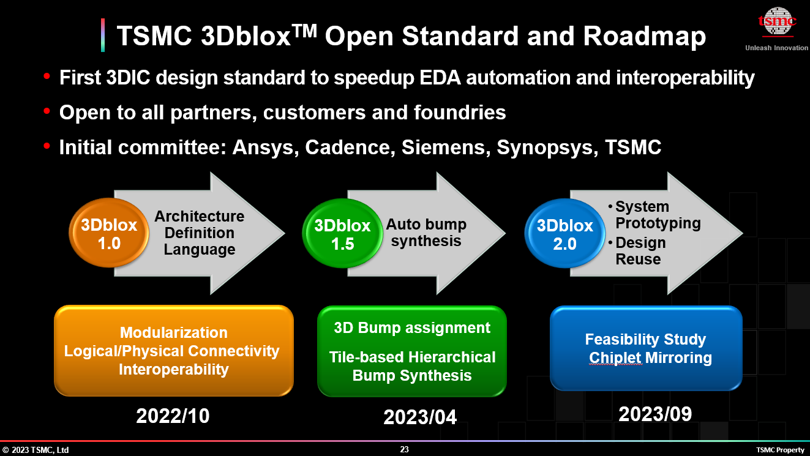
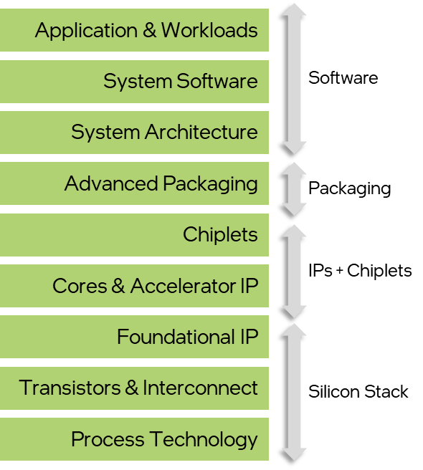
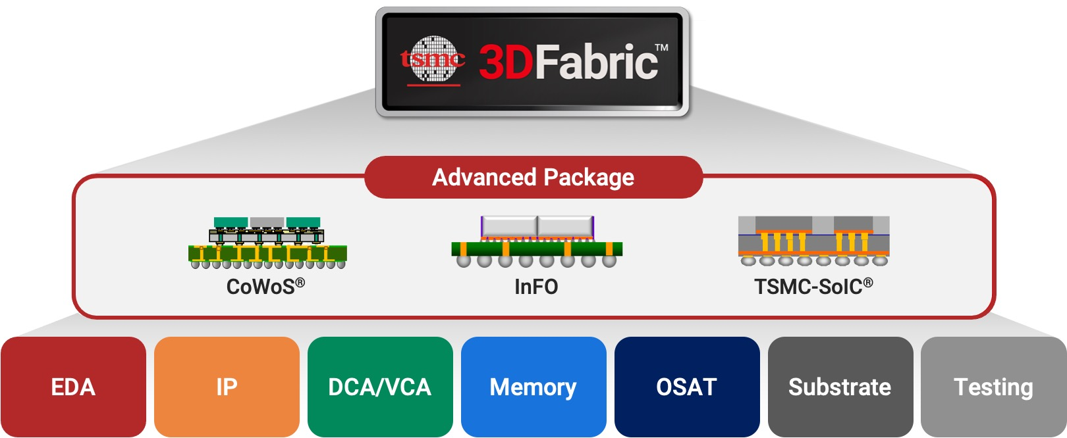
TSMC is Extending its Offerings to Systems
3Dblox standardizes physical architecture and relevant here
3Dblox is a language to model key physical stacking and the logical connectivity information in 3DIC designs in a single format
Example: 3DBlox co-developed with AMD; currently being standardized with EDA
A Bottom-up & Hardware Centric Approach: Language, Automation, Co-Design
Notes:
We did a survey of competitive solutions and let’s look at TSMC’s approach.
TSMC has successfully established 3D Fabric Alliance. And introduced 3DBlox in October 2022.
TSMC is further extending 3Dblox with increased automation and system prototyping as part of their 1.5 and 2.0 milestones
TSMC collaborates with its customers (such as Apple and AMD) and foundry alliance.
3DBlox was co-developed as part of AMD V-Cache and now being standardized with EDA for rest of the ecosystem
However, TSMC’s approach is bottom-up and Hardware centric. This is where we believe we can bring differentiation with a top-down approach and holistic STCO solution

Slide 11
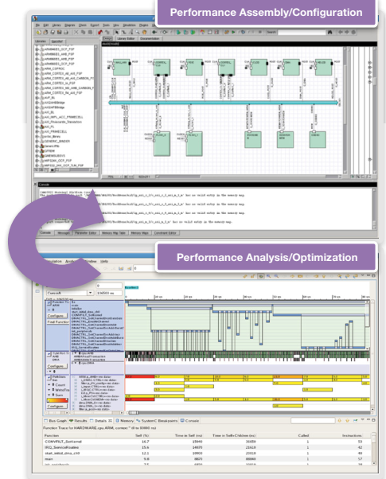
Industry offers SoC Design Frameworks
Arm Development Studio
Arm Development Studio
IDE, Arm Debugger, Mail Graphics Debugger and Streamline Performance Analyzer
C/C++ Compiler
Arm Compiler for Embedded FuSa
Arm Compiler for Embedded
Simulation Models
Arm Fixed Virtual Prototypes
Arm Fast Models
DSTREAM family
ULINK Family
Platform Architect [Synopsys]
SoC Architecture Performance Analysis and Optimization
Arm Development Studio
Top-Down & SoC Centric Approach: We can embrace
Notes:
We did a survey of competitive solutions and let’s look at TSMC’s approach.
TSMC has successfully established 3D Fabric Alliance. And introduced 3DBlox in October 2022.
TSMC is further extending 3Dblox with increased automation and system prototyping as part of their 1.5 and 2.0 milestones
TSMC collaborates with its customers (such as Apple and AMD) and foundry alliance.
3DBlox was co-developed as part of AMD V-Cache and now being standardized with EDA for rest of the ecosystem
However, TSMC’s approach is bottom-up and Hardware centric. This is where we believe we can bring differentiation with a top-down approach and holistic STCO solution

Slide 12
Agenda
 | Topic
1 | Setting the Context …
2 | Intel’s Turnaround Strategy
3 | Competition
4 | Intel’s Current Landscape
5 | Value Prop
6 | Recommending: System Design Studio
7 | Potential Internal and External Use Cases
8 | Next Steps and Call to Action

Slide 13
Intel has Full Stack Assets, But …
Assets
Value Prop
Challenges / Opportunity
Application & Workloads
Software
System Software
System Architecture
Packaging
Advanced Packaging
Chiplets
IPs +
Chiplets
Cores & Accelerator IP
Foundational IP
Silicon
Stack
Transistors & Interconnect
Process Technology

Slide 14
Intel has Full Stack Assets, But …
Assets
Value Prop
Challenges / Opportunity
Application & Workloads
Software
System Software
System Architecture
IPs
(with PnP models)
Proprietary 3D D2D IPs
On-going effort to drive ecosystem compliance and IP standards
Packaging
Advanced Packaging
Rich IP portfolio
Chiplets
D2D, PLLs, etc. IPs
IPs +
Chiplets
Cores & Accelerator IP
Foundational IP
Silicon
Stack
Transistors & Interconnect
Process Technology

Slide 15
Intel has Full Stack Assets, But …
Assets
Value Prop
Challenges / Opportunity
Application & Workloads
Software
System Software
System Architecture
EMiB
Packaging
Advanced Packaging
Advanced Package Technology Offering
Foveros is not offered thru IFS (yet)
Chiplets
Foveros
IPs +
Chiplets
Cores & Accelerator IP
Foundational IP
Silicon
Stack
Transistors & Interconnect
Process Technology

Slide 16
Intel has Full Stack Assets, But …
Assets
Value Prop
Challenges / Opportunity
Application & Workloads
Software
System Software
System Architecture
Cost
Signal Integrity
Packaging
Advanced Packaging
Unique Early Technology & System Co-Optimization Solution
Disjointed Solvers
Opportunity to standardize as an integrated solution
Chiplets
Thermal
Power Delivery
IPs +
Chiplets
Cores & Accelerator IP
Foundational IP
Silicon
Stack
Transistors & Interconnect
Process Technology

Slide 17
Intel has Full Stack Assets, But …
Assets
Value Prop
Challenges / Opportunity
Application & Workloads
Software
System Software
System Architecture
Task Level
Simulator
Functional
Simulator
Packaging
Advanced Packaging
Fast, dynamic PnPnT, differentiated and co-optimized simulation running modern workloads on Simulation Cloud
Incorporate 3rd party models (PnPnT)
Expand usage to IFS (accelerator models)
Chiplets
IPs +
Chiplets
Cores & Accelerator IP
Electrical
Simulator
Foundational IP
Silicon
Stack
Transistors & Interconnect
Process Technology

Slide 18
Intel has Full Stack Assets, But …
Assets
Value Prop
Challenges / Opportunity
Application & Workloads
Software
System Software
System Architecture
HW-SW Partitioning
Co-Simulation
Packaging
Advanced Packaging
Knowledgebase of diverse set of work-loads
Opportunity to automation
Research directions
Chiplets
IPs +
Chiplets
Cores & Accelerator IP
Foundational IP
Silicon
Stack
Transistors & Interconnect
Process Technology

Slide 19
Agenda
 | Topic
1 | Setting the Context …
2 | Intel’s Turnaround Strategy
3 | Competition
4 | Intel’s Current Landscape
5 | Value Prop
6 | Recommending: System Design Studio
7 | Potential Internal and External Use Cases
8 | Next Steps and Call to Action

Slide 20
To Win, We Must …
ACT
  Embrace industry solutions
  Extend with Intel differentiation
Scope + Focus of this TSLRP
Tools & Methods for STCO
DELIVER
  A design studio for top-down and full-stack systems
Need to also, address cultural challenges
Tools & methods necessary, but not sufficient
Such as IP standardization and reuse …
REALIZE
  Pervasive benefits to internal products and IFS customers
Intel uniquely positioned to LEAD a world-class
System Co-optimization Ecosystem
Notes:
To win:
WE MUST act to embrace existing Industry solutions and extend them with Intel differentiation
WE MUST deliver a studio for top-down design and end2end system solution
Doing so, WE WILL realize pervasive benefits to our internal products and IFS customers

Slide 21
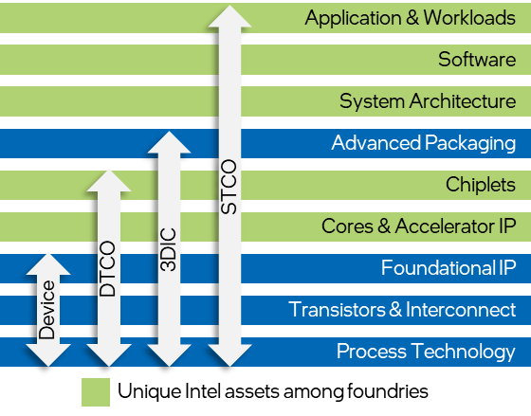






Studio Will Benefit Intel, IFS and Govt.
Super-powers
Ubiquitous Compute
Cloud to Edge Infrastructure
Pervasive Connectivity
Sensing
Artificial
Intelligence
New advanced node customers
Public-private partnership
Chiplet platform: enable startups & academics to rapidly innovate and drastically reduce costs
CSP
Auto OEM & Tiers
MAG
1
Full-stack optimization of systems
2
3
Bolster IFS business
Govt. benefits from the same
CSP: Cloud Service Provider
MAG: Military, Aerospace, Government
Notes:
Here are the upside for an Integrated Studio:
Enables full stack optimization from Applications → Process Technology (transistors + interconnect)
Be the framework to bolster IFS business with differentiating system solutions
CHIPS ACT for America has similar needs (public-private partnership and ask for a Chiplet platform) → Hence, US Government will also benefit form the same

Slide 22
Agenda
 | Topic
1 | Setting the Context …
2 | Intel’s Turnaround Strategy
3 | Competition
4 | Intel’s Current Landscape
5 | Value Prop
6 | Recommending: System Design Studio
7 | Potential Internal and External Use Cases
8 | Next Steps and Call to Action

Slide 23







Tech Strategy: Amplify with Differentiation Once we have a Connected Solution
Connect
Ease-of-Usage
Research
  Introduce common model
  Link (fragmented) assets
  Implement rewards driven AI solution
  Increase optimization space
  Application synthesis
  App store for Systems
Systems Co-Design
Spans multiple domains
Requires collaboration methods
Needs extensible solution
Hence, we propose a Studio Approach for Systems Design
EoU: Ease-of-Usage

Slide 24




We Propose … System Design Studio
Partitioning
Co-Simulation
research
Customer
Secure repository
Task Level
Functional
Electrical
Collateral
Libraries
tools
Cost
Thermal
Power Delivery
Signal Integrity
System Design Studio
Applications
System Design Studio
Reference Designs
Reference Methodologies
HW / SW Systems
reference
Constraints
Chiplets
(models)
Packages
(models)
Boards
(models)
Foundry Customers
stack
Tools
Solvers
Interconnect
IPs
(with PnP models)
Components
Secure Repositories
1
Framework for Foundry Customers
2
3X↓ in Concept to Engineering Commit time + effort
infrastructure
Cloud
Common representation
EDA Solutions
Embrace
Unique differentiation
Embrace + extend
Research
… quantification of 3X benefits in slides ahead
Notes:
To realize all of these benefits, WE propose a System Design Studio that is built using Industry standards extended with Intel differentiation.
Here are the building blocks for System Design Studio: → Click → Click → ….
Secure repositories built on Cloud with EDA solutions
Primed libraries with IPs, Chiplets, and components (that will continue to grow as Studio usage evolves)
Studio will also contain proven methodology with reference designs
demonstrating complete usage of analysis tools, such as:
cost, thermals and power-delivery solvers
and …
functional and electrical simulators
Research directions include: HW/SW Partitioning and co-simulation
System Design Studio will become the DEFACTO framework for foundry customers to discover Intel’s technologies
It will enable our Internal products to reduce concept to engineering commit time and effort by 3X

Slide 25
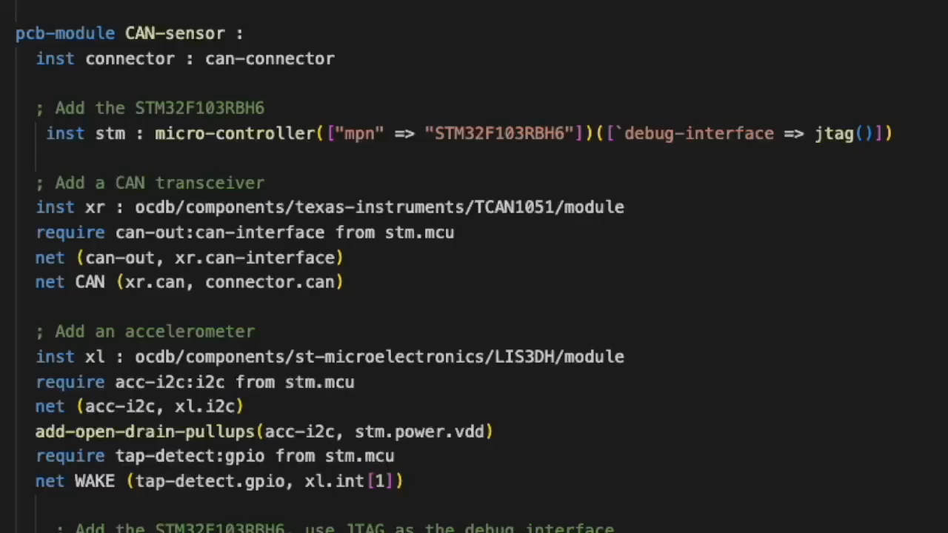
Connect: Common Model
HW Representation
Board
Package
Chiplets
Components
IPs
(Specs + FW)
Parametrized and reuse-friendly library
Common model represents full-stack HW
Software Defined Electronic System
Notes:
We introduce a COMMON REPRSENTATION for full-stack HW
This enables:
Rapid system prototyping
Design parametrization, and
Reuse friendly building blocks + components

Slide 26
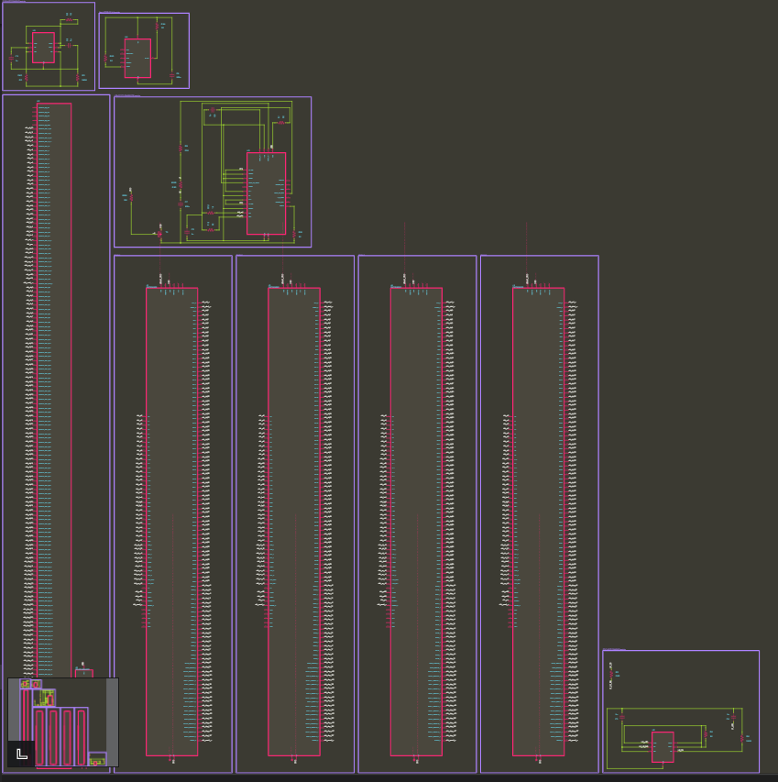
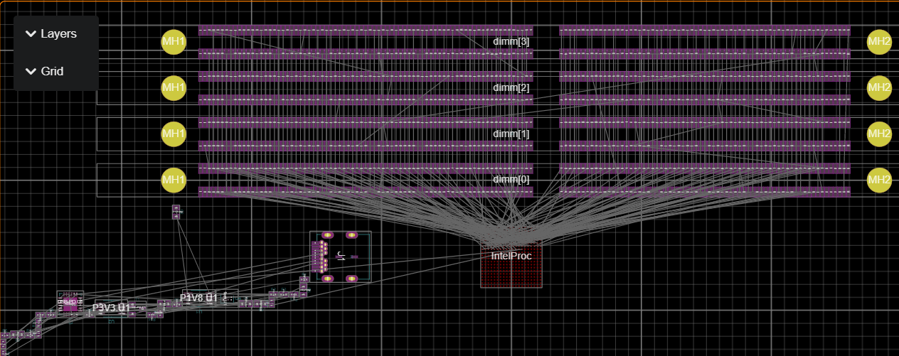
Connect: System Prototype
Optimized Schematic
; ================================
; Compute Chiplet
; ================================
module compute-chiplet :
port system-io : system-io
port ucie : UCIe-interface(UCIe-Advanced)
inst uclane : ucie-module(UCIe-Advanced, 22.0e-3)
net (uclane.ucie ucie)
inst hublane : ucie-module(UCIe-Advanced, 22.0e-3)
net (hublane.ucie ucie)
inst jtag-interface : io-block(jtag(), 55.0e-3)
net (jtag-interface.io system-io.jtag)
place(uclane) at loc(1.0, 0.0) on Top
place(hublane) at loc(-0.75, 0.0) on Top
place(jtag-interface) at loc(-0.0, 0.0) on Top
property(self.shape) = Rectangle(2.0, 2.0)
property(self.thickness) = 0.5
property(self.PDK) = "Intel-18A"
property(self.RTL) = "compute.vl" ; some model - composed of smaller models
layer(Courtyard(Top)) = property(self.shape)
schematic-group(uclane) = compute-1
schematic-group(hublane) = compute-2
; ================================
; Board (full system)
; ================================
module board :
port system-io : system-io
inst IntelProc : package-board-interface(0.6, Top)
net (system-io IntelProc.system-io)
net GND ()
inst dimm : DDR4-dimm/component[4]
for i in 0 to 4 do:
place(dimm[i]) at loc(0.0, to-double(i) * 9.0) on Top
require ddr : DDR4-interface from dimm[i]
net (system-io.ddr4 ddr)
net (dimm[0].VDD dimm[i].VDD)
net (dimm[0].VPP dimm[i].VPP)
net (GND dimm[i].VSS)
schematic-group(dimm[i]) = (Ref(to-string("DIMM-%_" % [i])))
inst P1V8 : components/ADP3336ARMZ/module(1.8)
inst P3V3 : components/ADP3336ARMZ/module(3.3)
inst J1 : ocdb/components/belfuse/SS-52400-003/component
inst USB-PD : components/STUSB4500QTR/module ; USB-C PD device
net (J1.vbus USB-PD.Vbus)
net (J1.CC1 USB-PD.CC1)
net (J1.CC2 USB-PD.CC2)
require ctrl:i2c from USB-PD.U1
net (system-io.sys-i2c ctrl)
inst flash : components/AT25SL321-U/module
place(IntelProc) at loc(0.0, -15.0) on Top
property(self.shape) = RoundedRectangle(200.0, 70.0, 1.0)
Characterized and parametrized system
Characterized and parametrized component
Optimized (layout) Design
Notes:
Here is an example of Chiplet with UCIe interface modeled in COMMON REPRESENTATION.
In additional there are process (PDK/Technology) bindings that enables co-design with unique Solvers
Similar approach can be taken for collection of Package and full board system
System Design Studio’s automation convers this code into schematic and layout in minutes

Slide 27
Connect: Explore Multiple Architectures
Data-sheets
Std. Interfaces, components, …
Placement
Library
Thermals
Supply chain data
Routing
Signal Integrity
Power Delivery
Design requirements & goals in code
ESIR
Design #1
ESIR
Design #2
ESIR
Design #3
ESIR
Solvers
Design validation
ESIR
Export CAD files
…
Optimization goals
Design space exploration
System SW, Firmware configuration
Test Plan
ESIR: Electronic Systems Intermediate Representation
ESIR is an open standard: https://github.com/JITx-Inc/open-components-database/blob/main/README.md
Notes:
The COMMON model is built on novel IR (Intermediate Representation) which allows us to take design requirements and goals and model them in code (software)
This is called ESIR: Electronic System Intermediate Representation. ESIR is an open-standard
ESIR enables rapid design space exploration and usage of MULTIPLE Solvers on common data-model (such as: Thermals, Power Delivery, Placement and Routing of components)
Once the system is optimized, it can be exported using EDA CAD for detailed implementation

Slide 28
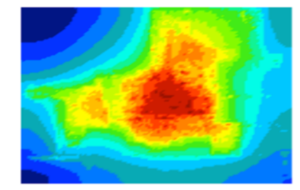
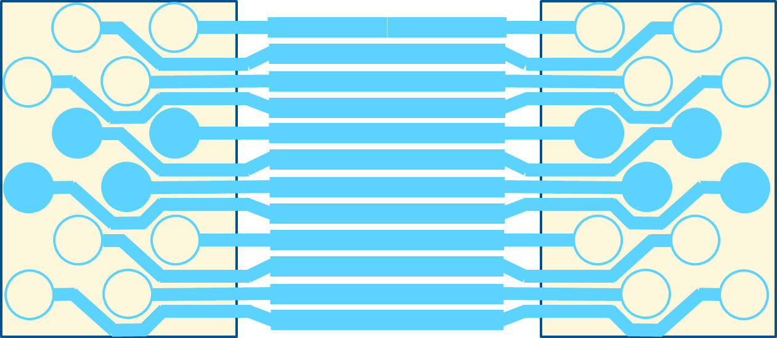
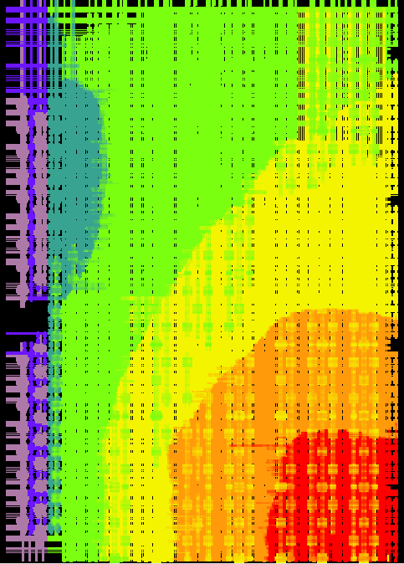
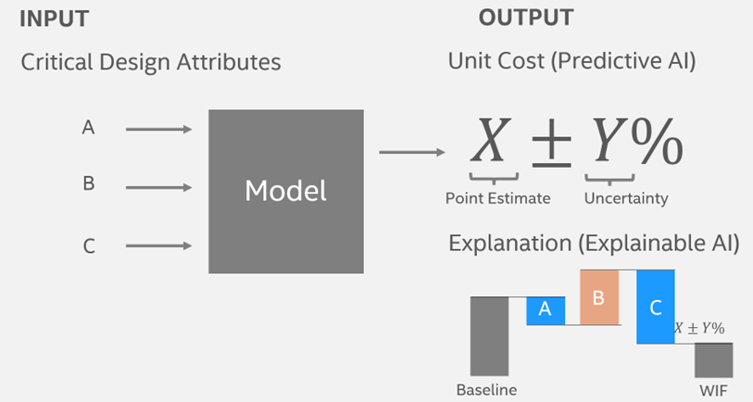
Connect: Integrated Solvers for System Prototyping & Cost Analysis
Mechanical
Electrical
Thermal
Thermal / temperature characteristics and constraints
Bump and wire sizes
Bonding footprint
xyz constraints
Cost Modeling
Power delivery
Noise margin
Capacitance
Predict PCOS
Democratize real-time cost prediction
https://unitcost.intel.com/
One Design Representation → Multiple Solvers
Notes:
Multiple Solvers such as:
Thermals
Mechanical
Power Delivery, AND
COST modeling
Will be interoperable with COMMON MODEL
This enables rapid decision making of System Concepts
At this point, my TSLRP co-lead, Tanay Karnik will present rest of the slides ….

Slide 29
Connect: Integrated Simulators for Modeling and Co-design - ISIM
Micro arch simulators: Microarchitectural tuning
Simics HW/SW Co-design and validation
Emulation, FPGA, RTL hybrids : Silicon Readiness to SW
CoFluent Architecture exploration
Docea
Power, performance and thermal tuning
Workloads (SW function)
Validated SW & architecture
Unique feature
Cross-domain PnPnT Modeling & Dynamic Simulation
Action
Leverage unified set of existing models/simulators in the studio
PnPnT: Power, Performance and Thermal
Notes:
Intel has simulators at higher level of system stack. The integrated framework is ISIM.
Intel has many simulators that take workloads as INPUTS. And enable fast System level HW/SW co-design
The simulators are:
CoFluent for ARCH exploration
Docea for PnPnT (power performance thermal)
IWPS for uarch simulation
Simcs for design and validation
And, …. FPGA emulation that works with RTL hybrids when silicon is not ready
These simulators ensure correctness of SW and HW. Offer unique differentiation for Intel by PnPnT modeling at high level of system stack and dynamic simulation.
System Design Studio will leverage unified models and simulators.
Hand over to Tanay

Slide 30
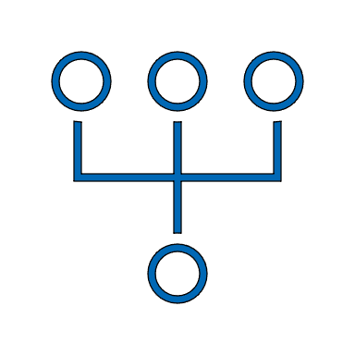



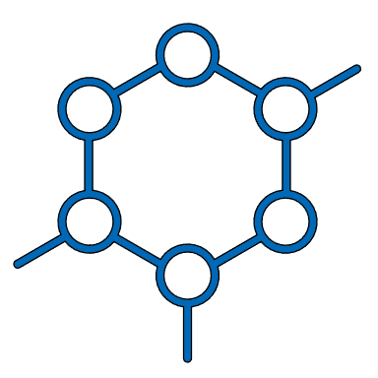

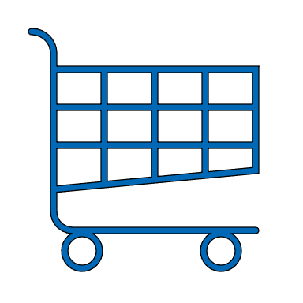
Once, We Have a Connected System …
Common model
Connected System
Connected
System Design Studio
Extend with
Differentiation
Make it
Ease to Use
Future Vision …
Systems App Store
Notes:
Thanks Vivek.
We explained a connected system of SW and HW and tools.
It is extended with Intel differentiation.
We briefly present how it can made easy to use and one of its research extensions.

Slide 31
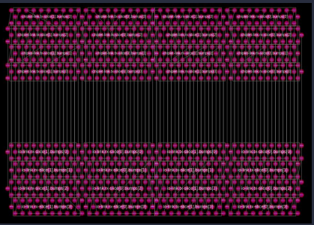
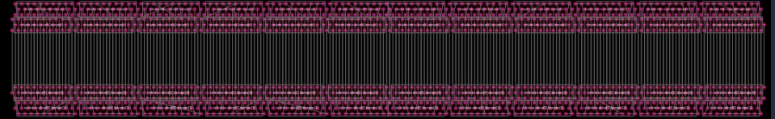
EoU: Intelligent System Exploration Will Make System Design Studio Easy to Use
objective function: Optimize-link-parameters(link)
substrate-pitch = 60.0e-3
link = UCIe-link ( :
bit-width = 128
tx-clk = 1.0e6
max-edge-width = 3.0
source-terminated? = true)
Cost Functions (sweep design)
# of Options
120
bit-width:
Configuration Setup
tx-clk:
6
max-edge-width:
12
Total # of Combinations
8640
Problem Statement: sweeps consume large amounts of analysis time & computational resources
Proposed Solution: intelligent explorer will increase user productivity
Power per UCIe link : 0.0001152W
Power per UCIe link : 0.0003456W
Notes:
System design studio will make it is easy to explore system options. We show a configuration setup of UCIe.
UCIe link parameters should be optimized. There are 8000+ combinations to tune.
This type of manual sweep consumes large analysis time.
The studio will enable intelligent exploration, provide alternative solutions varying in bump map and power consumption.

Slide 32
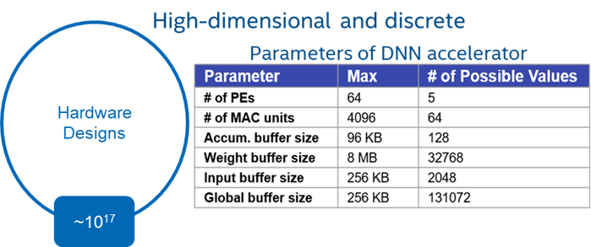
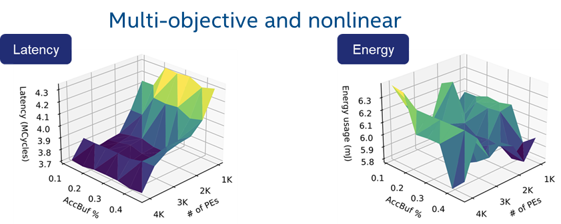

Research: Explore HW Bindings for AI/ML Algorithms
AI / ML Dataset
System Design Studio
design space exploration
large design space ~ 10¹⁷
optimized network
System = Chiplets + Software
….
SW
Achieves 5% more efficient system design
https://people.eecs.berkeley.edu/~ysshao/assets/papers/vaesa-ispass2022.pdf
Notes:
One of the research directions is to explore HW BINDINGS for new AI/ML data-sets …
Design space explodes with AI/ML algorithms. In this example: there are 10^17 parameters
The studio WILL perform automated network exploration for latency and energy tradeoffs
This allows us to create optimal mapping of AI/ML algorithms to Deep Neural Network
System Design Studio WILL further allow us to automatically generate Chiplets and SW bindings for DNN

Slide 33
Agenda
 | Topic
1 | Setting the Context …
2 | Intel’s Turnaround Strategy
3 | Competition
4 | Intel’s Current Landscape
5 | Value Prop
6 | Recommending: System Design Studio
7 | Potential Internal and External Use Cases
8 | Next Steps and Call to Action

Slide 34
Opportunity #1: Xeon STCO Analysis
M11
M12
M13
M14
Cost
Model
1
RAYS
hours
ROT
mins
PCOS
days
ChSolver
hours
The challenge: developing systems requires evaluating many options
High-expertise needed within and cross domains
Does not scale
Breaks down for IFS customers
M21
M22
M23
M24
KPI
Model 2
Simics
mins
Docea
hours
Martini
hours
Marlin
hours
M31
M32
M33
M34
M35
PnP
Model 3
To RECAP: System Design Studio will address with
Common (plug-able) model
Easy to use, extensible
Built on industry standards
System
Concept
Perf
mins
Keiko
days
Avalanche
weeks
IDPA
weeks
TCO
hours
M41
M42
M43
M44
M45
Electrical
Model 4
Scalars
days
SimTools
weeks
RedHawk
weeks
Clocking
weeks
SITools
weeks
M51
M52
Physical
Model 5
Floorplan
months
Thermals
weeks
EDA
Intel
STCO: system technology co-optimization
For detail map and description of tools/models, see our white-paper
Notes:
A typical Xeon STCO too suite is fragmented with numerous models.
System concept is transformed into a model for cost analysis. Individual tools in cost analysis domain have tool specific model extensions
Then there is a group of tools for key performance indices analysis, Same model diversity and complexity exists for power and performance analysis, electrical and physical layer
We have identified EDA tools from Intel proprietary tools.
These are the challenges. To evaluate system options, domain expertise is required. Manual exploration does not scale to large number of options and opportunities. This tool suite with numerous model extension approach breaks down for IFS customers.
Let us recap, we need
Common plug-able models
A studio framework that is easy to use and extensible to new tools
An industry wide standardization for the ecosystem enablement

Slide 35

System Design Studio Opportunity
M1
Cost
Unified Cost Analysis
50%
# models
M2
System
Concept
KPI
Integrated Architecture Exploration
Common
Model
M3
PnP
TCO
66%
Integrated Microarchitecture Exploration
TAT
M4
Electrical
Multi-Physics Early-Analysis Engine (SI, PI, Reliability)
EoU, interoperability
M5
Impact
easy-to-use
reduced # of models
resource optimized
Physical
Software Defined HW Generators
EDA
Intel
Embrace Industry Solution & Extend
TAT: Turn Around Time
➔ 3X redux in concept to engineering commit
Notes:
This is how studio will help Xeon products
System Design Studio embraces Common Modeling using ESIR, thus reducing complexity of modeling
System concept will be transformed into a common model for all domains.
Of course, there will be some domain specific model extensions. However, we envision due to tool interoperability in the domain, there will not be tool specific model extensions.
This will reduce the model requirement, and time and effort requirement across all domains. With the consolidation, runtime reduction and ease of use, the resource requirement will be optimized (go-down)
We project the impact to be 3X reduction in concept to engineering time

Slide 36
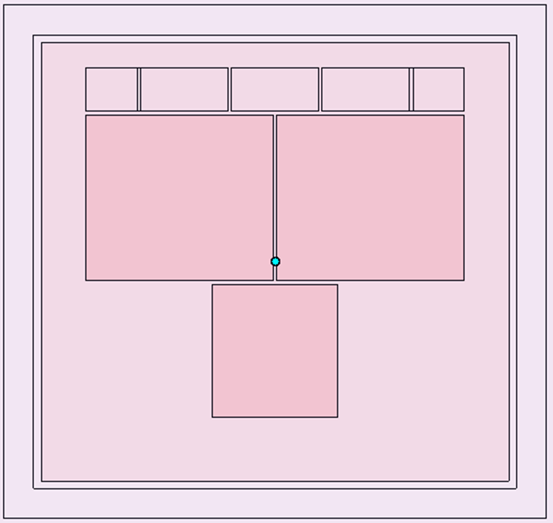
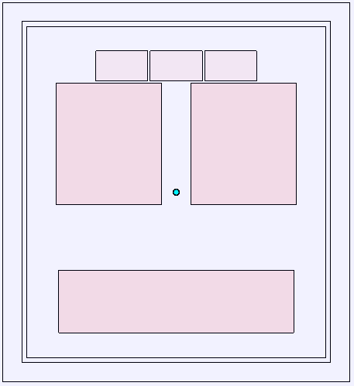
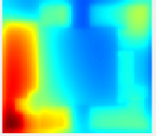
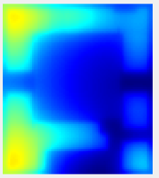
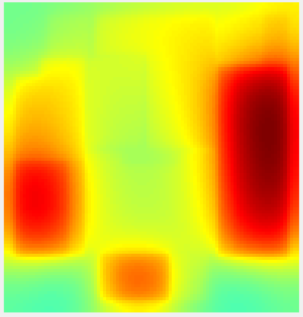

Opportunity #2: Thermal Challenge
Original proposal to customer
Thermal/architecture co-designed solution
T_{j,max,die1} = 130 ºC
T_{j,max,die2} = 125 ºC
TDP = 81.4 W
T_{amb} = 88.5 ºC
T_{j,max,die1} = 120.5 ºC
T_{j,max,die2} = 120.7 ºC
TDP = 80.7 W
T_{amb} = 88.5 ºC
Focused
2-week redesign
effort with Si Experts
Results from 2-weeks of Thermal/Silicon co-optimization: “un-selectable” → “winning the race on thermal”
Current Methods built for relatively slow optimization times!
System Design Studio Target: by end of 2024, optimization can be done in ~2 hours
Notes:
A real-life example demonstrates how we win a customer by re-floorplanning and IP redesign for Thermals.
Original proposal to customer was not acceptable due to thermal reasons. The team focused for 2 weeks and co-designed a solution with silicon experts
It took two weeks to win this customer.
System design studio will target 2 hours (instead of days) to design a thermally optimized system by 2024.

Slide 37
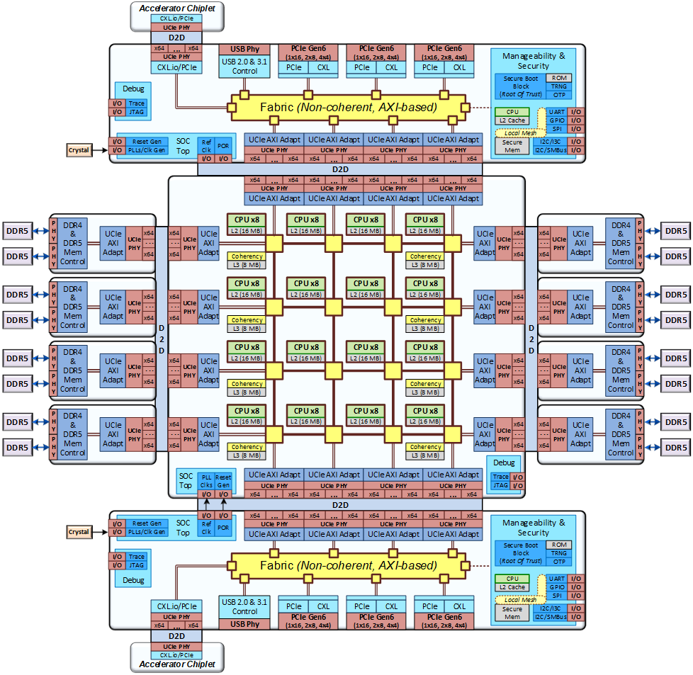
Opportunity #3: Optimal Silicon Partitioning for IFS
Cost Contributions | Monolithic (Intel18A) | Compute (Intel18A) + DDR/IO (Intel3) | All Chiplets (Intel18A)
PCOS ($/u) ± 1σ @ISO 685 | High | Low-1 | Low-2
Silicon Cost Contribution | High % | Medium % | Medium %
Packaging And Test (PAT) Cost Contribution | Low % | Medium % | Medium %
Advance Packaging Cost Contribution | N/A | < 10% | < 10%
Scrap Cost Contribution | < 5% | < 10% | < 10%
IO Chiplet
DDR Chiplet
Compute Chiplet
DDR Chiplet
IO Chiplet
Impact: Comparative / pairwise analysis for heterogeneous implementations
Model Built for Cost can also be used for Thermal or PD Analysis
Notes:
In 3rd Case Study, let us consider an IFS customer with a system concept looking for an optimal silicon partitioning for process selection.
This architecture can be separated into compute, IO and DDR regions. These can be potentially different chiplets.
System design studio allows customer to EXPLORE monolithic versus disaggregated system cost tradeoffs with multi-process capability.
The table shows a comparison of product, silicon, packaging cost comparison for these options.
System design studio offers comparative, pairwise analysis tool to IFS customers for homogenous or heterogeneous implementation.

Slide 38


Opportunity #4: Platform Enablement for Government Programs
Secure repositories and studio for semiconductor solutions
Upcoming USG Program | Description
NAPMP | Advanced packaging manufacturing
CHIPS | Chips for America
3D-PRODIGY | 3DIC-Physical design, validation, architecture
System Design Studio
repositories
secure access
with proven solutions
government
programs
Impact: Proven components, Chiplets, and IPs to jump start grand challenges
Notes:
US government has multiple programs in pipeline. Intel is planning to respond to these solicitations.
System design studio with secure repositories CAN be included as a valuable technology to seek government partnership.
The studio will allow secure access to multiple government programs with proven components, chiplet-platforms and IPs to jump start grand challenges.

Slide 39
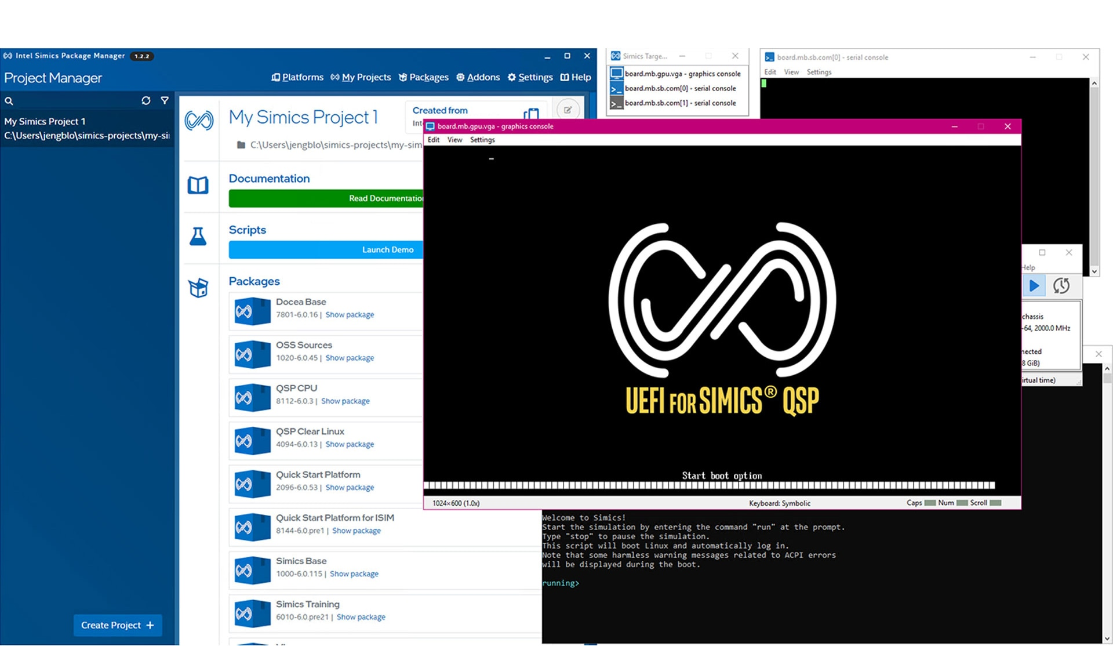

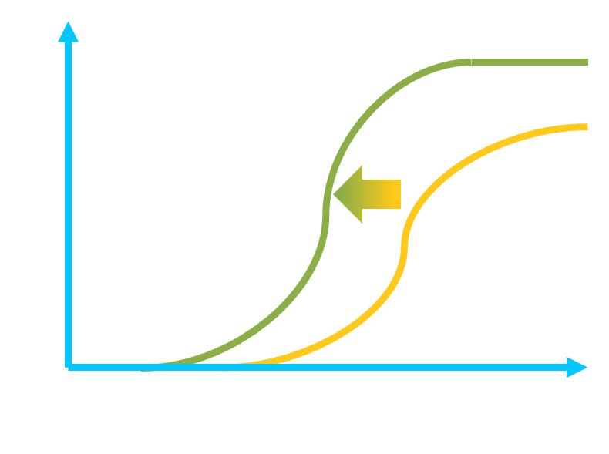

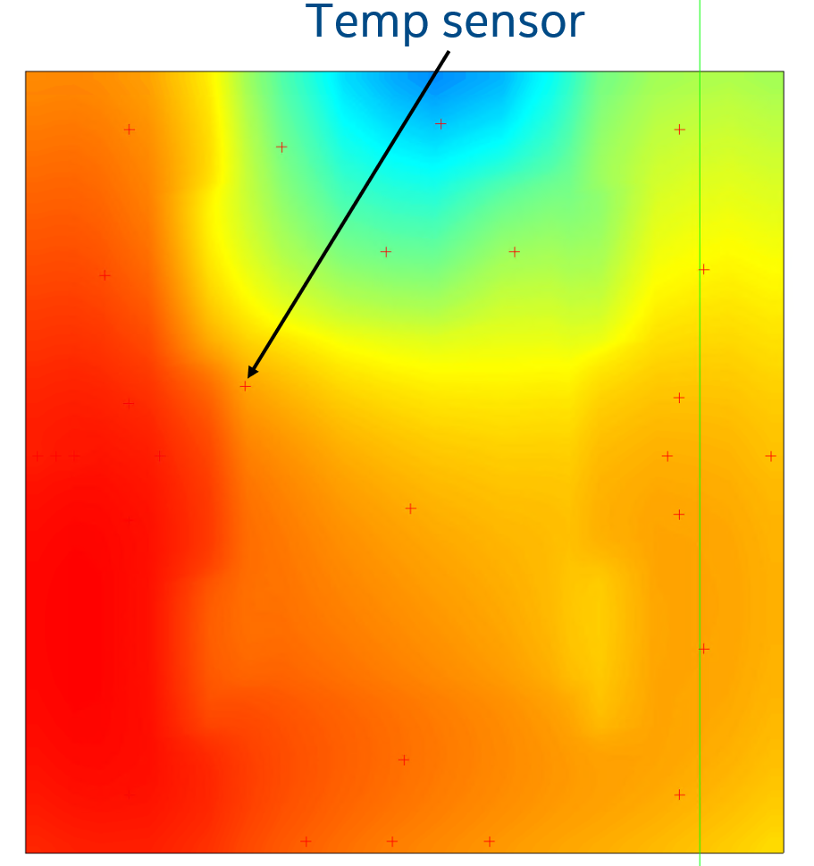
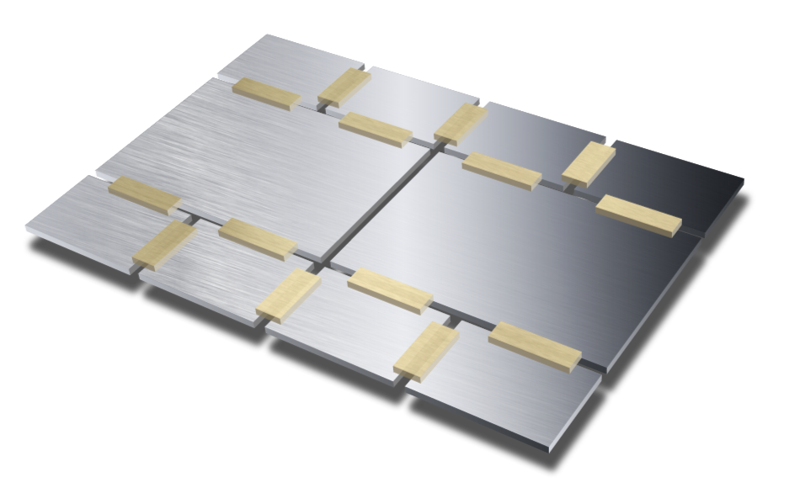


Value Thesis of an Integrated STCO
Bring heterogeneous parts to market, faster, with better PPA & yield
Accelerate Time to Leadership
Development Accelerated
Proven STCO Solutions
Robust Products
Architecture
STCO Optimization
Mechanical
Intel ® Simics®
Thermal
Intel® Docea™
Firmware Accelerated
Cost
Performance
Intel® CoFluent™
Validation Accelerated
STCO: system technology co-optimization
Notes:
The value thesis of the system design studio is “bring heterogeneous parts to market faster with better PPA and yield.
Development is accelerated with interoperable analysis engines.
We described how proven STCO methods will reduce time to engineering commit.
The pre-validated SW and HW system architecture will make the execution predictable
Our thesis is this will accelerate the time to leadership.

Slide 40
Agenda
 | Topic
1 | Setting the Context …
2 | Intel’s Turnaround Strategy
3 | Competition
4 | Intel’s Current Landscape
5 | Value Prop
6 | Recommending: System Design Studio
7 | Potential Internal and External Use Cases
8 | Next Steps and Call to Action

Slide 41




System Design Studio Dev Strategy
EDA Collaboration
Example: https://www.cadence.com
Pending strategic partnership
Niche start-ups with significant potential
Example: https://www.jitx.com
System Design Studio
University collaboration
Focus: research directions
Example: https://stanford.edu [App Store]
Lead driver of co-development: https://intel.com
Intel’s role: drive strategic alliance and use-cases for IDM 2.0
Notes:
Intel cannot do this in a silo.
We must collaborate with EDA companies, who have an established ecosystem. We plan to form strategic partnership.
Niche start-ups like JITX have common and open representation languages for hardware. We plan to partner with them
Universities will be approached to explore future research directions. We listened to the previous presentation from Stanford, They are already part of an Intel funded center to build an App Store for Hardware
We must lead by extending the studio by unique Intel differentiation, driving strategic alliance and offering proven use-cases for IDM 2.0

Slide 42
Our Approach will Drive Increasing Value
Continue Status Quo
Partner w/ Govt
All-In
Participation
Partnering
Leading
Heterogenous Systems will organically grow
Incubate & accelerate grand challenges
Prioritize holistic studio for systems
Approach
Participate in the ecosystem
Intel assets are key for system challenges
Leapfrog competition in system design
Assumptions
Our competitors (TSMC, AMD, …) leapfrog us
Competition acts faster seeing ↑ benefits
Culture & externalization challenges
Risks
Notes:
There are multiple approaches with increasing value.
We can participate by continuing the status quo. However, our competitors may leapfrog us.
We can partner with the government to incubate and accelerate solutions to grand challenges. Intel will have key assets to offer. Competition may act faster by seeing the increasing benefits of a system design studio.
The approach that will bring the MOST value to Intel is all-in and leadership APPROACH. We prioritize system design studio development. It will have massive benefits to leapfrog competition. We will have to address the cultural and externalization challenges.

Slide 43
Call To Action
Near Term: 1 year
Medium Term: 1 – 2 years
Long-Term: 4+ years
Develop Studio Tech
Acceleration
Strategic Innovation
TD
Enable APIs for Systems Solvers
Offer proven recipes for co-design
Advanced recipes for co-design
SATG
Leverage ISIM in Studio
Always-alive architecture models
Application synthesis
DEG
Embrace 3DBlox, ESIR
Pathfinding of 2026 products
AI + LLM for System exploration
IFS
Certify reference designs
Pilot use cases with IFS customers
Link: Natural Language Guided Si Product Development
Partnership
Confirm strategic EDA partner
Develop monetization streams
Establish an App store for Systems
We recommend to accelerate System Design Studio Tech by DEG, SATG and TD
Notes:
Our TSLRP Call to Action is to bring multiple entities together. We are including TD, SATG, DEG, IFS and external partners
In the near term, we propose to enable APIs for system solvers and embrace ISIM, 3DBlox and ESIR. In parallel, confirm EDA partnership
In the medium term, the studio will offer proven recipes, release always-alive models. We aspire to intercept pathfinding of 2026 products and pilot use cases with IFS customers. EDA partnership will continue to build monetization streams.
In the long term (4+ years) the studio will be enhanced with novel research and exploration methods. We would like to bring the App Store vision to fruition.
The future challenge of LLM usage for design is covered in another TSLRP presentation.
We recommend to accelerate System Design Studio Tech by DEG, SATG and TD

Slide 44
Acknowledgements & Sub-Teams
Relation to past TSLRPs
  [2021] Silicon at the Speed of Software – SiFive presentation
  [2021] Compiler Inspired HW Design
  [2022] Open-Source Silicon Stack
  [2017] Developing a chiplet ecosystem
  [2010] SiP Tiled architecture
  …
Current 2023 TSLRP
  Natural Language Guided Si Product Development
Team | Leads, Partners
Core Team | Vivek Rajan, Tanay Karnik, Bala Iyer, Rob Munoz, Surhud Khare, Sophie Lennon, Eric Fetzer, Atul Kwatra, Vinoo Srinivasan, Bob Brennan, Ravi Mahajan, Satish Surana, Lalitha Immaneni, Shubha Bommalingaiahnapallya, Slade Morgan, Ram Viswanath, Chris Rothstein, Rajiv Mongia
Studio Sub Team | Bala Iyer, Rajiv Mongia, Mark Doran, Nanda Kuruganti, Jin Yang
Product Fit Sub Team | Surhud Khare, Slade Morgan, Takuya Abe
Business / Market / Ecosystem Sub Team | Rob Munoz, John Miranda, Yahya Sotoudeh, Tak Abe, Len Neiberg, Rachel Rosenberg, Bill Bowhill, Jay Desai, Sindhu Xirasagar, Anu Rao, Saurabh Gayen, Peter Onufryk, Praveen Mosur, Amar Deogharia, Gena Gleason, Mark Bohr, Dan Willis, Abby Greenberg, Jeff Brown
Long Range Sub Team | Mahesh Subedar, Desmond Kirkpatrick, Fadi Aboud, Al Fazio
Notes:
We are identifying connections to other TSLRP topics in the recent years and this year.
This TSLRP readout would not be possible without the help of a large Intel team. We sincerely thank all the team members for their valuable contributions.

Slide 45
[Projected Use Model] System Design Studio for Customer0
Download System Design Studio
System Design Studio
System Synthesis
Profiling, Tracing, SW-HW Partitioning, Specification
For decades, TSMC spearheaded silicon foundry ecosystem
Intel is on a path to lead system foundry ecosystem
System design studio is a must to realize IDM 2.0 vision
Example Recipes
Cache L2 vs L3 Disaggregation Analysis
Cost modeling w/ Thermals impact
…
Integrated Analysis Tools
Cost
KPI
PnP
Electrical
Physical
Simulation Models
Common representation, Plug-n-Play Models
Secure Repositories with Models
SW
FW
IPs
Chiplets
Packages
Boards
Notes:
We would like to leave you with this projected vision of system design studio with its example recipes and its promise.

