Slide 1
3D DRAM Access Transistor Architecture
Stacking
Shark Fin Channel with Top Gate
Saddle Channel with Back Gate
Saddle Channel with Fin Gate
Cylindrical Channel with Back Gate
Ring Channel
Layering (Tier Socket)

Slide 2
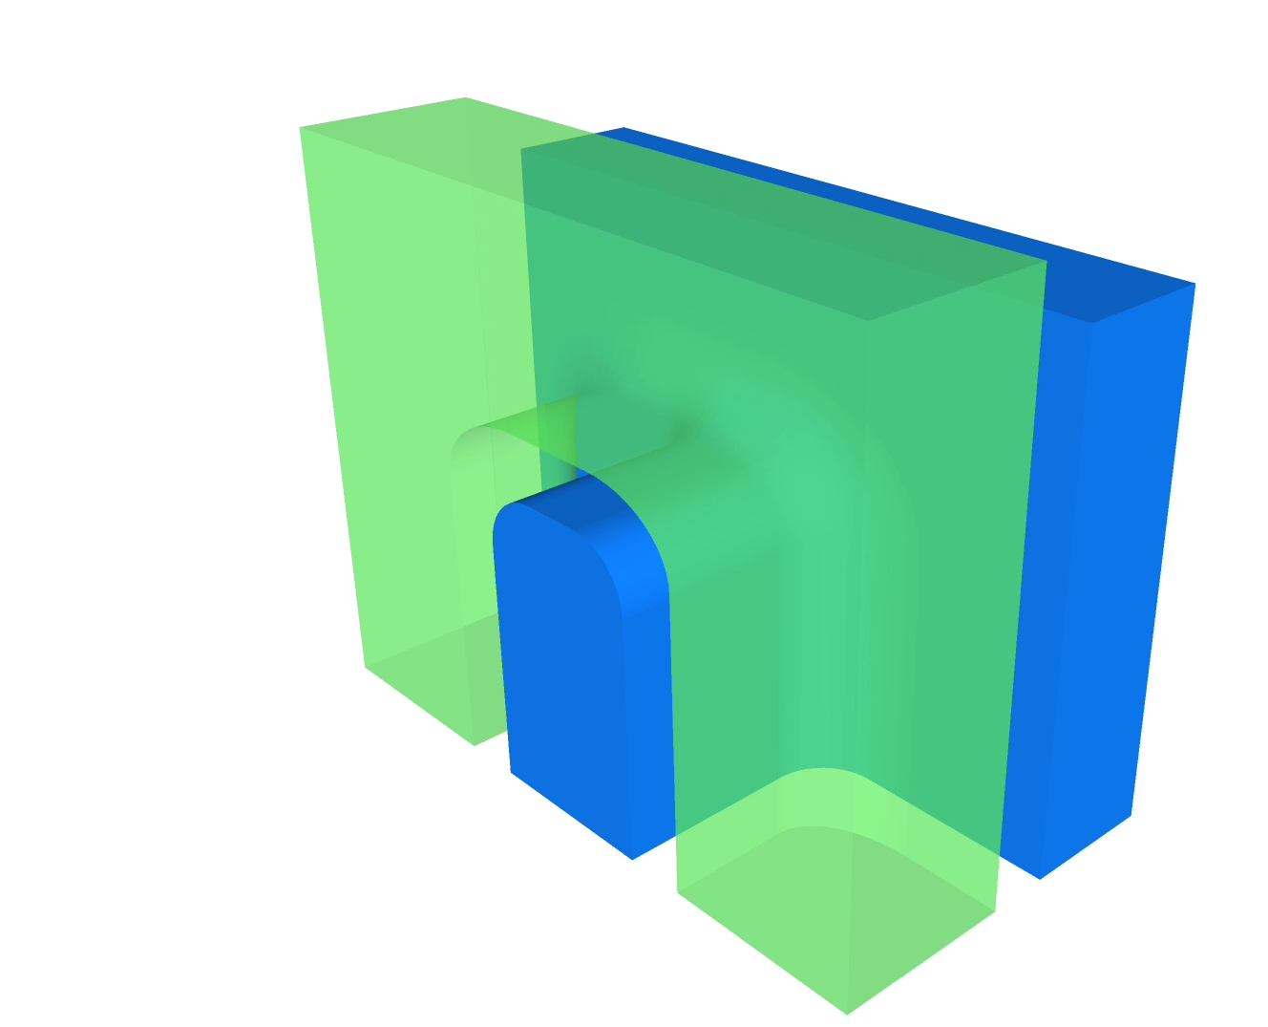
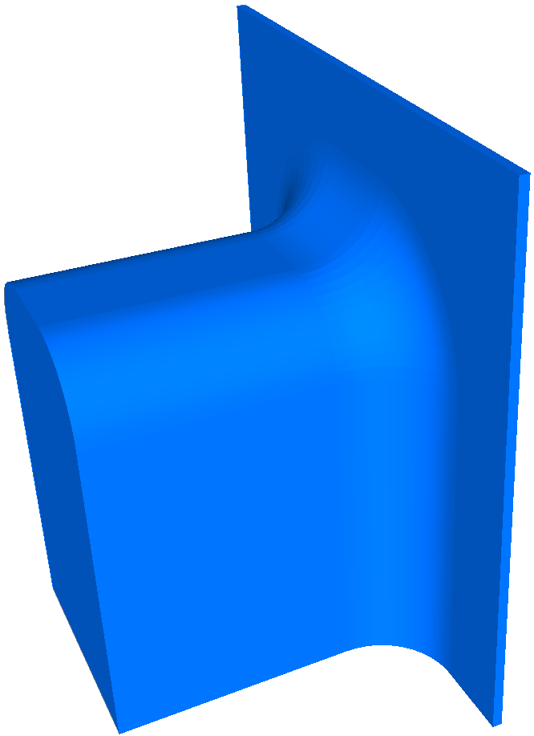
SF CAT : Shark Fin Channel Access Transistor
Half Channel + Gate
Half Channel

Slide 3
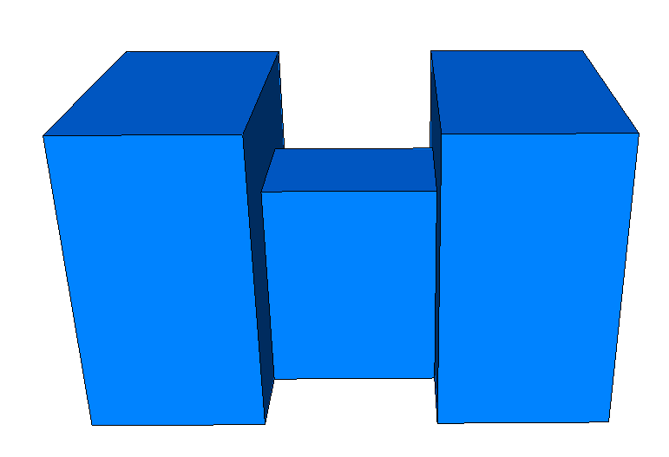
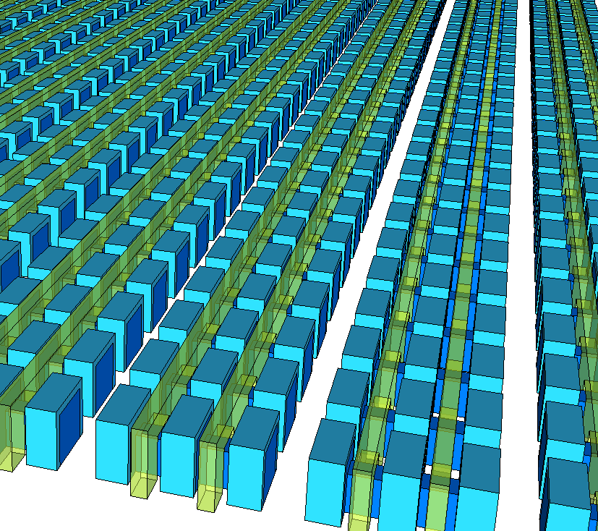
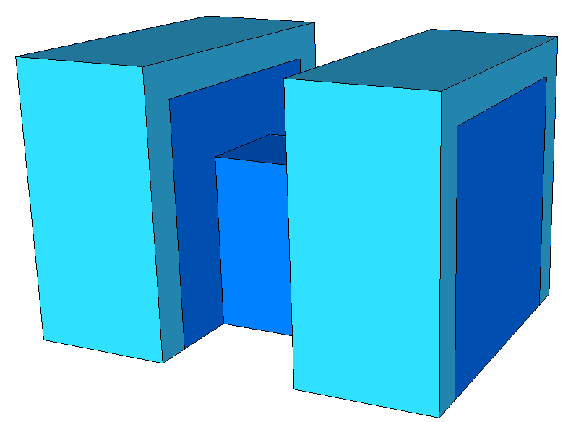
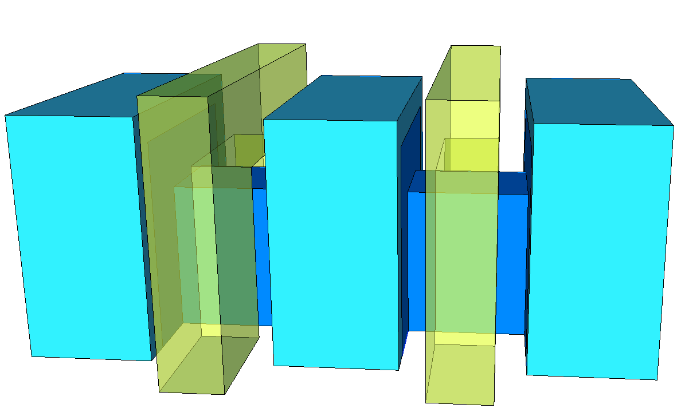
SF-CAT & array

Slide 4
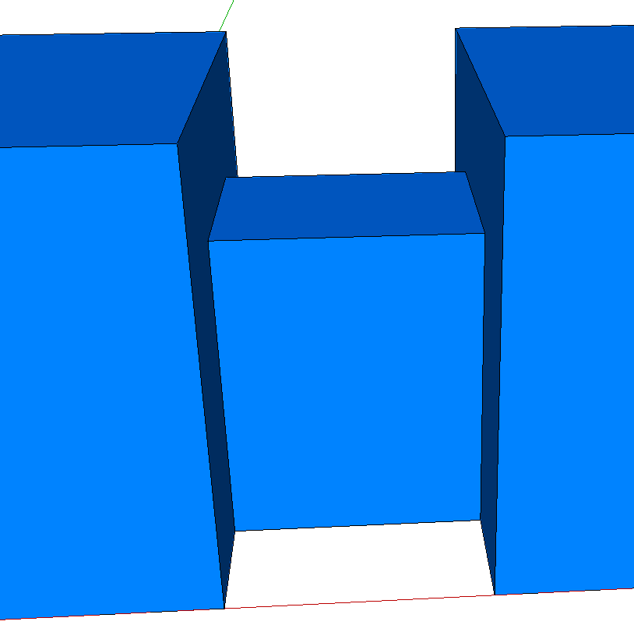
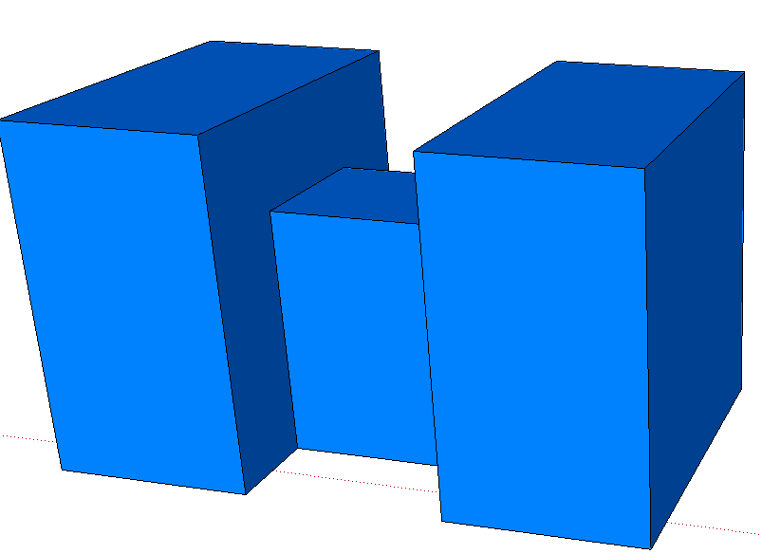
Z, L Design Strategy
Fin height for on-state resistance to optimize t_{sense}
Recess Fin to increase Chanel length to reduce leakage for retention time
S_{Z}
L₁ + 2 · L₂ ≈ L_{min} ;
Z_{2,H} = Z_{1,H} + L₂ ;
Z_{2,W} = Z_{1,W} + 2 · L₂ ;
R_{Ch1}⁻¹ = qµC_{ox}V_{on} · (2 · Z_{2,H} + Z_{2,W} – 4 · L₂) / L₁ ;
R_{Ch2}⁻¹ = qµC_{ox}V_{on} · (2 · Z_{2,H} + Z_{2,w} – 2 · L₂) / L₂ ;
where
V_{on} = V_{P} – V_{T} ;
R_{Ch} = R_{Ch1} + 2· R_{Ch2} ;
Active Design Rule (2 Cells)
Cell Active Pitch = Z_{2W}+ S_{Z} ;
Cell Active Pitch = 3 · L_{SD} + 2 · L₁ + S_{L}
Z_{2,W}
Z_{1,W}
L₁
L₂
Z_{1,H}
Z_{2,H}
L_{SD}
S_{L}
R_{Ch1} = (qµC_{ox}V_{on})⁻¹ · L/W
R_{Ch1}⁻¹ = qµC_{ox}V_{on}· (2·Z_{1,H}+ Z_{1,W})/L_{G1}
R_{Ch2} = (qµC_{ox}V_{on})⁻¹ · L₂/[ ½ ·(Z₁+Z₂)]
R_{Ch2}⁻¹ = qµC_{ox}V_{on}· [Z_{1,H}+ Z_{2,H}+ ½(Z_{1,w}+Z_{2,w})]/L₂

Slide 5
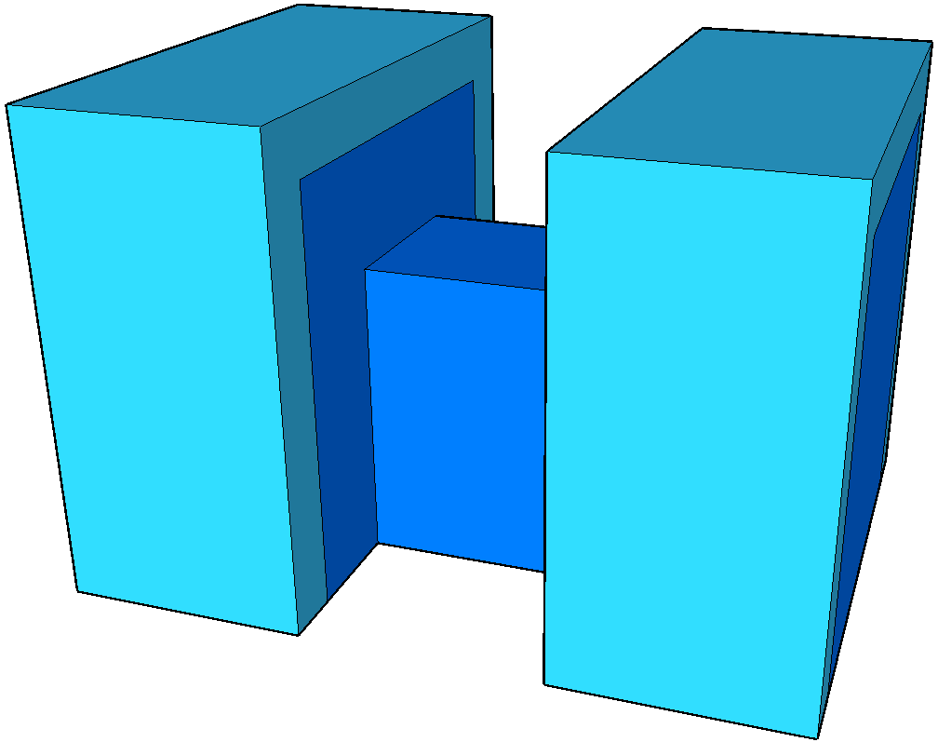
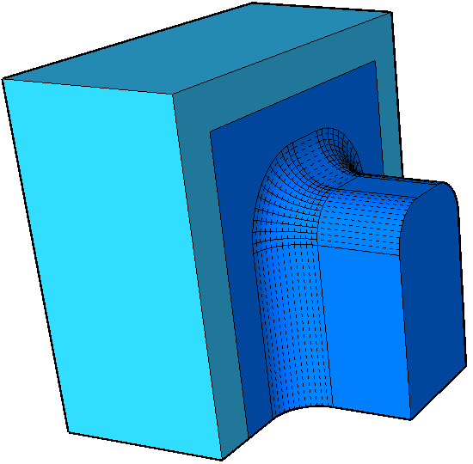
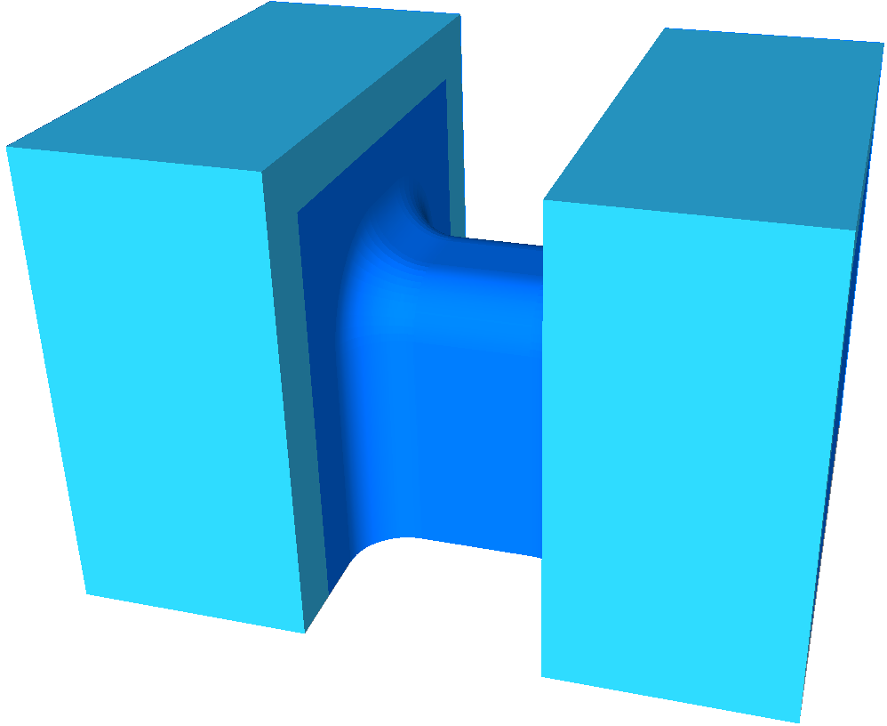
Channel Morphology
Sharp inner corners impede field effectiveness; it degrades I_{off} and R_{on}

