Slide 1
Optane Process Arch
Shafqat Ahmed

Slide 2
Arch Elements
Array WL/BL
Array Via & Hook-up
Pitch-Cell (LWL/LBL, GWL/GBL) ➔ 5V CMOS
Logic/ Datapath/IO ➔ 1.0-1.2V CMOS
Interconnect
Under-array (Cu layer for low-resistance)
Above-array (Al for power-bussing & wire-bonding)

Slide 3
Process Arch
Polyimide
Al for wire-bond
Stacking
Passivation
Top
Metal 2
(Al)
1^{st&} 2nd generations had
1 layer of top metal (power bussing)
Top
Metal 1
(Al)
W TV1
WL
B
L
4
-
WL
deck array
B
L
WL
Cu M2
M4 2x array pitch
M1/ M2/ M3 4x array pitch
M4 is the interface btw array & periphery
M2/M3 are the primary signal lines
-
M4,
Dual
-
Damascene
Cu Single damascene
LV CMOS
HV CMOS
H
V CMOS for under tile decoders

Slide 4
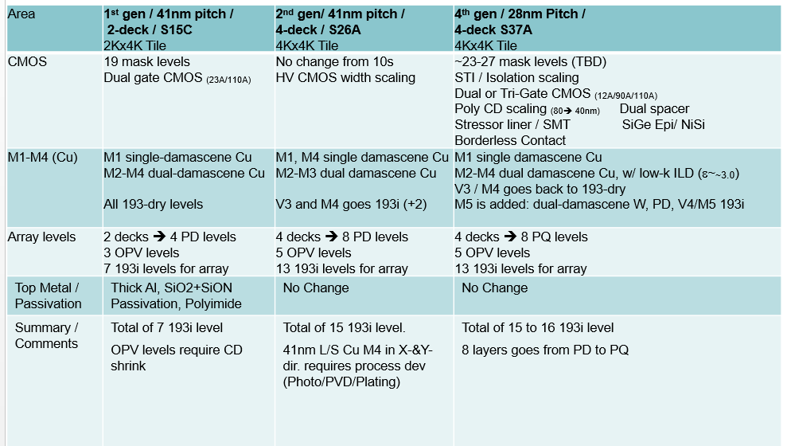
Arch Elements
OPV ➔ on pitch via
~$800 CPW for CMOS + 4LM Cu + Al & Passivation

Slide 5
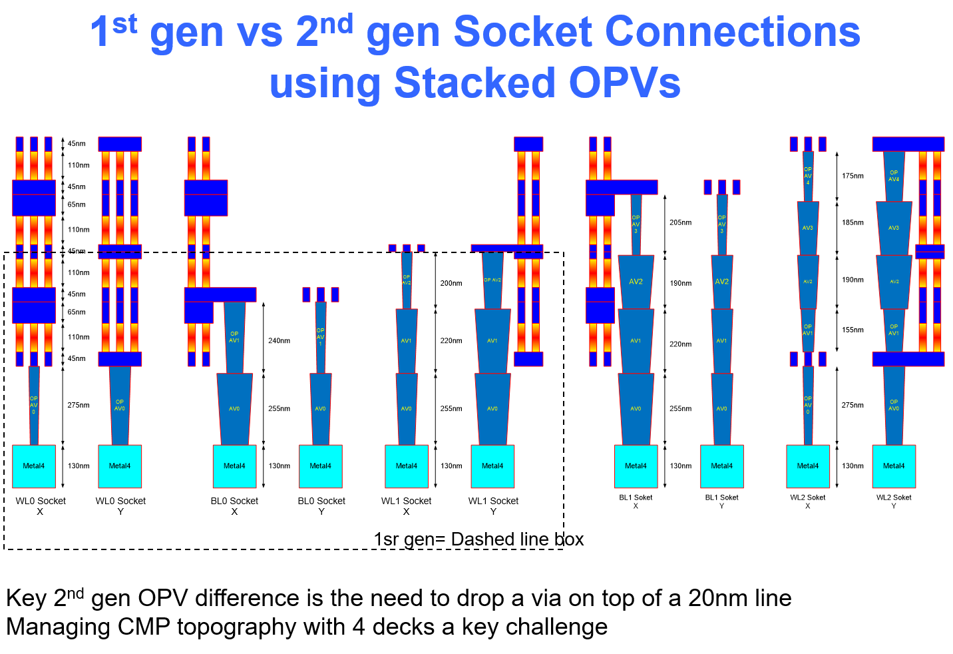
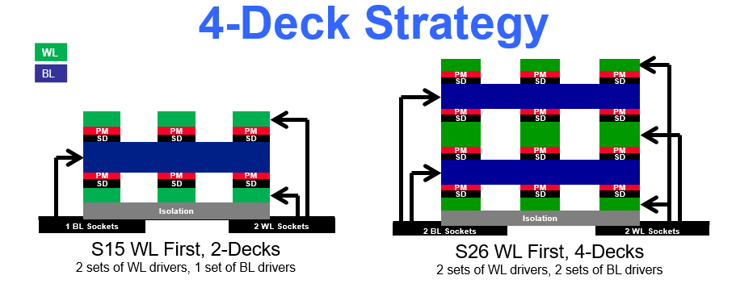

Slide 6
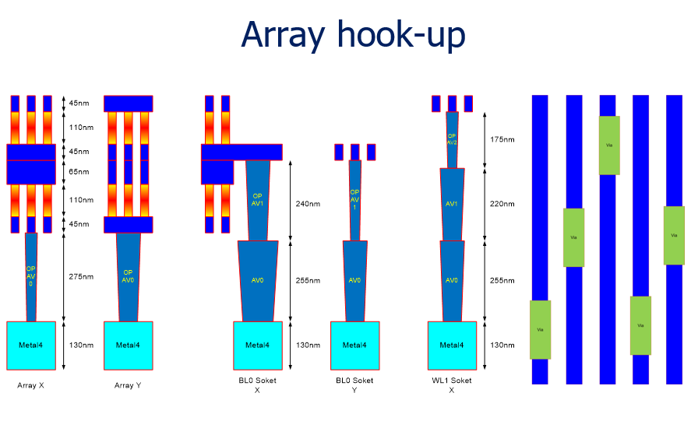

Slide 7
Tile – 1st gen – Staggered WL
WL2
DRV
WL 1
DRV
BL Drv

Slide 8
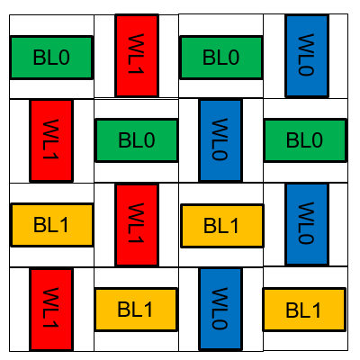
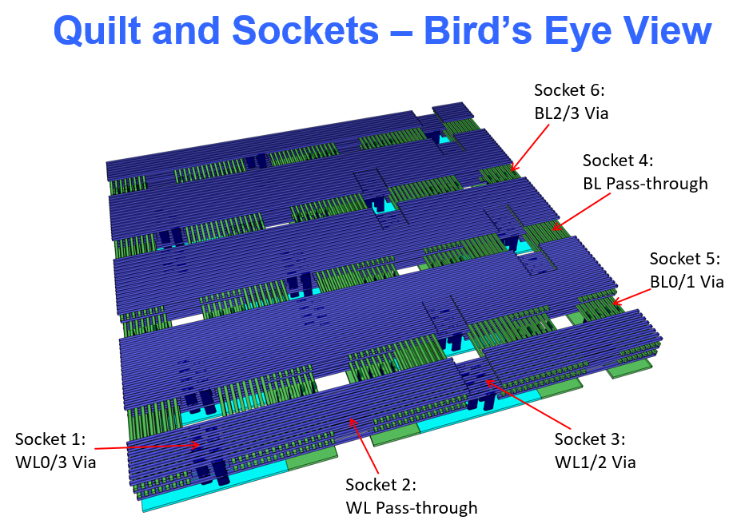
Tile – 2nd gen- Quilt

