Slide 1
HBM in Package
DerChang Kau, Sep/28/2022
Current Art
Fanout based Package
System Integrated Solution

Slide 2
HBM Current Art

Slide 3
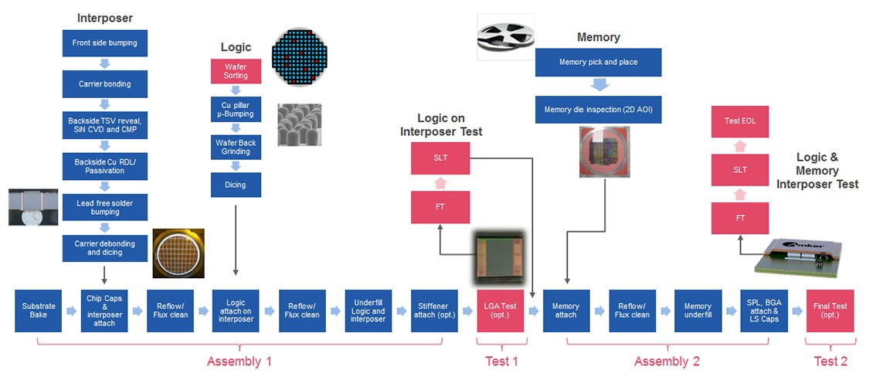
Avery Design Systems has built a verification platform based on its own tested verification IP (VIP) portfolio to enable pre-silicon validation of design elements, including HBM3, by providing memory models, protocol checkers, performance analysis, and compliance test-suites. (Courtesy Avery Design Systems)

