Slide 1
GTM Device Physics
Ricky Tseng, Peter Chang, David Kencke

Slide 2
Agenda
Introduction: Floating Body Gain Cells
Thyristor Action, Vfb (Steady State)
1T Gated Thyristor DRAM: Long Gate Length
Memory Operation (Transient State)
Evolution of Disturb “1” State
2T Scaling (DRAM Operation)
Summary

Slide 3
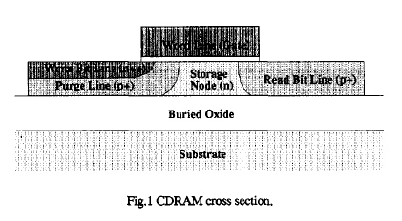
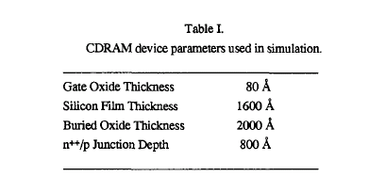
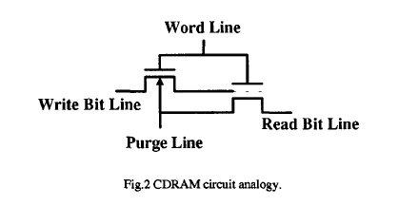
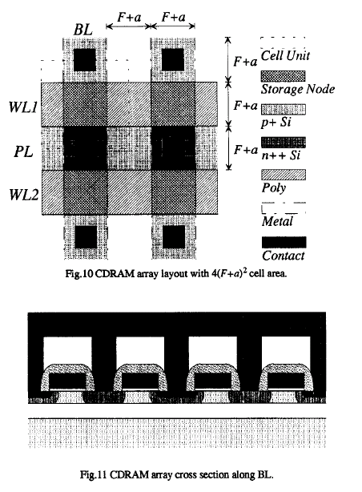
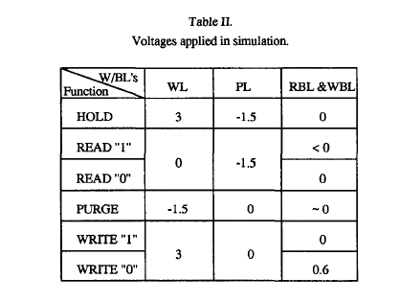
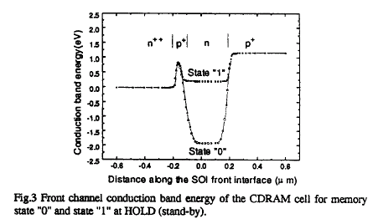
“2T” FB Gain Cell (‘93 Berkeley)
Storage
Program
Gate
P+
N++
N+
P+
Read
Program charge through NMOS and read on PMOS.
Cell layout and scaling problematic.

Slide 4
Thyristor Operation
J1
J2
J3
P+
N
P
N+
+V3-
Id (uA/cell)
+V1-
+V2-rev./for.
Vfb
Anode (V)
Lg=300
Vfb: forward breakover voltage
Sweep Vanode >3V →break over middle junction→ snapback occurs
Notes:
4

Slide 5
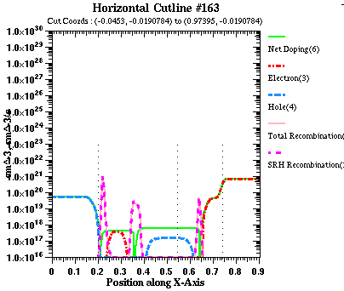
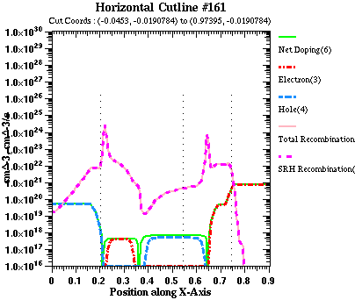
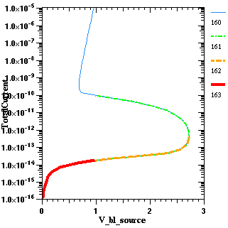
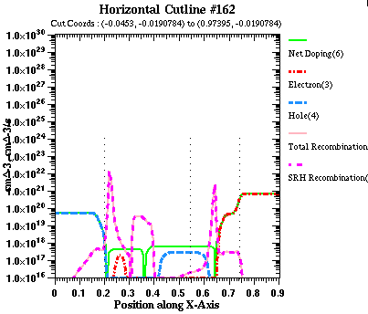
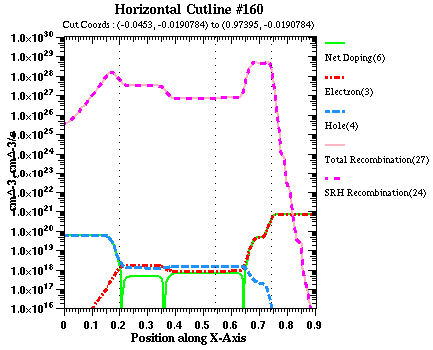
Carriers
4
net doping
1
3
3
2
R
G
R
1
n
p
Breakover
when reverse bias is large and starts to lower J1/J3
2
All junctions on
Breakover
4

Slide 6
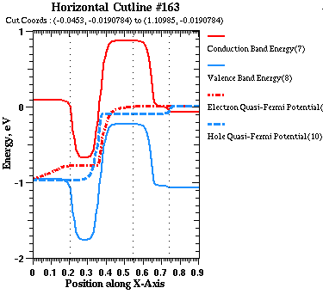
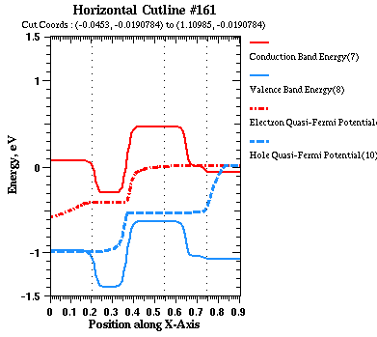
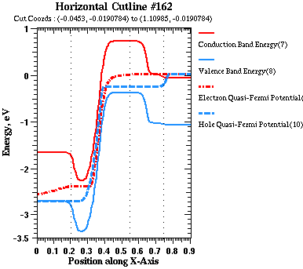
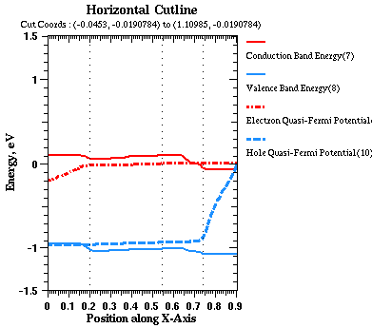
Band Diagram
Ec
3
4
Fn
3
Ev
Fp
2
1
1
Breakover
when reverse bias is large and starts to lower J1/J3
4
2

Slide 7
Vfb (w/o Gate)
Vfb=V_{B}(1-α1-α2 )^{1/n}, V_{B} is the reverse breakdown voltage, n is constant, α1, α2 is the current gain of pnp, npn transistors.
Ln=√Dτ , α~sech(W/Ln), τ↑, α↑, Vfb↓ (Ln~2um)
When α1+α2~1, the thyristor breaks over, and J2 is in the saturation state.
I_{E1}
Anode
P
N
P
I_{C1}=I_{B2}
I_{B1}=I_{C2}
Cathode
N
P
N
I_{E2}

Slide 8
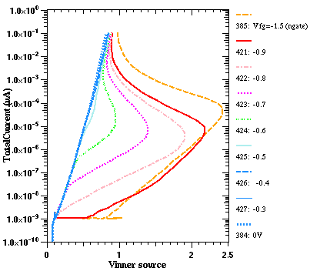
Vfb vs. Gate Voltages
VG= -0.4
1.1
0.5
0.4
0.3
J1
J2
G
J3
0.2
P+
N
P
N+
VG
(P-metal gate)
+V1-
+V2-
+V3-
Anode (V)
Gate voltages modulate the P body potential thus for breakover (Vfb) effect. In contrast no-gated thyristor relys on doping for Vfb.

Slide 9
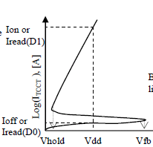
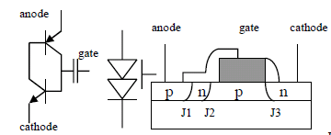
1T Thyristor DRAM (T-RAM ‘05)
It appears that Vfb > Vdd is still needed for DRAM.
Our finding: Vfb is a steady state characteristics, OK to be small for DRAM.
2T GTM is scalable to Lg=28nm.

Slide 10
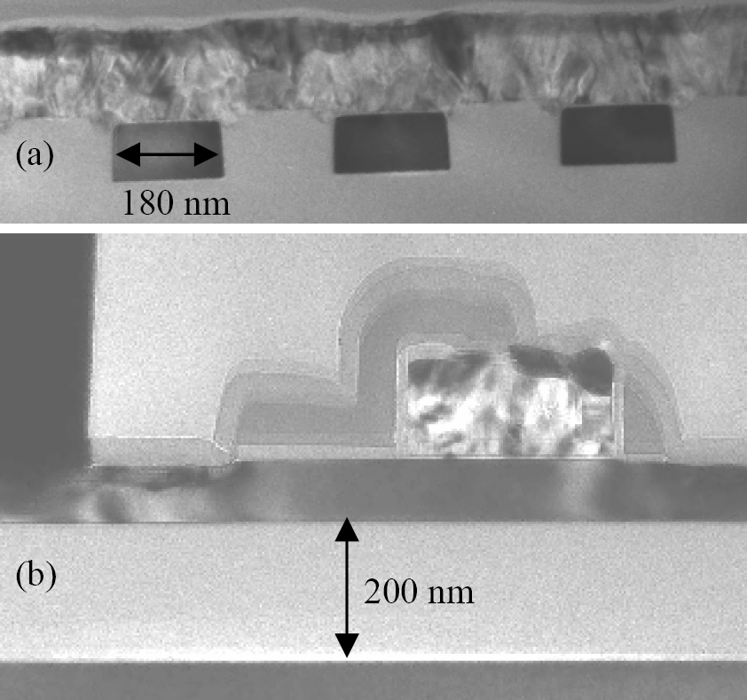
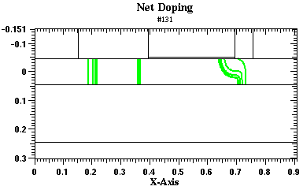
Simulation Model
Lg=300nm | dId, 125C (uA/cell) | dId 25C (uA/cell) | Ret (ms)
T-ram | 190 | 130 | 24
Intel SIM | 183 | 142 | 17
p+ n p n+
FBC Device Model calibrated w/ Intel bipolar FBC data.
Estimated and compared results vs. T-ram’s long Lg data.
Use this model for device design and array operations
Tram, IEDM’05
TRAM dimensions adjusted to fit

Slide 11
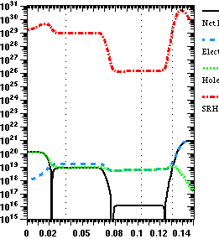
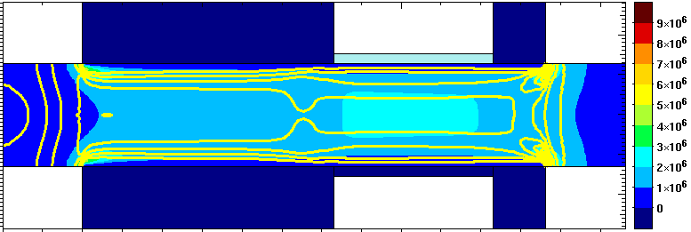
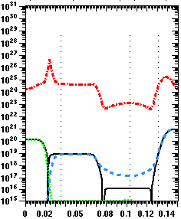
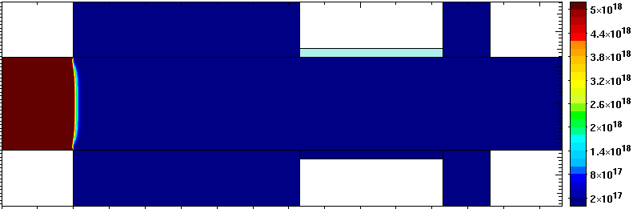
Memory Operation W1/W0
w1
W1
+1.05
SRH
J1
J2
J3
1.05
P+
N
P
N+
0
I hole →
←I elec
e-
h+
+1.05
Rate, doping, e/h conc. (cm⁻³)
P+
N
P
N+
W0
w0
J1
J2
+1.05
J3
0.6
P+
N
No holes
0
P
N+
+1.05
h+
Mechanism only involves SRH Rec/Gen.
Notes:
11

Slide 12
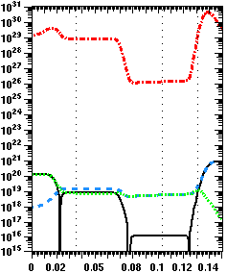
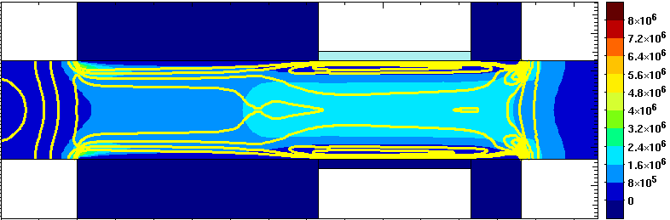
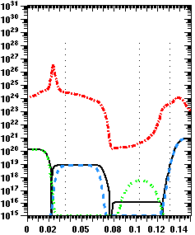
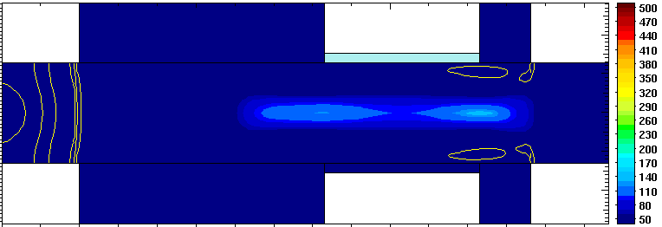
Memory Operation R1/R0
r1
R1
J1
J2
0.3
J3
1.05
I hole →
←I elec
P+
N
P
N+
0
e-
h+
0.3
Rate, doping, e/h conc. (cm⁻³)
P+
N
P
N+
R0
r0
J1
J2
0.3
J3
1.05
P+
N
0
I hole →
←I elec
P
N+
0.3

Slide 13
1T Disturb/Hold Retention
DG, Lg = 40nm.
“1”
“1”
hold
Holes
hold
Id (uA/cell)
dist
“0”
“0”
dist
Time (sec)
Time (sec)
1T Lg=40 | BL (anode) | WL (P-Gate) | SL (cathode)
Write1 | 1.05 | 1.05 | 0
hold | 1.05 | 0.3 | 0.9
Read | 1.05 | 0.4 | 0
Write0 | 0.6 | 1.05 | 0
Disturb | 0.6 | 0.3 | 0.9
Median retention (disturb “1”, hold “0”) ~4ms.
Disturb settles at “0” , Hold settles at “1”.
Notes:
13

Slide 14
Evolution of Dist “1”
120 holes
1us
40 holes
10ms
Id (uA/cell)
5 holes
1s
Time (sec)
Read condition @ VG=0.3
Long read after Dist “1” for 1s
Dist: BL=0.6 WL=0.3 SL=0.9V
Anode (V)
Transient state evolves into the steady state condition.
Transient state does not correspond to a steady state point.
Vfb is needed for read operation not retention.

Slide 15
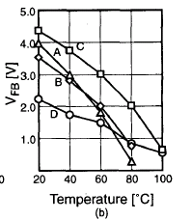
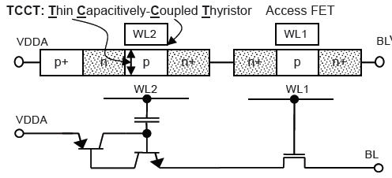
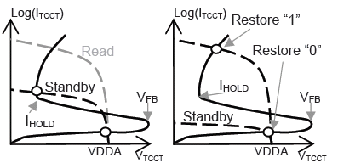
2T Gated Thyristor SRAM (Stanford ’98, ’99, T-RAM ‘04)
2T is needed for solving the BL disturb issue in 1T.

Slide 16
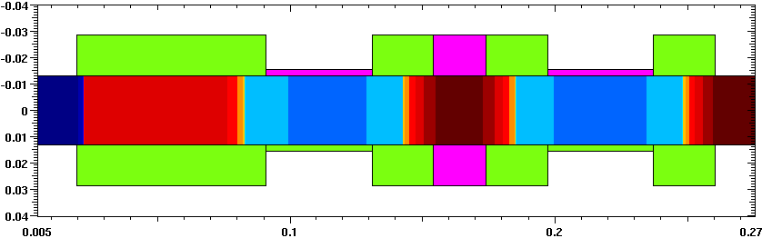
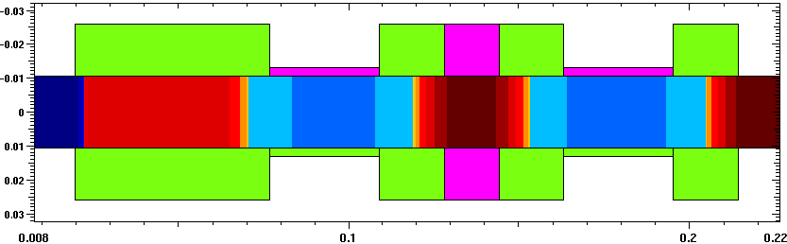
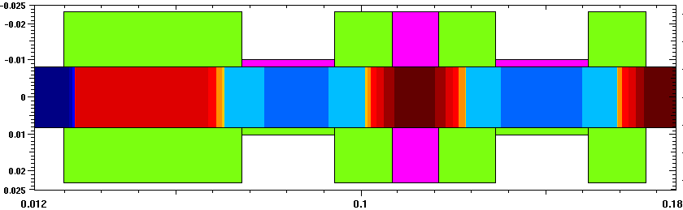
2T Cell Scaling
Lg=40
Lg=40
P1270
Cell: 270x80 nm2
0.8X0.7
Lg=32
Lg=32
P1272
Cell: 216x56 nm2
0.8X0.7
Lg=25
Lg=25
P1274
Cell:170x40 nm2

Slide 17
2T Lg=40 (P1270)
DG, Lg=40
Id (uA/cell)
tail
med
Holes
tail
med
Time (sec)
Median dId ~13.5uA @85C
Tail dId ~6.3uA @-5C
Median retention ~25ms
Tail retention ~14ms
Tail conditions (± 2nm Tsi, ±4.7s RDF)
Notes:
17

Slide 18
2T Scaling to Lg=25nm (P1274)
tail
med
Id/cell (uA)
1, 0 # of holes
tail
med
Time (sec)
Median dId ~15.6 uA @85C
Tail dId ~6 uA @-5C
Median retention ~1.5ms
Tail retention ~0.5ms
Lg=25 is functional, continue investigating shorter Lg.

Slide 19
Vfb Scaling
VG=0.3 tails
VG=0.3 median
Vfb (V)
(ret~ 1.5ms)
2T DRAM operation
(ret~ 0.5ms)
VG=0.9
@ 85C
Gate: P-metal gate
Lg (nm)
As device scaled, proper gate voltages and Tox are needed to maintain Vfb.
(Tails have condition of 4.7s RDF, +2nm Tsi)

Slide 20
Summary Table
 | Ox (nm) | Lg (nm) | Tsi (nm) | V range (V) | Results/Comments
Tram
1T | ? | 300 | 90 | 3 | Device data, DRAM operation, retention 27ms
2T | ? | 300 | 90 | 3.6 | 1.1MB Array, Claimed SRAM operation (restore).
 |  |  |  |  | Our finding: restore has no operating window given intrinsic 4.7s RDF and ± 2nm Tsi tail condition.
Intel Simulation |  |  |  |  | Matched cells shows comparable dId and retention.
1T | 6 | 300 | 90 | 3
1T DG | 2.4 | 40 | 26 | 1.1 | Lg=40 shows median retention 4ms Cannot scale to Lg=32 due to BL low disturb
2T DG | 2.4 | 40 | 26 | 1.8 | Isolate the floating node, which can eliminate the disturb issue in 1T Scalable to Lg=25
Tox scaling is the key for scaling down to 40nm Lg device.
Tox scaling is the key to generate scaled device.

Slide 21
Backup

Slide 22
Transient (Hold “0”) vs. Steady State
10ms
66 holes
27 holes
Id (uA/cell)
Short Read 6ns after Hold “0”
5 holes
10ns
Time (sec)
Long read after write0
Anode (V)

Slide 23
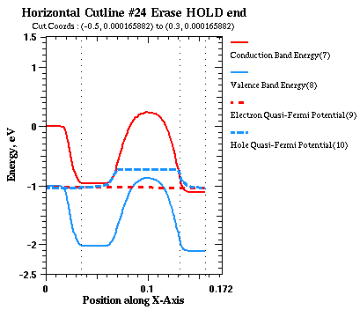
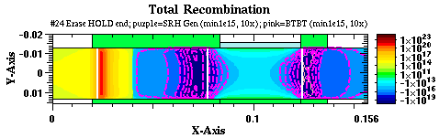
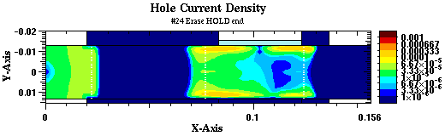
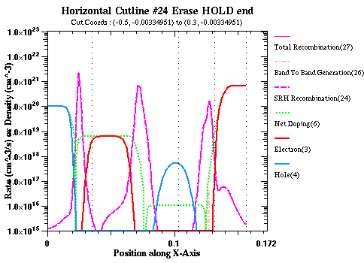
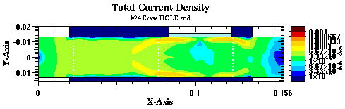
Erase Hold 4ms

Slide 24
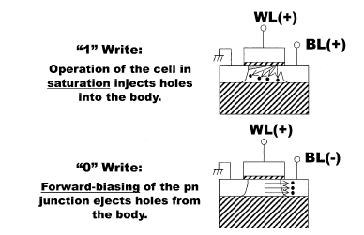
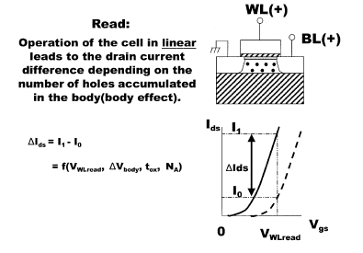
1T FB Gain Cell (ISi ‘01, Toshiba ’02, Berkeley ‘02)
Front channel for both program and read, back channel for storage.
Impact Ionization requires moderately high voltage.
Hole storage in back channel requires a BG coupling.
Pillar BG or -20V voltage for 150nm BOX

Slide 25
IDG 1T FBC (Intel ‘06)
FG
BG
Si
BOX
Low voltage operation with thin BG oxide.
But asymmetric FB/BG needed for optimal memory performance.

