Slide 1

A 1Gb 2GHz Embedded DRAM in 22nm Tri-Gate CMOS Technology
Fatih Hamzaoglu, Umut Arslan, Nabhendra Bisnik, Swaroop Ghosh, Manoj B. Lal, Nick Lindert, Mesut Meterelliyoz, Randy B. Osborne, Joodong Park, Shigeki Tomishima, Yih Wang, Kevin Zhang
Intel Hillsboro, OR

Slide 2
Outline
Motivation
eDRAM Process in 22nm Tri-Gate
Sub-Array Design
Integrated Charge Pumps
Die Architecture and Protocol
Silicon Data
Conclusions

Slide 3
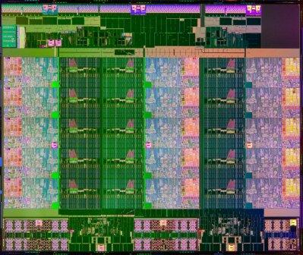
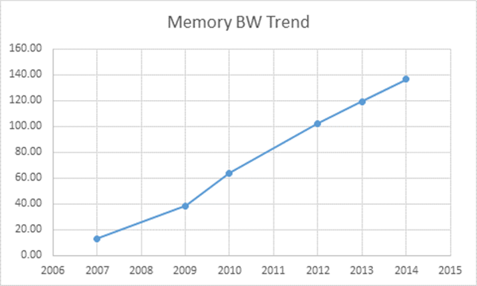
Motivation
25MB LLC
12.5MB LLC
120 GB/s
Memory BW Trend (GB/s)
Shih-Lien Lu, ISSCC’14, Forum2, 2-socket Dell DP Systems
Intel IvyTown Xeon®, ISSCC’14, Paper#5.4
Need for High Capacity and Low Energy/bit high-BW Memory increases
SRAM is not dense enough, and DDR Energy/bit is high
A high-density, high-BW In Package Memory is needed

Slide 4
Outline
Motivation
eDRAM Process in 22nm Tri-Gate
Sub-Array Design
Integrated Charge Pumps
Die Architecture and Protocol
Silicon Data
Conclusions

Slide 5
eDRAM Process in 22nm Tri-Gate
Key features of eDRAM Tech.:
0.029μm² eDRAM bitcell
3.2x smaller than SRAM (ISSCC’12)
BL
Wordline [N+1]
COB
COB
Wordline [N]
17.5Mb/mm² density for a 128Mb Macro
BL
High-k, Metal Tri-Gate transistors supporting both low leakage and high performance
1T-1C eDRAM: 0.029μm²
9 Metal Layers and 7-layers self-aligned Vias with ULK ILD
MIM Capacitor-Over-Bitline (COB) embedded in interconnect stack

Slide 6
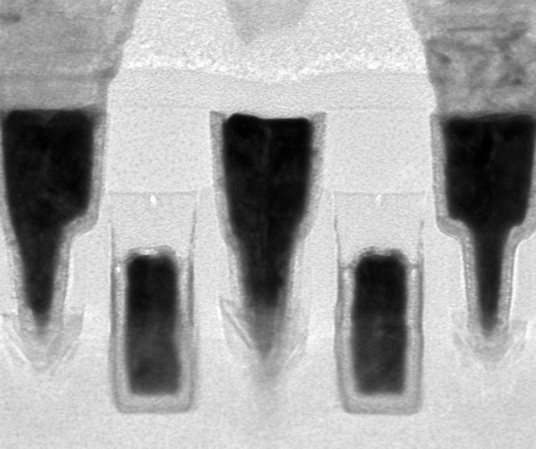
eDRAM Access Transistor
Storage
Node
(Drain)
V_{ds} = 1V @ 95°C
Bitline
Contact
(Source)
Drain Current (A/cell)
Wordline
(Gate)
Optimized Tri-Gate transistors for Latency, BW and Power
<<1pA/cell leakage with Gate Underdrive
Fifth-generation strained Si

Slide 7
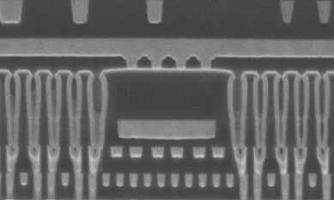
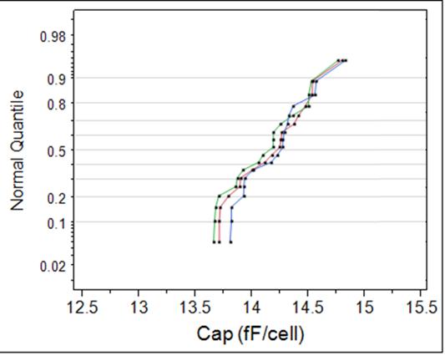
eDRAM Capacitor
Capacitor
14.2fF/cell
Fully integrated MIM Trench Capacitor
Aggressive aspect ratio and compatible with logic process
Median 14.2fF/cell, <<0.1pA/cell

Slide 8
Outline
Motivation
eDRAM Process in 22nm Tri-Gate
Sub-Array Design
Integrated Charge Pumps
Die Architecture and Protocol
Silicon Data
Conclusions

Slide 9
Subarray Architecture and Operation
256Kbit Subarray
Sense
Write-Back
WLoff
Pch
Row Redundancy
½ VCC Gen
64b*8 columns
tBL[i]
eDRAM
Column Redundancy
Prec+Sense+Mux
Timer
64b
bBL[i]
WL Dec
64b
128 rows
65% Array efficiency is achieved at 256Kbit Subarray
Subarray also includes Row and Column Redundancies, as well as local ½-VCC Generator
Random Cycle Time of 6 Array-Clock

Slide 10

WordLine Driver for Power and Vmax
VCC_WL
Plate
Sleep
Sleep_b
MIM
COB
(VSS → VCC_WL)
VCC_WL > VCC
Adr [i:0]
(VSS → VCC)
WLen [j:0]
VSS_WL < VSS
WL [N:0] (VSS_WL → VCC_WL)
Access
Transistor
Bitline
(VSS_WL → VCC)
(VSS_WL → VCC)
VSS_WL
NOR Wordline Driver is used for simplicity and Reliability
None of the transistors’ gate is exposed to >VCC_WL
Dynamic Sleep/Wakeup between VCC/VCC_WL

Slide 11
Area Efficient Column-IO
x128+
rGBL[j]
GBL[j]
WL[j]
tBL[i]
½-VCC Small Signal Sensing at Local Bitline
8
8
Csel_b [7:0]
column mux
precharge
8:1 Column-Mux to Read/Write 128bits per Subarray
½-VCC
Sense_b
2nd Stage Small Signal Sense at Global Bitline
Shared among Subarrays
Sense
bBL[i]
x128+
WL[i]

Slide 12
Outline
Motivation
eDRAM Process in 22nm Tri-Gate
Sub-Array Design
Integrated Charge Pumps
Die Architecture and Protocol
Silicon Data
Conclusions

Slide 13
Integrated Programmable Charge Pumps
WL-ON Voltage is generated through Voltage Doubler
WL-OFF Voltage is drived from –VCC/2
Separate Pumps for Leakage and Activity Charge Loss
Both Voltages are Regulated for Vmax and GIDL
Programmable

Slide 14
Outline
Motivation
eDRAM Process in 22nm Tri-Gate
Sub-Array Design
Integrated Charge Pumps
Die Architecture and Protocol
Silicon Data
Conclusions

Slide 15
1Gb Die Floorplan
256Kb Subarray
2Mbit ¼ Bank
Charge Pumps & Regulators
eFuse
Test Access Port
Low Freq. Test IO
High Frequency OPIO
Thermal Sensor
77mm² 1Gbit die, with 128 Independent Banks
On-die Positive and Negative Charge Pumps with 2% Area Overhead
Thermal Sensor for Tjmax

Slide 16
1Gb Die Operation and Bandwidth
RD
WR
REF
IOclk
Eclk
64bx2
64bx2
64bx2
64bx2
64bx2
64bx2
64bx2
64bx2
RD
WR
REF
64bx8
64bx8
IO transmition rate is 4x of eDRAM Array to save IO area
2x Frequency and samples at both rising & falling edges of IOclk
Array supports back to back Read/Write to different Banks
Completely decoupled Read and Write Datapaths
A Refresh can be issued every cycle in parallel

Slide 17
Outline
Motivation
eDRAM Process in 22nm Tri-Gate
Sub-Array Design
Integrated Charge Pumps
Die Architecture and Protocol
Silicon Data
Conclusions

Slide 18
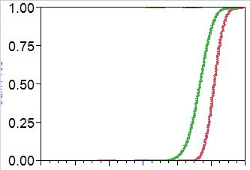
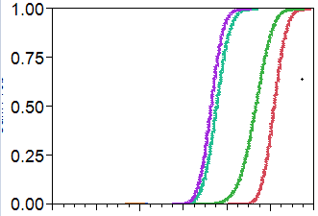
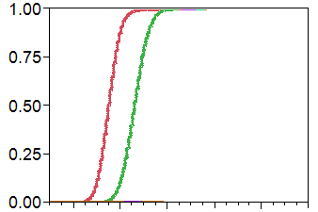
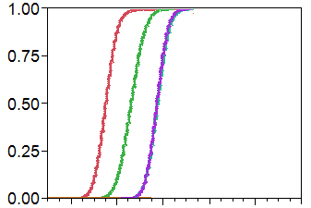
Integrated Programmable Charge Pumps
UnRegulated
UnRegulated
Cum Prob
Regulated-1
Cum Prob
Regulated-1
Hot
Cold
Regulated-2
Cold
Hot
Regulated-2
VCC_WL (V)
2*VCC
VSS_WL (V)
VSS
Tight VCC_WL control is achieved to avoid VCCmax
Similarly, tight VSS_WL control helps to achieve good Retention Time
Programmability allows optimizing Subthreshold leakage vs. GIDL

Slide 19
Retention Time Testing
Bit Fail @100μs RT, 95C
Plate
BL = 0.5*VCC
BL = 0/VCC
VSS_WL < VSS
Cum Prob
2x
0.5*VCC
1/0
Design Target
Isub
0/VCC
BitLine
Retention Time tested at worst case Bitline Voltage of 0V/1V
Potential 2x lower Bit Fail with BL = VCC/2 in Self Refresh

Slide 20
Retention Bit-Fail Optimization
Bit Fail @100μs RT, 95C
Die-by-Die VSS_WL setting
Cum Prob
Design Limit
Different fixed VSS_WL settings
Each die has different Subthreshold/Junction leakage trade-off
Hence different optimal VSS_WL per die
Die-by-die VSS_WL setting achieves significantly improved bit-fail distribution

Slide 21
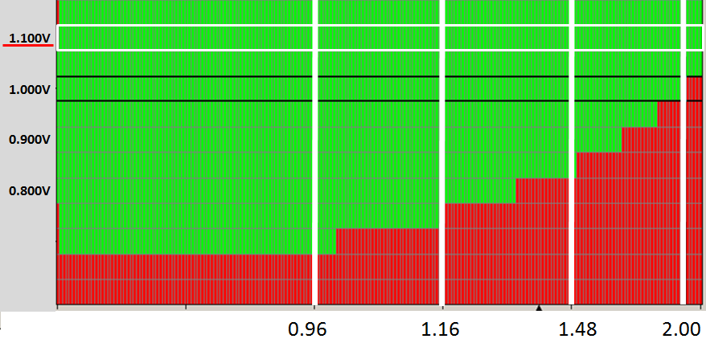
1Gbit Array Shmoo
1.05V, 2GHz
Supply Voltage (V)
0.7V, 1GHz
Clock Frequency (GHz)
0.7V/1GHz – 1.05C/2GHz operation @95C, 100μs RT
3ns Random Cycle Time @1.05V
64GB/s Read + 64GB/s Write Bandwidth @1.05V

Slide 22
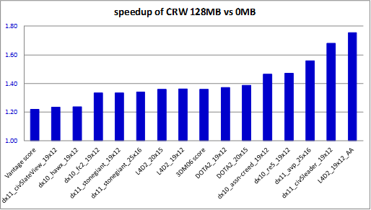
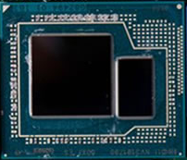
Iris ProTM with 1Gbit MCP eDRAM
DMI
PCI Express*
Display
Performance Improvement (eDRAM ON vs. OFF)
System
Agent
Processor
Graphics
IMC
Core
LLC
75% speed up
60%
Core
LLC
DDR
40%
Core
LLC
20%
Core
LLC
IO
1Gbit eDRAM
IO
eDRAM
N. Kurd, ISSCC’14, “Haswell: A Family of IA 22nm Processors”
Iris ProTM with 1Gb eDRAM MCP is commercially available
up to 75% Graphics Performance improvement with 1Gbit eDRAM

Slide 23
Outline
Motivation
eDRAM Process in 22nm Tri-Gate
Sub-Array Design
Integrated Charge Pumps
Die Architecture and Protocol
Silicon Data
Conclusions

Slide 24
Conclusions
A record density eDRAM Technology is developed in 22nm Tri-Gate Technology to provide high-BW and low Power Memory access
1Gb eDRAM is packaged with high-end graphics processor to improve the performance up to 75% for wide spectrum of applications.
The product is commercially available as Iris ProTM

Slide 25
Q&A

Slide 26


