Slide 1
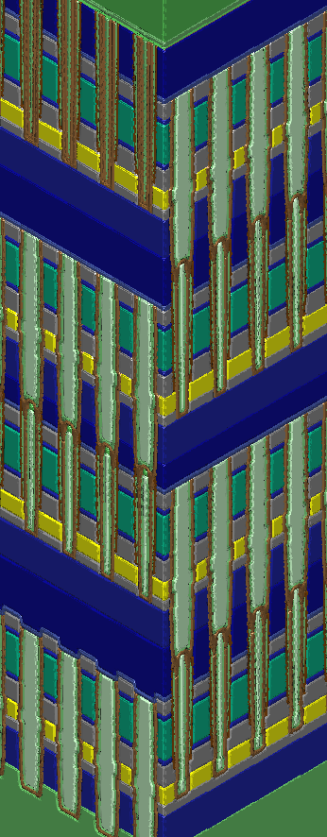
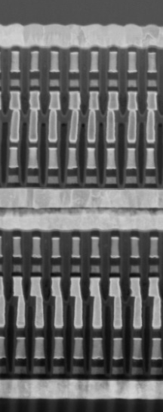
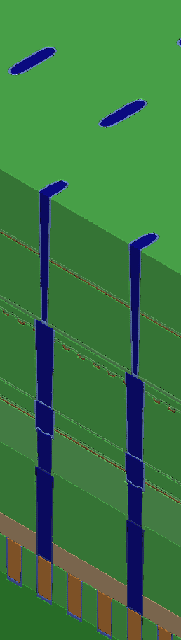
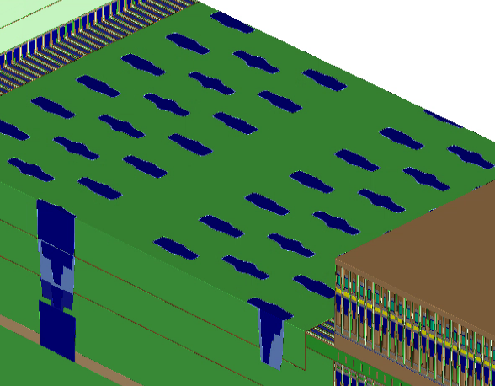
Cross Point and Decking Architecture Challenges
Materials/Device issue
Gap fill must be insulating (thermally/electrically)
Liners required post etch patterning to protect materials
Temperature limitations (~280-400’C depending on segment)
Cross point issues
Interface of first cut to second cut stack determined by series of CMPs; which also manage via topography
Second cut must etch both stack and gapfill/liners from 1st cut pattern.
Via sockets created by removal of gap fill/patterned stack. (below)
Deck stacking issues
Deck interface topography impacts next deck topography
First cut of Deck N+1 requires filling top portion of Deck N with W etch resistant material to avoid trenching down the gapfill.

