Slide 1
3DXP: BEOL memory
Circuit Under Array (CUA) – Sandeep Guliani will take us thru the evolution from 2 Decks to 4 Decks and die size pareto. He will also discuss the development of the sockets connecting memory decks to CMOS and pitch matching methodology. A product roadmap will be disclosed.
BEOL memory stacking – Max Hineman will speak to integration challenges on deck termination. Learning from 1D to 2D, to 4D.
Base cost – Shafqat Ahmed will gives a general idea of evolution of CMOS and interconnect technology for 3 generations of 3DXP.
Pathfinding direction – At high level, we will discuss scaling strategy, We have one alternative cell for 3DXP. Finally we talk about challenges in decoding switches and memory for collaboration topics

Slide 2
Scaling Challenges
Scaling Strategy ➔ Effective cell size metric
  Building the smallest planner cell vs 3D tier (3D NAND like contruct)
  (Tile size + array terminations) vs. CMOS for CUA vs. parallelism
Cell Pathfinding – SXP vs. BiSM
CMOS scaling
  Decoder device options for decoder such as SOI/FIN FET or thin film transistors
Memory Integration challenges
  Memory: Set Speed, endurance, Disturb
  Patterning:
    Pitch multiple for low cost beyond 10nm such as DSA intercept
    Chal chemical and mechanical stability due to hardmask, ambient control, clean, drying and possible downstream impact to CMP and etc.),
    liner/seal/gapfill in the space of 14nm and beyond
    On-pitch via, wl/bl metallization.
  Architecture options
    3-D architecture (NAND tier style for example)
    ADM for deck-select

Slide 3
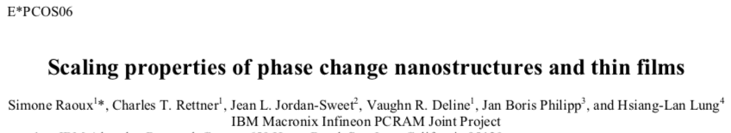
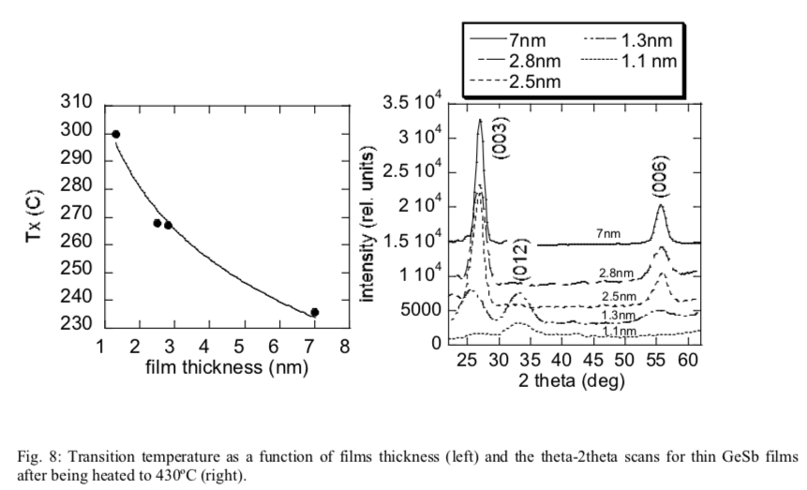
PM Scaling
SD Scaling
Researchers develop theories based on anecdotal empirical ➔ Intel possess most reliable data
What we know from
  CD scaling down to 20nm
  thickness scaling down to 10nm
  5nm C electrode works well.
  SubVt conduction scales with CD
  ITH
  J_{on} > 100MA/cm² for a few seconds
  NDR
  Open fail near Interface
  V_{T} linearly correlated to thickness and optical gap
  Thermal budget tolerances for integration

