Slide 1
TCM/IPM Options
Logic
Interposer
SRAM
(e)DRAM
STT/SOT-MRAM
ubump connections
Hybrid bond connections
SRAM Based High Bandwidth Solutions
monolithic
2.5D with interposer
3D with ubump
3D with HB (CoW)
3D with HB (WoW)
(e)DRAM Based High Bandwidth Solutions
monolithic
2.5D with interposer
3D with ubump
3D with HB (CoW)
3D with HB (WoW)
STT/SOT-MRAM Based
prashant majhi, FTE

Slide 2
TCM/IPM Landscape of High Bandwidth Options for System Performance
Technology (Foundry Options) | Density | Scalability | Bandwidth | Masks | Energy | Process Tech Readiness | Eco-System Readiness | 3D integration limitations | Ex-Industry Engagements | Expected Product Drivers
Monolithic SRAM |  |  |  |  |  |  |  |  | TSMC, Samsung
SRAM(s) chiplet ubump on Interposer |  |  |  |  |  |  |  |  | Samsung (X-Cube)
SRAM(s) chiplet ubump on Logic |  |  |  |  |  |  |  |  | Samsung, TSMC
SRAM chiplet HB (CoW) |  |  |  |  |  |  |  |  | Samsung, TSMC SOIC
SRAM chiplet HB (WoW) |  |  |  |  |  |  |  |  | Samsung, TSMC SOIC
Monolithic eDRAM / low latency DRAM |  |  |  |  |  |  |  |  | IBM, TSMC (sunset), Samsung DBM, Micron
DRAM(s) chiplet ubump on Interposer [HBM] |  |  |  |  |  |  |  |  | Samsung, Hynix, Micron,
DRAM(s) chiplet ubump on Logic [3D DRAM/Logic] |  |  |  |  |  |  |  |  | AMD..w/ ??
DRAM chiplet HB (CoW) |  |  |  |  |  |  |  |  | Samsung, Hynix w/ XPERI, TSMC w/ ??
DRAM chiplet HB (WoW) |  |  |  |  |  |  |  |  | Powerchip w/ logic vendor; TSMC?
STT/SOT-MRAM |  |  |  |  |  |  |  |  | SAMSUNG, TSMC
prashant majhi, FTE
Notes:
Up to 10 Gb
L1 KB
L2 100 KB
L3 10 MB
Per core? E.g. 8 core system
ADM → div between llc type perf-centric ipm; vs high cap
Energy/bit dependence on arch (MUX/data width/page size)

Slide 3
TCM/IPM Landscape of High Bandwidth Options for System Performance
Technology (Foundry Options) |  | Density (Gb/mm²) | Capacity (GB/die) | Bandwidth density (GB/s/GB) |  | Latency (ns) |  | Masks (#) |  | Array Energy (pJ/bit) |  |  | Process Tech Readiness | Limitations | Ex-Industry Engagements
 |  |  |  | R | W | R | W | Crit | Tot | Read | Write | Idle
eDRAM | ADM |  |  |  |  |  |  | 23 |  | 0.5 | 0.1 | 0.64 |  |  | IBM, TSMC (sunset), Samsung DBM, Micron
 | Si
SRAM | 6T |  |  |  |  |  |  |  |  | 0.17 | 0.1 | 0.64 |  |  | high reliability TSMC, Samsung
 | 3T
DRAM | HBM |  |  |  |  |  |  | 17 |  |  |  |  |  |  | Samsung, Hynix, Micron,
 | DBM
 | LL-DRAM
STT/SOT-MRAM | Classic STTM |  |  |  |  |  |  |  |  |  |  |  |  |  | SAMSUNG, TSMC
 | SOT
prashant majhi, FTE
Notes:
Command/Data Energy
Up to 10 Gb
L1 KB
L2 100 KB
L3 10 MB
Per core? E.g. 8 core system
ADM → div between llc type perf-centric ipm; vs high cap
Energy/bit dependence on arch (MUX/data width/page size)

Slide 4
TCM/IPM Landscape of High Bandwidth Options for System Performance
Technology (Foundry Options) |  | Density | Scalability | Bandwidth | Masks | Energy |  |  | Process Tech Readiness | Eco-System Readiness | 3D integration limitations | Ex-Industry Engagements
 |  |  |  |  |  | Macro | PHY | I/O
SRAM | Mono |  |  |  |  | 0.2 | 0.3 | 0.2 |  |  |  | TSMC, Samsung
 | WoW
 | DoW
 | Bumps
eDRAM | Mono |  |  |  | 23 | 0.5 | 0.67 | 0.2 |  |  |  | IBM, TSMC (sunset), Samsung DBM, Micron
 | WoW
 | DoW
 | Bumps
DRAM | Mono |  |  |  |  |  |  |  |  |  |  | Samsung, Hynix, Micron,
 | WoW
 | DoW
 | Bumps
STT/SOT-MRAM | Mono |  |  |  |  |  |  |  |  |  |  | SAMSUNG, TSMC
 | WoW
 | DoW
 | Bumps
prashant majhi, FTE
Notes:
Up to 10 Gb
L1 KB
L2 100 KB
L3 10 MB
Per core? E.g. 8 core system
ADM → div between llc type perf-centric ipm; vs high cap
Energy/bit dependence on arch (MUX/data width/page size)

Slide 5
TCM/IPM Landscape of High Bandwidth Options for System Performance
Technology (Foundry Options) | Density | Scalability | Bandwidth | Masks | Energy | Process Tech Readiness | Eco-System Readiness | 3D integration limitations | Ex-Industry Engagements | Expected Product Drivers
Monolithic SRAM |  |  |  |  |  |  |  |  | TSMC, Samsung
SRAM(s) chiplet ubump on Interposer |  |  |  |  |  |  |  |  | Samsung (X-Cube)
SRAM(s) chiplet ubump on Logic |  |  |  |  |  |  |  |  | Samsung, TSMC
SRAM chiplet HB (CoW) |  |  |  |  |  |  |  |  | Samsung, TSMC SOIC
SRAM chiplet HB (WoW) |  |  |  |  |  |  |  |  | Samsung, TSMC SOIC
Monolithic eDRAM / low latency DRAM |  |  |  |  |  |  |  |  | IBM, TSMC (sunset), Samsung DBM, Micron
DRAM(s) chiplet ubump on Interposer [HBM] |  |  |  |  |  |  |  |  | Samsung, Hynix, Micron,
DRAM(s) chiplet ubump on Logic [3D DRAM/Logic] |  |  |  |  |  |  |  |  | AMD..w/ ??
DRAM chiplet HB (CoW) |  |  |  |  |  |  |  |  | Samsung, Hynix w/ XPERI, TSMC w/ ??
DRAM chiplet HB (WoW) |  |  |  |  |  |  |  |  | Powerchip w/ logic vendor; TSMC?
STT/SOT-MRAM |  |  |  |  |  |  |  |  | SAMSUNG, TSMC
prashant majhi, FTE
Notes:
Up to 10 Gb
L1 KB
L2 100 KB
L3 10 MB
Per core? E.g. 8 core system
ADM → div between llc type perf-centric ipm; vs high cap
Energy/bit dependence on arch (MUX/data width/page size)

Slide 6
Array-based
System-integration based

Slide 7
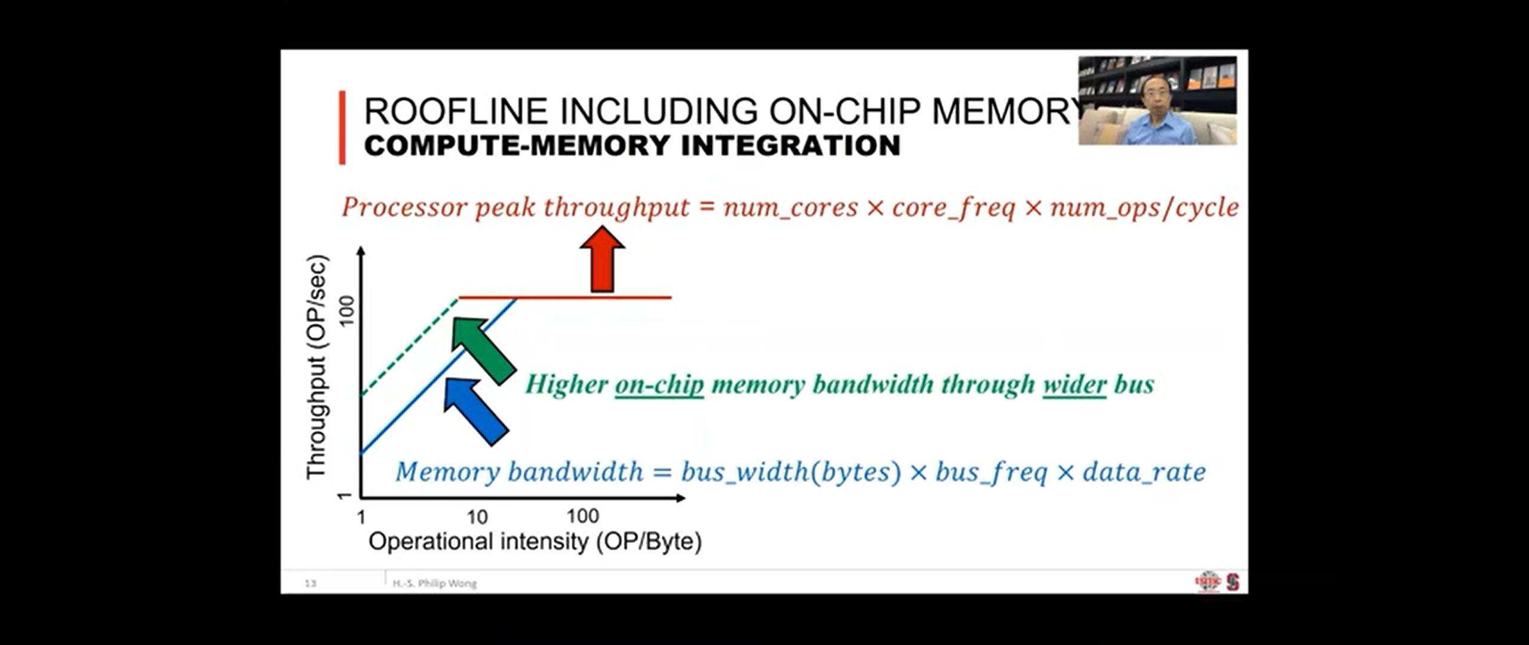
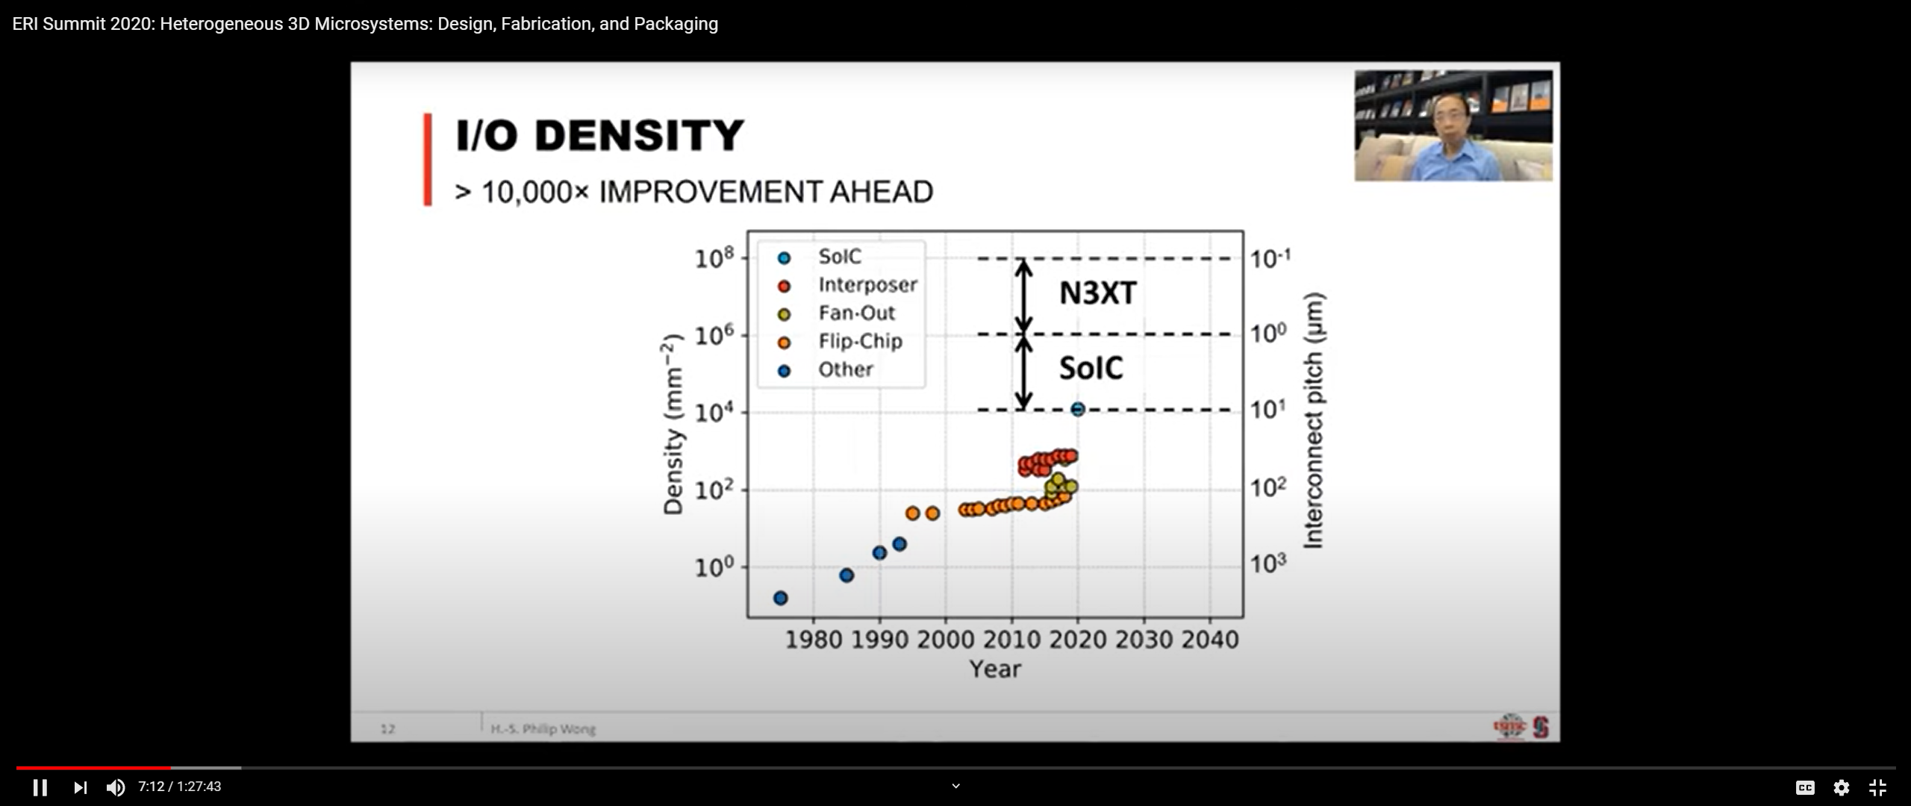
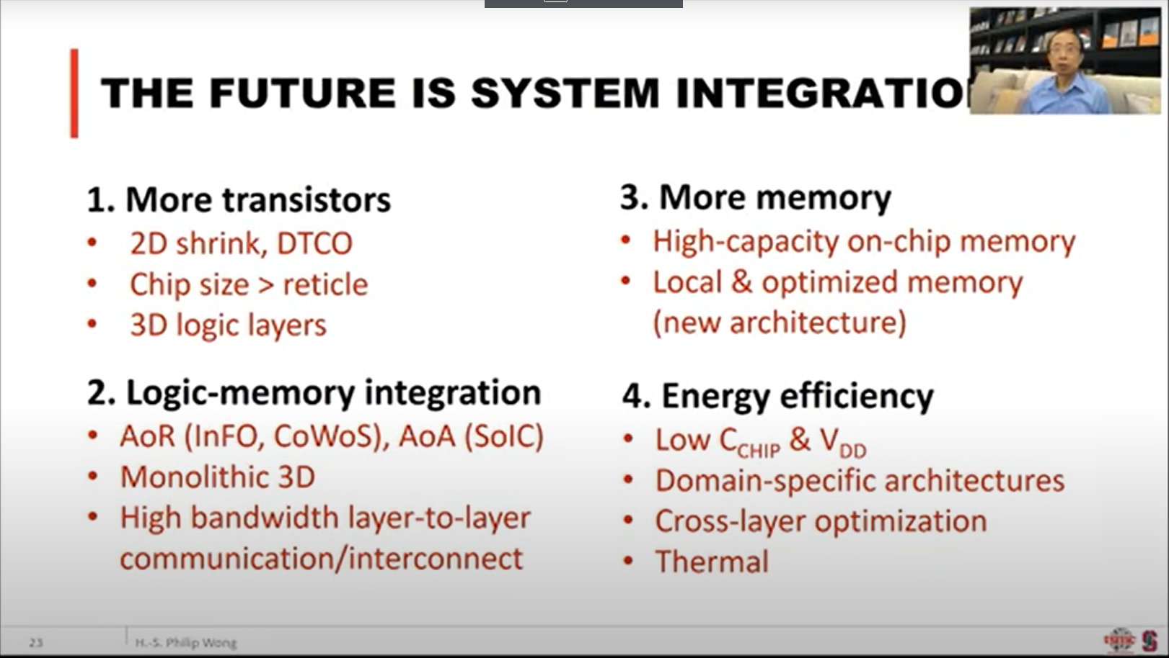
TSMC on High Bandwidth Memory
TSMC @ ERI , 2020
prashant majhi, FTE

Slide 8
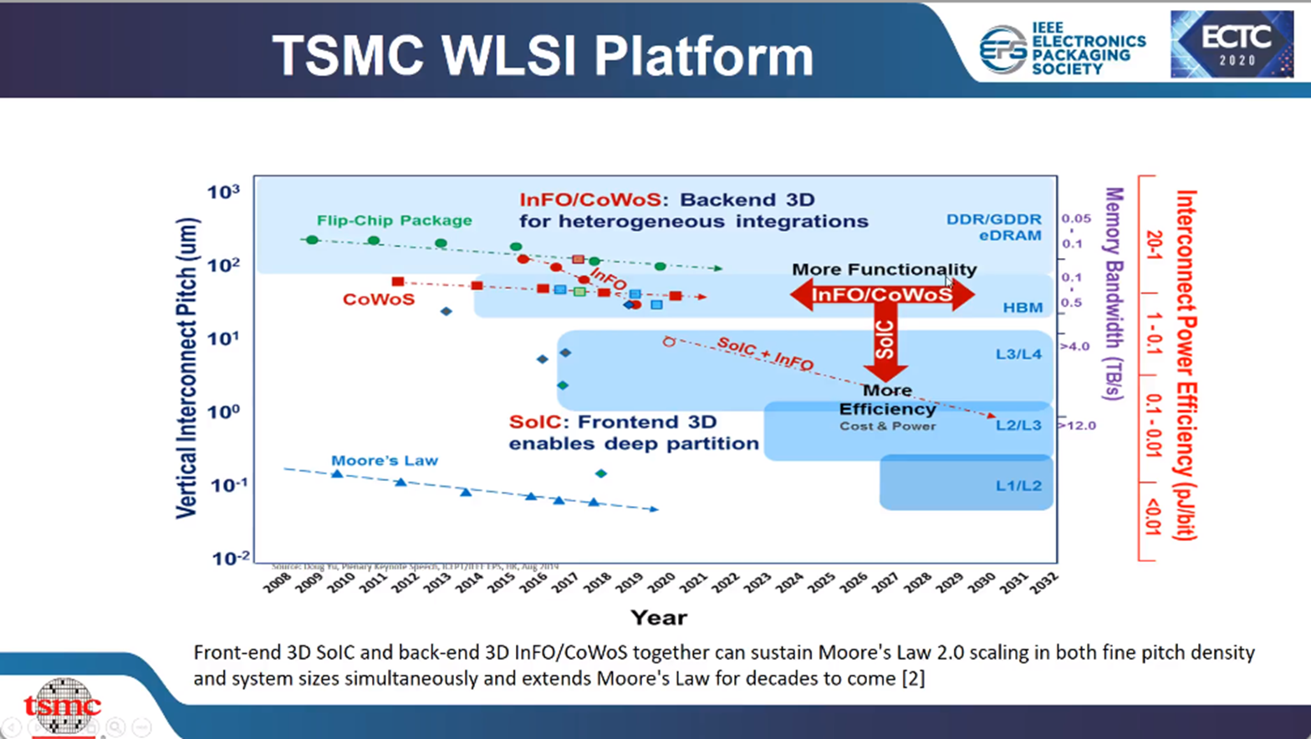
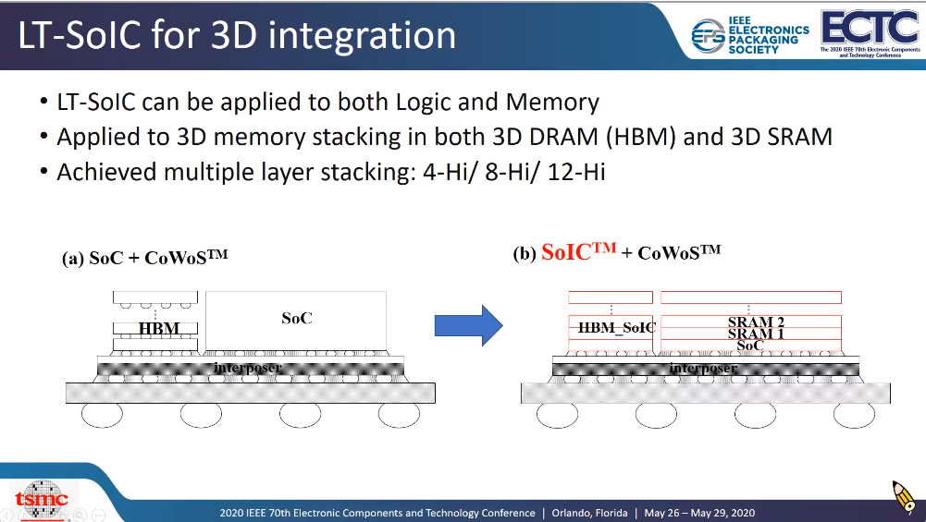
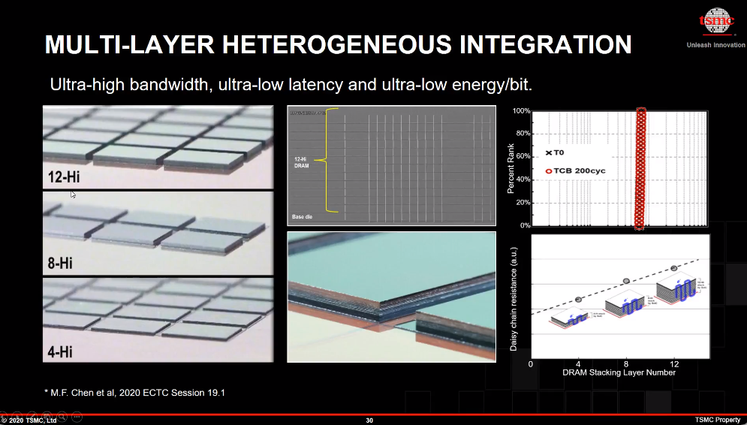
TSMC Enabling/Developing(?) High Bandwidth In-package Memory
prashant majhi, FTE

Slide 9
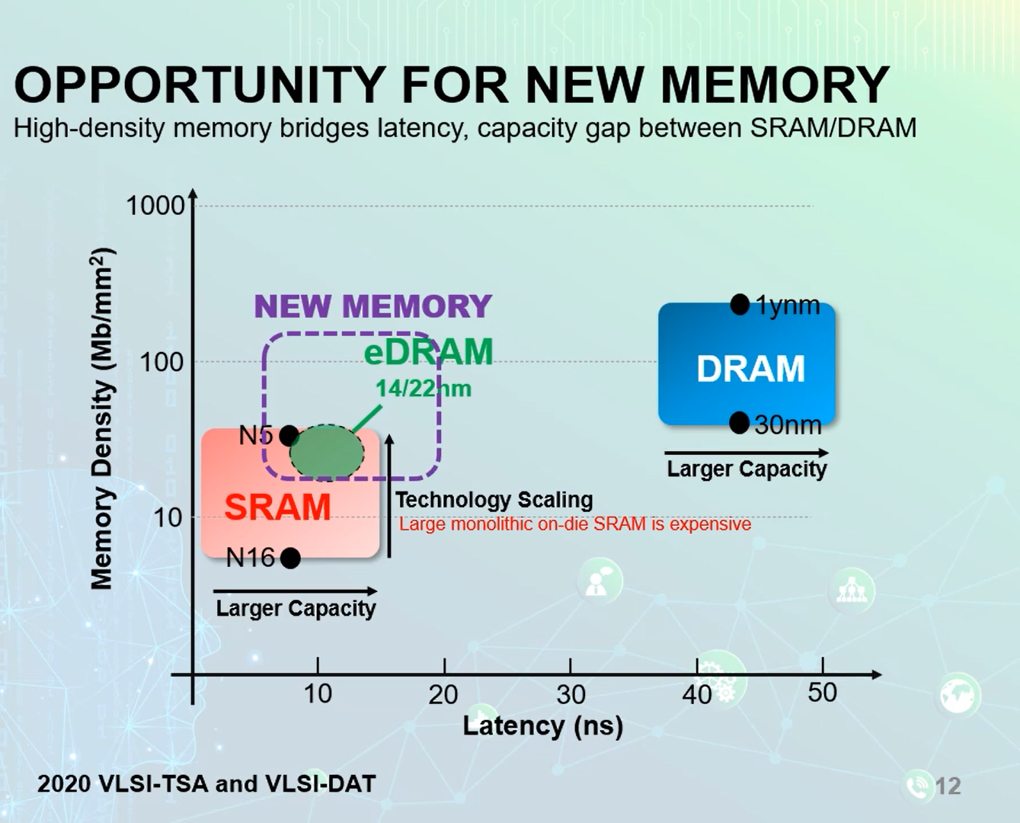

Slide 10
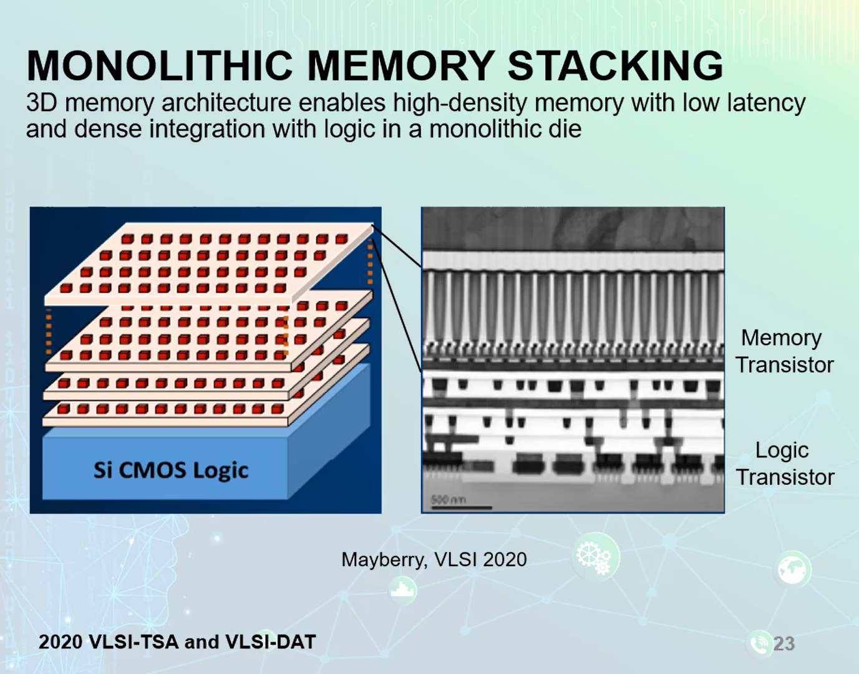
Adamantine:

Slide 11
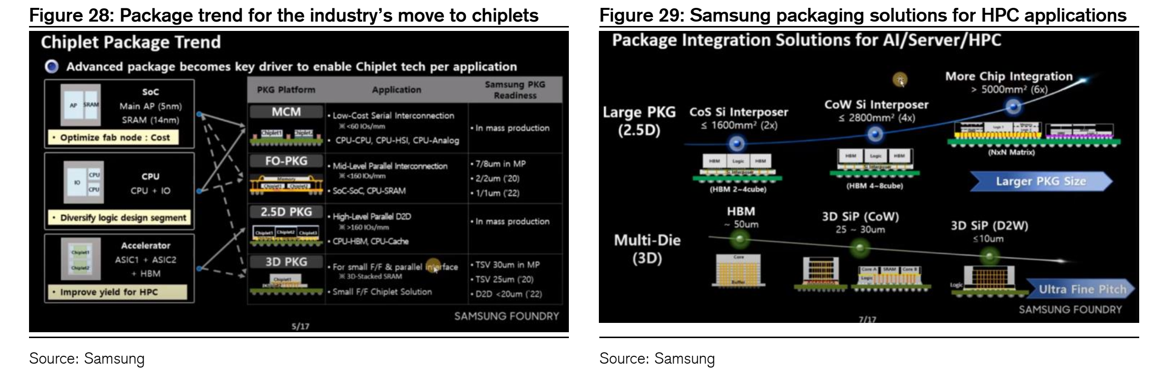
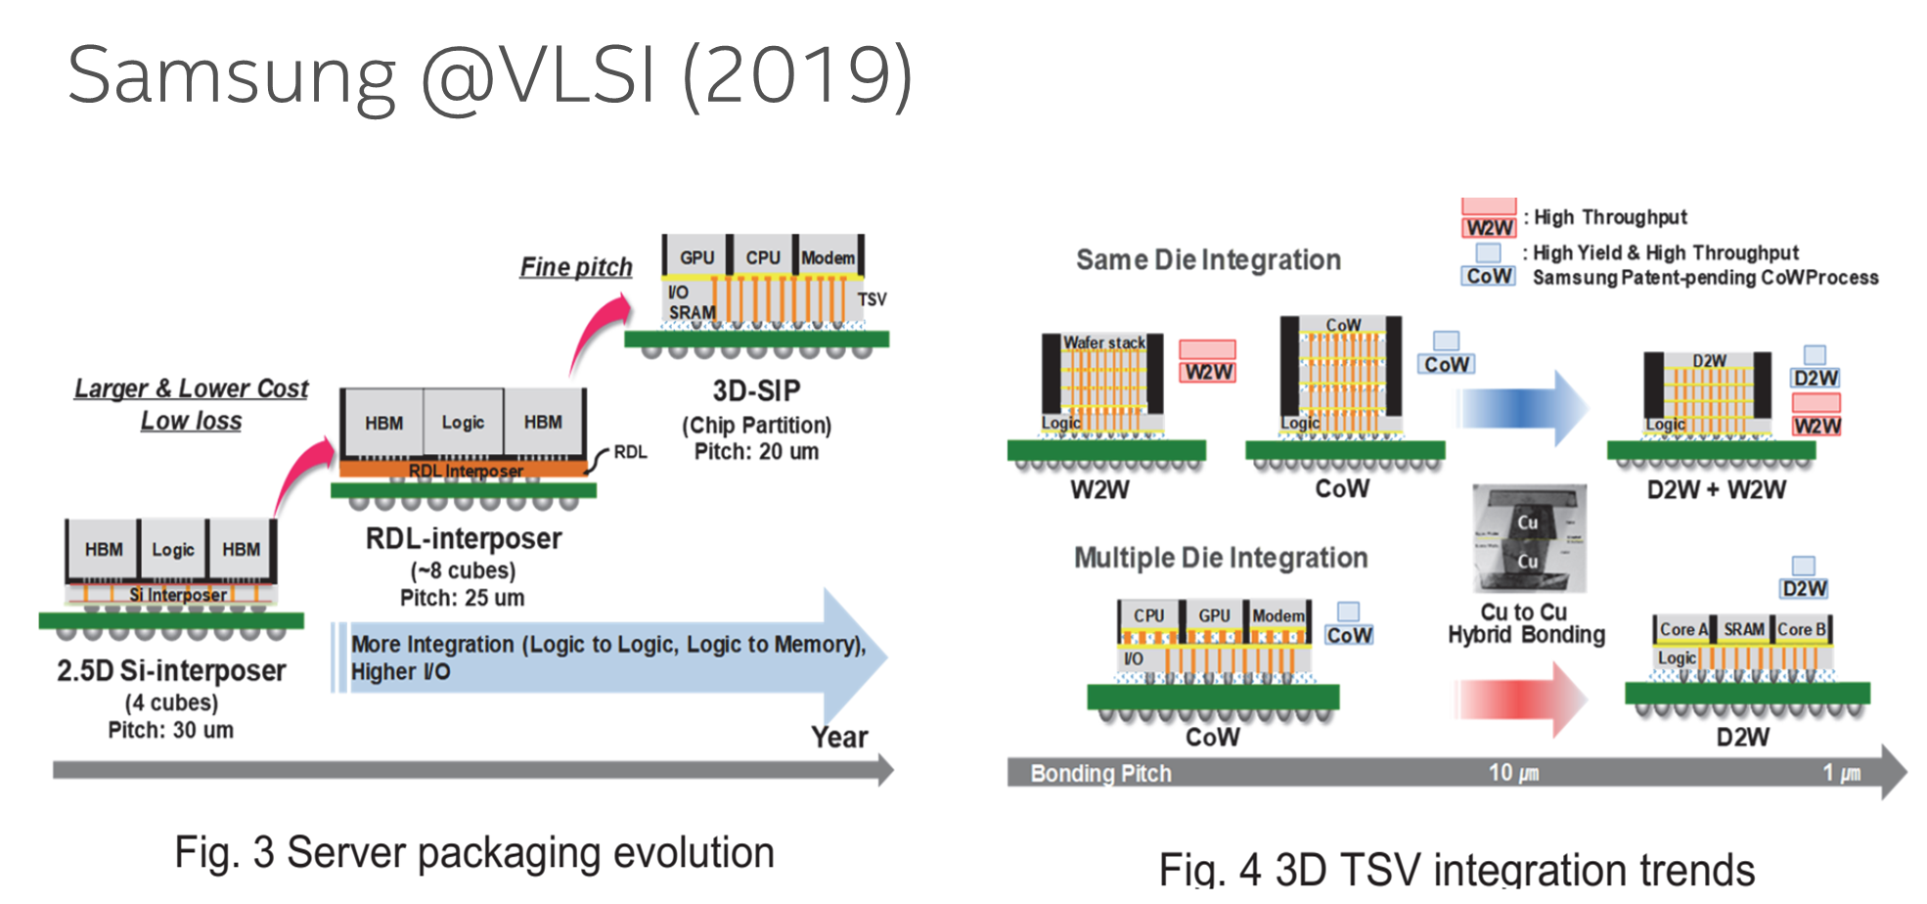
Samsung @ SAFE
prashant majhi, FTE

Slide 12
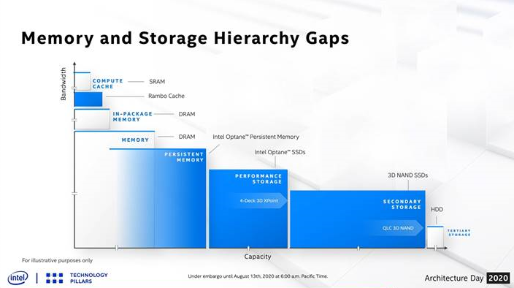
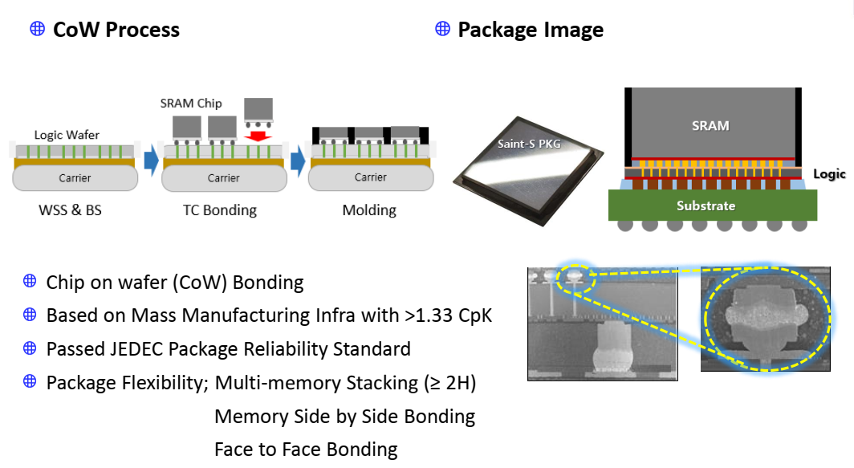
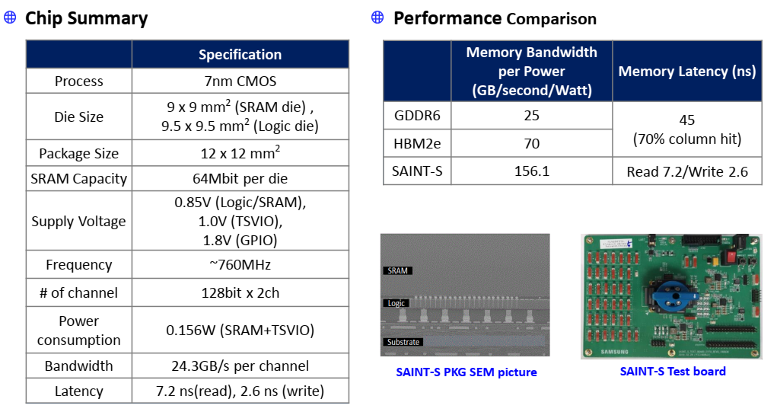
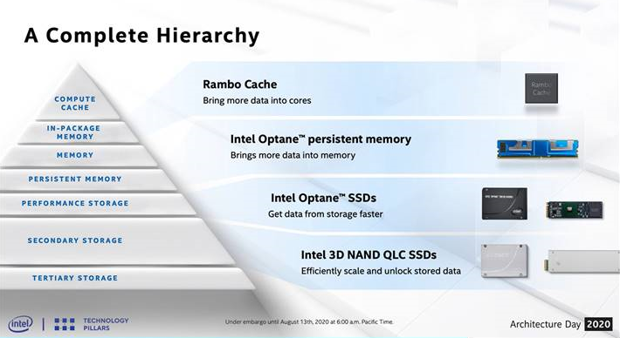
3D Stacked SRAM:
Rambo (Intel) vs Foundries
Samsung 3D SRAM (SAINT-S, X Cube)
Note: Not indicative of memory density as it is test chip w/ other functions included
prashant majhi, GSC-EID

Slide 13
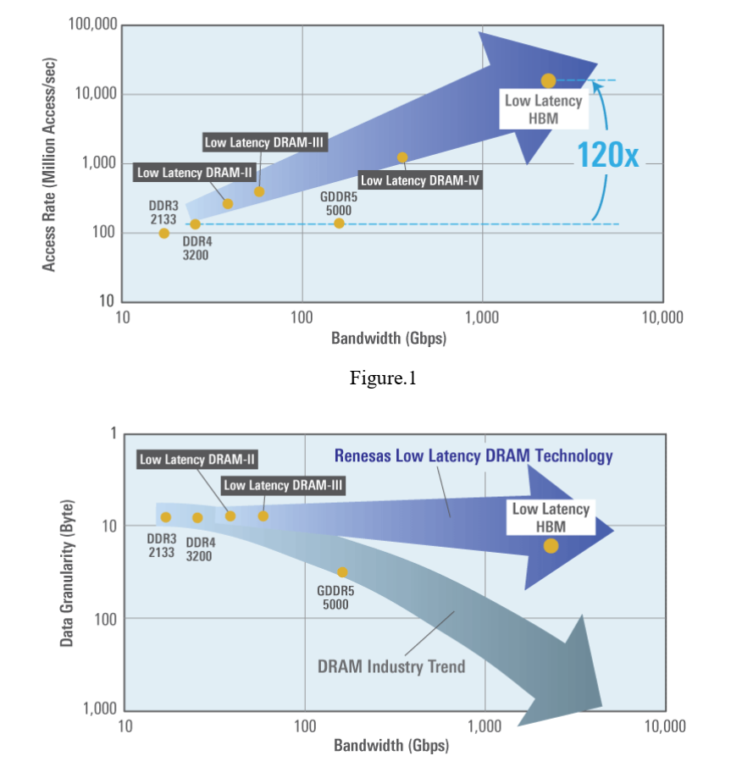
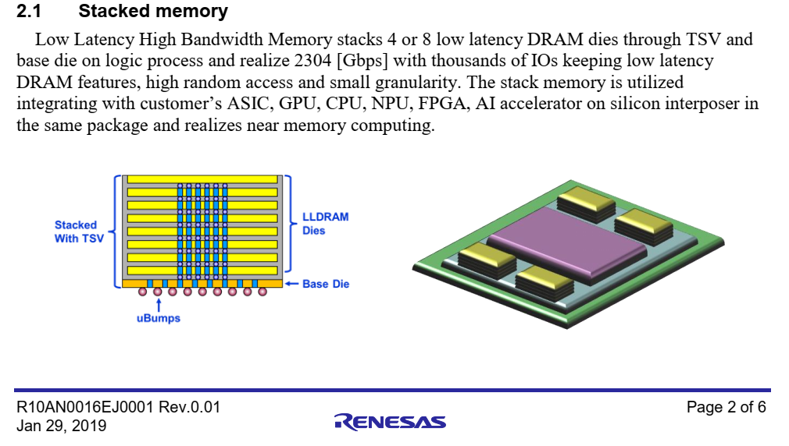
Renesas HBLL

Slide 14
HBM with WOW and FG-DRAM

Slide 15
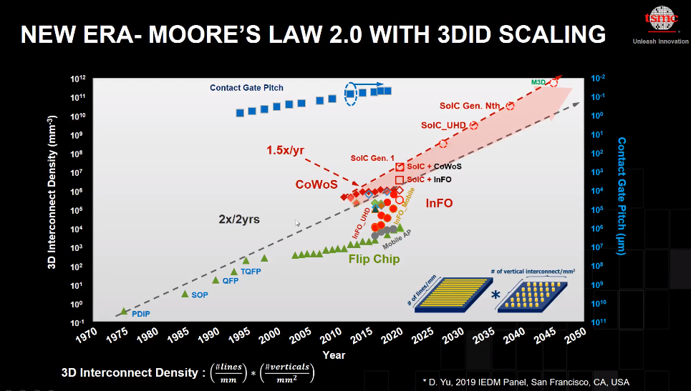
prashant majhi, GSC-EID

