Slide 1
Agenda
Tightly coupled memory (TCM) options
Interconnect/Integration eco system capabilities and competition mapping
Memory eco system capabilities and Intel engagements
Other Considerations
Power and thermals
Data movement power and arch options (common LLC or memory) vs distributed …
Supply chain and business model

Slide 2
Tightly Couple Memory Options
Interconnect/integration and vendor options
2.5D – memory (mono or 3D stacked) on the side – OSATs, TSMC, Samsung, Intel, ??
3D – memory (mono or 3D stacked) on the bottom or on the top – TSMC, T1 DRAM vendors, Intel, XMC (no memory wafer supply from non Chinese vendors are likely)
Memory type and vendor options:
SRAM: Intel, TSMC, Global Foundries (GF), Samsung,
DRAM (standard or custom):
Samsung, SK Hynix, Micron – Tier 1 with active TCM programs
Winbond, Powerchip – Tier 2 with active TCM programs
Nanya, CXMT – Tier 2 with no known TCM programs,
UMC?
STT/MRAM – TSMC, Samsung, GF
ADM/eDRAM – Intel
eDRAM – IBM/GF
Alternative technologies - All in research/dev phases
Memory usage model/architecture options
Global/shared memory
Local memory/clustered memory/distributed

Slide 3
Interconnect/Integration Options and Eco System

Slide 4
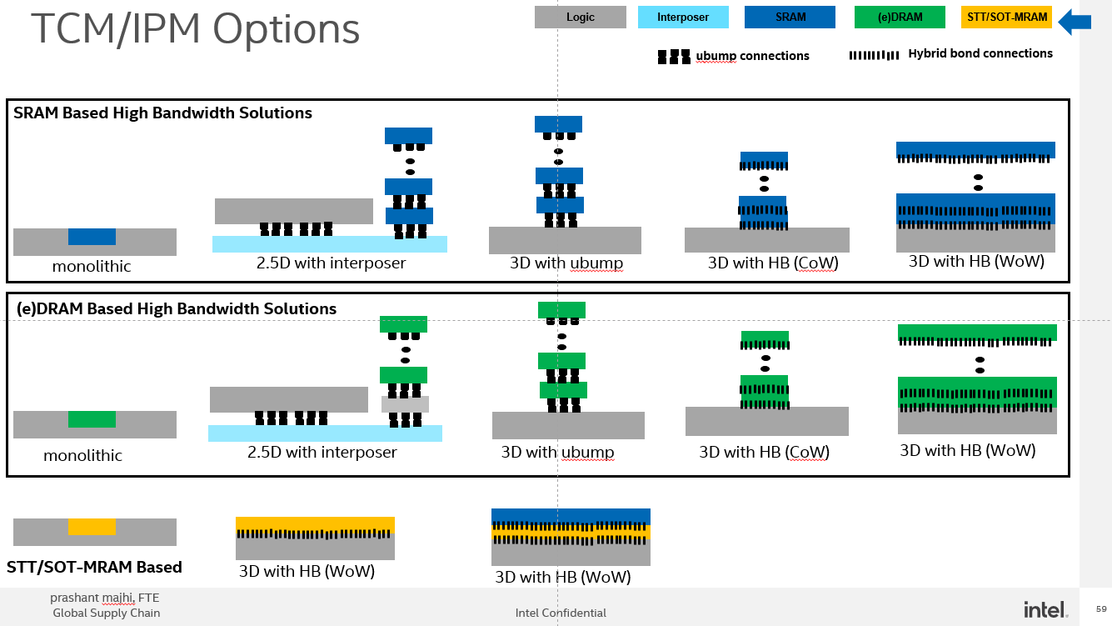
Potential Foundry competitive offering
prashant majhi, FTE

Slide 5
Samsung X-Cube
Samsung, GF
Samsung, GF
TSMC
TSMC
TSMC
IMEC, ARM
IMEC, ARM
Samsung, Micron, SKH
Samsung, Micron, SKH
Samsung, Micron, SKH
Winbond
Winbond
Winbond
AP Memory
AP Memory
AP Memory, Powerchip
TSMC
TSMC*
TSMC, Samsung, GF
TSMC
IMEC
Potential Foundry competitive offering
prashant majhi, FTE
* In pilot production status, unclear customer/node

Slide 6
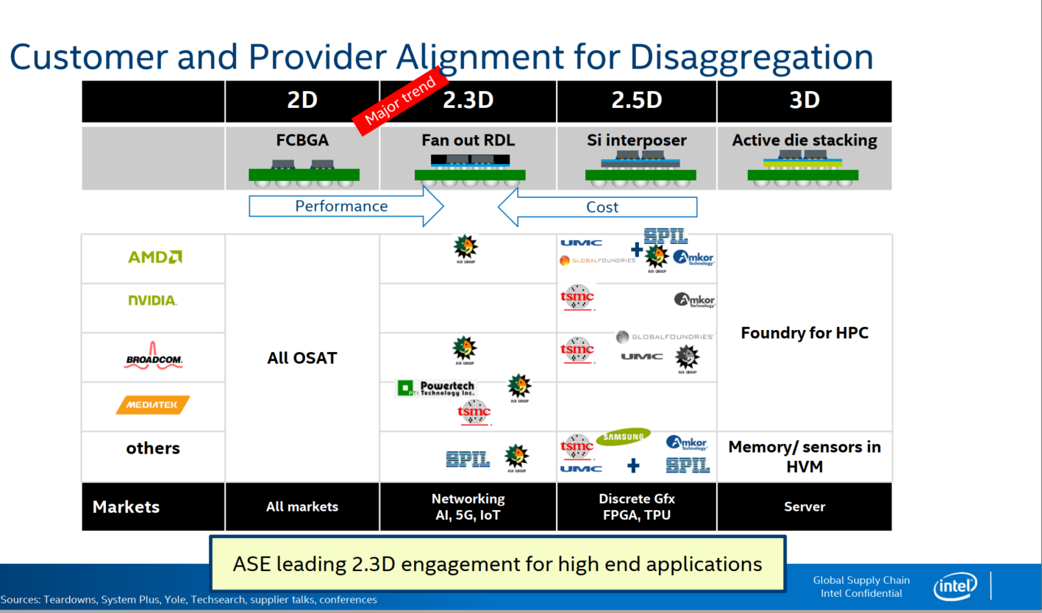
TSMC
Samsung
Intel
XMC ??
UMC

Slide 7
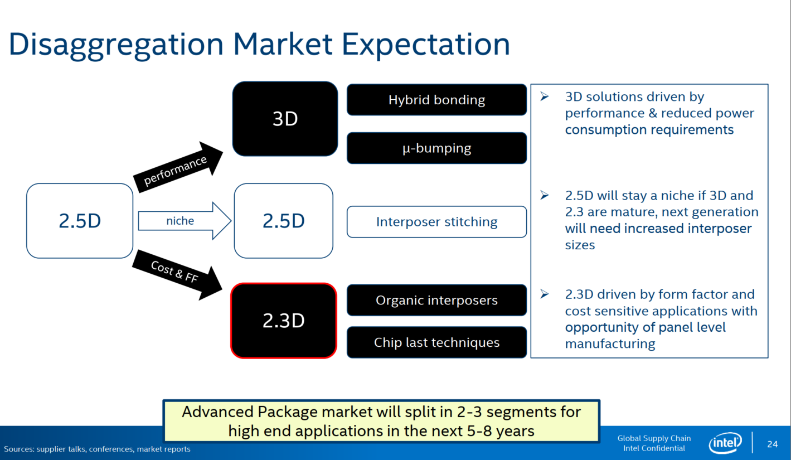

Slide 8
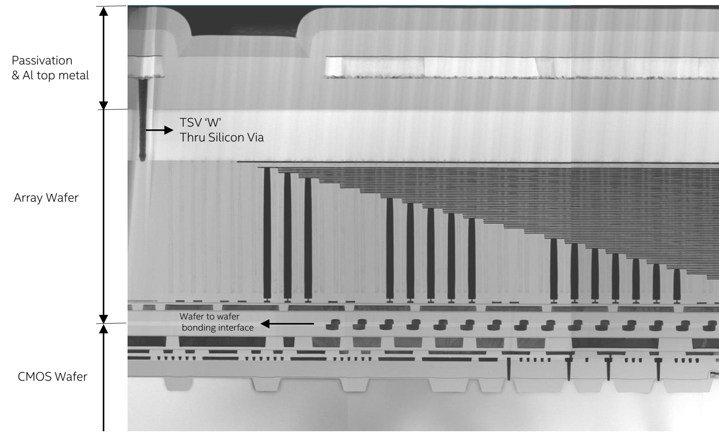
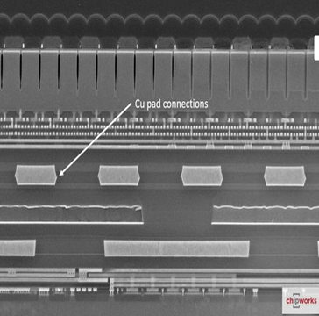
Bonding Landscape: R&D and HVM
C or W
C or W
Monolithic 3D
NMOS/PMOS
disagg
Hybrid Bonding HB [WoW]
SRAM or DRAM
Array/Peri Disagg
Hybrid Bonding [CoW, CoC]
CMOS/Interconnect
disagg
CPU/Cache
Disagg
uBump [CoW]
Std Cell IP Disagg
TSMC SOIC+ [CoW, WoW]
Global Foundry [WoW]
Hybrid Bonding (HB) in HVM
YMTC 3DNAND
[WoW]
TSMC SOIC [CoW]
HB R&D [Path Validation]
Connections/mm²
CIS [WoW]
HB R&D [Concept/ Early Research]
CIS [WoW]
TSMC SOIC [CoW]
DRAM HBM/3DS [CoC, WoW];
eFlash-Logic [WoW]
Current 2.5D/3D products
Note: Samsung claims competitive offering as other foundries
Pitch (um)
Update with latest announcements
Add source
Prashant Majhi , GSC-EID
INTEL CONFIDENTIAL

Slide 9
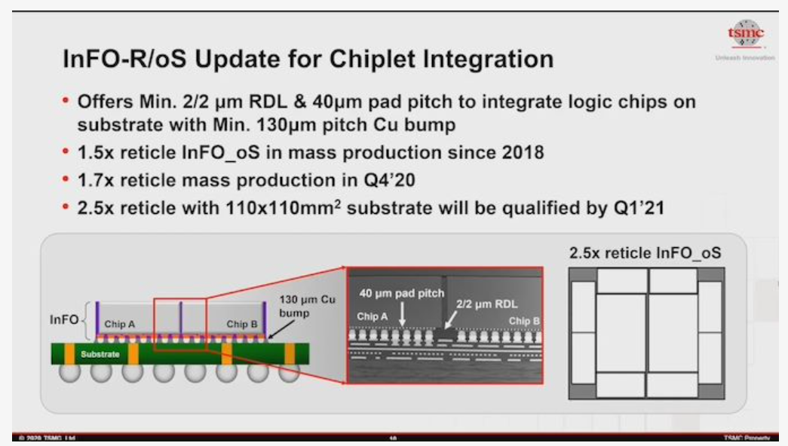
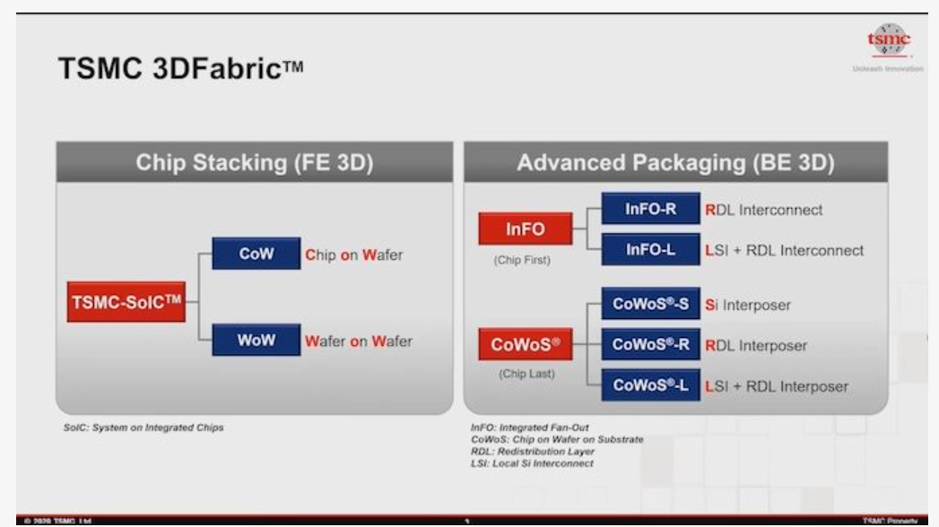
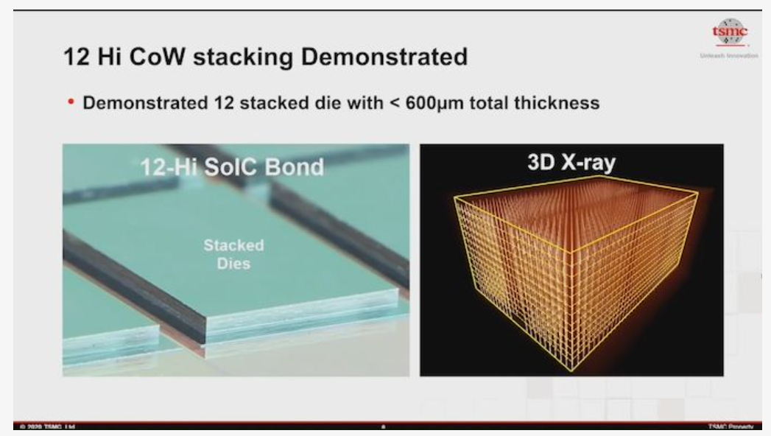

Slide 10
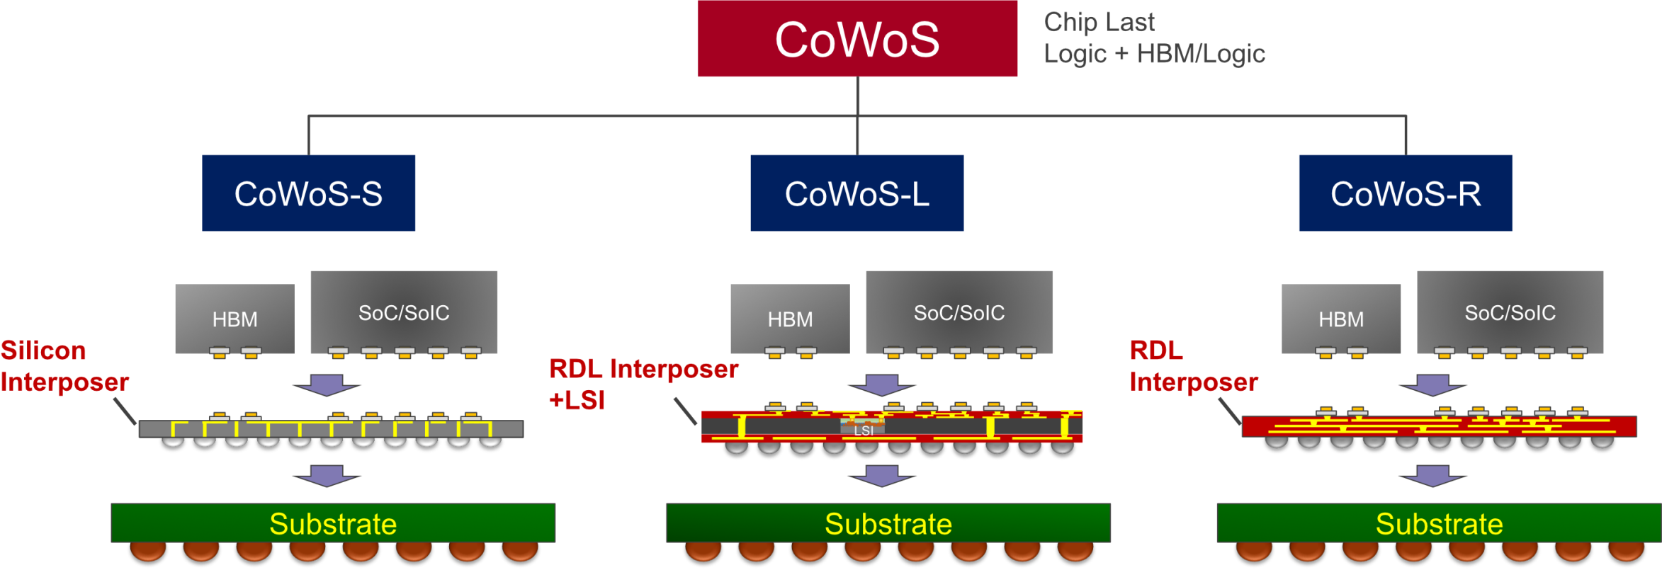
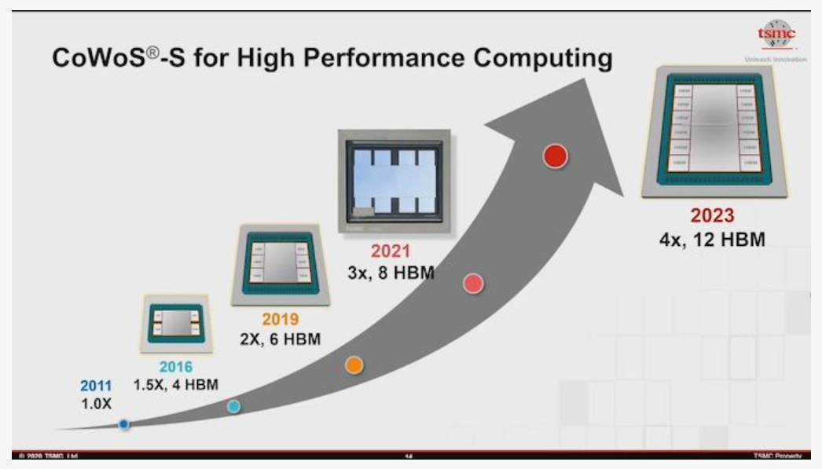
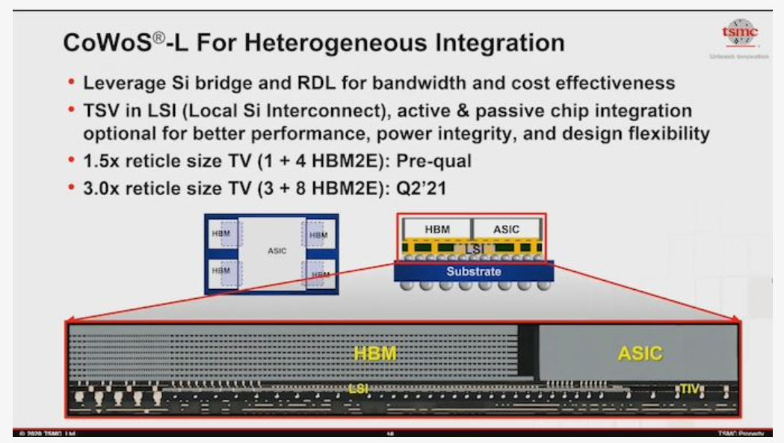
TSMC CoWoS® Platform for High-Performance Computing
TSMC has 10+ years of silicon interposer production and assembly
Increasing size of interposer and multiple HBMs (typically with 8 DRAMs per HBM)
TSMC expected to introduce CoWoS for up to 8 HBM + 2 logic die in 2021 in 70mm x 78mm package, up to 12 HBMs in 2023
CoWoS process with RDL and LSI (silicon bridge) referred to as CoWoS-L
Source: TSMC.

Slide 11
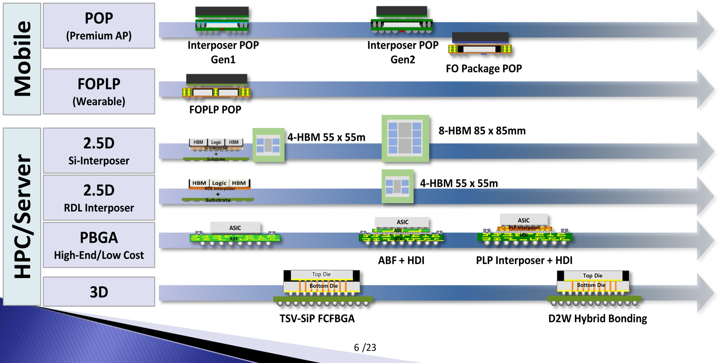
Samsung’s Packaging Roadmap for Mobile and HPC
offering many package options developed internally, but also partners with OSATs
Source: Samsung.

Slide 12
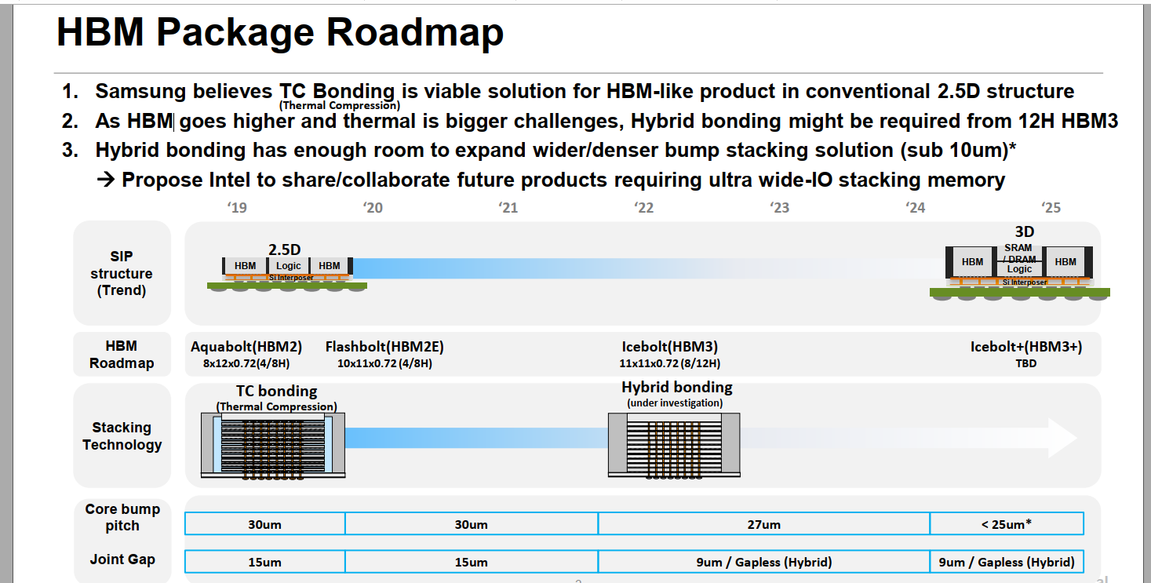
2 die HB at TSMC but 8 high may be challenging for producion

Slide 13
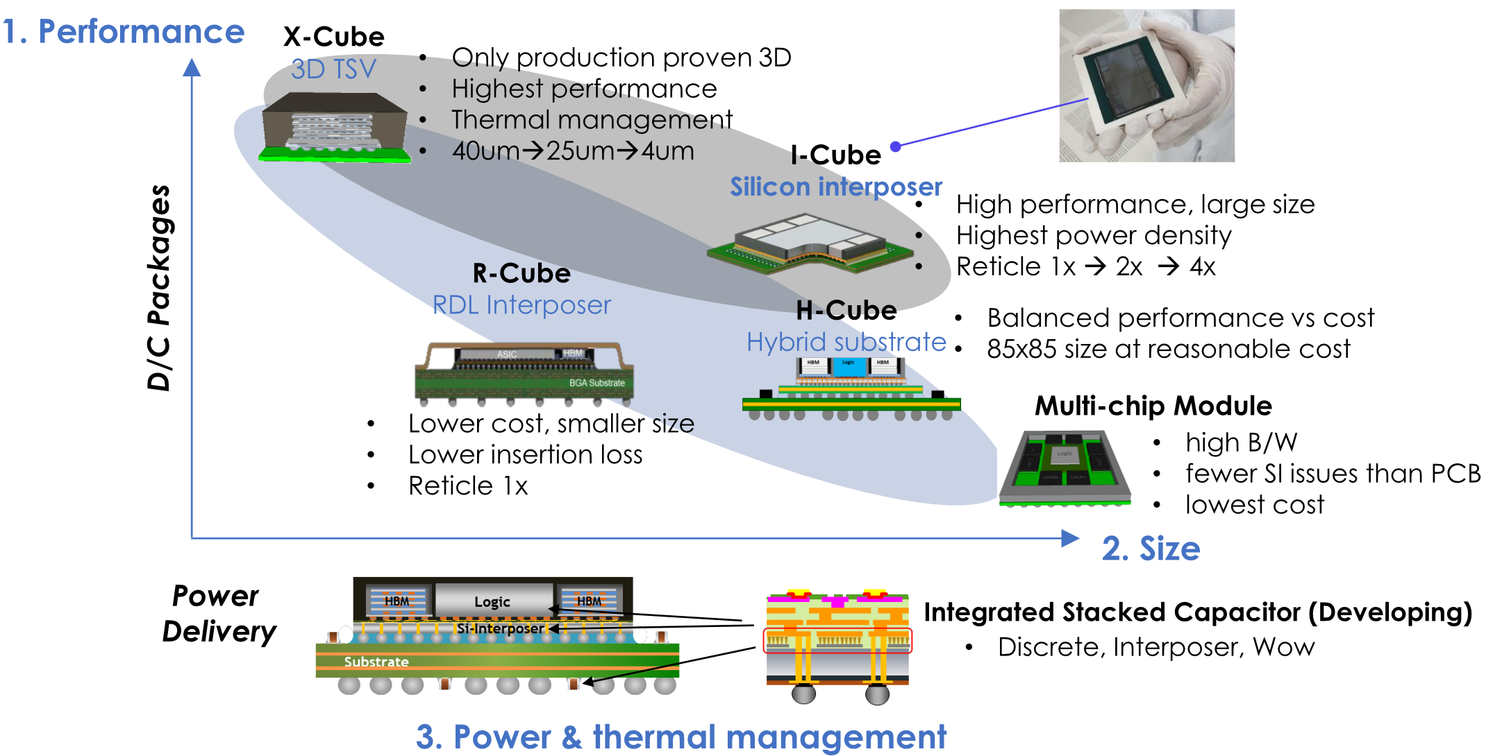
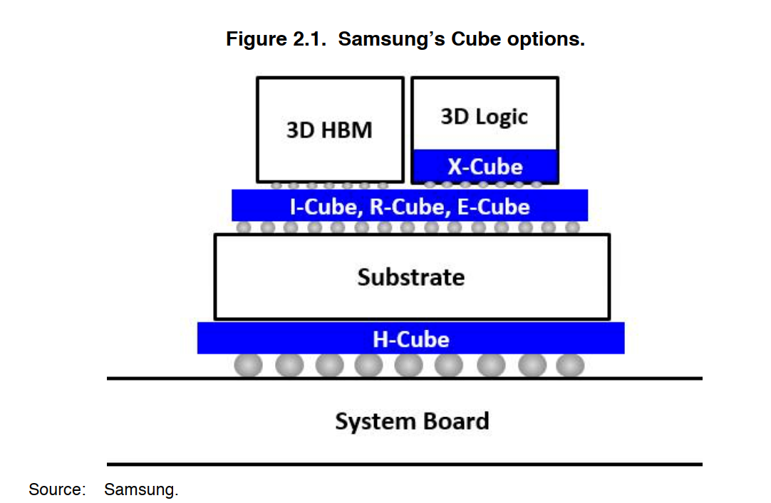
Samsung’s Cube Package Options for Foundry Customers
Source: Samsung.
I-Cube (silicon interposer) offered with OSAT
X-Cube is developed internally
R-Cube will be developed with OSAT
E-Cube (embedded bridge) will be offered using the panel line for the embedding of bridge chip
RDL will be fabricated on top

Slide 14

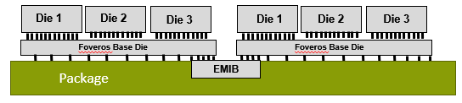
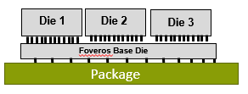
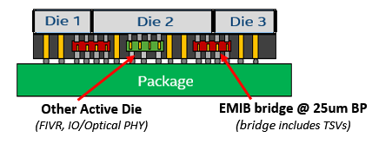
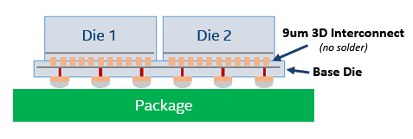
ATTD Advanced Packaging Architecture Portfolio
EMIB
Die to Die connection
on advanced package with EMIB
CoEMIB
Die to Die connection
With EMIB and Foveros
Foveros
Die to Die connection
On Active/Passive Silicon Base Die
Foveros Omni (ODI)
Die to Die connection via bridge in ODI complex.
Can also enable 3D Active Die connection
(Bridge can include TSV)
Foveros Ultra (HBI)
Die to Die solder less connection
On Silicon Base Die at <10um bump pitch

Slide 15
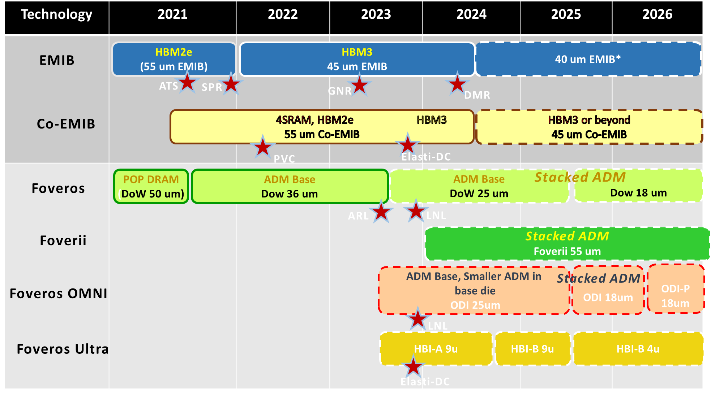
IPM Alignment with Packaging Architectures
ATTD POR
(Product Aligned)
Left Edge
HVM Ready
Directional Technology (No products Aligned))

Slide 16
Memory Eco System Capabilities and Intel Engagements

Slide 17
Company | Scope | Lead | Sponsor | Notes
Samsung | DRAM/Broad | Wilfred | Raja
SK Hynix | Interposer and stacked DRAM | WIlfred | Raja
Micron | High bandwidth, low capacity | Kujit
Winbond | Stacked DRAM | Wilfred
AP Mem | cDRAM – Cache DRAM, low capacity, high BW, 2.5/3D VHM – Very HBM, 0.6-4.5GB, 2.4/4.5TB/s | n/a | n/a | AP is a design house using Powerchip as DRAM foundry
TSMC |  |  | Boyd
GF |  |  | Raja
SunRise | 3DS QVM on logic. Scope TBD
Nantero
…

Slide 18
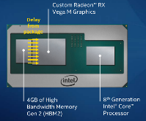
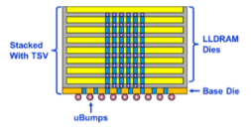


Performance Comparison of High Capacity Memories
SRAM
 | HBM3 (Samsung) | LL DRAM (Renesas) | ADM e-DRAM | SRAM
Bandwidth (GB/s) | 512 per 8GB | 288 per 4GB | >4000 per 1 GB | >8000 per 128 MB
Min capacity (GB) | 8 | 4 | 0.5 | <0.12
Density (GB/cm²) | 2 | 2 | 0.45 | ~0.29
Latency (ns) | 30 | 10 | 15 | 1.5
Energy (pJ/bit) | 4 | 3 | 0.4 (block-level) | 0.1 (block-level)
SRAM and e-DRAM need increased capacity while maintaining latency and BW to enable large model sizes (is it really doable)
Need to prepared to use each memory where it fits best instead of trying to come up with a “do it all” memory
(DDR, LPDDR, GDDR, RLDRAM, HBM, LLHBM, SRAM, eDRAM, ….)

Slide 19
DRAM Technology in Tier-2
NANYA:
Thanks to the direct-collaboration with Micron,
The most advanced process is available in Taiwan.
Main production has moved to 1Ynm.
Re-started Foundry Business with 2Znm since 2020.
Winbond:
Main production is at 2Ynm level.
Process definition is slightly different from Tier-1 company.
Their 2Ynm could be 2X/3Znm Cell in Tier-1.
PWC:
Traditional DRAM foundry.
DRAM process is very old. Maybe 3Znm level.
Metal process is still AL not Cu in DRAM industry.
CXMT:
----------
…

Slide 20
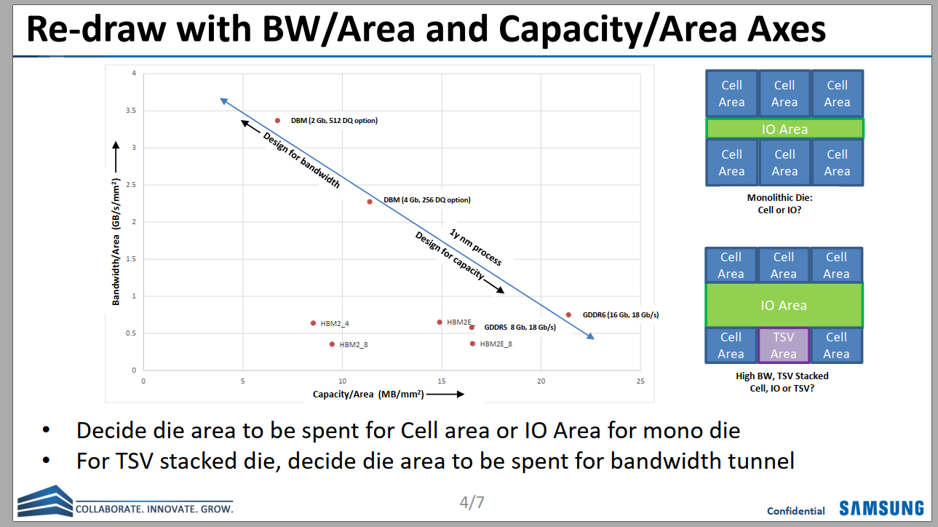

Slide 21
Intel Server Architecture + DRAM Interposer
#1. Mainstream/General Purpose Perf. Segment (Cache)
Bandwidth: 2.5 – 3 TB/s
Using SKH 128MB/128GB/s 9.9mm2 macro:
Need 24 macros for 3 TB/s
24 * 9.9 = ~240mm2
Capacity: 6 GB (Baseline)
Scalability option: 2x (12GB) to 4x (24GB) capacity at same bandwidth, additional cost
Using SKH 128MB/128GB/s 9.9mm2 macro:
Need 48 macros for 6GB →
Provide macro with different BW/capacity ratio. Ex. 256MB/128GB/s in 19.8mm2?
Construction Options
Compute area: ~1500mm2
Baseline 6GB DRAM area: ~480mm2
3x area delta , logic/DRAM will scale differently over time
Scalability option for 2x – 4x capacity?
Compute
Compute
Compute
Compute
DRAM Interposer
DRAM
DRAM
Option 1: Interposer
Use older/cheaper DRAM node?
Option 2: Intel ODI Packaging
Capacity | DRAM Area
6GB (1x) | ~480mm2
12GB (2x) | ~960mm2
24GB (4x) | ~1920mm2
DRAM
Compute
DRAM
Option 3: DRAM cube
With scalable height for capacity
Logic Interposer
Can we use the SK logic interposer without DRAM ?
Data shared under CNDA 30991112 & CNDA 112784

Slide 22
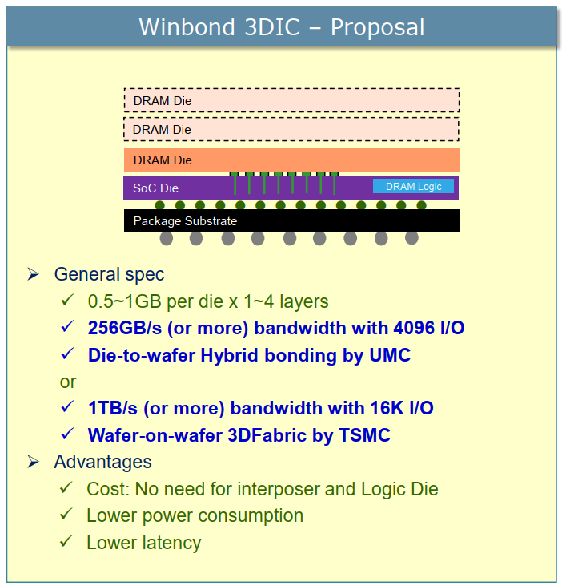
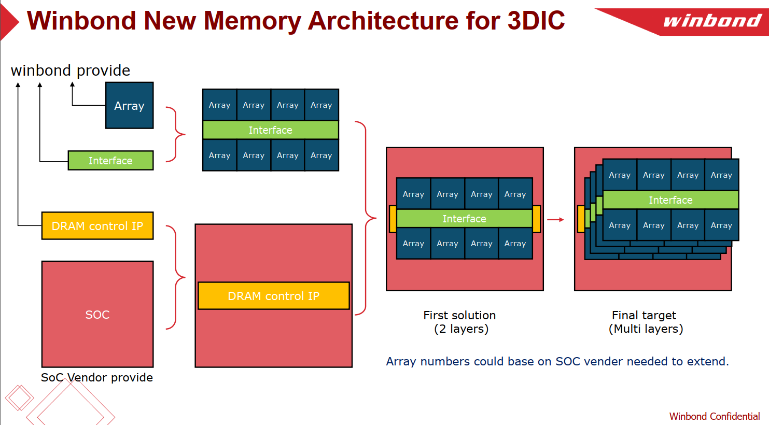

Slide 23
Memory Solution for Intel L3/L4 Cache
Parameter |  | unit | 3D DRAM 2Gb w/ ECC
 |  |  | Option 1 |  | Option 2 |  | Option 3 (Reference) |  | Option 3B
Process |  |  | D25s | D20 | D25s | D20 | D25s | D20 | D25s | D20
Size |  | mm^2 | 37.61 | 32.16 | 28.17 | 23.8 | 24.16 | 19.46 | 35.45 | 30.3
Size w/ bump pitch 25um |  | mm^2 |  |  |  |  |  |  | 33.93 | 28.83
Chip per wafers |  | est. | 1669 | 1952 | 2228 | 2637 | 2598 | 3225 | 1770 | 2071
Good Dies |  |  | 1418 | 1659 | 1894 | 2242 | 2208 | 2741 | 1505 | 1761
Stacked dies (layer) |  |  | 1 | 1 | 1 | 1 | 1 | 1 | 1 | 1
Channel (CH) # per Die |  |  | 16 | 16 | 8 | 8 | 8 | 8 | 4 | 4
Bank # per CH |  |  | 1 | 1 | 1 | 1 | 1 | 1 | 8 | 8
Memory per Die |  | MB | 256 | 256 | 256 | 256 | 256 | 256 | 256 | 256
Memory density |  | MB/mm^2 | 6.81 | 7.96 | 9.09 | 10.76 | 10.60 | 13.16 | 7.22 | 8.45
Memory per Channel |  | MB | 16 | 16 | 32 | 32 | 32 | 32 | 64 | 64
Peak Bandwidth* | per CH | Gbps | 256 | 256 | 256 | 256 | 128 | 128 | 256 | 256
 | per Die | Gbps | 4096 | 4096 | 2048 | 2048 | 1024 | 1024 | 1024 | 1024
 | per mm^2 | Gbps | 109 | 127 | 73 | 86 | 42 | 53 | 29 | 34
 | per 100 mm^2 | GB/s | 1361 | 1592 | 909 | 1076 | 530 | 658 | 361 | 422
Effective Bandwidth | per CH | GB/s | 2.8 | 2.8 | 2.8 | 2.8 | 1.4 | 1.4 | 22.8 | 22.8
 | per 1GB | GB/s | 182 | 182 | 91 | 91 | 46 | 46 | 364 | 364
 | per 100 mm^2 | GB/s | 121 | 142 | 81 | 96 | 47 | 58 | TBD | TBD
DQ I/O # | per CH |  | 512 | 512 | 512 | 512 | 64 | 64 | 128 | 128
 | per Die |  | 8192 | 8192 | 4096 | 4096 | 512 | 512 | 512 | 512
ECC IO # | per CH |  | 32 | 32 | 32 | 32 | 4 | 4 | 8 | 8
 | per Die |  | 512 | 512 | 256 | 256 | 32 | 32 | 32 | 32
Data Rate |  | Gbps | 0.5 | 0.5 | 0.5 | 0.5 | 2 | 2 | 2 | 2
Row Cycle time (tRC) |  | ns | 45 | 45 | 45 | 45 | 45 | 45 | 45 | 45
Memory core speed (tCCD) |  | ns | 4 | 4 | 4 | 4 | 4 | 4 | 4 | 4
Total Latency |  | ns | 21 | 21 | 21 | 21 | 21 | 21 | 21 | 21
Read Latency |  | nCK | 2 | 2 | 2 | 2 | 8 | 8 | 8 | 8
Access Time (RL + tAC) |  | ns | 9 | 9 | 9 | 9 | 9 | 9 | 9 | 9
* Under seamless read operation |  |  |  |  |  |  |  |  | * w/ Metal4
Need your confirmation for the number

Slide 24
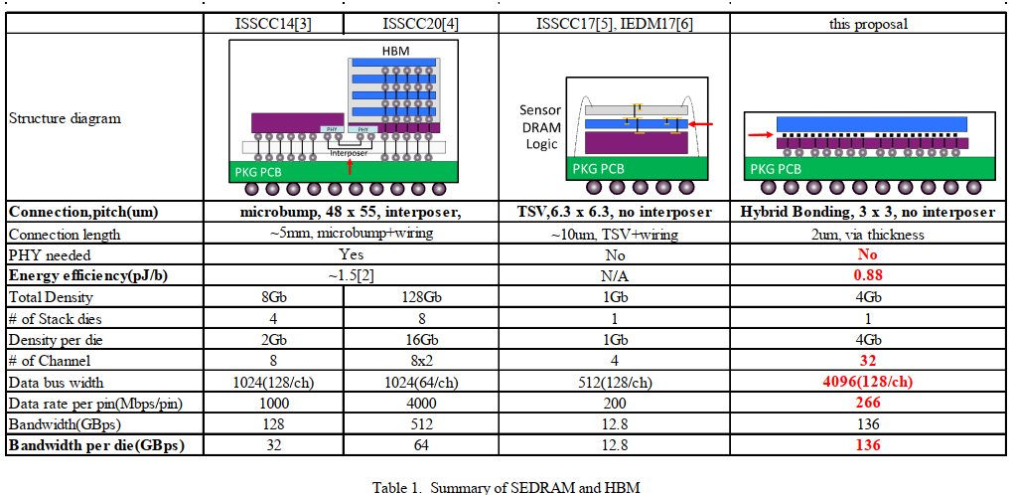
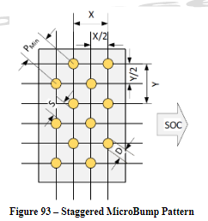
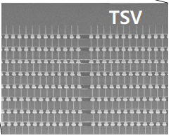
About C4 Bump
HBM1
HBM2E
SONY CMOS Imager
(IF Energy?)
8Gb
(Interposer IF)
(HBI IF)
X-Sec Photo from the same paper
Die thickness is ~50um,
Easily to guess how much DRAM Stack uBump/TSV pitch would be?

Slide 25
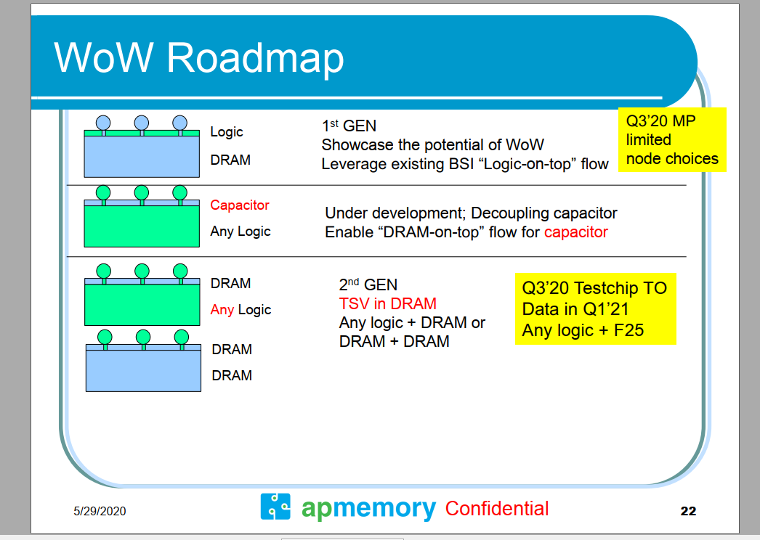
2020 Mar.: Hisilicion request the 600-700 uF capacitor and TSMC is working on Gen1 WoW solution, Gen1 DRAM also can replace by capacitor. Gen 1 now have two AI companys are working for that. Gen2 was request by a big design house and even Google intel also have highly interesting for that. Gen2 have better heating structure.
2021 Mar: 2-10 customer engagements

Slide 26
Micron – Kuljit to provide details

Slide 27
Architecture Options

Slide 28
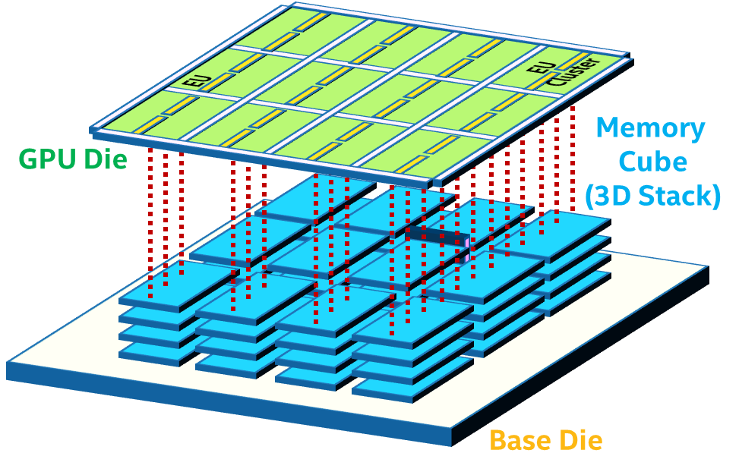
HW Trend w/o Cache Architecture Aspect
2.5D
3D
Logic
Memory
IO Connection is Long
Memory
IO Connection
is Short
Larger R & C → Larger power
Worse SI
Logic
Smaller R & C → Smaller power
Better SI
Suitable for
Global/Shared Cache Architecture.
Suitable for
Local Cache Architecture.

Slide 29
3D HW with Global/Shared Cache Architecture
3D
Memory
With including 2D IO Connections,
The signal length becomes Longer and complicated.
Logic
larger R & C → Larger power
Worse SI
In order to get the true merit from 3D Interconnects,
Need to shift Cache Architecture from “Global/Shared” to
“Localized Somehow” = “Clustering”.

Slide 30
For HPC/AI systems with larger memory capacity and higher BW,
scaling Global/Shared Cache Architecture is in jeopardy.
Clustering/Grouping/Partitioning approaches must be necessary
to improve the performance with less power.
Especially, in 3D Stacked Memory + Logic systems.
Sub-NUMA Clustering (SNC) is a good candidate to pursue.

Slide 31
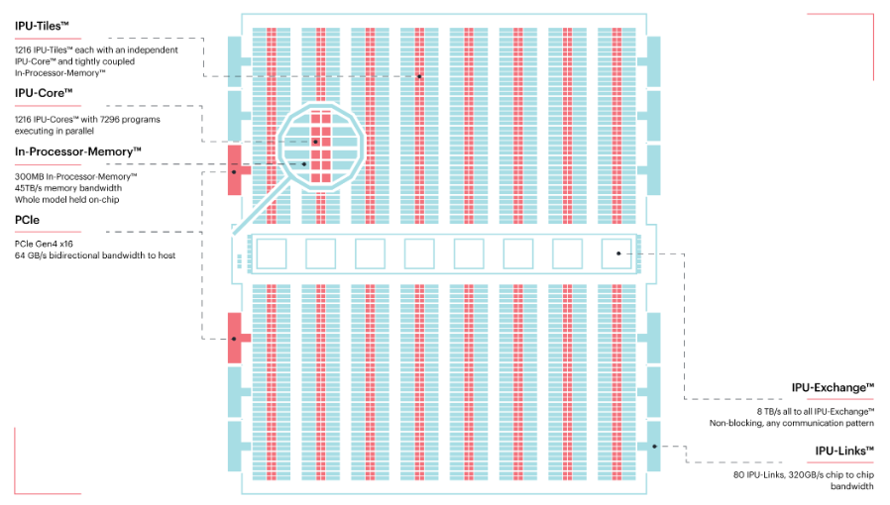
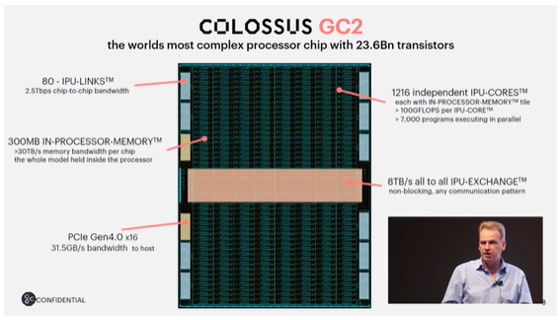
GC2 Processor Chip
Capacity: 256KB per Processor Tile x 1216 Tiles = 304 MB
24GB/s = 192 IOs x 1GHz
= 86 IOs x 1GHz x DDR
BW: 24 GB/s x 1216 Tiles = 30 TB/s (April 2018, 1GHz)
38 GB/s x 1216 Tiles = 48 TB/s (April 2019, 1.6GHz)

Slide 32
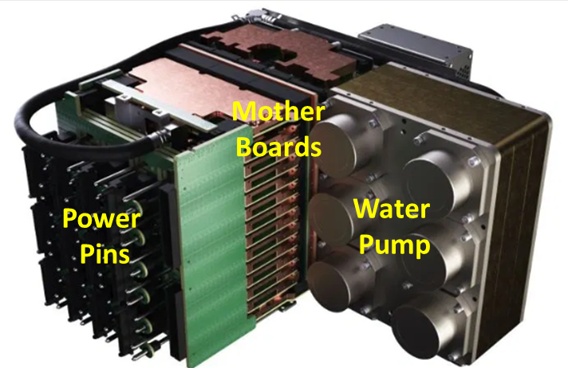
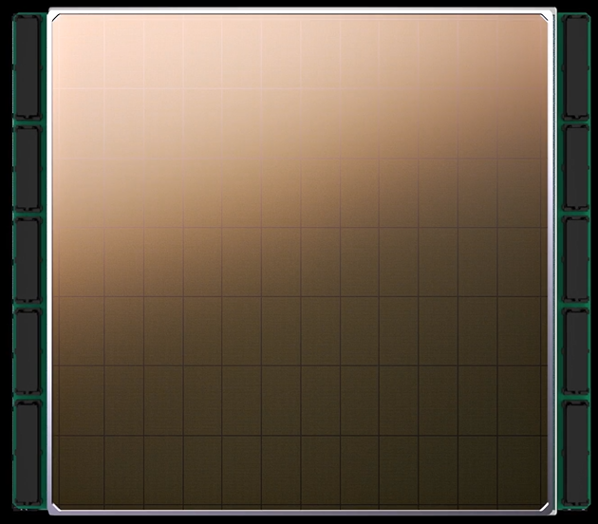
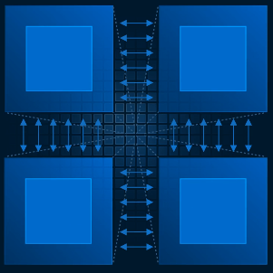
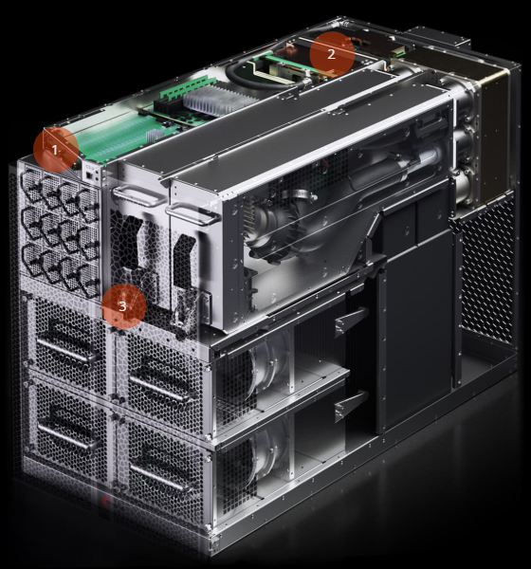
Cerebras SC19 Info.
Key attributes:
46,225 mm² die (=> Die size = 215 mm x 215 mm)
12 x 7 = 84 tiles (chips) on a wafer
1.2 Trillion Transistors by TSMC 16nm
400K Sparse Linear Algebra Compute (SLAC) cores
18GB On-chip SRAM Memory Capacity
9 PB/s Memory Bandwidth
100pb/s BW of 2D Mesh fabric
TSMC 16nm process
Key Readings:
Tile (chip) size is about 550mm2, still big.
9 PB/s (BW) for 18GB (Cap) in total → ~24GB/s, 47KB Local memory per Core.
3D liquid cooling and power supply seem to be MUST for 20KW.
Tile redundancy should be tricky and difficult,
IO Control
Device?
Engine Block
IO Block
Cooling System
Massive 400K core number and Local Memory!
Product: CS-1
Intel Confidential

Slide 33
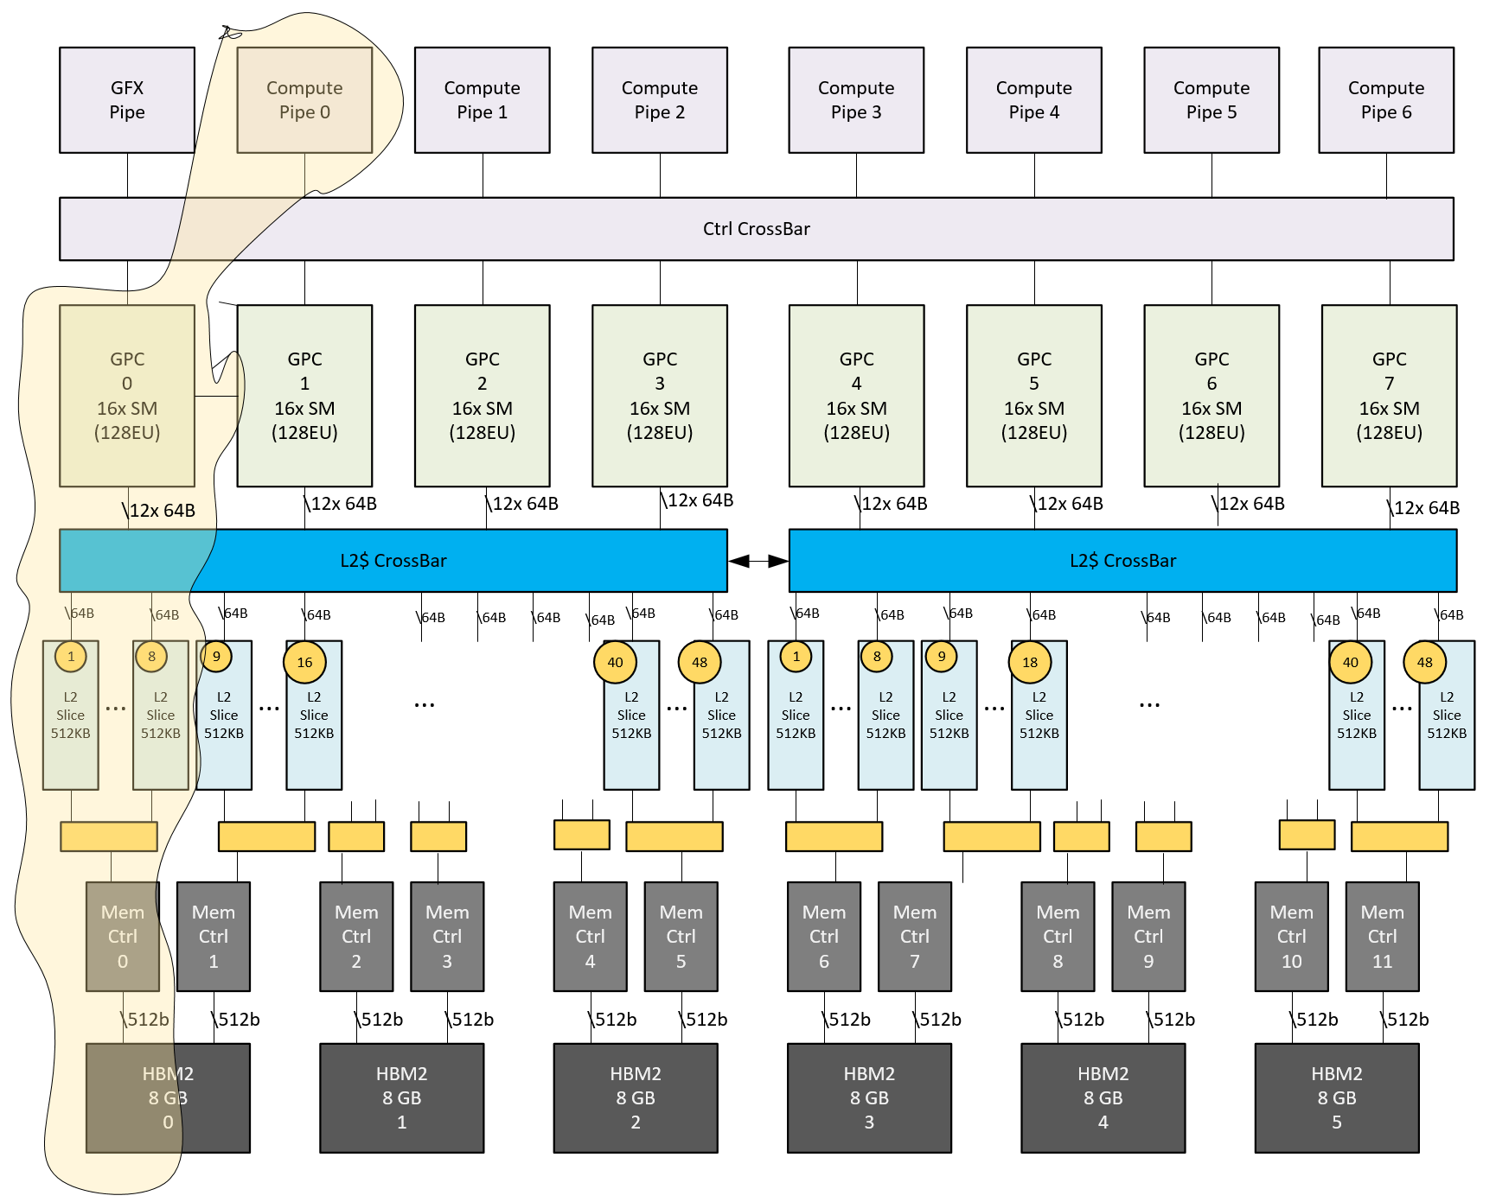
MIG In A100 - Hardware
QoS via isolation
Compute
SMs not shared across MIGs
Mem bandwidth
Non-overlapped L2 slices & mem channels across MIGs
Configuration
Creating/destroying one instance w/o affecting others
Error
Separately resettable
By Jayasimha, Jay
33

Slide 34
Competition Picture

Slide 35
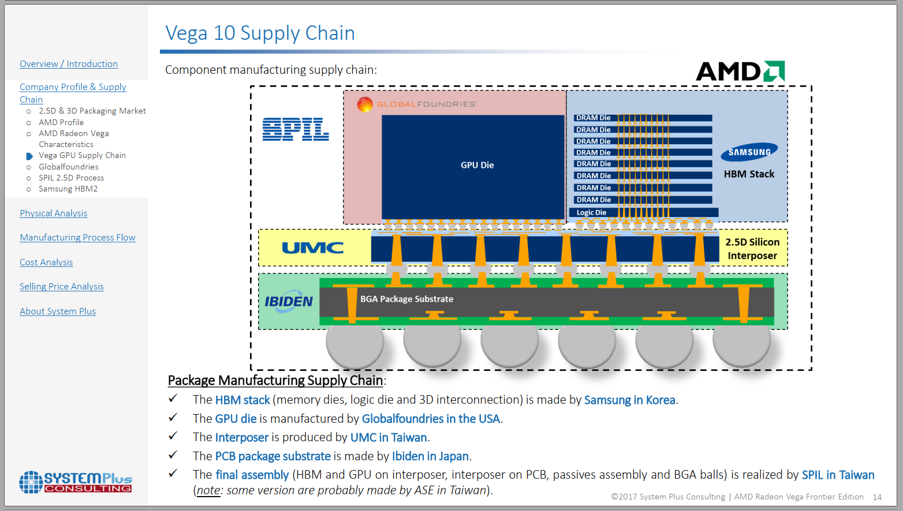

Slide 36
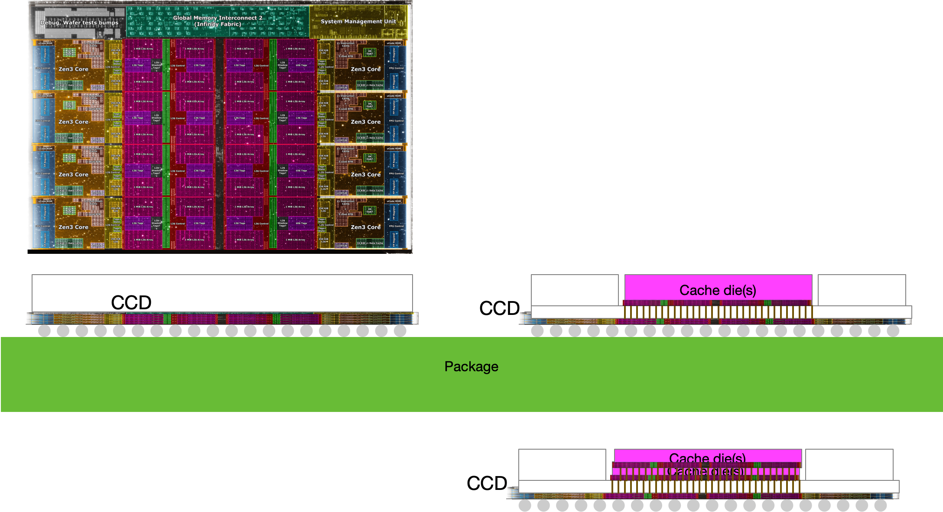
Intrepretation of AMD annoucment
CCD is 80mm2 – 8 cores + 32MB L3
Up to 2 CCD for high end desktop
Up to 8 CCD for EPYC (xeon competitor)
Announced:
64 MB, 36mm2 sram chiplet, also in 7nm
Hybrid bonded (face down) to back of SOC (face down)
32MB -> 96MB L3 (192 MB client, 768MB L3 EPYC)
Dummy silicon over core, sram chiplet only covers sram

Slide 37
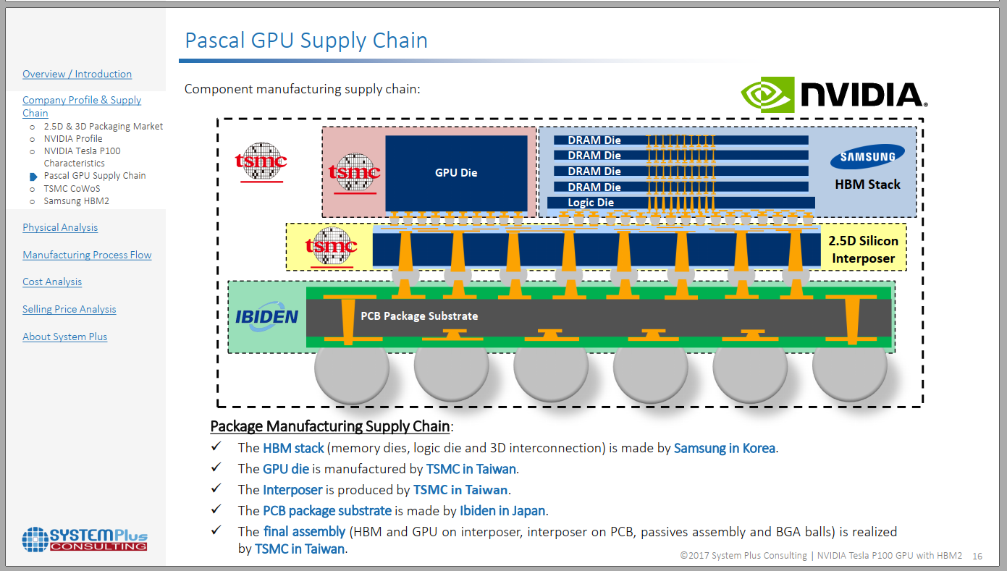

Slide 38
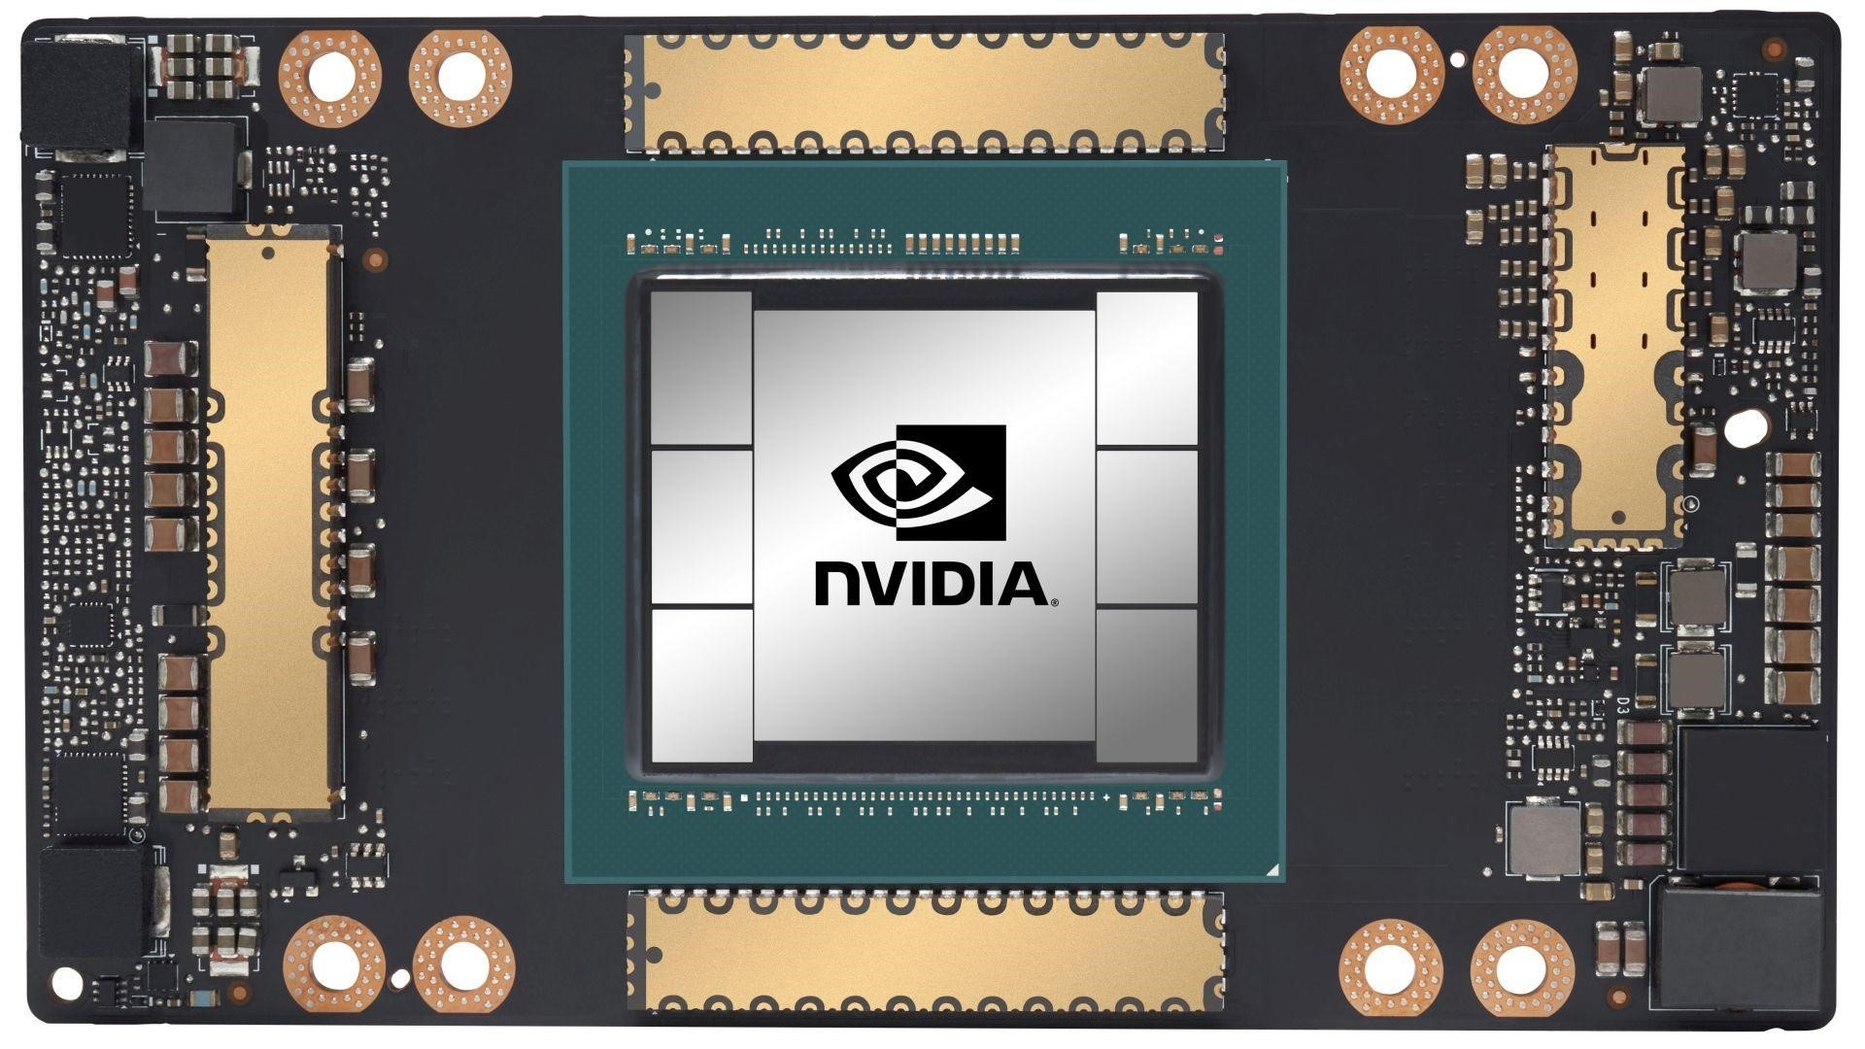
Hardware for AI
Samsung and TSMC indicate Si interposer used for AI
NVIDIA’s latest A100 uses GPU + 6 HBMs
Si interposer (∼1,600 mm²) using TSMC’s CoWoS process
Large GPU die (826 mm²)
Package body size 55 mm x 55 mm
Typical hardware for edge application would be Intel server board
2, 8-core CPUs + 3 NVIDIA GPU boards
GPU + HBM
Lots of AI libraries that go with NVIDIA GPU
Hardware must be compatible with libraries
Source: NVIDIA.

Slide 39
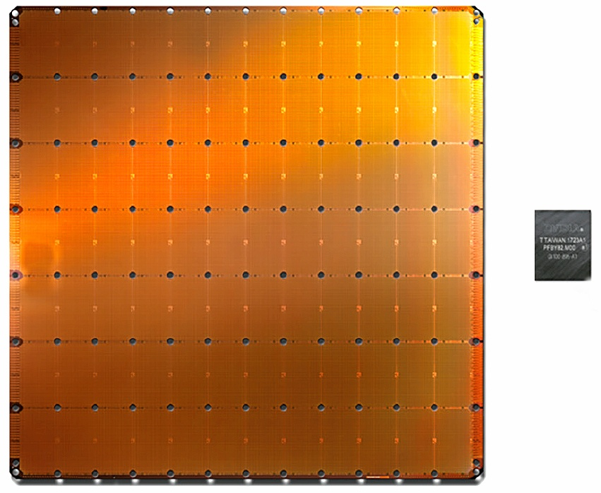
Cerebras Wafer Scale Engine for AI Compute
1.2 trillion transistors on single die (46,225mm²)
Packaged between heat spreader and power supply system
RDL used for interconnectivity within the wafer scale die and for power distribution

Slide 40
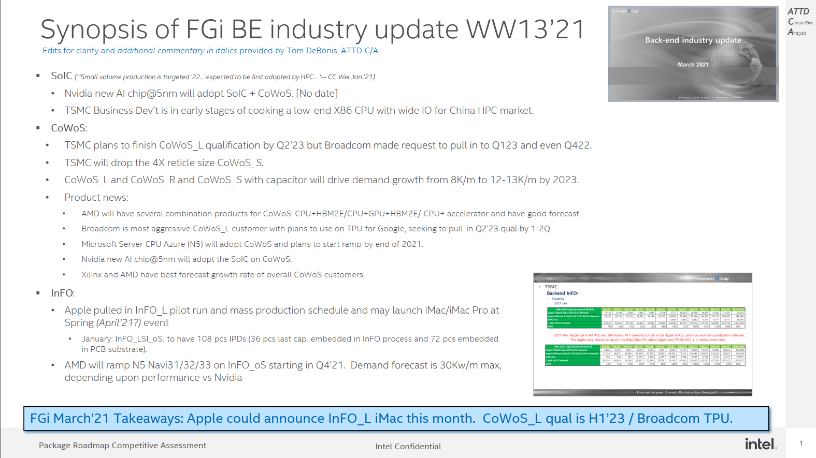

Slide 41
CoWoS • 2021 Mar.: Due to the CoWoS_L is getting more and more popular and will increase more flexibility for combination of different device and also can reduce the cost. So TSMC will drop the 4X reticle size CoWoS development. • 2021 Mar.: TSMC think the CoWoS_L and CoWoS_R and CoWoS with capacitor will let the CoWoS demand growth from 8k/M to 12-13K/m by 2023. • 2021 Mar.: The Broadcom is the most aggressive for CoWoS_L and plan to will use the TPU for Google to adopt the CoWoS_L,. TSMC plan to finish to finish qualification by Q223 and Broadcom request to pull in to Q123 and even Q422. • 2021 Mar. : The AMD will have several combination products for CoWoS CPU+HBM2E/CPU+GPU+HBM2E/ CPU+ accelerator and have good forecast in the coming. Now the AMD and Xilinix CoWoS have best forecast growth rate of overall customers. • 2021 Mar.: The Microsoft Server CPU for Azure@5nm will adopt CoWoS and plan to ramp up by end of 2021. • 2021 Mar.: The Nvidia new AI chip@5nm will adopt the SoIC on CoWoS

Slide 42
– InFO • 2021 Mar.: Apple cut 8-9M A12 and 2M around A13 demand but pill in the Apple InFO_L pilot run and mass production schedule…. • The Apple have chance to launch the iMac/iMac Pro adopt Apple own CPU@InFO _L in spring event date. • 2021 Mar.: AMD will ramp up the GPU@5nm Navu31/32/33 adopt the InFO_oS from Q421.Now total demand still forecast max is 30K/m but that will depe

Slide 43
y : – Backend 3D IC (WoW) : • 2021 Mar.: The TSMC BD (Business development) is cooking for low end X86 CPU with wide IO for high performance computing for China market due to China-USA trade conflict. But it’s in the early stage. – Backend InFO PTI • 2021 Mar.: The PTI have high possibility will give up the panel fan out due to PTI CTO was resign and now no specific owner to be in charge of the Panel fan out. But concentrate more resource for wafer base InFO and WoW. The PTI is working on the Sony CIS+ISP solution

Slide 44

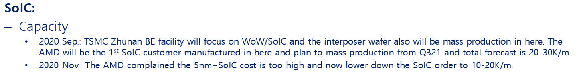

Slide 45
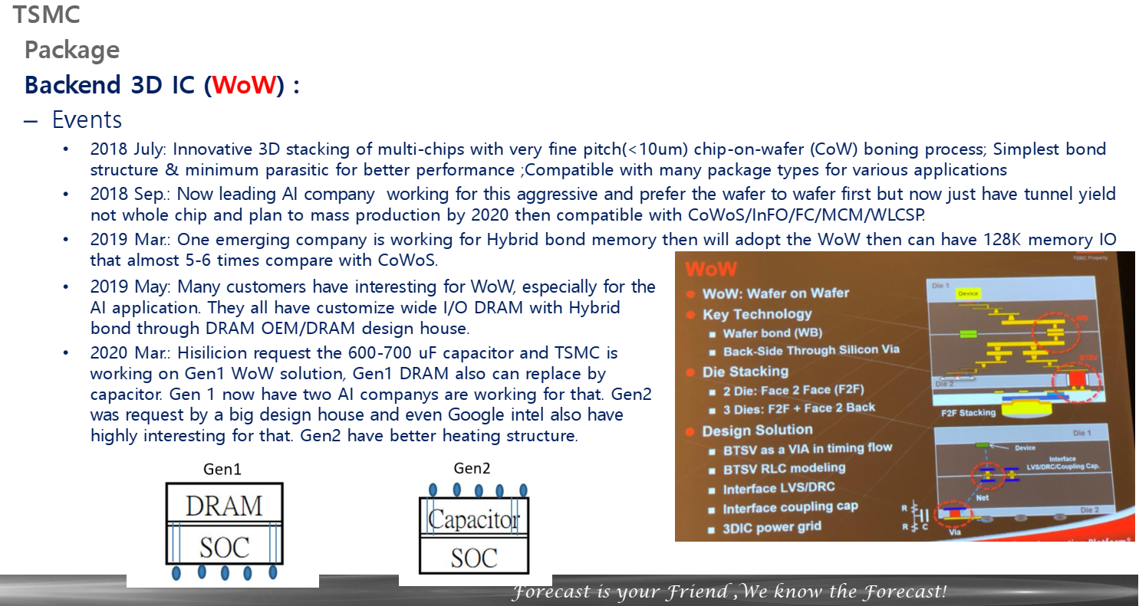
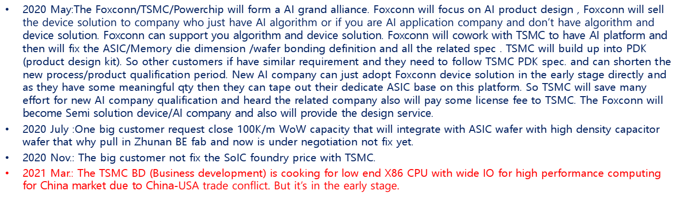

Slide 46
Alternative Tech

Slide 47






Emerging Technology in Memory Pyramid
Access Device
Access Device
Si channel planar / nonplanar XTOR
TFT channel planar / nonplanar XTOR
2T [independent read write] Option
Thermionic
[diode, MIEC, ..]
Volatile filament
Metal-Insulator Transition
Ovonic Threshold
High-k Capacitor
MRAM [STT/SOT]
Ferro-capacitor
Nanostructure change
Magnetic
[MRAM, STT(SOT)MRAM]
Resistance Change ReRAM[1D, 2D], PCM [3D]
Ferroelectrics
Memory Element
Memory Element

Slide 48
Executive Summary
Embedded memory – 1T-STTM with low write cycle time and high endurances were demonstrated.
TSMC-16nm, Samsung-28nm, GF-22nm and IBM-14nm improves write speed (~10ns) and reliability (10⁶ to 10¹² cycles).
IBM-Samsung JDP demo write speed limit at 2nsec; Read disturb is problematic.
1T-STTM density is low; Samsung’s 28nm yields 12Mb/mm² (~Intel’s eDRAM circa ’12), shipping buffer memory in LCD display.
2T-SOT is still in deep research.
In-Package Memory – Intel’s ADM is the leading low-latency alternative, but density is not competitive to bulk Si 1T1C solution
Samsung, Hynix and Micron have indications of monolithic 3DIC DRAM interest but no public disclosure.
low latency 1T-STTM technology requires large x’tor footprint or more advanced technology for high current bipolar operation.
1T-1FeCap, 1T-nFeCap, 1FeFET and 2T-0C gain-cell (IxZO class) in research stage. Long lead time is anticipated.
3D XPoint – Intel is leading competitive landscape by 24~36 months (SLC, MLC and BiSM)
Hynix: Although several papers published in 2020~21, no new information disclosed since IEDM18 paper (a S15-like product).
Samsung remains silent; Macronix-IBM primarily worked on cell level research with limited array activities.
Micron ceased SXP & SSM TD on March 16, 2021, 2y8m after ending IM-JDP. Gen-2 production at Lehi, UT ends by the end of ’21.
Alternative technologies for PM / SCM are either in primitive research, missed product milestone or dropped out.
Fujitsu-Nantero’s 40nm selector-less NRAM: missed sampling milestone of low-latency product.
Sony’s 20nm OTS-select CBRAM: missed sampling milestone likely due to Cu-integration, sigma, drift & disturb.
Avalanche 1S-STTM demonstrated very high NL single cell data; still no array information; disturb, sigma are likely showstoppers.
Crossbar/SMIC FAAST-VO⁺ cell has been radio-silent since their new CEO visited Intel in 2019. Co-funder’s resume is on the street.
Bipolar RRAM, Unipolar CeRAM and FeFET (NAND string) are either dropped out or in early stage of research.
Flash Memory: SunRise 3D QVM (NOR flash), Macronix 3D AND Flash,

Slide 49
Memory Architectures
Arch | Description | Companies
MRAM | Uses electron spin to store information; high-density, non-volatile, power efficient Challenges: Requires significant process integration to manufacture Status: Furthest along in development; Solutions already in the market (Everspin, Samsung, TSMC, GF) | Avalanche Escencia Everspin (IPOed) Spin Transfer Tech
RRAM | Changes the resistance across a dielectric solid-state material, non-volatile Challenges: Variability issues are proving to be difficult to overcome Status: Advertised as the ultimate scalable memory; Many RRAM companies trying to penetrate into the AI/ML market and worth with in-memory compute model | Crossbar Intrinsic NuMe ReBIT ReRAM Spin Memory
NRAM | Based on carbon nanotube technology for strong write-endurance, non-volatile Challenges: Have yet to deliver on promises Status: Have been around for 20+ years, Fujitsu announced to partner with Nantero to bring to market in 2019 | Nantero
FeRAM | Uses ferroelectric layer to achieve non-volatility, low power, fast write Challenges: Historically used materials that were difficult to integrate into FAB environment, lower storage densities than Flash Status: Advances made to use Hafnium Oxide to make more accessible for FAB environment | FerroElectric Memory
Other | SRAM NAND | Zeno (SRAM) Netlist Yangtze Memory Tech

Slide 50
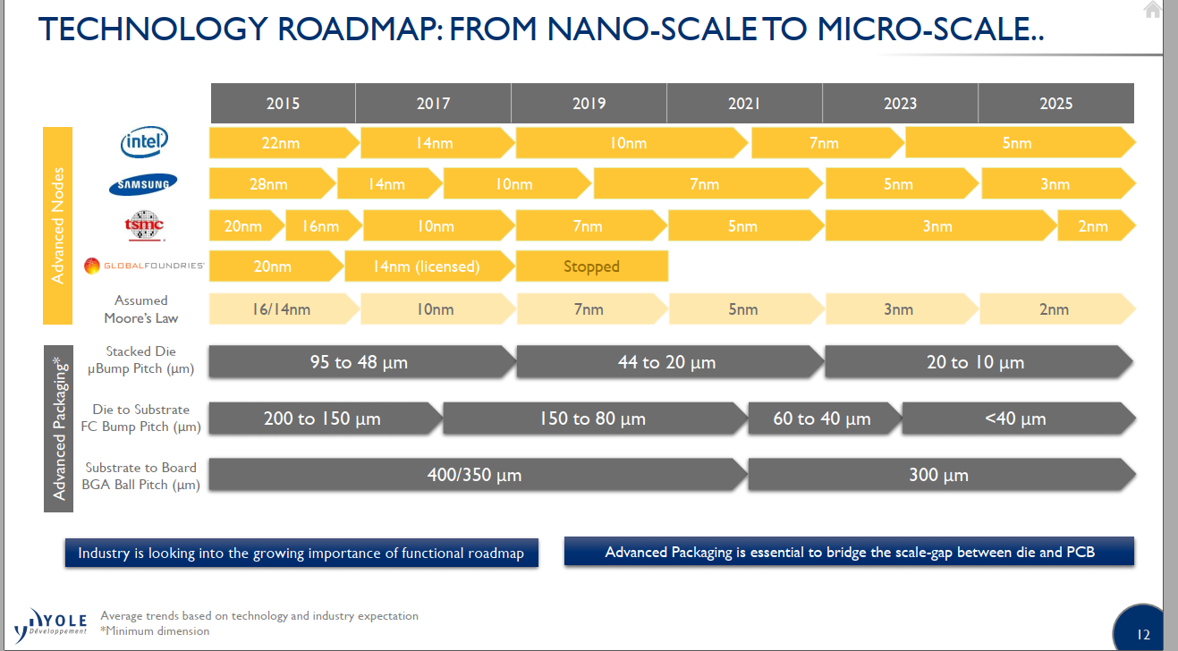

Slide 51
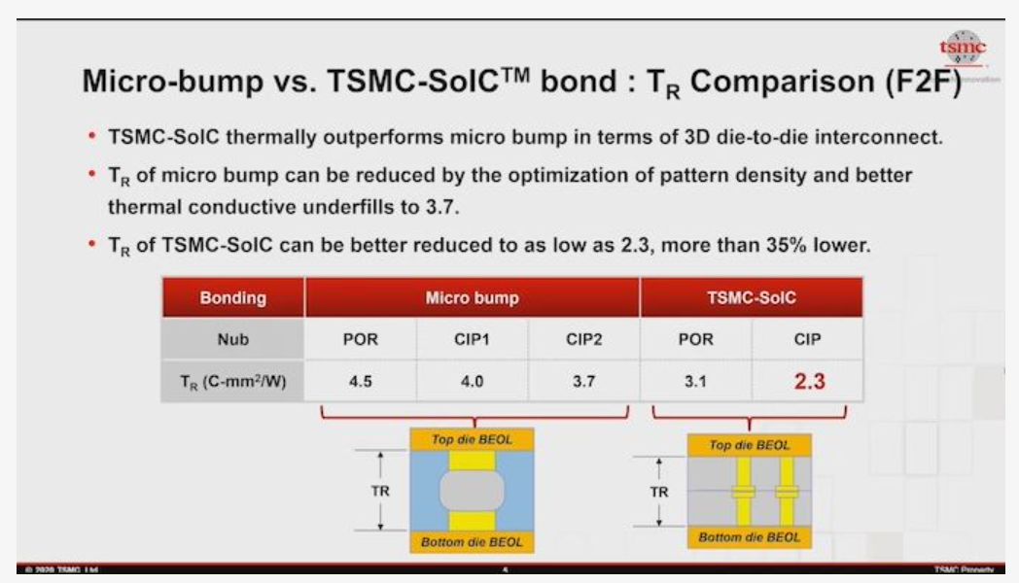
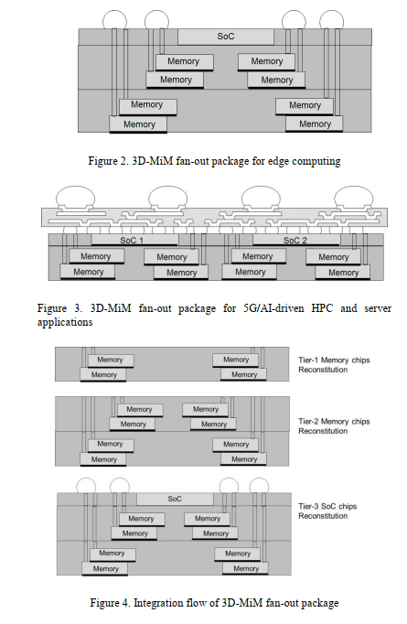

Slide 52
Mem On Top
Mem On Bottom
Adjacent
SRAM
ADM
DRAM
SRAM
ADM
DRAM
SRAM
ADM
DRAM
Intel
TSMC
Winbond
Samsung
SK
Samsung
AP Mem
Samsung
GF
New DRAM
AP Mem
Winbond
Micron
HBM
New DRAM
LP5
Custom GDDR
New DRAM
HBM
DRAM stacked on SRAM
7 permutations of DRAM adjacent to logic

Slide 53
Focus on taking advantage ef each memory type with the best available interconnect tech.
Focus on TTM execution and quality

