Slide 1
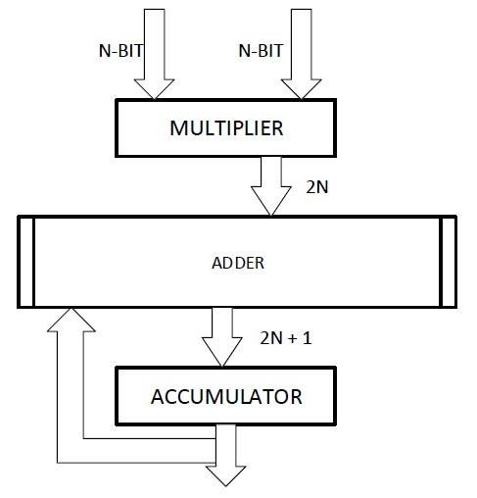
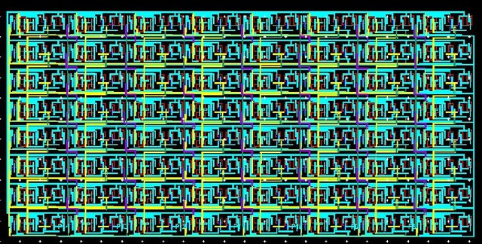
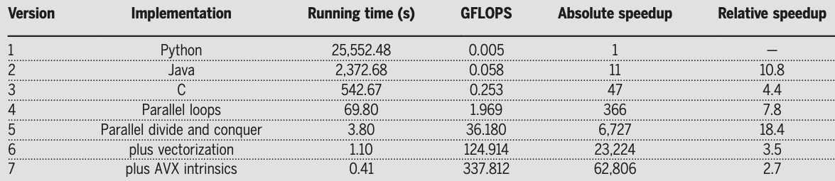
Matrix Multiply-Accumulate (MAC) or Multiply-Add (MAD) –
for i in xrange(4096):
for j in xrange(4096):
for k in xrange(4096):
C[i][j] += A[i][k] * B[k][j]
Multi-Core 7.8x
Coding Efficiency 47x
Upadhyay, et.al., Journal of Low Power Electronics, Volume 11, Number 1, March 2015, pp. 37-48(12)
18.4x
Memory Hierarchy
18.4x
Memory Hierarchy
3.5x
Vector Processing
2.7x
ISA Optimization
From “There’s plenty of room at the Top: What will drive computer performance after Moore’s law?”
Leiserson et.al. Science 368, eaam9744 (2020)
See also Dick Feynman’s “There’s plenty of room at the bottom” Eng. Sci.23,22–36 (1960)

Slide 2
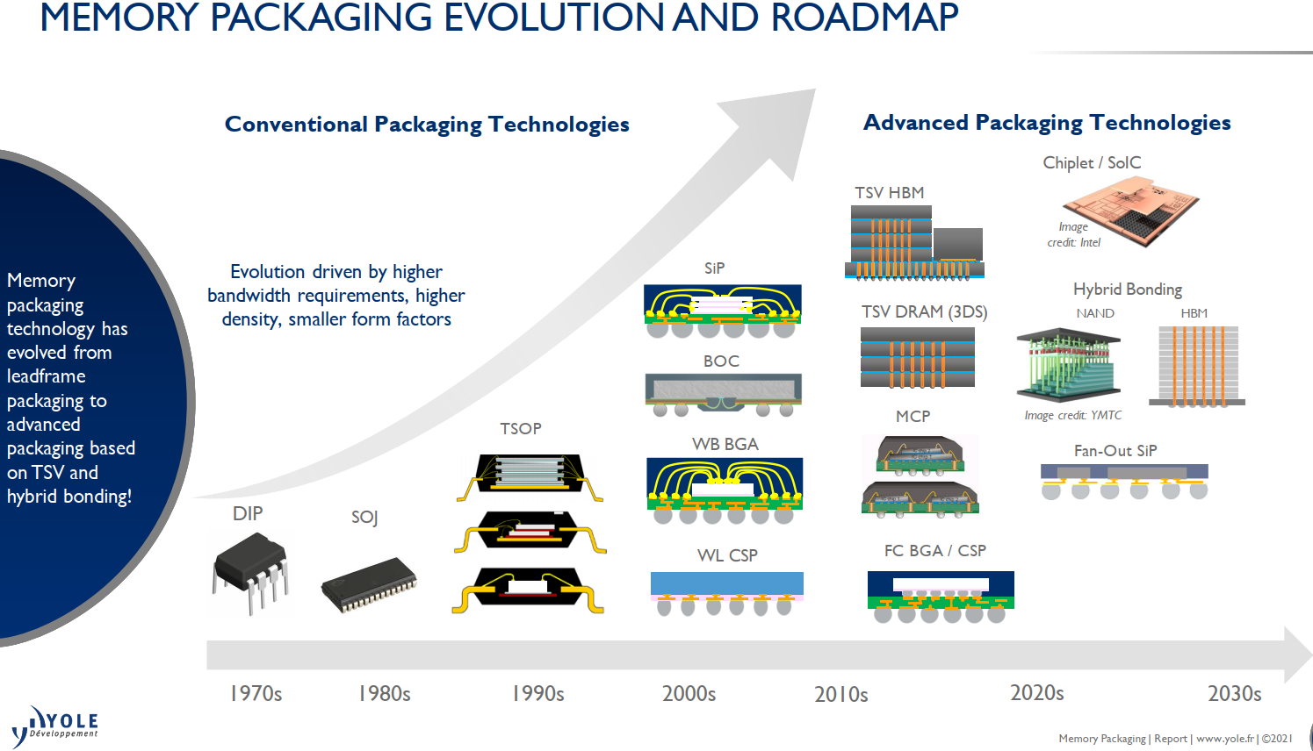

Slide 3
Memory Technology
DerChang Kau, Nov/27/’23
Memory Technology
Construct in System hierarchy
Generalized Control Access
Model in Memory Semantics
Benchmark

Slide 4
Memory Technology
Construct in System hierarchy
JEDEC Memory
Custom Memory

Slide 5
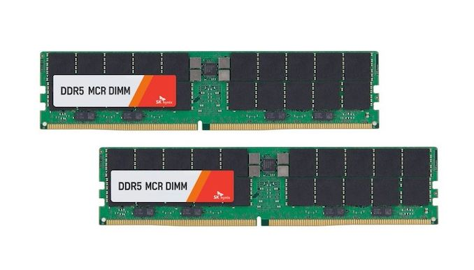
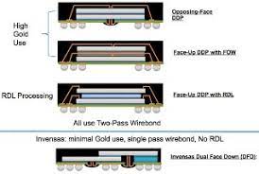
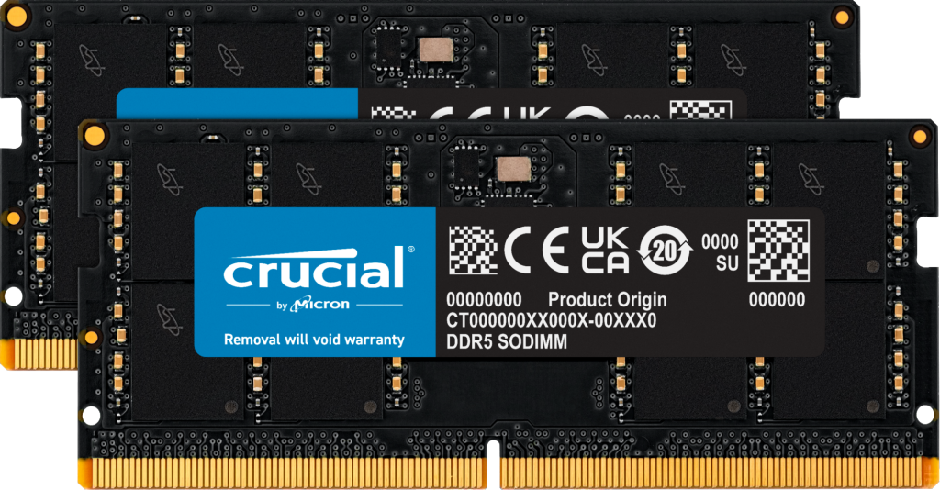
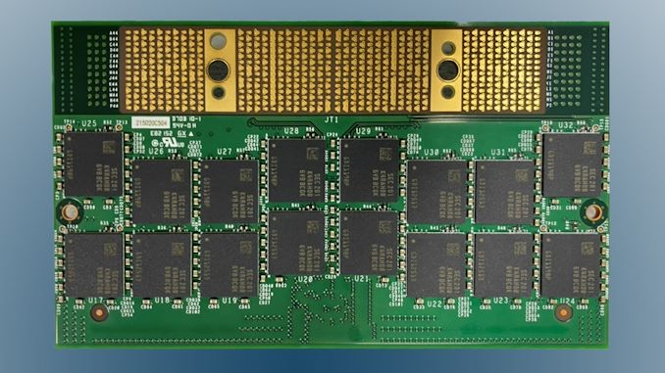
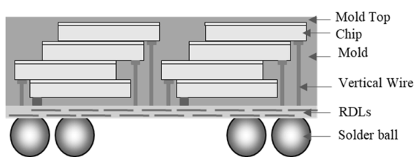
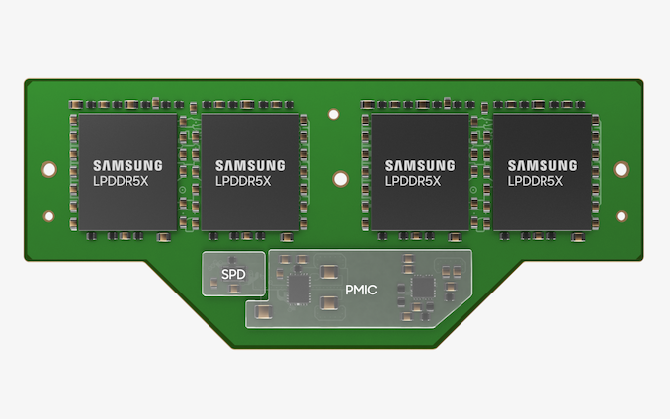
DDR is Memory Module Socketed on PCB
Ki-Jun Sung et.al., EDTM’23 DOI: 10.1109/EDTM55494.2023.10102966

Slide 6
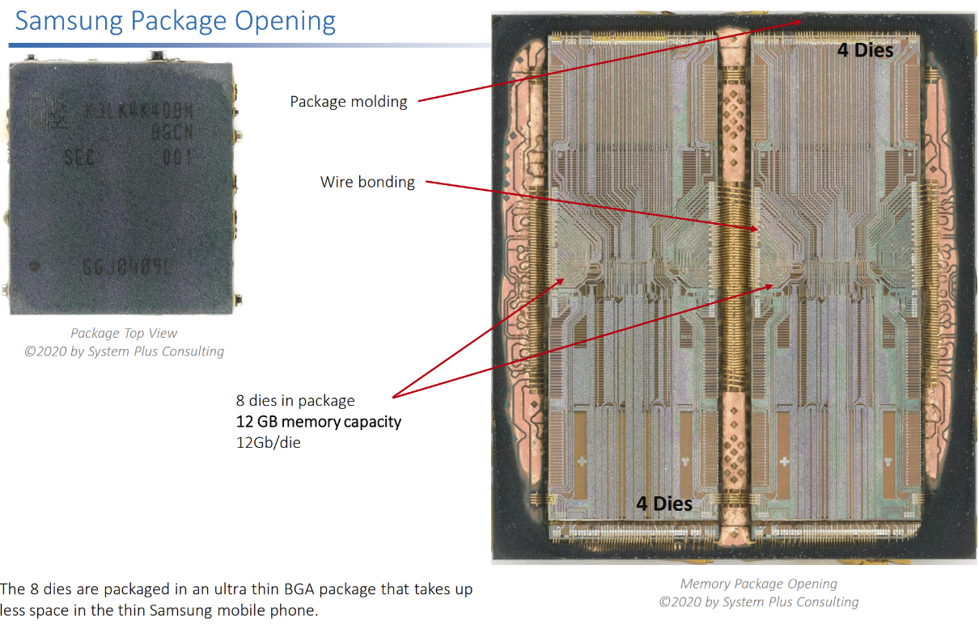
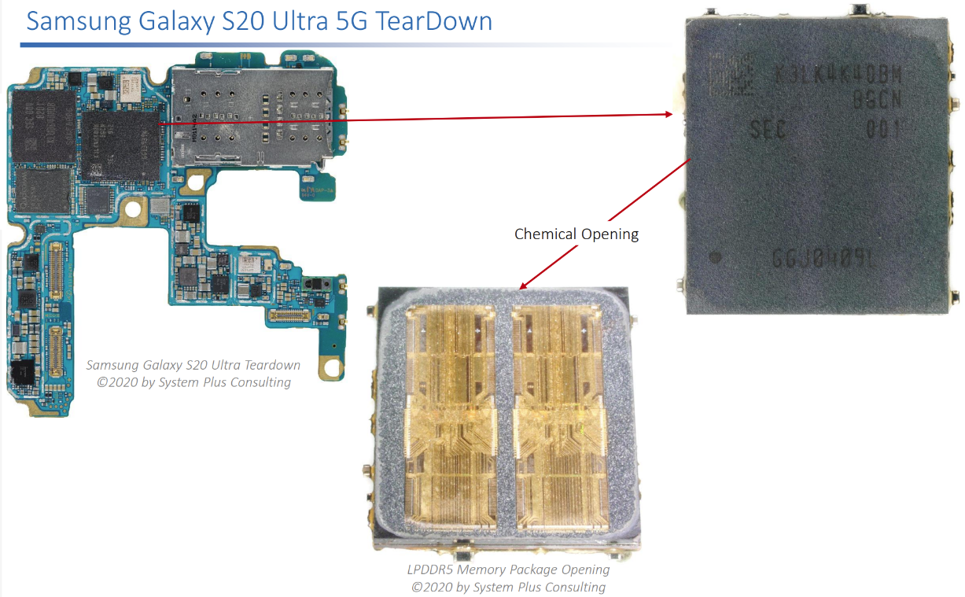
LPDDR5 in Phone
Wire-bonded Package surface mounted on a PCB

Slide 7
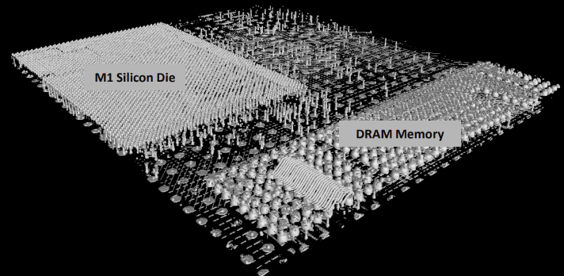
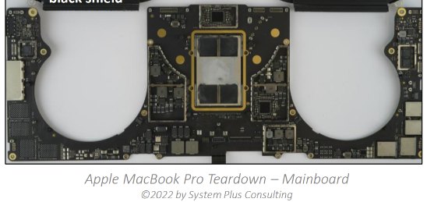
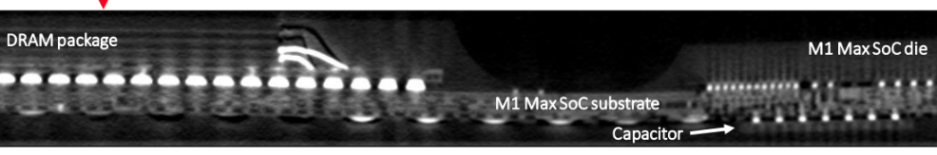
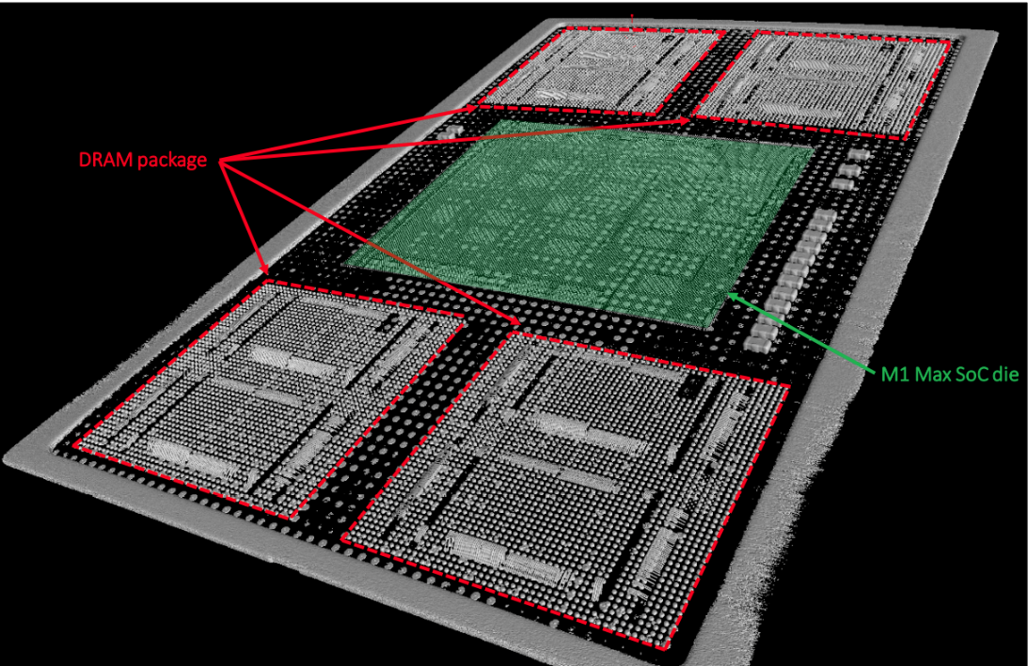
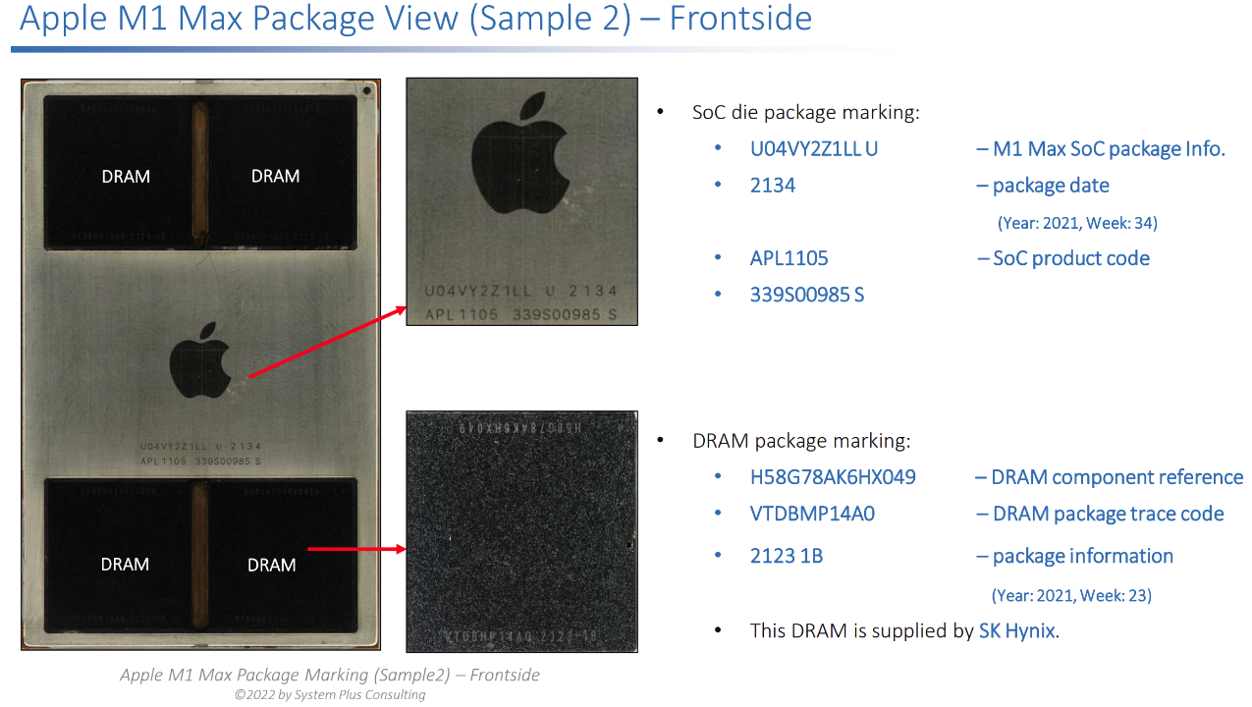
LPDDR5 in Client Compute System
Wire-bonded package micro bumped to an organic substrate surface mounted on PCB

Slide 8
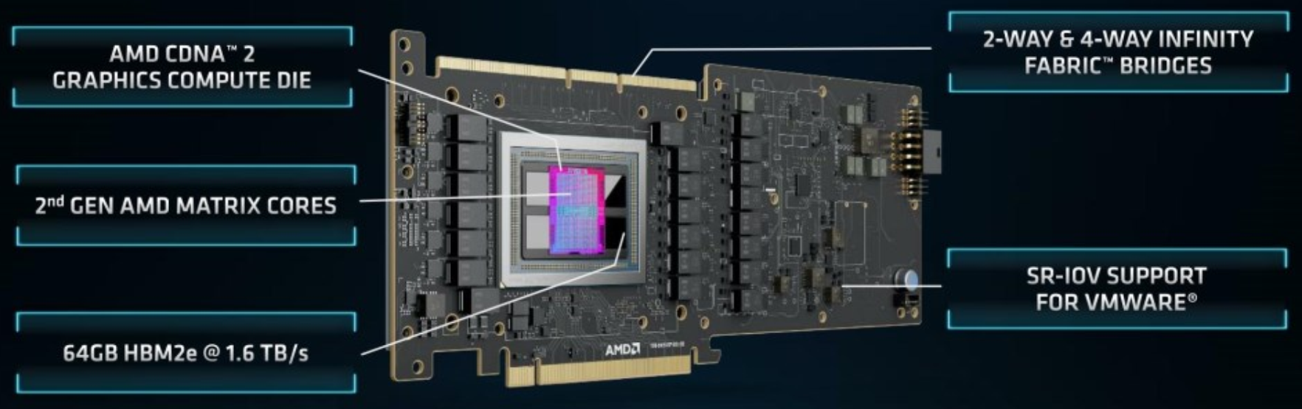
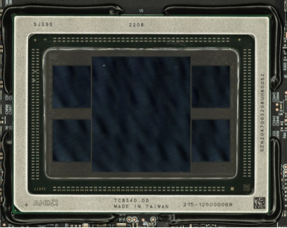
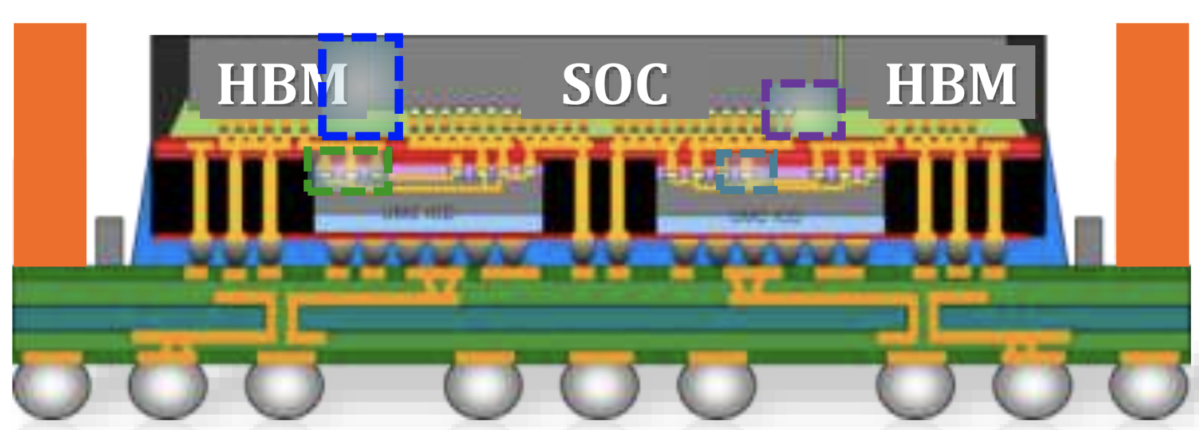
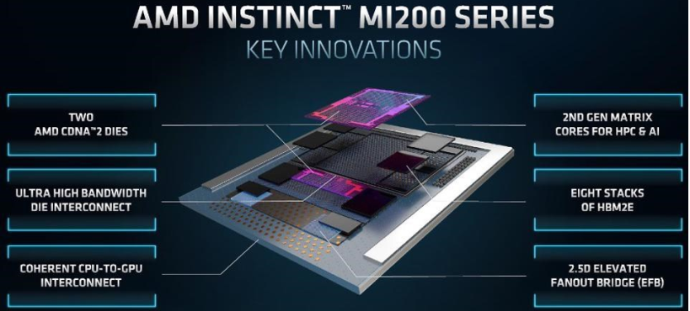
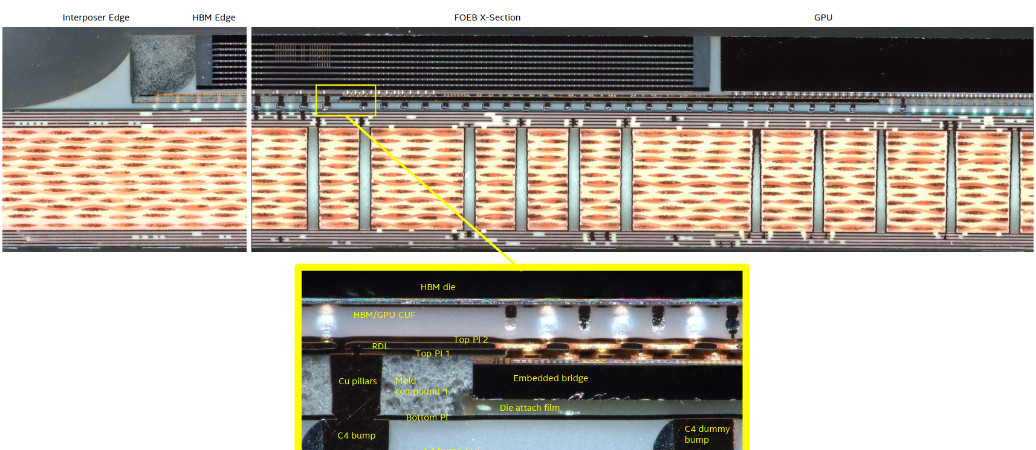
HBM in Accelerator
2.3D µB/TSV CoW Memory (8+1) chip stack in a 2.3D FO EB Module

Slide 9
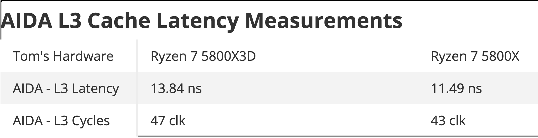
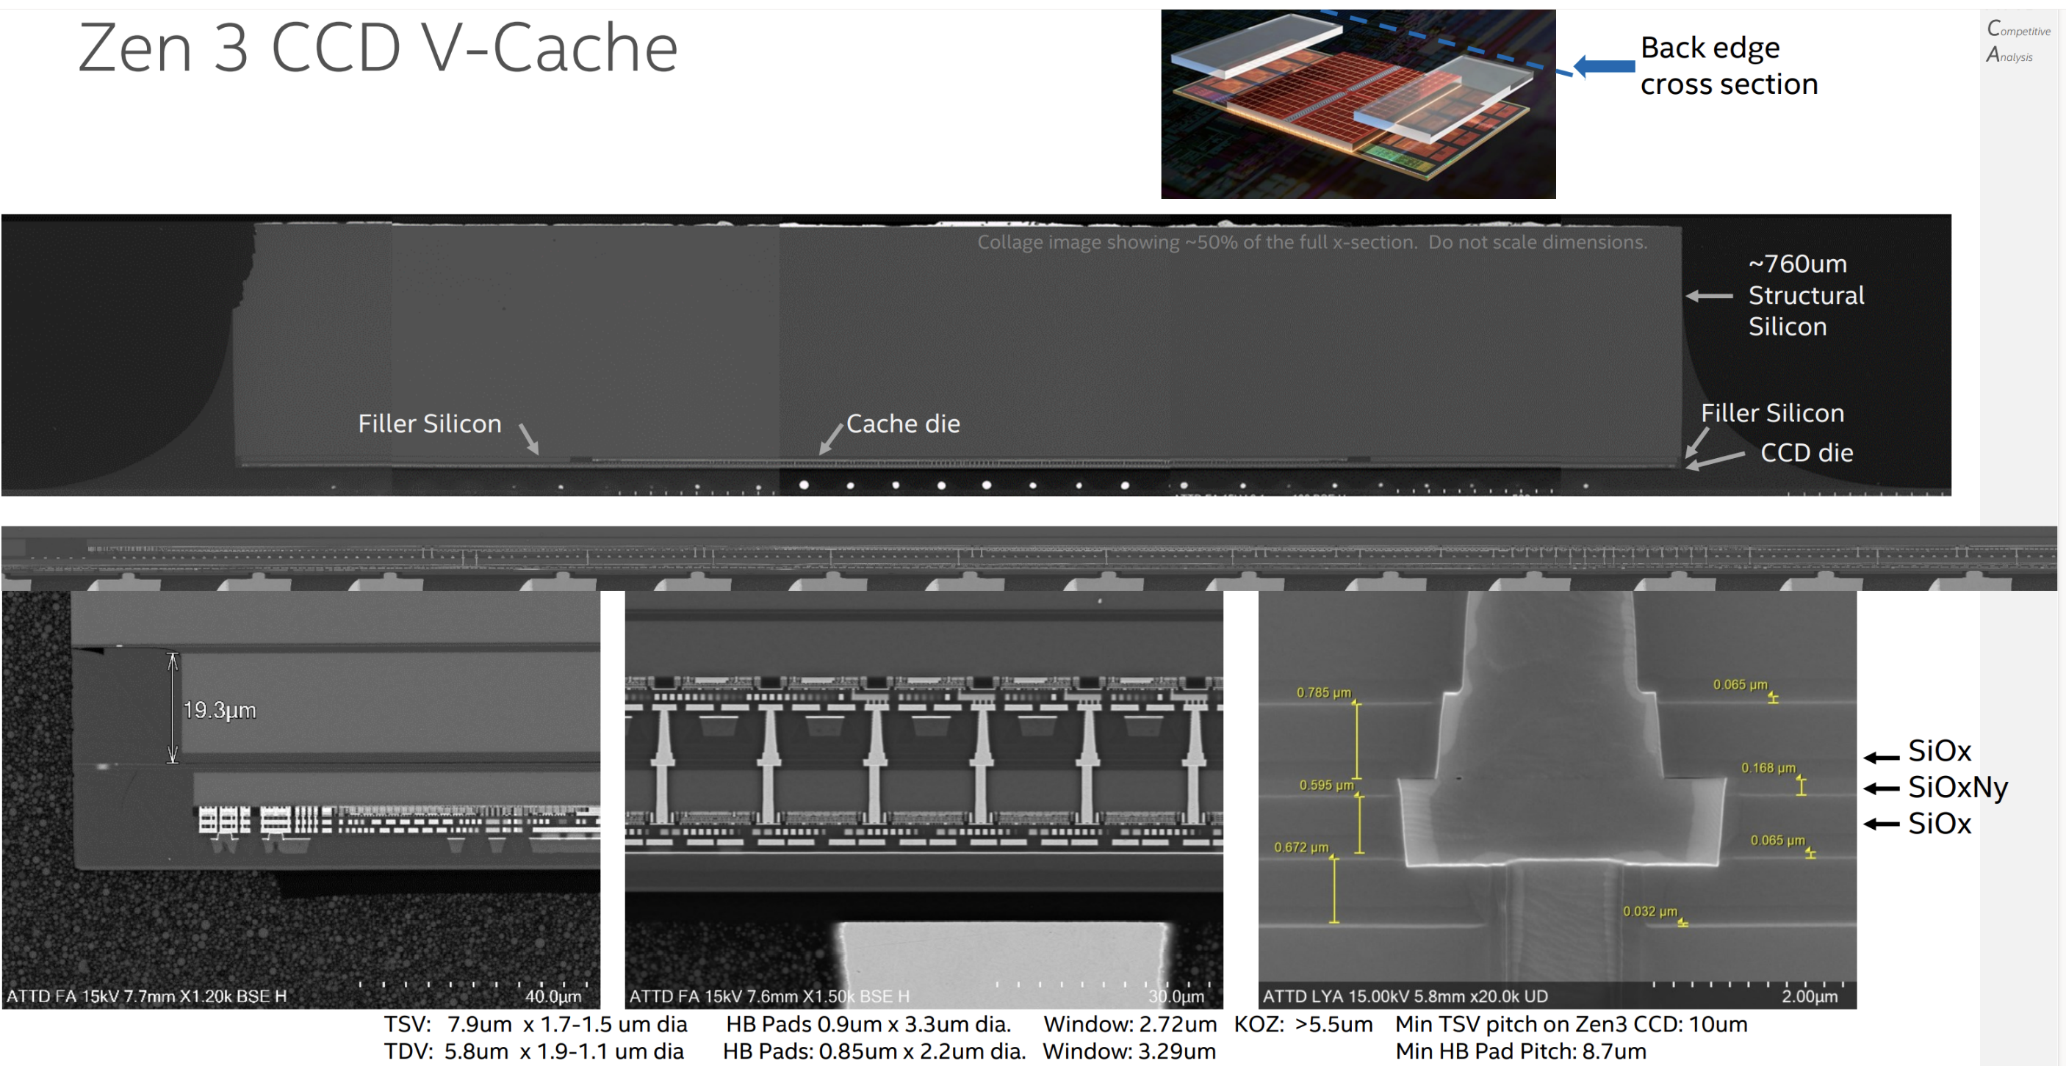
Disaggregated SRAM – AMD Zen 3 CCD V-Cache
7nm SRAM CoW F2B 9µm HBI to Logic Base die

Slide 10
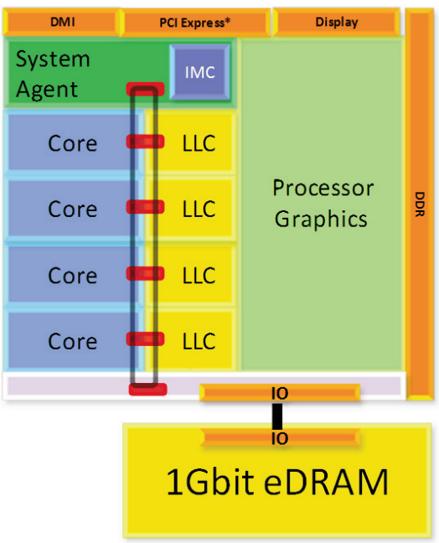
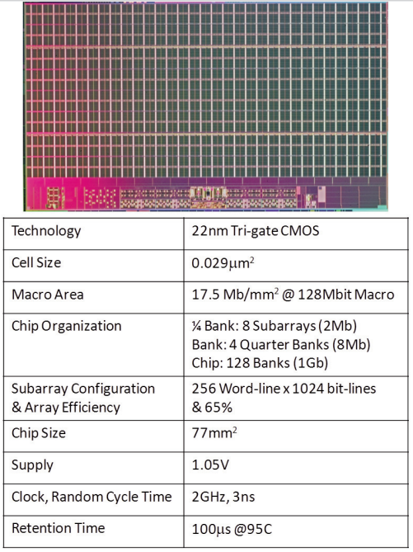
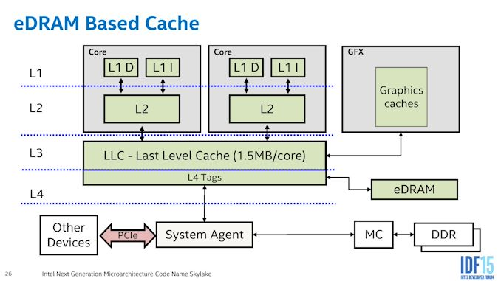
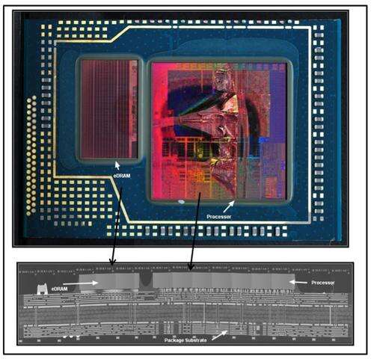
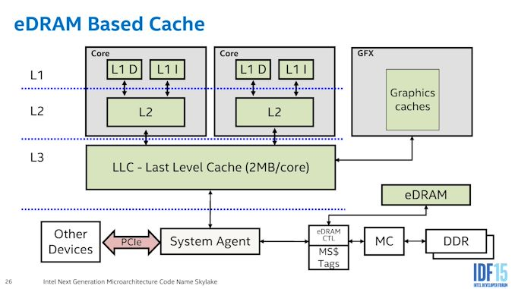
Custom DRAM (i) – MCP for Client Compute
~60nm 1T1C DRAM (~7nm 6T SRAM eq.) + 14nm Logic
Haswell/Broadwell eDRAM – L4 Cache
Skylake eDRAM – Memory Side Cache

Slide 11
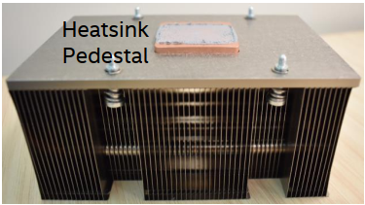
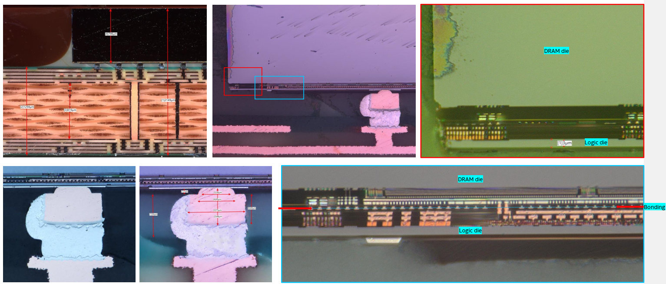
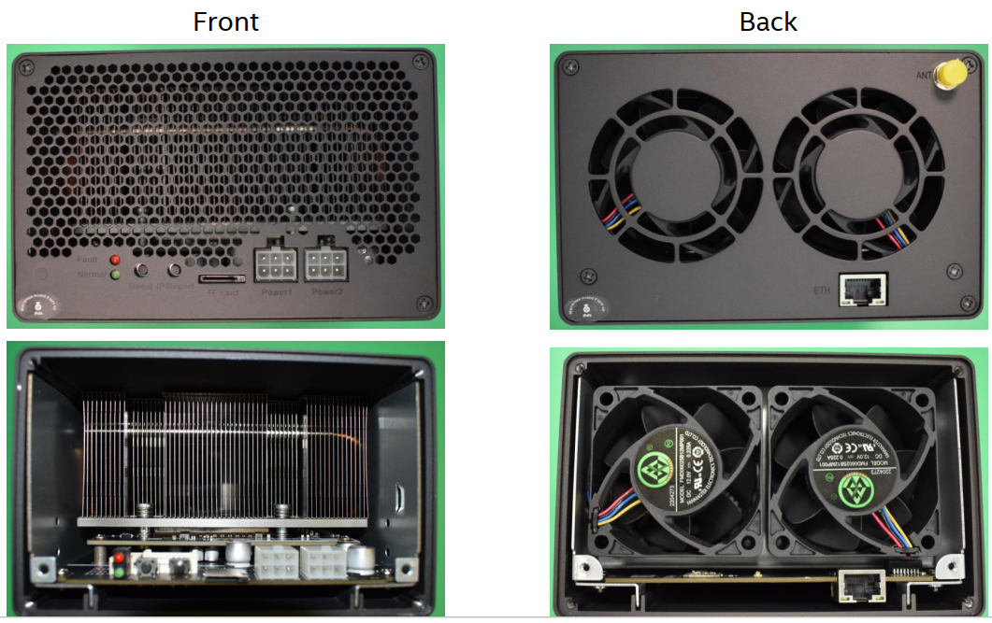
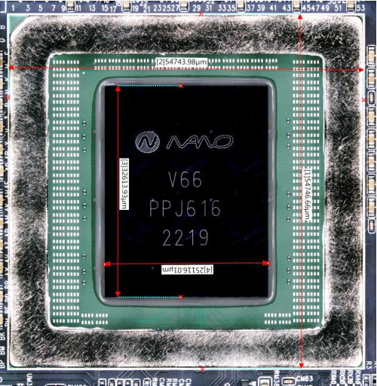
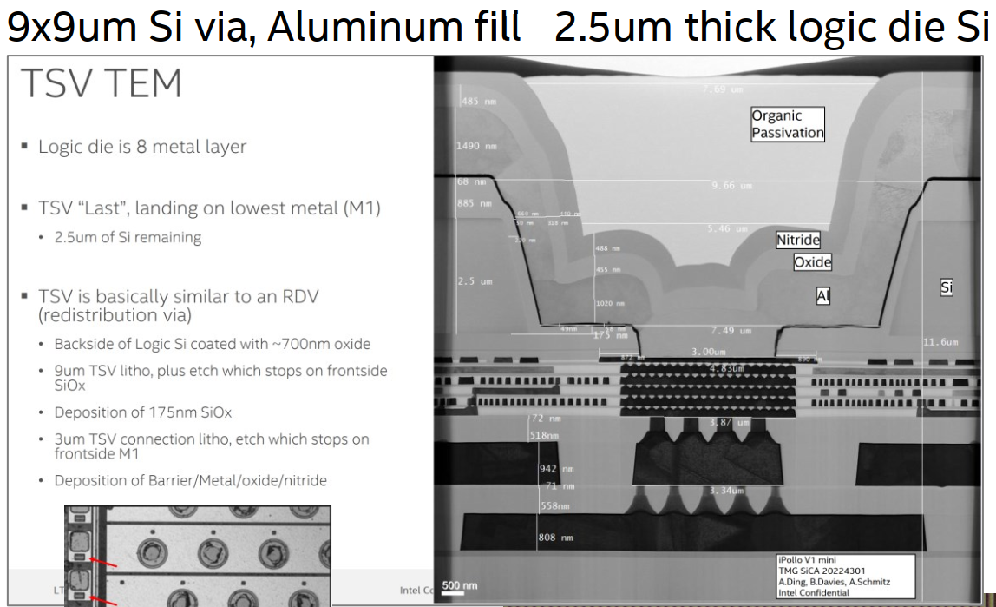
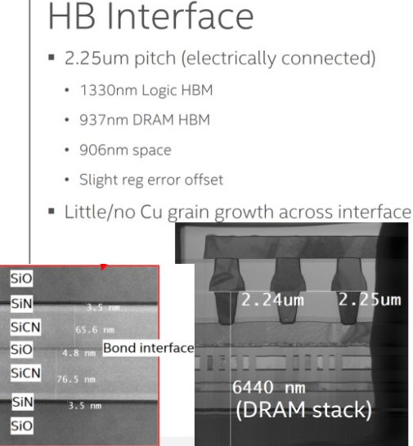
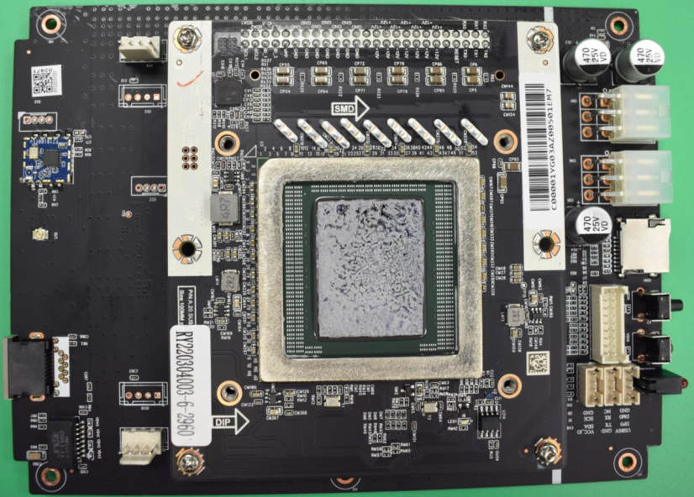
Custom DRAM (ii) – Cryptographic Hashing
Mixed SiFO/OSAT
PSMC 30nm DRAM | Logic: SMIC 40nm
3DIC: XMC WoW HBI2.25µm | C4 A/T: ASE

Slide 12
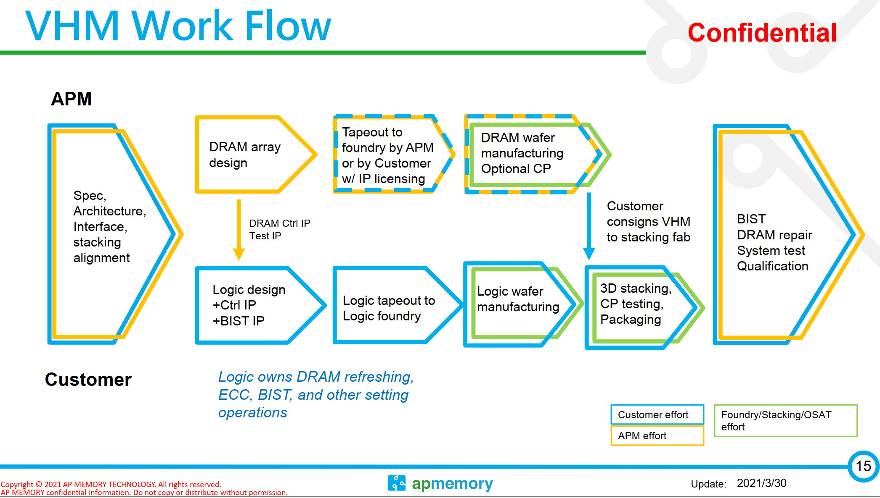

Slide 13
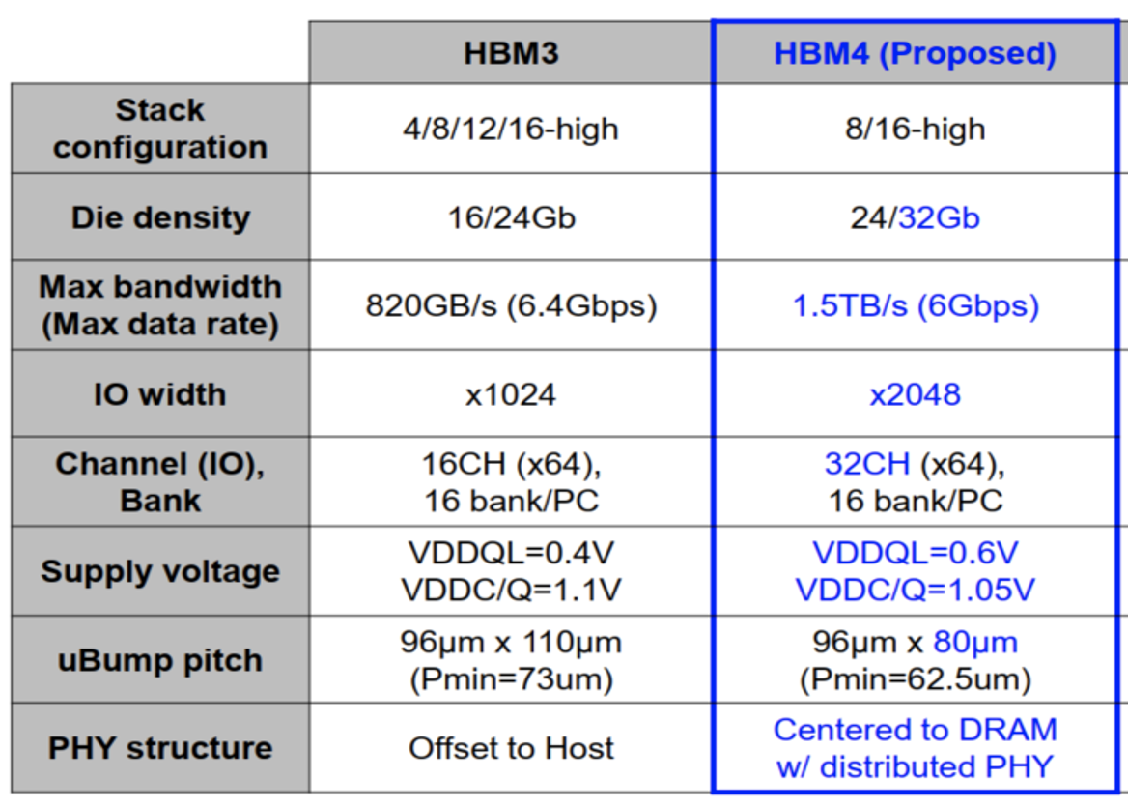
Beyond HBM3 – JEDEC In Package Memory

Slide 14
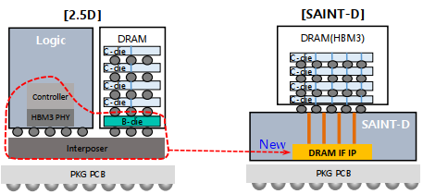
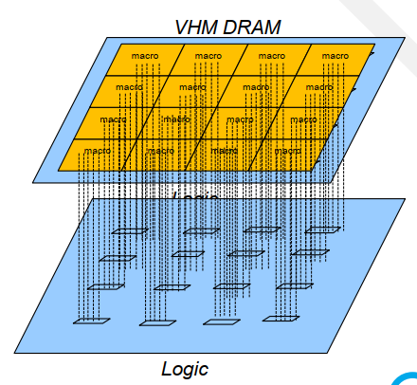
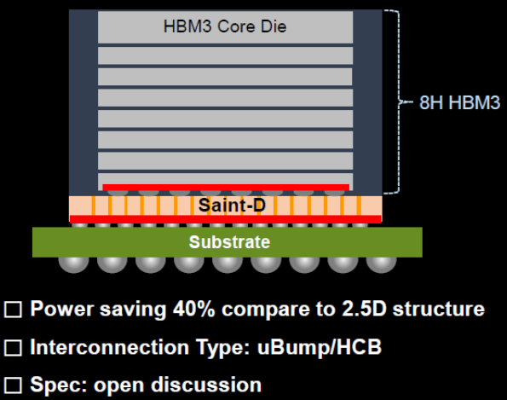
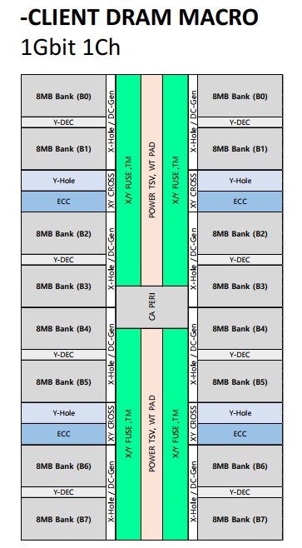
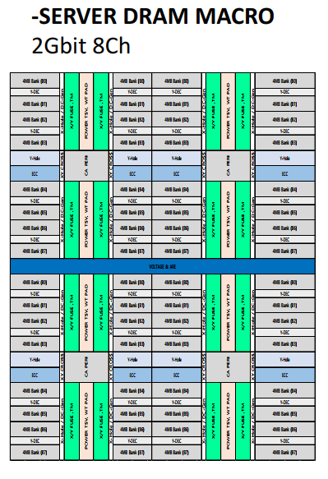
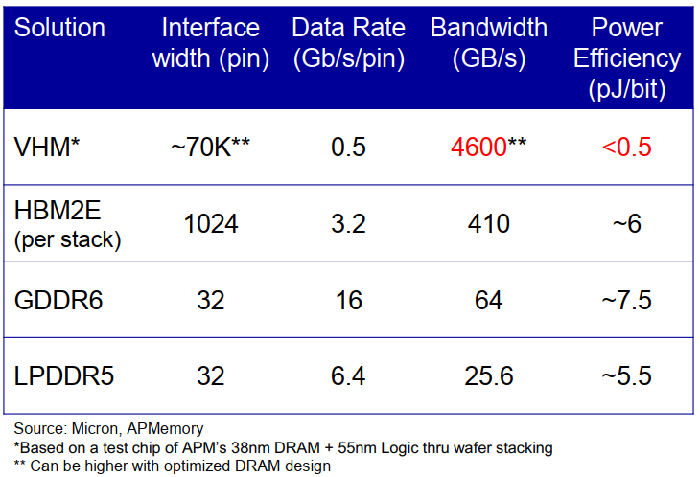
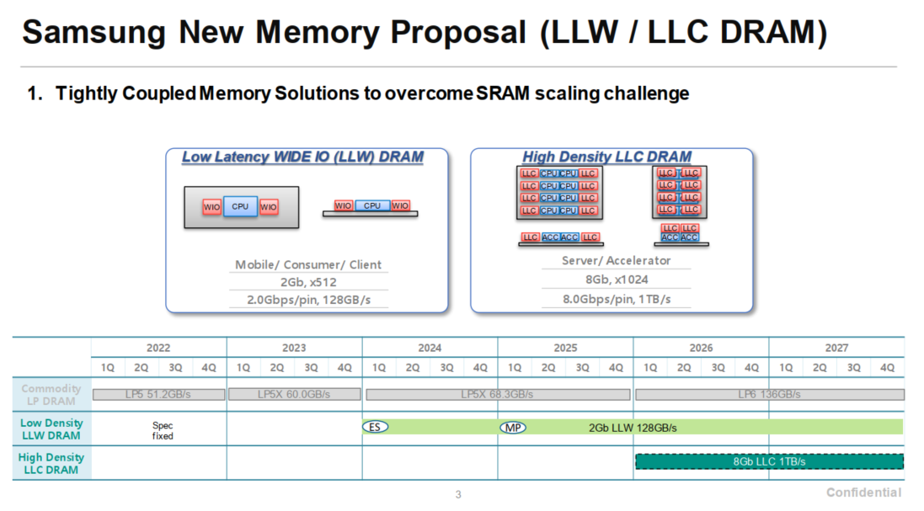
Beyond HBM3 – Custom In Package Memory
AP Memory
Intel-Hynix TCC-D
1 GB, 256GB/s 50mm²
1GB, 2TB/s
64mm²
2GB, 4TB/s
128mm²)
2 GB, 256GB/s 50mm²
High-Capacity Macro (128MB 1Ch)
21MB/mm2, 32GB/s/ch, 1.5pJ/b
High-Bandwidth Macro (16MB 1Ch)
16MB/mm², 32GB/s/Ch, 1.5pJ/b
Samsung LLW/LLC
a.k.a. DBM, SKH ULP

Slide 15
IPM Benchmark
What is the metric
Benchmark

Slide 16
Incumbent Technologies in Memory/Storage Hierarchy
“The Memory Organ – Ideally one would desire an indefinitely large memory capacity such that any particular … word would be immediately … available. … It does not seem possible physically to achieve such a capacity. …We are therefore forced to recognize the possibility of constructing a hierarchy of memories, each of which has greater capacity than the preceding but which is less quickly accessible.”
Preliminary Discussion of the Logical Design of an Electronic Computing Instrument
Arthur Burks, Herman Goldstine and John von Neumann,
June/28/1946
SRAM
DRAM
HDD
SSD
Capacity, Latency
Bandwidth, Cost

Slide 17




Memory Hierarchy
~10sMB, ~100ps
HC, HS SRAM:
Cell size and capacity, architecture and ip folding
~100sMB, ~1ns
~1sGB, ~10ns
Disagg. HD SRAM or Custom HBW DRAM:
Chiplet in 3DIC
~10sGB, ~100ns
JEDEC DRAM
Cell Size, 3D Topo
~100sGB, ~1µs
3D XPoint
Adoption tipping point, “Crossing the chasm”
~1sTB, ~10µs
3D NAND
HAR, Layer Transfer
~10sTB, ~100µs
Main Memory

Slide 18
Strategy for Memory Subsystem
Exploration, Development and Deployment
Choosing Right Success Criteria – “pick on someone your own size”
  Universal memory often sought, but hierarchy always existed and likely always will be
  FoM must be benchmarked with respect to the corresponding hierarchy of memories of a computer architecture
Memory Subsystem
  Pair memory tech with compute architecture/hierarchy.
  Software enabling to alleviate adoption barriers or to unlock value
  Power/Thermal conscious: Energy of moving bits back and forth becoming limiting
  Modular, Modular, Modular

Slide 19
Component (die) Attributes
 | JEDEC Memory |  |  |  | Custom In Package Memory
Tech Attributes | DDR5 | LPDDR5 | HBM3 | GDDR6 | P1271.3 | P1227.7 | Muddy Creek | APM VHM AI | APM VHM Blockchain | SKH TCCD | SEC LLW
Package Integration | FC | xDP WB | 2.xD | xDP WB | MCP | 2.5D/3D | 2.xD/3D | 3D HBI | 3D HBI | 3D HBI | 3D HBI
Silicon Technology @ NPI | 1z | 1z | 1z | 1z | 22nm | 22nm | SF4X | 30nm | 30nm | 1z | 1z
Capacity (GB) | 4 | 2 | 2 | 2 | 0.125 | 1 | 0.25 | 0.59 | 4.39 | 4 | 1
Die Size (mm²) | 120 | 58 | 121 | 121 | 78 | 153 | 95 | 100 | 600 | 293 | 123
Protocol (Cmd/addr/DQ) | DDR | LPDDR | LP like | GDDR | F. Duplex | LP Like | F. Duplex | SDR | SDR | LP Like | LP Like
# of Channel per die | 1 | 2 | 4 | 16 | 128 | 32 | 32 | 300 | 1125 | 256 | 32
Max DQ width | 16 | 16 | 256 | 32 | 128 | 16384 | 16384 | 38400 | 72000 | 131072 | 4096
Max Data rate/pin (GT/s) | 8.4 | 6.4 | 8 | 24 | 6.4 | 1.6 | 1.6 | 0.5 | 0.5 | 0.25 | 2
Theoretical max BW (GB/s) | 16.8 | 12.8 | 256 | 96 | 102 | 3277 | 6554 | 2400 | 4500 | 4096 | 1024
DQ Density (DQ/mm²) | 0.1 | 0.3 | 8.5 | 0.3 | 1.6 | 107.2 | 344.9 | 384.0 | 120.0 | 448.0 | 33.3
Pin footprint (µm square/ pin) |  |  |  |  |  | 68 | 44 | 36 | 65 | 33 | 122

Slide 20
Normalized Performance
 | JEDEC Memory |  |  |  | Custom In Package Memory
 | DDR5 | LPDDR5 | HBM3 | GDDR6 | P1271.3 | P1227.7 | Muddy Creek | APM VHM AI | APM VHM Blockchain | SKH TCCD | SEC LLW
Density (MB/mm²) | 34.1 | 35.3 | 16.9 | 16.9 | 1.6 | 6.7 | 2.7 | 6.0 | 7.5 | 14 | 8.3
BW/Capacity (BW/GB) | 4.2 | 6.4 | 128 | 48 | 819 | 3277 | 26214 | 4096 | 1024 | 1024 | 1024
BW/ Density ([GB/s]/mm²) | 0.140 | 0.221 | 2.12 | 0.79 | 1.31 | 21.4 | 69.0 | 24.0 | 7.5 | 14.0 | 8.3
Random Access Latency (ns) | 33 | 36 | 34 | 30 | 13 | 15 | 3 | 15 | 15 | 15 | 32
Access Energy (pJ/b) | 16 | 5 | 3.7 | 16 | 10 | 0.8 | 0.23 | 0.5 | 0.7 | 0.96 | 1.5
Power Density (mW/mm²) | 17.9 | 8.8 | 250.5 | 101.6 | 105.0 | 137.2 | 126.9 | 96.0 | 42.0 | 107.5 | 100.0
Performance of a 100mm² die
 | JEDEC Memory |  |  |  | Custom In Package Memory
 | DDR5 | LPDDR5 | HBM3 | GDDR6 | P1271.3 | P1227.7 | Muddy Creek | APM VHM AI | APM VHM Blockchain | SKH TCCD | SEC LLW
Capacity [GB] | 3.3 | 3.4 | 1.7 | 1.7 | 0.2 | 0.7 | 0.3 | 0.6 | 0.7 | 1.4 | 0.8
BW [TB/s] | 0.014 | 0.022 | 0.212 | 0.079 | 0.131 | 2.144 | 6.899 | 2.400 | 0.750 | 1.400 | 0.833
Power [W] | 1.8 | 0.9 | 25.0 | 10.2 | 10.5 | 13.7 | 12.7 | 9.6 | 4.2 | 10.8 | 10.0
Random Access Latency (ns) | 33 | 36 | 34 | 30 | 13 | 15 | 3 | 15 | 15 | 15 | 32
Access Energy (pJ/b) | 16 | 5 | 3.7 | 16 | 10 | 0.8 | 0.23 | 0.5 | 0.7 | 0.96 | 1.5

Slide 21
Performance Benchmark of a 100mm² die
 | JEDEC Memory |  |  |  | Custom In Package Memory
 | DDR5 | LPDDR5 | HBM3 (ref) | GDDR6 | P1271.3 | P1227.7 | Muddy Creek | APM VHM AI | APM VHM Blockchain | SKH TCCD | SEC LLW
Capacity [GB] | 3.3 | 3.4 | 1.7 | 1.7 | 0.2 | 0.7 | 0.3 | 0.6 | 0.7 | 1.4 | 0.8
(Large is better) | 2.02x | 2.09x |  | 1x | 0.1x | 0.4x | 0.16x | 0.35x | 0.44x | 0.83x | 0.49x
BW [TB/s] | 0.014 | 0.022 | 0.212 | 0.079 | 0.131 | 2.144 | 6.899 | 2.400 | 0.750 | 1.400 | 0.833
(Large is better) | 0.07x | 0.1x |  | 0.38x | 0.62x | 10.13x | 32.61x | 11.34x | 3.54x | 6.62x | 3.94x
Power [W] | 1.8 | 0.9 | 25.0 | 10.2 | 10.5 | 13.7 | 12.7 | 9.6 | 4.2 | 10.8 | 10.0
(Small is better) | 0.07x | 0.04x |  | 0.41x | 0.42x | 0.55x | 0.51x | 0.38x | 0.17x | 0.43x | 0.4x
Random Access Latency (ns) | 33 | 36 | 34 | 30 | 13 | 15 | 3 | 15 | 15 | 15 | 32
(Small is better) | 0.97x | 1.06x |  | 0.88x | 0.38x | 0.44x | 0.09x | 0.44x | 0.44x | 0.44x | 0.94x
Access Energy (pJ/b) | 16 | 5 | 3.7 | 16 | 10 | 0.8 | 0.23 | 0.5 | 0.7 | 0.96 | 1.5
(Small is better) | 4.32x | 1.35x |  | 4.32x | 2.7x | 0.22x | 0.06x | 0.14x | 0.19x | 0.26x | 0.41x

Slide 22
IPM Selection
~10sMB, ~100ps
HC, HS SRAM:
Cell size and capacity, architecture and ip folding
IPM Tech | Latency [ns] | BW [TB/s] | Capacity [GB] | Power [W]
MDC | 3 | 6.899 | 0.3 | 12.7
APM VHM | 15 | 2.400 | 0.6 | 9.6
P1227.7 | 15 | 2.144 | 0.7 | 13.7
SKH TCCD | 15 | 1.400 | 1.4 | 10.8
SEC LLW | 32 | 0.833 | 0.8 | 10.0
HBM3 | 34 | 0.212 | 1.7 | 25.0
LPDDR5 | 36 | 0.022 | 3.4 | 0.9
~100sMB, ~1ns
~1sGB, ~10ns
Disagg. HD SRAM or Custom HBW DRAM:
Chiplet in 3DIC
~10sGB, ~100ns
JEDEC DRAM
Cell Size, 3D Topo
~100sGB, ~1µs
3D XPoint
Adoption tipping point, “Crossing the chasm”
~1sTB, ~10µs
3D NAND
HAR, Layer Transfer
~10sTB, ~100µs
Main Memory

Slide 23
Generalized Control Access
Model in Memory Semantics
Exemplification in Read/Write Access Latency

Slide 24
Data Access: Generic Segmentation for PPA benchmark
2
Array
Command Transport
3
1
Address Register
Row Dec
2
Decode
…
3
Row Access
4
Control (i/p)
Col Sen/Dvr
Column Access
4
1
5
Data / Mux
5
Data Transport @ Bank
6
6
Data Transport @ Channel
D/Q

Slide 25
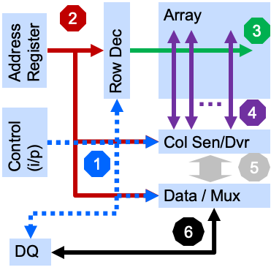
R/W Access Timing
Parts | SEC LP5 6400 | MU DDR5 8800AN | HBM3 JESD238 | APM VHM | P1271.3 eDRAM
Timing codes | 58-58-58 | 62-62-62-141-1
Bus Freq in GHz / Data Rate | 3.2 / DDR | 4.4 / DDR |  | 0.5 / SDR
tCL (ns) | 18.13 | 14.09
tRCD[ns] | 18.13 | 14.09 |  | 12
tRP[ns] | 18.13 | 14.09 | 15 | 12
tRAS[ns] | 42 | 32 | 33 | 13
CMD[ns] | 1 | 1
Access cross bank tCCD[ns] |  |  | 2(S), 4(L)
first access from a closed page tRCD+tCL (or tAA) [ns] | 36.25 | 28.18 | 32 |  | 13
Refresh Command or Active to Active: tRC = tRP+tRAS [ns] | 63 | 46.09 | 48 | 25 | 3
Number series of DDR timing , eg. 4-4-4-10-1, are cycle counts of bus clock, ie. tCL-tRCD-tRP-tRAS-CMD
tCL (CAS Latency): 1+5+6 – Time from asking (CAS) to the begin of data return.
tRCD (RAS to CAS Delay): 3 to 4 – Time to activate a row to access columns
To read the first bit without any row activation: tRCD + tCL (see tRAS)
tRP (RAS Precharge): 4 – Time to enable a row from another (disabling).
The new row can be accessed only after precharging the columns. Therefore, the overall time get data from new row is tRP + tRCD +tCL.
tRAS (Time to RAS) : 1~5 – Activate to Precharge Delay. Wait-time to access next row before tRCD + tCL + n cylces
CMD: Command Rate. Cycle count from activated to the first command, typically 1-2 cycles
Samsung LLW: Unlike conventional DDR DRAM, LLW DRAM uses a closed-page operation in which precise relationship between RAS and CAS events in known and single Read or Write commands triggers the whole sequence of events. Therefore, clock gating approach on LLW DRAM design can be optimized to only turn on/off various circuits and clocks during the precise time they are needed to save power.

Slide 26
IPM Metric and Optionality

Slide 27
Supporting Materials

Slide 28
Data Access: Generic Segmentation for PPA benchmark
2
Array
Command Transport
Decode
Row Access
Column Access
Data Transport @ Bank
Data Transport @ Channel
3
1
Address Register
Row Dec
2
…
4
3
Control (i/p)
Col Sen/Dvr
4
1
5
Data / Mux
5
6
6
DQ

Slide 29
R/W Access Timing
Parts | SEC LP5 6400 | MU DDR5 8800AN | HBM3 JESD238 | APM VHM | Samsung LLW | Samsung LLC | SKH-Intel TCD | ADM Gen1 | ELP MDC
Timing codes | 58-58-58 | 62-62-62-141-1
Bus Freq in GHz / Data Rate | 3.2 / DDR | 4.4 / DDR |  | 0.5 / SDR
tCL (ns) | 18.13 | 14.09 |  |  |  |  | 15
tRCD[ns] | 18.13 | 14.09 |  | 12
tRP[ns] | 18.13 | 14.09 | 15 | 12
tRAS[ns] | 42 | 32 | 33 | 13
CMD[ns] | 1 | 1
Access cross bank tCCD[ns] |  |  | 2(S), 4(L)
first access from a closed page tRCD+tCL (or tAA) [ns] | 36.25 | 28.18 | 32 |  | tRCR 32 tRCW 28 | 32 | 20 | 13
Refresh Command or Active to Active: tRC = tRP+tRAS [ns] | 63 | 46.09 | 48 | 25 | Elim’d to save pwr | 40 | 30 |  | tRCR 4.375 tRCW 2.5
Number series of DDR timing , eg. 4-4-4-10-1, are cycle counts of bus clock
That is tCL-tRCD-tRP-tRAS-CMD
tCL (CAS Latency): 1+5+6 – Time from asking (CAS) to the begin of data return.
tRCD (RAS to CAS Delay): 3 to 4 – Time to activate a row to access columns
To read the first bit without any row activation: tRCD + tCL (see tRAS)
tRP (RAS Precharge): 4 – Time to enable a row from another (disabling).
The new row can be accessed only after precharging the columns. Therefore, the overall time get data from new row is tRP + tRCD +tCL.
tRAS (Time to RAS) : 1~5 – Activate to Precharge Delay. Wait-time to access next row before tRCD + tCL + n cylces
CMD: Command Rate. Cycle count from activated to the first command, typically 1-2 cycles
Samsung LLW: Unlike conventional DDR DRAM, LLW DRAM uses a closed-page operation in which precise relationship between RAS and CAS events in known and single Read or Write commands triggers the whole sequence of events. Therefore, clock gating approach on LLW DRAM design can be optimized to only turn on/off various circuits and clocks during the precise time they are needed to save power.

Slide 30
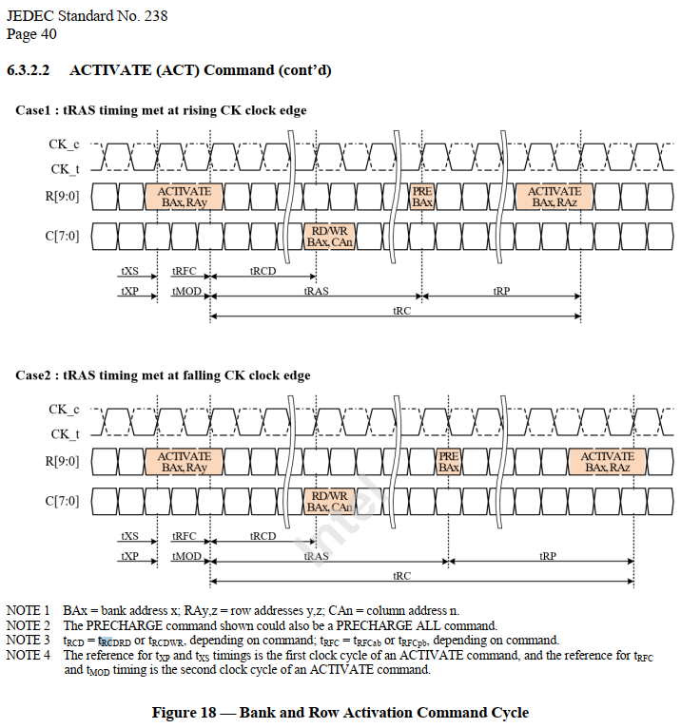
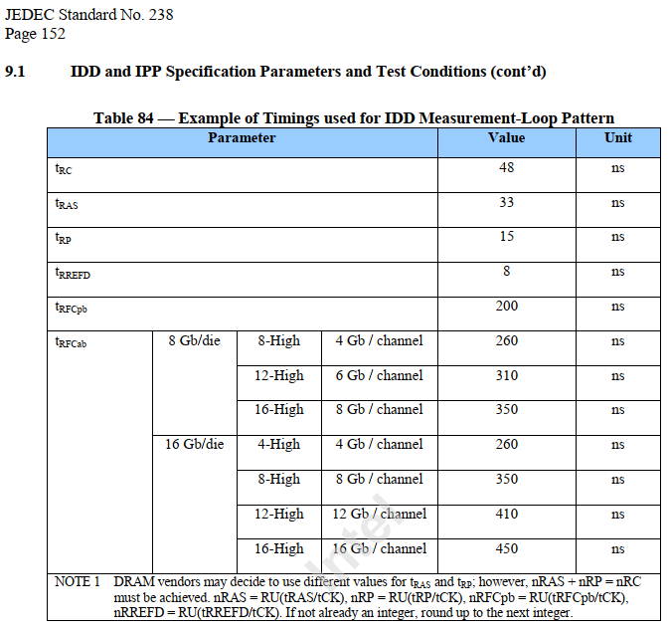
HBM3 JEDEC Spec

Slide 31
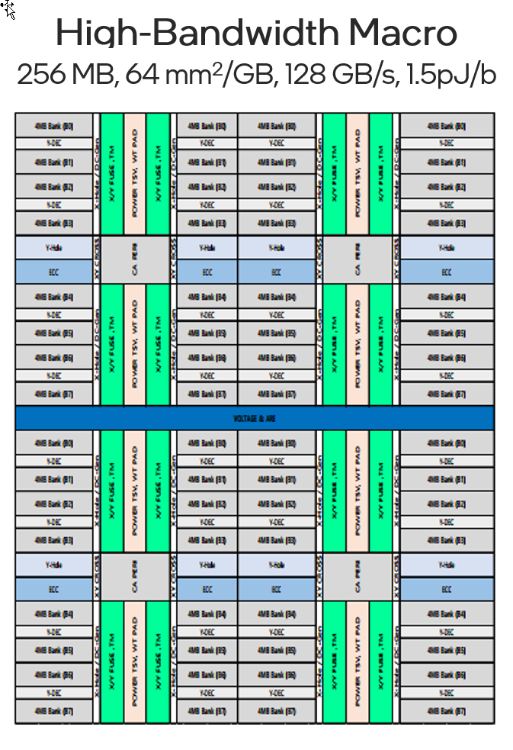
TCD macro key metrics (High Bandwidth)
Parameters \tech. | 2Gb Macro* (1znm) | 2Gb Macro* (1bnm) | 16Gb HBM2E (1ynm) | 16Gb HBM3 (1znm)
Density/mm2 | 16MB/mm² | 21.12MB/mm² | 19.66MB/mm² | 17.8MB/mm²
# Channel | 8 | ← | 8 | 16?
# pre-fetch/ch | 512b | ← | 1024b | ←
Page Size/ch | 0.5KB | ← | 1KB | TBD
# Bank/ch | 8 | ← | 32 | ←
tCCD target | 4ns | ← | 2.5ns | 1.25ns?
BW/ch | 16GB/s | ← | 51.2GB/s | 102.4GB/s
Total BW (per 1GB) | 512GB/s | ← | 51.2GB/s | 102.4GB/s
pj/bit ¹ | ~1.5 | ← | 5.2 | ~3-4?
LATENCY(Close) ² | 19.8ns | ← | 43.5ns | 48ns
LATENCY(Open) ³ | 15ns | ← | 28ns | 31ns
tRCR/tRCW | 30ns | ← | 60ns | 60ns
# DQ/Ch | 512b | ← | 128b | 64b?
In DRAM ECC | O | ← | X(Parity bit) | O(RS code)
BW/pin | 250Mbps | ← | 3.2Gbps | 6.4Gbps
High-Bandwidth Macro (2Gbit 8Ch)
16MB/mm2, 128GB/s, 1.5pJ/b
1 pj/bit: Watt/Bandwidth
2 Latency (Close page): tRCD + tAA (ACT~RD + RD~ DATA)
3 Latency (Open page): tAA ( RD~ DATA)
*TSV overhead not included. No-SerDes circuit assumed
**pJ/bit and latency numbers above are at macro level and do not account for base die/3D stack costs
Data shared under CNDA 30991112 & CNDA 112784

Slide 32
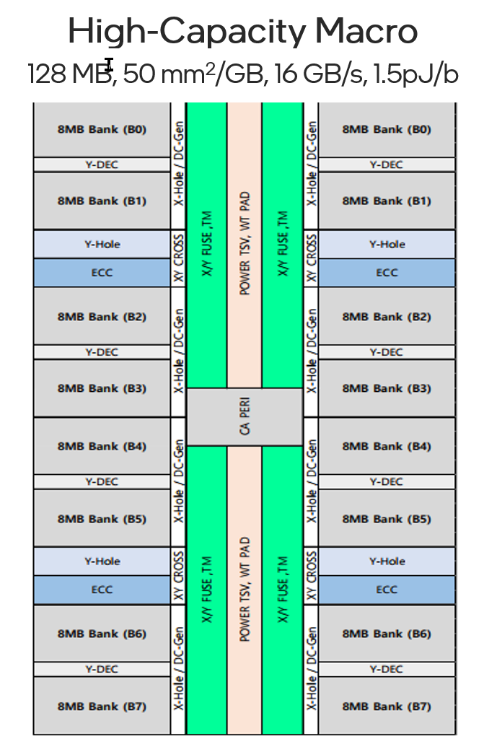
TCD macro key metrics (High Capacity)
Parameters \tech. | 1Gb Macro* (1znm) | 1Gb Macro* (1bm) | 16Gb LPDDR5 (1zm)
Density/mm2 | 19.17MB/mm2 | 25.56MB/mm2 | 33.73MB/mm2
# Channel | 1 | ← | 1
# pre-fetch/ch | 512b | ← | 128b
Page Size/ch | 1KB | ← | 2KB
# Bank/ch | 8 | ← | 16
tCCD target | 4ns | ← | 2.5ns
BW/ch | 16GB/s | ← | 12.8GB/s
Total BW (per 1GB) | 128GB/s | ← | 6.4GB/s
pj/bit ¹ | ~1.5 | ← | 3.5
LATENCY(Close) ² | ~25ns | ← | 40ns
LATENCY(Open) ³ | 15ns | ← | 25ns
tRCR/tRCW | 30ns | ← | 60ns
# DQ/Ch | 512b | ← | 16b
IDD6(4GB, mA) | 4.13 | ← | 1.28
In DRAM ECC | O | ← | O
BW/pin | 250Mbps | ← | 6.4Gbps
High-Capacity Macro (1Gbit 1Ch)
21MB/mm2, 32GB/s, 1.5pJ/b
1 pj/bit: Watt/Bandwidth
2 Latency (Close page): tRCD + tAA (ACT~RD + RD~ DATA)
3 Latency (Open page): tAA ( RD~ DATA)
*TSV overhead not included. No-SerDes circuit assumed
**pJ/bit and latency numbers above are at macro level and do not account for base die/3D stack costs
Data shared under CNDA 30991112 & CNDA 112784

Slide 34


Slide 35


Slide 36


Slide 37


Slide 38

https://www.maltiel-consulting.com/Hynix-DRAM-31Vs44nm-layout.html

Slide 39



3D System implementation for ARL/ELASTI with ADM memory learning
Memory options comparison table
Key Messages
ARL-px/ELASTI identified as the show piece intro for low latency/high bandwidth ADM memory technology
  ARL/ELASTI families cover both w/ADM and w/o ADM offerings
  ADM L3 memory option should be no worse than AMD’s 7nm V-cache
    L3 cache size -180-456MB(ELASTI)/640MB(ARL-px) vs. AMD’s V-cache 2x64=128 MB
    ADM memory cost per bit still cheaper than SRAM; but both approaches are expensive compared to commodity HBM DRAM using 2.5D interposer approach
      Higher memory density benefit (~2x; 4.4 vs. 1.77MB/mm2)
      ADM wafer(22nm) is still the cheapest wafer vs N7/N5 chiplets in MTL/ARL/ELASTI
1st generation 3D HIP product implementation learning
  Memory density can drop as high as 70-80% in final implementation
    High 3D packaging area overhead (30-50% memory penalty) needed in 3D HIP system
    Memory data block size decision (Peripherals +TSV OH) – another 20% area delta
  DTCO optimization – Significant 3D construction TAX needed for SRAM/DRAM wafers & various chiplets to address both power/IO/TSV routing issues.
3D HIPs w/ TCM using customized DRAM should be explored as a cheaper alternative due to its mature and predictable DRAM roadmap. Quick execution to see its performance/power limit.
Next Step Actions
LNL – ODI 3D HIP packaging – better XPU/memory pairing, less chip area penalty due to 3D construction
3D HB for Memory Cube project launched internally to drive 3DIC HB packaging capabilities
  Open external 3D HB alternatives using TCM or SRAM directly?
TCM integration w/ internal XPU using customized DRAM wafer
Table or Graphic Description
From: Osborne, Randy’s ADM implementation tutorial to Chiplets WG
Notes:
Emulation, too
Speaker’s notes:
GSC partners closely with Design Engineering Group (DEG) and Intel Business Units on Electronic Design Automation tools, Silicon IP, Engineering R&D design services, and Product Lab test & measurement systems.
There are 3 key messages in the design arena. First, with the introduction of the 1277 process, GSC has worked with EDA suppliers to enable EDA for 1277. This is a necessary shift in focus to make sure we have the right design tools, flows, and methods for 1277 technology. Second, GSC is anticipating silicon IP outsourcing needs for Lunar Lake & making sure we are ready to go once the make vs buy decision is made in 1Q21. Third, GSC will be renewing major enterprise contracts with Synopsys (EDA, Silicon IP) and Cadence (EDA). These are the largest contracts GSC manages for Intel design teams, and we are investing the effort to make sure the contracts meet our capability, capacity, and cost ambitions.
Highlights for 4Q20 include completing the Design Technology Co-Optimization (DTCO) on Intel 5nm with Synopsys and Arm, and enabling EDA readiness for 1278 PDK 0.5 and 1277 PDK 0.1ES – this allows Intel design teams the capability and capacity for product development. GSC managed the final contracts and statements of work (SoWs) for Meteor Lake SoC-M IPs, primarily with Synopsys. Moreover, GSC delivered a forecasting system for 3rd party IP (TULIP) that allows more control of our 3rd party IP needs. GSC established another design services center of excellence, joining a long list of cost-effective COEs that enable 3rd party design services for Intel. The Platform / Software COE is based in Poland. Finally, the RDSE team within GSC achieved cost-savings exceeding the 2020 annual cost-savings target. The graphic on the right-hand-side of the slide shows performance scores for the 9 outsource COEs – scores of ‘5’ indicate ‘delight’ as scored by our Intel business partners – COEs have proven to be a good investment for Intel in the design outsourcing arena.
Focus areas for the design area include renewing the enterprise contracts that comprise approximately 60 percent of Intel’s 3rd party IP and EDA spends. Moreover, our Engineering R&D teams are observing a tightening in the talent market in India. This has similar characteristics to recent trends in China, where cities are starting to form into tiers.
As for action plans, GSC will continue to work closely with the Big 4 EDA suppliers – Synopsys, Cadence, Siemens EDA (formerly Mentor), and Ansys to assure access to the right design capabilities. GSC will work closely with DEG to define the appropriate sourcing strategy for requisite 3rd party IP. GSC will continue to extend our outsource design engineering footprint toward TSMC N5 and N3, and Samsung foundry technologies. Finally, this is a big year for changes to the product lab testing protocols, and GSC will ensure lab equipment readiness for a new generation of protocols.

Slide 40


Slide 41


Slide 42


Slide 43


