Slide 1
Memories
WW32’22
Objective | A primer of memory subsystem for advanced computer architecture
Presenters | DerChang Kau
Meeting Type | Insights and education
Desired Outcome/ Decisions to be Made | Level setting on disaggregated cache (D-Cache) strategy
Abstract | Develop scaling paths of von Neumann architecture through modular technologies and system disaggregation.

Slide 2






Memory Organ
“The Memory Organ – Ideally one would desire an indefinitely large memory capacity such that any particular … word would be immediately … available. … It does not seem possible physically to achieve such a capacity. …We are therefore forced to recognize the possibility of constructing a hierarchy of memories, each of which has greater capacity than the preceding but which is less quickly accessible.”
Arthur Burks, Herman Goldstine and John von Neumann, Preliminary Discussion of the Logical Design of an Electronic Computing Instrument, Jun. 28,1946.
“TPC-C...were spent waiting for memory . . . . MPEG… limited by memory accesses . . . . Processor speed has seriously outstripped memory speed. . . . The real design action is in the memory subsystems — caches, buses, bandwidth and latency.”
Dick Sites, It’s the Memory, Stupid! Microprocessor Report, 10(10):2–3, Aug. 5 1996.

Slide 3
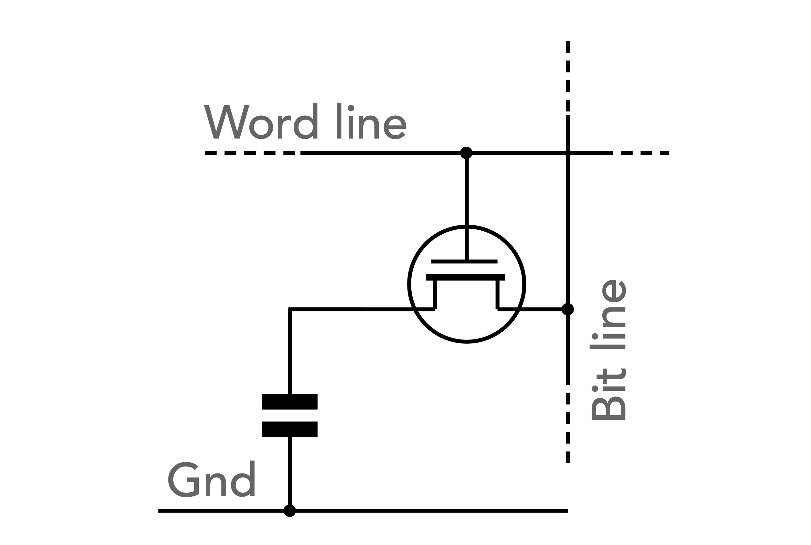
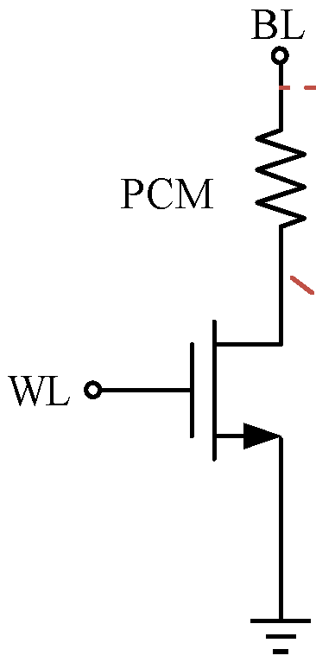
SoA Memory Organization
Host
Memory Farm
Channel
Bank Group
Bank
Channel₀
Bank Group₀
Bank₀
….
Bank_{b-2}
Macro₀
….
Macro_{b-2}
…
…
….
Channel_{n-1}
Bank Group_{g-1}
Bank₁
….
Bank_{b-1}
Macro₁
….
Macro_{b-1}
Macro
Cell
Array/Mat/Tile
Array
a.k.a.
Mat or
Tile
Row Dec
WL Decoder / Driver
C/A
CSL
BL
BL
SA
Col Dec
WL
WL
BL Mux / SA / Data Latch
Mux / Word
DQ + Metadata

Slide 4
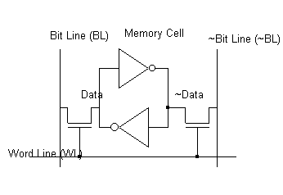

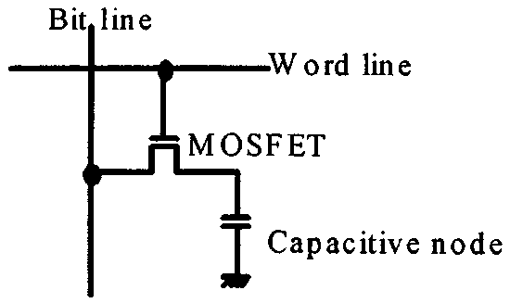
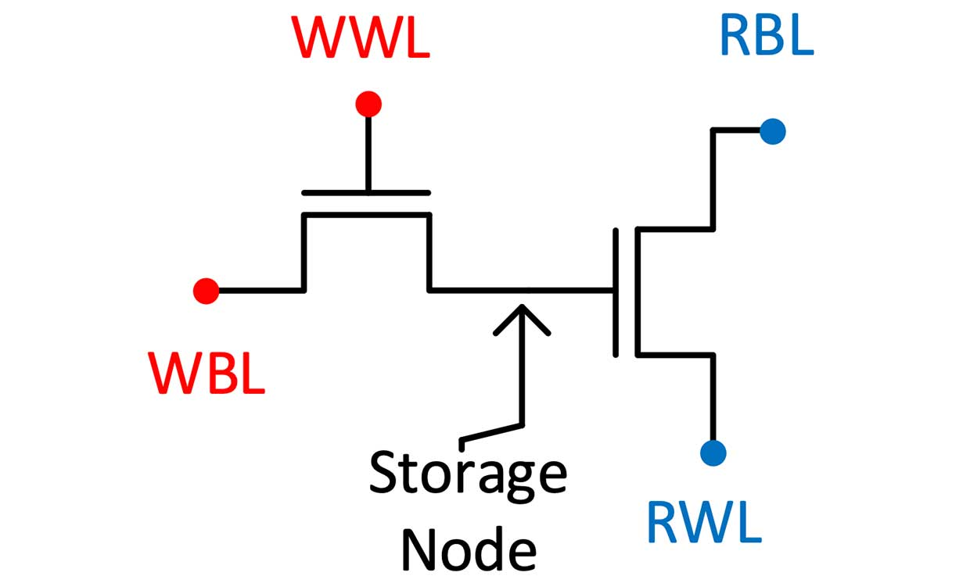
Cell Types
6T-SRAM
Cross Point Array
1T1C-DRAM
2T-DRAM
WL
BL

Slide 5
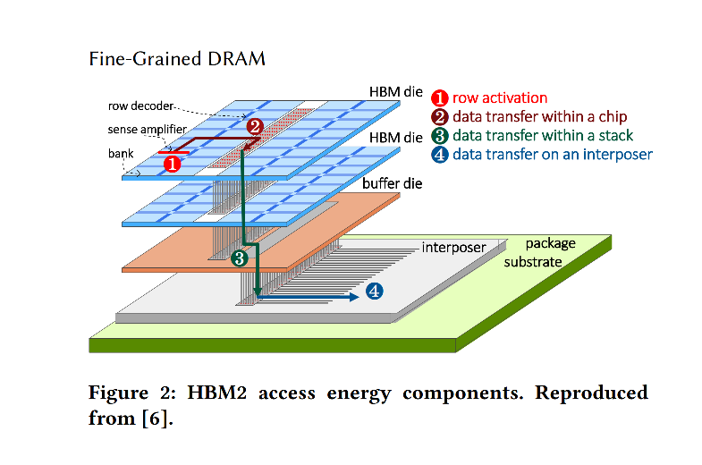
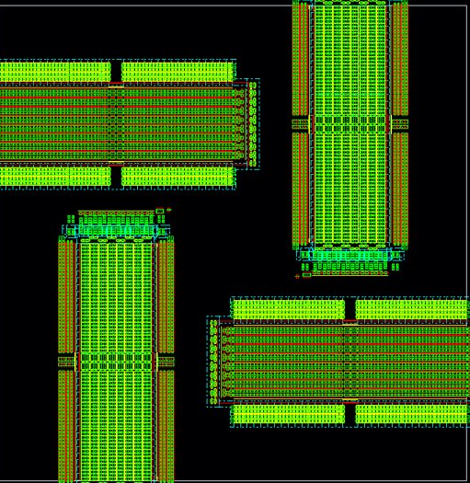
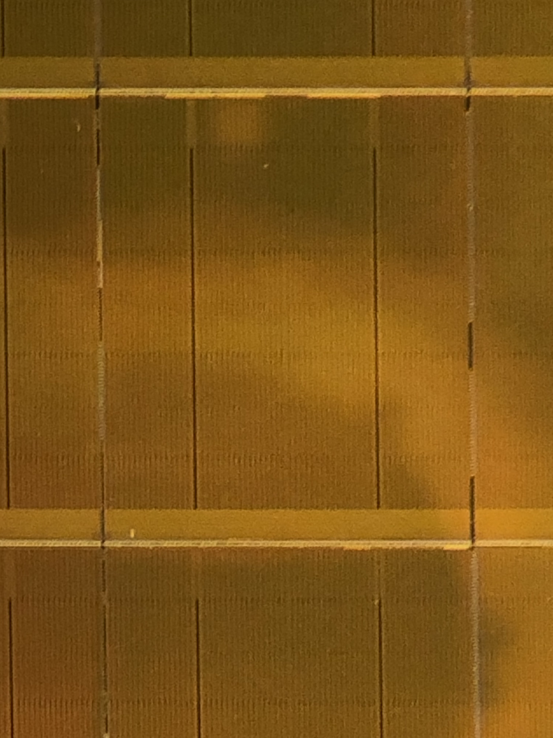
Component (64MB)
Channel: 8 Bank groups (8MB)
Bank group: 4 Banks (1MB)
64MB SRAM Cache Density 2MB/mm²
Latency ns
BW 1000(GB/s)/MB
Energy 0.1pJ/b
Channel 0
Channel 1
Bank3
Bank2
4:1
800 MT/s per lane
Channel 2
Channel 3
Bank1
512
8:1
Bank0
512
64B per channel
6.4 GT/s per lane
Channel 4
Channel 5
macro
macro
512
512
256
256
512
512
Channel 6
Channel 7
Bank Group Mux
1GBx8 HBM3
Density 20MB/mm2
Latency 30s ns
BW 300(GB/s)/GB
Energy 4.5pJ/b
1/4th Tile (1K x 1K)
32GB Optane
Density 350MB/mm²
Latency 300s ns
BW 1(GB/s)/GB
Energy 50pJ/b
Bank 31
GBLS DRVR/TERM ANALOG
Tile 127
CUA
GWLS DRVR/TERM CAPS
PCL/LBLS & LBLd DRVRS
Bank 0
Tile 0
PERIPHERY
LWLs/LWLd/PCL CTRL DRVRS
IO

Slide 6
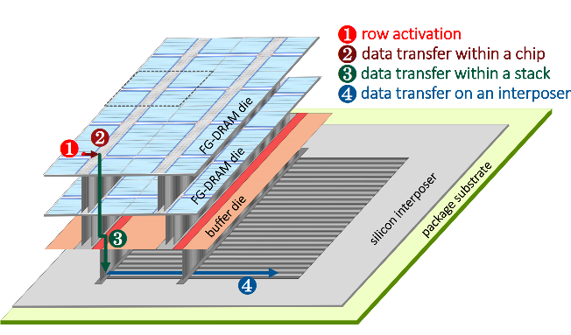
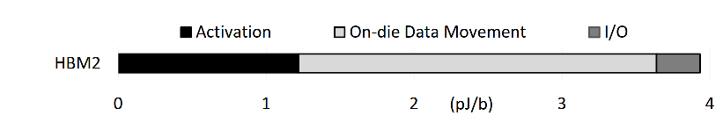
Disaggregation: An access energy consideration
Fine-grained DRAM: energy-efficient DRAM for extreme bandwidth systems
Mike O'Conner et.al, Nvidia
ACM Symposium on Microarchitecture, 2017
Developing Disaggregation Strategy
System level PPA
Build PPA Pareto by module
Monolithic Design as baseline/reference
HBM3
HBI
ADM Gen 1
ADM HBI

Slide 7
High Bandwidth Memories
 |  |  | DRAM |  |  |  | SRAM
 |  |  | HBM3 | HBM4 | LLC | ADM Gen 2 | D-Cache | V-Cache
Component | Component Capacity | Gb | 16 | 16 | 8 | 2 | 0.5 | 0.5
 | die stacking | # | 6.4 | 8 | 1 | 1 | 1 | 1
 | Density | MB/mm² | 22.6 | 21.6 | 12.0 | 6.7 | 2.2 | 1.56
 | R+W Max Bandwidth | TB/s | 0.65536 | 2.048 | 1.024 | 3.2768 | 6.5536 | 2.048
 | R/W Energy | pJ/bit | 4.5 | 3.6 | 2.7 | 0.800 | 0.1 | 0.1
 | Latency (Open) (t_{RP}+t_{CCDS}) | ns | 21 | 21 | 15 | 9 | <3 | 6
 | Latency (Close) (t_{RC}+t_{CCDS}) | ns | 55 | 55 | 33 | 14 | <3 | 6
 | R+W Max BW/GB | (TB/s)/GB | 0.32768 | 1.024 | 1.024 | 13.107 | 104.858 | 32.768
 | R+W Max BW/W | (TB/s)/W | 0.028 | 0.035 | 0.054 | 0.955 | 1.250 | 1.250
Channel | # of Channel / Component | # | 2 | 4 | 32 | 8 | 8 | 8
 | DQ per Channel | # of Lanes | 64 | 64 | 32 | 512 | 512 | 256
 | R+W Max Bandwidth | GB/s | 51.2 | 64 | 32 | 409.6 | 819.2 | 256
Bank | # Bank Group / Channel | # | 8 | 8 | 2 | 1 | 8
 | # Bank / Bank Group | # | 4 | 4 | 4 | 32 | 4
 | # Bank / Channel | # | 32 | 32 | 8 | 32 | 32
 | # Bank / Component | # | 64 | 128 | 256 | 256 | 256
 | # Bank / Cube | # | 409.6 | 1024 | 256 | 256 | 256

