Slide 1
N7

Slide 2
A brain teaser: High Capacity Cache (HCC) Possibility
xPU
Memory
SoC
Mold
embedded
Subst
Capability:
All chiplet interfaces can be hybrid bonded (bumpless) with combination of CoW and WoW from Foundry. “Cube” would likely be assembled using WoW, then diced before attachment.
DFT (sort, class, bist, redundancy, repair, RBER, ECC and etc.), and media management need to be explored along with leveraging suppliers’ experiences to mitigate yield escape.
Cost:
Capacity: Substantial capacity of advanced mainstream technology such as N7/N6 is expected.
Technology | Availability | [MB/mm²] | [(TB/s)/GB] | Norm. $/wfr | Norm. GB/$ | Norm. BW/$ | References
TSMC N7 | 2021 | 1.77 | 500 | 0.7 | 0.11 | 437 | Cerebras CS2 Analysis, WW03/22, DeBonis
P1222.6 | 2023 | 3.4 | 13 | 1.0 | 0.30 | 25
P1222.7 | 2024 | 6.7 | 13 | 1.2 | 0.25 | 25 | TCC Benchmark, Jan/25/22, Hamzaoglu
HBM3 | 2022 | 22.6 | 0.128 | 1 | 1 | 1 | SKH 1z 16Gb HBM3, Feb/7/22, Bains

Slide 3
 | X’tor density M X’tor/mm² | SRAM Size µm² | SRAM density MB/mm² | Layers EUV/Total | 2023 | 2024 | Scheme
N7 | 79.85 | 0.02736 | 1.77 | 0/75 | $ | $ | 5x193i for MD and M0, 4xVGVD, M1 3xV0, M2 DDB
N7P |  | 0.02736 |  | 0/75 |  | $ | SDB
N7+ | 97.47 | 0.02736 |  | 4/65 | $12K | $ | V0, M1, V1, M2 to EUV M2:ply = 3:2
N6 |  | 0.02736 |  | 6/57? | $12.1K | $ | + MD and M0 to EUV 13 layers of metals M2:ply = 1:1
N5 | 137.60 | 0.02142 | 2.1? | 14/59? | $

Slide 4
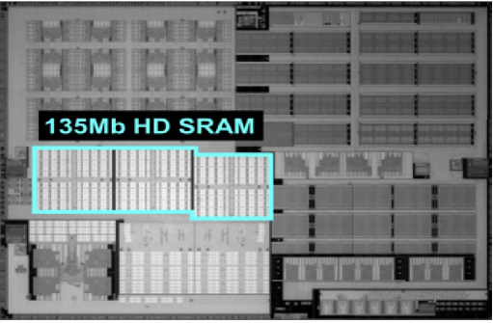
N7 MD, M0 (trench contact, LI) ➔ 5 193i for one EUV

Slide 5
 | Layers EUV/Total | 2023 | 2024
N16 |  | $ | $
N10
N7 | 0/75 | $ | $
N7P | 0/75 |  | $
N7+ | 4/65 | $12K | $
N6 | 6/57? | $12.1K | $
N5 | 14/59? | $
 | X’tor density M X’tor/mm² | SRAM Size µm² | SRAM density MB/mm² | Layers EUV/Total | Scheme
N7 | 79.85 | 0.02736 | 1.77 | 0/75 | 5x193i for MD and M0, 4xVGVD, M1 3xV0, M2 DDB
N7P |  | 0.02736 |  | 0/75 | SDB
N7+ | 97.47 | 0.02736 |  | 4/65 | V0, M1, V1, M2 to EUV
N6 |  | 0.02736 |  | 6/57? | + MD and M0 to EUV 13 layers of metals
N5 | 137.60 | 0.02142 | 2.1? | 14/59?

