Slide 1
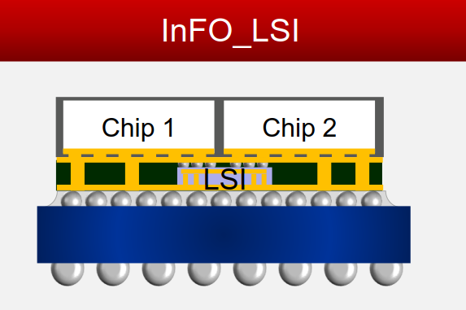
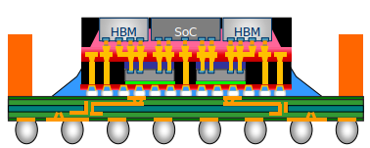
Embedded N6 active die
N5 or N3
GPU
GPU
TSMC 6nm SoC
Substrate
Pricing of Interests
N6 1P13 vs. N6 1P9M
1P9M + InFO_L
(36µm pitch µB + TSV)
Above + DTC
If we use OSAT for 3D stacking,
What is the wafer pricing of
(1P9M+TSV) and (1P9M+TSV+DTC)
SPIL’s FO-EB

