Slide 1
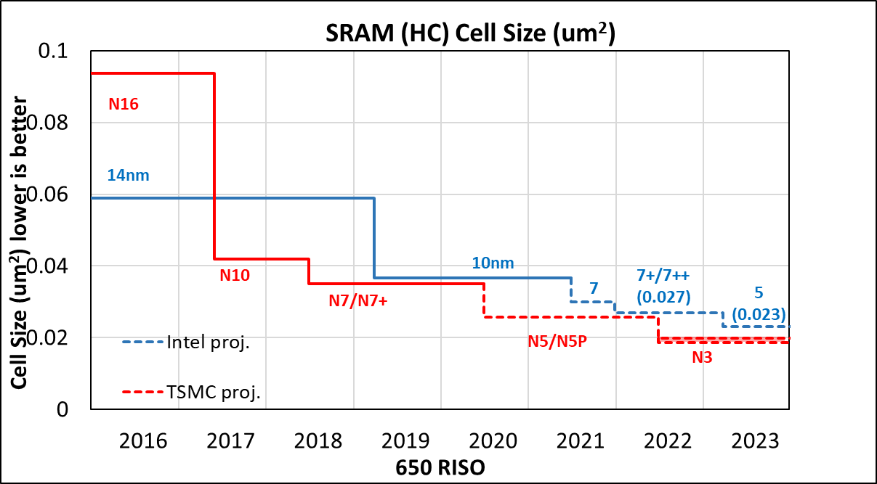
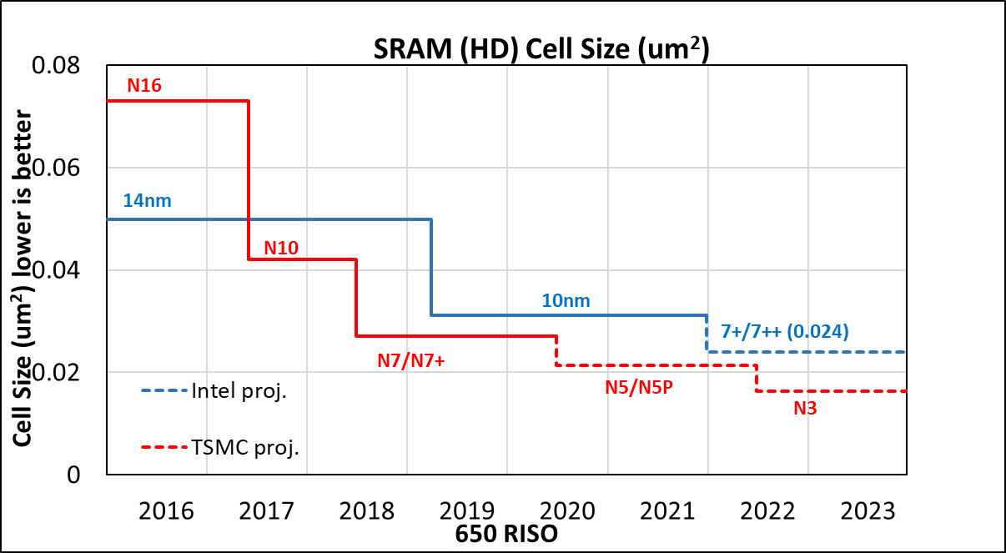
Process SRAM area scaling
TSMC has the overall lead thru 2023 in both HC/HD SRAM cell area scaling.
Need additional scaling in I7/I5 to be competitive with TSMC
* There is no HD SRAM bit cell for 1276 new. HC SRAM defined for 1278 share the same cell height of 1276+/1276++ HD SRAM bit cell.
Intel Top Secret

Slide 2
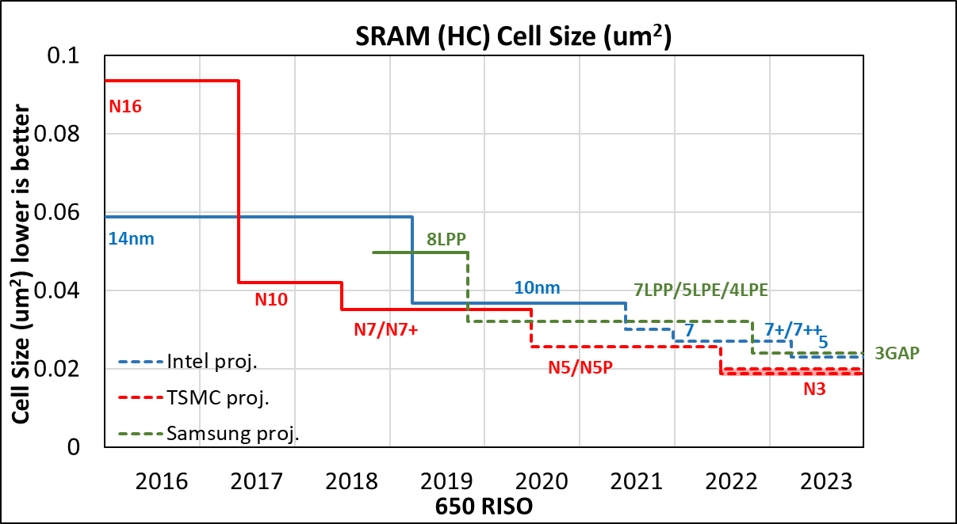
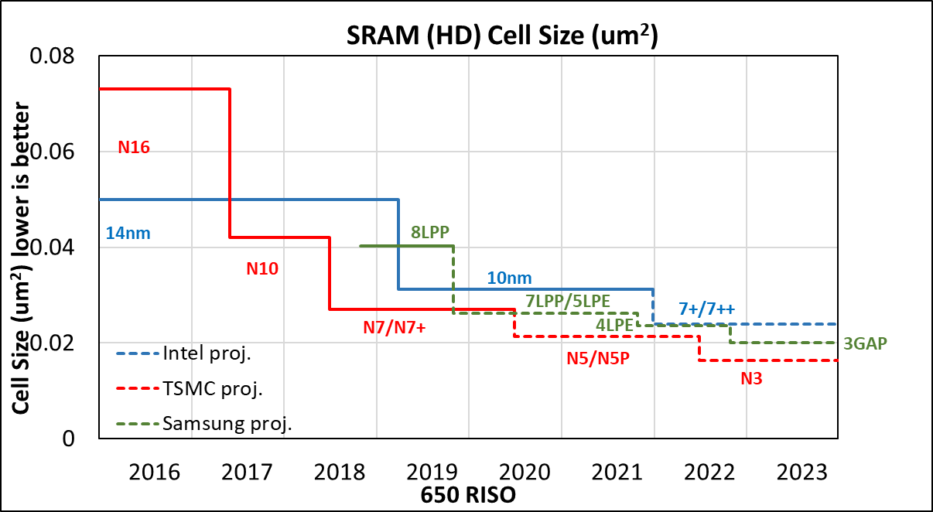
Process SRAM area scaling (w/Samsung)
TSMC has the overall lead thru 2023 in both HC/HD SRAM cell area scaling.
Expect both HD/HC bit cell to shrink from Samsung 4LPE to 3GAP.
Intel Top Secret

