Slide 2
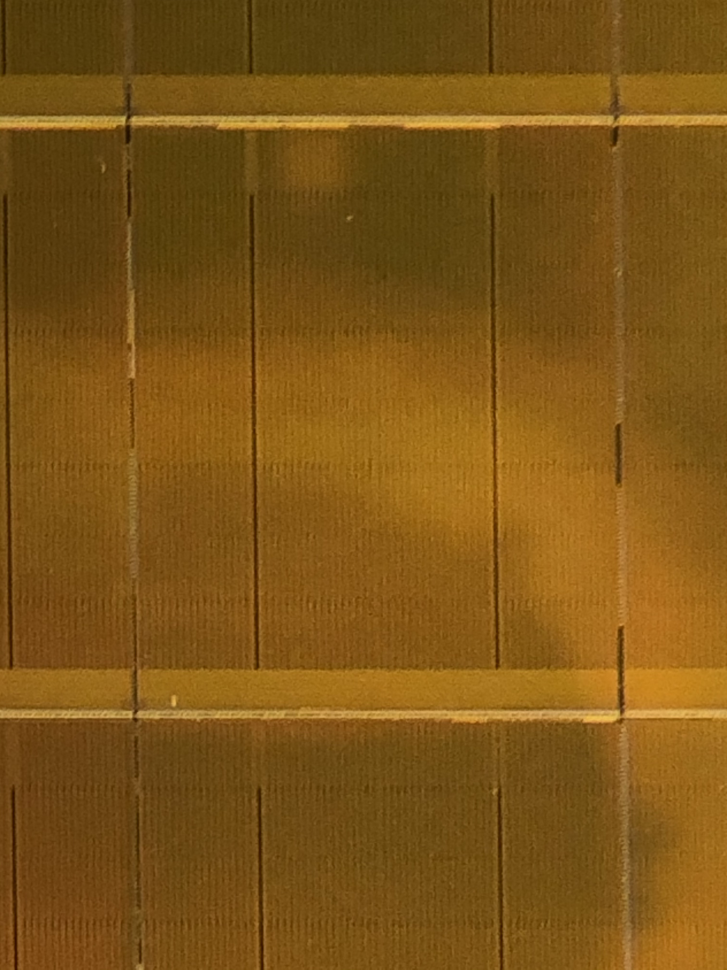
3DXP Component Organization
1/Tile
Array
64Mb/tile
4X4 Patches/Tile
Patch footprint is ~[50µm]²
@ 41P node
Data Buffer
Read / Write
64/Patch
Global MUX
Command /
Data
Interface
Address Tag
Analog / control
32/Patch
64/Patch
Local MUX
State Machine
(Instruction)
1K/Patch
On Pitch Via
HiZ Path
LoZ Path
LVT
Mixed
HVT
Die size = 200mm²
Shaded area is global ~ 17mm²
4KTiles (64K Patches) occupy ~155mm²
Routing takes ~20mm²

Slide 4
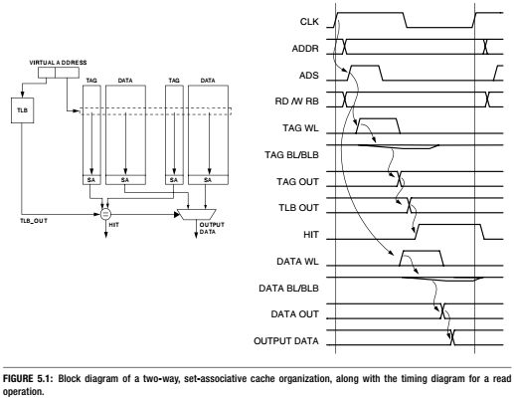

Slide 5
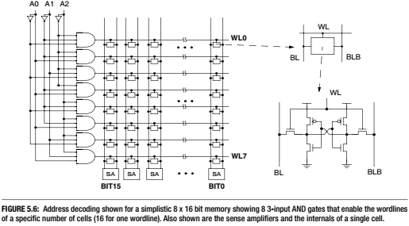

Slide 6
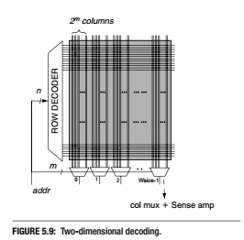

Slide 7
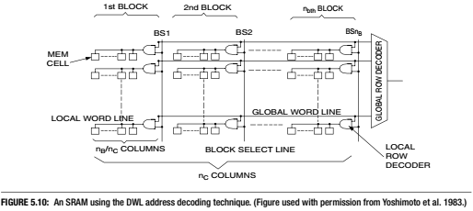

Slide 8
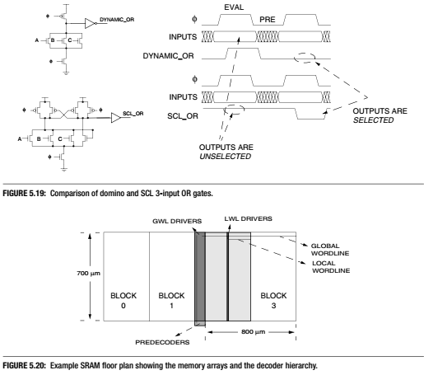

Slide 9
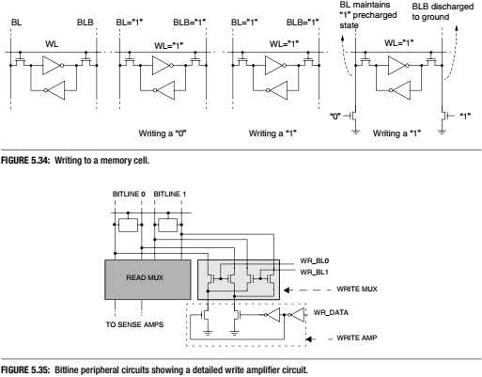

Slide 10


Slide 11
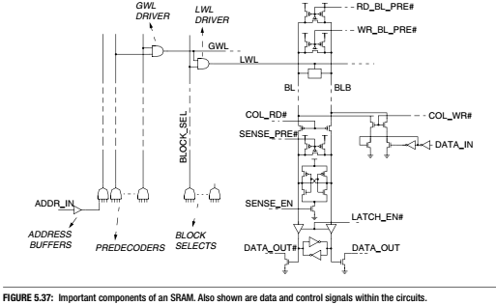

Slide 12
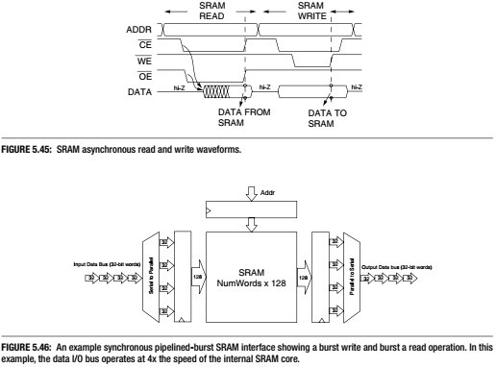

Slide 13
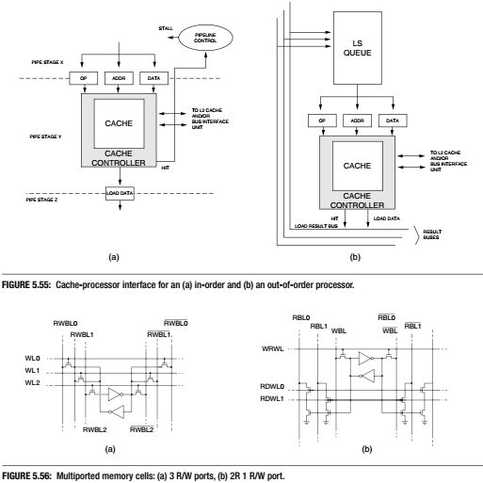

Slide 14
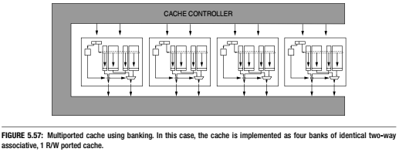

Slide 15
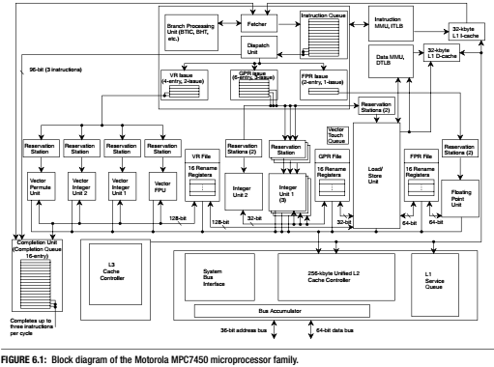

Slide 16
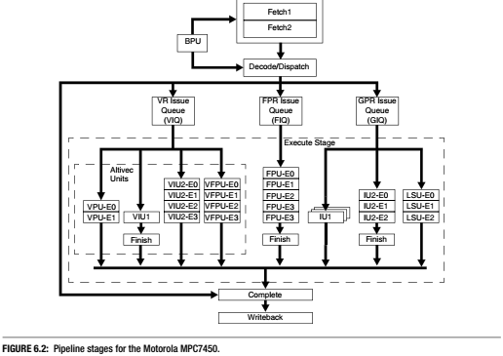

Slide 17
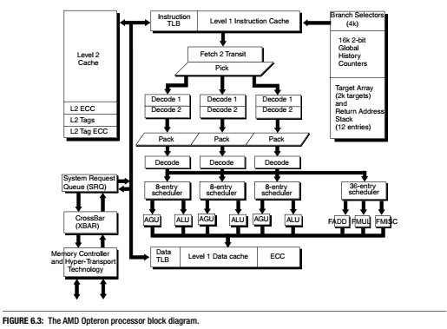
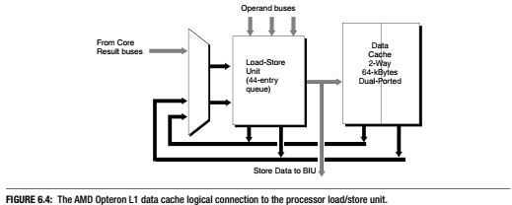

Slide 18
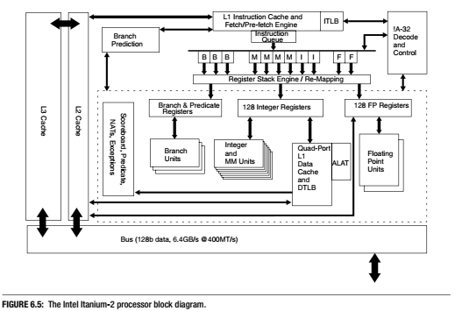
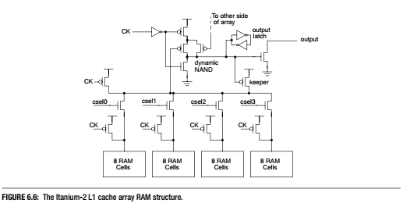

Slide 19

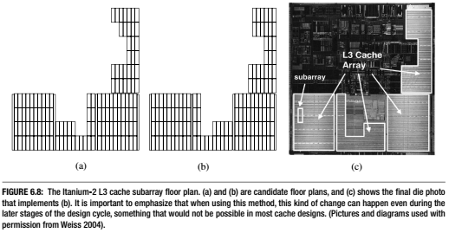
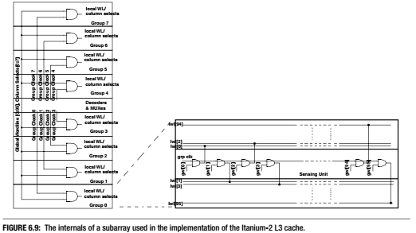

Slide 20
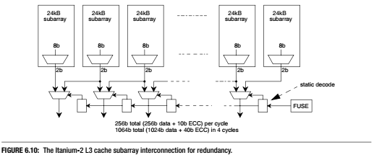
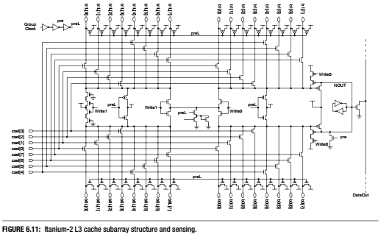

Slide 21
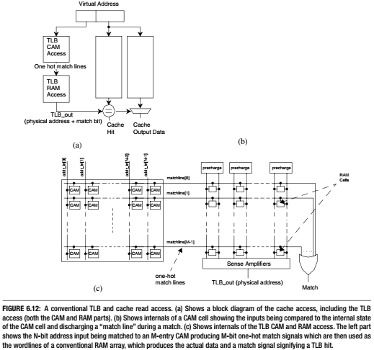

Slide 22
