Slide 1
NVL-PX by courtesy of Mike Goldsmith
LPDDR
LPDDR
MiP
MiP
MiP
MiP
CPU-PX
PCD-P
GPU-PX
Substrate (UCIe-S)
LPDDR PHY
LPDDR PHY
LPDDR PHY
LPDDR PHY
Mem Controller (D-Unit)
Mem Controller (D-Unit)
E-Core Cluster
IDI
MLC (L2$)
Slice
EU
EU
L4/SLC/MSC
L1$
L1$
LPDDR
LPDDR
P-Core
System Agent
System Agent
CPU-PX
PCD-P
GPU-PX
MLC (L2$)
EU
EU
LLC (L3$)
L1$
L1$
P-Core
IDI
LLC (L3$)
i16 Si Interposer/MiM
MLC (L2$)
EU
EU
L1$
L1$
Substrate
P-Core
MLC (L2$)
EU
EU
L1$
L1$
HS IOSF Fabric (PSF)
VDEC
CTRL
CTRL
MS IOSF Fabric
Display
LPDDR
LPDDR
CPU-PX
PCD-P
GPU-PX
TBT PHY
PCIe PHY
CTRL
CTRL
Si Interposer / MiM / i3FV SLC
MIPI PHY
UART
Substrate

Slide 2
2.5D ➔ 2.3D
Cost advantages
420mm² of I3FV vs. 100mm² of N6 ($20)
Silicon interposer is 20% higher in cost of making than Fanout packaging
Capability and Limitation
Besides thermal, there are many unknow in physical constraint
CPU-PX
CPU-PX
Si Interposer / MiM / SRAM
DTC
SRAM

Slide 3
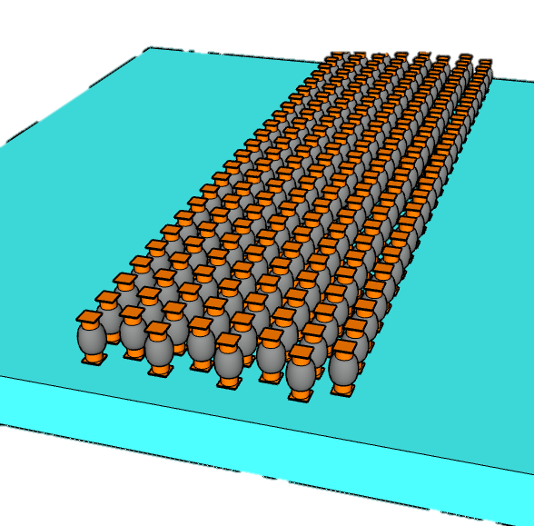
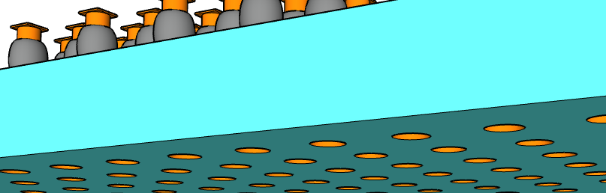
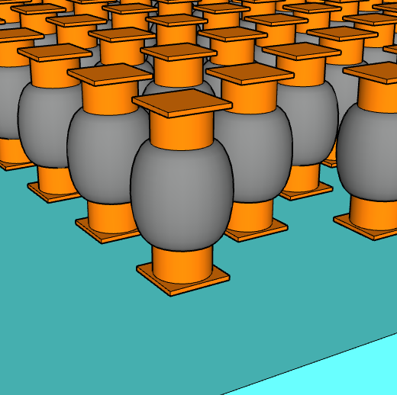
∆T between Embedded SRAM & Top Die
Embedded SRAM Chiplet
Base Line and experiment explored
Base Line ∆T: Emb. SRAM is 4.4˚C higher than Top Die at Full BW
25µm pitch µBump process change
  Upto 40% ∆T reduction with
  thickness, CD and Underfill material change
Layout effects:
  Upto 60% ∆T reduction by deploying Thermal Chimney
  (µBump dummification, method under development)
  Lower SRAM density to 1.66MB/mm² (~25%) reduce ∆T by 20%
Other Design impact
  ½ Transfer Rate, ½ ∆T whereas +20% ∆T with Half Duplex @ constant BW
  ∆T inversely correlated with channel capacity
µBump Pitchw | µBump thicknes | µBump CD | K_{µBump} | K_{UnderFill} | Adding TS PDN Via µBump | Adding Thermal Chimney | SRAM Density | I/O Duplex | Transfer Rate | Capacity
µm | µm | µm | W/°C·m | W/°C·m |  |  | MB/mm² |  | MT/s | MB/ch
25 | 26 | 12 | 8.8 | 0.55 | No | No | 2.25 | Full | 1.6 | 8
 | 25 | 14 |  | 1.1 | Yes | Yes | 1.66 | Half | 0.8~3.2 | 2~16
µBump connect to top die
1.1˚C ∆T (76% reduction) can be achieved with process change and dummification
TSVs connect to Substrate
t_{µB}
CD_{µB}
Pitch_{µB}
Early Engagement with Suppliers and Customer to achieve STCO before Design Start

Slide 4
Embedded Features impede Effective Power Delivery
CPU-PX
CPU-PX
Si Interposer / MiM / SRAM
DTC
SRAM
DTC
CPU-PX
CPU-PX
DTC
SRAM
DTC
SRAM
DTC
design requirement vs. physical constraint
Yet another example of pathfinding engagement for product leadership
t

Slide 5
NVL-PX with 256MB embedded SRAM
5.25mm
10mm
CPU-PX
Discrete DTC
not shown)
CPU-PX
Discrete DTC
not shown)
CPU-PX
Discrete DTC
not shown)
Embedded
256MB
Emb.
64MB
Emb.
64MB
9.75mm
Emb.
128MB
Emb.
128MB
4.87mm
17.5mm
9.84~
10.91mm
Emb.
64MB
Emb.
64MB
PCD-PX
(HBI DTC
not Shown)
PCD-PX
PCD-PX
5.46mm
Bridge
Bridge
Bridge
Bridge
Bridge
Bridge
GPU-PX
GPU-PX
GPU-PX
10.5mm

Slide 6
2.3D BT² Chip-Last Mockup Flow
(SPIL/FO-3D, TSMC/InFO-3D)
Discrete
CPU-PX DTC
not
shown)
Emb.
64MB
Emb.
64MB
1
IPD
not shown
2
SRAM
2
1
2
1
Emb.
64MB
3
Bridge
Emb.
64MB
A
PCD-PX
(HBI DTC
not shown)
A’
4
Carrier Prep
RDL, Cu Pillar
Em. Chiplets Attachment
Mold, RDL
2
2
3
Bridge
5
3
4
CPU
25µm µB
6
Bridge
Micro Bumping
GPU-PX
7
5
GPU
9 µm
HBI
6
PCD
PCD
A
A’
Top Die Attachment
CPU-PX N3P
GPU-PX I18A
7
DTC
DTC
C4
Top Carrier Bond,
Back Carrier Debond.
Bumping
64M SRAM
DTC
N6/N4P
DTC
Bridge
80µm C4

Slide 7
Is 2.3D BT² superior?
2.5D Foveros
  Si interposer with RDL and IPD addresses interconnect scalability and power/signal integrity
  Base die CMOS enables IP-folding thru stacking
  Combining them simplify assembly logistics but reduces feature utilization efficiency; increase BOM cost
2.3D-BT²
  2.3D-BT: RDL, bridge die for high density shore connectivity;
  IPD chiplets w/ TSV for PI/SI
  T: Si Chiplets w/ TSV for IP-folding
  What is design requirement vs. physical constraint
Holistic Co-pathfinding with SiFO/OSAT/Design for successful new product-technology deployment

Slide 8
Rumsfeld Matrix known knowns, known unknowns, and unknown unknowns
“… there are known knowns; there are things we know we know. We also know there are known unknowns; that is to say we know there are some things we do not know. But there are also unknown unknowns—the ones we don't know we don't know…”
Known and Unknown: A Memoir by Donald Rumsfeld

Slide 9
Why ELP
Inspired by Client PX processor
  Medium Power (~50W/package), High BW SLC (~TB/s/core)
"2.3D is superior"; is it?
  One of CCG’s interests but no resources/bandwidth assess it.
"Si is smarter"
  Learnings comes from entire cycle (design to tests)
2.3D is system pathfinding priority
  Pick ELP for System Integration learning
  Beyond known knowns/unknowns, exploring unknown unknowns
  Afterall, pathfinding is only useful if “It works”

Slide 10
Scratchpad

Slide 11
5.25mm
10mm
5.25mm
10mm
CPU-PX
Discrete DTC
not shown)
Embedded
256MB
9.75mm
CPU-PX
I3FV
Upto 420MB
~1MB/mm²
17.5mm
17.5mm
9.84~
10.91mm
PCD-PX
(HBI DTC
not Shown)
PCD-PX
CPU-PX
Bridge
Bridge
Si Interposer / MiM / SRAM
GPU-PX
GPU-PX
CPU-PX
10.5mm
10.5mm
DTC
SRAM

