Slide 1
SORT enablement status – WW13.3
MuddyCreek A0 Single Die ATE High-level Status:
Power-up started WW10.4. Most functional test items enabled. Tracking about 1 wk ahead of schedule. ECD: WW15.5
  No showstopper on silicon so far, all modules working.
Key test items outstanding (WIP):
  False pass in MBIST at SPEED test
  Validation of current measurements during workloads
Planning wafer run with all test items integrated in SORT tape by end this week
Milestone | ECD | Actual | Notes
Power On and Continuity | WW11.5 | WW10.4 | Power-on upon wafer received
Basic Functionality | WW12.5 | WW12.3 | All working on day-1 except PLL 2 out 37 RO are not working(non-gating)
Core Functionality, Performance and Yield Characterization Enabling | WW13.5 | WW12.3 | Validation is WIP non gating MBIST and TE @SPEED are marginally passing at nominal conditions on limited dies sampling; segmentation in progress
Full Flow Sort and Yield, Process, Product | Ww14.5 | WIP | Tracking to WW14.1

Slide 2
MDC V93K Sort Weekly Rollup – Vijaya Maganti
Status:
ECD | Test items | Status | Notes
PO+1wk (WW11.5) | Power Short Test | Validated (WW10.4)
 | Open Short (IO continuity) Function test & PPMU test | Validated (WW10.4)
 | JTAG Continuity test | Validated (WW10.4)
PO+2wk (WW12.5) | GPIO tests (leakage, VIL/VIH, VOL, VOH) | Validated (WW10.4)
 | SIDD | Validated (WW10.4)
 | OSC | Validated (WW10.4)
 | PLL | Validated (WW12.3) | Resolved high freq readout issue this week
 | PROMISE | Validated (WW10.4) | 2 out of 37 ring-oscillators not working as expected (low priority)
PO+4wk (WW14.5) | MBIST @ TCK | Validated (WW10.4)
 | TEST Engine @ TCK | Validated (WW12.3)
 | MBIST @ SPEED | Implemented | Validation is WIP 1) both MBIST @SPEED and TE @SPEED are marginally passing at nominal conditions on limited dies sampling; experimenting with test conditions to understand V/f limitations
 | TEST Engine @ SPEED | Implemented
 | Ubump IO Loopback Test | Validated (WW10.4)
PO+5wk (WW15.5) | Full wafer flow sorting | Not started | Working on dry-runs in WW13. Pending validation of all test items.
 |  | Legend:
 |  | Not started
 |  | WIP
 |  | Implemented
 |  | Validated

Slide 3
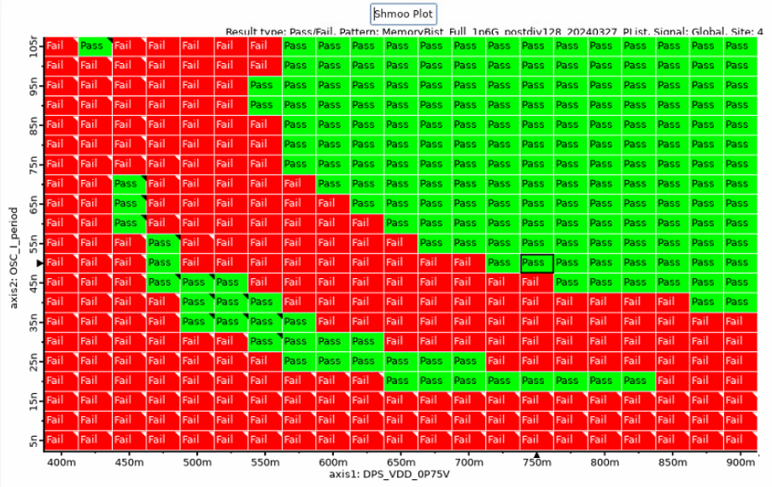
MBIST ATSPEED Fake Pass band SHMOO on WW13.3
LOTID:FZ573-01
Site4 X5,Y7
Target frequency:
PLL: 1.6GHz
Memory: 800MHz
Nominal voltage: 750mV
False pass → Expected FAIL

