Slide 1
NVL PX/MX Intercept
Mike Goldsmith, Long Wang, Dany Ly-Gagnon, Jason Zhang

Slide 2
NVL-PX by courtesy of Mike Goldsmith
Lowest-Cost State (MCP)
LPDDR
LPDDR
CPU-PX
PCD-P
GPU-PX
MiP
MiP
MiP
MiP
Substrate (UCIe-S)
LPDDR PHY
LPDDR PHY
LPDDR PHY
LPDDR PHY
POR passive interposer (2.5D)
Mem Controller (D-Unit)
LPDDR
LPDDR
Mem Controller (D-Unit)
CPU-PX
PCD-P
GPU-PX
E-Core Cluster
IDI
i16 Si Interposer/MiM* (UCIe-A)
MLC (L2$)
Slice
EU
EU
Substrate
L4/SLC/MSC
L1$
L1$
P-Core
System Agent
System Agent
MLC (L2$)
EU
EU
LLC (L3$)
L1$
L1$
P-Core
eLLC
LLC (L3$)
MLC (L2$)
IDI
EU
EU
Active interposer for eLLC / SLC (2.5D)
L1$
L1$
LPDDR
LPDDR
P-Core
CPU-PX
PCD-P
GPU-PX
MLC (L2$)
EU
EU
L1$
L1$
Si Interposer / MiM / i3FV SLC
VDEC
Substrate
HS IOSF Fabric (PSF)
CTRL
CTRL
MS IOSF Fabric
Display
Embedded Die interposer (2.3D-BT²)
TBT PHY
PCIe PHY
CTRL
CTRL
LPDDR
LPDDR
CPU-PX
PCD-P
GPU-PX
MIPI PHY
UART
SLC
DTC
SLC
Substrate

Slide 3
Processor in a package
LPDDR
LPDDR
LPDDR
LPDDR
PCD-P
CPU-PX
PCD-P
GPU-PX
CPU-PX
GPU-PX
i16 Si Interposer/MiM* (UCIe-A)
Substrate (UCIe-S)
Substrate
MCP Cost $8~10
Passive interposer (2.5D)
LPDDR
LPDDR
LPDDR
LPDDR
CPU-PX
PCD-P
GPU-PX
CPU-PX
PCD-P
GPU-PX
SLC
DTC
SLC
Si Interposer / MiM / i3FV SLC
Substrate
Substrate
Embedded Die interposer (2.3D-BT²)
Active interposer for eLLC / SLC (2.5D)

Slide 4
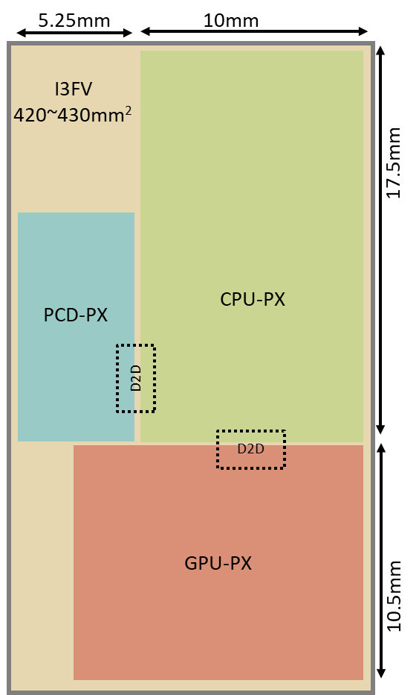
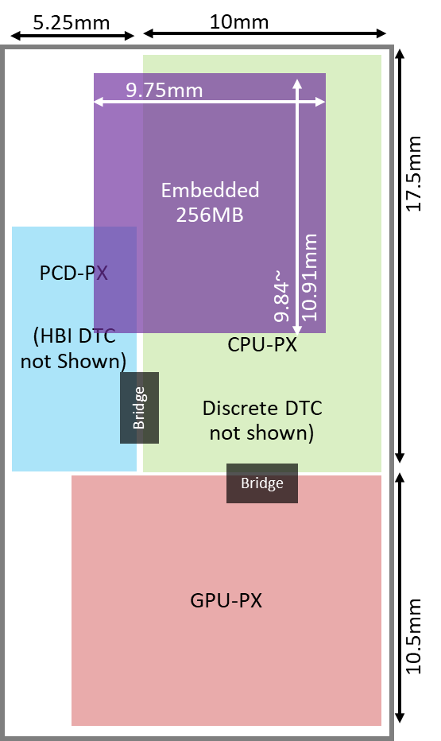
2.5D ➔ 2.3D
DLVR
DLVR
DLVR
DLVR
DLVR
DLVR
HS / LS IO
DLVR
DLVR
LPDDR PHY
Cost advantages
420mm² of I3FV vs. 100mm² of N6 ($20)
Silicon interposer is 20% higher in cost of making than Fanout packaging
Capability and Limitation
Besides thermal, there are many unknown physical constraints
DLVR
DLVR
LPDDR PHY
CPU-PX
CPU-PX
Si Interposer / MiM / SRAM
DTC
SRAM

Slide 5
Power Delivery
Discrete
CPU-PX DTC
not
shown)
Emb.
64MB
Emb.
64MB
Emb.
64MB
Emb.
64MB
~5x5mm^2 64MB SRAMs provide flexibilities to implement Decaps within proximity of consumers
Smaller capacity SRAM benefits power saving with power management
DTC enables high density cap for CPU/GPU per high freq/high current demanding
Adding discreet caps at spare space to eliminate on-pkg caps benefiting both performance and cost
A
PCD-PX
A’
Bridge
Bridge
GPU-PX
A
A’
CPU-PX N3P
GPU-PX I18A
64M SRAM
DTC
N6/N4P
DTC
Bridge
DTC/discreet cap

Slide 6
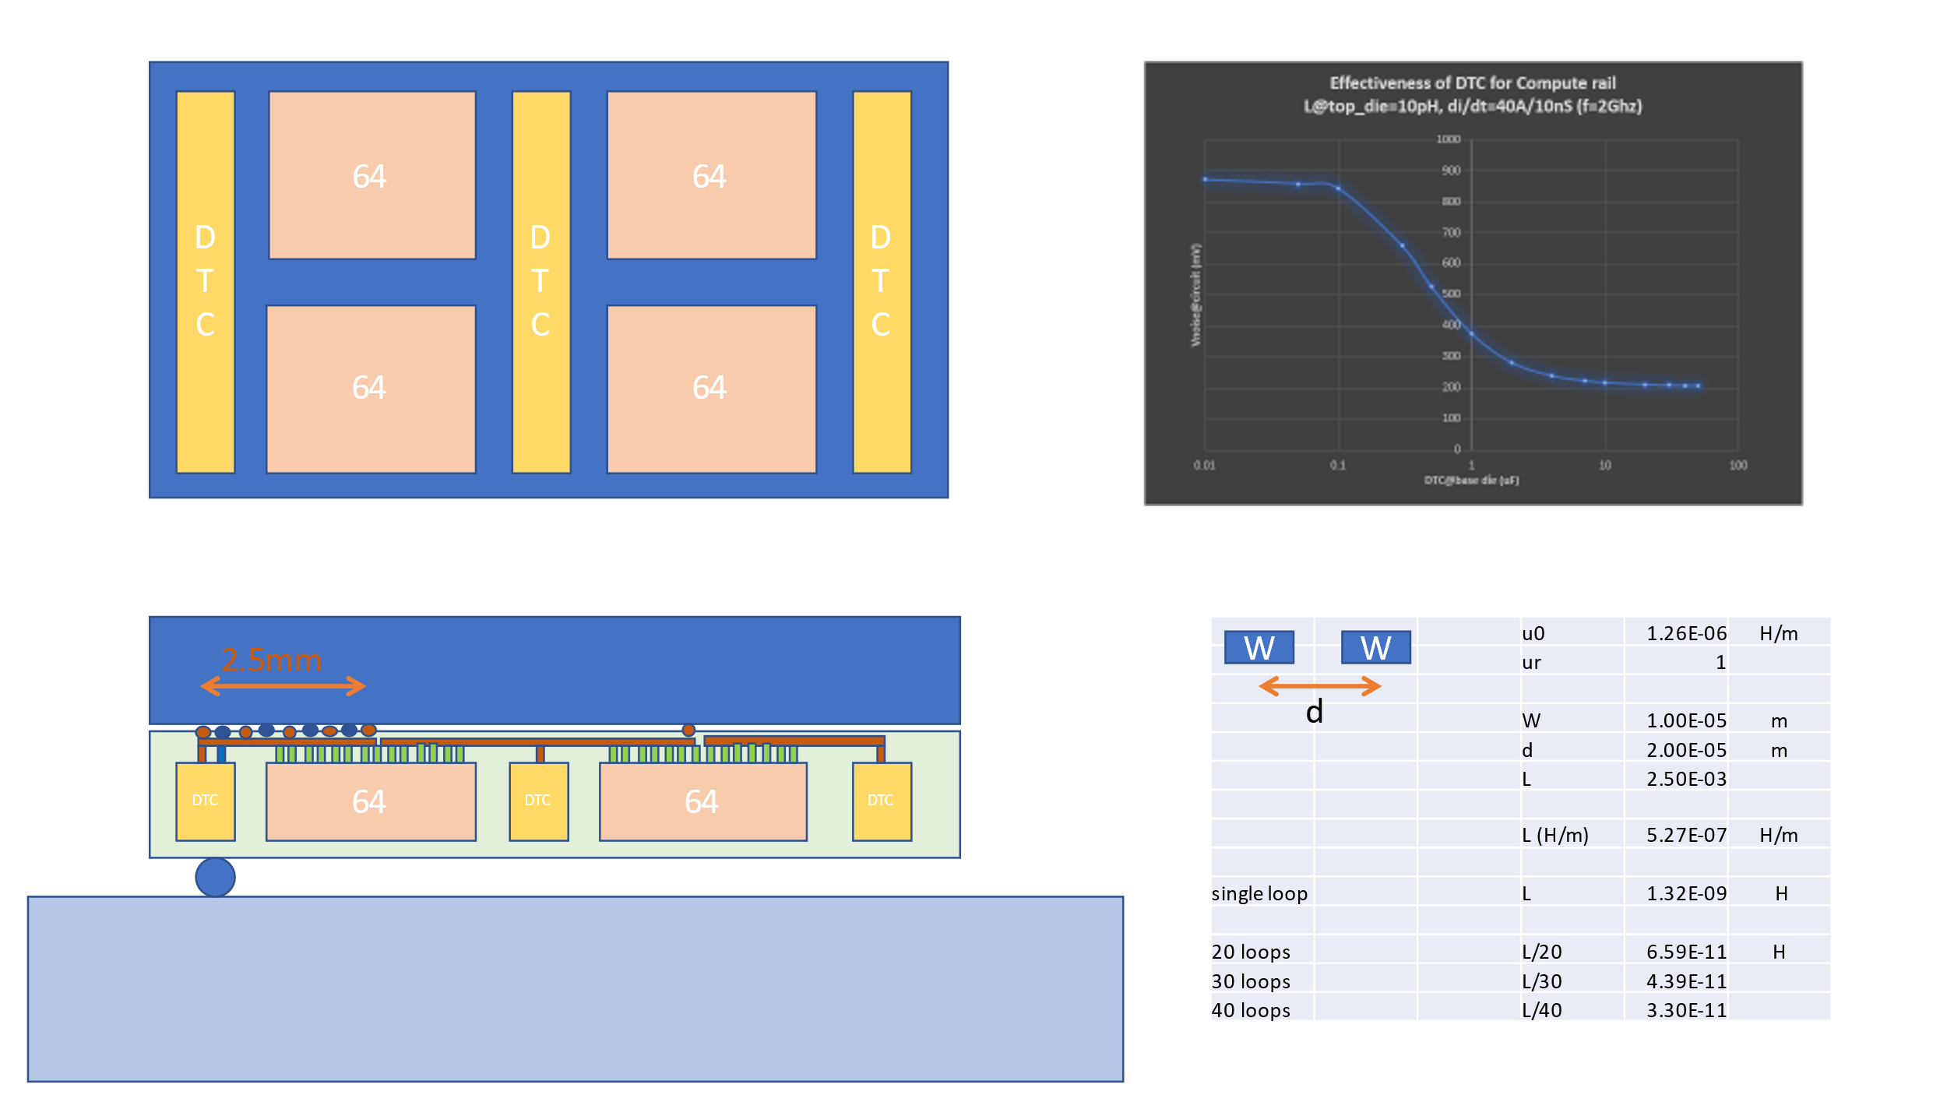
Power Delivery
CPU/GPU
  >1uF/mm^2 DTC implemented on base die
  RDL with alternating PWR/GND scheme to minimize L
  Additional discreet Caps could be added in the dummy areas as needed to further lower the LL
  Possible removing LL cap under the die resulting in no-cavity that benefits LL
PCD
  Adding FET’s caps for high-speed instant current demanding w/o MIM
  DTC/ Discreet silicon caps provide possibilities to eliminate on-pkg caps

Slide 7
SRAM Floorplan model & assumptions
TSVs
 | Dimension | Assumption
Width | Macro to bank overhead | 10%
 | Mux logic | 38um
 | Gap width for drivers | 16um
 | Gap width w/o drivers | 4um
Height | Macro to bank Overhead | 4%
 | Gap height w/ TSV | 27um
 | Gap height w/o TSV | 12um
TSVs
TSVs
IO drivers
Mux logic
IO drivers
Assumptions for floorplan:
Overall similar architecture to ELP, with 25um microbump pitch
Macro vs. bank overhead same as ELP (10% in width dimension, 4% in height dimension)
Driver size do not scale; drivers inserted in gaps between half banks.
8:1 redundancy for memory
Channel Capacity [MB] | Technology node | Channel Area [mm2] | 256MB die area [mm2] | Area efficiency [MB/mm2]
8MB | N6 | 3.32 | 106.34 | 2.41
 | N4 | 2.59 | 83.01 | 3.08
 | 4LPP | 2.80 | 89.58 | 2.86
16MB | N6 | 6.57 | 105.17 | 2.43
 | N4 | 5.12 | 81.94 | 3.12
 | 4LPP | 5.53 | 88.49 | 2.89
32MB | N6 | 12.90 | 103.20 | 2.48
 | N4 | 10.03 | 80.24 | 3.19
 | 4LPP | 10.84 | 86.71 | 2.95
28%
~1%
Area efficiency slightly increasing with larger channel capacity
Model assuming TSV area not changing
Reduction in gaps where no driver not providing significant benefit
→ focus on 8MB / channel case scenarios

Slide 8
SRAM options 256MB
Total Capacity [MB] | 64 | 64 | 64 | 128 | 128 | 128 | 256 | 256 | 256
Tech node | N6 | N4P | SF4 | N6 | N4P | SF4 | N6 | N4P | SF4
Channel Capacity [MB] | 8 | 8 | 8 | 8 | 8 | 8 | 8 | 8 | 8
# channels | 8 | 8 | 8 | 16 | 16 | 16 | 32 | 32 | 32
N Channels in width dimension | 2 | 2 | 2 | 4 | 4 | 4 | 4 | 4 | 4
N Channels in height dimension | 4 | 4 | 4 | 4 | 4 | 4 | 8 | 8 | 8
DQ / channels | 512 | 512 | 512 | 512 | 512 | 512 | 512 | 512 | 512
CLK speed [GHz] | 1.6 | 1.6 | 1.6 | 1.6 | 1.6 | 1.6 | 1.6 | 1.6 | 1.6
Bus Width D/Q | 4096 | 4096 | 4096 | 8192 | 8192 | 8192 | 16384 | 16384 | 16384
Total transfer rate [GT/s] | 6553.6 | 6553.6 | 6553.6 | 13107.2 | 13107.2 | 13107.2 | 26214.4 | 26214.4 | 26214.4
Duplex | Full | Full | Full | Full | Full | Full | Full | Full | Full
Duplex factor | 2 | 2 | 2 | 2 | 2 | 2 | 2 | 2 | 2
Total transfer rate (w/duplex) [GT/s] | 13107.2 | 13107.2 | 13107.2 | 26214.4 | 26214.4 | 26214.4 | 52428.8 | 52428.8 | 52428.8
IO drivers | 8192 | 8192 | 8192 | 16384 | 16384 | 16384 | 32768 | 32768 | 32768
Total Area per channel [mm2] | 3.7 | 2.9 | 3.1 | 3.7 | 2.9 | 3.1 | 3.7 | 2.9 | 3.1
Total Area per die [mm2] | 29.6 | 23.1 | 24.9 | 59.2 | 46.2 | 49.9 | 118.5 | 92.3 | 99.7
Area efficiency [MB/mm2] | 2.160499 | 2.7721 | 2.56736 | 2.160499 | 2.7721 | 2.56736 | 2.160499 | 2.7721 | 2.56736
Yield (Q1'25) | 93.3% | 92.9% | 93.9% | 89.9% | 89.5% | 88.2% | 81.3% | 81.9% | 77.8%
Good die per wafers (Q1'25) | 1884 | 2417 | 2262 | 894 | 1150 | 1047 | 396 | 516 | 453
Cost per wafer [$] | 9321 | 13081 | 11461 | 9321 | 13081 | 11461 | 9321 | 13081 | 11461
Dies required | 4 | 4 | 4 | 2 | 2 | 2 | 1 | 1 | 1
Cost for 256MB dies [$] | 19.78981 | 21.64832 | 20.26702 | 20.85235 | 22.74957 | 21.89303 | 23.53788 | 25.35078 | 25.30022
Total latency (estimated) [ns] | 4.253625 | 4.134405 | 4.169422 | 4.253625 | 4.134405 | 4.169422 | 4.253625 | 4.134405 | 4.169422
Leakage/bit normal mode [nW/bit] TT/0.75V/85C | 0.252533 | 0.267487 | 0.506439 | 0.252533 | 0.267487 | 0.506439 | 0.252533 | 0.267487 | 0.506439
Leakage/bit IDDQ [nW/bit] | 0.638908 | 0.676741 | 1.281291 | 0.638908 | 0.676741 | 1.281291 | 0.638908 | 0.676741 | 1.281291
Total Static Power per die [W] | 0.343011 | 0.363323 | 0.687888 | 0.686023 | 0.726645 | 1.375776 | 1.372045 | 1.45329 | 2.751552
Total Dynamic energy per die [W] | 3.28 | 3.14 | 3.18 | 6.55 | 6.28 | 6.37 | 13.11 | 12.56 | 12.74
Total Energy per die [W] | 3.62 | 3.50 | 3.87 | 7.24 | 7.01 | 7.74 | 14.48 | 14.02 | 15.49
Total Energy [W] | 14.47841 | 14.01641 | 15.48817 | 14.47841 | 14.01641 | 15.48817 | 14.47841 | 14.01641 | 15.48817
Area efficiency from 2.16 to 2.77 MB/mm2 for N6→ N4
Cost driven by yield → 15% difference in yield expectations between 1 large die vs 4 small dies
Latency / energy metrics not changed between 1 large die vs 4 small dies → scaling # of channels (independent units)

Slide 9
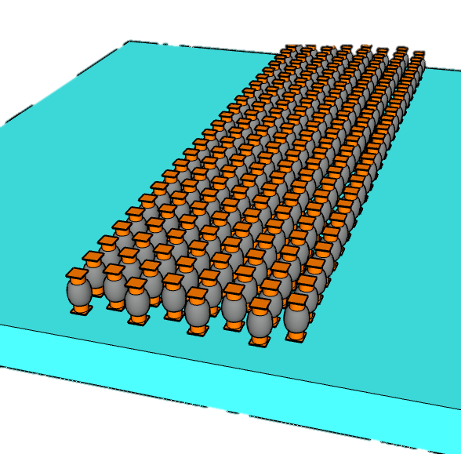
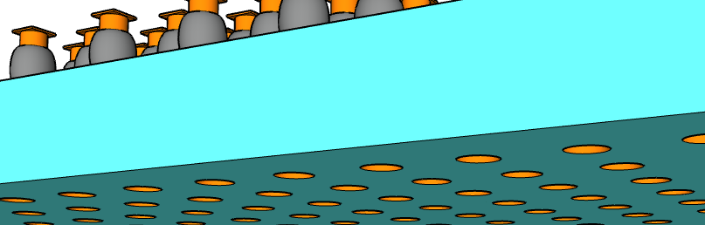
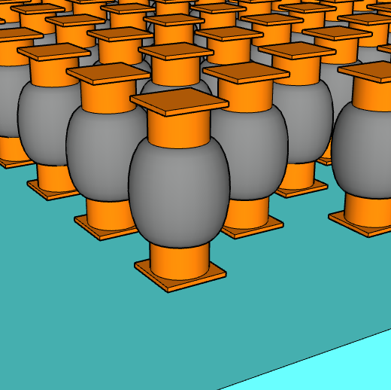
∆T between Embedded SRAM & Top Die
Embedded SRAM Chiplet
Base Line and experiment explored
Base Line ∆T: Emb. SRAM is 4.4˚C higher than Top Die at Full BW
25µm pitch µBump process change
  Upto 40% ∆T reduction with
  thickness, CD and Underfill material change
Layout effects:
  Upto 60% ∆T reduction by deploying Thermal Chimney
  (µBump dummification, method under development)
  Lower SRAM density to 1.66MB/mm² (~25%) reduce ∆T by 20%
Other Design impact
  ½ Transfer Rate, ½ ∆T whereas +20% ∆T with Half Duplex @ constant BW
  ∆T inversely correlated with channel capacity
µBump Pitchw | µBump thicknes | µBump CD | K_{µBump} | K_{UnderFill} | Adding TS PDN Via µBump | Adding Thermal Chimney | SRAM Density | I/O Duplex | Transfer Rate | Capacity
µm | µm | µm | W/°C·m | W/°C·m |  |  | MB/mm² |  | MT/s | MB/ch
25 | 26 | 12 | 8.8 | 0.55 | No | No | 2.25 | Full | 1.6 | 8
 | 25 | 14 |  | 1.1 | Yes | Yes | 1.66 | Half | 0.8~3.2 | 2~16
µBump connect to top die
1.1˚C ∆T (76% reduction) can be achieved with process change and dummification
TSVs connect to Substrate
t_{µB}
CD_{µB}
Pitch_{µB}
Early Engagement with Suppliers and Customer to achieve STCO before Design Start

Slide 10
Assembly SCM for Pricing
Note: Price not include SLCs and DTCs since we do not have information; SCM is not fully validated for advanced packages
2.5D is the most expensive, while traditional MCP the cheapest
ACK:: Li, Erin, CC, Max, Sandeep, Thomas

Slide 11
Backup

Slide 12
Embedded Features impede Effective Power Delivery
CPU-PX
CPU-PX
Si Interposer / MiM / SRAM
DTC
SRAM
DTC
CPU-PX
CPU-PX
DTC
SRAM
DTC
SRAM
DTC
design requirement vs. physical constraint
Yet another example of pathfinding engagement for product leadership
t

Slide 13
NVL-PX with 256MB embedded SRAM
5.25mm
10mm
CPU-PX
Discrete DTC
not shown)
CPU-PX
Discrete DTC
not shown)
CPU-PX
Discrete DTC
not shown)
Embedded
256MB
Emb.
64MB
Emb.
64MB
9.75mm
Emb.
128MB
Emb.
128MB
4.87mm
17.5mm
9.84~
10.91mm
Emb.
64MB
Emb.
64MB
PCD-PX
(HBI DTC
not Shown)
PCD-PX
PCD-PX
5.46mm
Bridge
Bridge
Bridge
Bridge
Bridge
Bridge
GPU-PX
GPU-PX
GPU-PX
10.5mm

Slide 14
2.3D BT² Chip-Last Mockup Flow
(SPIL/FO-3D, TSMC/InFO-3D)
Discrete
CPU-PX DTC
not
shown)
Emb.
64MB
Emb.
64MB
1
IPD
not shown
2
SRAM
2
1
2
1
Emb.
64MB
3
Bridge
Emb.
64MB
A
PCD-PX
(HBI DTC
not shown)
A’
4
Carrier Prep
RDL, Cu Pillar
Em. Chiplets Attachment
Mold, RDL
2
2
3
Bridge
5
3
4
CPU
25µm µB
6
Bridge
Micro Bumping
GPU-PX
7
5
GPU
9 µm
HBI
6
PCD
PCD
A
A’
Top Die Attachment
CPU-PX N3P
GPU-PX I18A
7
DTC
DTC
C4
Top Carrier Bond,
Back Carrier Debond.
Bumping
64M SRAM
DTC
N6/N4P
DTC
Bridge
80µm C4

Slide 15
Is 2.3D BT² superior?
2.5D Foveros
  Si interposer with RDL and IPD addresses interconnect scalability and power/signal integrity
  Base die CMOS enables IP-folding thru stacking
  Combining them simplify assembly logistics but reduces feature utilization efficiency; increase BOM cost
2.3D-BT²
  2.3D-BT: RDL, bridge die for high density shore connectivity;
  IPD chiplets w/ TSV for PI/SI
  T: Si Chiplets w/ TSV for IP-folding
  What is design requirement vs. physical constraint
Holistic Co-pathfinding with SiFO/OSAT/Design for successful new product-technology deployment

Slide 16
Rumsfeld Matrix known knowns, known unknowns, and unknown unknowns
“… there are known knowns; there are things we know we know. We also know there are known unknowns; that is to say we know there are some things we do not know. But there are also unknown unknowns—the ones we don't know we don't know…”
Known and Unknown: A Memoir by Donald Rumsfeld

Slide 17
Why ELP
Inspired by Client PX processor
  Medium Power (~50W/package), High BW SLC (~TB/s/core)
"2.3D is superior"; is it?
  One of CCG’s interests but no resources/bandwidth assess it.
"Si is smarter"
  Learnings comes from entire cycle (design to tests)
2.3D is system pathfinding priority
  Pick ELP for System Integration learning
  Beyond known knowns/unknowns, exploring unknown unknowns
  Afterall, pathfinding is only useful if “It works”

Slide 18
Scratchpad

Slide 19
5.25mm
10mm
5.25mm
10mm
CPU-PX
Discrete DTC
not shown)
Embedded
256MB
9.75mm
CPU-PX
I3FV
420~430mm²
17.5mm
17.5mm
9.84~
10.91mm
PCD-PX
(HBI DTC
not Shown)
PCD-PX
CPU-PX
Bridge
D2D
Bridge
Si Interposer / MiM / SRAM
GPU-PX
D2D
GPU-PX
CPU-PX
10.5mm
10.5mm
DTC
SRAM

Slide 20
