Slide 1
NVL PX/MX Intercept
CPG/GEMS/FTE presenting
DerChang Kau
By courtesy of Team Electric Pond, Dany Ly-Gagnon, Mike Goldsmith, Jason Zhang and Long Wang
March 31, 2023

Slide 2
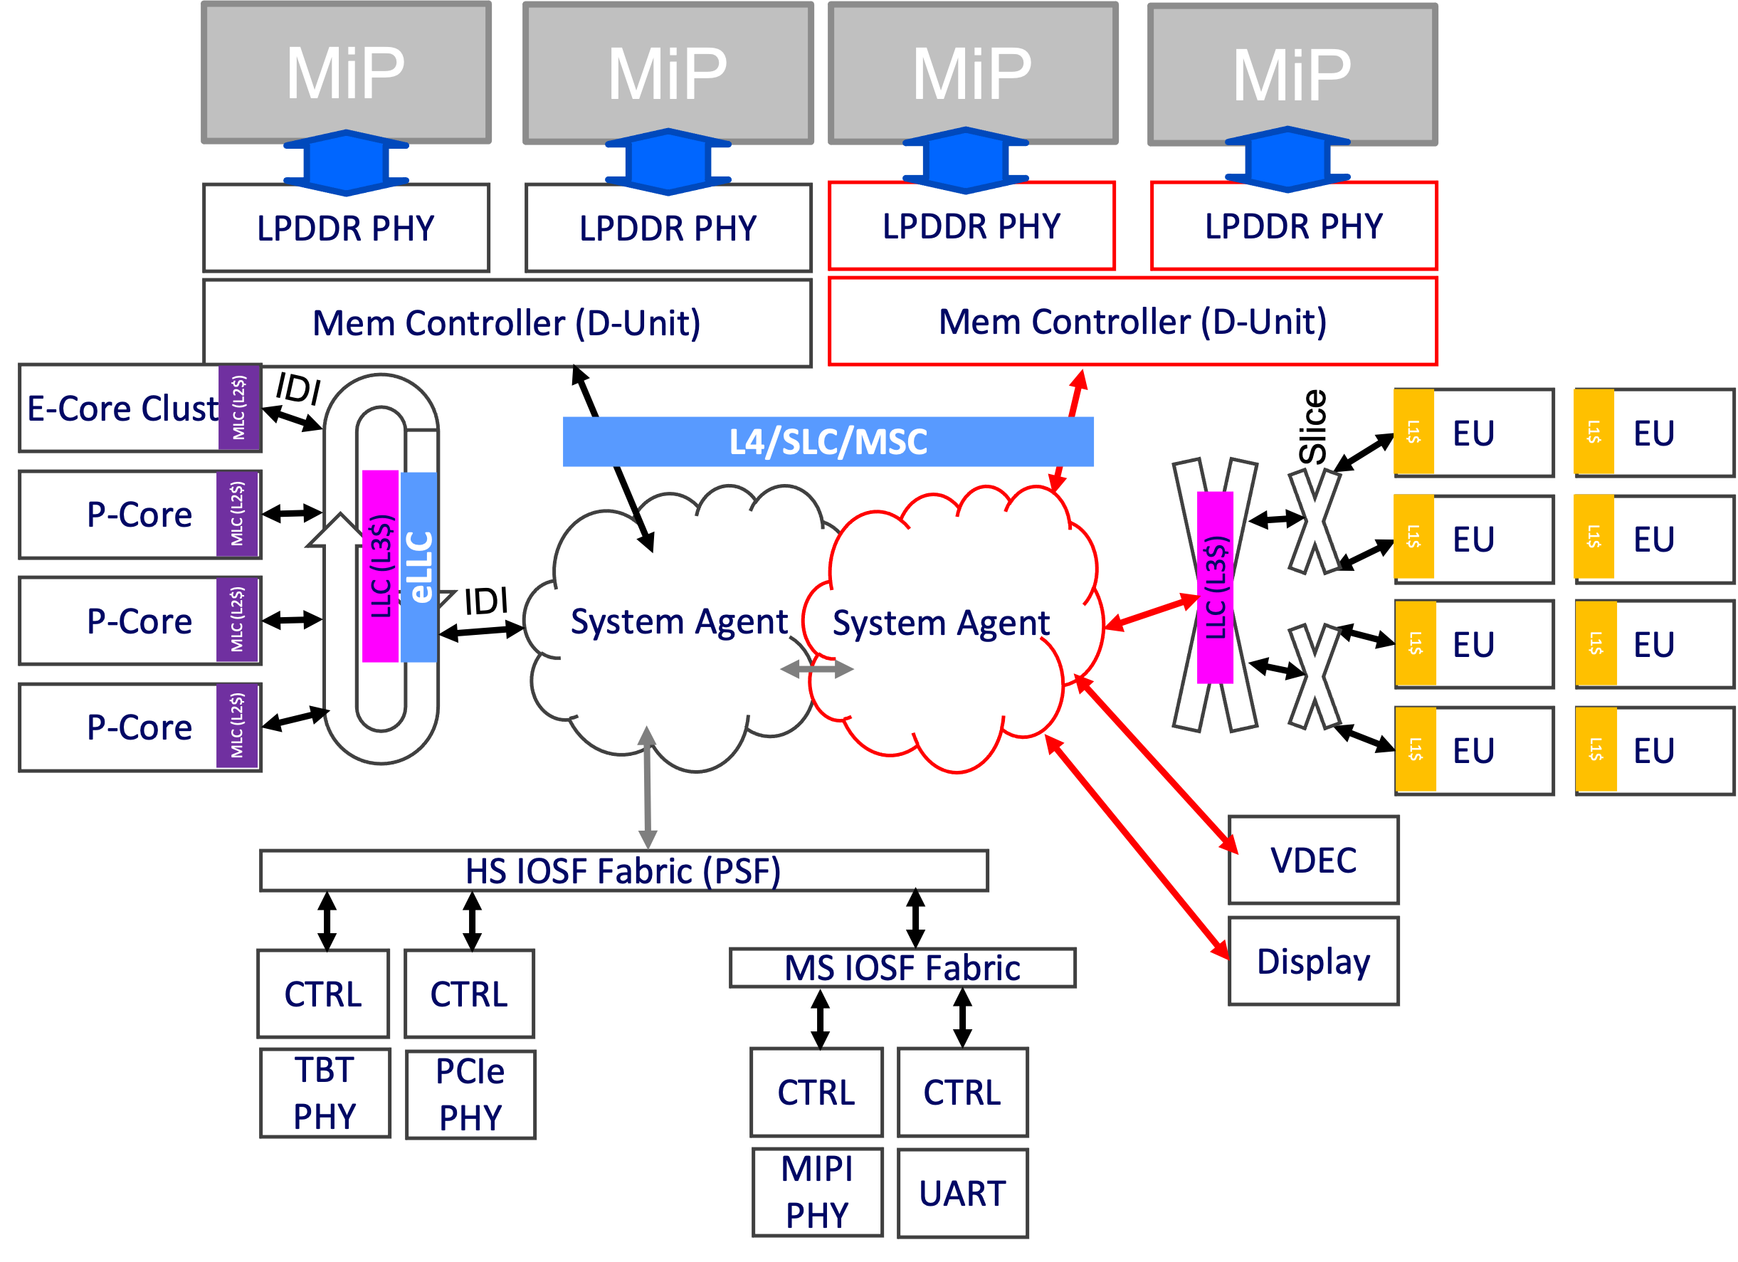
System in Package Mockup: Inspired by PX Processer
LPDDR
LPDDR
LPDDR
LPDDR
PCD-P
CPU-PX
PCD-P
GPU-PX
CPU-PX
GPU-PX
i16 Si Interposer/MiM* (UCIe-A)
Substrate (UCIe-S)
Substrate
MCP
Packaging cost baseline $8~$10
Passive interposer
(FOV, 2.5D)
For $25 addition:
$7~$8 packaging process adder
$10~$20 Interposer & MiM of P1227
LPDDR
LPDDR
LPDDR
LPDDR
CPU-PX
PCD-P
GPU-PX
CPU-PX
PCD-P
GPU-PX
Si Interposer / MiM / i3FV SLC
SLC
DTC
SLC
Substrate
Substrate
Active interposer for eLLC / SLC
(Active FOV, 2.5D)
Fanout Package w/ Embedded Chiplet (2.3D-BT²)
For > $150 addition
$7~$8 packaging process adder
$150~$200 Interposer, MiM & 400MB SRAM of I3FV
For $25 addition
$4~$6 packaging process adder
$20 256MB SRAM of N6, SF4 or N4P
1¢/µF optional DTC or ISC for PDN

Slide 3
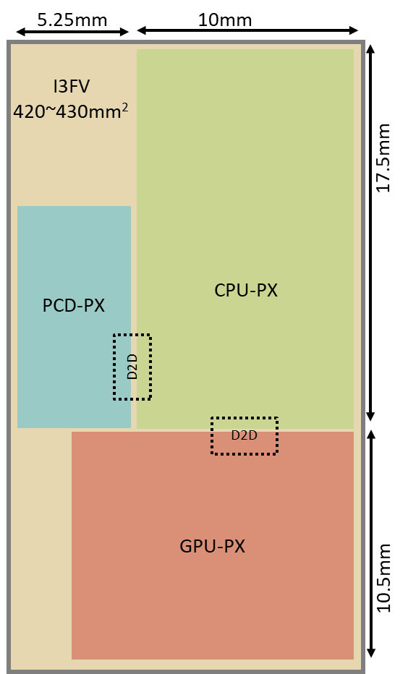
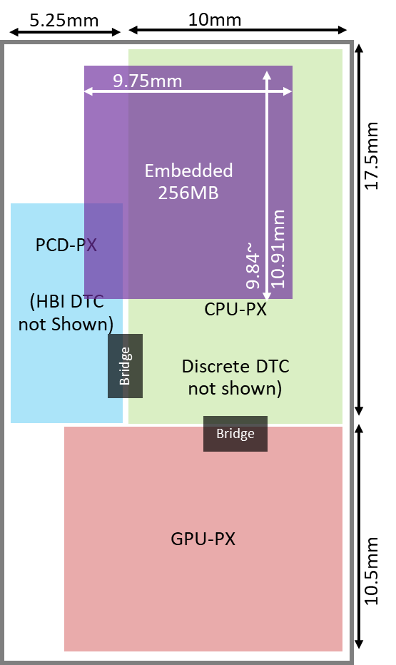
Base Die (Advanced Packaging) Technology: 2.5D (Si Interposer) ➔ 2.3D (Fan-out)
Capability
2.3D provides flexible low parasitic interconnect of heterogenous technology integrating features for performance augmentation with TTM advantage
Cost
2.5D degrades feature utilization efficiency hence higher cost ~420mm² I3FV (~$150) vs. ~120mm² N6 (~$20)
Silicon interposer (TSV + BEOL) is 20% higher ($2~$3) in cost of making than Fanout packaging (TMV + RDL)
Additional 2.3D cost reduction opportunities in development
Capacity of 2.3D Family
TSMC’s InFO-3D and SPIL’s FO-3D are under development (Intel’s ODI ZBB’d)
Maturity of 2.3D Family
(maturity and roadmap)
Topics under evaluation in 2.3D
D2D IP design and performance difference between 2.5D and 2.3D (UCIe and beyond), including R/W latency, IO, ESD, power/thermal and PDN
Explore unknowns in Chip-Package Interaction using "Electric Pond" for 2.3D integration flow flushing
CPU-PX
CPU-PX
Si Interposer / MiM / SRAM
DTC
SRAM

Slide 4
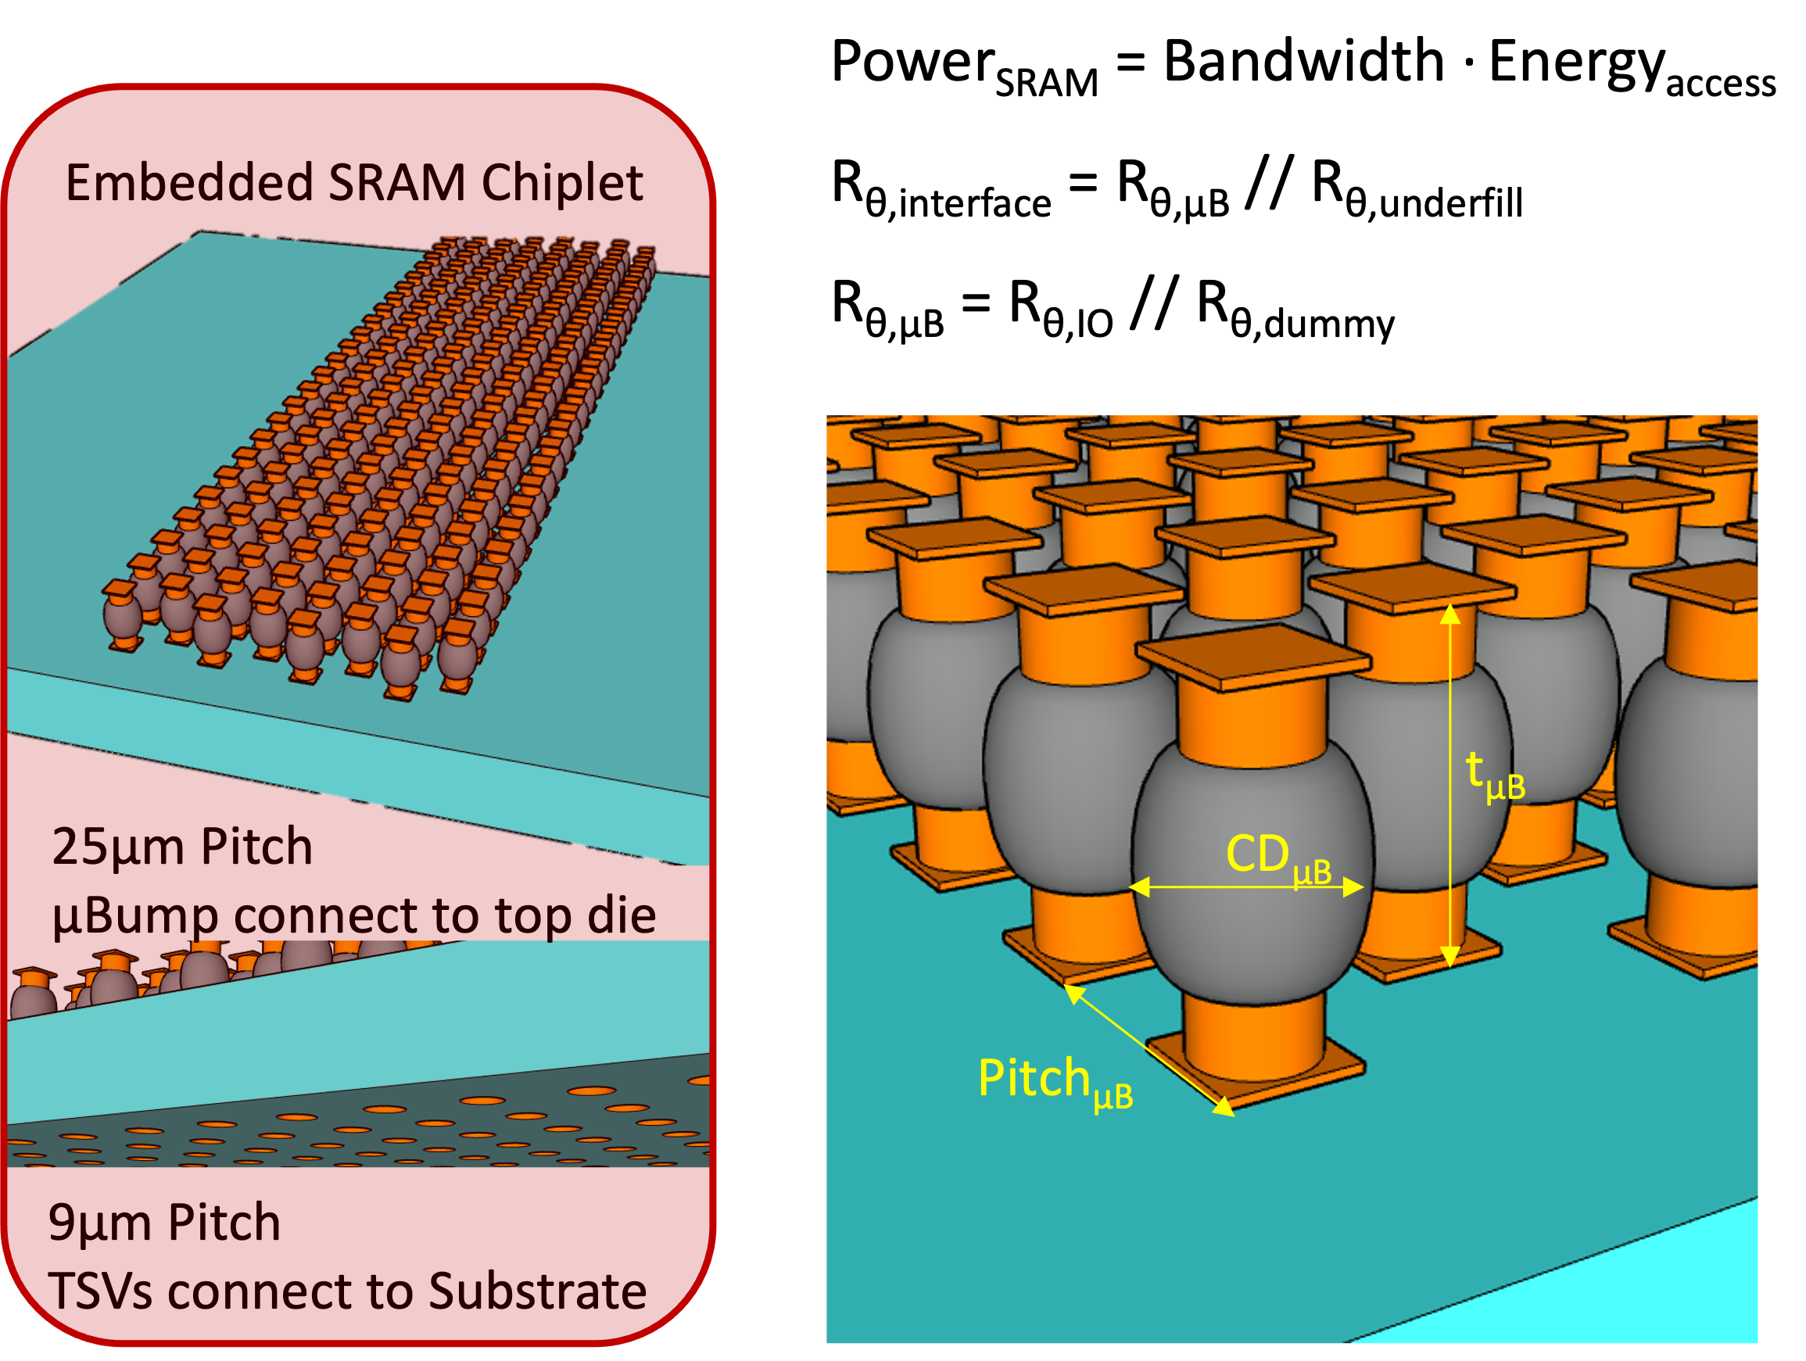
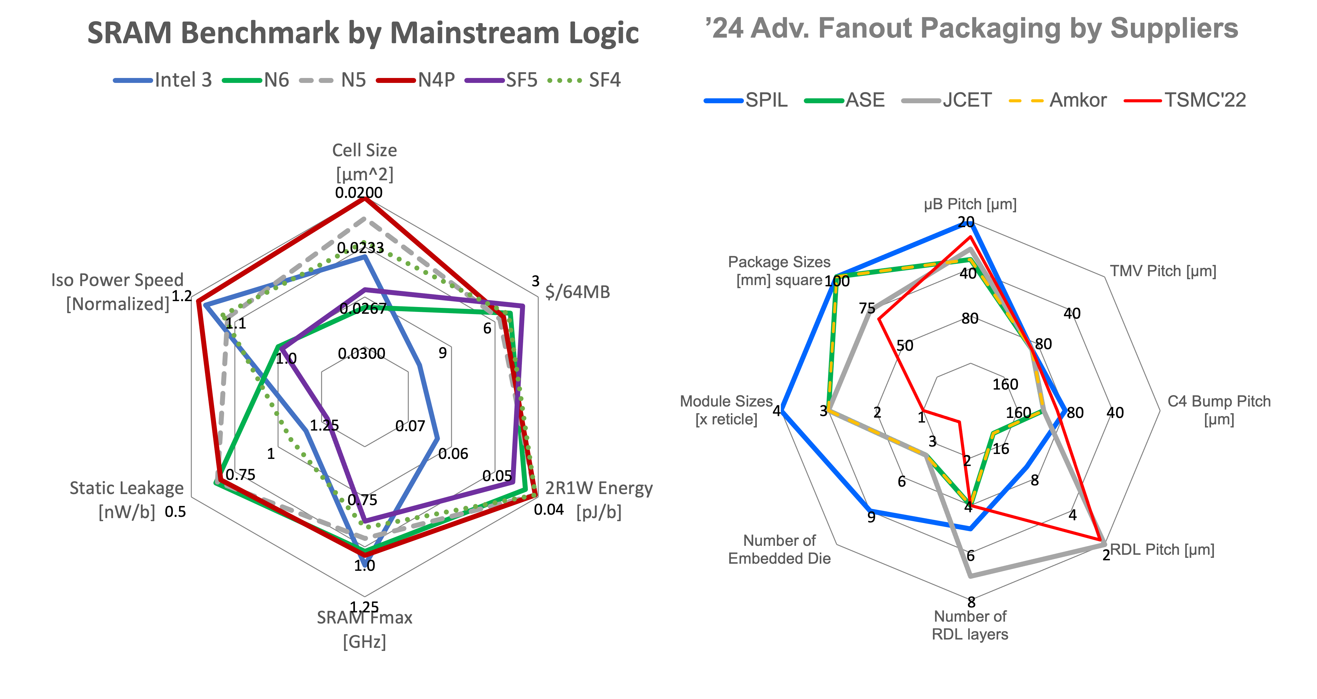
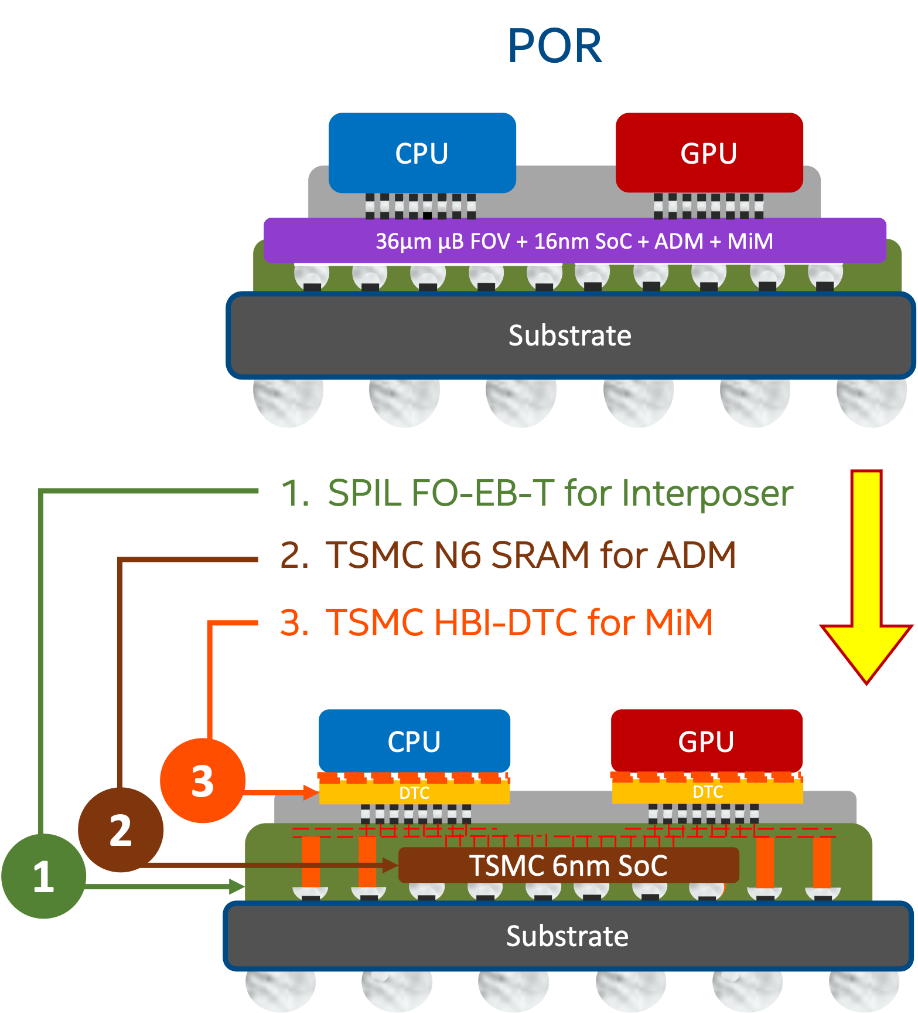
Disaggregated SRAM
256MB System Level Cache organization
8MB channel: 32 banks in 8 bank groups, 256KB/bank 64B ECC Full Duplex DQ @ 1.6MT/s, 0.2pJ/b 102 MB/s for read/write @ 3ns latency
32 channels deliver max BW 6.6TB/s @ 10~11W
"Electric Pond": 2MB channel in FO-3D package for SV
Choices of technology and die capacity
64MB/die yields the best cost due to yield
Emb. SRAM is estimated < 3˚C (∆T) higher than top die
Feasibility in reducing ∆T with 25µm-Pitch bump/underfill optimization and “thermal chimney” design / TFM development
Early Engagement between suppliers and design team to achieve STCO before design start
256MB SRAM | N6 | SF4 | N4P
Density [MB/mm²] | 2.16 | 2.57 | 2.77
Footprint [mm²] | 118 | 100 | 92
4x 64MB/die | $19.79 | $20.27 | $21.65
2x 128MB/die | $20.85 | $21.89 | $22.75
1x 256MB/die | $23.54 | $25.30 | $25.35

Slide 5
2.3D BT² Chip-Last Mockup Flow (SPIL/FO-3D, TSMC/InFO-3D)
Discrete CPU-PX DTC not shown)
1
IPD not shown
Emb. 64MB
Emb. 64MB
2
SRAM
3
Bridge
Carrier Prep
RDL, Cu Pillar
Em. Chiplets Attachment
Mold, RDL
2
1
2
1
Emb. 64MB
Emb. 64MB
A
PCD-PX (HBI DTC not shown)
A’
4
CPU
25µm µB
Micro Bumping
4
5
GPU
2
2
3
9 µm HBI
Bridge
5
6
PCD
PCD
3
7
DTC
DTC
25µm
Bumping
Top Die Attachment
6
Bridge
GPU-PX
C4
Top Carrier Bond,
Back Carrier Debond.
Bumping
7
80µm C4
Power Delivery
Small chiplet embedded in 2.3D-BT² package enables flexibilities for PDN optimization for parasitic insertion loss (I·R, di/dt·L) reduction and noise de-coupling by effective capacitor placement within proximity of consumption.
TSMC DTC and SF ISC are the high-density de-cap choices for CPU/GPU in scaling path.
A
A’
CPU-PX N3P/N3X/N2
GPU-PX N3P
64M SRAM
DTC
N6/N4P
DTC
Bridge

Slide 6
Backup

Slide 7
NVL-PX
Lowest-Cost State (MCP)
LPDDR
LPDDR
CPU-PX
PCD-P
GPU-PX
MiP
MiP
MiP
MiP
Substrate (UCIe-S)
LPDDR PHY
LPDDR PHY
LPDDR PHY
LPDDR PHY
POR passive interposer (2.5D)
Mem Controller (D-Unit)
LPDDR
LPDDR
Mem Controller (D-Unit)
CPU-PX
PCD-P
GPU-PX
E-Core Cluster
IDI
i16 Si Interposer/MiM* (UCIe-A)
MLC (L2$)
Slice
EU
EU
Substrate
L4/SLC/MSC
L1$
L1$
P-Core
System Agent
System Agent
MLC (L2$)
EU
EU
LLC (L3$)
L1$
L1$
P-Core
eLLC
LLC (L3$)
MLC (L2$)
IDI
EU
EU
Active interposer for eLLC / SLC (2.5D)
L1$
L1$
LPDDR
LPDDR
P-Core
CPU-PX
PCD-P
GPU-PX
MLC (L2$)
EU
EU
L1$
L1$
Si Interposer / MiM / i3FV SLC
VDEC
Substrate
HS IOSF Fabric (PSF)
CTRL
CTRL
MS IOSF Fabric
Display
Embedded Die interposer (2.3D-BT²)
TBT PHY
PCIe PHY
CTRL
CTRL
LPDDR
LPDDR
CPU-PX
PCD-P
GPU-PX
MIPI PHY
UART
SLC
DTC
SLC
Substrate

Slide 8
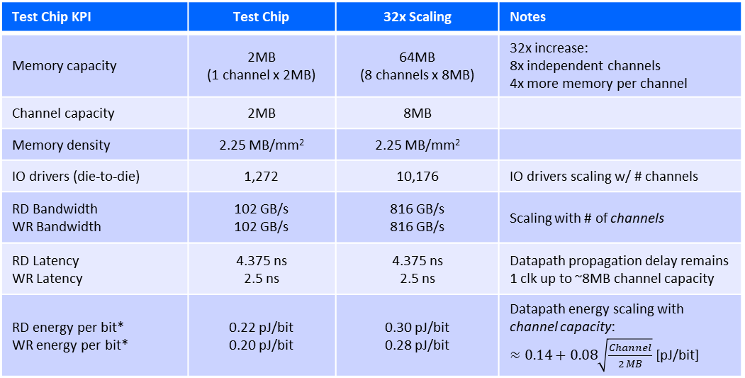
Electric Pond - Summary
Top Die
(Controller)
Controller
SRAM
SRAM
MUX
SRAM
SRAM
RDL layer
SRAM
Substrate
Embedded Die
(SRAM)
SRAM
SRAM
SRAM
SRAM
Power & test signals to bottom die
Power & test signals to top die
Drivers
Drivers
Test Chip KPI | Test Chip | 32x Scaling | Notes
Memory capacity | 2MB (1 channel x 2MB) | 64MB (8 channels x 8MB) | 32x increase: 8x independent channels 4x more memory per channel
Channel capacity | 2MB | 8MB
Memory density | 2.25 MB/mm² | 2.25 MB/mm²
IO drivers (die-to-die) | 1,272 | 10,176 | IO drivers scaling w/ # channels
RD Bandwidth WR Bandwidth | 102 GB/s 102 GB/s | 816 GB/s 816 GB/s | Scaling with # of channels
RD Latency WR Latency | 4.375 ns 2.5 ns | 4.375 ns 2.5 ns | Datapath propagation delay remains 1 clk up to ~8MB channel capacity
RD energy per bit* WR energy per bit* | 0.22 pJ/bit 0.20 pJ/bit | 0.30 pJ/bit 0.28 pJ/bit | Datapath energy scaling with channel capacity: $≈0.14+0.08\sqrt{\frac{Channel}{2 MB}}$ [pJ/bit]
Electric Pond Testchip
Technology: TSMC N6
Memory density: 2.25 MB/mm²
Databus width: 64B cache line
Die-to-die link (data, cmd, red): 1272 pads @ 1.6GT/s
Package Assembly
Technology: SPIL FO-EB (Fan-Out, Embedded Bridge)
Face-to-Face integration between top die and embedded die
Micro-bump pitch @ 25µm, 1.78K bumps per mm² in HCP
RDL layer: 1 layer for routing test signals & power
(*) preliminary

Slide 9
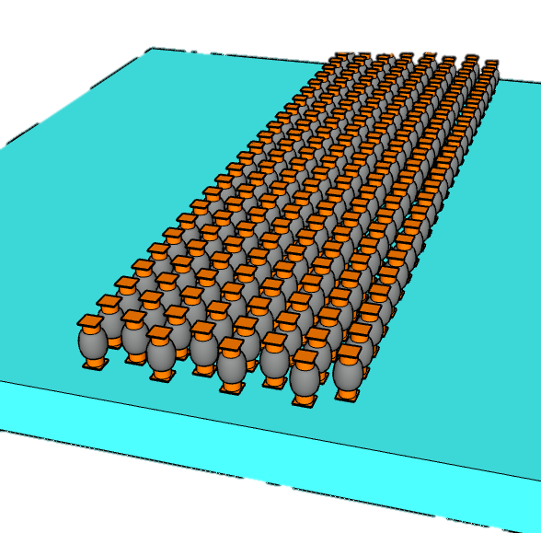
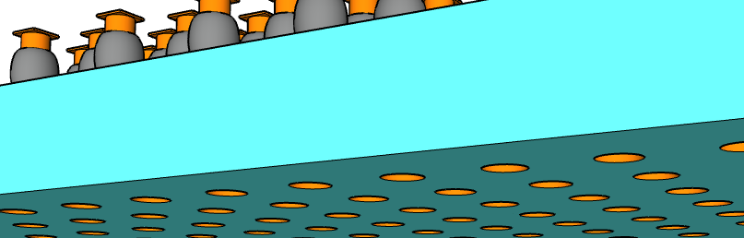
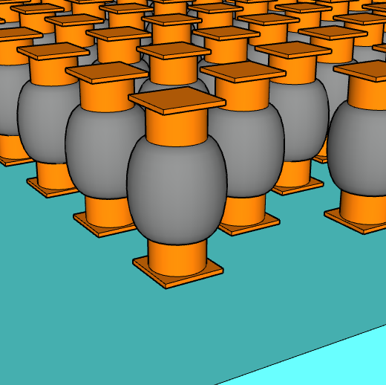
∆T between Embedded SRAM & Top Die
Embedded SRAM Chiplet
Base Line and experiment explored
Base Line ∆T: Emb. SRAM is <3˚C higher than Top Die at Full BW
25µm pitch µBump process change
Upto 40% ∆T reduction with thickness, CD and Underfill material change
Layout effects:
Upto 60% ∆T reduction by deploying Thermal Chimney (µBump dummification, method under development)
Lower SRAM density to 1.66MB/mm² (~25%) reduce ∆T by 20%
Other Design impact
½ Transfer Rate, ½ ∆T whereas +20% ∆T with Half Duplex @ constant BW
∆T inversely correlated with channel capacity
µBump Pitchw | µBump thicknes | µBump CD | K_{µBump} | K_{UnderFill} | Adding TS PDN Via µBump | Adding Thermal Chimney | SRAM Density | I/O Duplex | Transfer Rate | Capacity
µm | µm | µm | W/°C·m | W/°C·m |  |  | MB/mm² |  | MT/s | MB/ch
25 | 26 | 12 | 8.8 | 0.55 | No | No | 2.25 | Full | 1.6 | 8
 | 25 | 14 |  | 1.1 | Yes | Yes | 1.66 | Half | 0.8~3.2 | 2~16
µBump connect to top die
0.7˚C ∆T (76% reduction) can be achieved with process change and dummification
TSVs connect to Substrate
t_{µB}
CD_{µB}
Pitch_{µB}
Early Engagement with Suppliers and Customer to achieve STCO before Design Start

Slide 10
0.0200
20
0.0233
3
100
40
1.2
0.0267
75
1.1
6
80
40
1.0
0.0300
9
50
80
160
1.25
0.07
4
3
2
1
160
80
40
1
0.06
3
16
0.75
0.05
2
6
8
0.5
0.75
0.04
4
4
9
1.0
6
2
1.25
8

Slide 11
Disaggregated SRAM
256MB SRAM | N6 | SF4 | N4P
Density [MB/mm²] | 2.16 | 2.57 | 2.77
Footprint [mm²] | 118 | 100 | 92
4x 64MB/die | $19.79 | $20.27 | $21.65
2x 128MB/die | $20.85 | $21.89 | $22.75
1x 256MB/die | $23.54 | $25.30 | $25.35
256MB System Level Cache organization
8MB channel: 32 banks in 8 bank groups, 256KB/bank 64B ECC Full Duplex DQ @ 1.6MT/s, 0.2pJ/b 102 MB/s for read/write @ 3ns latency
32 channels deliver max BW 6.6TB/s @ 10~11W
"Electric Pond": 2MB channel in FO-3D package for SV
Choices of technology and die capacity
64MB/die yields the best cost due to yield
Emb. SRAM is estimated < 3˚C (∆T) higher than top die
Feasibility in reducing ∆T with 25µm-Pitch bump/underfill optimization and “thermal chimney” design (dummification TFM) development
Early Engagement between suppliers and design team to achieve STCO before design start
Embedded SRAM Chiplet
t_{µB}
CD_{µB}
25µm Pitch
µBump connect to top die
Pitch_{µB}
9µm Pitch
TSVs connect to Substrate

