Slide 1
NVL PX/MX Intercept
CPG/GEMS/FTE presenting
By courtesy of Team Electric Pond, Dany Ly-Gagnon, Mike Goldsmith, Jason Zhang and Long Wang

Slide 2
System in Package Mockup: Inspired by PX Processer
LPDDR
LPDDR
LPDDR
LPDDR
PCD-P
CPU-PX
PCD-P
GPU-PX
CPU-PX
GPU-PX
i16 Si Interposer/MiM* (UCIe-A)
Substrate (UCIe-S)
Substrate
MCP
Packaging cost baseline $8~$10
Passive interposer
(FOV, 2.5D)
For $25 addition:
$7~$8 packaging process adder
$10~$20 Interposer & MiM of P1227
LPDDR
LPDDR
LPDDR
LPDDR
CPU-PX
PCD-P
GPU-PX
CPU-PX
PCD-P
GPU-PX
Si Interposer / MiM / i3FV SLC
SLC
DTC
SLC
Substrate
Substrate
Active interposer for eLLC / SLC
(Active FOV, 2.5D)
Fanout Package w/ Embedded Chiplet
(2.3D-BT²)
For > $150 addition
$7~$8 packaging process adder
$150~$200 Interposer, MiM &
400MB SRAM of I3FV
For $25 addition
$4~$6 packaging process adder
$20 256MB SRAM of N6, SF4 or N4P
1¢/µF optional DTC or ISC for PDN

Slide 3
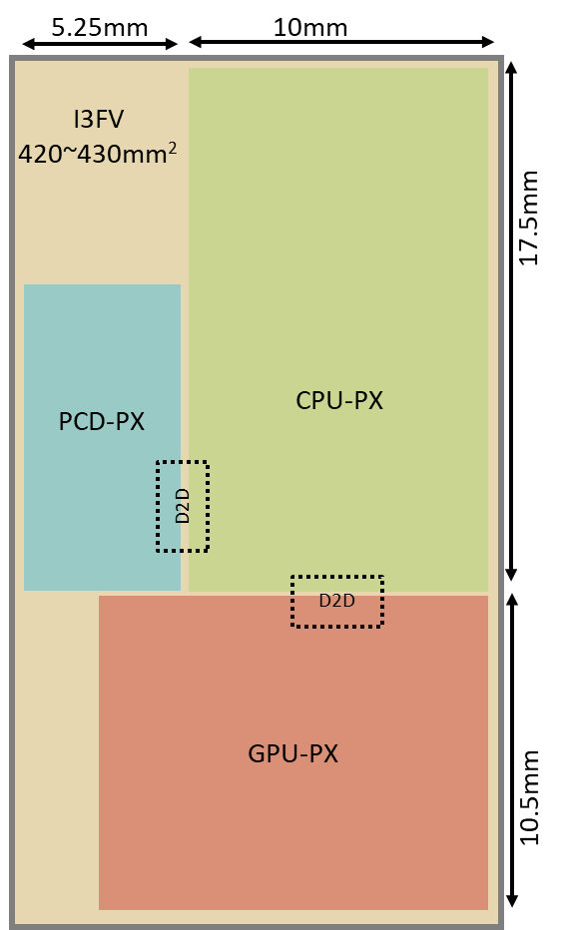
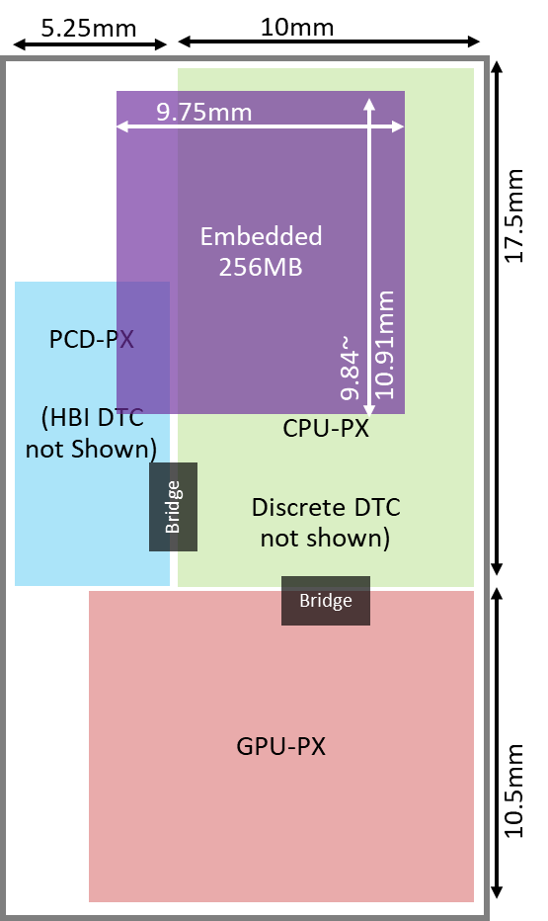
Base Die (Advanced Packaging) Technology:
2.5D (Si Interposer) ➔ 2.3D (Fan-out)
Capability
2.3D provides flexible low parasitic interconnect of heterogenous technology integrating features for performance augmentation with TTM advantage
Cost
2.5D degrades feature utilization efficiency hence higher cost
~420mm² I3FV (~$150) vs. ~120mm² N6 (~$20)
Silicon interposer (TSV + BEOL) is 20% higher ($2~$3) in cost of making than Fanout packaging (TMV + RDL)
Additional 2.3D cost reduction opportunities in development
Capacity of 2.3D Family
TSMC’s InFO-3D and SPIL’s FO-3D are under development (Intel’s ODI ZBB’d)
Topics under evaluation in 2.3D
D2D IP design and performance difference between 2.5D and 2.3D (UCIe and beyond), including R/W latency, IO, ESD, power/thermal and PDN
Explore unknowns in Chip-Package Interaction using "Electric Pond" for 2.3D integration flow flushing
CPU-PX
CPU-PX
Si Interposer / MiM / SRAM
DTC
SRAM

Slide 4
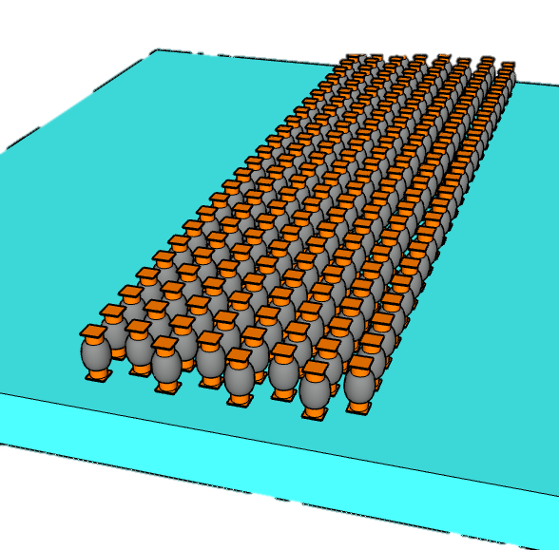
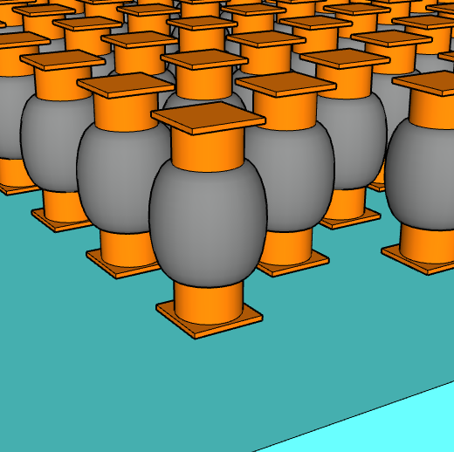
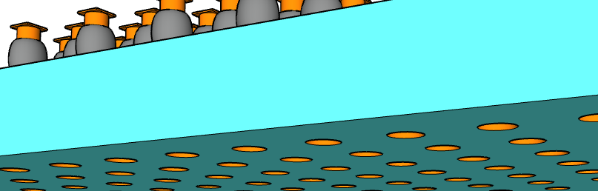
Disaggregated SRAM
256MB SRAM | N6 | SF4 | N4P
Density [MB/mm²] | 2.16 | 2.57 | 2.77
Footprint [mm²] | 118 | 100 | 92
4x 64MB/die | $19.79 | $20.27 | $21.65
2x 128MB/die | $20.85 | $21.89 | $22.75
1x 256MB/die | $23.54 | $25.30 | $25.35
256MB System Level Cache organization
  8MB channel:
  32 banks in 8 bank groups, 256KB/bank
  64B ECC Full Duplex DQ @ 1.6MT/s, 0.2pJ/b
  102 MB/s for read/write @ 3ns latency
  32 channels deliver max BW 6.6TB/s @ 11W
  "Electric Pond": 2MB channel in FO-3D package for SV
Choices of technology and die capacity
  64MB/die yields the best cost due to yield
Emb. SRAM is estimated < 3˚C (∆T) higher than top die
  Feasibility in reducing ∆T with 25µm-Pitch bump/underfill optimization and “thermal chimney” design (dummification TFM) development
  Early Engagement between suppliers and design team to achieve STCO before design start
Embedded SRAM Chiplet
t_{µB}
CD_{µB}
25µm Pitch
µBump connect to top die
Pitch_{µB}
9µm Pitch
TSVs connect to Substrate

Slide 5
2.3D BT² Chip-Last Mockup Flow
(SPIL/FO-3D, TSMC/InFO-3D)
Discrete
CPU-PX DTC
not
shown)
1
IPD
not shown
Emb.
64MB
Emb.
64MB
2
SRAM
3
Bridge
Carrier Prep
RDL, Cu Pillar
Em. Chiplets Attachment
Mold, RDL
2
1
2
1
Emb.
64MB
Emb.
64MB
A
PCD-PX
(HBI DTC
not shown)
A’
4
CPU
25µm µB
Micro Bumping
4
5
GPU
2
2
3
9 µm
HBI
Bridge
5
6
PCD
PCD
3
7
DTC
DTC
25µm
Bumping
Top Die Attachment
6
Bridge
GPU-PX
C4
Top Carrier Bond,
Back Carrier Debond.
Bumping
7
80µm C4
Power Delivery
Small chiplet embedded in 2.3D-BT² package enables flexibilities for PDN optimization for parasitic insertion loss (I·R, di/dt·L) reduction and noise de-coupling by effective capacitor placement within proximity of consumption.
TSMC DTC and SF ISC are the high-density de-cap choices for CPU/GPU in scaling path.
A
A’
CPU-PX N3P/N3X/N2
GPU-PX N3P
64M SRAM
DTC
N6/N4P
DTC
Bridge

