Slide 1
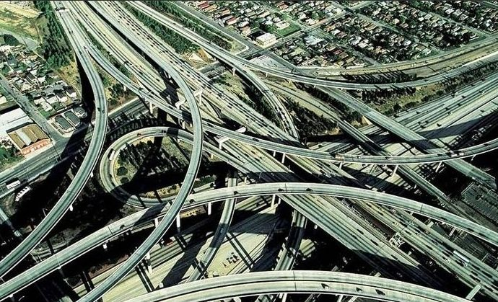

Slide 2
3D SRAM + Logic
Mike Goldsmith, Prashant Majhi and DerChang Kau, WW06, 2022
Competitive Landscape and References
3DIC External Suppliers
High Capacity Cache (HCC) – a Possibility Thinking

Slide 3
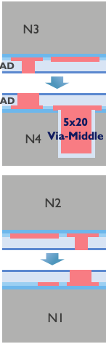
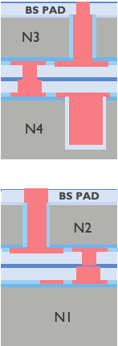
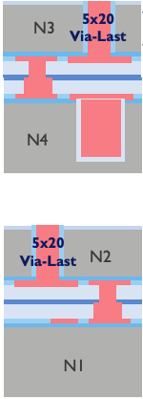
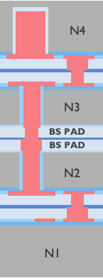
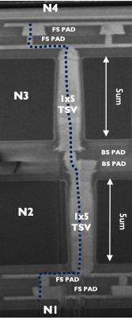
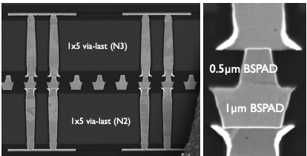
IMEC Dual-Layer Multi-Stack
https://intel.sharepoint.com/...IMEC/...PTW...2021_H2/3D W2W
Integration upto four layers, 5 and 20µm thick, using Hybrid Bonding
W2W HB capability and reliability
HB process, characterization and optimization: CMP, Cu pad bulge, Low √D·T

Slide 4
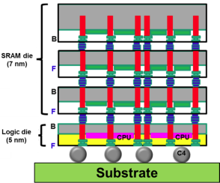


TSMC 3DIC STCO
DTCO of System on Integrated Chip at IEDM-20
DTCO of system on integrated chip (SoIC) for mobile and HPC applications
Chiplet partitioning, integration and interconnect.
Technology | 5nm FinFET
Vsw (V) | 0.5
Bus Width | 2586
Channel | SOIC <10 µm
Die-to-Die Bump Pitch (µm) | <10
Data Rate (Gb/s/pin) | 2
IO Power Eff. (pJ/bit) | 0.001745
PHY Power Eff. (pJ/bit) | 0.001745
Bandwidth Density (Tb/s/mm²) | 2.45

Slide 5
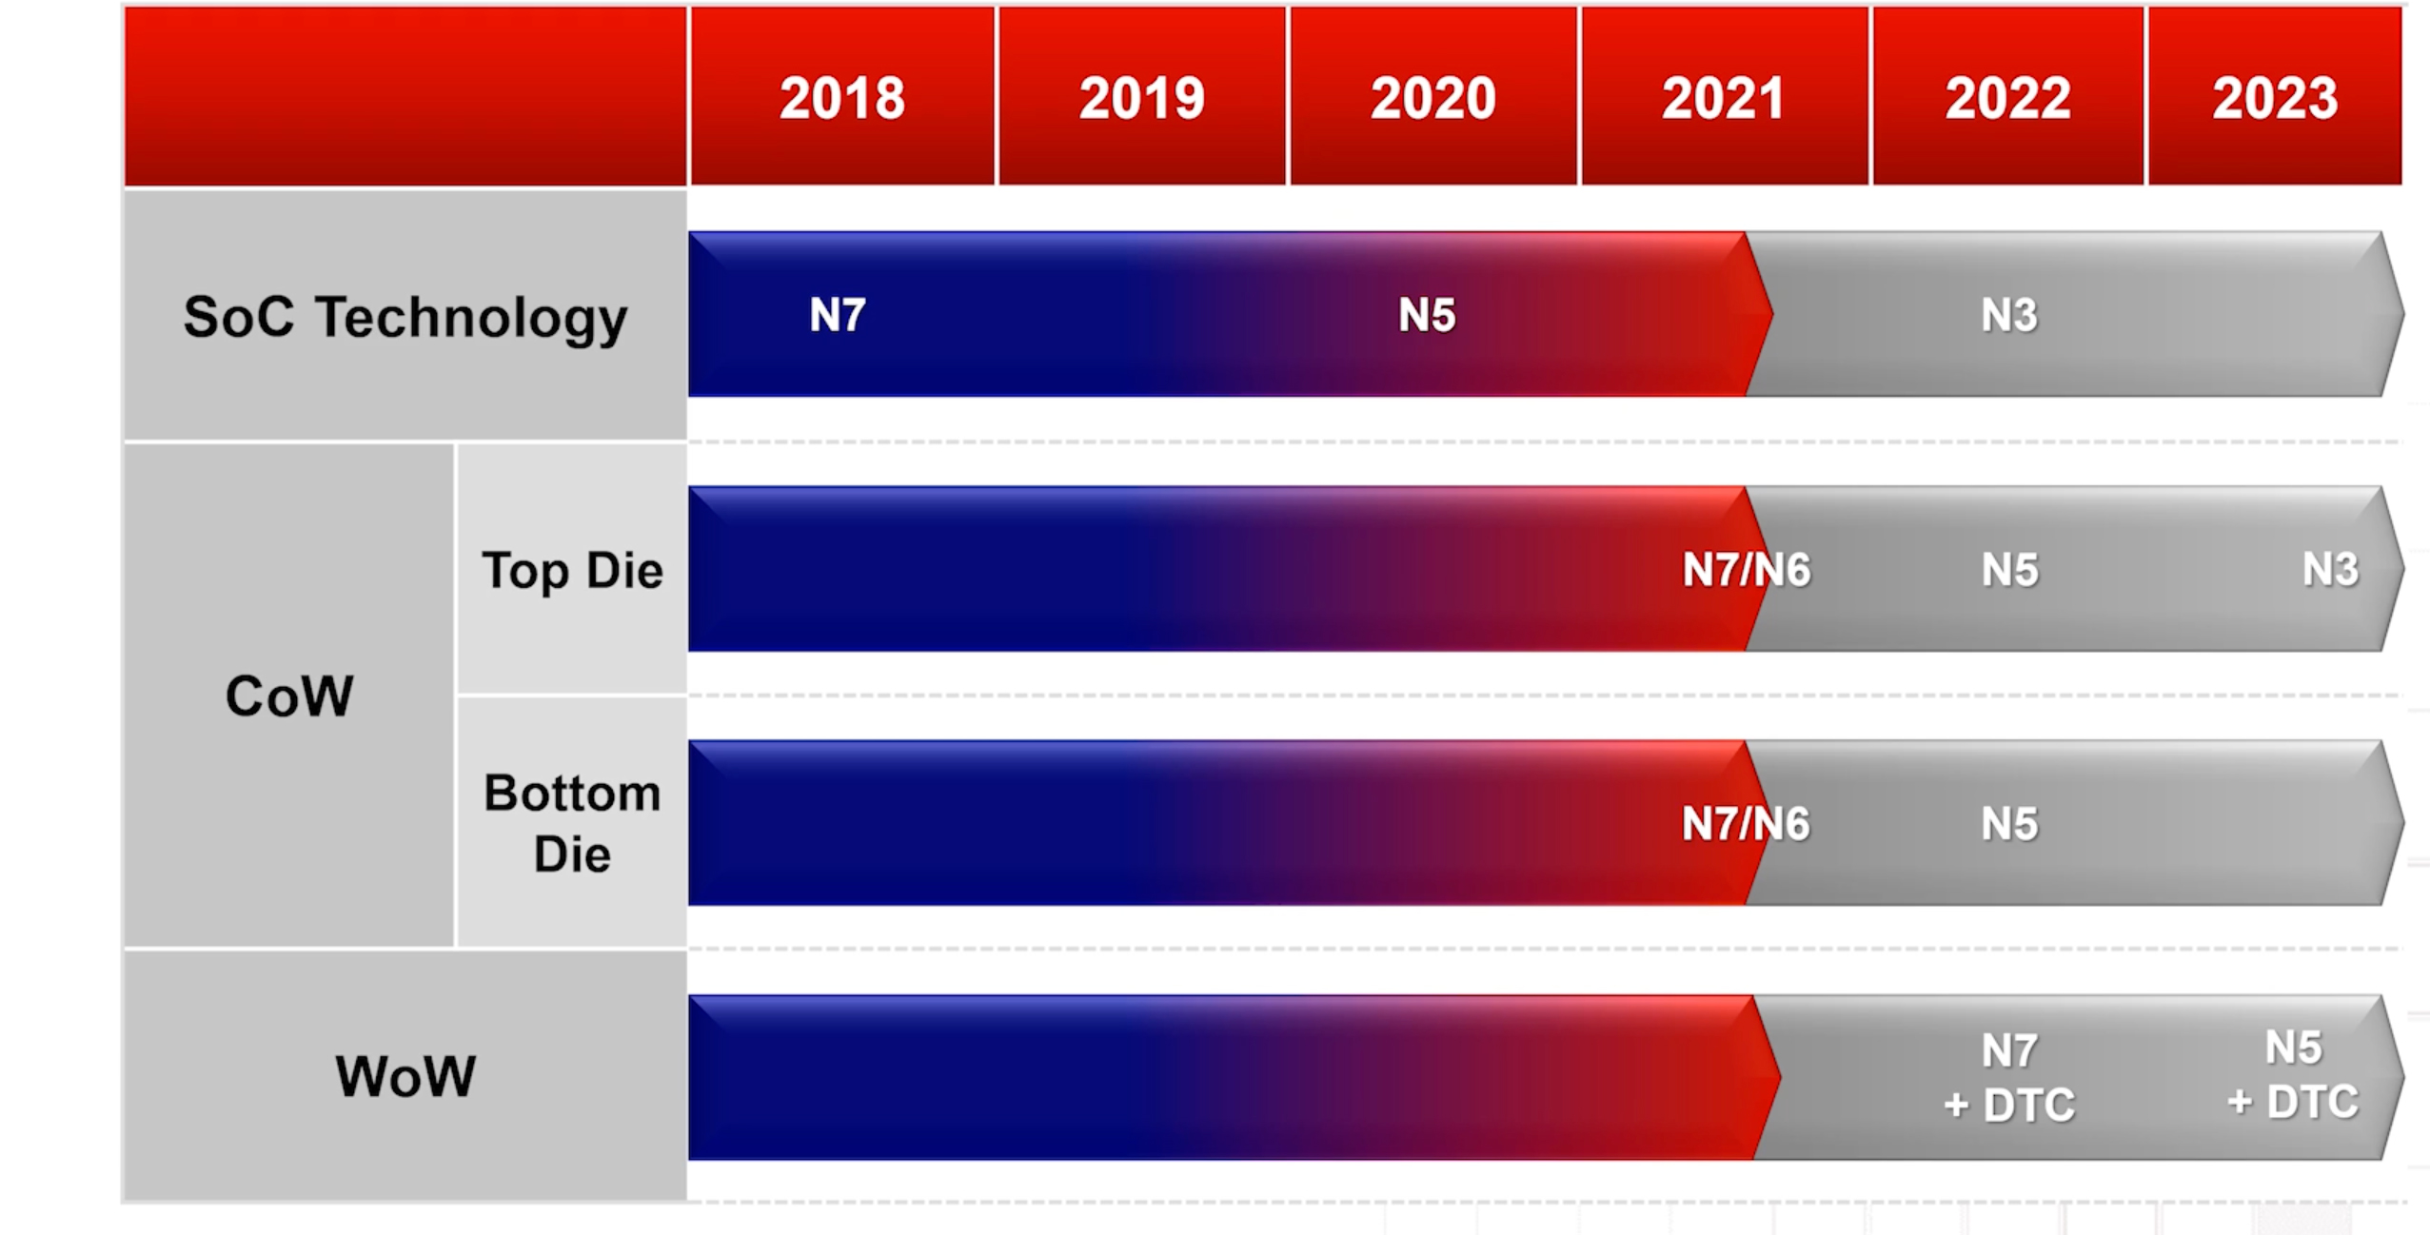
TSMC 3DIC Program
HB Pitch [µm] | 9 | 6 | 4.5
TSV Pitch [µm] | 9 | 6 | 4.5

Slide 6
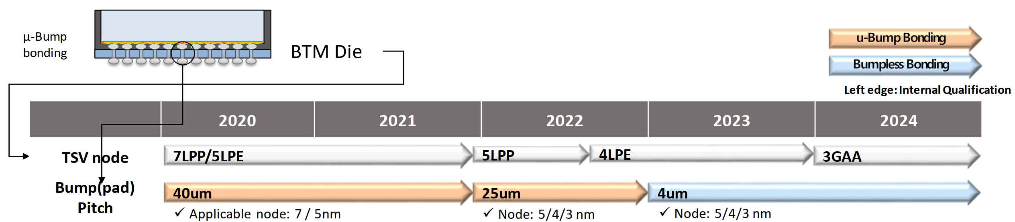
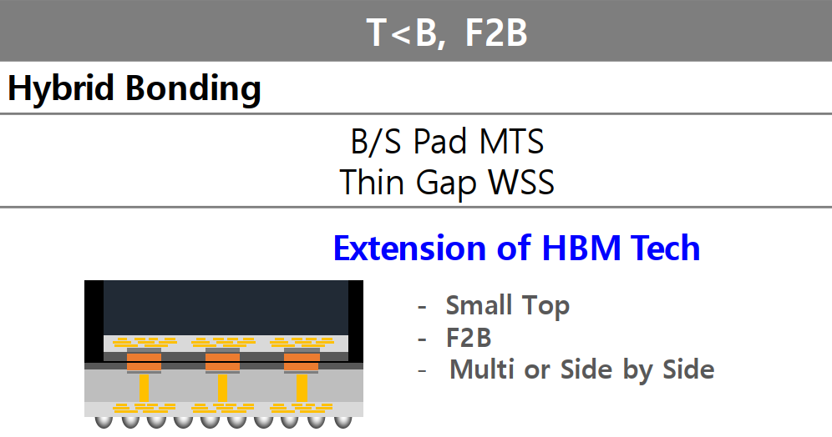
Samsung 3DIC Program
Extension of HBM tech adding Hybrid bond

Slide 7
A brain teaser: High Capacity Cache (HCC) Possibility
xPU
Memory
SoC
Mold
embedded
Subst
Capability:
All chiplet interfaces can be hybrid bonded (bumpless) with combination of CoW and WoW from Foundry. “Cube” would likely be assembled using WoW, then diced before attachment.
DFT (sort, class, bist, redundancy, repair, RBER, ECC and etc.), and media management need to be explored along with leveraging suppliers’ experiences to mitigate yield escape.
Cost:
Capacity: Substantial capacity of advanced mainstream technology such as N7/N6 is expected.
Technology | Availability | [MB/mm²] | [(TB/s)/GB] | Norm. $/wfr | Norm. GB/$ | Norm. BW/$ | References
TSMC N7 | 2021 | 1.77 | 500 | 0.7 | 0.11 | 437 | Cerebras CS2 Analysis, WW03/22, DeBonis
P1222.7 | 2024 | 6.7 | 13 | 1.2 | 0.25 | 25 | TCC Benchmark, Jan/25/22, Hamzaoglu
HBM3 | 2022 | 22.6 | 0.128 | 1 | 1 | 1 | SKH 1z 16Gb HBM3, Feb/7/22, Bains

