Slide 1
Mitigation Strategy for P1222.6 Capacity Constraint
DerChang Kau, WW10’22
Executive Summary
TSMC N6 SoC + SoIC hybrid bonding is an asset to graphics products
A mature high-volume technology with PDK R1.0.3
6nm Logic technology with 6µm pitch HB/TSV meets FOV10 requirements
Cost-effective high-density SRAM IP to replace ADM eDRAM
Additional opportunities in cost-performance tuning by exploiting ~10x BW/$ and BW/watt advantage over ADM
Full featured or SRAM optimized N6 potentially to augment client, server and accelerator products
HBM3 displacement is cost- and capability-prohibitive

Slide 2
P1222.6 Capacity Mitigation
GPU
GPU
GPU
GPU
36µm µB FOV + 16nm SoC + ADM
TSMC 6µm HB N6 SoIC
Substrate
Substrate
TSMC N6 SoIC
Capability:
6nm Logic with high density SRAM IP and 6µm hybrid bonded chiplet interfaces using CoW or WoW
SoIC technology with mature DTCO design kit (PDK Rev 1.0.3 on March 4, 2022, 8 flow variants)
Capacity: Intel secured substantial capacity of the mainstream SoC technology with SoIC packaging
Cost:
Technology | Availability | Cell Size [µm²] | pJ/bit | MB/mm² | (TB/s)/GB | (TB/s)/Watt | $/wfr | $/GB | $/(TB/s)
TSMC N6 (f) | 2021 | 0.02736 | 0.1 | 1.779 | 500 | 1.250 | ~$12K | $120 | $0.24
TSMC N6 (d) | 2021 | 0.02736 | 0.1 | 1.779 | 500 | 1.250 | ~$8K (est.) | $80 | $0.16
P1222.6 | 2023 | 0.01458 | 0.8 | 4.087 | 13 | 0.156 | ~$8K | $35 | $2.70
N6 price references in ‘23 include full featured 1P15M and defeatured 1P9M (SRAM optimized, next slide)
P1222.6 wafer cost in ‘23 is based on LRP golden doc @ Q3/21
Assumption- SRAM: 1200Mb die @ 84mm², 41% AE, 100µm scribe, 3mm ec, 95% yield, $12~18/die DRAM: 3200Mb die @ 98mm², 50% AE, 100µm scribe, 3mm ec, 95% yield, $14/die

Slide 3
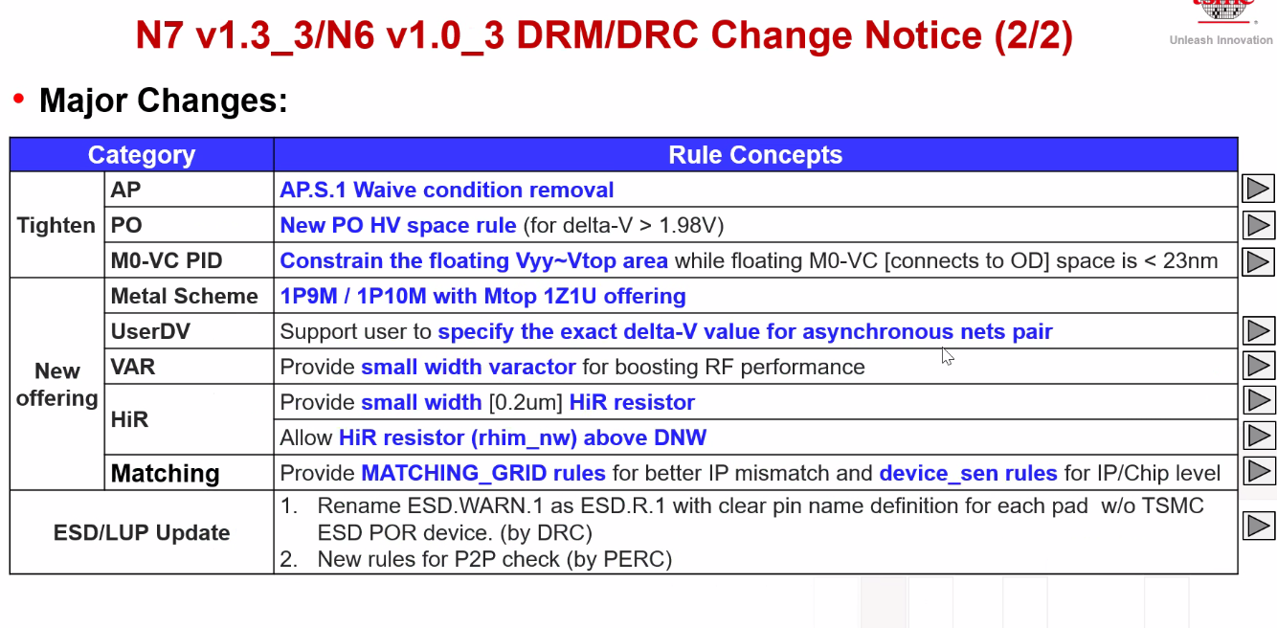
TSMC’s N6 new offering – 1P9M and 1P10M effective March 4, 2022 Intel LRP using 1P13M and 1P15M (full featured, $12K/wafer)
1P9M eliminates 8 metal and via layers (y4, yy1, yy2 and z2) and replaces xa1 with x2.

Slide 4
Biz Proposition

Slide 5
Supporting Materials

Slide 6
SRAM replacement vs. HBM displacement
Technology | Availability | Size_{cell}[µm²] | [pJ/bit] | [MB/mm²] | [(TB/s)/GB] | [(TB/s)/Watt] | $/wfr | $/GB | $/[TB/s]
TSMC N6 | 2021 | 0.02736 | 0.1 | 1.778 | 500 | 1.250 | $12,000 | $120 | $0.24
TSMC N6 (d) | 2021 | 0.02736 | 0.1 | 1.778 | 500 | 1.250 | $8,000 | $80 | $0.16
P1222.6 | 2023 | 0.01458 | 0.8 | 4.088 | 13 | 0.156 | $8,000 | $35 | $2.70
HBM3 (1z) | 2022 | 0.00197 | 4.5 | 22.600 | 0.125 | 0.028 | $6,576 | $4.9 | $39.2
Normalized to ADM
> 5X advantage |  | > 5X disadvantage |  | 3~5X disadvantage
Technology | Availability | Cell Size | Energy | Density | Iso cap. BW | Iso power BW | $/wfr | $/GB | $/[TB/s]
TSMC N6 | 2021 | 1.88 | 0.13 | 0.43 | 38.46 | 8.00 | 1.50 | 3.42 | 0.09
TSMC N6 (d) | 2021 | 1.88 | 0.13 | 0.43 | 38.46 | 8.00 | 1.00 | 2.28 | 0.06
P1222.6 | 2023 | 1 | 1 | 1 | 1 | 1 | 1 | 1 | 1
HBM3 (1z) | 2022 | 0.14 | 5.63 | 5.53 | 0.01 | 0.18 | 0.82 | 0.14 | 14.5
It is cost and capability prohibitive to deploy HBM3 for ADM displacement
Cost: 100x capacity required to match bandwidth or 15x cost to replace for performance
Capability: Complicated FOV 3D + EMBI 2.xD advanced packaging required at 6X power consumption.
SRAM stacking opportunity: capacity-performance tradeoff by exploiting 10x BW/$ & BW/watt advantage

Slide 7
Drafting proposal with product/architecture owners for Battlemage
+Satish, Randy
+Brian, Gopi
Presentation to GEMS sotu in two weeks
Build a path (cost, capacity, NRE)
Intel product portfolios including technology ingredients using N6 SRAM
ARL-PX Halo and etc.
Changhong
develop partnership with product owner to form proposal (Randy and Satish), and PX - with Brian and Gopi
Give this presentation for State of the Union meeting -- TY get this lined up
How to position - risk mitigation to 1222.6
Cost not biggest selling point
May not have volume on N6

