Slide 1
Battlemage Base / ARL-PX Dual Drive Proposition
DerChang Kau, WW12’22
with competitive analytics by
Margaret H., Mike G., CherSian C., Max W., Jason Z., Andy W. and Kala S.
Special thanks to Randy Osborne for his feedback and critiques.
Executive Summary
Assess external technologies to mitigate P1222.61 capacity constraint
TSMC N6 is the best-known replacement of P1222.61 for Battlemage base die
HBM3 displacement is cost- and capability-prohibitive
Propose a 4-week TF to make a go/nogo decision

Slide 2
P1222.61 Capacity Mitigation
GPU
GPU
GPU
GPU
36µm µB FOV + 16nm SoC + ADM
TSMC 9µm HB N6 SoIC F2B
Substrate
Substrate
TSMC N6
Capability:
  Mature SoC: “7nm” cell library and high-density SRAM IP with PDK Rev 1.0.3 released March 4, 2022, 8 flow variants
  Proven 3DIC integration: low-cost BE-3D with 25µm micro-bump or high-performance FE-3D with 6µm Hybrid-bond
  Solid endorsement in competitive landscape since 2019 (A11, Ryzen, V-cache, MK1-IPU, CS-2, A100)
Capacity: Intel secured substantial capacity of the mainstream SoC technology
Cost: Cost-effective high-density SRAM IP to replace ADM eDRAM
> 5X advantage |  | > 5X disadvantage |  | 3~5X disadvantage
Technology | Availability | Cell Size [µm²] | pJ/bit | MB/mm² | (TB/s)/GB | (TB/s)/Watt | $/wfr | $/GB | $/(TB/s)
P1222.61 | 2023 | 0.01458 | 0.8 | 3.3 | 13 | 0.156 | ~8K | 43 | 3.35
P1222.7 | 2024 | 0.00729 | 0.8 | 6.7 | 13 | 0.156
N6 1P13M | 2021 | 0.02736 | 0.1 | 1.6~2.1 | 500 | 1.250 | ~12K | 100~130 | 0.20~0.27
N6 1P9M | 2022 | 0.02736 | 0.1 | ~2 | 500 | 1.250 | ~10K (est.) | 89 | 0.18
N5 SRAM | 2021 | 0.02142 | 0.1 | ~2.66 | 500 | 1.250
HBM3 (1z) | 2022 | 0.00197 | 4.5 | 22.6 | 0.125 | 0.028 | 6.6K | 4.9 | 39.2
Wafer Pricing: N6 (f) – ’23 full featured price
N6 (d) – 9ML for optimized SRAM drive-to target
P1222.61 wafer cost in ‘23 is based on LRP golden doc @ Q3/21
HBM3 based on MIO intelligence

Slide 3
Cost Estimate for Battlemage Base Replacement
Packaging Density
 | Logic Gate Density [MG/mm²] | Memory Technology | Array density [MB/mm²]
P1222.61 | 5.41 | ADM Gen1 | 3.3
P1222.7 | 5.41 | ADM Gen2 | 6.7
TSMC N6 | 24.06 | 6T HD SRAM | 2.1
 |  |  | P1222.61 Die Size |  |  |  |  | N6 Die Size estimate
Componet | eu | Capacity MB | ADM Technology | Die size [mm²] | ADM area [mm²] | Logic/Peri [mm²] |  | Die Size [mm²] | SRAM Area [mm²] | Logic/Peri [mm²]
BMG G10 (X3) | 448 | 512 | Gen 1 | 366 | 231 | 135 |  | 274 | 244 | 30
BMG G12 (x4) | 640 | 640 | Gen 1 | 443 | 279 | 164 |  | 342 | 305 | 37
CLS G11 | ? | 870 | Gen 2 | 366 | 231 | 135 |  | 445 | 414 | 30
N6 die size estimated (Memory + Logic)
  Memory footprint: [Memory capacity] ÷ [array density]
  Logic footprint: Scaled based on gate density ratio
  Die size mismatch to be managed by low cost RDL solutions
  (Intel ODI readiness is Q2’25)
P1222.61 Yield Model 75% with repair and binning
N6 Yield Model
  D₀ reaches plateau at mid 2023
  D₀ models: 13ML vs. 9ML
  Yield calculation: Logic vs. SRAM footprint used;
  down-bin @50% area recoverable assumed
Wafer Pricing @ Q3’23
  N6 1P13M ’23 price: ~$12K
  N6 1P9M: $10K (drive-to target)
  P1222.61: $8K based on LRP golden doc @ Q3’21
ARL-PX die size: 356mm², 348eu, similar to BMG-X3
$12K N6 1P13M vs. $8K P1222.61
Component | Technology | Die Size [mm²] | DPW | Yield | GDPW | Die Cost
BMG G10 X3 | P1222.61 | 366 | 150 | 78.0% | 118 | $67.80
 | N6 | 274 | 207 | 79.7% | 164 | $73.17
BMG G12 X4 | P1222.61 | 443 | 121 | 75.0% | 90 | $88.89
 | N6 | 342 | 163 | 74.4% | 122 | $98.36
CLS G11 | P1222.7 | 366 | 150
 | N6 | 445 | 125 | 69.7% | 88 | $136.36
$10K N6 1P9M vs. $8K P1222.61
Component | Technology | Die Size [mm²] | DPW | Yield | GDPW | Die Cost
BMG G10 X3 | P1222.61 | 366 | 150 | 78.0% | 118 | $67.80
 | N6 | 274 | 207 | 82.5% | 170 | $58.82
BMG G12 X4 | P1222.61 | 443 | 121 | 75.0% | 90 | $88.89
 | N6 | 342 | 163 | 77.7% | 127 | $78.74
CLS G11 | P1222.7 | 366 | 150
 | N6 | 445 | 125 | 71.9% | 90 | $111.11

Slide 4
Summary and Proposal
TSMC N6 SoC is the best-known replacement for P1222.61 in 3Cs
  Capability: Mature “7nm” cell library and high-density SRAM IP (PDK Rev 1.0.3)
  Cost: Mainstream process yields smaller die size due to superior logic gate density (> 4x)
  Capacity: Intel secured substantial capacity
Low cost 3DIC options available from multiple packaging suppliers
  Die size mismatch can be managed by low cost RDL solutions
  Proven 3DIC with solid endorsement in competitive landscape
Propose a 4-week TF to develop a dual drive go/nogo decision
  Dual-drive feasibility and strategies for BMG base and/or ARL-PX intercept
  Analyze risks and develop a risk management plan for execution
  Cross FTE technologists, Graphic architects and product owners
Team GEMS is actively exploring High Capacity SRAM Cube for
Companion Chiplet Solutions for 2024 and beyond

Slide 5
Supporting Materials

Slide 6
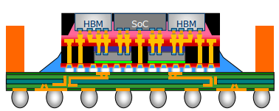


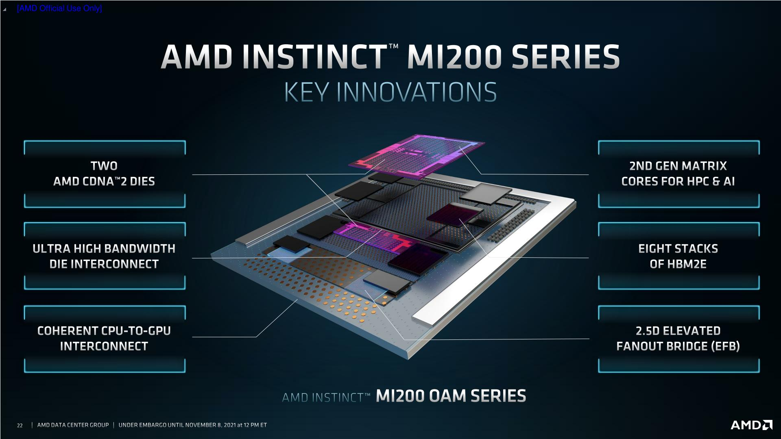

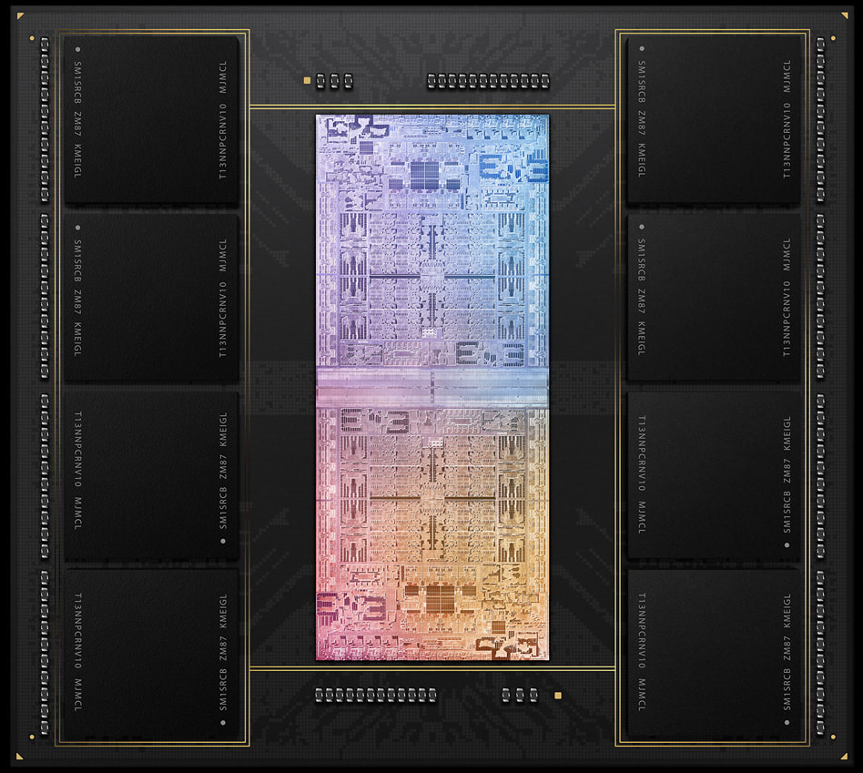




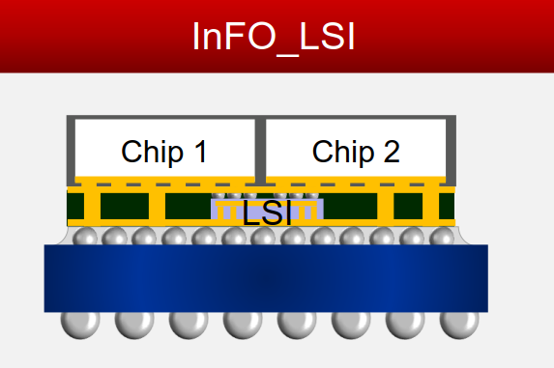
Relocate µB with RDL
Package Technology |  | 2.3D w/ Si bridge
Ref.: |  | ODI in Foveros Omni (‘25)
OSAT |  | FOCoS-B
 |  | FO-EB 45µm µB
 |  | S-Connect
SiFo |  | InFO-L (CF) 25µm µB
 |  | CoWoS-L
 |  | Si embedded RDL interposer
GPU
GPU
GPU
GPU
36µm µB FOV + 16nm SoC + ADM
TSMC 6nm SoC
Substrate
Substrate
Q4‘21
Q1‘22
Engineering
Qualified
Production
Notes:
Along 2.3D, 2.5D and 3D platforms, here is OSAT and SiFO landscape. In each tech. session, there is production experience in either OSAT or SiFO, which shows in green background, indicating the readiness and capability is available for the tech. we’re talking here.
And, If we jump to competitor analysis to see how they use these tech., and we can notice that especially for this year AMD announced 3 new products using adv. tech., one is well-known SoIC, another one is FO-EB, both tech. are ready outside in external world, but ongoing development inside intel. The key msg I would like you to takeaway is our competitor and OSAT/SiFO are moving fast.

Slide 7
Randy’s Concerns and Considerations
Focusing on 2023 misses market windows due to BMG-G10-X3 in execution. In order for this slide set to have value it needs to be focused on 2024 and 2025.
  should the intercept be BMG-G12, and CLS-G10?
Should consider ADM Gen 2 replacement
  N5/N4 scaled SRAM cell by 22/25% correspondingly. CLS-G10 with N5 die sizes comes in @ 10mm², 2.7%, smaller than LRP. Patterning cost increases by ~10% (+7 193i-equivalent steps cost);
Asymmetric assumption in ADM and SRAM sizes. If someone external can make SRAM smaller than top die, then why can’t Intel do that with ADM? That may be a Intel packaging technology issue… doesn’t mean it is a ADM issue
  If this is an Intel packaging issue, build ADM die smaller, use OSAT; you can reduce cost nevertheless.
Need to consider cost of adding MAXMIM to N6 SRAM. ADM has MAXMIM, which saves cost of adding MAXMIM to N3.
  ~$12K/wafer is full featured N6, including MiM. DTC is also offered as exhibited in Graphcore’s public disclosure. N6 platform supports several cost reduction flows by removing interconnect from 13ML to 9ML, optional DWN and etc. Final cost should be part of pricing negotiation after technical decision on technology feature.

Slide 8
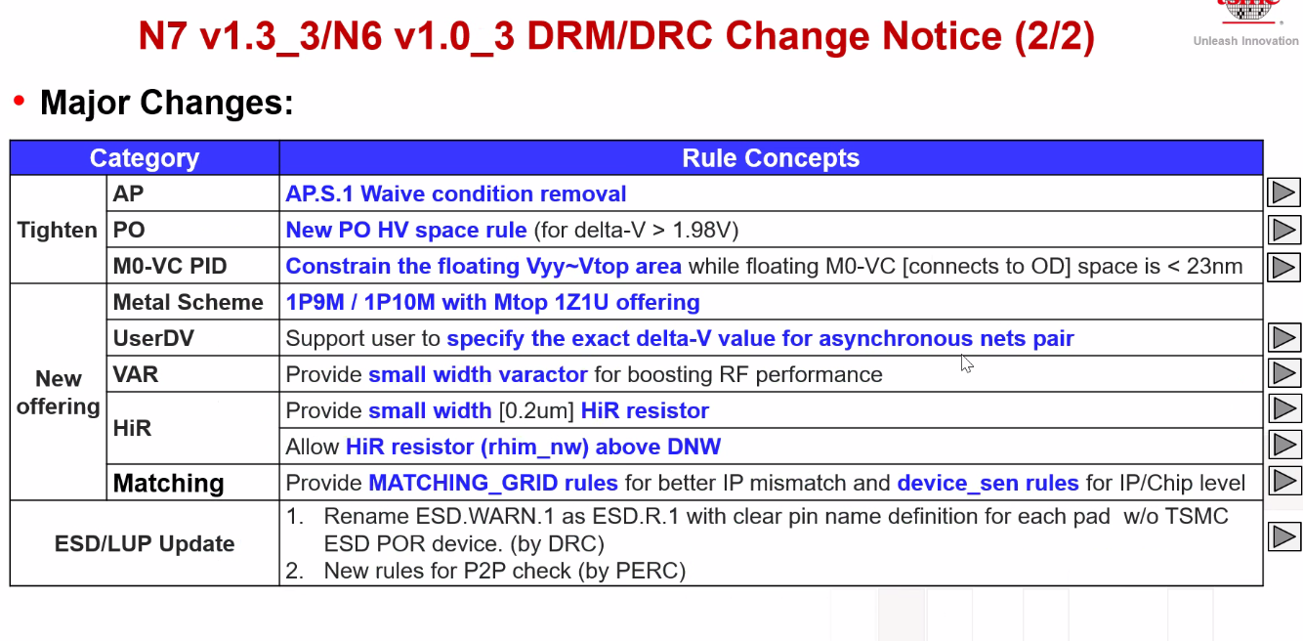
TSMC’s N6 new offering – 1P9M and 1P10M effective March 4, 2022
Intel LRP using 1P13M and 1P15M (full featured, $12K/wafer)
1P9M eliminates 6 pairs of metal/via layers (1·2x , 3·3x, 2·6x). 1x L/S = 20nm/20nm

Slide 9
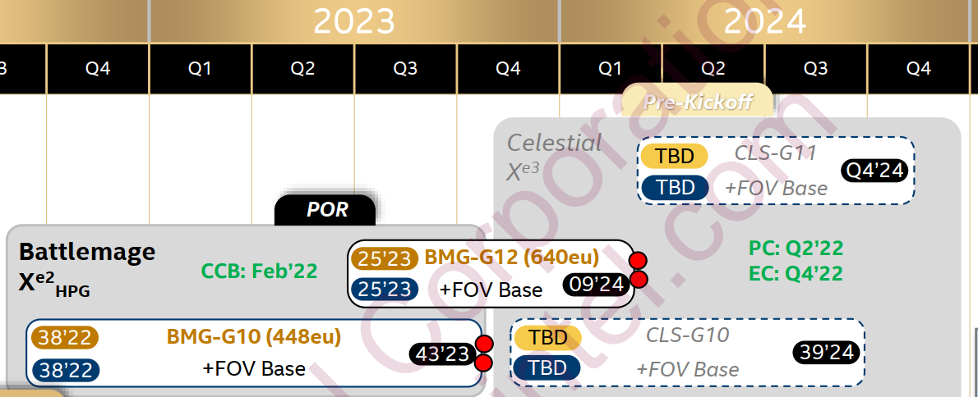
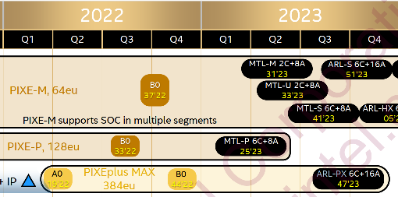
POR Schedule

Slide 10
High Capacity Cache (HCC) Pathfinding (WIP)
xPU
Memory
SoC
Mold
embedded
Subst
Capability:
  All chiplet interfaces can be hybrid bonded (bumpless) with combination of CoW and WoW from Foundry. “Cube” would likely be assembled using WoW, then diced before attachment.
  DFT (sort, class, bist, redundancy, repair, RBER, ECC and etc.), and media management need to be explored along with leveraging suppliers’ experiences to mitigate yield escape.
Cost:
Capacity: Substantial capacity of advanced mainstream technology such as N7/N6 is expected.
Next Step
Finalized high level capability and cost
3C alignment for product roadmap fungibility alignment
Technology | Availability | [MB/mm²] | [(TB/s)/GB] | Norm. $/wfr | Norm. GB/$ | Norm. BW/$ | References
TSMC N7 | 2021 | 1.77 | 500 | 0.7 | 0.11 | 437 | Cerebras CS2 Analysis, WW03/22, DeBonis
P1222.7 | 2024 | 6.7 | 13 | 1.2 | 0.25 | 25 | TCC Benchmark, Jan/25/22, Hamzaoglu
HBM3 | 2022 | 22.6 | 0.128 | 1 | 1 | 1 | SKH 1z 16Gb HBM3, Feb/7/22, Bains

