Slide 1
Cost Estimate
Packaging Density
 | Logic Gate Density [MG/mm²] | Memory Technology | Array density [MB/mm²]
P1222.6 | 5.41 | ADM Gen1 | 3.7
P1222.7 | 5.41 | ADM Gen2 | 7.4
TSMC N6 | 24.06 | 6T HD SRAM | 2.1
 |  |  | FOV + ADM Die Size |  |  |  |  | N6 Die Size estimate
Componet | eu | Capacity MB | ADM Technology | Die size [mm²] | ADM area [mm²] | Logic/Peri [mm²] |  | Die Size [mm²] | SRAM Area [mm²] | Logic/Peri [mm²]
BMG G10 (X3) | 448 | 512 | Gen 1 | 366 | 231 | 135 |  | 274 | 244 | 30
BMG G12 (x4) | 640 | 640 | Gen 1 | 443 | 279 | 164 |  | 342 | 305 | 37
CLS G11 | ? | 870 | Gen 2 | 366 | 231 | 135 |  | 445 | 414 | 30
N6 die size estimated (Memory + Logic)
  Memory footprint: Memory capacity / array density
  Logic footprint: Scaled based on gate density ratio
  Die size mismatch to be managed by low cost RDL solutions
N6 Yield Model
  13ML full feature vs. 9ML+ defeatured (DNW/MiM)
  Consider Logic vs. SRAM footprint ⬅ to be revised
  D₀ reaches plateau at mid 2023
P1222.6 Yield Model 75% with repair and binning
Wafer Pricing @ Q3’23
  N6 ’23 full featured price: ~$12K
  N6 SRAM optimized (defeatured): $8K (drive-to target)
  P1222.6: $8K based on LRP golden doc @ Q3’21
$12K Full featured N6 wafer pricing vs. $8K P1222.6 wafer cost
Component | Technology | Die Size [mm²] | DPW | Yield | GDPW | Die Cost
BMG G10 X3 | P1222.61 | 366 | 150 | 78.0% | 118 | $67.80
 | N6 | 274 | 207 | 50.9% | 105 | $114.29
BMG G12 X4 | P1222.61 | 443 | 121 | 75.0% | 90 | $88.89
 | N6 | 342 | 162 | 46.7% | 76 | $157.89
CLS G11 | P1222.7 | 366 | 150
 | N6 | 445 | 121 | 40.8% | 50 | $240.00
$8K defeatured N6 wafer pricing vs. $8K P1222.6 wafer cost
Component | Technology | Die Size [mm²] | DPW | Yield | GDPW | Die Cost
BMG G10 X3 | P1222.61 | 366 | 150 | 78.0% | 118 | $67.80
 | N6 | 274 | 207 | 57.2% | 118 | $67.80
BMG G12 X4 | P1222.61 | 443 | 121 | 75.0% | 90 | $88.89
 | N6 | 342 | 162 | 53.3% | 87 | $91.95
CLS G11 | P1222.7 | 366 | 150
 | N6 | 445 | 121 | 47.6% | 58 | $137.93
Yield challenge: P1222.6 higher mask count bigger die yet higher yield than N6, attributed to repair and binning in ADM. Is ADM’s DFM/DFT learning portable to SRAM?

Slide 2
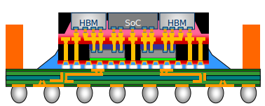


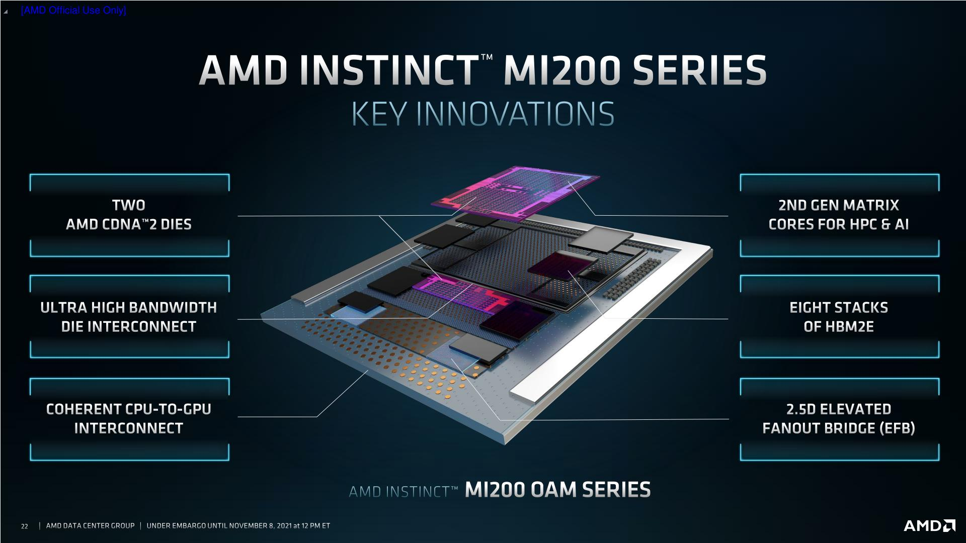

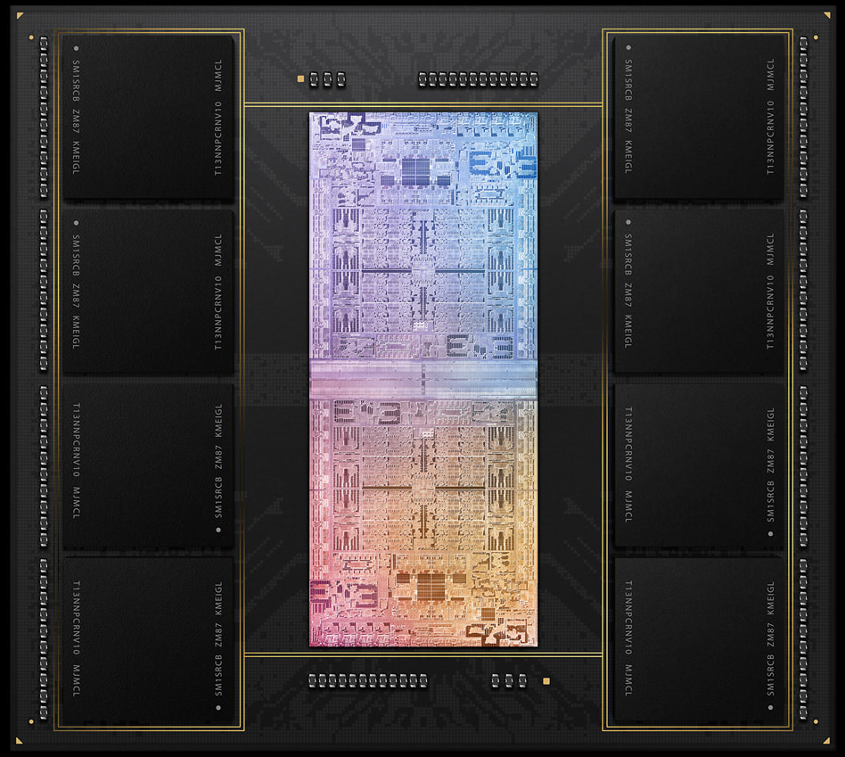




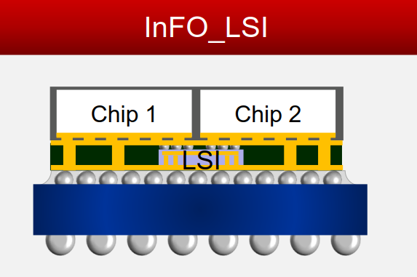
Relocate µB with RDL
Package Technology |  | 2.3D w/ Si bridge
Ref.: |  | ODI in Foveros Omni (‘25)
OSAT |  | FOCoS-B
 |  | FO-EB
 |  | S-Connect
SiFo |  | InFO-L (CF)
 |  | CoWoS-L
 |  | Si embedded RDL interposer
GPU
GPU
GPU
GPU
36µm µB FOV + 16nm SoC + ADM
TSMC 6µm SoC
Substrate
Substrate
Q4‘21 MI200
Q1‘22 M1 ultra
Engineering
Qualified
Production
Sources: IROC, Teardowns, System Plus, Yole, TechSearch,
Forecast Group, supplier talks, conferences
Notes:
Along 2.3D, 2.5D and 3D platforms, here is OSAT and SiFO landscape. In each tech. session, there is production experience in either OSAT or SiFO, which shows in green background, indicating the readiness and capability is available for the tech. we’re talking here.
And, If we jump to competitor analysis to see how they use these tech., and we can notice that especially for this year AMD announced 3 new products using adv. tech., one is well-known SoIC, another one is FO-EB, both tech. are ready outside in external world, but ongoing development inside intel. The key msg I would like you to takeaway is our competitor and OSAT/SiFO are moving fast.

