Slide 1
Discrete Graphic Base Die Dual Drive Proposition
DerChang Kau, WW14.1’22
with competitive analytics by
Margaret H., Markus A., Mike G., CherSian C., Max W., Jason Z., Andy W. and Kala S.
Special thanks to Randy Osborne for his feedback and critiques.
Executive Summary
Assess external technologies to mitigate ADM capacity constraint
TSMC N6 the best-known candidate for ADM Gen 1/2 dual drive
HBM3 displacement is cost- and capability-prohibitive
Propose a 4-week TF to make a go/nogo decision

Slide 2
P1222.61 Gen 1 Adamantine Capacity Mitigation
GPU
GPU
GPU
GPU
36µm µB FOV + 16nm SoC + ADM
TSMC 6nm SoC
Substrate
Substrate
TSMC N6
Capability:
  Mature SoC: “7nm” cell library and high-density SRAM IP
  Proven 3DIC integration: low-cost BE-3D with 25µm micro-bump or high-performance FE-3D with 6µm Hybrid-bond
  Solid endorsement in competitive landscape (Apple A11, Nvidia A100, Cerabras CS-2, AMD Ryzen/V-cache, Graphcore MK1-IPU)
Capacity: Intel secured substantial capacity of the mainstream SoC technology
Cost: Cost-effective high-density SRAM IP to replace ADM eDRAM
> 5X advantage |  | > 5X disadvantage
Technology | Availability | Cell Size | $/wafer | Energy/bit | Density | Iso Cap BW | Iso Power BW | Bit Cost | BW Cost
Adm Gen 1 | 2023 | 1
N6 9ML HD | 2022 | 1.88 | 0.60 | 0.13 | 0.47 | 38 | 8 | 1 .27 | .03
HBM3 (1z) | 2022 | 0.14 | 0.40 | 5.63 | 6.28 | 0.01 | 0.18 | 0.06 | 6.14
Data exhibited in the table are nominalized to ADM Gen 1 @’23 capability and cost
Wafer Pricing: N6 1P9M from ‘23~’25
P1222.61 wafer cost in ’23~’25 is based on LRP golden doc @ Q1/22
HBM3 based on MIO intelligence

Slide 3
Cost Estimate for Discrete Graphic Base Dual Drive
N6 vs. ADM (per Q1’22 LRP)
Component | Technology | Die Size [mm²] | Wafer Cost | Yield | Die Cost
BMG G10 X3 512MB, Q3’23 | P1222.61 | 366 | ~$16.6K | 77.3% | $143
 | N6 | 274 | ~$10.5K | 82.5% | $ 62
BMG G12 X4 640MB, Q3’23 | P1222.61 | 443 | ~$16.6K | 71.9% | $191
 | N6 | 342 | ~$10.5K | 77.7% | $ 83
CLS G10 870MB, Q3’24 | P1222.7 | 366 | ~$16.9K¶ | 77.3% | $145
 | N6 | 445 | ~$10.5K | 71.9% | $117
¶: Need LRP; estimated based on P1222.61 in 2024 and 2nd deck process adder
Smaller N6 die size than P1222.61 due to effective array and high gate density
  Memory footprint: [Memory capacity] ÷ [array density]
  Logic footprint: Scaled based on gate density ratio
  Die size mismatch can be managed by low cost RDL solutions
  (Intel ODI readiness is Q2’25)
N6 yield is comparable to or slightly better than P1222.61
  D₀ reaches plateau at mid 2023
  D₀ models: 9ML
  Yield calculation: Logic vs. SRAM footprint used; down-bin @50% area recoverable assumed
Packaging Density
 | Logic Gate Density [MG/mm²] | Memory Technology | Array density [MB/mm²]
P1222.61/.7 | 5.41 | ADM Gen1/2 | 3.6/6.7
TSMC N6 | 24.06 | 6T HD SRAM | 1.7~2.1*
*2MB/mm² is used for die size assessment

Slide 4
Summary and Proposal
TSMC N6 SoC is the best-known candidate replacement for ADM in 3Cs
  Capability: Mature “7nm” cell library and high-density SRAM IP (PDK Rev 1.0.3)
  Cost: Mainstream process yields smaller die size due to superior logic gate density (> 4x)
  Capacity: Intel secured substantial capacity
  Seeking also Samsung 5LPP as a strategic maneuver for ADM dual-drive.
Low cost 3DIC options available from multiple packaging suppliers
  Die size mismatch can be managed by low cost RDL solutions
  Proven 3DIC in competitive landscape
Propose a 4-week TF to develop a dual drive go/nogo decision
  Dual-drive feasibility and strategies for discrete graphics memory chiplets
  Analyze risks and develop a risk management plan for execution
  Cross FTE technologists, Graphic architects and product owners
Team GEMS is actively exploring High Capacity SRAM Cube for
Companion Chiplet Solutions for 2024 and beyond

Slide 5
Supporting Materials

Slide 6
Cost Analysis
PRQ~PRQ+2years Cost
Component | Technology | Die Size [mm²] | DPW | Time | $/wafer | Yield | GDPW | Die Cost
BMG G10 X3 | P1222.61 | 366 | 150 | Q2'23 | $16,628 | 77.3% | 116 | $143.34
 | P1222.61 | 366 | 150 | Q2'24 | $13,543 | 79.3% | 119 | $113.81
 | P1222.61 | 366 | 150 | Q2'25 | $6,288 | 79.3% | 119 | $52.84
 | N6 | 274 | 207 | Q2'23 | $10,526 | 82.5% | 170 | $61.92
 | N6 | 274 | 207 | Q2'24 | $10,526 | 82.5% | 170 | $61.92
 | N6 | 274 | 207 | Q2'25 | $10,526 | 82.5% | 170 | $61.92
BMG G12 X4 | P1222.61 | 443 | 121 | Q2'23 | $16,628 | 71.9% | 87 | $191.13
 | P1222.61 | 443 | 121 | Q2'24 | $13,543 | 74.4% | 90 | $150.48
 | P1222.61 | 443 | 121 | Q2'25 | $6,288 | 74.4% | 90 | $69.87
 | N6 | 342 | 163 | Q2'23 | $10,526 | 77.7% | 127 | $82.88
 | N6 | 342 | 163 | Q2'24 | $10,526 | 77.7% | 127 | $82.88
 | N6 | 342 | 163 | Q2'25 | $10,526 | 77.7% | 127 | $82.88
CLS G11 | P1222.71 | 366 | 150 | Q2'24 | $16,929 | 77.3% | 116 | $145.94
 | P1222.71 | 366 | 150 | Q2'25 | $7,860 | 79.3% | 119 | $66.05
 | P1222.71 | 366 | 150 | Q2'26 | $7,119 | 79.3% | 119 | $59.82
 | N6 | 445 | 125 | Q2'24 | $10,526 | 71.9% | 90 | $116.96
 | N6 | 445 | 125 | Q2'25 | $10,526 | 71.9% | 90 | $116.96
 | N6 | 445 | 125 | Q2'26 | $10,526 | 71.9% | 90 | $116.96
TSMC TSV process not included

Slide 7
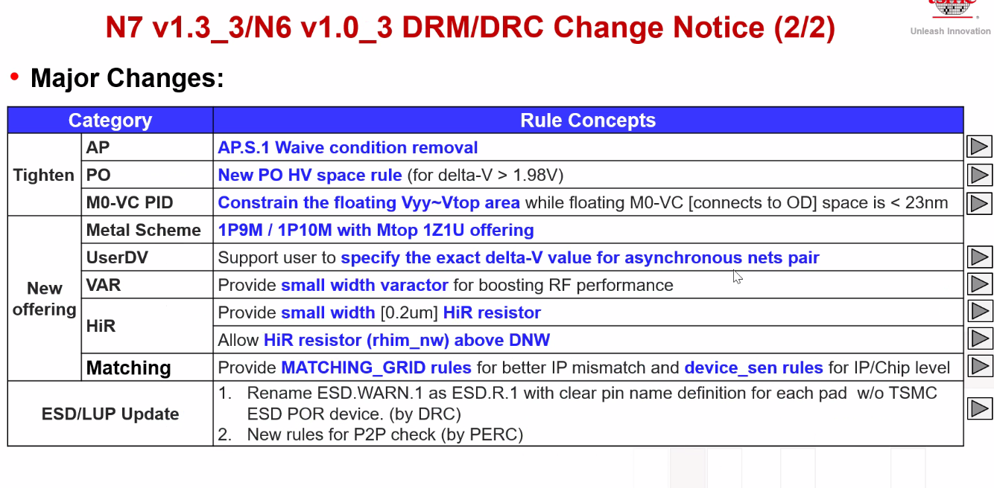
TSMC’s N6 new offering – 1P9M and 1P10M effective March 4, 2022
Intel LRP using 1P13M and 1P15M (full featured, $12K/wafer)
1P9M eliminates 6 pairs of metal/via layers (1·2x , 3·3x, 2·6x). 1x L/S = 20nm/20nm

Slide 8
6T FinFET SRAM (High Density Cell)

Slide 9
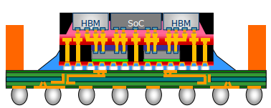


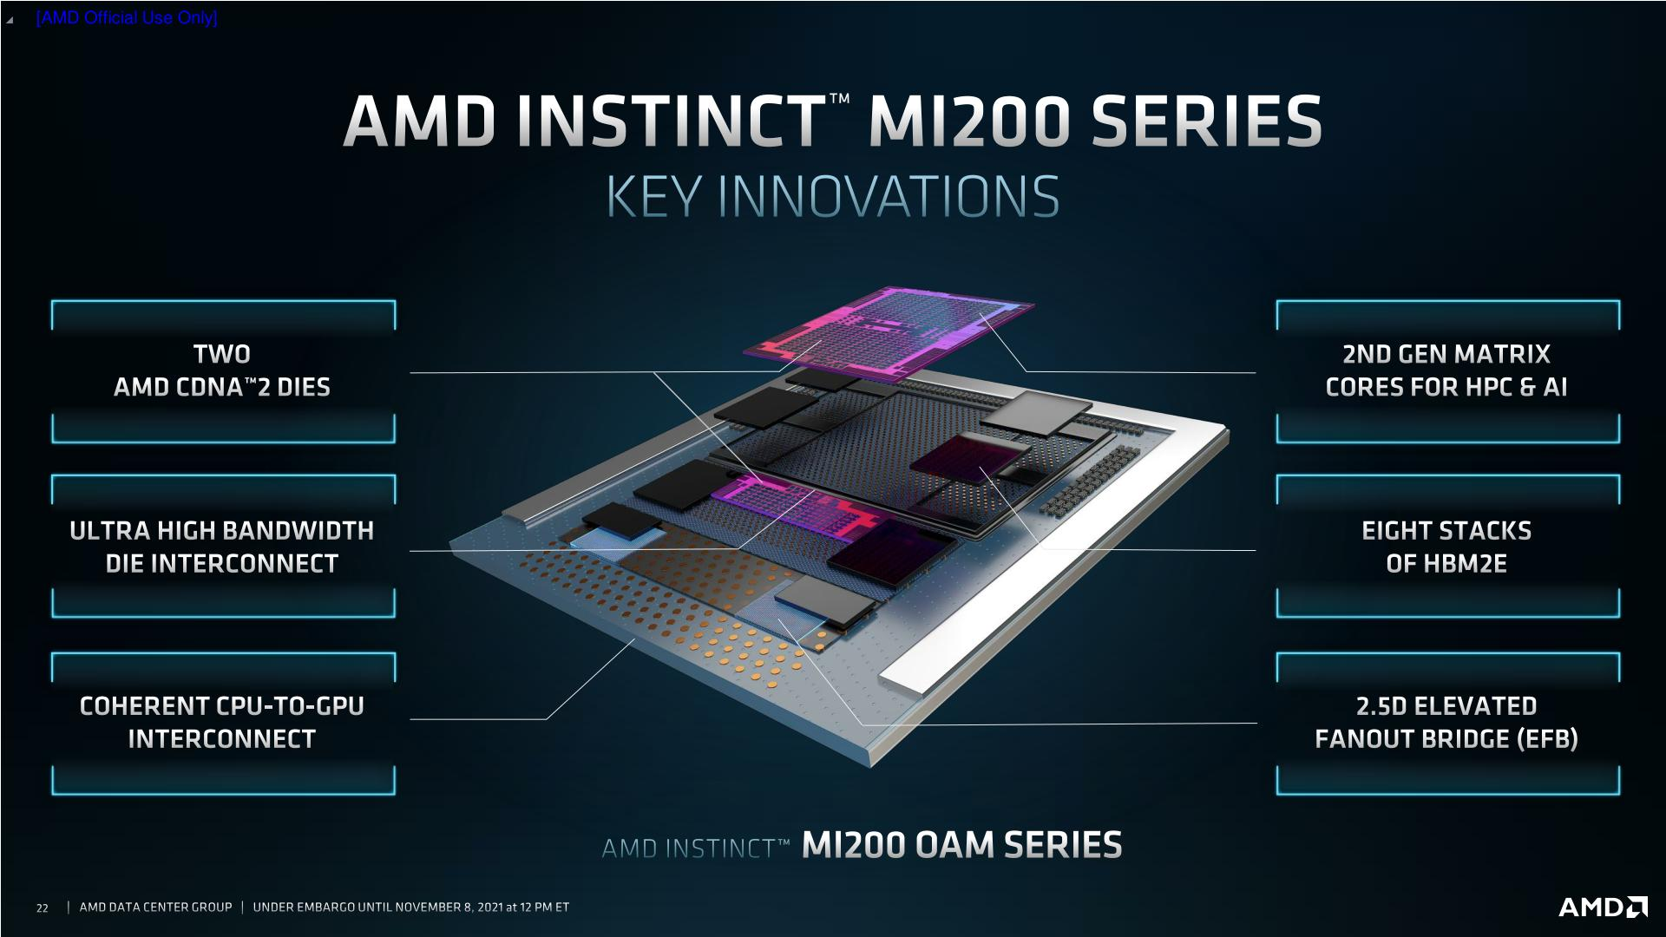

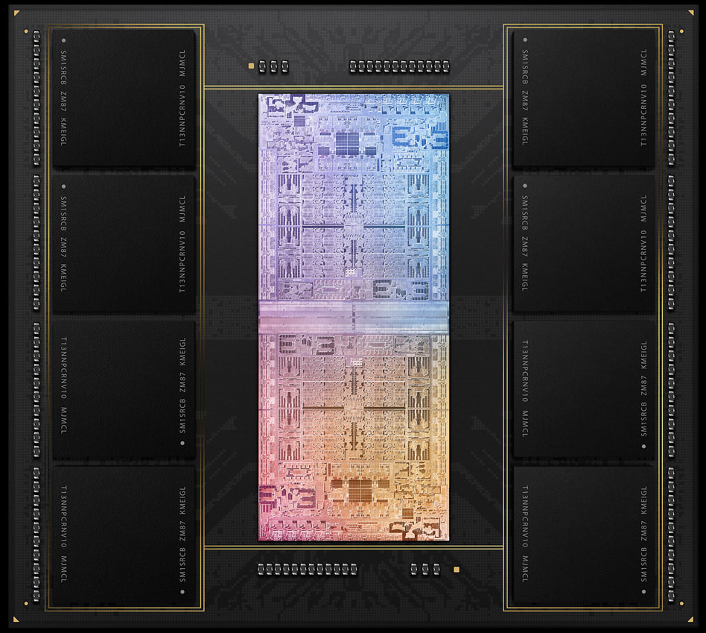




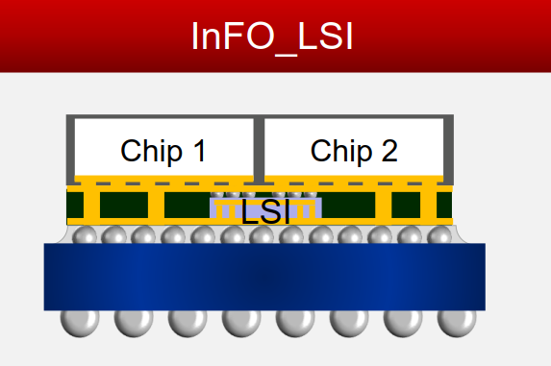
Relocate µB with RDL
Package Technology |  | 2.3D w/ Si bridge
Ref.: |  | ODI in Foveros Omni (‘25)
OSAT |  | FOCoS-B
 |  | FO-EB 45µm µB
 |  | S-Connect
SiFo |  | InFO-L (CF) 25µm µB
 |  | CoWoS-L
 |  | Si embedded RDL interposer
GPU
GPU
GPU
GPU
36µm µB FOV + 16nm SoC + ADM
TSMC 6nm SoC
Substrate
Substrate
Q4‘21
Q1‘22
Engineering
Qualified
Production
Notes:
Along 2.3D, 2.5D and 3D platforms, here is OSAT and SiFO landscape. In each tech. session, there is production experience in either OSAT or SiFO, which shows in green background, indicating the readiness and capability is available for the tech. we’re talking here.
And, If we jump to competitor analysis to see how they use these tech., and we can notice that especially for this year AMD announced 3 new products using adv. tech., one is well-known SoIC, another one is FO-EB, both tech. are ready outside in external world, but ongoing development inside intel. The key msg I would like you to takeaway is our competitor and OSAT/SiFO are moving fast.

Slide 10
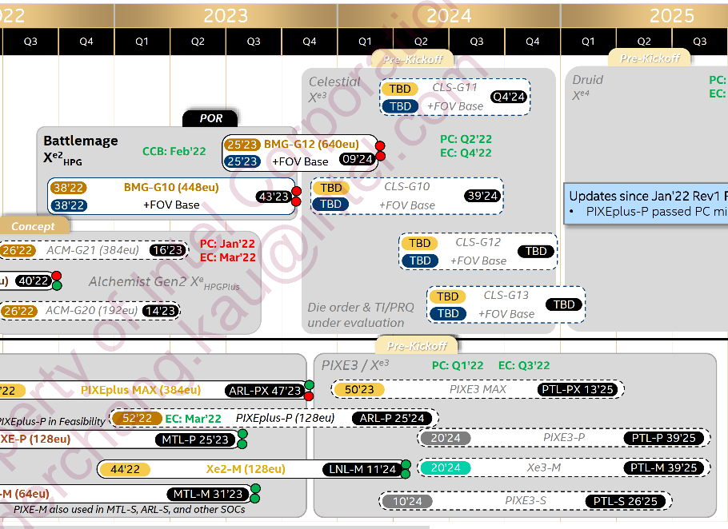
Feb’22 IROC

Slide 11
High Capacity Cache (HCC) Pathfinding (WIP)
xPU
Memory
SoC
Mold
embedded
Subst
Capability:
  All chiplet interfaces can be hybrid bonded (bumpless) with combination of CoW and WoW from Foundry. “Cube” would likely be assembled using WoW, then diced before attachment.
  DFT (sort, class, bist, redundancy, repair, RBER, ECC and etc.), and media management need to be explored along with leveraging suppliers’ experiences to mitigate yield escape.
Cost:
Capacity: Substantial capacity of advanced mainstream technology such as N7/N6 is expected.
Next Step
Finalized high level capability and cost
3C alignment for product roadmap fungibility alignment
Ideation Stage Only
Technology | Availability | [MB/mm²] | [(TB/s)/GB] | Norm. $/wfr | Norm. GB/$ | Norm. BW/$ | References
TSMC N7 | 2021 | 1.77 | 500 | 0.7 | 0.11 | 437 | Cerebras CS2 Analysis, WW03/22, DeBonis
P1222.7 | 2024 | 6.7 | 13 | 1.2 | 0.25 | 25 | TCC Benchmark, Jan/25/22, Hamzaoglu
HBM3 | 2022 | 22.6 | 0.128 | 1 | 1 | 1 | SKH 1z 16Gb HBM3, Feb/7/22, Bains

Slide 12
Cost Estimate for Battlemage Base Replacement
Packaging Density
 | Logic Gate Density [MG/mm²] | Memory Technology | Array density [MB/mm²]
P1222.61 | 5.41 | ADM Gen1 | 3.3
P1222.7 | 5.41 | ADM Gen2 | 6.7
TSMC N6 | 24.06 | 6T HD SRAM | 2.1
 |  |  | P1222.61 Die Size |  |  |  |  | N6 Die Size estimate
Componet | eu | Capacity MB | ADM Technology | Die size [mm²] | ADM area [mm²] | Logic/Peri [mm²] |  | Die Size [mm²] | SRAM Area [mm²] | Logic/Peri [mm²]
BMG G10 (X3) | 448 | 512 | Gen 1 | 366 | 231 | 135 |  | 274 | 244 | 30
BMG G12 (x4) | 640 | 640 | Gen 1 | 443 | 279 | 164 |  | 342 | 305 | 37
CLS G11 | ? | 870 | Gen 2 | 366 | 231 | 135 |  | 445 | 414 | 30
N6 die size estimated (Memory + Logic)
  Memory footprint: [Memory capacity] ÷ [array density]
  Logic footprint: Scaled based on gate density ratio
  Die size mismatch to be managed by low cost RDL solutions
  (Intel ODI readiness is Q2’25)
P1222.61 Yield Model 75% with repair and binning
N6 Yield Model
  D₀ reaches plateau at mid 2023
  D₀ models: 13ML vs. 9ML
  Yield calculation: Logic vs. SRAM footprint used;
  down-bin @50% area recoverable assumed
Wafer Pricing @ Q3’23
  N6 1P13M ’23 price: ~$12K
  N6 1P9M: $10K (drive-to target)
  P1222.61: $8K based on LRP golden doc @ Q3’21
ARL-PX die size: 356mm², 348eu, similar to BMG-X3
Cost Model Illustration
Quantification Obsolete
$12K N6 1P13M vs. $8K P1222.61
Component | Technology | Die Size [mm²] | DPW | Yield | GDPW | Die Cost
BMG G10 X3 | P1222.61 | 366 | 150 | 78.0% | 118 | $67.80
 | N6 | 274 | 207 | 79.7% | 164 | $73.17
BMG G12 X4 | P1222.61 | 443 | 121 | 75.0% | 90 | $88.89
 | N6 | 342 | 163 | 74.4% | 122 | $98.36
CLS G11 | P1222.7 | 366 | 150
 | N6 | 445 | 125 | 69.7% | 88 | $136.36
$10K N6 1P9M vs. $8K P1222.61
Component | Technology | Die Size [mm²] | DPW | Yield | GDPW | Die Cost
BMG G10 X3 | P1222.61 | 366 | 150 | 78.0% | 118 | $67.80
 | N6 | 274 | 207 | 82.5% | 170 | $58.82
BMG G12 X4 | P1222.61 | 443 | 121 | 75.0% | 90 | $88.89
 | N6 | 342 | 163 | 77.7% | 127 | $78.74
CLS G11 | P1222.7 | 366 | 150
 | N6 | 445 | 125 | 71.9% | 90 | $111.11

