Slide 1
XPS Analysis of SD
Subtitle
Speaker name
and title

Slide 2
Bullet Slide Example
Bullet points are sentence case
Bullet points are size 24 Segoe UI
  Sub-bullets are size 20
    Level 3 sub-bullets are size 18

Slide 3
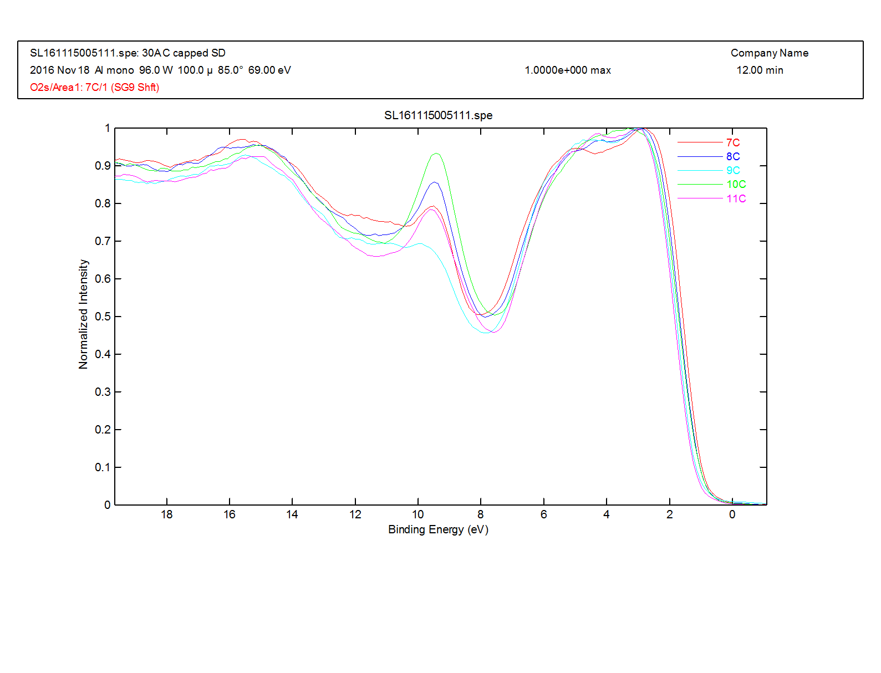
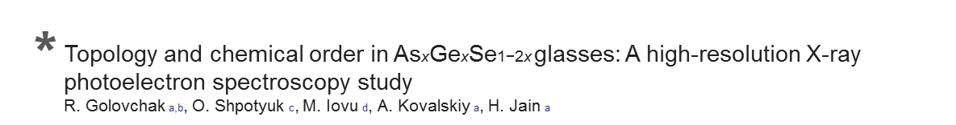
XPS Valence band spectra
Wafer ID | Film | Anneal
7353-07 | ~As2Se3 | No
7353-08 | 9% Ge, SiSeAsGe | No
7353-09 | 9% Ge, SiSeAsGe | Yes
7353-10 | 18% Ge, SiSeAsGe | No
7353-11 | 18% Ge, SiSeAsGe | Yes
*
The peak at the top of the valence band around ~2 eV corresponds to the XPS signal from lone pair electrons of Se atoms [28].
Bonding states related to Se 4p electrons within Se–Ge, Se–As and Se–Se covalent bonds give rise to the wide band centered at ~5 eV [23,24,28].
The Ge 4p and As 4p electronic states of the atoms participating in Ge–Ge, Ge–As and As–As bonding should contribute to the peak around ~3 eV [24,29], but it could be partially overlapped also with stronger Se 4p band shifted towards lower binding energy because of decreased number of Se–Se bonds as per specific composition.
The next broad features in the 6–16 eV range correspond to the signal from 4s electrons of As, Ge and Se [23,24,28,29].

Slide 4
3d Core level spectra
Se3d
As3d
Wafer ID | Film | Anneal
7353-07 | ~As2Se3 | No
7353-08 | 9% Ge, SiSeAsGe | No
7353-09 | 9% Ge, SiSeAsGe | Yes
7353-10 | 18% Ge, SiSeAsGe | No
7353-11 | 18% Ge, SiSeAsGe | Yes
Ge3d
Shift to lower BE for the higher Ge film due to “wrong” bond formation (As, Ge)-As-(Ge, As) *
*
Topology and chemical order in AsxGexSe1−2x glasses: A high-resolution X-ray
photoelectron spectroscopy study
R. Golovchak a,b, O. Shpotyuk c, M. Iovu d, A. Kovalskiy a, H. Jain a
Shift to higher BE post anneal; oxidation?
Intensity differences reflect composition

Slide 5
2p3 core level spectra
As2p3
Ge2p3

