Slide 1
Campaign K preliminary results
See the notes on the left margin of many of these slides for instructions on their use.
3297243 lot

Slide 2
Split table/thermal stability/scorecard
NOTES:
Lot healthy is good very poor wf to wf variability and spread;
Spread seems more alloy related;
From TH stability only K004/6/8 satisfy the criteria, unfortunately these alloys are the one with very high spread;
Leakage with In % increasing seems not increase (no correlation between In amount and leakage value).

Slide 3
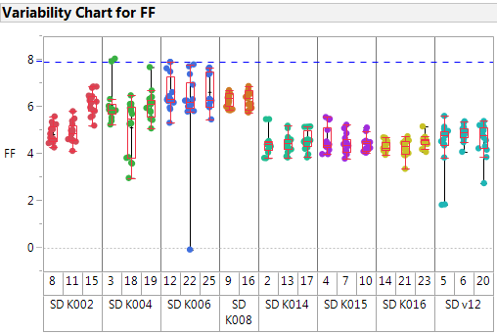
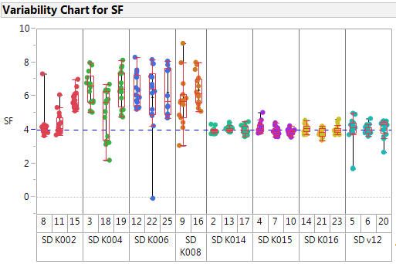
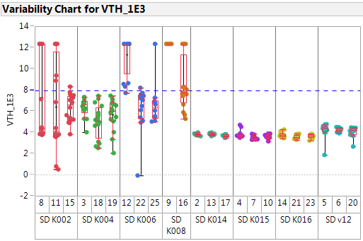
FF/SF/Vth cycled
Good lot;
variability seems to be alloy related more than wf to wf variability → not clear why: K004/6/8 have been retested to conform these data on a complementary map → Hp: Is variability ascribed to the too high Si?

Slide 4
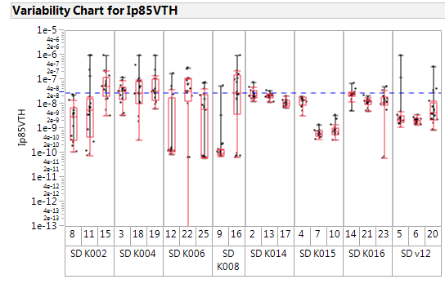
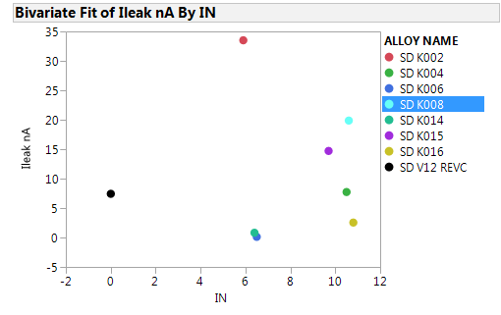
Leakage
Leakage is not increasing with In concentrations

Slide 5
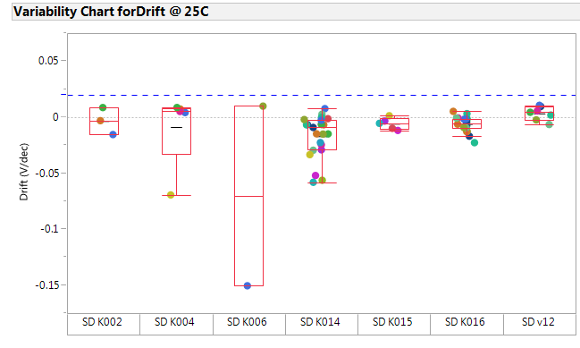
Short time drift
Up to 1 sec at RT, all alloys are stable for drift and no particular differences among alloys are detectable.
We will address the WLR drift char for K016 and v12 to enhance our data with this kind characterization.

Slide 6
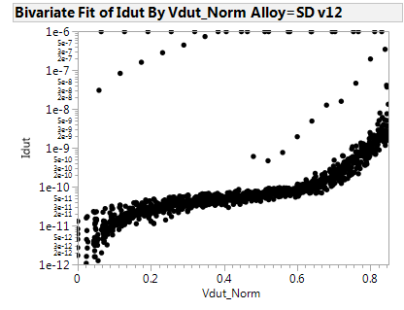
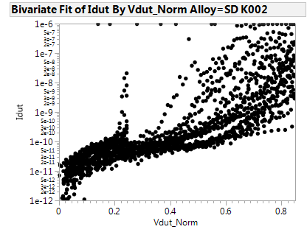
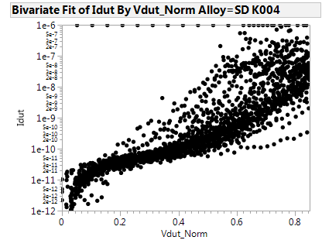
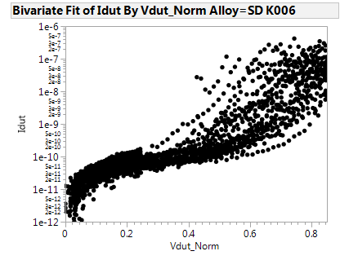
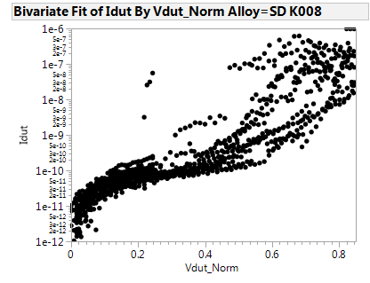
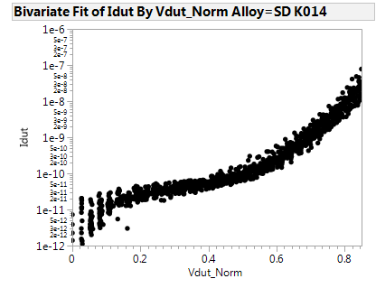
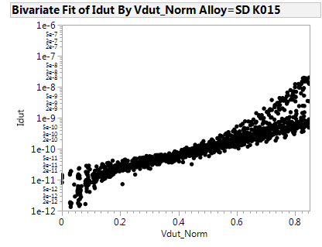
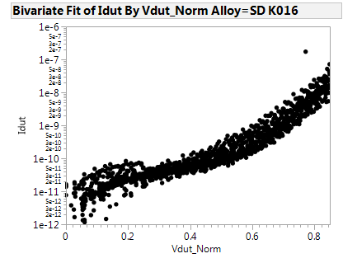
Subthtreshold IV
Thermally stable alloys present a very high spread. While pretty good variability is found for K014-K015 and K016 alloys having Si<7%, but they did not pass the thermal stability test.

Slide 7
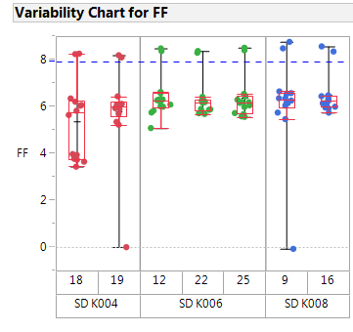
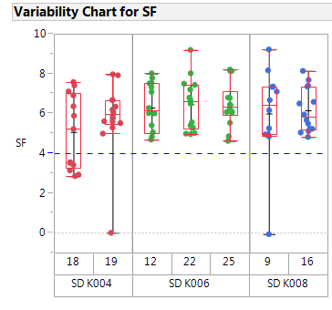
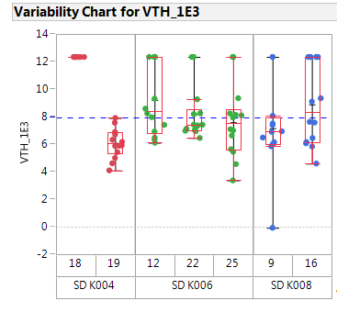
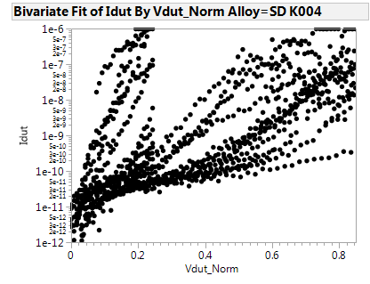
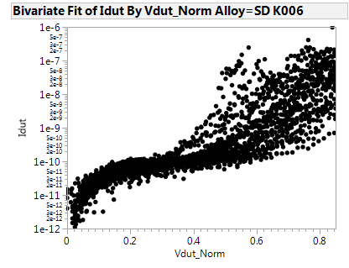
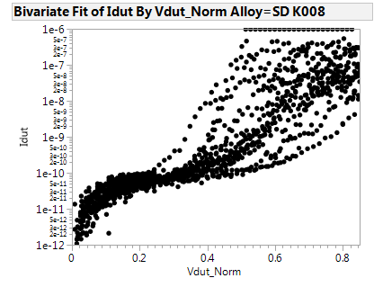
Retest data
After retest the spread is confirmed on K004/6/8 alloys.

Slide 8
Conclusions
Lot healthy is good very poor wf to wf variability and spread;
Variability, when rises-up, is ascribed to alloy goodness;
On the basis of the past experience we ascribe the bad shape of K002/4/6/8 to the presence of Si > 7% ➔ see recommendations
Alloy K014/15/16 that present controlled spread did not pass the thermal stability test
Recommendation and follow-up
In order to meet the thermal stability criterion avoiding to Si > 7% we suggest to change the target configuration:
As₂Se₃
As₂Se₃
Actual config
Proposed config
Indeed ~Si60Ge40 on wf
SiGe
In₂Se₃
Si_{3.5}Ge_{6.5}
In₂Se₃

Slide 9
Possible scheduling
L0/L1 check point to assess the possible L3 promotion of some compositions

Slide 10
Comments on thermal stability limit
This is the thermal stability picture of the lot 9742432.003 with low Ge skew that is going to probe:
Alloys | As-dep | 270C | 280C | 290C | 300C | 310C | 320C
v12
A36
Ge10 Si6
Ge9.5 Si6
Ge9.0 Si6
Today limit
We are now considering as thermal stability limit for new alloys that we are exploring: 290C yellow → these alloys, in fact, demonstrated good probe yield w/o issues
If the new lot 9742432.003 with low Ge skew would demonstrate good probe yield also for the alloys with the limit at 280C we propose to shift down at that level the thermal stability limit

Slide 11
Long time drift @85C

Slide 12
Long time drift (up to 100 sec) evaluation @85C
The drift curves @85C form 1msec to 100 sec has been measured on two alloys:
SDv12 as reference
K016 that was good in terms of variability and not far from the thermal stability goal

Slide 13
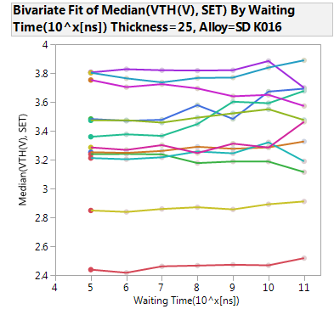
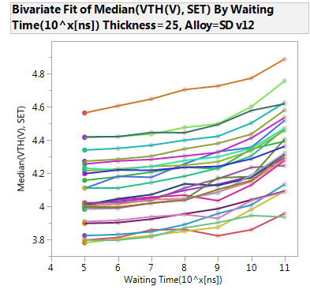
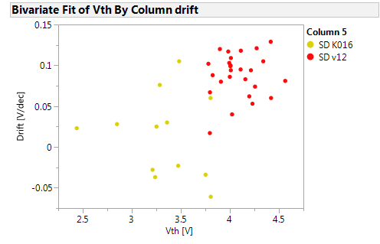
Long time drift (up to 100 sec) evaluation @85C
data and comments
10s to 100s Drift slope
CLV data @85C show the typical feature we also experience on S15: drift slope rises-up after ~100 msec
In-SiSAG is again confirmed to be very stable in terms of drift!
We will continue the characterization adding data after 3hrs and, possibly, (depending on the wfs availability) after 2days
V_{T}
1μs
0.1s
Log(t)

