Slide 1
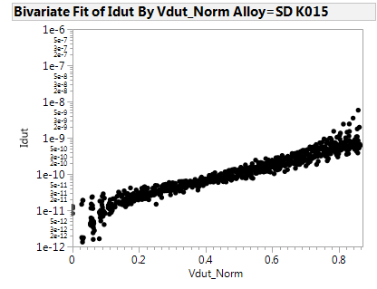
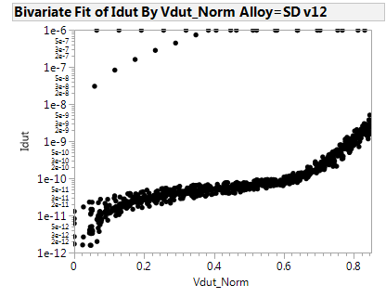
K-campaign preliminary IV curves
Due to tool down we have available the IV curves for only 4wfs: 2 SDv12 and 2 SD K015. The expectation is have the test completed for beginning next week.
From the IV the leakage is comparable for both alloys.
As: 25.3%
Se: 53.4%
Ge: 5.2%
In: 9.7%
Si: 6.3%

