Slide 1
SD Camp K* - InSiSeAsGe
Swapnil Lengade, Paolo Fantini, Enrico Varesi, Dan Gealy

Slide 2
Camp K* - InSiSeAsGe (InSiSAG)
Motivation
  The primary motivation for adding In to the SAG (Camp J*) was CLV data on Camp Kappa from Agrate which showed almost “0” forming, “0” drift behavior
    The downside was ~10x higher leakage compared to SiSAG
  Camp K* is an extension of Camp J* where we want to investigate In addition into SiSAG. The idea is to mitigate the higher leakage seen on In-SAG with the addition of Si to the film
Goal
  Achieve low drift, low forming, acceptable leakage SD that meets the PG1 DTS spec

Slide 3
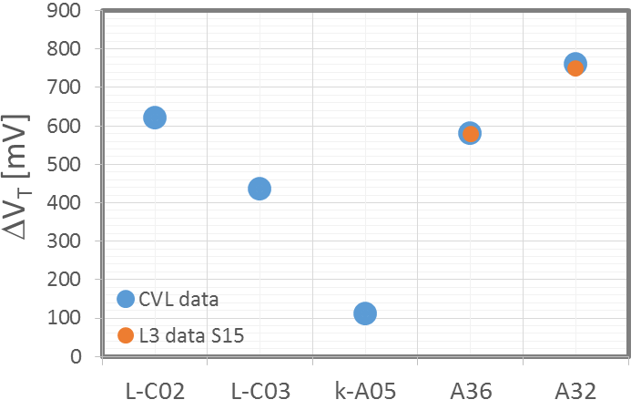
Looking for 200 mV memory spec: WLR-like CLV data
Courtesy: PFANTINI
Summary:
CLV and L3 data on A3* camp match
CLV data of lambda indicate the possibility to improve drift with F* (since we reduce Ge% in the ‘well tempered’ including Si)
The In-SAG composition shows the possibility to get the Memory spec
Se% | As% | Si% | Ge% | In%
53.0 | 21.8 | 1.1 | 13.0 | 11.1
Normalized IVs @ 1E3cyc
SD-κ A005 ScoreCard
Indium addition
Strengths of SD-κ: Forming ~0, lowest Drift, Low spread
Weakness of SD-κ: Leakage
> x10 higher leakage

Slide 4
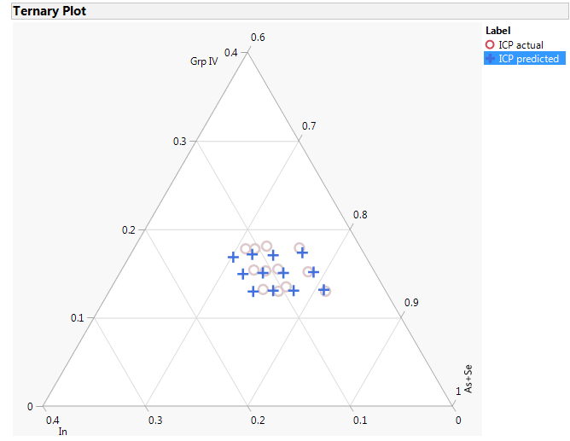
Camp K* - InSiSeAsGe
Methodology
  Experiment
    Grp IV skew from 13 to 18%
      Ge from 6.0 to 8.0%
      Si from 7.0 to 9.0%
    In skew from 6 to 13%
  L0 data collection
  L1 CLV assessment
  L1D based on CLV results
  L3 based on L1D results
Ge | As | Se | Si | In
6.0 | 34.7 | 52.1 | 7.2 | 0.0
6.0 | 27.2 | 53.6 | 7.2 | 6.0
6.0 | 24.8 | 53.1 | 7.1 | 9.0
6.0 | 23.1 | 52.8 | 7.1 | 11.0
6.0 | 21.6 | 52.4 | 7.0 | 13.0
7.0 | 26.5 | 52.3 | 8.2 | 6.0
7.0 | 24.1 | 51.8 | 8.1 | 9.0
7.0 | 22.5 | 51.4 | 8.1 | 11.0
7.0 | 20.8 | 51.2 | 8.0 | 13.0
8.0 | 25.7 | 50.9 | 9.4 | 6.0
7.9 | 23.4 | 50.5 | 9.2 | 9.0
8.0 | 21.7 | 50.1 | 9.2 | 11.0
7.9 | 20.1 | 50.0 | 9.0 | 13.0

Slide 5
Camp K* deposition specifics
Camp K* runs on MMUM4C0300 F1 3C chamber (stage @75C)
Targets
  Gun1: As₂Se_{3,} Rf
  Gun2: SiGe, Rf
  Gun3: In₂Se₃, Rf
Ran a 5-pt DOE to define a process space (As₂Se₃ gun1 fixed at 150W)
SiGe / In₂Se₃ | 30W | 90W | 150W
75W | x |  | x
125W |  | x
175W | x |  | x

Slide 6
Si_{0.5}Ge_{0.5} composition not exactly 50-50
The Rf power matrix on SiGe only and the 5pt DOE composition data indicate that…

Slide 7
Camp K* 13-way skew
 |  |  | Predicted based on 5pt DOE |  |  |  |  | Actual
As2Se3 Rf | SiGe Rf | In2Se3 Rf | Ge | As | Se | Si | In | Ge | As | Se | Si | In
150W | 115W | 0W | 6.0 | 34.7 | 52.1 | 7.2 | 0.0 | 7.1 | 32.4 | 52.4 | 8.2 | 0.0
150W | 108W | 34W | 6.0 | 27.2 | 53.6 | 7.2 | 6.0 | 5.9 | 27.9 | 53.2 | 7.1 | 5.9
150W | 127W | 68W | 6.0 | 24.8 | 53.1 | 7.1 | 9.0 | 6.1 | 24.6 | 52.3 | 7.4 | 9.5
150W | 133W | 90W | 6.0 | 23.1 | 52.8 | 7.1 | 11.0 | 6.0 | 24.1 | 52.3 | 7.0 | 10.5
150W | 140W | 110W | 6.0 | 21.6 | 52.4 | 7.0 | 13.0 | 6.2 | 22.6 | 52.3 | 7.0 | 11.9
150W | 124W | 35W | 7.0 | 26.5 | 52.3 | 8.2 | 6.0 | 6.9 | 26.8 | 51.5 | 8.3 | 6.5
150W | 147W | 69W | 7.0 | 24.1 | 51.8 | 8.1 | 9.0 | 7.2 | 24.2 | 51.1 | 8.3 | 9.3
150W | 153W | 92W | 7.0 | 22.5 | 51.4 | 8.1 | 11.0 | 7.2 | 23.4 | 50.8 | 8.1 | 10.6
150W | 160W | 110W | 7.0 | 20.8 | 51.2 | 8.0 | 13.0 | 7.2 | 22.2 | 50.6 | 8.2 | 11.7
150W | 145W | 33W | 8.0 | 25.7 | 50.9 | 9.4 | 6.0 | 8.4 | 26.0 | 50.0 | 9.5 | 6.0
150W | 167W | 70W | 7.9 | 23.4 | 50.5 | 9.2 | 9.0 | 8.4 | 23.3 | 49.6 | 9.7 | 9.1
150W | 175W | 92W | 8.0 | 21.7 | 50.1 | 9.2 | 11.0 | 8.4 | 22.5 | 49.3 | 9.4 | 10.4
150W | 180W | 110W | 7.9 | 20.1 | 50.0 | 9.0 | 13.0 | 8.4 | 21.5 | 49.4 | 9.4 | 11.3

Slide 8
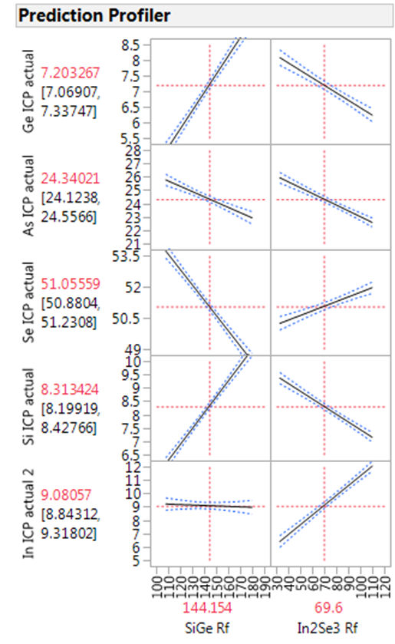
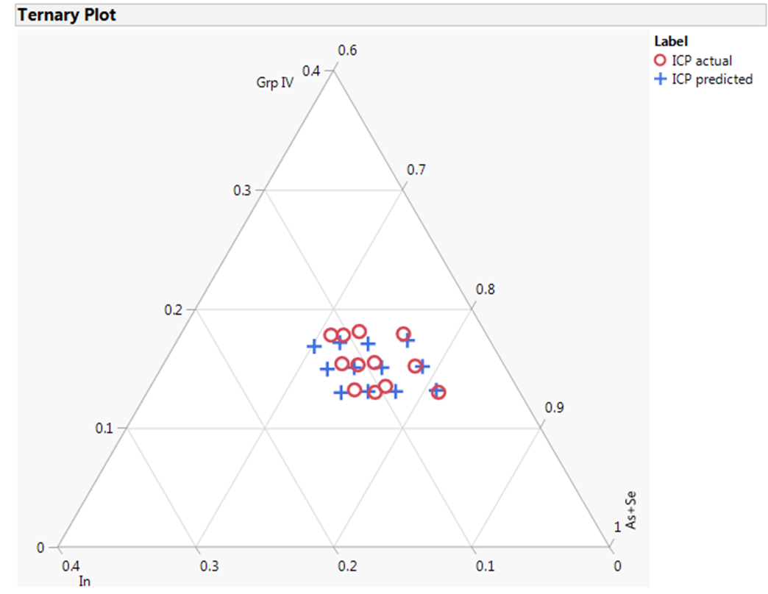
Camp K* split ternary – predicted vs. actual ICP data

Slide 9
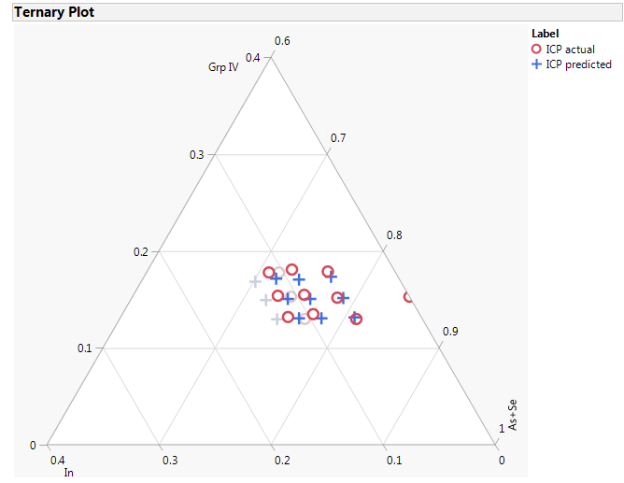
Camp K* proposed split table for L1
Split 1 will be changed to get a thermally stable alloy (~8% Ge)
Detailed split table on the next slide

Slide 10
Camp K* proposed split table - detailed
The alloys agreed upon for L1 are highlighted in the last column
L0 data will be collected on these alloys in addition to some high In alloys

Slide 11
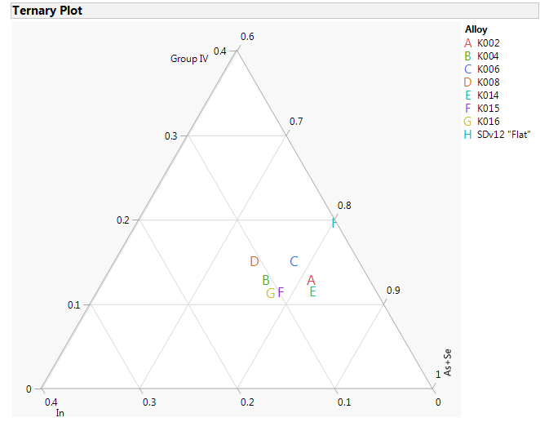
Camp K L1 split table
3x2 matrix on Ge x In with an added alloy K015 (F on the ternary plot)
Disclaimer: these set of alloys are likely going to be thermally unstable based on Camp J*.

Slide 12
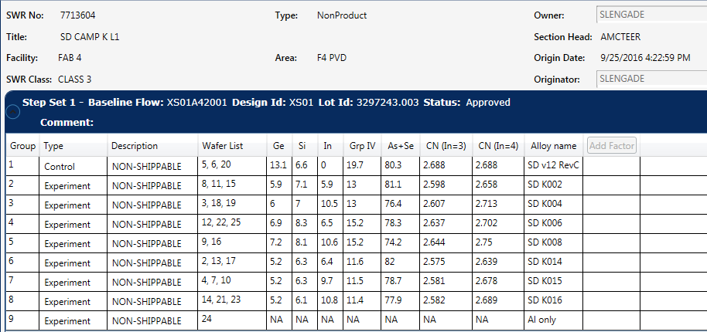
SWR7713604 - SD CAMP K L1

Slide 13
Extended L0
Split | As2Se3 Rf | SiGe Rf | In2Se3 Rf | Alloys
2 | 150W | 108W | 34W | K002
4 | 150W | 133W | 90W | K004
6 | 150W | 124W | 35W | K006
8 | 150W | 153W | 92W | K008
14 | 150W | 90W | 34W | K014
15 | 150W | 107W | 68W | K015
16 | 150W | 113W | 90W | K016
18 | 150W | 147W | 130W | K018
19 | 150W | 154W | 150W | K019
21 | 150W | 134W | 150W | K021
Collected L0 data on the above table of compositions
This has 3 more alloys (the last 3) in addition to the ones that ran on L1
  These alloys have higher (>12.5%) In in them

Slide 14
ICP data
Split | Alloys | ICP Ge | ICP As | ICP Se | ICP Si | ICP In | As+In | Grp IV | As+Se | CN (In=3) | CN (In=4) | As/Se | delta Se
2 | K002 | 5.9 | 27.9 | 53.2 | 7.1 | 5.9 | 33.8 | 13.0 | 81.1 | 2.598 | 2.657 | 0.524 | -23.5
4 | K004 | 6.0 | 24.1 | 52.3 | 7.0 | 10.5 | 34.6 | 13.0 | 76.4 | 2.604 | 2.709 | 0.461 | -25.5
6 | K006 | 6.9 | 26.8 | 51.5 | 8.3 | 6.5 | 33.3 | 15.2 | 78.3 | 2.637 | 2.702 | 0.520 | -28.9
8 | K008 | 7.2 | 23.4 | 50.8 | 8.1 | 10.6 | 34.0 | 15.3 | 74.2 | 2.648 | 2.754 | 0.461 | -30.9
14 | K014 | 5.2 | 27.9 | 54.1 | 6.3 | 6.4 | 34.3 | 11.5 | 82.0 | 2.571 | 2.635 | 0.516 | -20.3
15 | K015 | 5.2 | 25.3 | 53.4 | 6.3 | 9.7 | 35.0 | 11.5 | 78.7 | 2.578 | 2.675 | 0.474 | -22.0
16 | K016 | 5.2 | 24.7 | 53.2 | 6.1 | 10.8 | 35.5 | 11.3 | 77.9 | 2.581 | 2.689 | 0.464 | -22.7
18 | K018 | 6.4 | 21.0 | 52.5 | 7.2 | 12.8 | 33.8 | 13.6 | 73.5 | 2.611 | 2.740 | 0.400 | -25.5
19 | K019 | 6.4 | 19.6 | 52.3 | 7.1 | 14.6 | 34.2 | 13.5 | 71.9 | 2.612 | 2.758 | 0.375 | -26.0
21 | K021 | 5.3 | 20.4 | 53.1 | 6.2 | 15.1 | 35.5 | 11.5 | 73.4 | 2.584 | 2.735 | 0.383 | -23.0

Slide 15
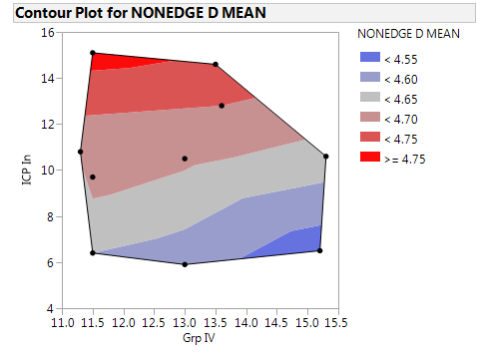
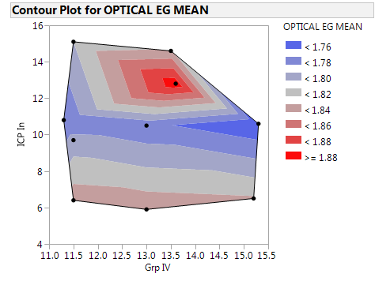
XRR Density & Optical Eg
For the current composition space, In content controls the film density
Eg shows a unilateral decrease with In content for up to 10% In (jives with the historically high leakage seen in In-SAG). At higher In, the picture is not so clear
  Need to get a re-fit of the Eg data since some of the samples showed higher std. dev.

Slide 16
Optical Eg data fit quality is questionable for some samples
Alloys | OPTICAL EG MEAN | OPTICAL EG %RSD
K002 | 1.835 | 0.11
K004 | 1.765 | 3.83
K006 | 1.822 | 2.22
K008 | 1.743 | 3.57
K014 | 1.832 | 0.24
K015 | 1.788 | 3.45
K016 | 1.761 | 3.13
K018 | 1.892 | 12.56
K019 | 1.824 | 7.99
K021 | 1.800 | 2.85

Slide 17
SEM Wrinkle Summary
Based on the table above, the splits capable of running 300C Dt are
  K004, K006, K008, K018, K019, and likely K021

Slide 18
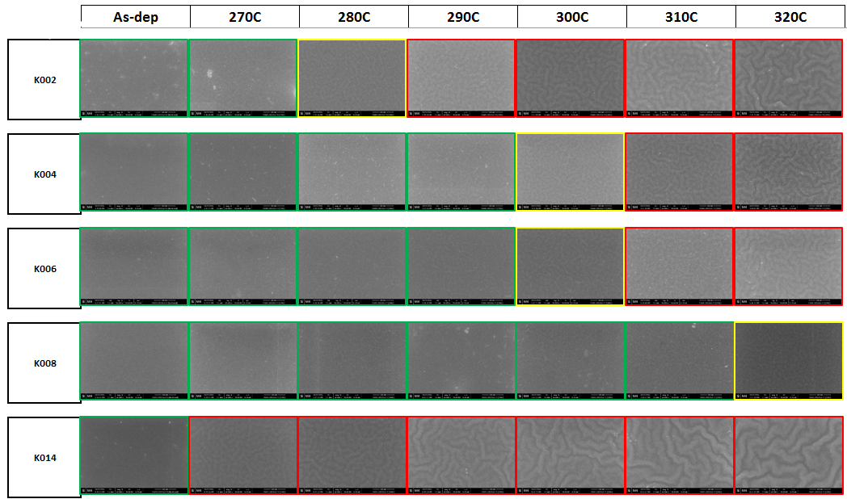
SEM Wrinkle test
TOP DOWN

Slide 19
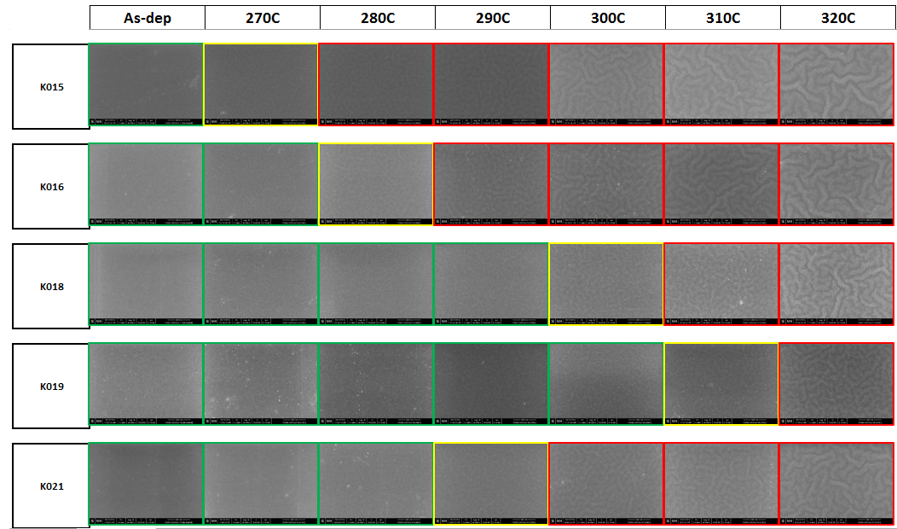
SEM Wrinkle test
TOP DOWN

Slide 20
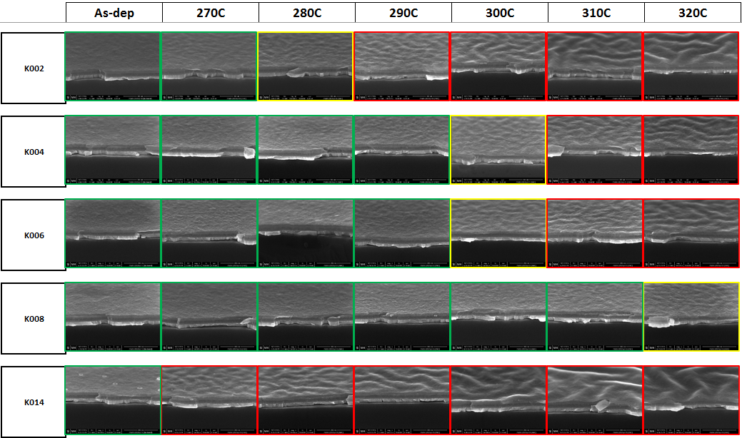
SEM Wrinkle test
ANGLED

Slide 21
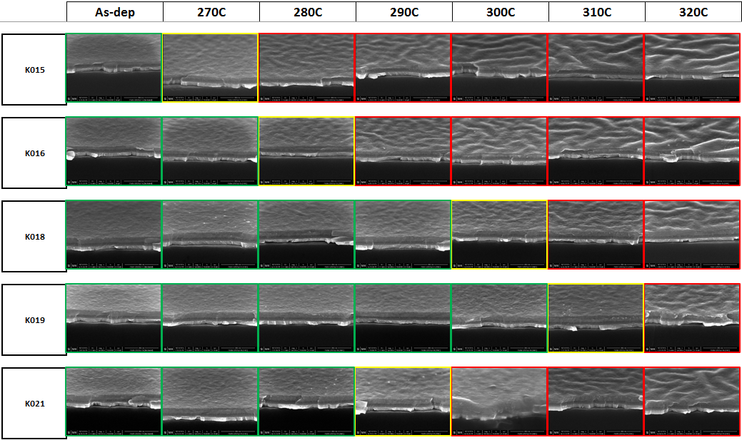
SEM Wrinkle test
ANGLED

Slide 22
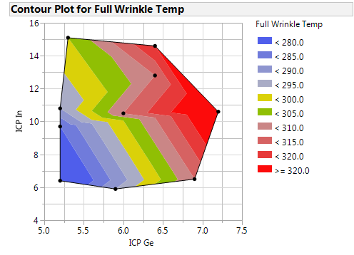
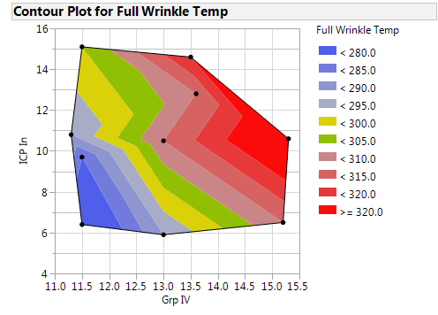
Full Wrinkle temp vs. composition
Addition of Indium does move the thermal stabililty to lower Ge/Grp IV regions.

Slide 23
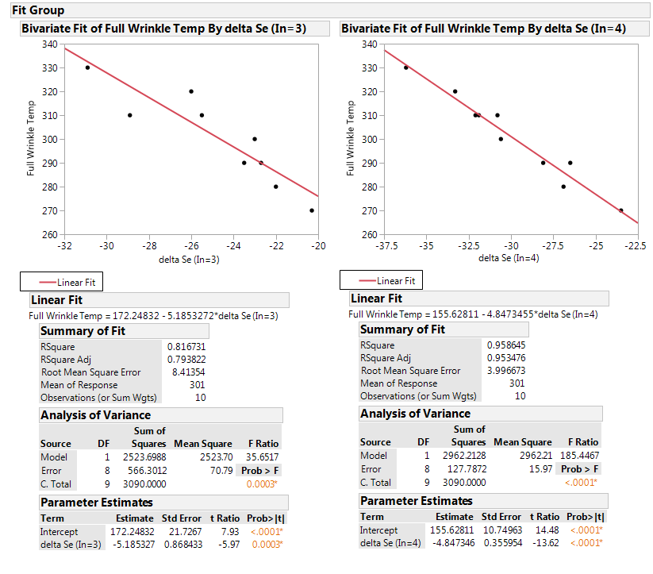
Full Wrinkle temp vs. Se Index
The full wrinkle temp correlates well with the Se index with a tetravalent In used in the calculation

Slide 24
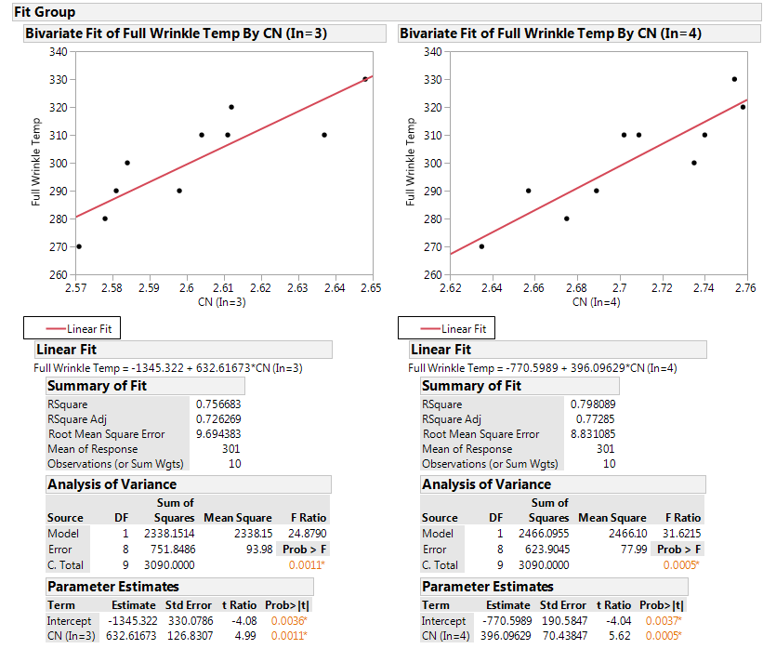
Full Wrinkle temp vs. CN
The full wrinkle temp correlates better with the Co-ord. No. (CN), with a tetravalent In used in the calculation

Slide 25
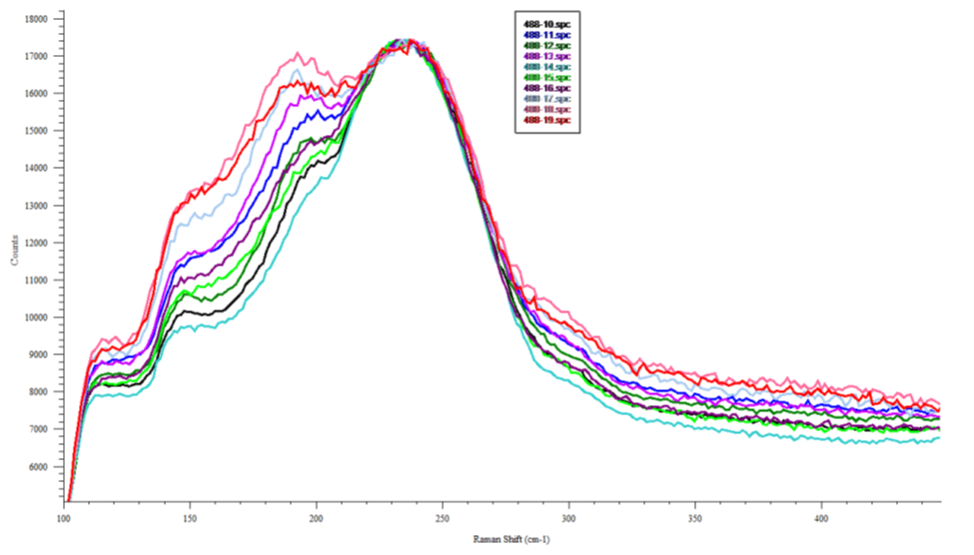
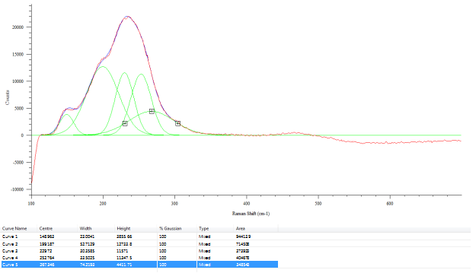
In-SiSAG Raman
slot | ICP Ge | ICP As | ICP Se | ICP Si | ICP In
10 | 5.9 | 27.9 | 53.2 | 7.1 | 5.9
11 | 6 | 24.1 | 52.3 | 7 | 10.5
12 | 6.9 | 26.8 | 51.5 | 8.3 | 6.5
13 | 7.2 | 23.4 | 50.8 | 8.1 | 10.6
14 | 5.2 | 27.9 | 54.1 | 6.3 | 6.4
15 | 5.2 | 25.3 | 53.4 | 6.3 | 9.7
16 | 5.2 | 24.7 | 53.2 | 6.1 | 10.8
17 | 6.4 | 21 | 52.5 | 7.2 | 12.8
18 | 6.4 | 19.6 | 52.3 | 7.1 | 14.6
19 | 5.3 | 20.4 | 53.1 | 6.2 | 15.1
“The Raman spectra suggest that the structure of In₂Se₃ film is composed of linked InSe₄ tetrahedral clusters with locally distributed Se_{n} polymer and Se₈ ring molecules.” -
very similar to GeSe4 tetrahedral clusters in SAG glasses. This is how the In in the current Camp K manifests structurally. More so because of the low Ge content in the film, In takes over the Ge-like behavior and hence we see the CS peak (~190cm-1) rise in the RS with increasing Indium content
In
LINK
In-Se/
Ge-Se
As-Se
Se_{n}, Se₈

Slide 26
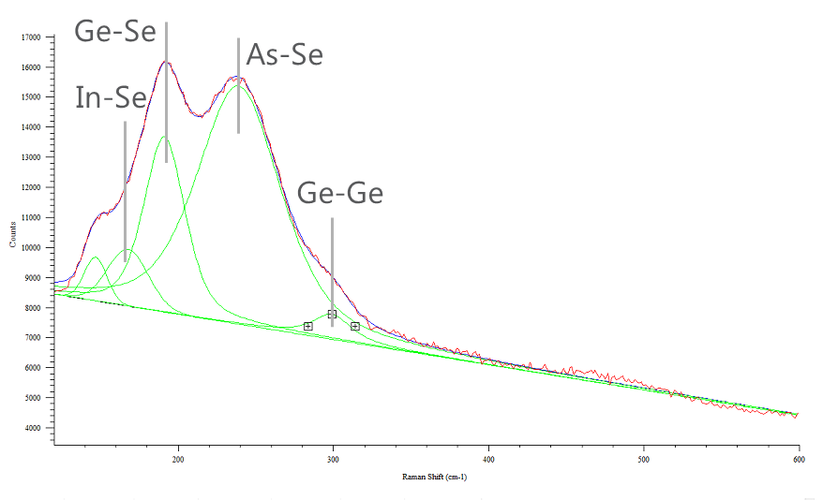
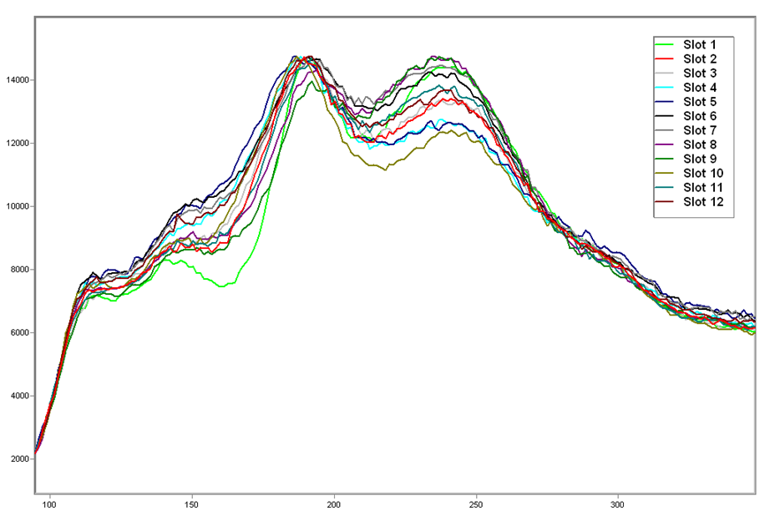
In-SAG Raman
“For InSe2, the structure of the film seems to be composed of InSe4 clusters linked by Se atoms at the corners shared by two vicinal tetrahedra” -
This suggests lack of Se chains and rings in the structure. This is the case for the Camp J where the Se is used up by As and the higher Ge and so we see the InSe₂ like structural behavior of the In in the In-SAG. Hence the manifestation at the 170cm-1
LINK

Slide 27
Raman Spectra

Slide 28
XRF setup for InSiSAG
Samples at the lab

