Slide 1
Atomistic model of the In-doped GST system
Return from the collaboration with Prof. Marco Bernasconi
Paolo Fantini

Slide 2
Questions:
How does In affect the structure of GST alloy?
How does In affect the electronic properties of GST alloy?
How does In affect the speed of crystallization of GST?
A summary of the atomistic modeling activity to address these questions is here reported. The full report can be found at this link

Slide 3
Summary
Structure:
  Indium atoms are mostly coordinated with Te.
  The coordination number of In is 4 consistent with a mostly tetrahedral bonding geometry (as occurs in the crystalline phase of In_{X}Te_{(1-X)} and others InGeTe and InSbTe amorphous alloys.
  Possible changes in the fraction of tetrahedral Ge is within the variability range obtained by different models of pure GST
  As a consequence of the tetrahedral bonding scheme of In atoms leading to the reduction of the total octahedral-like bonding, the number of four-membered rings decreases with In doping, while the number of larger 6- and 7-membered rings, typical of tetrahedral bonding, increases.
  The reduction in the number of 4-membered rings with In doping might lead to a reduction in the crystallization speed.
Electronic features:
  Indium does not introduce localized states in the gap of the electronic density of states (DoS)
  Band gap vs doping:
    Substituting Sb is a more effective way to enlarge the band gap than substituting Ge. A clear widening of the band gap by ~8meV/In at% is observed, substituting Sb by In, consistently with our experimental data.
    In related states are deeper in the valence and conduction bands. By increasing the difference in electronegativity between Te and the cation (Sb vs In) one possibly imparts a stronger charge transfer to the antibonding states which move deeper the electronic states in the conduction band, thus widening the band gap.

Slide 4
Simulation framework
A 297-atom cubic cell of molten Ge₂Sb₂Te₅ (GST) from quenching from ~1000 K to 300 K in ~100 ps
2 doping levels and 2 doping fashions (In substitution of Ge or Sb) have been considered:
  14 atoms of Ge or Sb atoms substituted with In corresponding to a doping of ~4.7 %
  30 atoms of Ge or Sb atoms substituted with In corresponding to a doping of ~10 %
Structural and electronic properties have been analyzed separately for In-doped GST, considering both In substituting Ge atoms and Sb atoms.
Technical note: In-based phase change compounds are better described by the Becke-Lee-Yang-Parr exchange and correlation functional (BLYP) than by the more commonly used Perdew-Burke-Enrzerhof (PBE) functional. On the other hand the BLYP and PBE functionals yield very similar results for pure GST. The obligate choice of BLYP functional for In-GST leads to a large underestimation of the band gap with respect to experiments. However, it is believed that the relative change of the band gap with composition/doping could be correctly captured.

Slide 5
In doped GST: structural properties
InDIUM substitution of sb – the same graph is obtained for Ge substitution
Distribution of the coordination numbers for the different species have been computed
Indium atoms are mostly coordinated with Te.
  CN of In is 4 consistently with tetrahedral bonding geometry (see next slide) as occurs in crystalline In₂Te₃, in amorphous InGeTe₂, In₃SbTe₂
  Possible structural changes of other GST atoms are within the variability range of different models of pure GST

Slide 6
In doped GST: bond angles distribution
Sb substitution with InDIUM – the same graph is obtained for Ge substitution
Indium bond angle is peaked ~109 consistently with tetrahedral bonding geometry and CN = 4 (see prev slide)
Other bonding schemes are the same as in the amorphous GST matrix:
Tetrahedral 4-coor Ge, In
sp³ bonding
(defective) octahedral 4-coor Ge, Sb and Te
Pyramidal-like 3-coor Ge, Sb and Te
p– type bonding

Slide 7
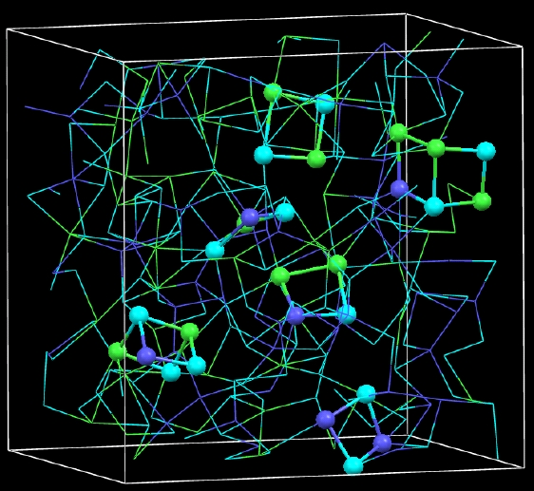
Ring statistics and phase transition
Background:
There is scientific consensus about that four-folded rings in a-GST and in the super-cooled phase act as nuclei for crystallization. In fact, four-membered rings with chemical alternation (`ABAB squares', A, Sb or Ge; B, Te), which are a structural motif of the metastable rock-salt crystal structure of GST, act as nuclei for crystallization. Thus, the larger is the fraction of four-membered rings the faster is the nucleation.
References:
Akola et al., Nat. Mat., 10, p. 129 (2011)
S. Caravati et al. APL 2007; J. Phys. Cond. Matt. 2009; Phys Rev. B 2010
Akola and Jones, Phys Rev. B 76, p. 235201 (2007)
Hegedus and Eliott, Nat. Mat. 7, p. 399 (2008)
Four-fold rings in a model of amorphous GST obtained by means of ab initio simulations

Slide 8
Ring length statistics: amorphous phase
    As a consequence of the tetrahedral bonds privileged by In, the number of four-membered rings typical of the octahedral-like bonding scheme decreases upon doping, while the larger 6- and 7-membered rings, typical of the tetrahedral bonding, increases.

Slide 9
Ring length statistics: super-cooled phase
Ring length distribution: Super-cooled liquid phase Nucleation temp proxi
5% In substituting Ge
5% In substituting Sb
    Also in the super-cooled phase at ~650 K, close to the peak of nucleation temperature, the number of four-membered rings favoring crystallization decreases with In doping, while the larger 6- and 7-membered rings, typical of the tetrahedral bonding, increases. This should explain the reduced crystallization speed we experimentally observe
Pure GST225

Slide 10
In doped GST: electronic properties
Electronic dos
The electronic DoS of the In-doped GST and the pure GST are almost overlapped
No In-induced localized states are promoted inside the band gap
In related states are deeper in the conduction band. Ge related states appear less relevant for the E_{G} definition (p-states in the conduction band are higher in energy), while the Sb-Te states dominate the edge of the valence and conduction bands. This could explain the higher band gap when In substitutes Sb (next slides).

Slide 11
In doped GST: electronic properties (In_{Sb} doping)
Note: the BLYP functional lead to underestimate the band gap, but the relative change with doping should be captured.
Tauc plot for optical band gap
~5% In instead of Sb
~10% In instead of Sb
    A clear widening of the band gap is observed by substituting Sb by In, the Tauc gap increasing by 40 meV at low doping (~5%) and by 80 meV at high doping (~10%) giving a ~ linear E_{G} increase by 8meV by In at%

Slide 12
In doped GST: electronic properties (In_{Ge} doping)
Tauc plot for optical band gap
~5% In instead of Ge
~10% In instead of Ge
    Substituting Sb is a more effective way to enlarge the band gap than substituting Ge. In fact, at the lower doping concentration (4.7 atom%) the substitution of Ge leads actually to a small decrease of the Tauc gap of about 50 meV with respect to pure GST, while the band gap increases by about 40 meV at high doping (10 atom%).

Slide 13
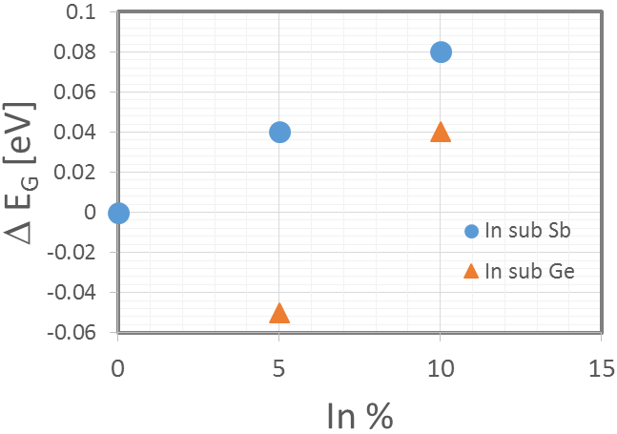
Band gap of In-doped GST: comparison with experiments
Experimental data
Simulation results
In these experiments Indium atoms substitute, equally, Ge and Sb
8 meV ⋅ In at%
8 meV ⋅ In at%
    Simulation-experiments comparison of the Tauc gap as a function of In doping returns a good matching when In substitutes Sb resulting the more effective way to enlarge the band gap than substituting Ge with ~8 meV by In at% rate. At variance, when a small amount of In (~5 at%) substitutes Ge a small decrease of the Tauc gap of about 50 meV with respect to pure GST, while the band gap increases by about 40 meV at high doping.

Slide 14
Conclusions
A reduction of the 4-membered rings both in the amorphous and in the super-cooled matrix is observed upon In doping, due to In atoms mostly coordinated with Te with a tetrahedral 4-coord bonding scheme → This should be the cause of the slower SET speed
Indium atoms substituting Sb enlarge the band gap consistently with the model of the band gap mainly controlled by Sb-Te bonds. By increasing the electronegativity difference between Te and the cation one could impart a stronger charge transfer character to the band gap which could lead to a gap widening. The E_{G} widening is in line with our experimental data.
Recommendation
Substitute some Sb atoms with elements with higher electronegativity difference with Te to enlarge the band gap → Running on the simulation with Yttrium, iso-electronic with Sb, but where: χ_{Y}=1.22 and χ_{Sb}=2.05

Slide 15
Next step
The possibility to investigate the effect of H-based contaminants in the GST film to get an atomistic insight of their role in the PM performances

