Slide 1
Camp J* wind-up/ Camp K* update
30s Material Pathfinding
Swapnil Lengade
Fab 4 PVD

Slide 2
MMUM4C0300 F1 Camp J* Gun3 In2Se3 target
Chamber was opened on 08/05/2016 to look at the Camp J* targets
  Gun1: As2Se3 @4.61 kWhrs
  Gun2: Ge @3.70 kWhrs
  Gun3: In2Se3 @4.40 kWhrs
The targets in guns 1 and 2 looked alright. Gun1 showed erosion, Gun2 Ge did not show a race-track.
Gun3 target In2Se3 was cracked. See pictures of this target in the subsequent slides
The follow targets were installed into the chamber (new kit/shield pcs)
  Gun1: As2Se3 @4.61 kWhrs (same one that was in there)
  Gun2: New SiGe 50/50 (this will allow In doped SiSAG and also let us keep the Ge% low)
  Gun3: New In2Se3

Slide 3
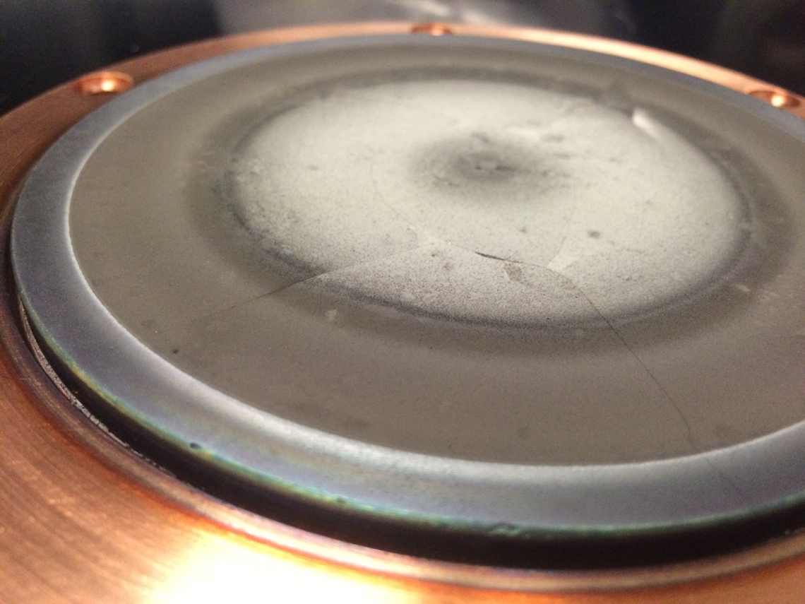
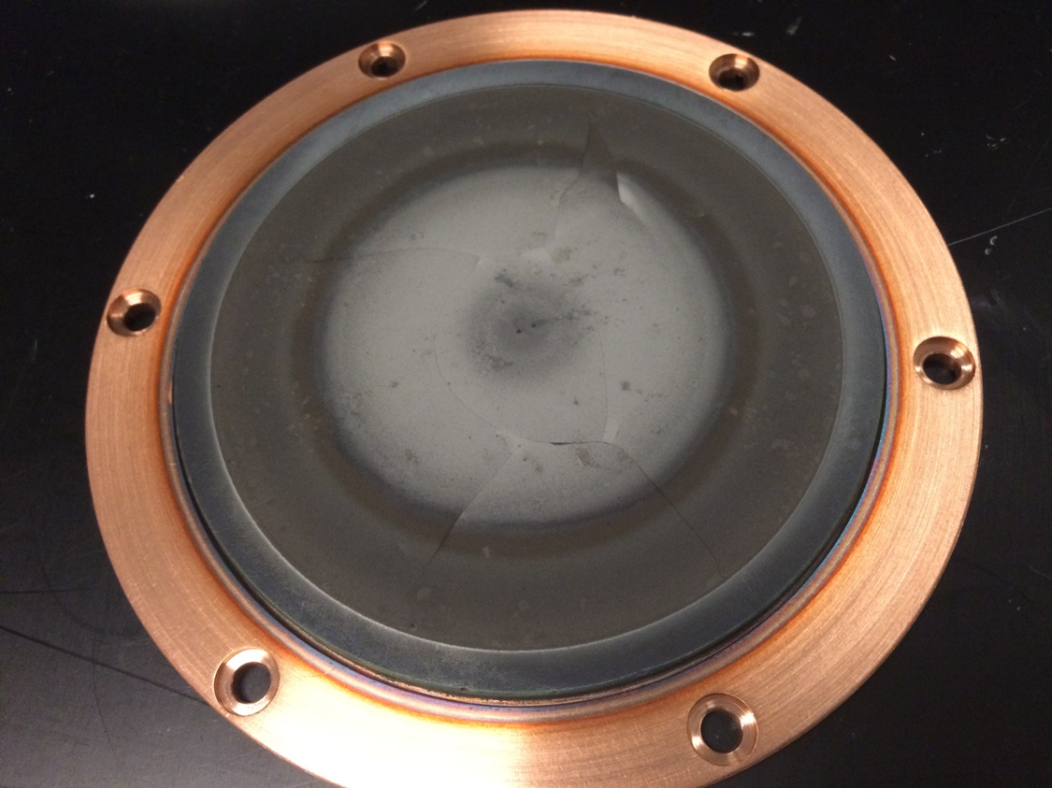
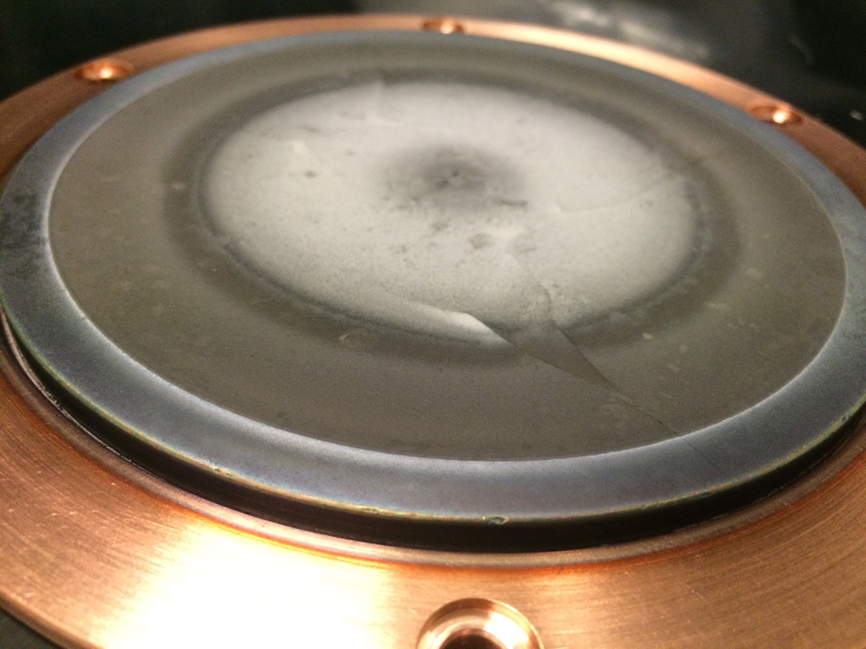
In2Se3 [160112-N-1] @4.40 kWhrs

Slide 4
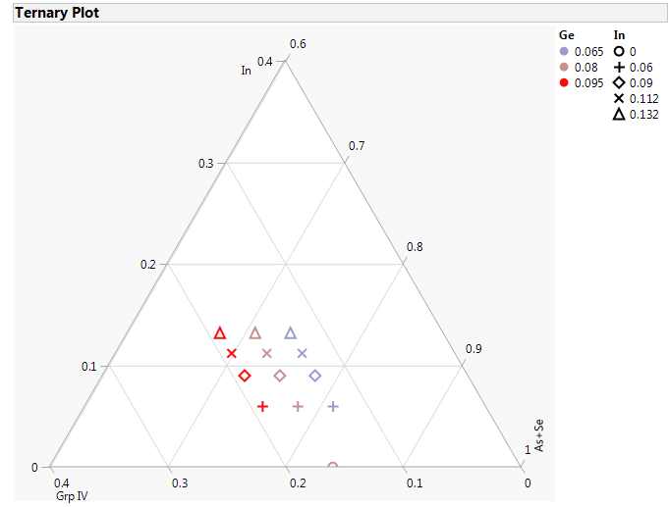
Pseudo-ternary of desired compositions with Si50Ge50
CAMP K*
Targets
  As2Se3
  Si50Ge50
  In2Se3
Grp IV skew from 13 to 19%
  Ge from 6.5 to 9.5%
  Si from 6.5 to 9.5%
In skew from 6 to 13%

Slide 5
Approximate split table with Si50Ge50
Ge | As | Se | Si | In | As+In | Grp IV | As+Se | CN | As/Se | delta Se
8.0 | 33.6 | 50.4 | 8.0 | 0.0 | 33.6 | 16.0 | 84.0 | 2.66 | 0.67 | -32.0
6.5 | 28.8 | 52.2 | 6.5 | 6.0 | 34.8 | 13.0 | 81.0 | 2.61 | 0.55 | -26.0
6.5 | 25.8 | 52.2 | 6.5 | 9.0 | 34.8 | 13.0 | 78.0 | 2.61 | 0.49 | -26.0
6.5 | 23.6 | 52.2 | 6.5 | 11.2 | 34.8 | 13.0 | 75.8 | 2.61 | 0.45 | -26.0
8.0 | 27.6 | 50.4 | 8.0 | 6.0 | 33.6 | 16.0 | 78.0 | 2.66 | 0.55 | -32.0
8.0 | 24.6 | 50.4 | 8.0 | 9.0 | 33.6 | 16.0 | 75.0 | 2.66 | 0.49 | -32.0
8.0 | 22.4 | 50.4 | 8.0 | 11.2 | 33.6 | 16.0 | 72.8 | 2.66 | 0.44 | -32.0
9.5 | 26.4 | 48.6 | 9.5 | 6.0 | 32.4 | 19.0 | 75.0 | 2.70 | 0.54 | -38.0
9.5 | 23.4 | 48.6 | 9.5 | 9.0 | 32.4 | 19.0 | 72.0 | 2.70 | 0.48 | -38.0
9.5 | 21.2 | 48.6 | 9.5 | 11.2 | 32.4 | 19.0 | 69.8 | 2.70 | 0.44 | -38.0
6.5 | 21.6 | 52.2 | 6.5 | 13.2 | 34.8 | 13.0 | 73.8 | 2.61 | 0.41 | -26.0
8.0 | 20.4 | 50.4 | 8.0 | 13.2 | 33.6 | 16.0 | 70.8 | 2.66 | 0.40 | -32.0
9.5 | 19.2 | 48.6 | 9.5 | 13.2 | 32.4 | 19.0 | 67.8 | 2.70 | 0.40 | -38.0

Slide 6
Camp K* Projected timeline
Install K* targets
K* L0
K* L1
8/5/2016
8/16/2016
9/7/2016
2016
Week 1
2
3
4
5
6
2016
Today
1 day
Install K* targets in 03F1
8/5/2016
5 days
03F1 bakeout macro
8/5/2016 - 8/9/2016
1 day
03F1 VPDs
8/10/2016
6 days
Target burn-in
8/10/2016 - 8/15/2016
22 days
L0 data collection
8/16/2016 - 9/6/2016
3 days
L1 CLV SWR
9/7/2016 - 9/9/2016

