Slide 1
Y doped GST447
SWR

Slide 2
Current Status
ICP from last week was not as predicted.
Follow up ICP runs showed In was present in the film.
New Target and New Kit will be installed. Hypothesis-GST target added to the system was incorrect, will verify serial numbers with vendor.
Time Table:
Target Change: 8/7 to 8/8
ICP Model deposition/ICP 8/10
Composition Verification 8/11
L0 suite of wafers to run 8/14-8/21. Data from lab and fab will be gated by WIP at each station. Priority has been assigned to the segregated materials tested and the contamination work.

Slide 3
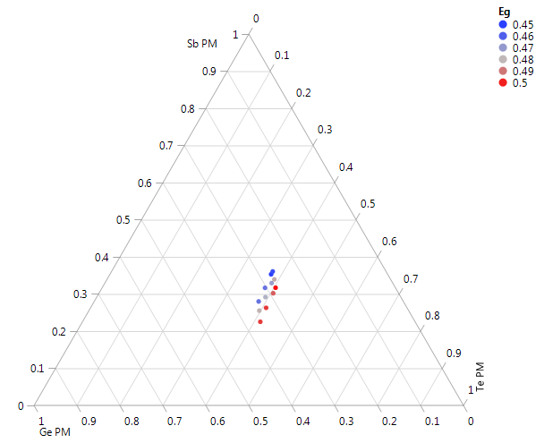
Eg
GST
F14
3% Y/Sb increment
Eg is decreasing with Y
or increasing with Te

Slide 4
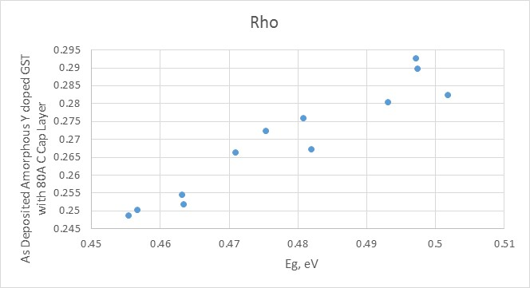
Rho vs Eg as deposited amorphous
Band Gap trend vs Rho of amorphous 300A MatX/80A UB Carbon showed expected increase.
Note many previous test were not able to read stack resistance and gave compliance errors. E

Slide 5
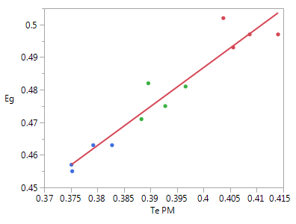
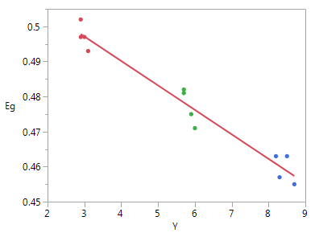
Eg
Eg = 0.007367 + 1.1986445*Te PM
Eg = 0.5180643 - 0.0069778*Y
12 mV/%Te
-7mV/%Y
F14 data
Based on previous data, Y should be the main factor
1mV/%Te

Slide 6
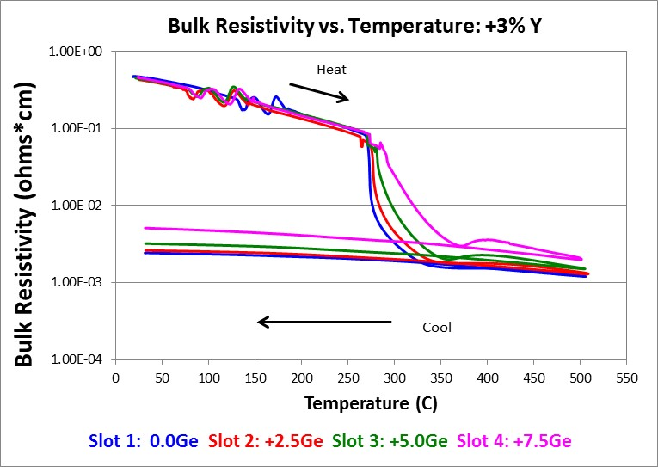
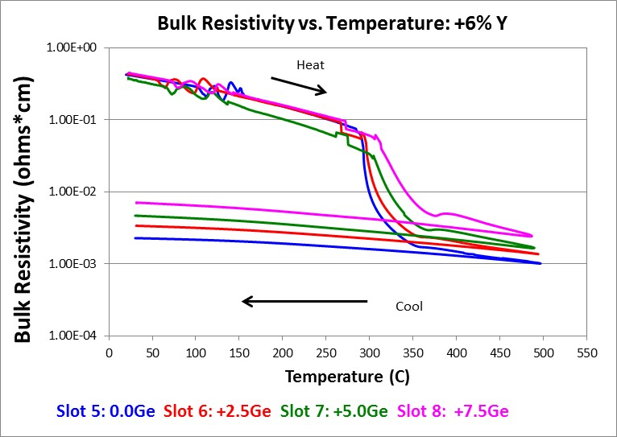
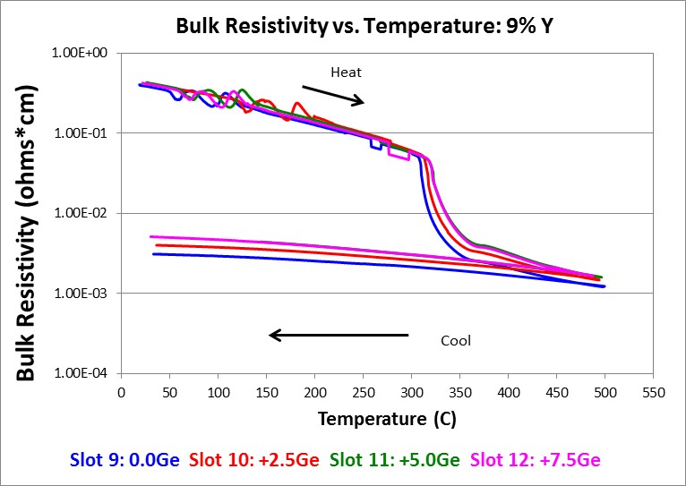
Rs vs T
Slot ID | Lot # | Description
1 | 3537463.003 | +3%Y +0Ge 300
2 | 3537463.003 | +3%Y +2.5Ge 300
3 | 3537463.003 | +3%Y +5.0Ge 300
4 | 3537463.003 | +3%Y +7.5Ge 300
5 | 3537463.003 | +6%Y +0Ge 300
6 | 3537463.003 | +6%Y +2.5Ge 300
7 | 3537463.003 | +6%Y +5.0Ge 300
8 | 3537463.003 | +6%Y +7.5Ge 300
9 | 3537463.003 | +9%Y +0Ge 300
10 | 3537463.003 | +9%Y +2.5Ge 300
11 | 3537463.003 | +9%Y +5.0Ge 296.4
12 | 3537463.003 | +9%Y +7.5Ge 300
Increase In GeTe as expected moved crystallization to higher temperatures.
Final delta Rho of crystalline vs amorphous difficult interpret; 6% Y shows change in Carbon Slope during amorphous region. Note the as deposited film did decrease Rho with increase in Y.

Slide 7
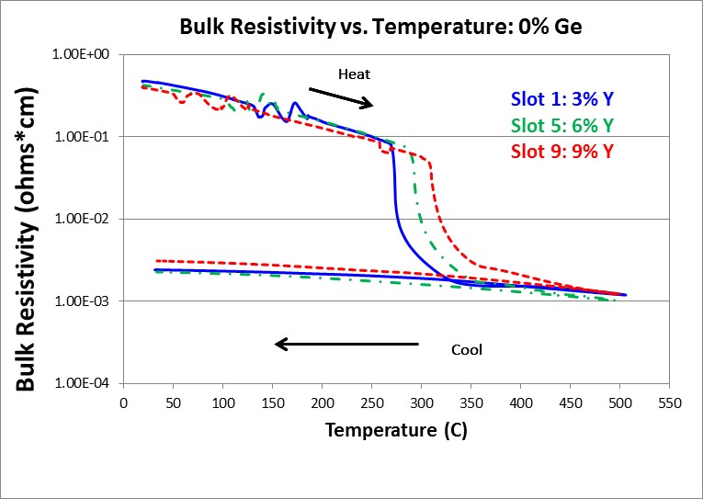
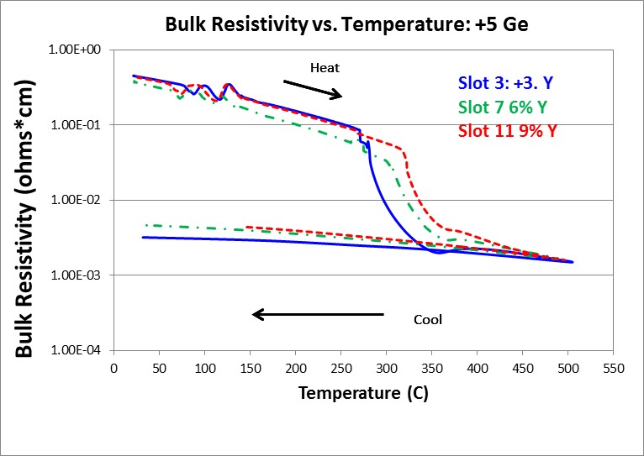
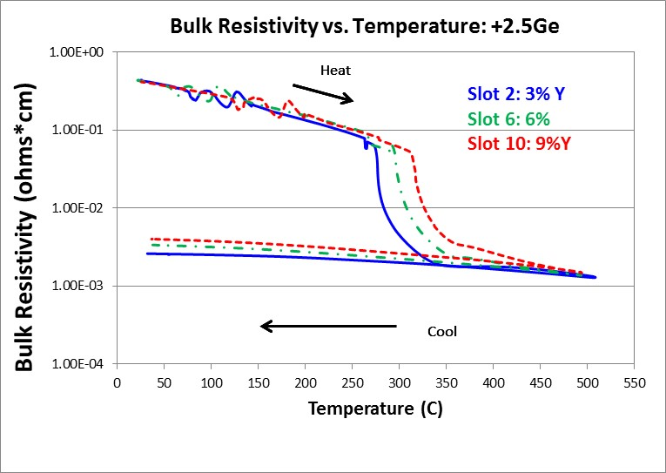
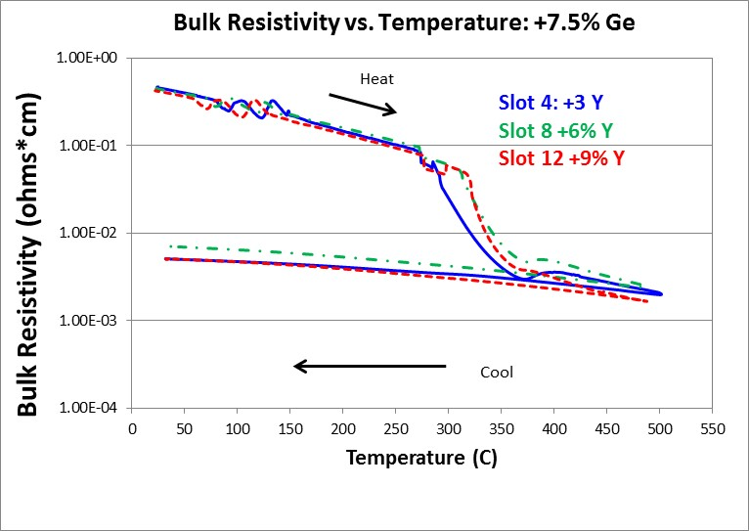
Rs vs T
Slot ID | Lot # | Description
1 | 3537463.003 | +3%Y +0Ge 300
2 | 3537463.003 | +3%Y +2.5Ge 300
3 | 3537463.003 | +3%Y +5.0Ge 300
4 | 3537463.003 | +3%Y +7.5Ge 300
5 | 3537463.003 | +6%Y +0Ge 300
6 | 3537463.003 | +6%Y +2.5Ge 300
7 | 3537463.003 | +6%Y +5.0Ge 300
8 | 3537463.003 | +6%Y +7.5Ge 300
9 | 3537463.003 | +9%Y +0Ge 300
10 | 3537463.003 | +9%Y +2.5Ge 300
11 | 3537463.003 | +9%Y +5.0Ge 296.4
12 | 3537463.003 | +9%Y +7.5Ge 300
Trend for increase in Y to higher crystallization temperatures was found up to 5% additional Ge added as GeTe.
At 7.5%, there appears to be minimal difference with addition of Y from 6 to 9% Y.

Slide 8
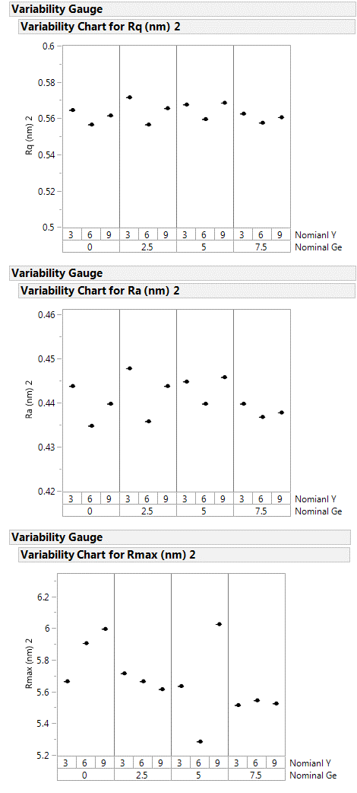
Surface roughness 300A Mat X/ Oxide
XRR data indicated that film roughness might be impacted by the Y content (uncapped films/ Oxidation?)
Roughness of the Carbon is not modulated by the composition of the Mat X.
Follow up of crystalline stacked material was run but is currently going through XRD.
Slot ID | Lot # | Description
1 | 3537463.003 | +3%Y +0Ge 300
2 | 3537463.003 | +3%Y +2.5Ge 300
3 | 3537463.003 | +3%Y +5.0Ge 300
4 | 3537463.003 | +3%Y +7.5Ge 300
5 | 3537463.003 | +6%Y +0Ge 300
6 | 3537463.003 | +6%Y +2.5Ge 300
7 | 3537463.003 | +6%Y +5.0Ge 300
8 | 3537463.003 | +6%Y +7.5Ge 300
9 | 3537463.003 | +9%Y +0Ge 300
10 | 3537463.003 | +9%Y +2.5Ge 300
11 | 3537463.003 | +9%Y +5.0Ge 296.4
12 | 3537463.003 | +9%Y +7.5Ge 300

