Slide 1
In-SAG - J* campaign
L1P1 data
Cristina and Paolo

Slide 2
Summary
Data are aligned with what previously observed in the K campaign in F14
In particular:
  @ same Ge at% leakage increases with In content
  The look at the I-V curves indicates an enhancement of the sub-V_{T} Poole-Frenkel component with In
  A decrease of the V_{T} values wrt v13 at the thickness
The need to reinforce the L1 screening methodology has been highlighted
  WRL metric (2dd @85C) and Probe-like (100sec @85C) need to be re-considered as screening methodology for Drift
Recommendation
  Complete the campaign exploring alloys with lower Ge and In up to 15% to add points on the V_{T}-leakage trade-off with In
  Consider the thickness skew for the J007 (with 9% In) that appears the best alloy
  Consider In-SiSAG as more promising exploration

Slide 3
Scorecard
Testing issues, data that are not reliable
Considering the overall features (electrical and thermal stab), J007 is the best alloy

Slide 4
Scorecard: comments on the L1 Screening Methodology
Here below the L1 Scorecard of two pure SAG film:
The first one deposited in F4 with Ge 17.7 at%
The second one deposited ~two years ago in F14 with Ge 19 at%
As | Ge | Se
32.4 | 17.7 | 50.0
SAG Ge 19
As | Ge | Se
30.2 | 19.1 | 50.7
They both returned all green lights. The one that, in particular, appears ‘surprising’ is the one related to the drift, whereas we know that a so Ge at% is detrimental for S15 drift limit acceptance.
Recommendation: to address and validate a new more severe drift metric
Options: WRL metric (2dd @85C); Probe-like (100sec @85C)

Slide 5
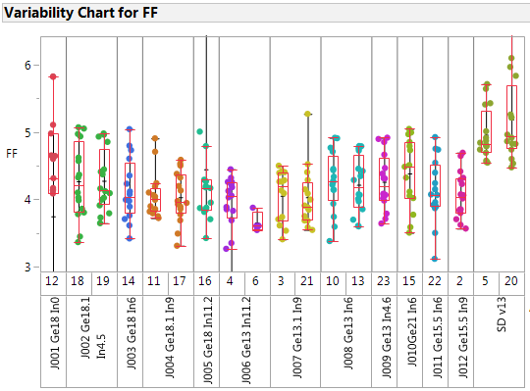
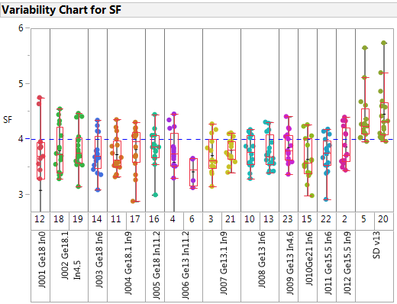
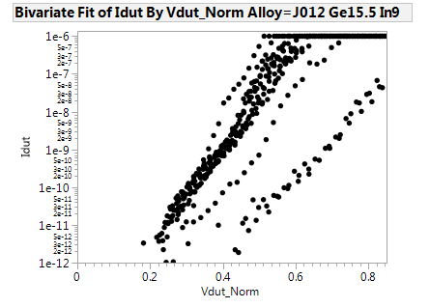
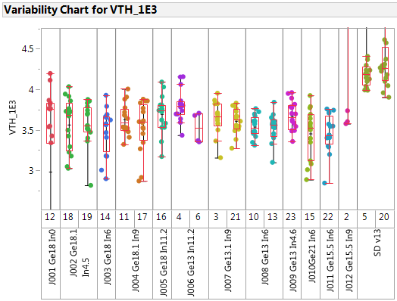
FF-SF V_{T} and after 1Kcyc
J012 has also bad IV curves
FF
SF
Comments:
Higher V_{T} for SD v13 wrt the splits with In
This is coherent with the Bandgap lowering with In
Nevertheless, low forming for In skew – see also slide #3 - is also confirmed wrt K campaign
VTH_1e3

Slide 6
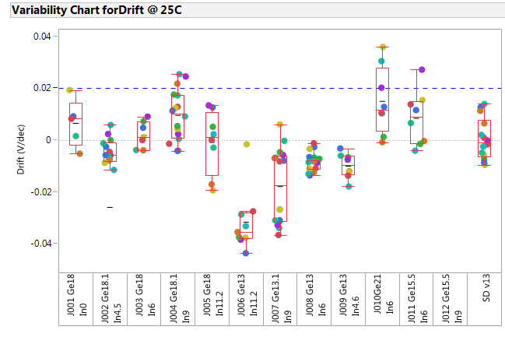
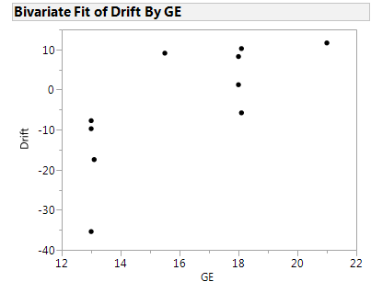
Drift results @ L1-P1 (up to 1sec)
All alloys meet the drift requirements. But see slide #4 about the need of a more severe drift assessment.
A trend with Ge content can be observed – perhaps more since we expect that…

Slide 7
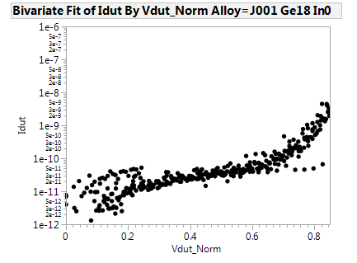
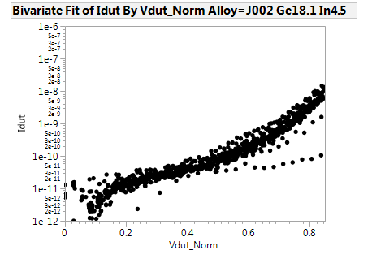
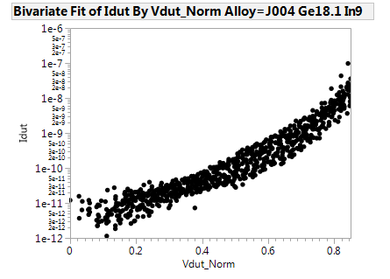
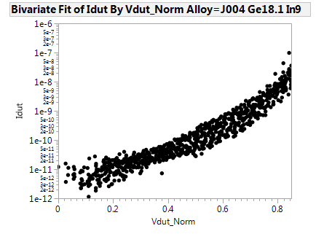

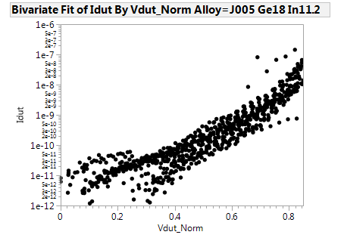
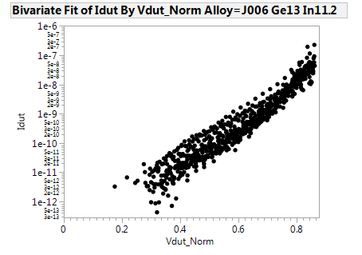
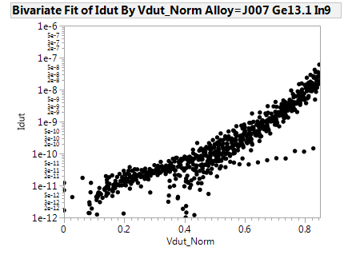
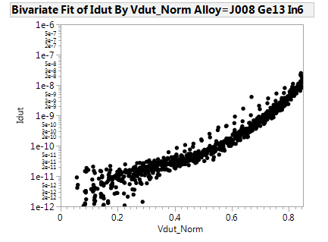
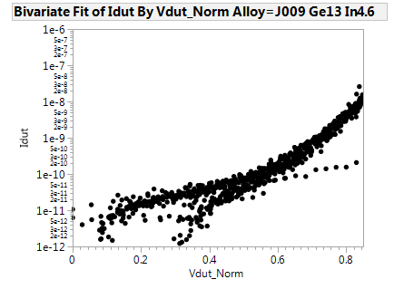
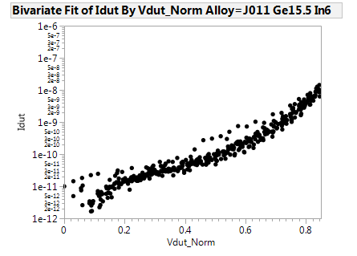
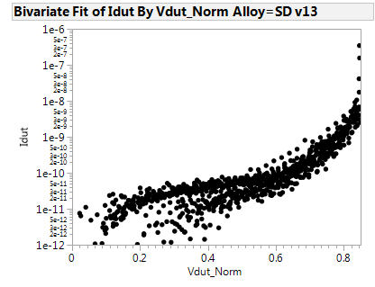
Normalized I-V curves
The progressive In addition tends to increase the sub-V_{T} P-F conduction. See here the comparison with SDv13.
This appears the criticality of this alloys.
The same feature was before observed – see below. Now very reliable result
Ge 13%
Ge 13%
Ge 13%
In 11%
In 9%
In 6%
From the K camp
SDv13
In addition

Slide 8
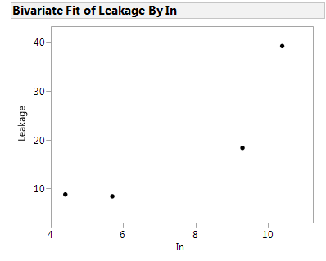
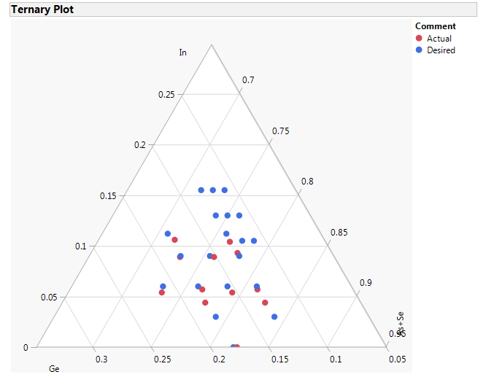
Conclusions and proposals
@ 13% Ge
Conclusions:
  Leakage increase with In content;
  Scattered data suggest that higher Ge, higher is the drift
  best alloy considering drift data is JA07
Leakage
Proposal to run a second lot with:
  JA07 thickness skew to see the drift and V_{T} scaling;
  Alloy 1/2/4/5/6/7/8 from Swapnil proposal, we took only one split with In 15.5% just to add another point on the leakage graph to confirm the trend of leakage with In
  Further checks on the drift screening methodology
In
# | Ge | In | Thick (nm)
1 | 13.1 | 10.4 | 25
2 | 13 | 13 | 25
3 | 13 | 15.5
4 | 12 | 10.5 | 25
5 | 12 | 13 | 25
6 | 12 | 15.5 | 25
7 | 11 | 10.5 | 25
8 | 11 | 13 | 25
9 | 11 | 15.5
JA07 | 13.1 | 9 | 20
JA07 | 13.1 | 9 | 25
JA07 | 13.1 | 9 | 30
New alloys
J007

