Slide 1
Y doped GST447
SWR

Slide 2
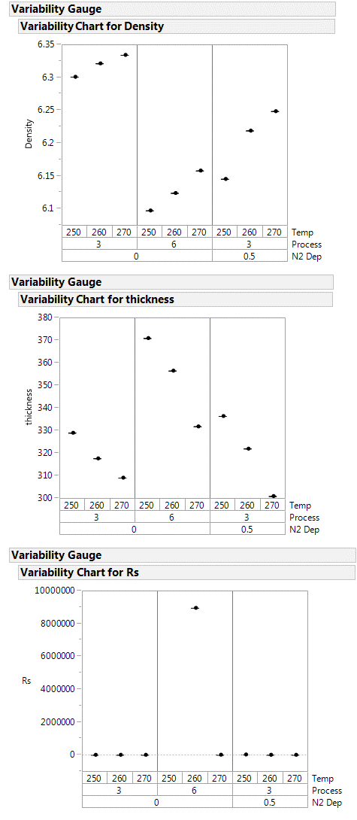
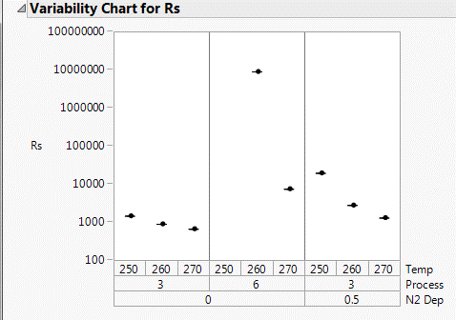
XRR and Rs data
Density of the film without N2 shows a gradual change in density and thickness.
With N2 there is a small density shift but the film is

Slide 3
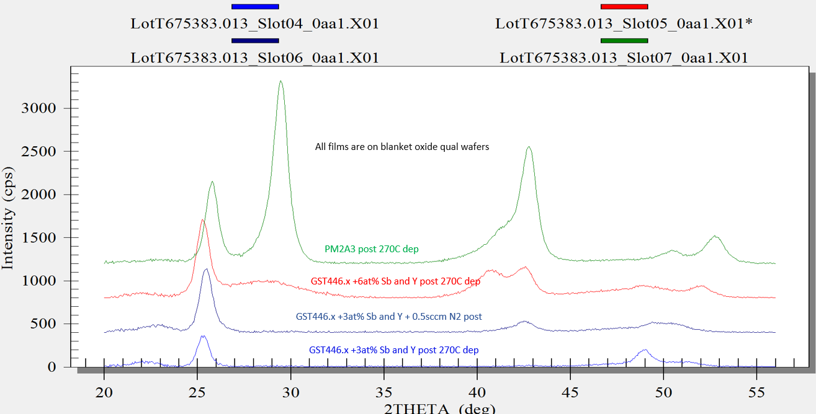
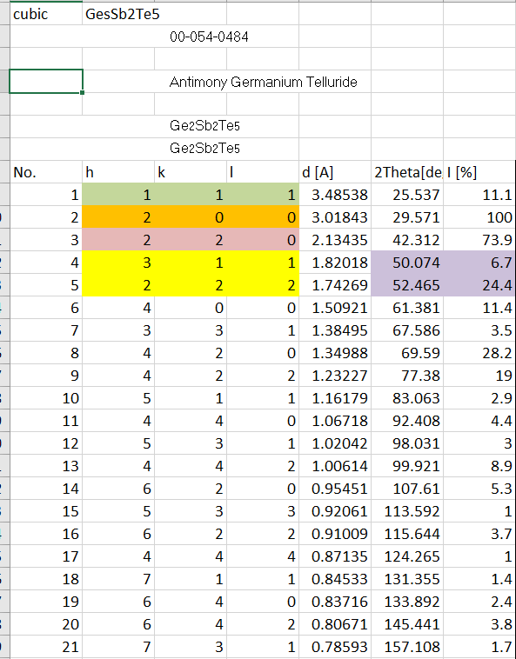
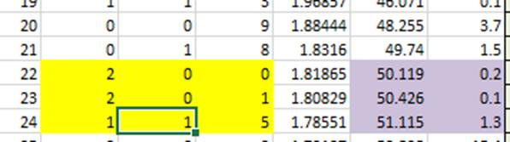
XRD-post 270C dep on oxide
GST446.x at 3at% Sb and Y shows anomalous crystalline behavior.
Small 111 cubic peak found and unusual peak ~49 2-theta
GST225 Cubic Peaks
GST225 HCP Peaks

Slide 4
XRD-post 270C dep on oxide
after deposition at 270C, Y-Sb doped GST446.x result quite crystallized compared to undoped, consistent with trigonal structure
Some residual of fcc (29 degree peak) is detected mostly for Y-Sb 6%
Slot 4 Y-Sb 3% shows very few peaks, consistent with highly texturing in trigonal structure.
No evidence of spurious segregation with peaks significantly different from usual fcc and trigonal 225-like.

Slide 5
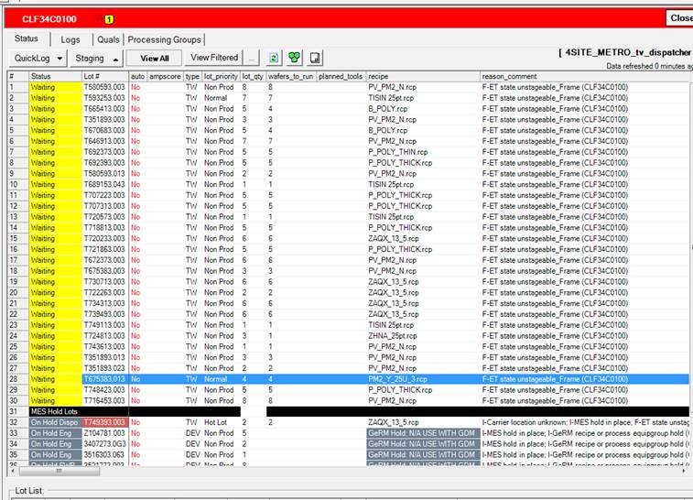
Compositon
ICP
LEXES-Across wafer uniformity pending
Lot | Wafer | Y | Ge | Sb | Te
T675383.023 | 1 | 3.1 | 27.3 | 30.1 | 39.5
T675383.023 | 2 | 6.2 | 25.9 | 30.95 | 36.95
T675383.023 | 3 | 3.3 | 27.3 | 30.4 | 39.1

Slide 6
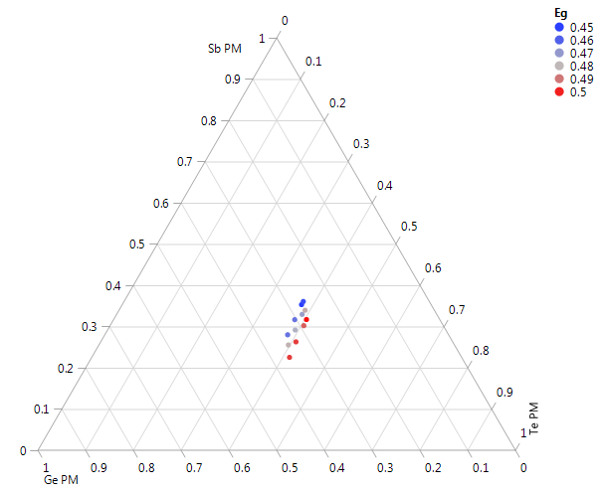
Eg
GST
F14
3% Y/Sb increment
Eg is decreasing with Y
or increasing with Te

Slide 7
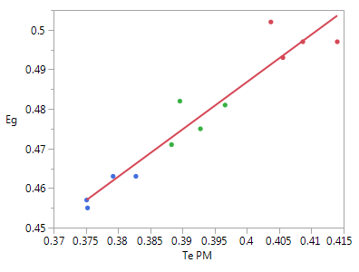
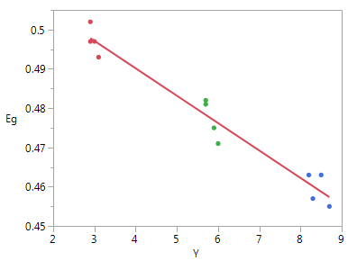
Eg
Eg = 0.007367 + 1.1986445*Te PM
Eg = 0.5180643 - 0.0069778*Y
12 mV/%Te
-7mV/%Y
F14 data
Based on previous data, Y should be the main factor
1mV/%Te

