Slide 1
Collaboration with Prof. Matthias Wuttig RWTH (Aachen University)
Competitive advantage in building a material roadmap
Aachen and Micron

Slide 2
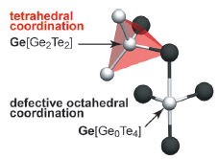
PM fundamentals
Intrinsic speed-window trade-off
Floppy, resonant
bonding
Strong, localized
SPEED
PM structure
WINDOW
Fast crystallization (main factors):
  Cubic structure embryos present in amorphous
  High fragility (high diffusivity above Tg)
Amorphous low conductivity & switching threshold field
  Relatively strong localized bonds
  Dangling bonds/lone pairs
Looking for EOL composition (and doping) to optimize and tune the trade-off

Slide 3
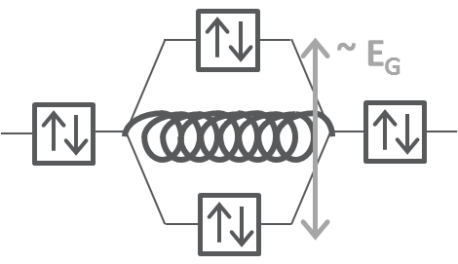
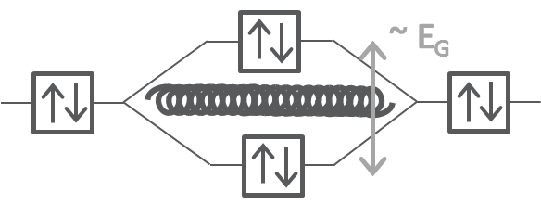
Problem statement: The V_{T} window vs. set-speed dilemma
The larger is the PM V_{T} window, the slower is the SET process
Is this a fundamental physics barrier?
…let’s say: the stronger are the bonds and the higher is the glass rigidity and then the inertia to crystallize and higher is the E_{G}, thus the V_{T}?
Goal
Time for crystallization in sigma
ΔV_{T} [mV]
The Goal for 30S scaling is finding a PM material offering high V_{T} window without slowing down the crystallization speed necessary to have a high-throuput memory technology
The ability to handle this correlation is fundamental for SxP technology scaling: How can we tailor materials with high V_{T} preserving a very good SET speed?

Slide 4
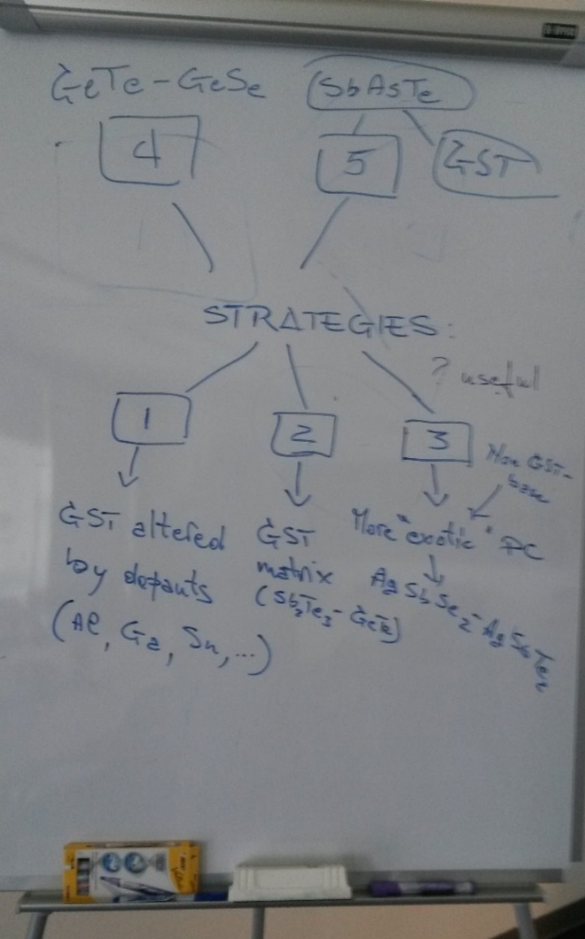
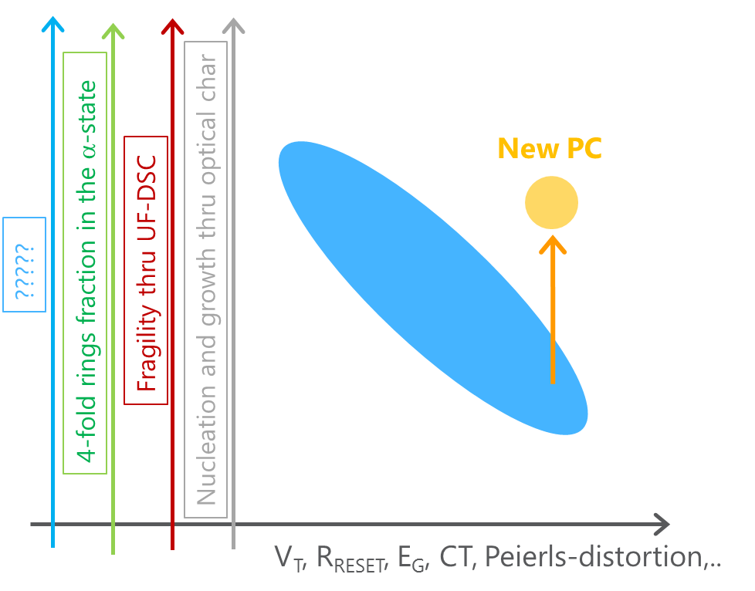
Kick-off meeting summary
Kick-off meeting for the collaboration has been held on June 1st Update phone-call meeting will be held every 6 wks
‘Italy flipped boot’ strategy
Map speed-Vth related parameters (on different alloys with corner properties)
  Speed (nucl.rate, crystal. rate, fragility, 4-ring structure, …)
  Vth (Eg, strong bonding, dangling bonds, long-pairs, avalance factor, …)
Evaluate structural/physical feature of mapped alloys to identify aspects which enable better trade-off (connections with ab-initio and structure (Raman-EXAFS) data)
We will start plotting some fundamental quantities related to SET speed vs other related to the band-gap (and then the V_{T}) for the strategies #2 (GST matrix) and #4 (GeTe-GeSe)

Slide 5
Metrics
 | speed | Vth
measured | Crystall speed (DSC, fDSC) | Eg (optical)
 | Crystall speed (optical) | amorphous resistance
 | Nucl. rate (TEM) | Vth (CLV)
 | Growth rate (TEM)
 | Fragility (DSC, fDSC)
 | Tm, Tx (DSC)
Calculated/ extracted |  | Electronic localization
 |  | Born effective charge
 |  | ionicity
 |  | Peierls distorsion

Slide 6
Strategy
Blending of two different PM: one slow with high V_{T} with a second one fast with low V_{T}
We should get a first glance on data for these systems at the next meeting (within July)
We should get also a ‘feeling’ about the promise of this system that Wutting is investigating for different purposes
Known high speed enabling:
  Ag, Ti, Sn, Bi, W
Known high resistance enabling:
  Se, Si, H, In

Slide 9
Eg optical measurement

