Slide 1
Camp J* proposal
Swapnil Lengade, Dan Gealy
Fab 4

Slide 2
Camp J* Proposal
Constraints
High In leads to high leakage
Cap In content at 11.2% (from Agrate’s SD kappa campaign)
Co-ordination number
Lower limit at 2.62 (assuming In as tri-valent co-ordination)
Upper limit at 2.75 (for the As2Se3 based SAG systems, Vt drift dependency on Ge content makes splits with higher Ge content electrically not viable)

Slide 3
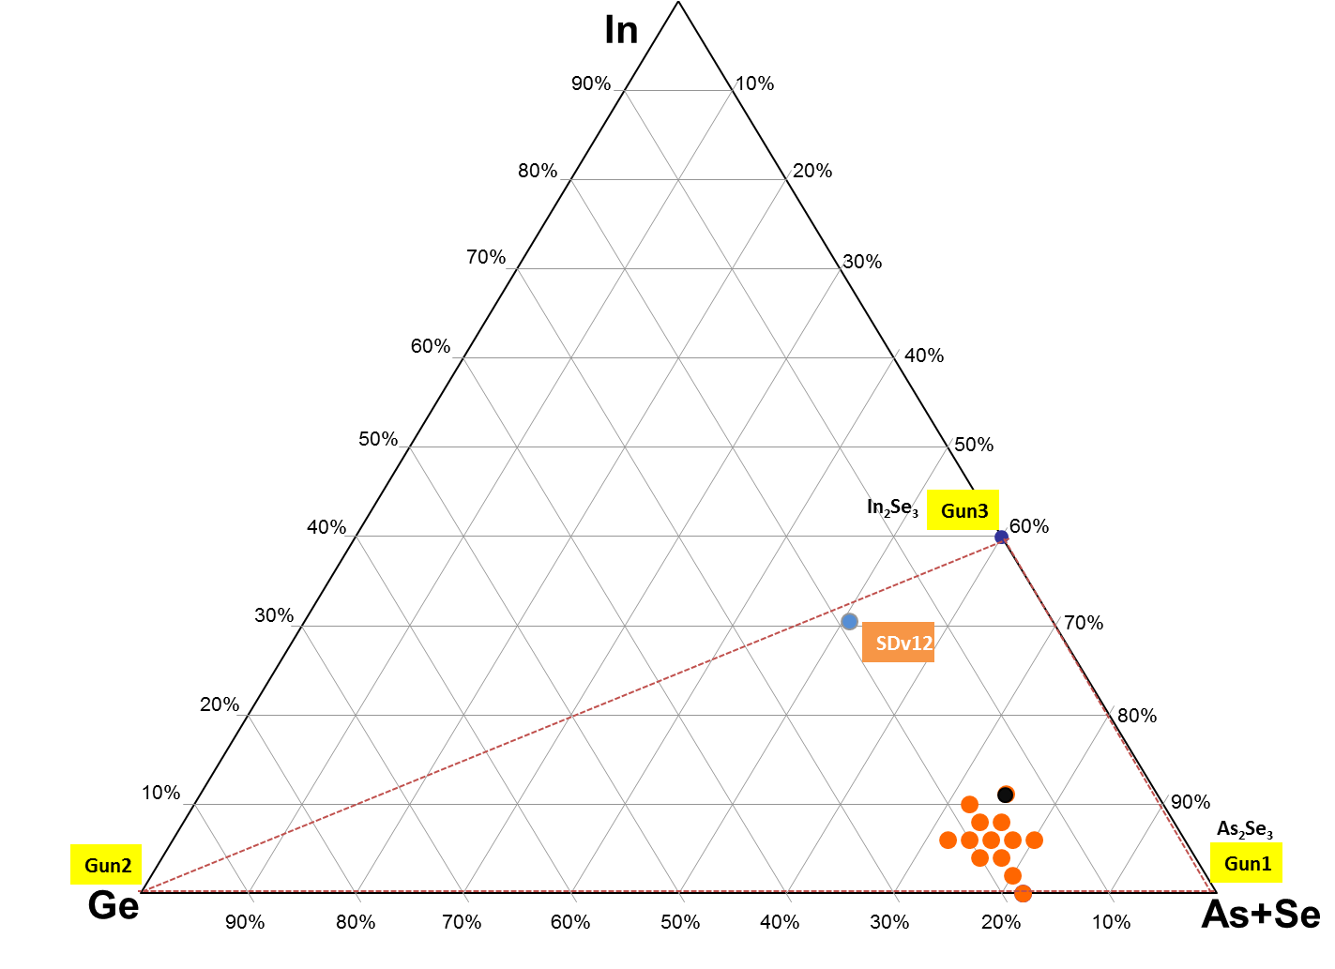
Camp J* L0 proposal
Recipe | In(at.%) | Ge (at.%) | As (at.%) | Se (at.%) | Si (at.%) | Ge+In
SDkappa.A005 | 11.1 | 13 | 21.8 | 53 | 1.1 | 24.1
CN>2.75
CN<2.62
In>11.2%

Slide 4
Campaign J* L0 proposal
Alloy | targets |  |  | Film
 | In2Se3 | Ge | As2Se3 | Ge | As | Se | Si | In | As+In | As+Se | CN | As/Se
1 | 0 | 18 | 82 | 18.0 | 32.8 | 49.2 | 0.0 | 0.0 | 32.8 | 82.0 | 2.69 | 0.67
2 | 5 | 18 | 77 | 18.0 | 30.8 | 49.2 | 0.0 | 2.0 | 32.8 | 80.0 | 2.69 | 0.63
3 | 10 | 18 | 72 | 18.0 | 28.8 | 49.2 | 0.0 | 4.0 | 32.8 | 78.0 | 2.69 | 0.59
4 | 15 | 18 | 67 | 18.0 | 26.8 | 49.2 | 0.0 | 6.0 | 32.8 | 76.0 | 2.69 | 0.54
5 | 20 | 18 | 62 | 18.0 | 24.8 | 49.2 | 0.0 | 8.0 | 32.8 | 74.0 | 2.69 | 0.50
6 | 25 | 18 | 57 | 18.0 | 22.8 | 49.2 | 0.0 | 10.0 | 32.8 | 72.0 | 2.69 | 0.46
7 | 20 | 16 | 64 | 16.0 | 25.6 | 50.4 | 0.0 | 8.0 | 33.6 | 76.0 | 2.66 | 0.51
8* | 28 | 14 | 58 | 14.0 | 23.2 | 51.6 | 0.0 | 11.2 | 34.4 | 74.8 | 2.62 | 0.45
9 | 15 | 14 | 71 | 14.0 | 28.4 | 51.6 | 0.0 | 6.0 | 34.4 | 80.0 | 2.62 | 0.55
10 | 10 | 20 | 70 | 20.0 | 28.0 | 48.0 | 0.0 | 4.0 | 32.0 | 76.0 | 2.72 | 0.58
11 | 15 | 20 | 65 | 20.0 | 26.0 | 48.0 | 0.0 | 6.0 | 32.0 | 74.0 | 2.72 | 0.54
12 | 15 | 16 | 69 | 16.0 | 27.6 | 50.4 | 0.0 | 6.0 | 33.6 | 78.0 | 2.66 | 0.55
13 | 15 | 22 | 63 | 22.0 | 25.2 | 46.8 | 0.0 | 6.0 | 31.2 | 72.0 | 2.75 | 0.54
Recipe | In(at.%) | Ge (at.%) | As (at.%) | Se (at.%) | Si (at.%) | Ge+In
SDkappa.A005 | 11.1 | 13 | 21.8 | 53 | 1.1 | 24.1
* SD kappa A005-like

Slide 5
CN=2.61 safe for wrinkle 300C
EVARESI

Slide 6
EVARESI

Slide 7
B5
B2
B3
EVARESI

Slide 8
EVARESI

Slide 9
Campaign J* new proposal
Incorporating Enrico and Paolo’s proposal
CN>2.74
CN<2.61
In>11.2%

Slide 10
Modified Campaign J* L0 proposal
Alloy | targets |  |  | Film
 | In2Se3 | Ge | As2Se3 | Ge | As | Se | Si | In | As+In | As+Se | CN | As/Se
1 | 0 | 18 | 82 | 18.0 | 32.8 | 49.2 | 0.0 | 0.0 | 32.8 | 82.0 | 2.69 | 0.67
2 | 7.5 | 18 | 74.5 | 18.0 | 29.8 | 49.2 | 0.0 | 3.0 | 32.8 | 79.0 | 2.69 | 0.61
3 | 15 | 18 | 67 | 18.0 | 26.8 | 49.2 | 0.0 | 6.0 | 32.8 | 76.0 | 2.69 | 0.54
4 | 22.5 | 18 | 59.5 | 18.0 | 23.8 | 49.2 | 0.0 | 9.0 | 32.8 | 73.0 | 2.69 | 0.48
5 | 28 | 18 | 54 | 18.0 | 21.6 | 49.2 | 0.0 | 11.2 | 32.8 | 70.8 | 2.69 | 0.44
6* | 28 | 13 | 59 | 13.0 | 23.6 | 52.2 | 0.0 | 11.2 | 34.8 | 75.8 | 2.61 | 0.45
7 | 22.5 | 15.5 | 62 | 15.5 | 24.8 | 50.7 | 0.0 | 9.0 | 33.8 | 75.5 | 2.65 | 0.49
8 | 15 | 15.5 | 69.5 | 15.5 | 27.8 | 50.7 | 0.0 | 6.0 | 33.8 | 78.5 | 2.65 | 0.55
9 | 15 | 21 | 64 | 21.0 | 25.6 | 47.4 | 0.0 | 6.0 | 31.6 | 73.0 | 2.74 | 0.54
10 | 22.5 | 13 | 64.5 | 13.0 | 25.8 | 52.2 | 0.0 | 9.0 | 34.8 | 78.0 | 2.61 | 0.49
11 | 15 | 13 | 72 | 13.0 | 28.8 | 52.2 | 0.0 | 6.0 | 34.8 | 81.0 | 2.61 | 0.55
12 | 7.5 | 13 | 79.5 | 13.0 | 31.8 | 52.2 | 0.0 | 3.0 | 34.8 | 84.0 | 2.61 | 0.61
Recipe | In(at.%) | Ge (at.%) | As (at.%) | Se (at.%) | Si (at.%) | Ge+In
SDkappa.A005 | 11.1 | 13 | 21.8 | 53 | 1.1 | 24.1
* SD kappa A005-like

Slide 11
L0 data

Slide 12
Camp J ICP composition data table

Slide 13
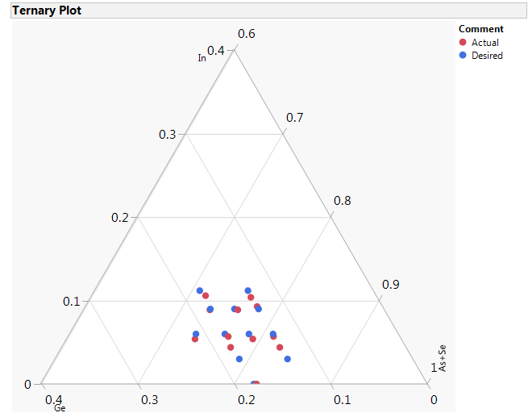
Pseudo-ternary
Lowest In content in the film, achievable, was ~4.4%
Besides the low In splits, the other compositions were pretty close to the desired values

Slide 14
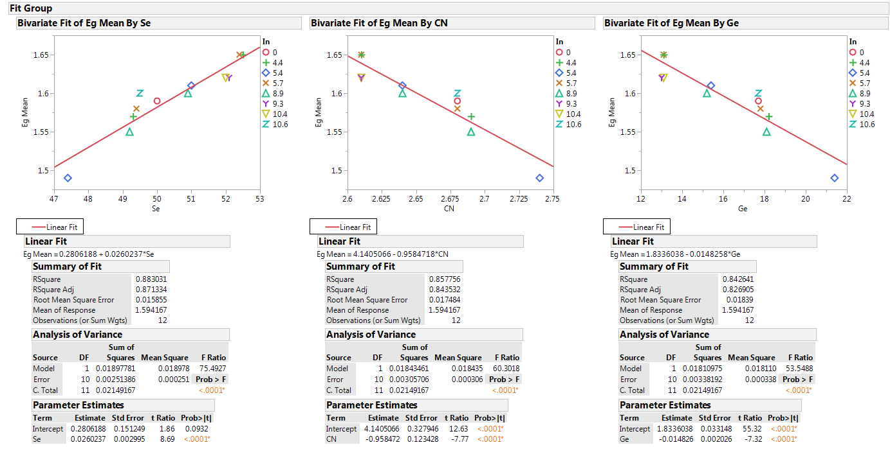
Optical Bandgap, Eg
Eg shows dependance on Se, Ge content of the film and on the film CN.

Slide 15
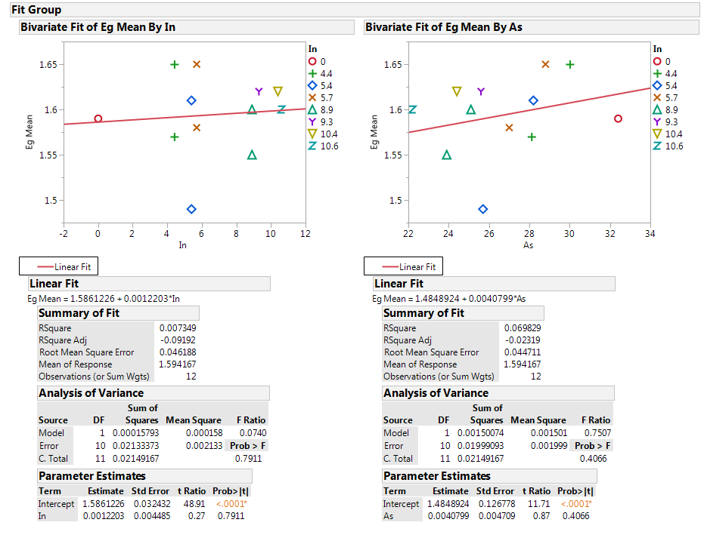
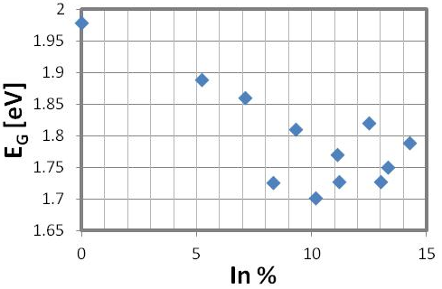
Optical Bandgap, Eg
Effect of In on SAG – from the Kappa camp run in F14
Eg does not show any correlation to the In content

Slide 16
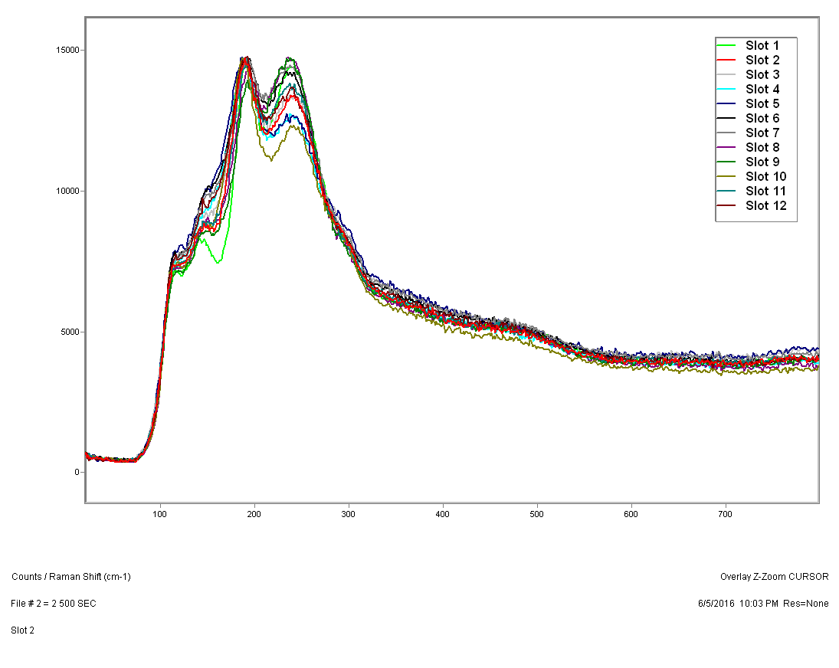
Raman spectra
Currently working on peak de-convolution and understanding the impact of In on the structural arrangement of the In-SAG

Slide 17
SEM Wrinkle test
wafer | As | Ge | In | Se | Si | As/Se | As+Se | CN | Sepoor/rich | 270 | 280 | 290 | 300 | 310 | 320 | 330 | 340 | 350 | 360 | 370
1 | 32.4 | 17.7 | 0.0 | 50.0 |  | 0.648 | 82.3 | 2.68 | -33.9
2 | 28.1 | 18.2 | 4.4 | 49.3 |  | 0.571 | 77.5 | 2.69 | -35.8
3 | 27.0 | 17.8 | 5.7 | 49.4 |  | 0.547 | 76.4 | 2.68 | -35.4
4 | 23.9 | 18.1 | 8.9 | 49.2 |  | 0.485 | 73.1 | 2.69 | -36.1
5 | 22.2 | 17.7 | 10.6 | 49.5 |  | 0.450 | 71.7 | 2.68 | -35.2
6 | 24.4 | 13.1 | 10.4 | 52.0 |  | 0.470 | 76.5 | 2.61 | -26.5
7 | 25.6 | 13.0 | 9.3 | 52.1 |  | 0.491 | 77.7 | 2.61 | -26.1
8 | 28.8 | 13.1 | 5.7 | 52.4 |  | 0.551 | 81.2 | 2.61 | -25.6
9 | 30.0 | 13.1 | 4.4 | 52.5 |  | 0.571 | 82.5 | 2.61 | -25.2
10 | 25.7 | 21.4 | 5.4 | 47.4 |  | 0.543 | 73.1 | 2.74 | -42.2
11 | 28.2 | 15.4 | 5.4 | 51.0 |  | 0.553 | 79.2 | 2.64 | -30.3
12 | 25.1 | 15.2 | 8.9 | 50.9 |  | 0.493 | 75.9 | 2.64 | -30.4
All the 18 at% Ge splits did ok at 300C.
For the 13 at% Ge splits, the highest In split was marginal, all the other splits did not survive
The 15 at% Ge splits with ~6 and 9% In were marginal at 300C
Repeating the Group 7 wafer because of questionable sequence of annealing /SEM

Slide 18
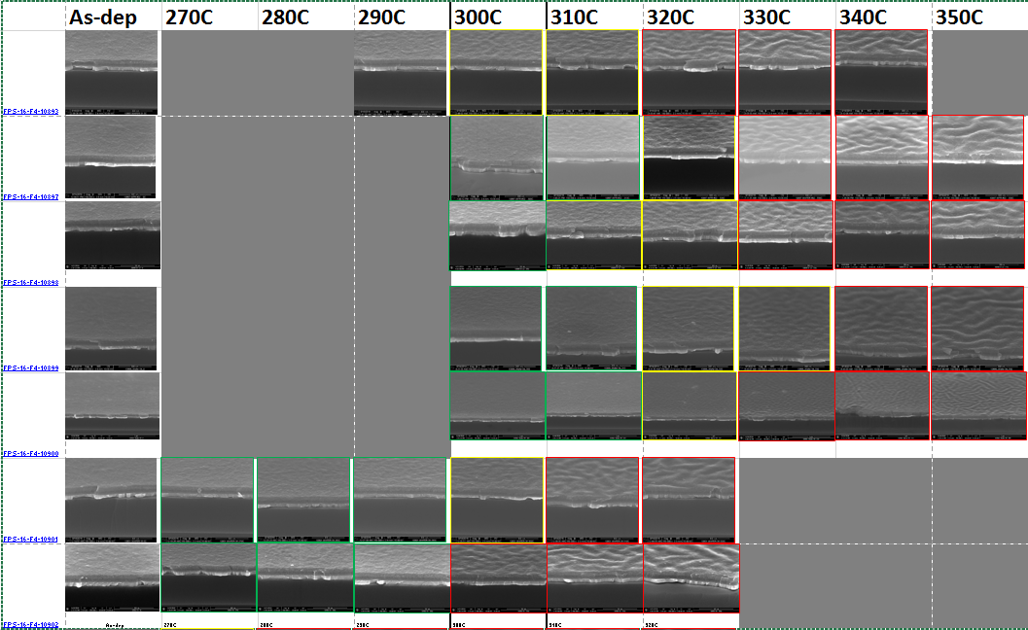
G1
G2
SEM WRINKLE
G3
G4
G5
G6
G7

Slide 19
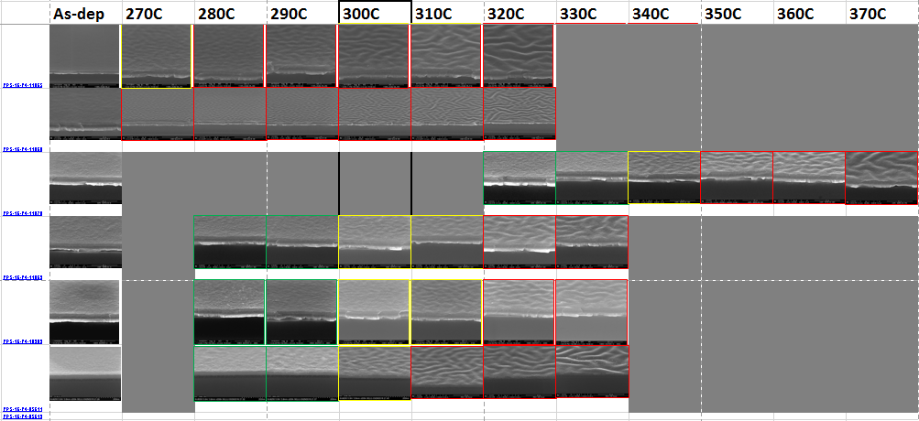
SEM Wrinkle
G8
G9
G10
G11
G12
SDv13

Slide 20
Summary so far…
Eg shows a dependence on the Ge and Se content of the film but not on the In
So In may not likely affect Vt /drift
Based on the SEM wrinkle data, 9 out of the original 12 splits survived the 300C anneal
All the surviving splits have Ge >15.0 at% except the one with Ge 13%, In 10.4%
To get a better picture, we will collect L0 and L1 data on some splits in the (11% < In < 20%) region with (10% < Ge < 13%)
Deciphering the Raman data
Waiting on XRD at 300C to especially check if the higher In can induce some crystallinity

Slide 21
Thermal stability
(300C)
Eg
wrinkle
v13 level
No wrinkle
Suitable area of further interest
Enrico/ Paolo

