Slide 1
Y Doping of GeSbTe Campaign W Targets: GST447 (PDC)/SbY (RF)/GeTe (PDC)

Slide 2
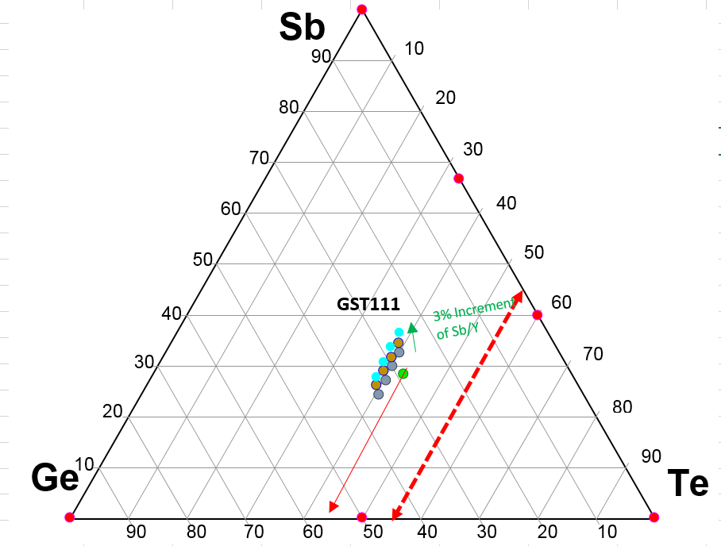
Current Configuration
3 and 6% Sb with no additional Ge have been run for L1. Results pending.
L0 Data for all target values has started. ICP data should be reported 6/27-6/28
Once ICP confirms recipes are correct, remaining L0 data will be collected.
Rs vs T lab submission ~6/30
XRD ~7/10
Target Change to higher Te content can be done 6/30 if L1 is completed

Slide 3
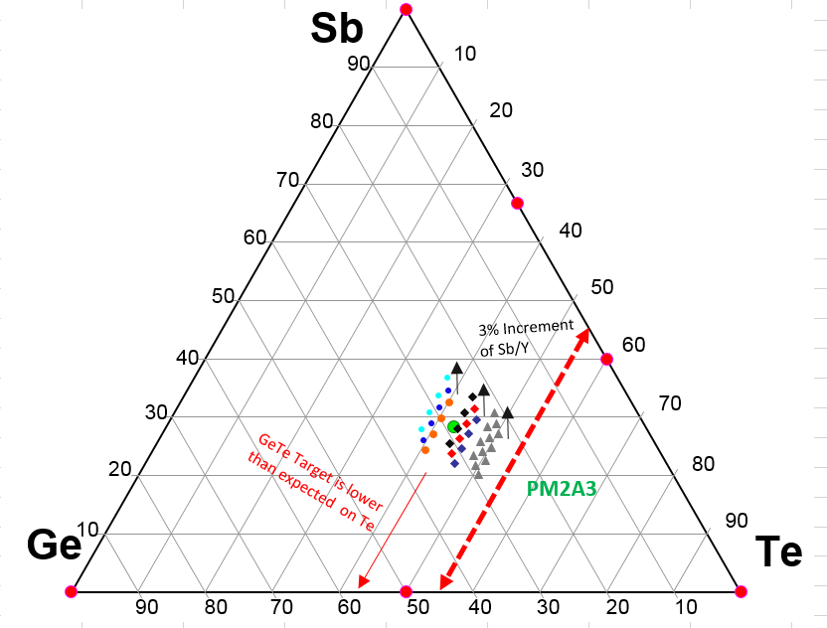
Te Rich Region
GST225 Target estimates are shown in grey triangles
Another target could conceivably give near the PM2A3 range
As predicted, movement can only be a single line unless an increase in the dopant Y. This will move the material in the Sb direction.
5th element would be addition of N2 if needed for voiding.

