Slide 1
3DXP 30S Path Finding
Kick-off meeting
June 15th, 2016

Slide 2
3DXP scaling challenges
Material exploration opportunities:
3DXP scaling presents challenges going beyond the architecture:
  PM scaling maintaining the same V_{T} and speed, trying to reduce segregation and volume changes
  SD sigma/forming/drift improvement with more integration friendly alloys than SiSAG → to get RWB benefit
  Evaluation of interfaces to improve the PM and SD stability and functionality
In this scenario, a dedicated forum for both Material exploration and Characterization aspects looking forward the 30S node is reintroduced with these constrains and opportunities:
  Avoiding resources conflict with higher priority (10S activity), but capitalizing some bandwidth to re-start new materials screening at fundamental level
  The 4C chamber allows to cover compositional areas with wider flexibility and shorter time
  Methodology based on more and more robust L0/L1 screening, and acquired know-how on process impact, to select and promote few promising new alloys to integration level

Slide 3
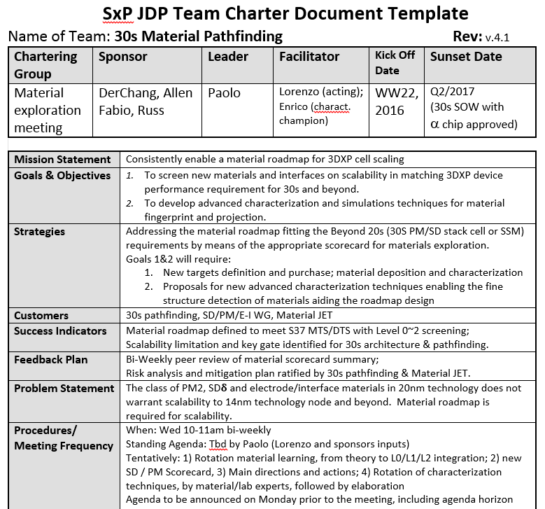
30S material roadmap forum charter
1) Material exploration tasks:
- To plan campaigns & target purchase
- To track the execution of campaigns (L0, L1)
- To review L0/L1 data, keeping scorecard updated, and give directions to potential good alloys to be promoted to L1D/L2/L3
2) Material characterization:
- Continuous improvement of standard metrics (TEM, EDX, … Si/N/O detection…)
- Consolidation of advanced techniques for internal structure (optical, UF-DSC, NMR, EXAFS,…)
3) Material understanding/roadmap
Sharing of progress on atomistic simulation
Sharing progress from external collaboration
Discuss new ideas, publications, models …

Slide 4
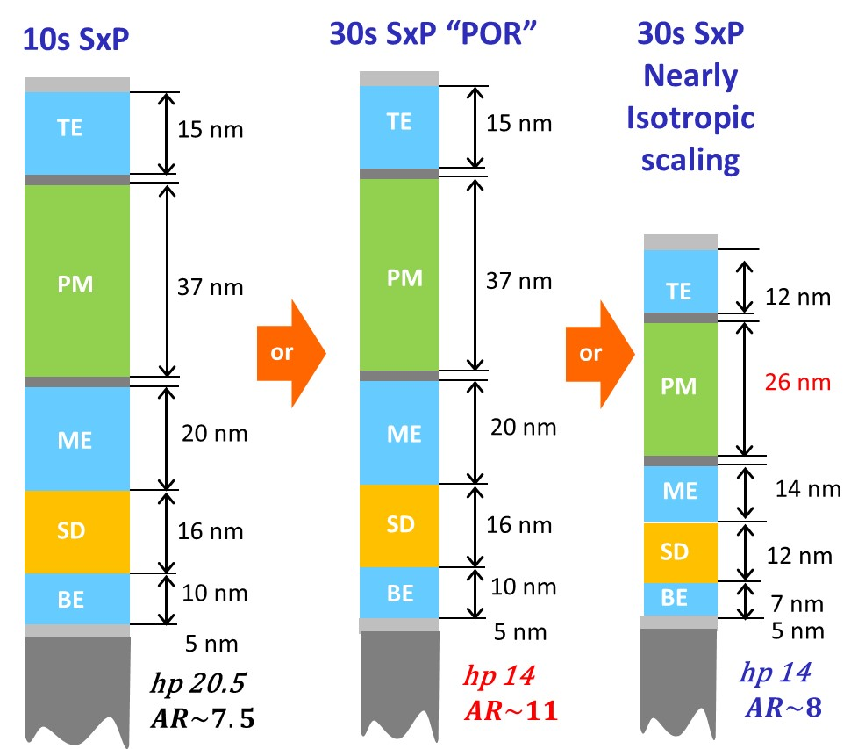
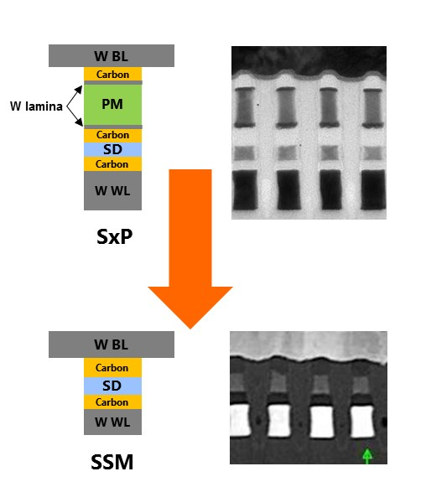

3DXP 30S – The two options
hp 14
$$AR\sim 6$$
The mainstream: 10S SD/PM cell scaling down
- X ~14nm, Y tbd HP. Major challenges:
PM → thickness scaling but maintaining ΔV_{T} & set speed (same RWB as 10S). No solution so far
SD → need to improve VT spread and set VT drift. SiSAG might not be the best known material.
A stable high-R “heater’ Electrode would help
The breakthrough, to be validated on S26: SD-only dual polarity SSM cell. Challenges:
SD → understanding & control of the role of vertical segregation (if confirmed as the root cause) on large ΔV_{T}, V_{T} spread, endurance;
→ need to improve drift, endurance (?)

Slide 5
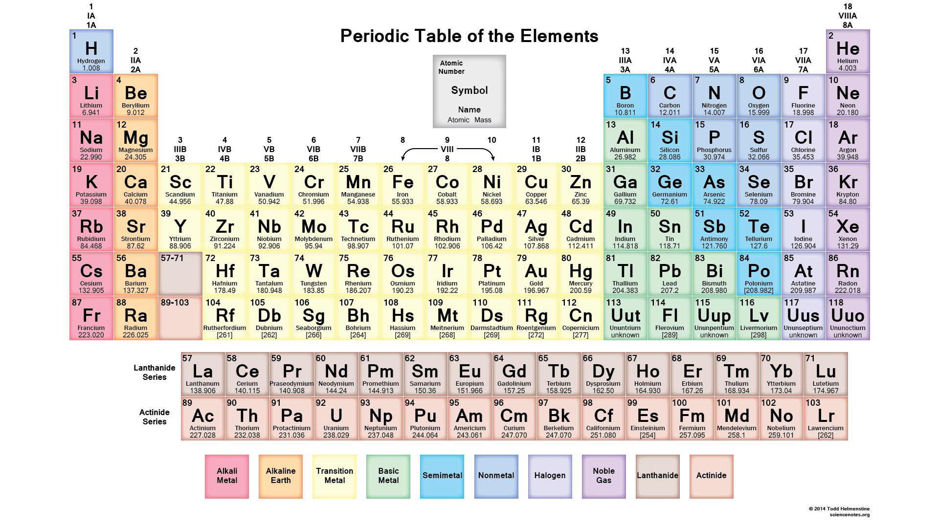
GST doping opportunities for PM
p-orbital ‘semiconductors’ that we have, at least partially, tried/considered
Only one free electron… doubts about bonding
Iso-chemical to TiO₂, ZrO₂,…
Radioactive
Not so suitable for industry
d-type valence orbitals
with Oxygen: Mott-insulators

Slide 6

III-IV-V and VI group p-type dopant elements
Through implant (N also via reactive sputtering). No pronounced beneficial effects.
Proofed both by co-sputter and implant. C can be considered via implant, but via co-sputter high % produces conductive paths. No significant effects of B.
Proofed via implant: V_{T} a bit higher, but set-ability issues
Integration issues expected and more suitable for SD
They widen E_{G} (addressed the ab-initio simulation for In-GST), thus they offer a larger V_{T}.
Al-GIST campaign running in the 10S bed.
Se quickly provides SD-like behavior , a further attempt could be evaluated…
It will require the W lamina elimination?
It is expected to play a role similar to Bi: good PC, but low V_{T}, but we have Sn and Sn-based targets
Phase-change facilitator (fast transition), but it lowers V_{T}.

Slide 7
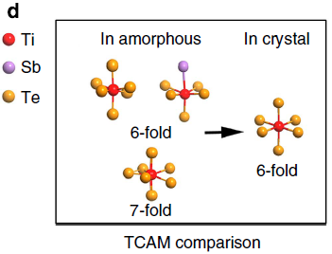
Transition metals family [d valence orbitals]
Ti: improved crystallization speed and programming power have been demonstrated. Ti-centered atomic motifs increase the system coord. number and the number of four-membered rings that are crucial for crystallization speed is double wrt GST [Nat. Comm. 2014]. We expect that it lowers V_{T}.
Zr, Hf: they could preserve high E_{G} (thus V_{T}), when compared with the homologous oxides.
Y under scrutiny with ab-initio simulation.
We recognize a value in trying these!
Ag: It works like ‘oil’, facilitating the phase transition. But, being Ag as a good metal it is expected to reduce E_{G} and V_{T}. [APL 102, 41907 (2013)]
Zn: increases E_{G}, thus V_{TH}, but it promotes phase separation due to the so high T_{M} of ZnTe wrt GST [Zn-campaign in F14].
MoCh₂: as lubricant in mechanics and for 2D MOSFETs [Adv. Funct. Mat. 2013].
V, Cr, Mn, Fe: They provide ferromagnetic features to GST [PRB 90, 144417 (2014)].

Slide 8
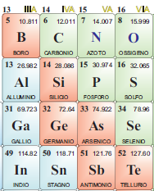
Forward-looking SD: what better than Si-SAG?
30s PATHFINDING and SSM ORIENTED Optimization
Strategy: IIIrd Gr. Elements: Boron, Aluminum, Gallium, Indium are expected to form III Group-centered tetrahedron.
Preferred bonding scheme as for Si.
Periodic table opportunities
B-SAG
Group III
Insulating: it could prevent leakage issues
Bond dissociation energy:
Al-Se: 318 kJ mol⁻¹
In-Se: 245 kJ mol⁻¹
Al-SAG
It could facilitate integration (see PM lesson)
They could be stable enough…
Al₂Se₃: T_{M} = 1220K, E_{G} = 3.1 eV
In₂Se₃: T_{M} = 933 K, E_{G} =2.1 eV
Status: Targets enabling the IIIrd Group-SAG campaigns have been purchased (In-SAG, B-SAG, Al-SAG, Ga-SAG)
In-SAG
It gave VERY good drift results on CLV in F14

Slide 9
Scheduling sketch
Coherently with the aforementioned strategy this is the tentative plan we see today for SD and PM material exploration.
We have in house the targets to run these experiments on “M300 3C and M300 4C”. We can considered to use the 4C chamber when
one campaign can take advantage from a wider co-sputter flexibility
?
?
?
PM
Check-point on the basis of which we could address different directions

Slide 10
Horizon of some topics for future meetings:
Next meeting will be dedicated to the review of first L0 and L1 results for the In-SAG campaign (J* camp)
‘Ab-initio’ simulation results are expected for the following meeting aiding the check-point on In-SAG
Elaboration of the chamber configuration and SWR to run Zr-GST campaign that should start at mid July
Scorecard and advanced characterization review
What after In-SAG for SD?
Molecular doping strategy → a review from PVD
Returns from the collaboration we have with Prof. Ielmini

