Slide 1
Hf-GST campaign
Check-point
30S Material Pathfinding Team

Slide 2
Split table and score card
Main messages:
Hf-GST tends to lower V_{T}
Hf-GST does not degrade the set-speed
These messages are substantially coherent with theoretical prediction [link]

Slide 3
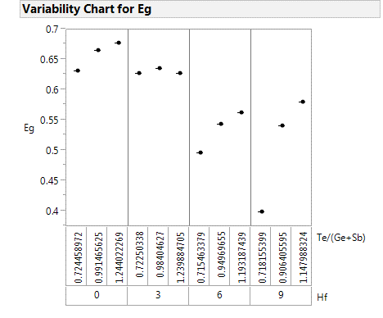
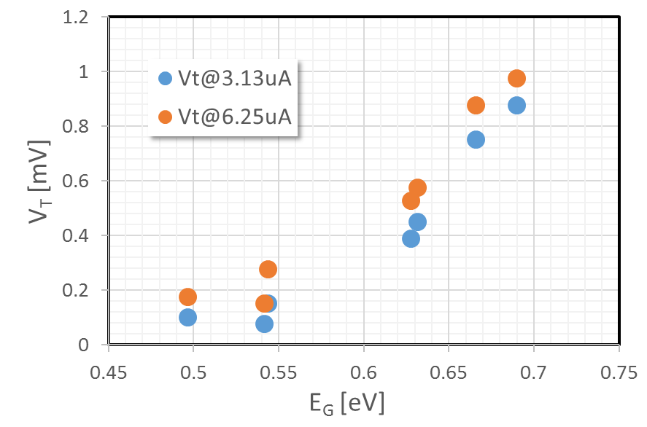
V_{T} and Optical band gap correlation
30s goal
PM2.A3
Hf 3%
ΔE_{G}
Hf 6-9%
V_{T} and optical band gap correlates:
We need alloy with E_{G} ~ 30 meV > E_{G} of PM2.A3 to allow PM scalability coherently with link

Slide 4
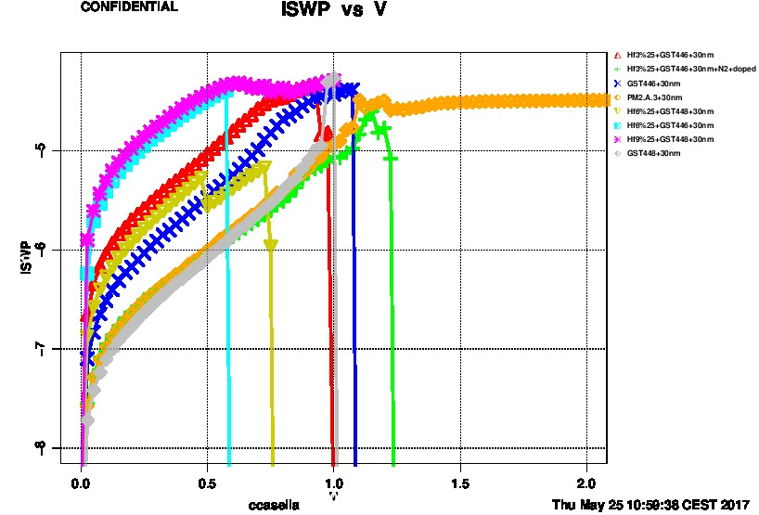
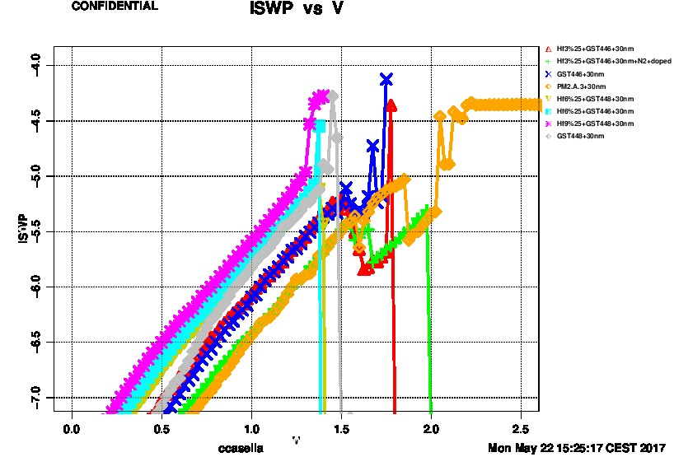
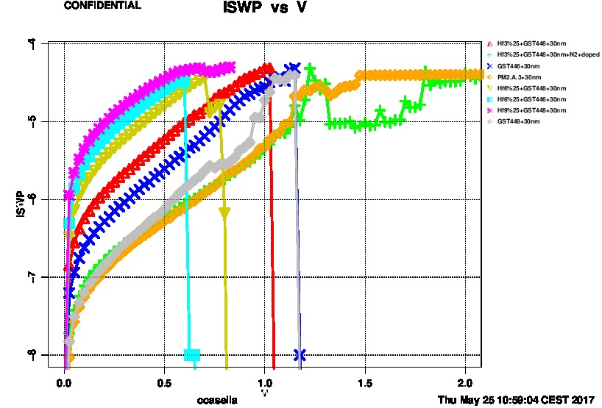
I-V curves for V_{T} extraction
1 Kcycles
POR
First Fire
POR
Fresh – used for V_{T} extraction
POR
PM2A.3 (POR) presents the higher V_{T}
3%Hf-GST + N2 is also aligned with POR, but it appears a consequence of N2, since the same alloy w/o N2 presents very low V_{T} (olive curve)

Slide 5
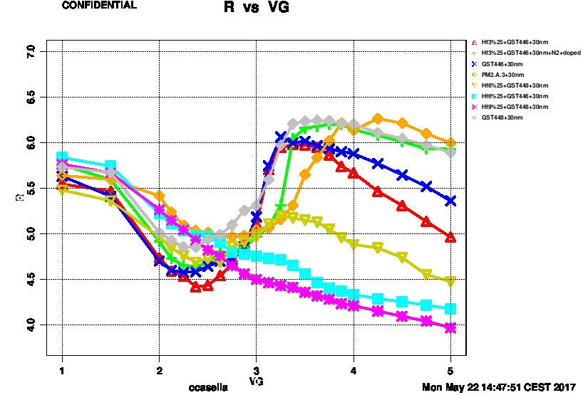
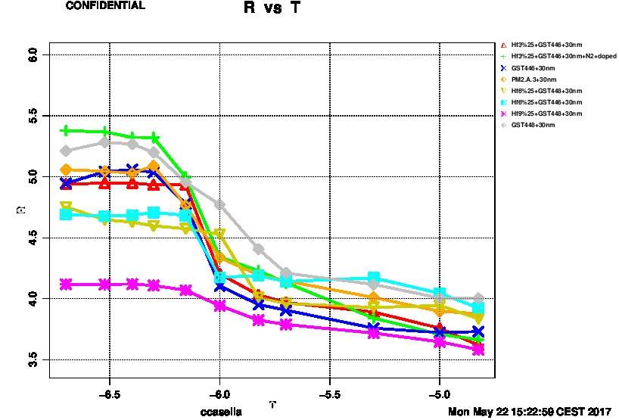
Set to Reset/Set speed
Any particular speed issue, again accordingly with theoretical expectations [link]

Slide 6
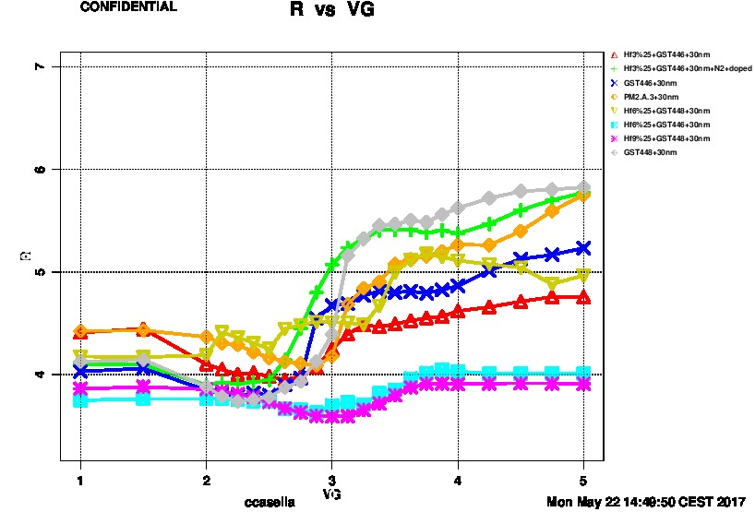
Programming curves after cycling

